Slide 1


College of Management
Business Ethics
Lecturer: Dr. Raef Baraka
PMG 750
Lecture 02

Slide 2

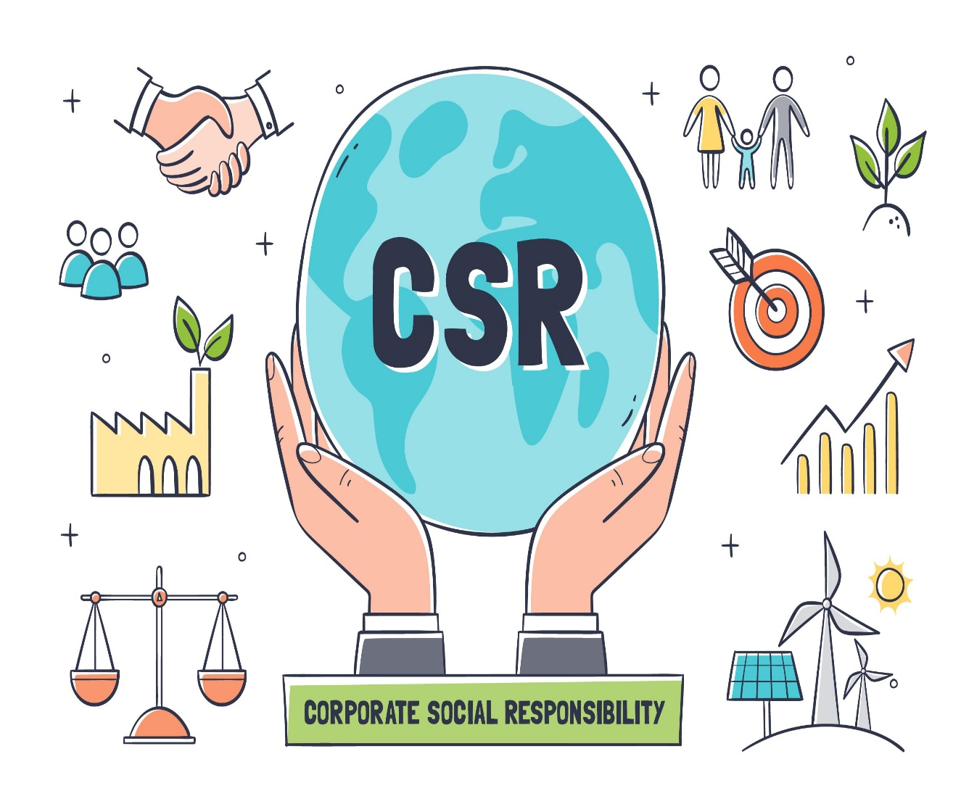
Chapter 2: STAKEHOLDER RELATIONSHIPS, SOCIAL RESPONSIBILITY, AND CORPORATE GOVERNANCE
CHAPTER OBJECTIVES:
Identify stakeholders’ roles in business ethics.
Define social responsibility.
Examine the relationship between stakeholder orientation and social responsibility.
Delineate a stakeholder orientation in creating corporate social responsibility.
Explore the role of corporate governance in structuring ethics and social responsibility in business.
List the steps involved in implementing a stakeholder perspective in social responsibility and business ethics.

Slide 3
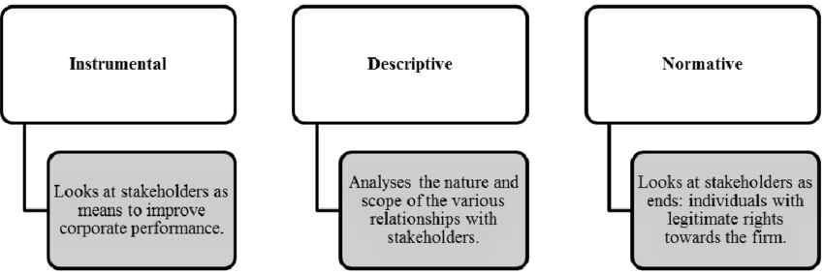
STAKEHOLDER RELATIONSHIPS, SOCIAL RESPONSIBILITY, AND CORPORATE GOVERNANCE
Stakeholders Define Ethical Issues In Business

Slide 4
STAKEHOLDER RELATIONSHIPS, SOCIAL RESPONSIBILITY, AND CORPORATE GOVERNANCE
Stakeholders Define Ethical Issues In Business
Stakeholders: In a business context, customers, shareholders, employees, suppliers, government agencies, communities, and many others who have a “stake” or claim in some aspect of a company’s products, operations, markets, industry, and outcomes are known as stakeholders.
Businesses engage and influence these groups, but these groups also have the ability to engage and influence businesses; thus, the relationship between companies and their stakeholders is a two-way street.
Sometimes activities and negative press generated by special interest groups force a company to change its practices.

Slide 5
STAKEHOLDER RELATIONSHIPS, SOCIAL RESPONSIBILITY, AND CORPORATE GOVERNANCE
Stakeholders Define Ethical Issues In Business
There are three approaches to stakeholder theory: normative, descriptive, and instrumental approaches.
The normative approach identifies ethical guidelines that dictate how firms should treat stakeholders. Normative stakeholder theory affirms that stakeholders have legitimacy and a right to engage organizations. Principles and values provide direction for normative decisions.
The descriptive approach focuses on the firm’s behavior and usually addresses how decisions and strategies are made for stakeholder relationships.
The instrumental approach to stakeholder theory describes what happens if firms behave in a particular way.

Slide 6
STAKEHOLDER RELATIONSHIPS, SOCIAL RESPONSIBILITY, AND CORPORATE GOVERNANCE
Stakeholders Define Ethical Issues In Business
The instrumental approach is useful because it examines relationships involved in the management of stakeholders, including the processes, structures, and practices that implement stakeholder relationships within an organization.
The survival and performance of any organization are a function of its ability to create value for all primary stakeholders and its attempt to do this fairly, not favoring one group over the others.
Many firms experience conflicts with primary stakeholders and consequently can damage their reputations and shareholder confidence.
Stakeholders most directly affected by negative events experience a corresponding shift in their perceptions of a firm’s reputation.

Slide 7
STAKEHOLDER RELATIONSHIPS, SOCIAL RESPONSIBILITY, AND CORPORATE GOVERNANCE
Stakeholders Define Ethical Issues In Business
Many firms experience conflicts with primary stakeholders and consequently can damage their reputations and shareholder confidence.
While many threats to reputations stem from uncontrollable events such as economic conditions, ethical misconduct is more difficult to overcome than poor financial performance.
Stakeholders most directly affected by negative events experience a corresponding shift in their perceptions of a firm’s reputation.
On the other hand, firms sometimes receive negative publicity for misconduct that destroys trust and tarnishes their reputations, making it more difficult to retain existing customers and attract new ones

Slide 8
STAKEHOLDER RELATIONSHIPS, SOCIAL RESPONSIBILITY, AND CORPORATE GOVERNANCE
Stakeholders Define Ethical Issues In Business
Ethical misconduct and decisions that damage stakeholders generally impact the company’s reputation in terms of both investor and consumer confidence.
As investor perceptions and decisions begin to take their toll, shareholder value drops, exposing the company to consumer scrutiny that can increase the damage.
New reforms intended to improve corporate accountability and transparency suggest that stakeholders, including regulatory agencies, local communities, attorneys, and public accounting firms, play a major role in fostering responsible decision making.

Slide 9
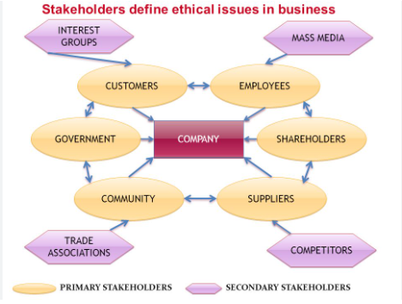
STAKEHOLDER RELATIONSHIPS, SOCIAL RESPONSIBILITY, AND CORPORATE GOVERNANCE
Identifying Stakeholders

Slide 10
STAKEHOLDER RELATIONSHIPS, SOCIAL RESPONSIBILITY, AND CORPORATE GOVERNANCE
Identifying Stakeholders
We can identify two types of stakeholders:
Primary stakeholders:
Primary stakeholders are those whose continued association and resources are absolutely necessary for a firm’s survival.
These include employees, customers, and shareholders, as well as the governments and communities that provide necessary infrastructure.
Ethical corporate cultures are important because they are linked to positive relationships with stakeholders.
By the same token, concern for stakeholders’ needs and expectations is necessary to avoid ethical conflicts.

Slide 11
STAKEHOLDER RELATIONSHIPS, SOCIAL RESPONSIBILITY, AND CORPORATE GOVERNANCE
Identifying Stakeholders
We can identify two types of stakeholders:
Secondary stakeholders:
Secondary stakeholders do not typically engage directly in transactions with a company and are therefore not essential to its survival.
These include the media, trade associations, and special interest groups like the American Association of Retired People (AARP), a special interest group working to support retirees’ rights, such as health care benefits.
Both primary and secondary stakeholders embrace specific values and standards that dictate acceptable and unacceptable corporate behaviors.

Slide 12
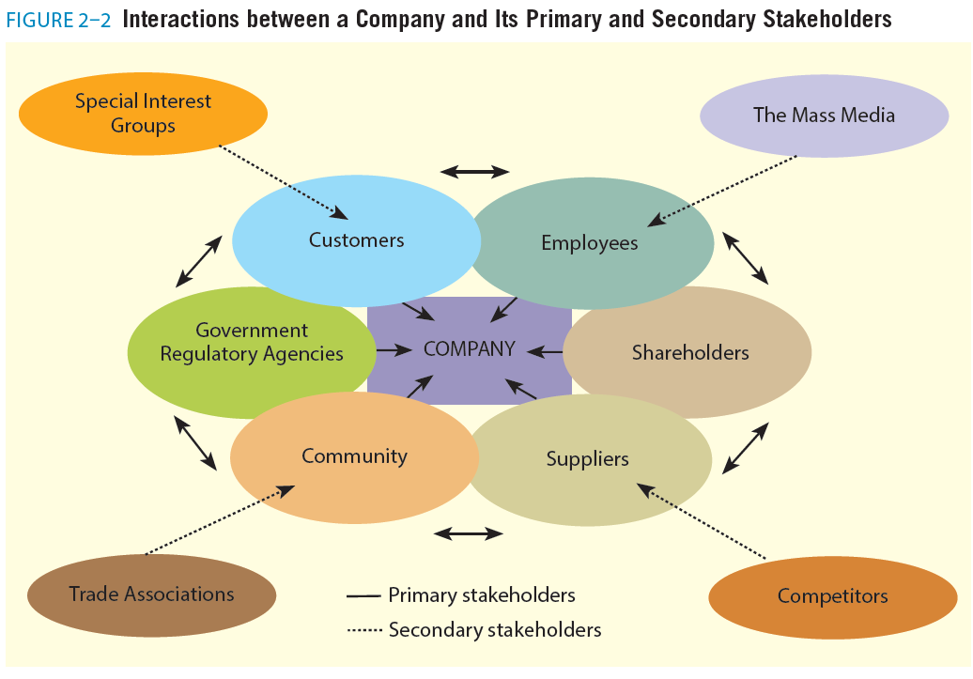
STAKEHOLDER RELATIONSHIPS, SOCIAL RESPONSIBILITY, AND CORPORATE GOVERNANCE

Slide 13
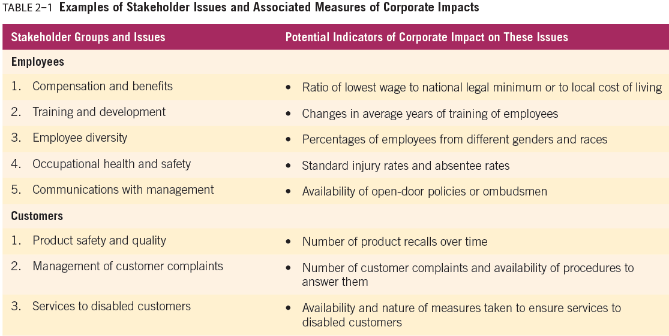
STAKEHOLDER RELATIONSHIPS, SOCIAL RESPONSIBILITY, AND CORPORATE GOVERNANCE

Slide 14
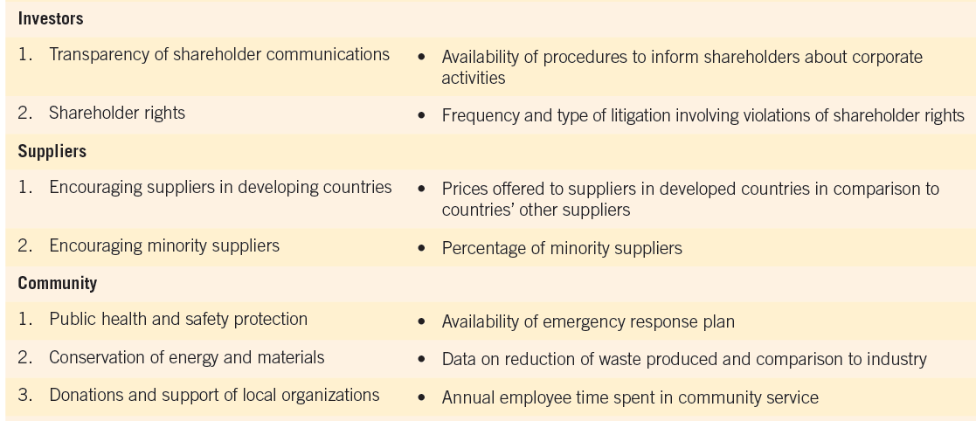
STAKEHOLDER RELATIONSHIPS, SOCIAL RESPONSIBILITY, AND CORPORATE GOVERNANCE

Slide 15
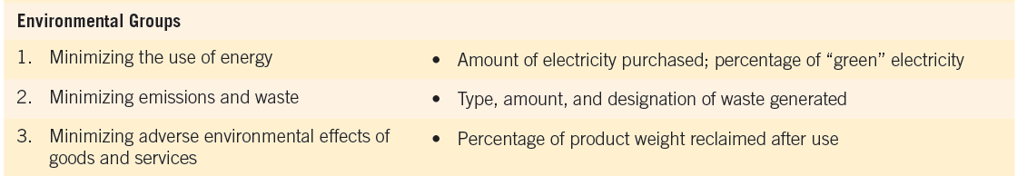
STAKEHOLDER RELATIONSHIPS, SOCIAL RESPONSIBILITY, AND CORPORATE GOVERNANCE

Slide 16
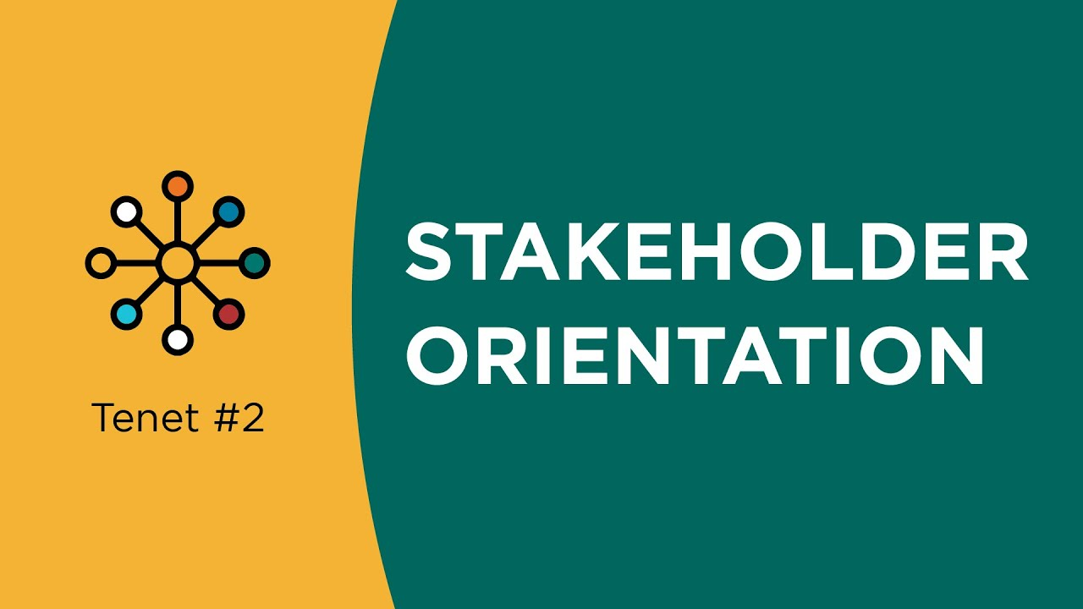
STAKEHOLDER RELATIONSHIPS, SOCIAL RESPONSIBILITY, AND CORPORATE GOVERNANCE
A Stakeholder Orientation

Slide 17
STAKEHOLDER RELATIONSHIPS, SOCIAL RESPONSIBILITY, AND CORPORATE GOVERNANCE
A Stakeholder Orientation
A Stakeholder Orientation: The degree to which a firm understands and addresses stakeholder demands can be referred to as a stakeholder orientation.
A stakeholder orientation involves “activities and processes within a system of social institutions that facilitate and maintain value through exchange relationships with multiple stakeholders.
This orientation comprises three sets of activities:
(1) the organization-wide generation of data about stakeholder groups and assessment of the firm’s effects on these groups,
(2) the distribution of this information throughout the firm, and
(3) the responsiveness of the organization as a whole to this information

Slide 18
STAKEHOLDER RELATIONSHIPS, SOCIAL RESPONSIBILITY, AND CORPORATE GOVERNANCE
A Stakeholder Orientation
A Stakeholder Orientation:
Generating data about stakeholders begins with identifying the stakeholders relevant to the firm.
Relevant stakeholder groups should be analyzed based on the power each holds, as well as the ties between them and the company.
Next, the firm should identify the concerns about the business that are relevant to each stakeholder group.
This information is derived from formal research, including surveys, focus groups, Internet searches, and press reviews.

Slide 19
STAKEHOLDER RELATIONSHIPS, SOCIAL RESPONSIBILITY, AND CORPORATE GOVERNANCE
A Stakeholder Orientation
A Stakeholder Orientation:
A stakeholder orientation can be viewed as a continuum in that firms are likely to adopt the concept to varying degrees.
To gauge a firm’s stakeholder orientation, it is necessary to evaluate the extent the firm adopts behaviors that typify the generation and dissemination of stakeholder intelligence and the responsiveness to this intelligence.
A given organization may generate and disseminate more intelligence about some stakeholder communities than others and respond accordingly.

Slide 20
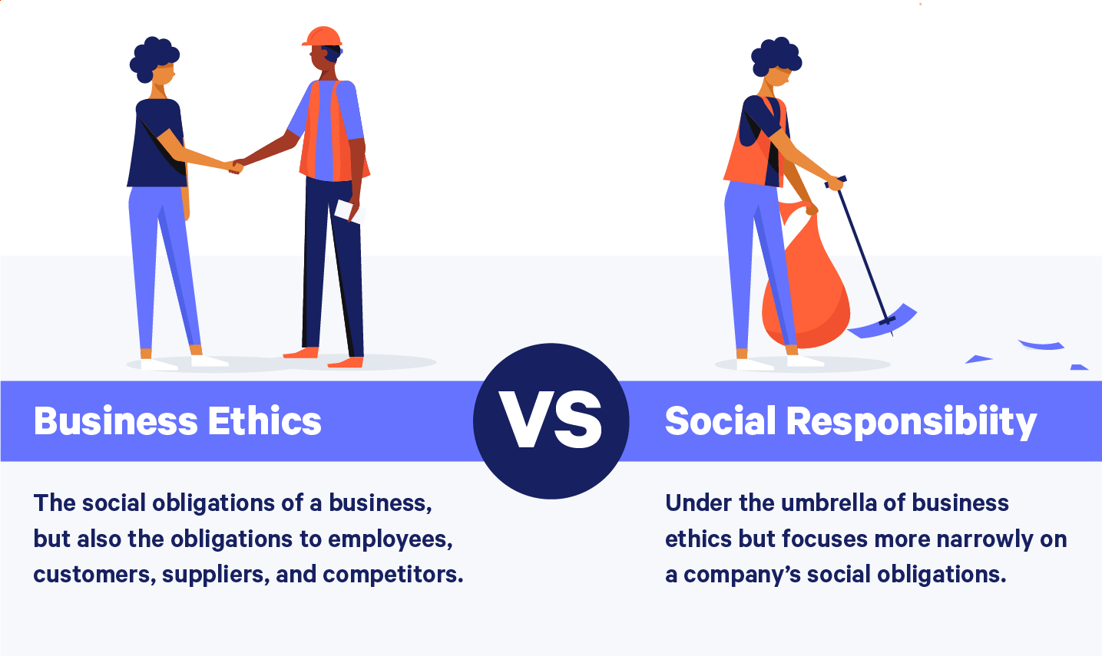
STAKEHOLDER RELATIONSHIPS, SOCIAL RESPONSIBILITY, AND CORPORATE GOVERNANCE
Social Responsibility And Business Ethics

Slide 21
STAKEHOLDER RELATIONSHIPS, SOCIAL RESPONSIBILITY, AND CORPORATE GOVERNANCE
Social Responsibility And Business Ethics
The terms ethics and social responsibility are often used interchangeably, but each has a distinct meaning.
Social responsibility is an organization’s obligation to maximize its positive impact on stakeholders and minimize its negative impact.
Social responsibility can be viewed as a contract with society, whereas business ethics involves carefully thought-out rules or heuristics of business conduct that guide decision making.
There are four levels of social responsibility—economic, legal, ethical, and philanthropic.

Slide 22
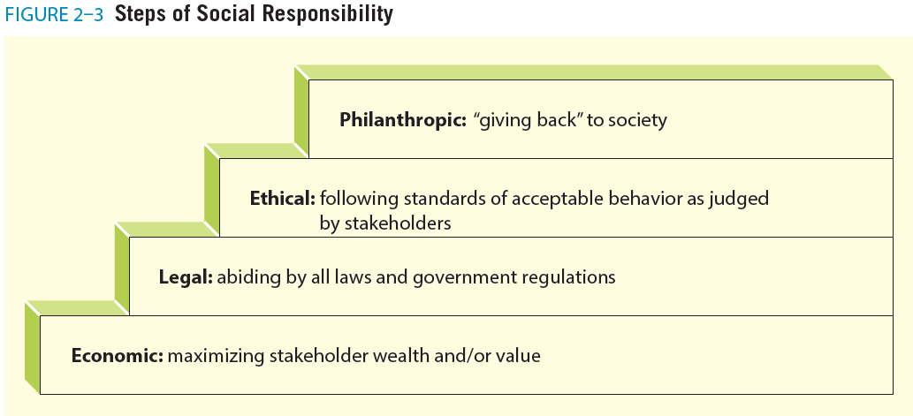
STAKEHOLDER RELATIONSHIPS, SOCIAL RESPONSIBILITY, AND CORPORATE GOVERNANCE

Slide 23
STAKEHOLDER RELATIONSHIPS, SOCIAL RESPONSIBILITY, AND CORPORATE GOVERNANCE
Social Responsibility And Business Ethics
The terms ethics and social responsibility are often used interchangeably, but each has a distinct meaning.
Social responsibility is an organization’s obligation to maximize its positive impact on stakeholders and minimize its negative impact.
Social responsibility can be viewed as a contract with society, whereas business ethics involves carefully thought-out rules or heuristics of business conduct that guide decision making.
There are four levels of social responsibility—economic, legal, ethical, and philanthropic.

Slide 24
STAKEHOLDER RELATIONSHIPS, SOCIAL RESPONSIBILITY, AND CORPORATE GOVERNANCE
Social Responsibility And Business Ethics
There are four levels of social responsibility—economic, legal, ethical, and philanthropic.
At the most basic level, companies have a responsibility to be profitable at an acceptable level to meet the objectives of shareholders and create value.
Of course, businesses are expected to obey all relevant laws and regulations.

Slide 25
STAKEHOLDER RELATIONSHIPS, SOCIAL RESPONSIBILITY, AND CORPORATE GOVERNANCE
Social Responsibility And Business Ethics
The terms ethics and social responsibility are often used interchangeably, but each has a distinct meaning.
Business ethics, as previously defined, comprises principles and values that meet the expectations of stakeholders.
Philanthropic responsibility refers to activities that are not required of businesses but that contribute to human welfare or goodwill.
Ethics, then, is one dimension of social responsibility.
Ethical decisions by individuals and groups drive appropriate decisions and are interrelated with all of the levels of social responsibility.

Slide 26
STAKEHOLDER RELATIONSHIPS, SOCIAL RESPONSIBILITY, AND CORPORATE GOVERNANCE
Social Responsibility And Business Ethics
The term corporate citizenship is often used to express the extent to which businesses strategically meet the economic, legal, ethical, and philanthropic responsibilities placed on them by various stakeholders.
Corporate citizenship has four interrelated dimensions:
Strong, sustained economic performance,
Rigorous compliance,
Ethical actions beyond what the law requires, and
Voluntary contributions that advance the reputation and stakeholder commitment of the organization..

Slide 27
STAKEHOLDER RELATIONSHIPS, SOCIAL RESPONSIBILITY, AND CORPORATE GOVERNANCE
Social Responsibility And Business Ethics
Reputation is one of an organization’s greatest intangible assets with tangible value. The value of a positive reputation is difficult to quantify, but it is important.
A single negative incident can influence perceptions of a corporation’s image and reputation instantly and for years afterward.
Corporate reputation, image, and brands are more important than ever and are among the most critical aspects of sustaining relationships with constituents, including investors, customers, employees, media, and regulators.
Although an organization does not control its reputation in a direct sense, its actions, choices, behaviors, and consequences influence stakeholders’ perceptions of it.

Slide 28
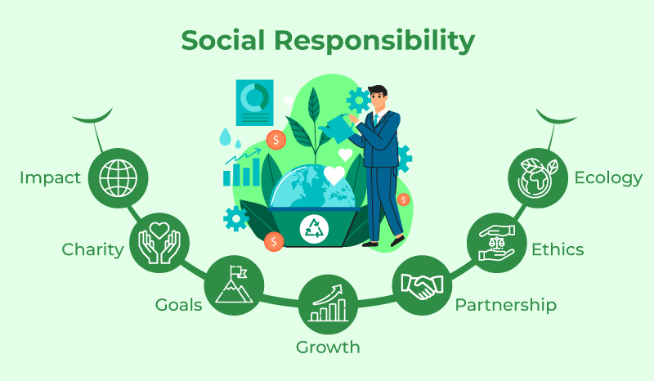
STAKEHOLDER RELATIONSHIPS, SOCIAL RESPONSIBILITY, AND CORPORATE GOVERNANCE
ISSUES IN SOCIAL RESPONSIBILITY

Slide 29
STAKEHOLDER RELATIONSHIPS, SOCIAL RESPONSIBILITY, AND CORPORATE GOVERNANCE
Issues In Social Responsibility
Social responsibility rests on a stakeholder orientation. The realities of global warming, obesity, consumer protection, and other issues are causing companies to look at a broader, more inclusive stakeholder orientation.
In other words, a broader view of social responsibility looks beyond pragmatic and firm-centric interests and considers the long-term welfare of society.
Social issues may encompass events such as jobs lost through outsourcing, health issues, gun rights, and poverty. While these issues may be indirectly related to business, there is a need to reflect on them in developing strategies in certain cases.
Issues that directly relate to business include obesity, smoking, and exploiting vulnerable or impoverished populations, as well as a number of other issues.

Slide 30
STAKEHOLDER RELATIONSHIPS, SOCIAL RESPONSIBILITY, AND CORPORATE GOVERNANCE
Issues In Social Responsibility
Critical issues in social responsibility:
Data privacy: It is one of the most important social and ethical issues facing marketing today.
Cybercrimes, such as identity theft and online fraud, are major concerns.
There is a need to address the ethical and legal responsibilities to determine risks and develop protection for consumers.
All organizations need to understand how to develop cybersecurity and have contingency plans to respond if a data breach happens.
With big data and the need to collect consumer data comes the responsibility to establish a data privacy ethical culture as a top priority.

Slide 31
STAKEHOLDER RELATIONSHIPS, SOCIAL RESPONSIBILITY, AND CORPORATE GOVERNANCE
Issues In Social Responsibility
Critical issues in social responsibility:
Consumer protection, which is often occurs in the form of laws passed to protect consumers from unfair and deceptive business practices.
Issues involving consumer protection usually have an immediate impact on the consumer after a purchase.
Major areas of concern include advertising, environmental hazards, financial practices, and product safety.
Because consumers are less knowledgeable about certain products or business practices, it is the responsibility of companies to take precautions to prevent consumers from being harmed by their products.

Slide 32
STAKEHOLDER RELATIONSHIPS, SOCIAL RESPONSIBILITY, AND CORPORATE GOVERNANCE
Issues In Social Responsibility
Critical issues in social responsibility:
Sustainability: We define sustainability as the potential for the long-term well-being of the natural environment, including all biological entities, as well as the mutually beneficial interactions among nature and individuals, organizations, and business strategies.
With major environmental challenges such as global warming and the passage of new environmental legislation, businesses can no longer afford to ignore the
natural environment as a stakeholder.
Companies with an effective environmental management system certified by ISO 14001 tend to have improved financial performance in the long run.

Slide 33
STAKEHOLDER RELATIONSHIPS, SOCIAL RESPONSIBILITY, AND CORPORATE GOVERNANCE
Issues In Social Responsibility
Critical issues in social responsibility:
Corporate governance involves the development of formal systems of accountability, oversight, and control.
Strong corporate governance mechanisms remove the opportunity for employees to make unethical decisions.
Research has shown that corporate governance has a positive relationship with social responsibility.
Firms with strong corporate governance mechanisms can establish legitimacy and trust among their stakeholders.

Slide 34
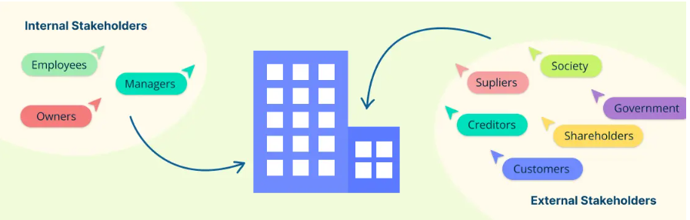
STAKEHOLDER RELATIONSHIPS, SOCIAL RESPONSIBILITY, AND CORPORATE GOVERNANCE
IMPLEMENTING A STAKEHOLDER PERSPECTIVE

Slide 35
STAKEHOLDER RELATIONSHIPS, SOCIAL RESPONSIBILITY, AND CORPORATE GOVERNANCE
Implementing A Stakeholder Perspective
An organization that develops effective corporate governance and understands the importance of business ethics and social responsibility in achieving success should also develop processes for managing these important concerns..
Although there are different approaches to this issue, we provide basic steps found effective in utilizing the stakeholder framework to manage responsibility and business ethics.
The steps include (1) assessing the corporate culture, (2) identifying stakeholder groups, (3) identifying stakeholder issues, (4) assessing organizational commitment to social responsibility, (5) identifying resources and determining urgency, and (6) gaining stakeholder feedback.

Slide 36
STAKEHOLDER RELATIONSHIPS, SOCIAL RESPONSIBILITY, AND CORPORATE GOVERNANCE
Implementing A Stakeholder Perspective
Assessing the corporate culture.
To enhance organizational fit, a social responsibility program must align with the corporate culture of the organization.
The purpose of this first step is to identify the organizational mission, values, norms, and behavior likely to have implications for social responsibility.
Relevant existing values and norms are those that specify the stakeholder groups to engage and stakeholder issues deemed most important by the organization.
Often, relevant organizational values and norms can be found in corporate documents such as the mission statement, annual reports, sales brochures, and codes of ethics.

Slide 37
STAKEHOLDER RELATIONSHIPS, SOCIAL RESPONSIBILITY, AND CORPORATE GOVERNANCE
Implementing A Stakeholder Perspective
Identifying Stakeholder Groups.
In managing this stage, it is important to recognize stakeholder needs, wants, and desires.
Stakeholders have a level of power over a business because they are in the position to withhold organizational resources to some extent. Stakeholders have the most power when their survival is not affected by the success of the organization and when they have access to vital organizational resources.
Companies can be transparent or can use various avenues, including technology, to avoid communication and interaction.
This creates a need to prioritize the stakeholders who are most important to engage

Slide 38
STAKEHOLDER RELATIONSHIPS, SOCIAL RESPONSIBILITY, AND CORPORATE GOVERNANCE
Implementing A Stakeholder Perspective
Identifying Stakeholder Issues.
Together, steps 1 and 2 lead to the identification of the stakeholders who are both the most powerful and legitimate. The level of stakeholders’ power and legitimacy determines the degree of urgency in addressing their needs.
Step 3, then, consists of understanding the main issues of concern to these stakeholders.
Conditions for collaboration exist when problems are so complex that multiple stakeholders are required to resolve the issue, and adversarial approaches to problem solving are clearly inadequate.

Slide 39
STAKEHOLDER RELATIONSHIPS, SOCIAL RESPONSIBILITY, AND CORPORATE GOVERNANCE
Implementing A Stakeholder Perspective
Assessing Organizational Commitment to Stakeholders and Social Responsibility.
Steps 1 through 3 are geared toward generating information about social responsibility among a variety of influences in and around an organization.
Step 4 brings these three stages together to arrive at an understanding of social responsibility that specifically matches the organization of interests.
This general definition will then be used to evaluate current practices and to select concrete social responsibility initiatives.

Slide 40
STAKEHOLDER RELATIONSHIPS, SOCIAL RESPONSIBILITY, AND CORPORATE GOVERNANCE
Implementing A Stakeholder Perspective
Identifying Resources and Determining Urgency.
The prioritization of stakeholders and issues and the assessment of past performance lead to the allocation of resources.
Two main criteria can be considered: the level of financial and organizational investments required by different actions and the urgency when prioritizing social responsibility challenges.
When the challenge under consideration is viewed as significant and stakeholder pressures on the issue can be expected, the challenge is considered urgent.

Slide 41
STAKEHOLDER RELATIONSHIPS, SOCIAL RESPONSIBILITY, AND CORPORATE GOVERNANCE
Implementing A Stakeholder Perspective
Gaining Stakeholder Feedback.
Stakeholder feedback is generated through a variety of means.
First, stakeholders’ general assessment of a firm and its practices can be obtained through satisfaction or reputation surveys.
Second, to gauge stakeholders’ perceptions of a firm’s contributions to specific issues, stakeholder-generated media such as blogs, websites, podcasts, and newsletters can be assessed. Many firms use media tracking services to identify and classify content related to the company.
Third, more formal research may be conducted using focus groups, observation, and surveys. Many watchdog groups use the web to inform consumers and publicize their messages.

Slide 42
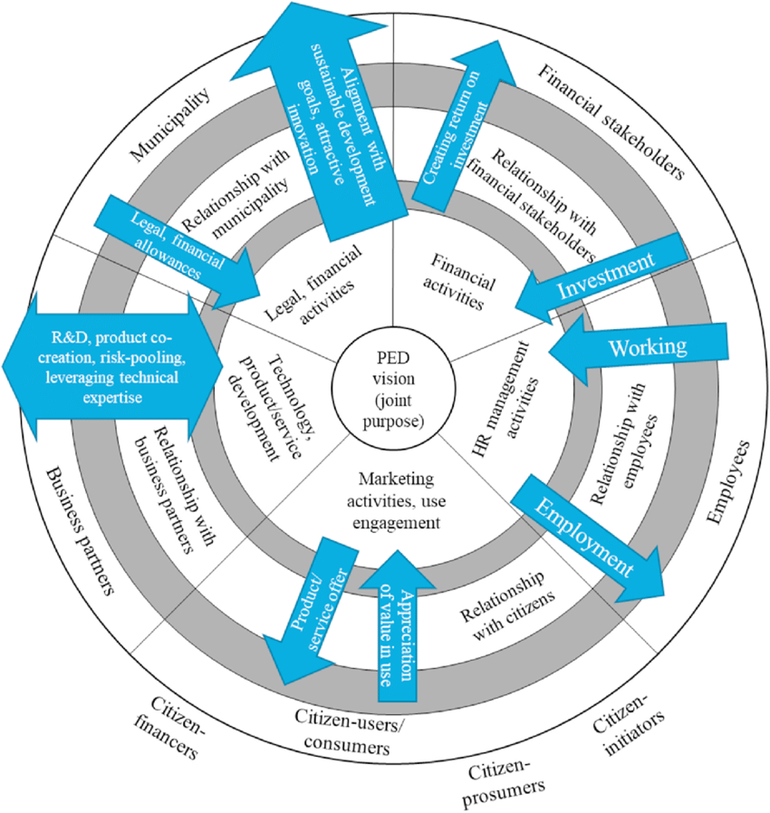
STAKEHOLDER RELATIONSHIPS, SOCIAL RESPONSIBILITY, AND CORPORATE GOVERNANCE
CONTRIBUTIONS OF A STAKEHOLDER PERSPECTIVE

Slide 43
STAKEHOLDER RELATIONSHIPS, SOCIAL RESPONSIBILITY, AND CORPORATE GOVERNANCE
Contributions Of A Stakeholder Perspective
While we provide a framework for implementing a stakeholder perspective, balancing stakeholder interests requires information and good judgment.
When businesses attempt to provide what consumers want, broader societal interests can create conflicts.
Consider, for example, that many of the metals in consumer electronics products come from countries such as the Democratic Republic of the Congo riddled by warfare and human rights violations.
What is most advantageous for consumers is not beneficial to the people living in the conflict region. It is clear that balancing stakeholder interests can be a challenging process.

Slide 44



Thank You

