Slide 1



Communication and Its Power at the Program Level: Managing Power Brokers with Effective Communication
Prepared by Dr. Sami Alzahrani
Lecture 7
PMG 665
Program and Portfolio Management
Lecture 7

Slide 2


Introduction
Chapter
07
Introduction
Communication management is one of the key skills required for a successful program. It is important for a program manager to master the art and practice of effective communication to succeed in the field. The management of projects involves 70% to 80% communication, and its value is even more significant at the program level where stakeholders, complexity, and delegation often increase geometrically.

Slide 3
Chapter
07
Introduction
If program managers spend most of their time communicating, then it is critical to ensure this skill is used to manage the program power brokers effectively and most importantly to bring them to support the program and its plans.

Slide 4
Determine the power brokers
Chapter
07
Determine the power brokers
First, it is necessary to identify, map, and segment program stakeholders to have a clear view of the program’s power brokers as we would need to spend more time and effort on managing them than other stakeholders. A common approach is the 80/20 Rule, also known as the ‘law of vital few’ which can be applied in this context that 80% of the power and influence in a program reside with 20% of the stakeholder (the power brokers).

Slide 5
Determine the power brokers
Chapter
07
Determine the power brokers
The Power/Influence grid in Figure 10.1 below is a popular, yet simple way to determine who the power brokers really are. The program manager groups his or her stakeholder’s according to their power and interest in the program to determine the power brokers that need to be managed closely.

Slide 6
Determine the power brokers
Chapter
07
Determine the power brokers
Once determined, most of the communication effort needs to be channeled to this group. They have high interest and high power, which would be essential to the success of the program if they are positive toward the program and remain so during the program’s life cycle.

Slide 7
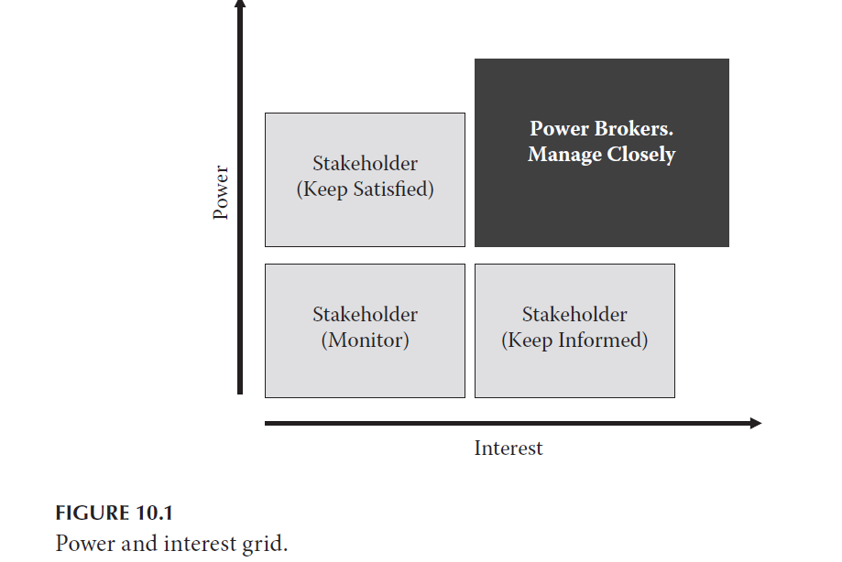
Determine the power brokers
Chapter
07
Determine the power brokers

Slide 8
Have a clear and achievable strategy
Chapter
07
Have a clear and achievable strategy
Once the program manager determines the “who is who” among his or her stakeholders, he or she should have a clear and achievable communication strategy designed and tailored specifically for the program with the aim of managing the power brokers and their expectations, determining their influence, and resolving their issues and conflicts in the program.

Slide 9
Have a clear and achievable strategy
Chapter
07
Have a clear and achievable strategy
The communication strategy should contain an explicit plan and strategy to disseminate and ensure prompt delivery of information to the right stakeholders at the right times using the most appropriate approach, method, and technique. The program manager and the team should ensure that the communication strategy aligns with the organizational communication strategy and also should be organizationally driven.

Slide 10
Have a clear and achievable strategy
Chapter
07
Have a clear and achievable strategy
To ensure the strategy is still effective in managing the communication expectation of the power brokers, the program manager should include in the communication strategy an audit to assess its continuous effectiveness. The audit should be carried out as often as possible but at a minimum before the start of a new phase in the program life cycle.

Slide 11
Have a clear and achievable strategy
Chapter
07
Have a clear and achievable strategy
To ensure the goal of the communication audit is achieved, it should be performed by a key member of the power broker group who is:
1. Actively and constantly involved in the program and its communications
2. Positive toward the program success in achieving its intended benefits
3. Objective, analytical, and unbiased.

Slide 12
Chapter
07
Communication and diversity of program stakeholders
Great! I have identified my program stakeholders, I have prepared the required documentation, and since they are key stakeholders, they should understand it and provide required responses if they have any.
This is a key area in which many program managers fail in managing their program power brokers effectively. It is important to understand cultural differences, values, perspectives, work styles, and communication styles of these stakeholders. This becomes more important in programs that span geographical locations, cultures, and time zones.

Slide 13
Chapter
07
Communication and diversity of program stakeholders
Communication is a two-way process, and effective communication with each of your program stakeholders is important, as it would help to create a better relationship with them and get them to support your program. This does not mean a program manager needs to create 20 versions of the same communication to 20 different stakeholders, but he or she must understand the particular needs of the individual stakeholder in terms of communication requirements and manage them appropriately.

Slide 14
Chapter
07
Getting it right: communication type, strategy and channel
Verbal or Non-Verbal? Formal or Informal? A Mixture or a Model? Program managers need to determine what is most appropriate. In programs, there are instances where some stakeholders prefer written reports, while others prefer verbal briefings (e.g. meetings, seminars, and presentations).

Slide 15
Chapter
07
Getting it right: communication type, strategy and channel
There is nothing like the ‘most acceptable’ or ‘generally accepted’ communication type or strategy. Choosing the right form of communication is based on an individual, and it is important that a program manager is able to determine what works best for each of his or her power brokers.

Slide 16
Chapter
07
Getting it right: communication type, strategy and channel
As shown in Figure 10.3, the program manager can decide to use:
1. Formal written communications: When writing those formal documents, emails, memos, or letters, keep in mind the different power brokers:
a. Am I convincing enough to get their buy-in?

Slide 17
Chapter
07
Getting it right: communication type, strategy and channel
b. Is the information precise and clear enough to all and to ensure I am being professional? Your program power brokers would most likely not be on your side if you are seen to be unprofessional.
c. Do I need to have different versions to meet the needs of the stakeholders? d. How persuasive am I?
e. Would I be generating controversy instead of support?

Slide 18
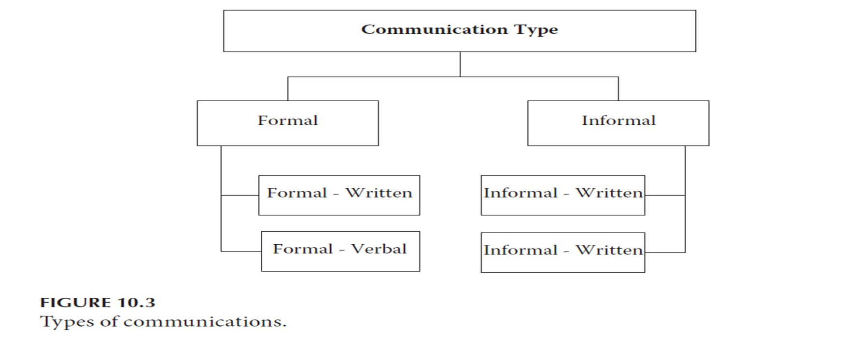
Chapter
07
Getting it right: communication type, strategy and channel

Slide 19
Chapter
07
Getting it right: communication type, strategy and channel
2. Formal verbal communications: During the formal meetings and presentations, you have a goal to persuade, to be clear, to present the details, and to win the power brokers to your side. Consider the following tips:
a. Read the body language to gauge support
b. Make quick necessary adjustments
c. Take note of the voice characteristics (para lingual)
d. Take note of the effect of spoken language and choice of language

Slide 20
Chapter
07
Getting it right: communication type, strategy and channel
3. Informal verbal communications: This includes non-formal communication. It is one of the better ways to build interpersonal relationships and rapport with key stakeholders and to obtain informal feedback, which is often quite valuable. Program managers must learn to use the power of informal verbal communication when dealing with the power brokers.

Slide 21
Chapter
07
Getting it right: communication type, strategy and channel
4. Informal written communications: This includes all non-legal documents, notes, informal emails, pre-contract documents, even instant message-chats. Program managers can use the informality of these documents to measure and gain support of the power brokers.

Slide 22
Start with the most important
Chapter
07
Star with the most important
The goal is to get the power brokers buy in and support; therefore, a good strategy is to begin communication with what is most important or brings the most benefits to the power broker. This might not necessary be the latest news in the program or what is considered the most important to the program manager or the team. Often, determining what brings the most benefit to a key stakeholder might vary, may be easy to figure out, or may be difficult to define.

Slide 23
Chapter
07
Use the communication log
During the course of a program, information requests and information dissemination are constantly ongoing and can become a major part of a program manager’s workload, more so, as some power brokers leave and are replaced by others with inadequate information transfer, and while other stakeholders either join afresh or evolve from a different category to a power broker status, there is a need to recognize the information that has been distributed. This is where a communication log is extremely helpful.

Slide 24
Chapter
07
Rapport Building: Dose the magic !
Communications through rapport building does magic when managing the power brokers!
Getting your program power brokers to support your program involves some rapport building using communication; this would help when dealing with difficult issues and when trying to influence and negotiate with these stakeholders. Rapport is about creating a connection and bringing other people closer to understand you, building harmony, and having a close relationship with others. Building rapport is one of the first essential steps to communication, which is the main job of a program manager.

Slide 25
Manage the communication channels
Chapter
07
Manage the communication channels
A program might have several key stakeholders who are in the ‘Power Brokers’ grid, hence the communication channels might increase significantly and need to be properly managed. For any group of program stakeholders, there are n(n-1)/2 communication channels, which the program manager needs to manage.

Slide 26
Manage the communication channels
Chapter
07
Manage the communication channels
This includes the power brokers and the other stakeholders. Knowing the complexity and numbers of communication channels in program will help a program manager determine how to manage these channels properly.

Slide 27
Listening to win and influence
Chapter
07
Listen to win the influence
It is popularly said that we have two ears and one mouth for specific reasons. Listen more!
While growing up, most of us were taught to talk more than listen, which has led people to being keen on expressing their opinions, providing feedback, and responding to issues quickly. However, the most important part of a two-way communication is listening and understanding the other party, not just listening but actively listening and showing it.

Slide 28
Chapter
07
Constant engagement
Constantly engaging the power brokers with some form of communication (either formally or informally), even when nothing much has changed in the program, is an excellent way to manage your key program stakeholders effectively. The momentum and communication bridge need to be kept alive and active throughout the program.

Slide 29
Chapter
07
Build strong personality: focusing on the power of non-verbal communication
To gain and sustain the support of power brokers, the program manager needs to have a strong blend of good communication skills and a strong personality. Create and cultivate a positive impression with your power brokers through the building of a strong personality, using the power of non-verbal communication. This positive impression might be the key ingredient to getting the required support needed from the program power brokers during the entire program or at key decision points within it.

Slide 30
Chapter
07
Build strong personality: focusing on the power of non-verbal communication
A strong personality projects self confidence, openness, clarity, passion, and sincerity. With over 80 percent of communication being non-verbal, your key stakeholders are surely not only listening to your verbal communication but are constantly ‘feeling’ and watching your non-verbal communication and evaluating you accordingly.

Slide 31
Chapter
07
Build strong personality: focusing on the power of non-verbal communication
A program manager should learn to use the power of the facial expression, body posture, tone of voice, quality and pitch, eye contact and engagement, conversational pace, rhythm, gestures, and the architecture of his or her message to win the confidence of his or key stakeholders. Remember, even when you are silent, you are still communicating non-verbally, and a power broker is probably ‘listening’ and gauging the level of support you should get based on his or her perception of you.

Slide 32
Keep it simple
Chapter
07
Keep it simple
Communication to your power brokers must be clearly understood and convey the necessary message. It must also fulfill its goal: to gain support, influence, negotiate, or alignment with regard to a particular course of action.

Slide 33
Keep it simple
Chapter
07
Keep it simple
To achieve this goal, the program manger should keep communication simple; avoid unnecessary acronyms not understandable to all especially when the communication has not been streamlined for a particular group. Reports, presentations, phone calls, and emails should convey the desired message in the simplest way possible, while all other detailed information is prepared and made available on request by the respective power brokers.

Slide 34
Chapter
07
Reference
Reference
Program Management: A Life Cycle Approach
by Ginger Levin, PMP, PgMP
Chapter 10

