Slide 1


College of Management
Business Ethics
Lecturer: Dr. Raef Baraka
PMG 750
Lecture 10

Slide 2

Ethical Implications of AI in Business
LECTURE OBJECTIVES:
Explain the key ethical challenges associated with AI-driven decision making, including algorithmic bias, transparency, privacy risks, and accountability.
Analyze how AI technologies influence ethical behavior and decision structures within organizations, especially in HR, marketing, finance, and operations.
Evaluate the impact of AI on stakeholder trust, consumer rights, and organizational reputation.
Differentiate between technical, ethical, and managerial factors that contribute to unfair or discriminatory AI outcomes.

Slide 3
Ethical Implications of AI in Business
LECTURE OBJECTIVES:
Discuss the role of governance, regulation, and industry standards in ensuring responsible AI development and deployment.
Formulate practical recommendations for organizations to design and implement ethical AI systems that align with legal, social, and corporate values

Slide 4
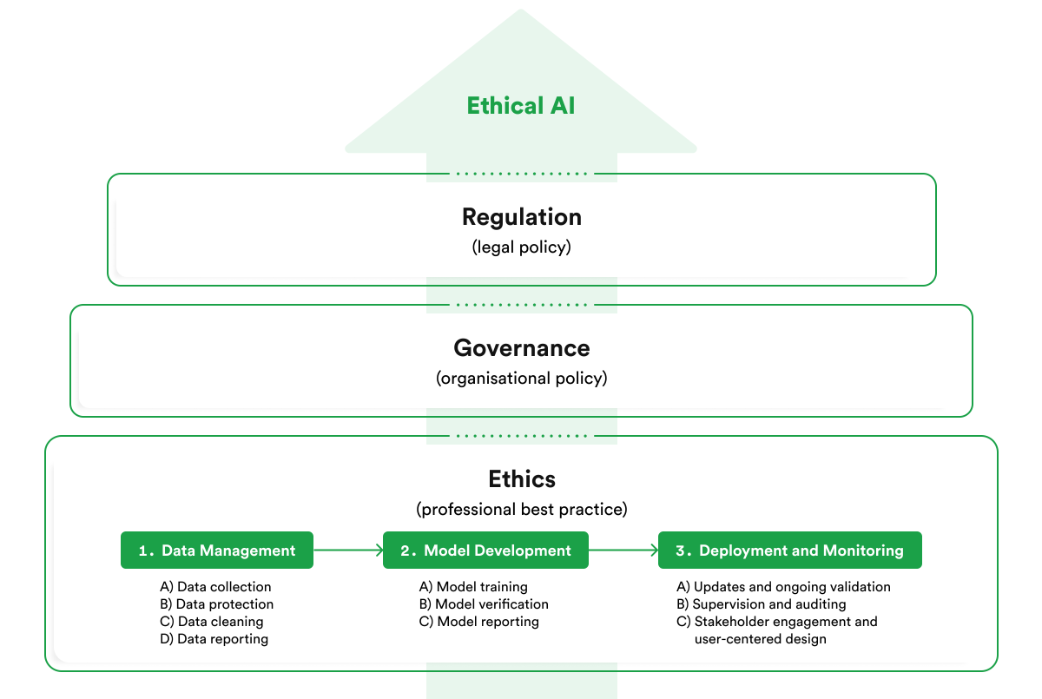
Ethical Implications of AI in Business
DEFINING SUSTAINABILITY

Slide 5
Ethical Implications of AI in Business
Introduction
Artificial intelligence is now deeply integrated into business decision-making, influencing areas such as hiring, marketing, finance, and operations.
While AI offers major improvements in efficiency and accuracy, it also introduces new ethical challenges that organizations must carefully manage.
Because AI systems rely on large datasets and automated algorithms, their decisions can create unintended consequences that affect fairness, privacy, and accountability.
As businesses increasingly depend on AI, understanding its ethical implications becomes essential for ensuring responsible and trustworthy organizational practices.

Slide 6
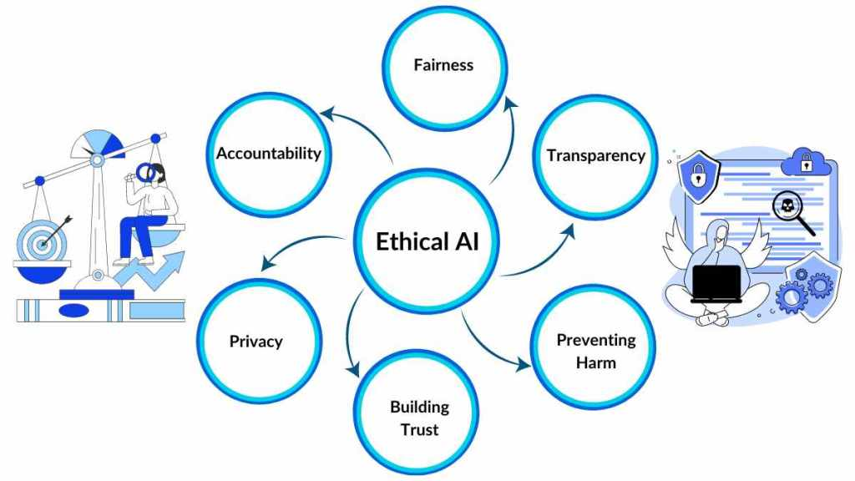
Ethical Implications of AI in Business
Key Ethical Challenges Associated With Ai-driven Decision-making

Slide 7
Ethical Implications of AI in Business
1. Algorithmic Bias
Artificial intelligence has become a central component of organizational decision-making, yet its rapid adoption has introduced a set of complex ethical challenges that businesses must address.
One of the most prominent issues is algorithmic bias, where AI systems unintentionally produce unfair or discriminatory outcomes due to biased training data, flawed model design, or embedded human assumptions.
These biases can affect hiring decisions, credit scoring, insurance pricing, and customer targeting, with potentially harmful consequences for marginalized groups

Slide 8
Ethical Implications of AI in Business
2. Transparency
Another challenge is transparency, often referred to as the “black-box problem,” where the internal logic of AI systems is difficult or impossible to interpret.
This lack of clarity undermines trust among users, customers, and regulators, and complicates efforts to explain or justify automated decisions.
Closely related are privacy risks, as AI systems frequently rely on large volumes of personal and behavioral data.
Without strong safeguards, organizations may violate consumer rights, expose sensitive information, or engage in intrusive data practices.

Slide 9
Ethical Implications of AI in Business
3. Accountability
Finally, accountability poses a critical ethical dilemma: when AI systems make harmful or erroneous decisions, responsibility becomes diffuse and ambiguous.
Organizations must determine whether developers, managers, or automated systems themselves are accountable for outcomes.
The absence of clear accountability mechanisms can create moral and legal gaps, making it difficult to ensure fairness, remedy harm, and uphold ethical standards.
Together, these challenges highlight the need for organizations to adopt robust governance frameworks, ethical guidelines, and oversight mechanisms to ensure responsible AI-driven decision making.

Slide 10
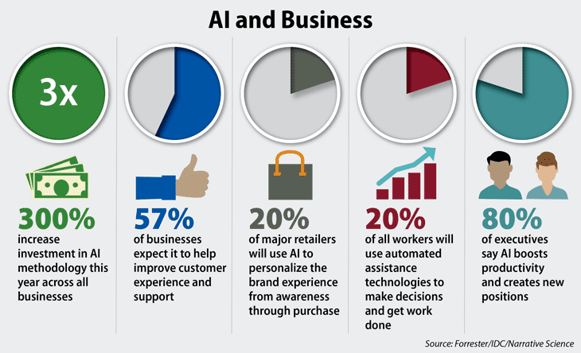
Ethical Implications of AI in Business
AI Influence in HR, Marketing, Finance, and Operations

Slide 11
Ethical Implications of AI in Business
AI Influence in HR, Marketing, Finance, and Operations
Across all functional areas, AI influences organizational behavior by introducing new decision structures that prioritize data-driven outcomes.
This can reduce opportunities for human oversight, weaken accountability, and alter internal power dynamics.
As a result, organizations must ensure that AI-guided decisions reflect not only efficiency and performance but also ethical responsibility, fairness, and compliance with stakeholder expectations.

Slide 12
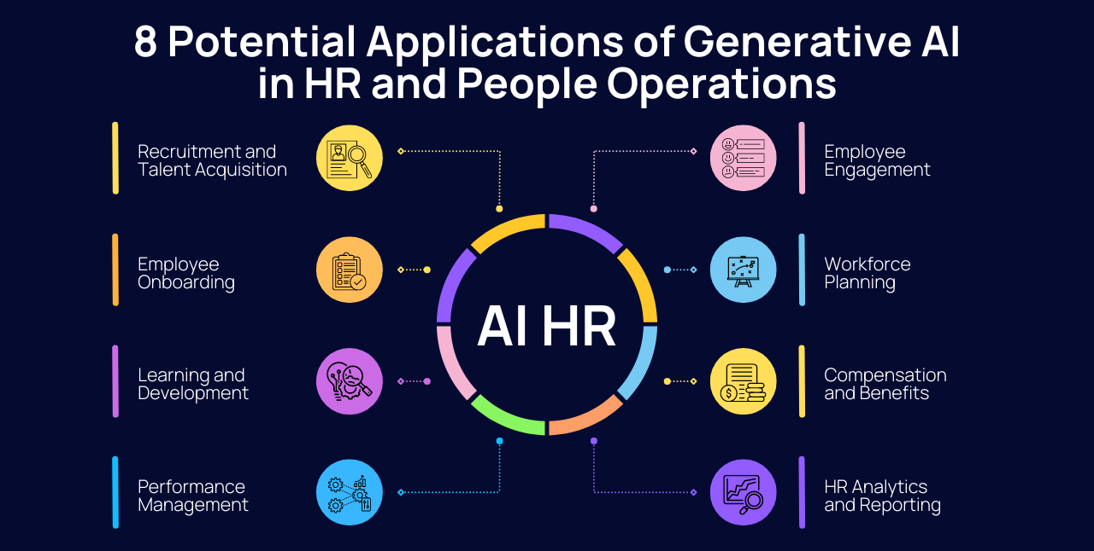
Ethical Implications of AI in Business
AI Influence in HR Function

Slide 13
Ethical Implications of AI in Business
AI influence in HR Function
AI technologies fundamentally reshape how organizations make decisions, often shifting the balance between human judgment and automated processes.
In human resources, AI-driven tools screen résumés, predict candidate performance, and evaluate employee behavior.
While these systems can increase efficiency and reduce human bias, they may also reinforce hidden prejudices in training data, influencing hiring and promotion decisions in ethically problematic ways.

Slide 14
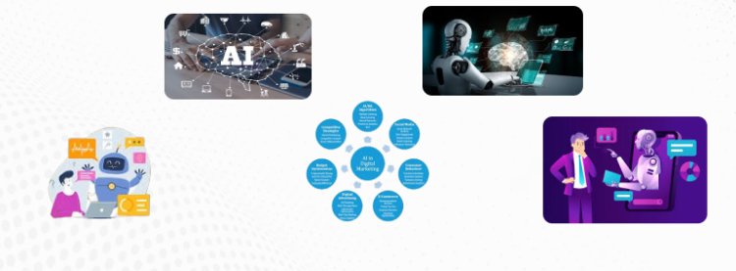
Ethical Implications of AI in Business
AI Influence in the MARKETING Function

Slide 15
Ethical Implications of AI in Business
AI Influence in the MARKETING Function
In marketing, AI personalizes advertising and forecasts consumer behavior, but the use of granular personal data raises concerns about manipulation, consent, and the fairness of targeted marketing strategies.

Slide 16
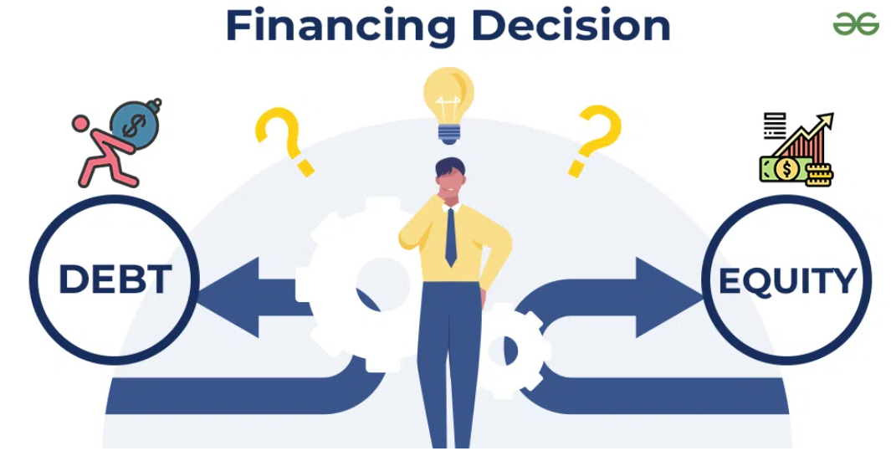
Ethical Implications of AI in Business
AI Influence in the Financial Decision-Making

Slide 17
Ethical Implications of AI in Business
AI Influence in the Financial Decision-Making
In financial decision-making, AI supports credit scoring, fraud detection, and investment modeling.
These systems improve accuracy but may unintentionally exclude certain groups or produce opaque decisions that individuals cannot challenge.

Slide 18
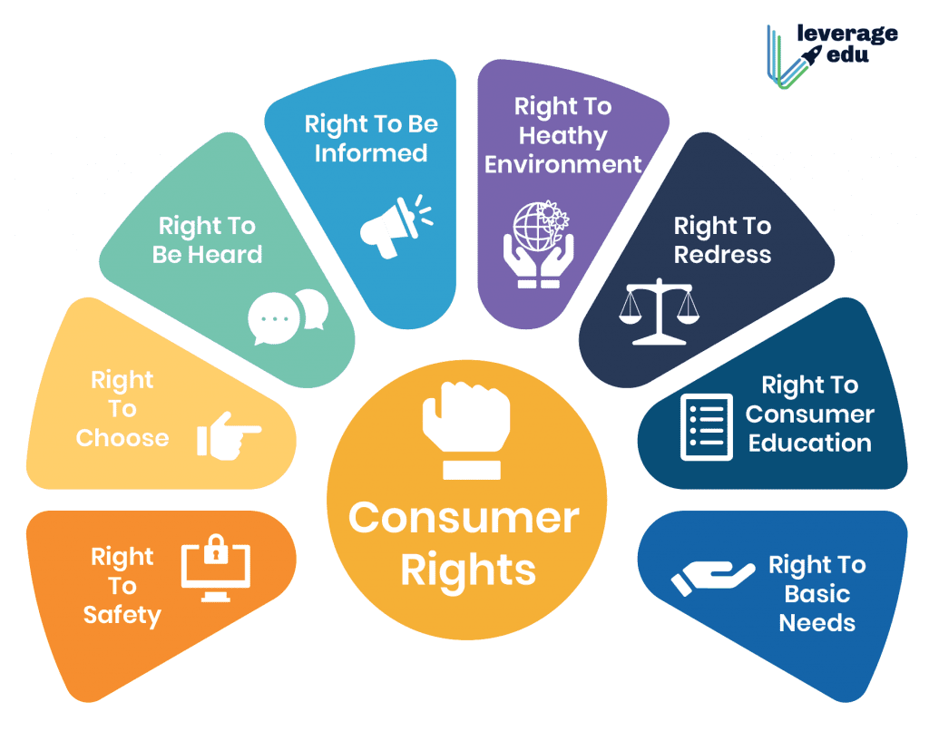
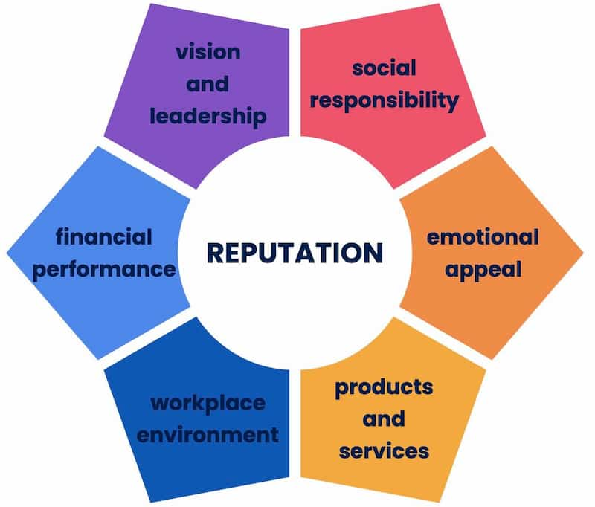
Ethical Implications of AI in Business
AI Influence on stakeholder trust, consumer rights, and organizational reputation.

Slide 19
Ethical Implications of AI in Business
AI Influence on stakeholder trust, consumer rights, and organizational reputation.
As organizations integrate AI into more of their processes, its influence extends beyond internal operations and begins to shape how external stakeholders perceive the company.
Ethical or unethical uses of AI can directly affect trust, public expectations, and long-term reputation.
Therefore, evaluating how AI impacts stakeholders is essential for understanding its broader ethical implications.

Slide 20
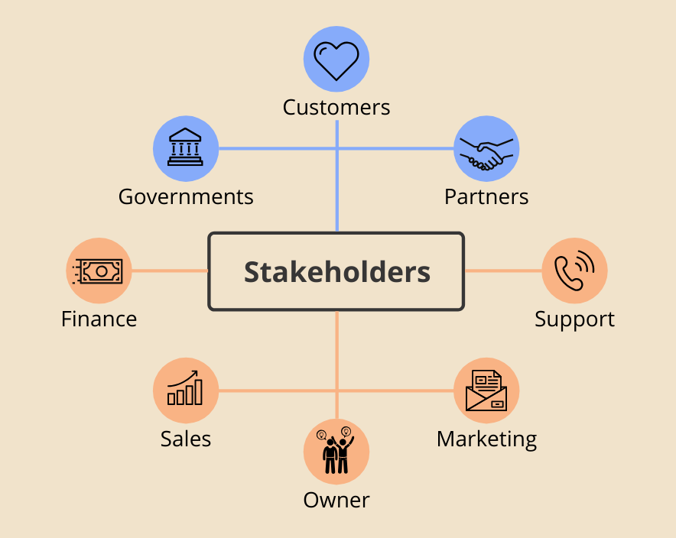
Ethical Implications of AI in Business
AI Influence in stakeholder trust

Slide 21
Ethical Implications of AI in Business
AI Influence on Stakeholder Trust
The adoption of AI-driven decision systems significantly influences how stakeholders perceive an organization’s integrity and reliability.
When AI technologies operate transparently and produce fair outcomes, they can enhance stakeholder trust by demonstrating consistency, accuracy, and data-driven rigor.
However, when AI systems make decisions that appear biased, opaque, or intrusive, trust can deteriorate rapidly.
Employees may question the fairness of automated performance evaluations, while consumers may lose confidence in companies that use AI in ways that feel manipulative or discriminatory.

Slide 22
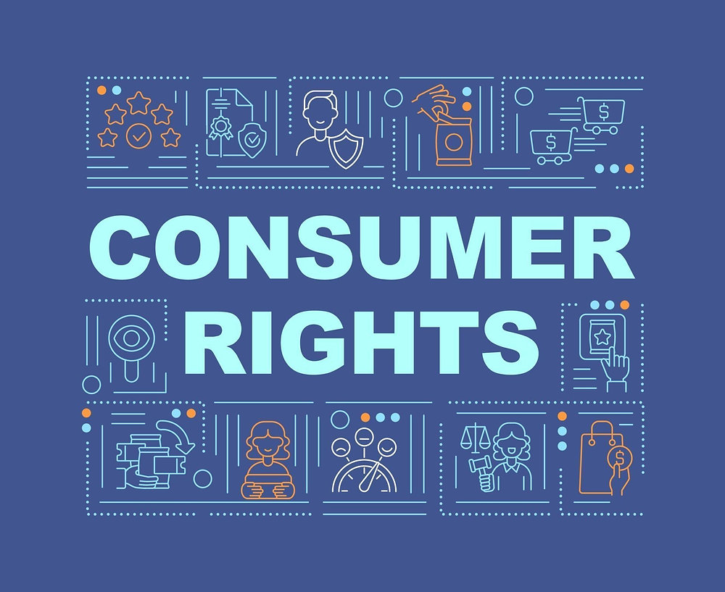
Ethical Implications of AI in Business
AI Influence on Consumer Rights

Slide 23
Ethical Implications of AI in Business
AI Influence on Consumer Rights
AI also has important implications for consumer rights, particularly in areas related to privacy, data protection, and informed consent.
Many AI applications depend on collecting and analyzing sensitive personal data, and misuse or inadequate safeguards can lead to ethical violations and legal consequences.
Consumers increasingly expect transparency about how their data is used, and failure to meet these expectations can undermine loyalty and public support.

Slide 24
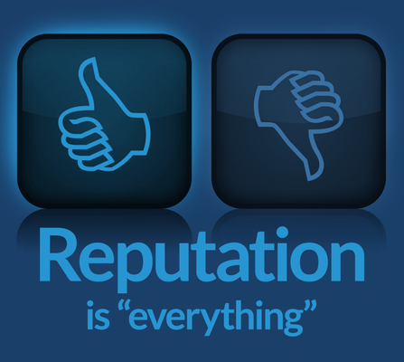
Ethical Implications of AI in Business
AI Influence on Organizational Reputation

Slide 25
Ethical Implications of AI in Business
AI Influence on Organizational Reputation
Finally, the ethical use of AI directly affects organizational reputation.
High-profile controversies—such as biased hiring algorithms, unfair credit decisions, or data misuse—can damage a company’s credibility and lead to regulatory penalties, negative media coverage, and loss of market value.
Conversely, organizations that adopt AI responsibly and communicate openly about risks and safeguards can strengthen their reputations as ethical and forward-thinking leaders.

Slide 26
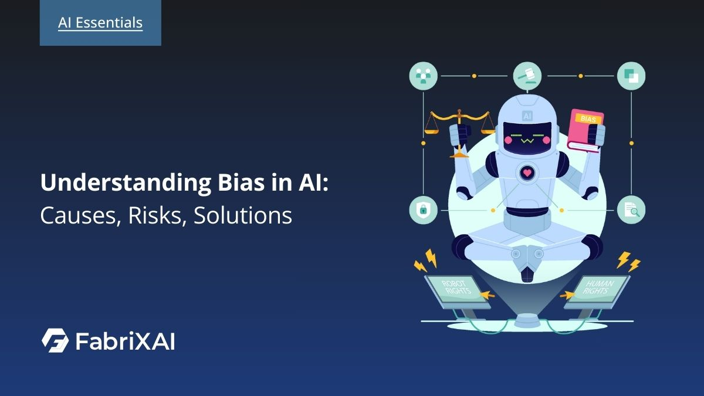
Ethical Implications of AI in Business
Unfair or Discriminatory AI Outcomes

Slide 27
Ethical Implications of AI in Business
Unfair or Discriminatory AI Outcomes
As AI systems take on more decision-making roles within organizations, it becomes essential to understand not only what these systems do, but how they produce their outcomes.
Many ethical issues arise from technical and managerial choices embedded in AI models.
Therefore, distinguishing between technical, ethical, and managerial sources of unfairness helps organizations better identify risks and design more responsible AI systems.

Slide 28
Ethical Implications of AI in Business
1. Technical factors
Unfair or discriminatory outcomes in AI systems can emerge from multiple sources, and understanding these distinctions is critical for effective oversight.
Technical factors often stem from the data and algorithms that power AI models.
Biased, incomplete, or unrepresentative datasets can lead to skewed decisions that disadvantage certain groups.
Additionally, algorithmic design choices—such as weighting variables or optimizing for specific performance metrics—can unintentionally reinforce systemic inequalities, even when no explicit bias is intended.

Slide 29
Ethical Implications of AI in Business
2. Ethical factors
Beyond technical issues, ethical factors reflect broader concerns about fairness, justice, and respect for stakeholder rights.
These include decisions about what constitutes an “acceptable” trade-off between efficiency and equity, whether individuals can challenge automated decisions, and how transparent an AI system should be.
Ethical considerations also involve determining which values the organization prioritizes—accuracy, inclusiveness, privacy, or accountability—and how these values shape AI development.

Slide 30
Ethical Implications of AI in Business
3. Managerial factors
Finally, managerial factors play a significant role in determining how AI systems are implemented and monitored.
Managers who prioritize speed, cost savings, or performance targets may overlook fairness concerns or fail to establish sufficient oversight mechanisms.
Organizational pressures, such as aggressive sales goals or limited AI literacy among decision makers, can influence how AI is used and interpreted.
Inadequate governance, unclear leadership responsibility, and weak internal controls further increase the risk of discriminatory outcomes.

Slide 31
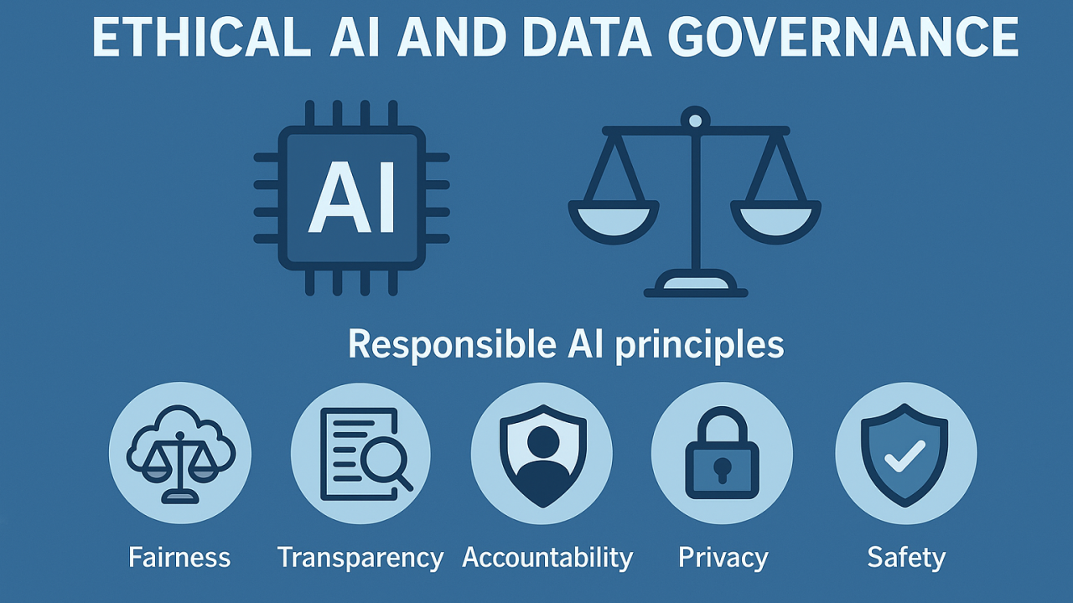
Ethical Implications of AI in Business
Ethical Governance of AI Systems

Slide 32
Ethical Implications of AI in Business
Ethical Governance of AI Systems
As AI technologies reshape business operations, companies face increasing pressure to ensure these systems are governed responsibly.
Ethical risks such as bias, privacy violations, and lack of transparency require structured oversight mechanisms. Evaluating how organizations design and implement AI governance frameworks is essential for understanding how ethical standards can be operationalized in practice.

Slide 33
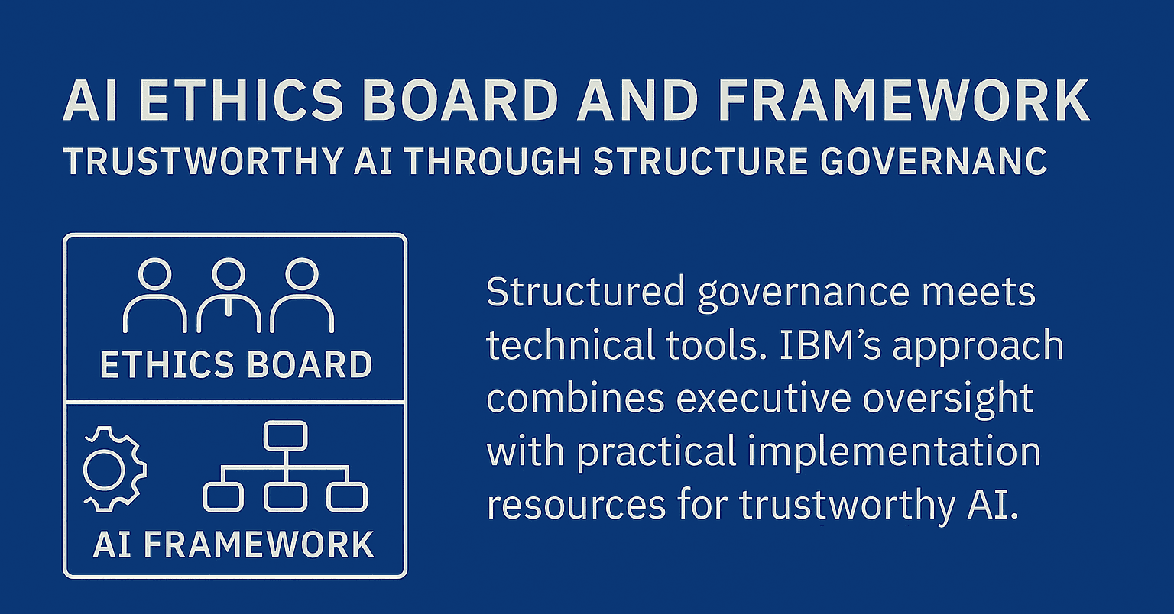
Ethical Implications of AI in Business
AI Governance Committees or Ethics Boards

Slide 34
Ethical Implications of AI in Business
AI Governance Committees or Ethics Boards
Effective governance of AI systems requires organizations to develop clear structures, policies, and processes that guide ethical design, deployment, and monitoring.
A foundational strategy is establishing AI governance committees or ethics boards, which bring together technical, legal, and ethical experts to oversee system development and ensure decisions align with broader organizational values.
These bodies review potential risks, evaluate data sources, assess fairness, and ensure compliance with emerging regulations.

Slide 35
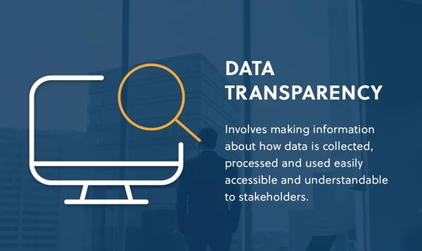
Ethical Implications of AI in Business
Transparent Data Policies and Documentation Practices

Slide 36
Ethical Implications of AI in Business
Transparent Data Policies and Documentation Practices
Organizations also rely on transparent data policies and documentation practices, such as maintaining algorithmic impact assessments, model cards, and data lineage records.
These tools help internal and external stakeholders understand how AI systems function, what data they use, and what limitations exist.
Transparency supports accountability and enables organizations to detect and correct potential ethical issues early.

Slide 37
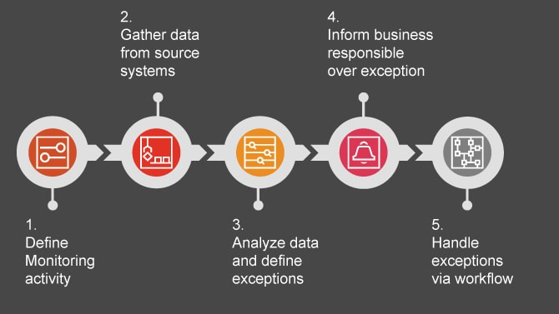
Ethical Implications of AI in Business
Continuous Monitoring and Auditing Processes

Slide 38
Ethical Implications of AI in Business
Continuous Monitoring and Auditing Processes
Another key governance strategy is implementing continuous monitoring and auditing processes.
AI systems can change over time as they learn from new data, which means risks may evolve after deployment.
Regular audits assess whether models continue to operate fairly, lawfully, and safely, while monitoring mechanisms help detect drift, bias, or unintended consequences.
Organizations increasingly integrate human-in-the-loop controls to ensure oversight in high-risk decision areas such as hiring, credit scoring, and healthcare.

Slide 39
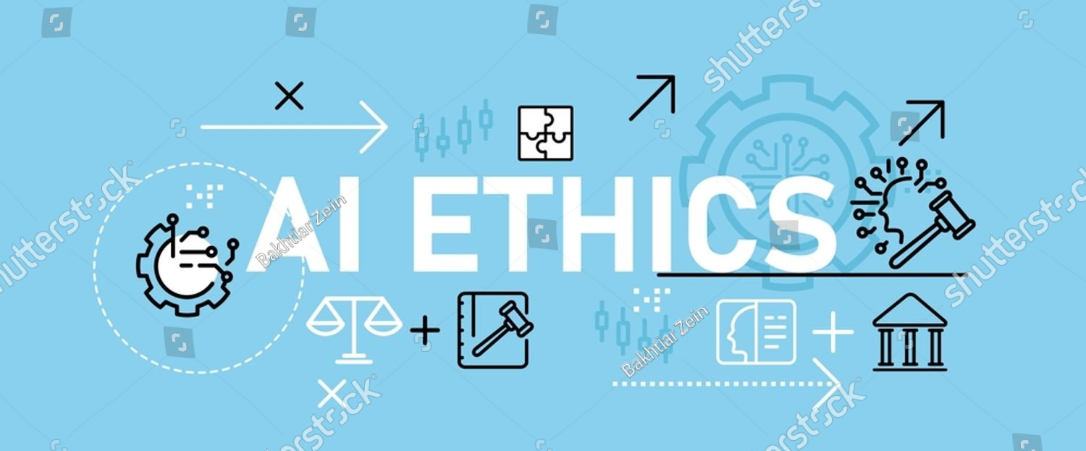
Ethical Implications of AI in Business
AI Ethics Training

Slide 40
Ethical Implications of AI in Business
AI Ethics Training
Training and capacity building are also central to ethical governance.
Many firms provide AI ethics training for employees, ensuring that developers, managers, and decision-makers understand ethical risks and regulatory requirements.
This cultural reinforcement helps integrate ethical thinking across the organization, not just within technical teams.

Slide 41
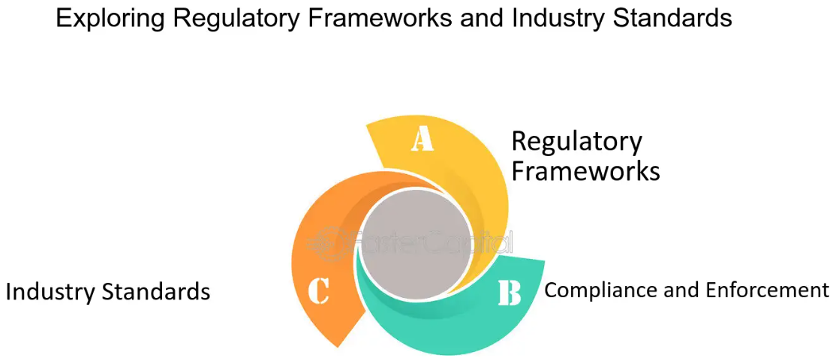
Ethical Implications of AI in Business
Industry Standards and Regulatory Frameworks

Slide 42
Ethical Implications of AI in Business
Industry Standards and Regulatory Frameworks
Finally, organizations adopt industry standards and regulatory frameworks, such as the EU AI Act, ISO AI governance guidelines, and OECD AI Principles, to benchmark and improve their ethical practices.
Adherence to these frameworks promotes consistency, mitigates legal risks, and enhances stakeholder trust.

Slide 43



Thank You

