Slide 1


Machine Learning
for Finance
Prepared by Dr. Diaa Salama
FNT633
Forecasting
Time Series Models
Lecture 8

Slide 2



Machine Learning
for Finance
Lecture 8
FNT633
Forecasting
Time Series Models
Prepared by
Dr. Diaa Salama
www.midocean.ae

Slide 3
Week
09
Today
Forecasting
Time Series Models
www.midocean.ae

Slide 4
Week
What Kind of Problem do I Need to Solve?
How do I Solve it?
09
The Problem to Solve | The Category of Techniques | Covered in this Course
I want to group items by similarity. I want to find structure (commonalities) in the data | Clustering | K-means clustering
I want to discover relationships between actions or items | Association Rules | Apriori
I want to determine the relationship between the outcome and the input variables | Regression | Linear Regression Logistic Regression
I want to assign (known) labels to objects | Classification | Naïve Bayes Decision Trees
I want to find the structure in a temporal process I want to forecast the behavior of a temporal process | Time Series Analysis | ACF, PACF, ARIMA
I want to analyze my text data | Text Analysis | Regular expressions, Document representation (Bag of Words).
www.midocean.ae

Slide 5
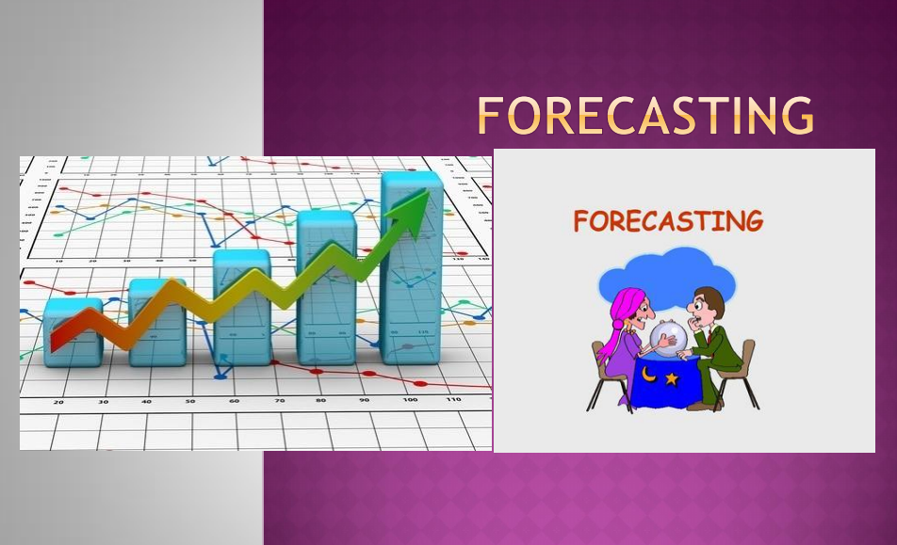
Week
09
Forecasting
www.midocean.ae

Slide 6
Week
09
Agenda
    Appreciate the importance of forecasting to every organization
    List different types of forecasting method
    Discuss the characteristics of judgmental forecasting
    Use a variety of approaches to judgmental forecasting
    Describe the characteristics of projective forecasting
    Understand the importance of time series
    Calculate errors and a tracking signal for forecasts
    Forecast using simple averages, moving averages, and exponential smoothing
    Forecast time series with seasonality and trend.
www.midocean.ae

Slide 7
Week
09
Introduction to Forecasting
What is forecasting?
  Primary Function is to Predict the Future using (time series related or other) data we have in hand
Why are we interested?
  Affects the decisions we make today
Where is forecasting used ?
  forecast demand for products and services
  forecast availability/need for manpower
  forecast inventory and materiel needs daily
www.midocean.ae

Slide 8
Week
09
What makes a good Forecast
It should be timely
It should be as accurate as possible
It should be reliable
It should be in meaningful units
The method should be easy to use and understand in most cases.
www.midocean.ae

Slide 9
Week
09
Forecasting Learning Objective
Generate forecasts for data with different patterns: level, trend, seasonality, and cyclical
Describe causal modeling using linear regression
Compute forecast accuracy
Explain how forecasting models should be selected.
www.midocean.ae

Slide 10
Week
09
Forecasting steps
    Decide what needs to be forecast
        Level of detail, units of analysis & time horizon required
    Evaluate and analyze appropriate data
        Identify needed data & whether it’s available
    Select and test the forecasting model
        Cost, ease of use & accuracy
    Generate the forecast
    Monitor forecast accuracy over time
www.midocean.ae

Slide 11
Week
09
Reasons for forecasting in organizations
    We have to calculate a break-even analysis to maximize organization profit by calculating the number of units of a product that a firm must sell before it begins to make a profit
    If sales of a new product are unlikely to reach the break-even point, the organization should not bother making it.
    Unfortunately, it cannot know exactly what future sales will be – so its only option is to forecast likely sales.
www.midocean.ae

Slide 12
Week
09
Reasons for forecasting in organizations Cont;
    So managers should not base their decisions on present situations, but on conditions as they will be when the decisions become effective.
    These conditions must be forecast, and this suggests that forecasting is a core concern of every organization.
    it becomes clear that virtually every decision made by managers depends on forecasts of future conditions.
    The implication is that forecasting is an essential job in every organization.
    there is no single best way of forecasting, and managers have to choose the method that best suits their needs.
www.midocean.ae

Slide 13
Week
09
Reasons for forecasting in organizations Cont;
  A lot of the following discussion talks of ‘forecasting demand’,
  but this is only a convenient label.
  In practice, virtually everything has to be
    forecast –demand,
    costs,
    availability of resources,
    weather,
    staff turnover,
    competitors’ actions,
    exchange rates, taxes,
    inflation,
    energy consumption,
    traffic levels,
    customer complaints –
    and just about anything else.
www.midocean.ae

Slide 14
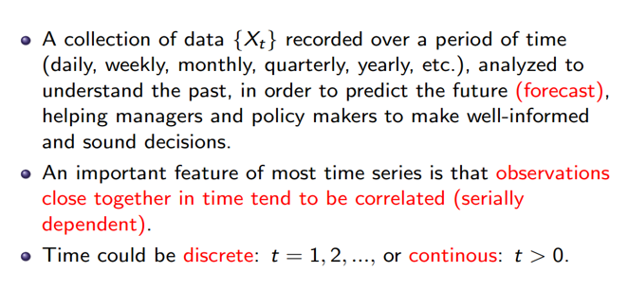
Week
09
What is a Time Series?
www.midocean.ae

Slide 15
Week
09
Methods of forecasting
One classification of forecasting methods concerns the time in the future they cover
  Long-term forecasts; look ahead several years – the time typically needed to build a new factory
  Medium-term forecasts look ahead between three months and two years –the time typically needed to replace an old product by a new one.
  Short-term forecasts cover the next few weeks – describing the continuing demand for a product.
www.midocean.ae

Slide 16
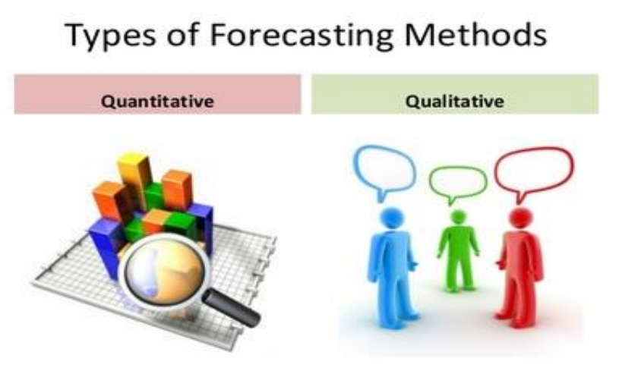
Week
09
Methods of forecasting
    Another classification of methods draws a distinction between qualitative and quantitative approaches
www.midocean.ae

Slide 17
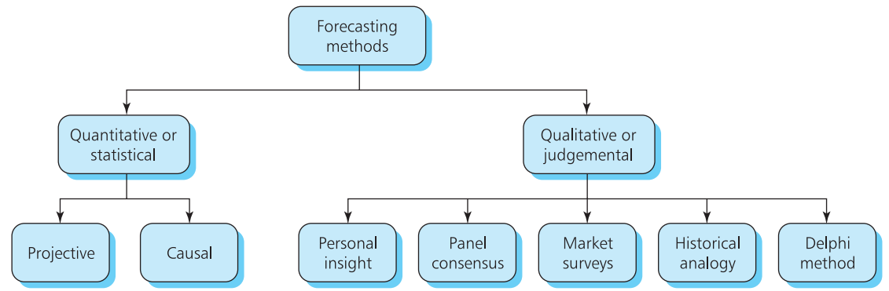
Week
09
Methods of forecasting
    Another classification of methods draws a distinction between qualitative and quantitative approaches
www.midocean.ae

Slide 18
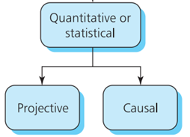
Week
09
Methods of forecasting
    When a company is already making a product, it has records of past sales and knows the factors that affect them. Then it can use a quantitative method
    to forecast future demand. There are two ways of doing this:
www.midocean.ae

Slide 19
Week
09
Methods of forecasting
    Causal methods analyze the effects of outside influences and use these to produce forecasts (linear regression) .
    Projective methods examine the pattern of past demand and extend this into the future.
    If demand in the past five weeks has been 10, 20, 30, 40 and 50, it seems reasonable to project this pattern into the future and suggest that demand in the next week will be 60.
    Both of these methods need accurate, quantified data.
www.midocean.ae

Slide 20
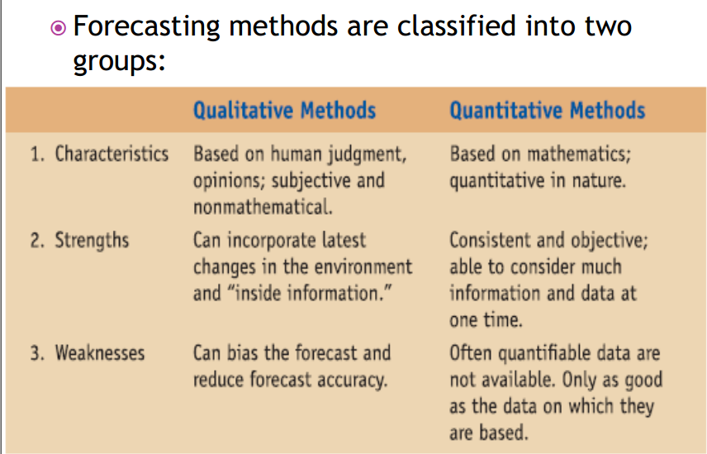
Week
09
Methods of forecasting
www.midocean.ae

Slide 21
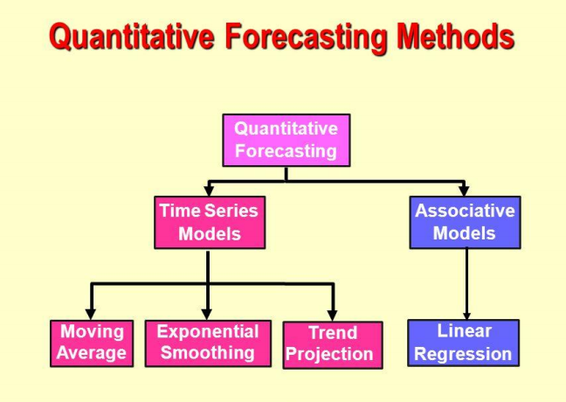
Week
09
Projective forecasts (Time Series forecast)
www.midocean.ae

Slide 22
Week
09
Time Series Pattern
    Projective forecasts often work with time series, such as monthly unemployment figures, daily rainfall, weekly sales, quarterly profit, and annual fuel consumption.
    When you have a time series it is always useful to draw a graph, and a simple scatter diagram shows any underlying patterns.
      constant series (Level) ; with observations taking roughly the same value over time, such as annual rainfall
      series with a trend ; with values either rising or falling steadily, such as the gross national product per capita
      seasonal series; which have a cyclical component, such as the weekly sales of soft drinks.
www.midocean.ae

Slide 23
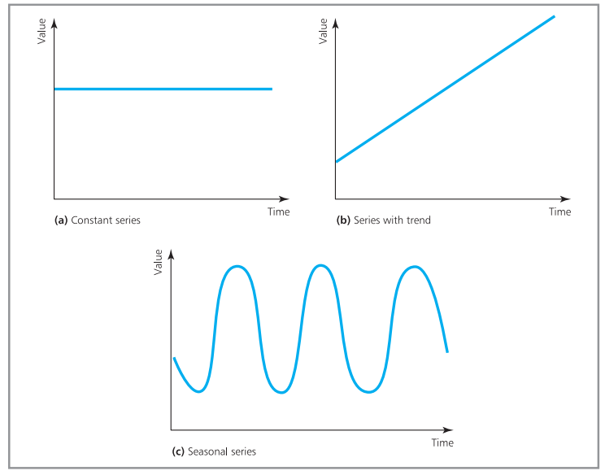
Week
09
Time Series Pattern
www.midocean.ae

Slide 24
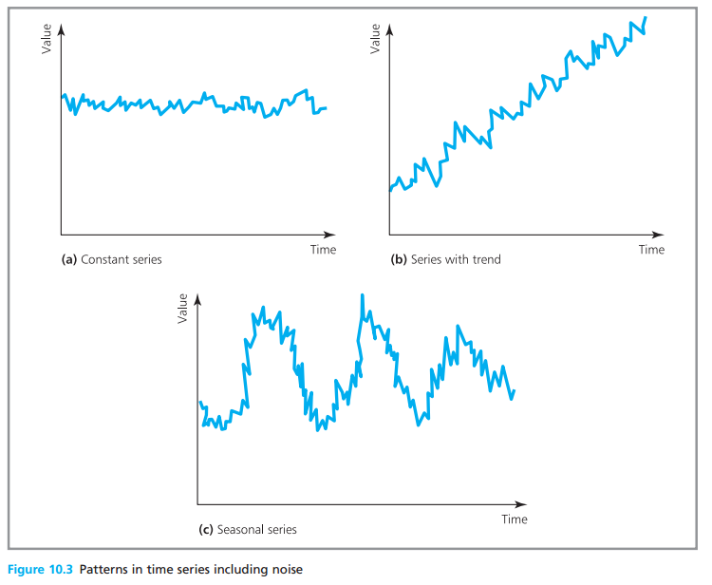
Week
09
Time Series Pattern
    If observations followed such simple patterns, there would be no problems with forecasting.
    Unfortunately, there are nearly always differences between actual observations and the underlying pattern.
    Random noise is apply to on the underlying pattern
Constant series, for example, does not always take exactly the same value, but is somewhere close. Then:
200 205 194 195 208 203 200 193 201 198
is a constant series of 200 with superimposed noise.
www.midocean.ae

Slide 25
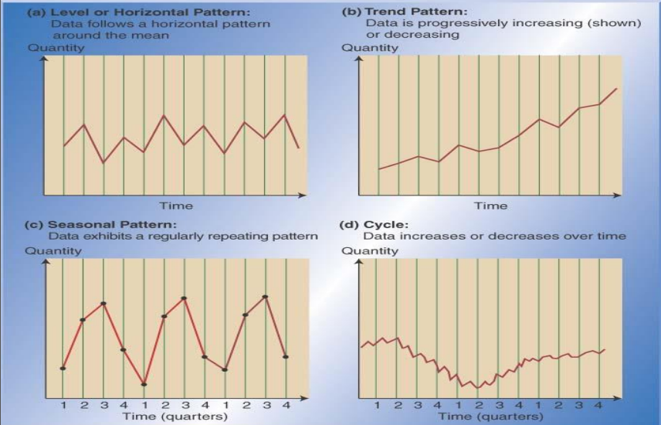
Week
09
Time Series Pattern
www.midocean.ae

Slide 26
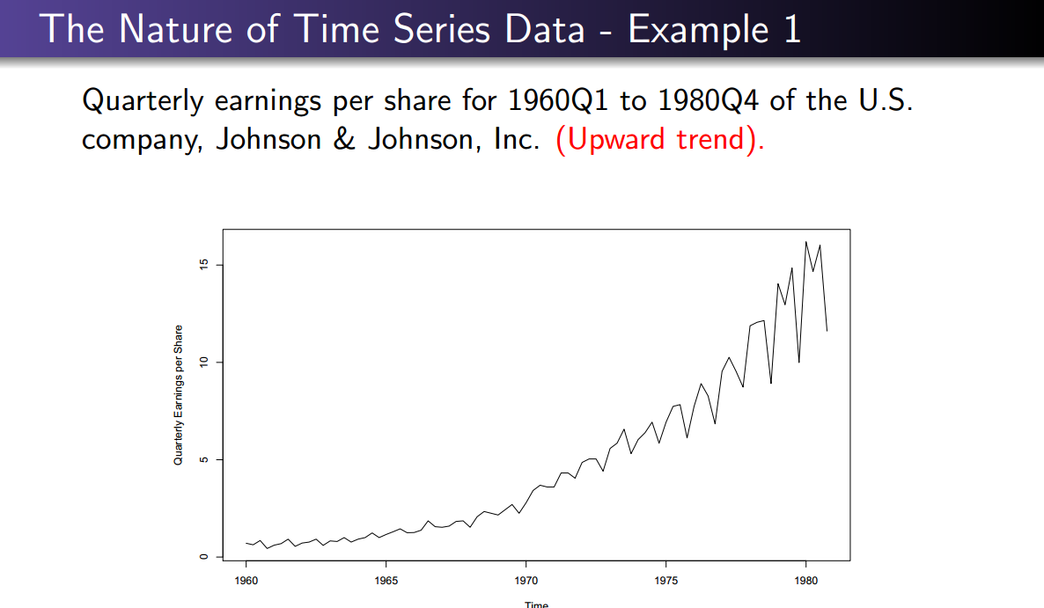
Week
09
Fundamental Concepts
www.midocean.ae

Slide 27
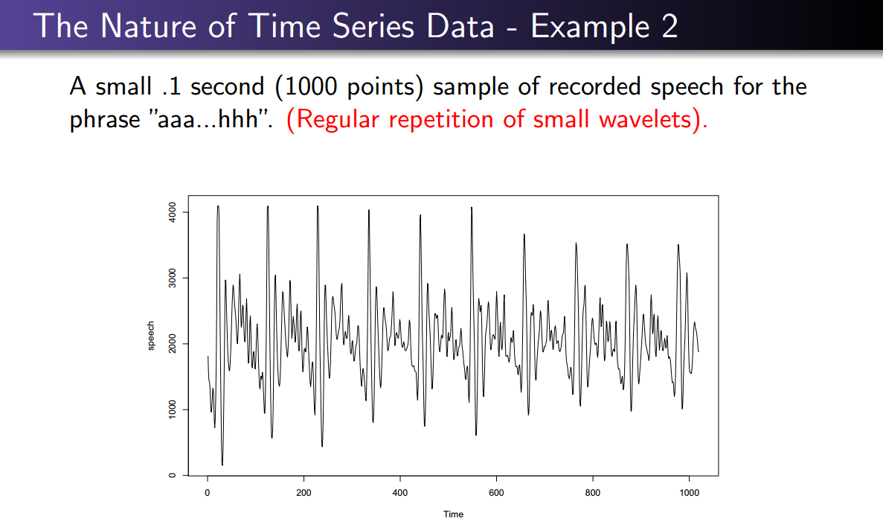
Week
09
Fundamental Concepts
www.midocean.ae

Slide 28
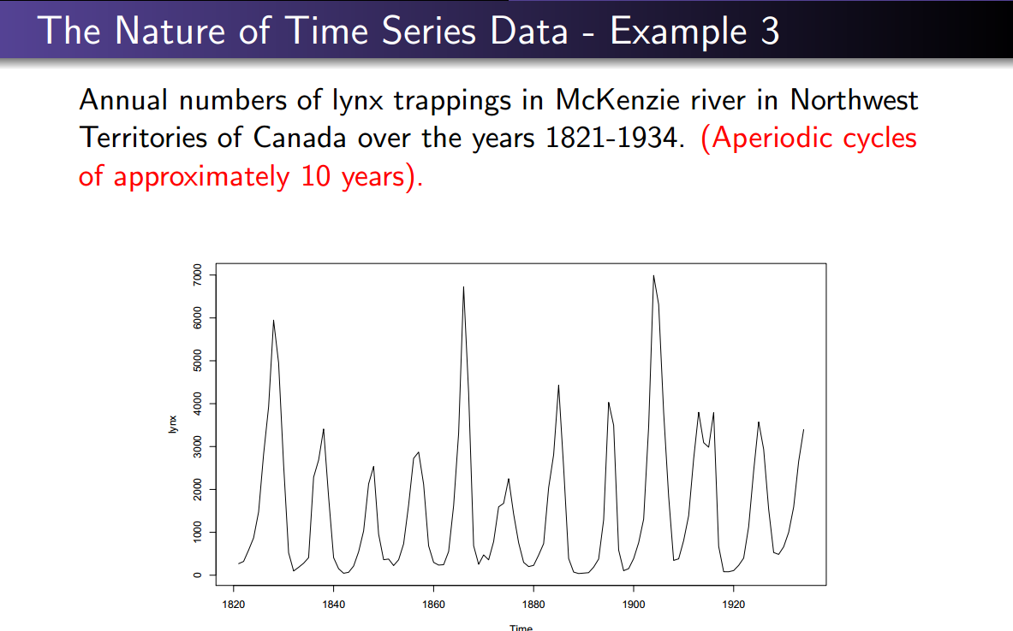
Week
09
Fundamental Concepts
www.midocean.ae

Slide 29
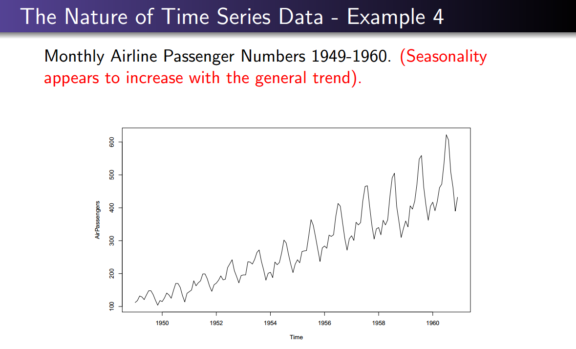
Week
09
Fundamental Concepts
www.midocean.ae

Slide 30
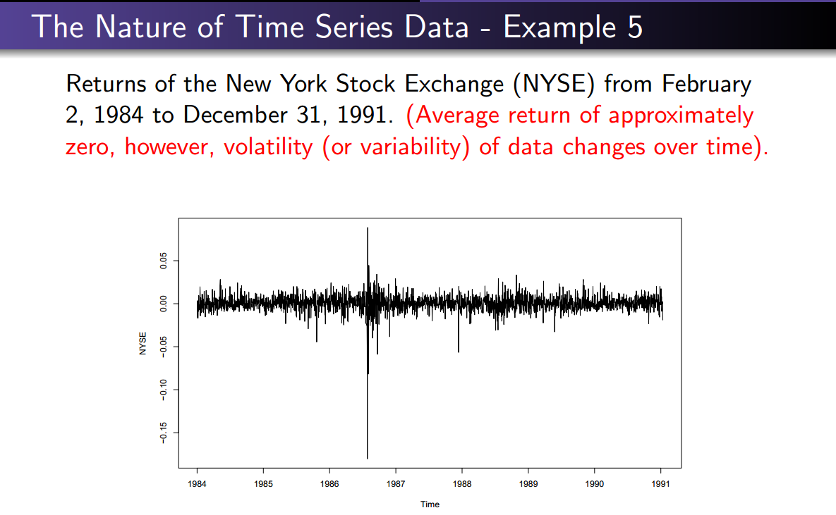
Week
09
Fundamental Concepts
www.midocean.ae

Slide 31
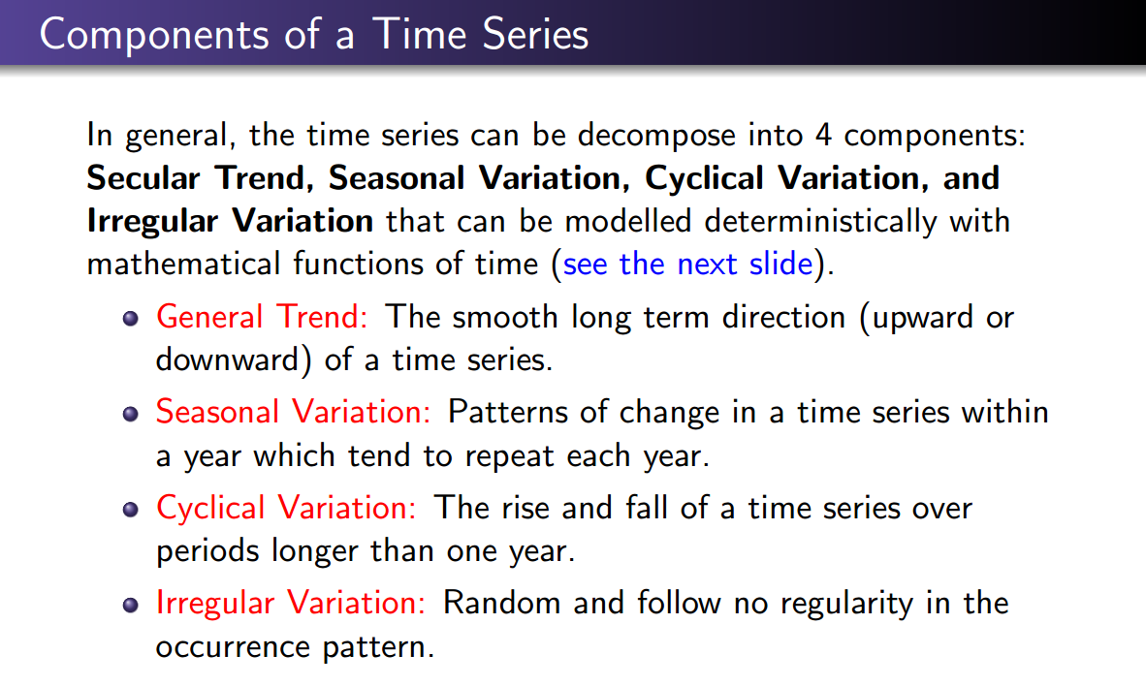
Week
09
Components of a Time Series
www.midocean.ae

Slide 32
Week
09
Time Series Models
Forecaster looks for data patterns as
  Data = historic pattern + random variation
Historic pattern to be forecasted:
  Level (long-term average) – data fluctuates around a constant mean
  Trend – data exhibits an increasing or decreasing pattern
  Seasonality – any pattern that regularly repeats itself and is of a constant length
  Cycle – patterns created by economic fluctuations
Random Variation cannot be predicted
www.midocean.ae

Slide 33

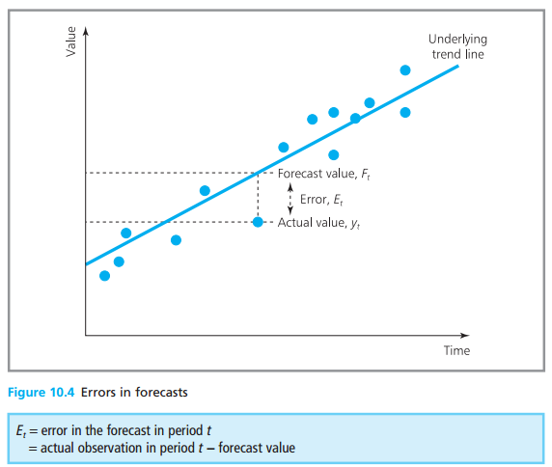

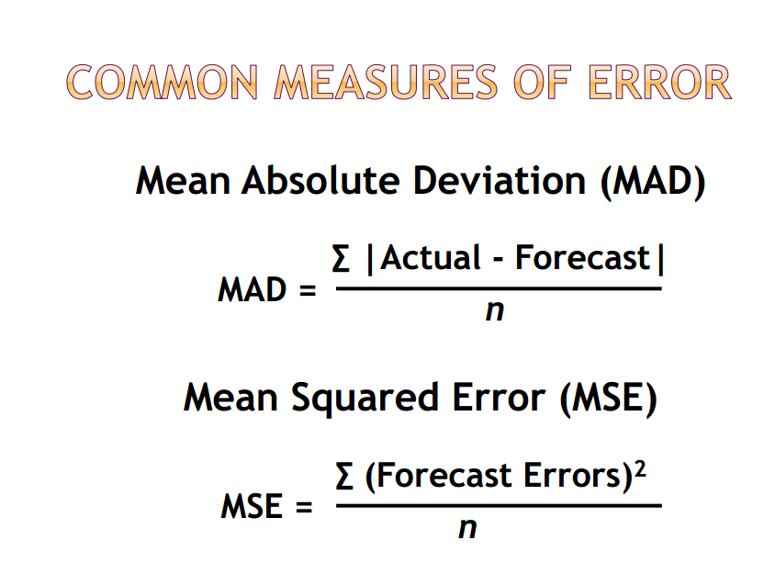
Week
09
Common Measures of Error
www.midocean.ae

Slide 34
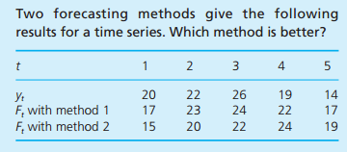
Week
09
Common Measures of Error
    Example
www.midocean.ae

Slide 35
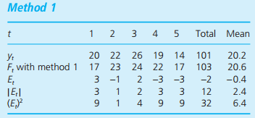
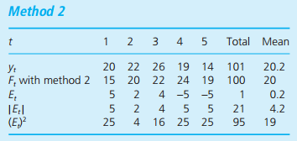
Week
09
Common Measures of Error
    Method 1 gives forecasts that are always nearer to actual demand than method 2, so in this case the decision is easy. We can confirm this by calculating the errors.
        The first method has lower mean absolute error and mean squared error, and is the better choice.
        The second method has slightly less bias, measured
www.midocean.ae

Slide 36
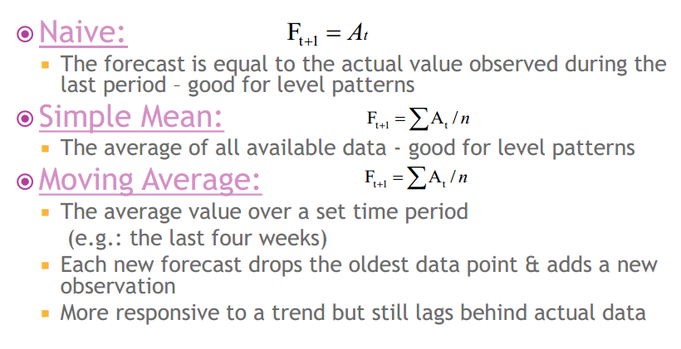
Week
09
Time Series Model
www.midocean.ae

Slide 37
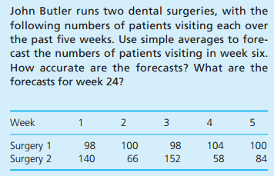
Week
09
Time Series Model
www.midocean.ae

Slide 38
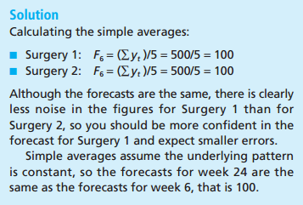
Week
09
Time Series Model
www.midocean.ae

Slide 39
Week
09
Simple Averages model
    Simple averages can give good forecasts for constant series
        Simple averages do not work well when the underlying Pattern changes
        The problem is that older data tends to swamp the latest figures and the forecast is very slow to follow the changing pattern.
www.midocean.ae

Slide 40
Week
09
Simple Average model limitations
    Suppose that demand for an item has been constant at 100 units a week for the past two years (104 weeks). Simple averages give a forecast demand for week 105 of 100 units.
    But if the actual demand in week 105 suddenly rises to 200 units, simple averages give a forecast for week 106
    If demand continues at 200 units a week, following forecasts are:
    If demand continues at 200 units a week, following forecasts are:
www.midocean.ae

Slide 41
Week
09
Simple Average model limitations
    Simple averages only actually work for constant series.
    The forecasts are rising but the response is very slow.
    But very few time series are in fact stable over long periods, so this restriction makes them of limited value.
    The problem with simple averages is that old, out-of-date data tends to swamp newer, more relevant data.
    A way around this is to ignore old data and use only a number of the most recent observations.
www.midocean.ae

Slide 42
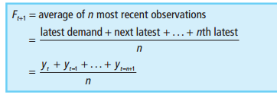
Week
09
Moving Average method
As patterns of demand tend to vary over time
  only a certain amount of historical data is relevant to future forecasts.
  The problem with simple averages is that old, out-of-date data tends to swamp newer, more relevant data
the principle of moving averages is to ignore old data and use only a number of the most recent observations.
www.midocean.ae

Slide 43
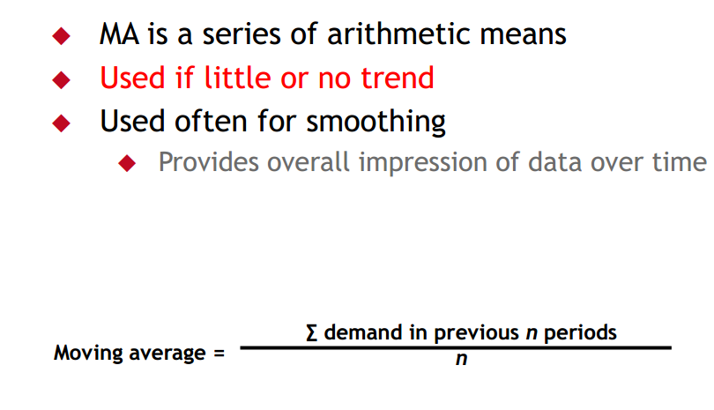
Week
09
Moving Average method
www.midocean.ae

Slide 44
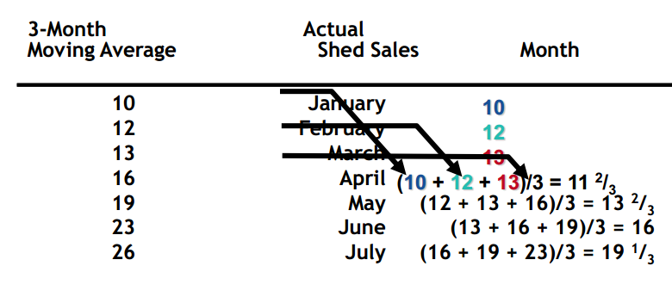
Week
09
Moving Average Example
www.midocean.ae

Slide 45
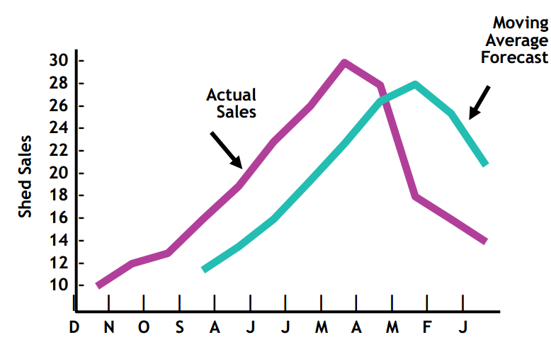
Week
09
Graph of Moving Average
www.midocean.ae

Slide 46
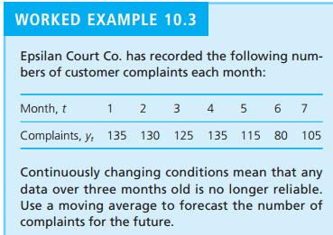
Week
09
Moving Average Quiz
www.midocean.ae

Slide 47
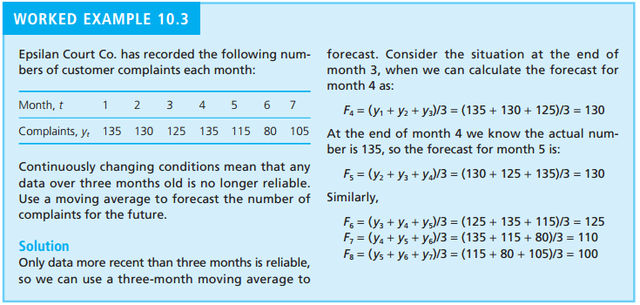
Week
09
Moving Average Quiz Solution
www.midocean.ae

Slide 48
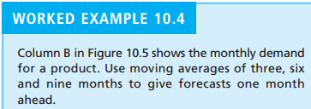
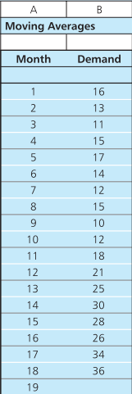
Week
09
Moving Average example with different value of N
www.midocean.ae

Slide 49
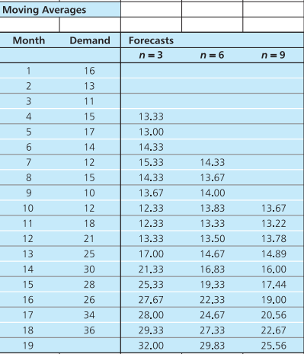
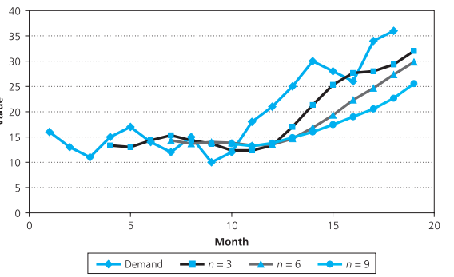
Week
09
Moving Average example with different value of N
www.midocean.ae

Slide 50
Week
09
Moving Average model advantages
    You can see from the last example that moving averages give good results for stable patterns, but they tend to fall behind trends.
    However, they have a very useful property for data with strong seasonal variations; when you choose n equal to the number of periods in a season
www.midocean.ae

Slide 51
Week
09
Moving Average model limitations
Although moving averages overcome some of the problems of simple averages, the method still has defects, including the following:
  It gives all observations the same weight.
  It works well only with constant time series (as we have seen, it lags behind trends and either removes seasonal factors or gets the timing wrong).
  It needs a lot of historical data to update the forecast.
  The choice of n is often arbitrary
  We can overcome the first of these problems by assigning different weights to observations.
www.midocean.ae

Slide 52
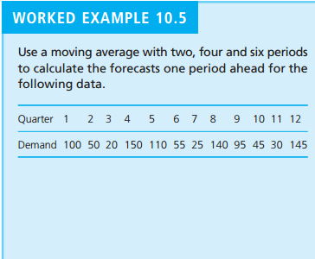
Week
09
Moving Average model for seasonality
www.midocean.ae

Slide 53
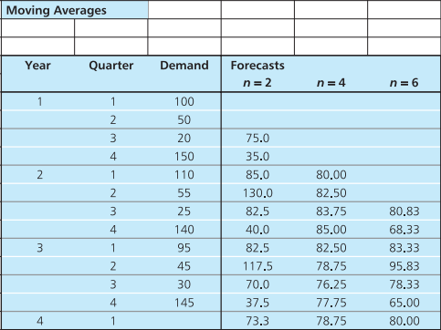
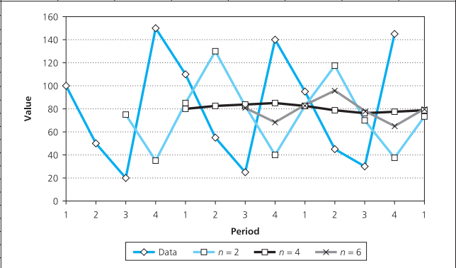
Week
09
Moving Average model for seasonality
www.midocean.ae

Slide 54
Week
09
Moving Average model for seasonality
    This data has a clear seasonal pattern, with a peak in the fourth quarter of every year.
    The moving averages with both n=2 and n=6 have responded to the peaks and troughs of demand,
        but neither has got the timing right: both forecasts lag behind demand.
        As you would expect, the two-period moving average is much more responsive than the six-period one
        the most interesting result is the four-period moving average, which has completely deseasonalised the data.
www.midocean.ae

Slide 55



Thank You

