Slide 1




Social Media and Crises
Lecture 3
DGM 730
Analysis of Social Media Crisis
Prepared by
Dr. Doaa Rady

Slide 2

Lecture
03
Lecture outline
Analysis of Social Media Crisis
What is crisis management in social media?
  How does social media affect a crisis?
The categories of Social Media Crisis
The levels of Social Media Crisis
The life cycle of Social Media Crisis
How to analyze a crisis?
Principles of Crisis Response

Slide 3
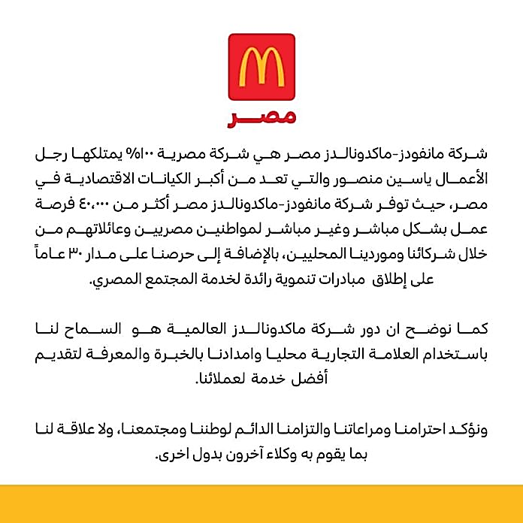

Lecture
03
Principles of Crisis Response
Live session
Macdonald’s case study
https://alhorianews.com/%D9%85%D8%A7%D9%83%D8%AF%D9%88%D9%86%D8%A7%D9%84%D8%AF%D8%B2-%D9%85%D8%B5%D8%B1-%D8%AA%D8%B1%D8%AF-%D8%B9%D9%84%D9%89-%D8%AD%D9%85%D9%84%D8%A9-%D9%85%D9%82%D8%A7%D8%B7%D8%B9%D8%A9-%D9%88%D8%AA%D8%A4/

Slide 4
Lecture
03
Principles of Crisis Response
Fall back on your values.
Johnson & Johnson case study
https://www.ou.edu/deptcomm/dodjcc/groups/02C2/Johnson%20&%20Johnson.htm
https://tamersalah.com/tylenol-pharmaceutical-case/
Case Study
Live session

Slide 5
Lecture
03
Social Media Reach
Coca Cola’s campain
https://www.youtube.com/watch?v=4dJ16WcfclY&list=PLRxRXcHqgCbIRy2lobx0a42KOe53a-__a
Case Study
As a brand that stands for happiness, for their 100th birthday we created a campaign that spread happiness on social media and celebrate the iconic bottle shape.
Live session

Slide 6
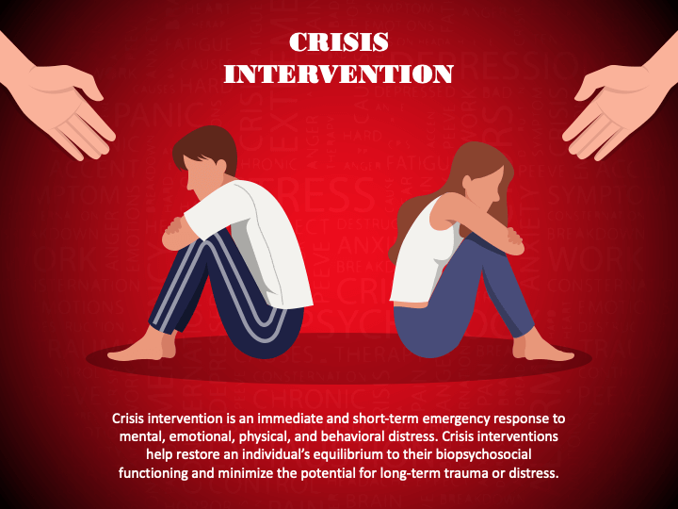
Lecture
03
Principles of Crisis Response
Live session

Slide 7
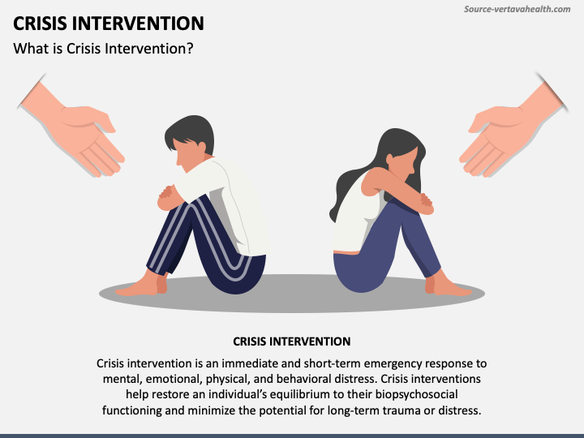
Lecture
03
Principles of Crisis Response
Live session

Slide 8
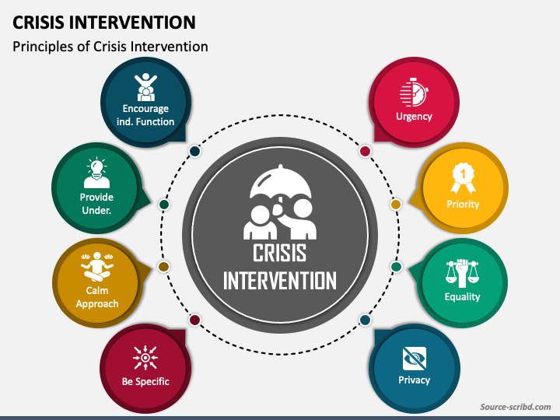
Lecture
03
Principles of Crisis Response
Live session

Slide 9
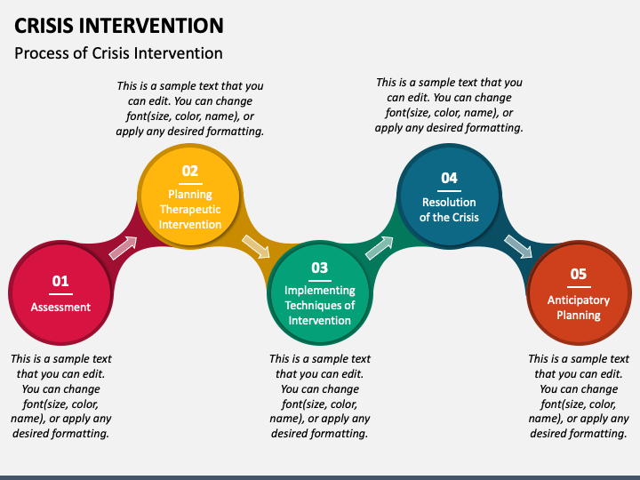
Lecture
03
Principles of Crisis Response
Live session

Slide 10
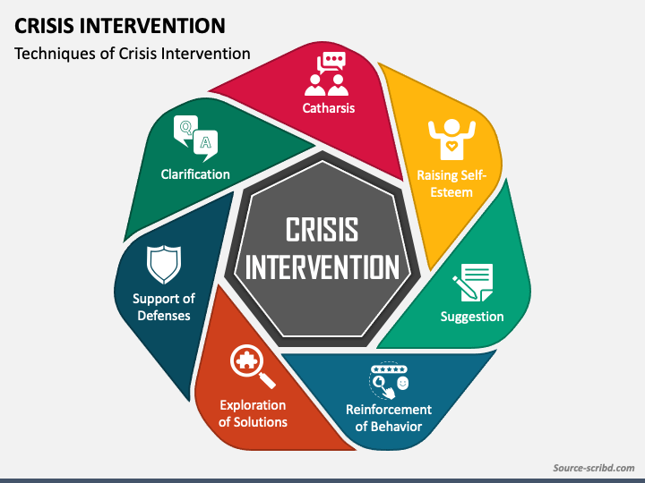
Lecture
03
Principles of Crisis Response
Live session

Slide 11
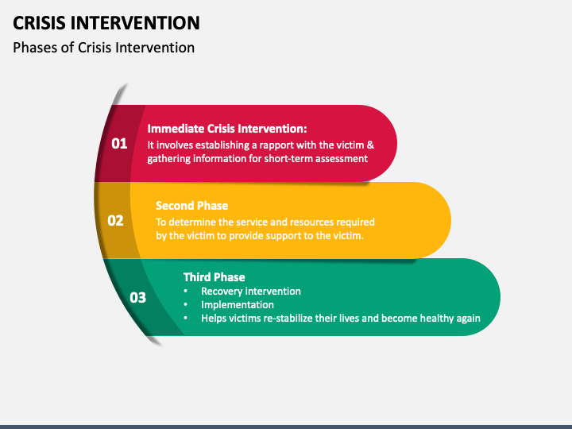
Lecture
03
Principles of Crisis Response
Live session

Slide 12
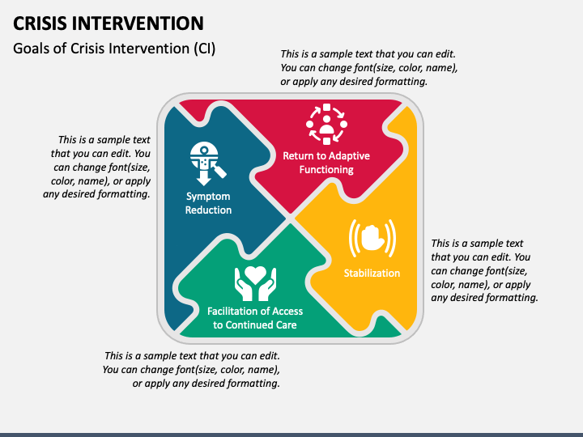
Lecture
03
Principles of Crisis Response
Live session
Source: https://www.sketchbubble.com/en/presentation-crisis-intervention.html

Slide 13


Thank You

