Slide 1




Social Media and Crises
Lecture 1
DGM 730
Social Media and Ethics
Prepared by
Dr. Doaa Rady

Slide 2

Lecture
01
Introduction
Lecture outline
Social Media and Ethics
    Social Media Policy and adherence
    Understanding copyright and creative commons
    Disclosure and Transparency
    Social Media risks and rewards
    Conclusion
    Recommended References

Slide 3
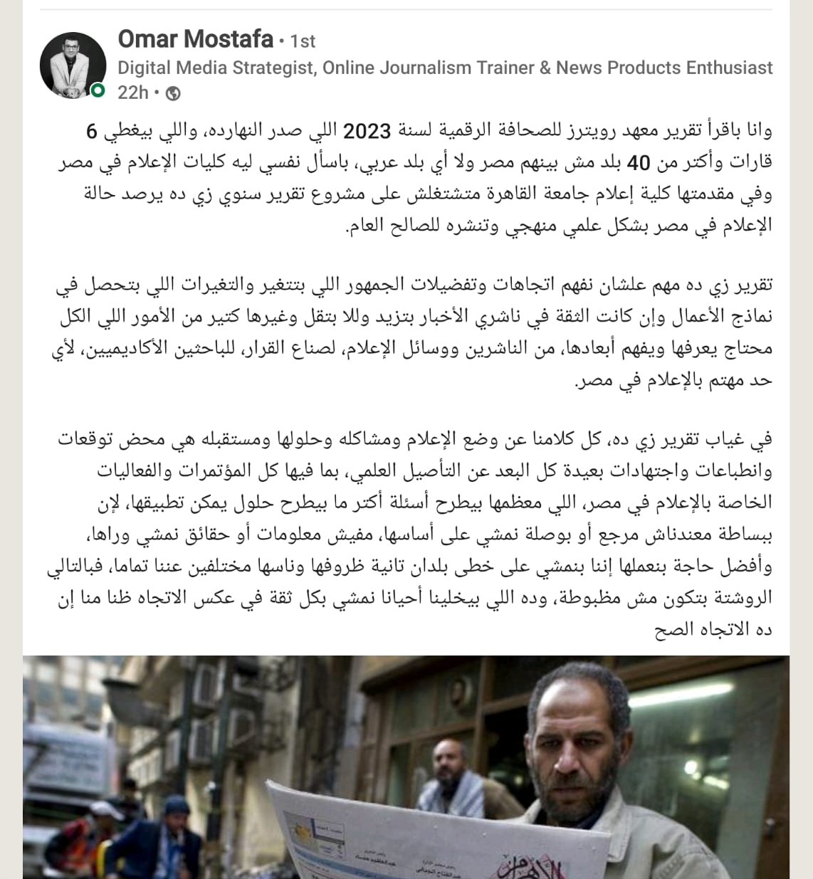
Lecture
01
Digital News Report 2023
Overview and key findings of the 2023 Digital News Report
https://reutersinstitute.politics.ox.ac.uk/digital-news-report/2023/dnr-executive-summary
https://open.spotify.com/episode/4tqp5uLJCYbiEUq7MRHFnr?go=1&sp_cid=83f14e36d8021722d85a5a143cf2a311&t=8&utm_source=embed_player_p&utm_medium=desktop&nd=1
14th June 2023
Live Session

Slide 4
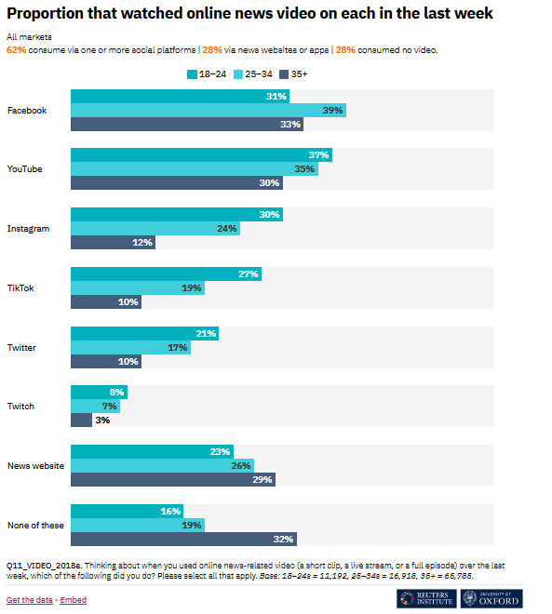
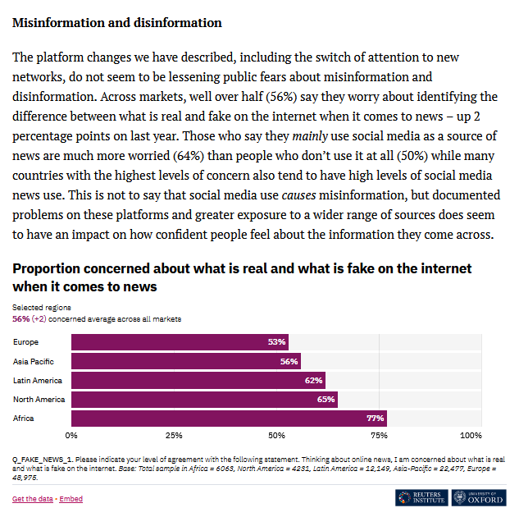
Lecture
01
Digital News Report 2023
Live Session

Slide 5


Live sessions
Social Media Crisis Example

Slide 6
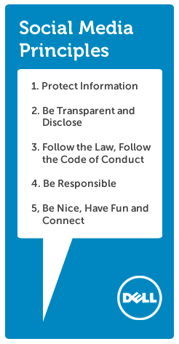
Lecture
01
Examples of social media policy
Dell Global Social Media Policy
Dell has a very simple and straightforward social media policy. It boils down to six overarching policies.
Protect Information
Be Transparent and Disclose
Follow the Law, Follow the Code of Conduct
Be Responsible
Be Nice, Have Fun and Connect
Source: https://everyonesocial.com/blog/need-sample-social-media-policies-here-are-7-to-inspire-yours/
Live Session

Slide 7
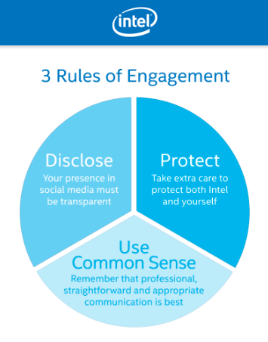
Lecture
01
Examples of social media policy
Intel Social Media Guidelines
Intel is another example of a good social media policy. They’ve split their policy into five parts. There are three sections for disclosure, protect trade secrets, and use common sense. In addition, there are sections for contractors or anyone else who is paid to contribute to Intel’s social media activity.
Source: https://everyonesocial.com/blog/need-sample-social-media-policies-here-are-7-to-inspire-yours/
Live Session
Your common sense is your natural ability to make good judgments and to behave in a practical and sensible way.

Slide 8

Lecture
01
Examples of social media policy
Ford Motor Company Digital Participation Guidelines
Honest about who you are
Clarity that your opinions are your own
Respect and humility in all communication
Good judgement in sharing only public information – including financial data
Awareness that what you say is permanent
Source: https://everyonesocial.com/blog/need-sample-social-media-policies-here-are-7-to-inspire-yours/
Live Session

Slide 9

RAISE
AWARENESS
Steps of social media policy
Source: Laura Click
Founder & CEO - Blue Kite Marketing
www.flybluekite.com

Slide 10

Build relationships.

Slide 11
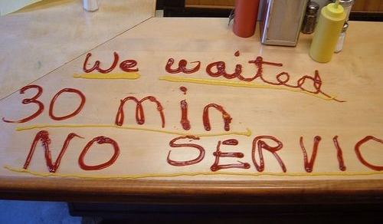
Enhance customer service.

Slide 12

Communicate during a crisis.
Image credit: Kelsey Wynns

Slide 13
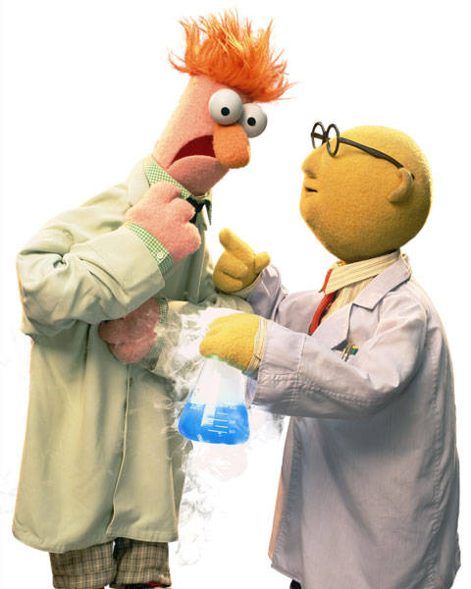
Test ideas & get feedback.
Image credit

Slide 14

Find business opportunities.

Slide 15

But, how can you do it ethically?

Slide 16
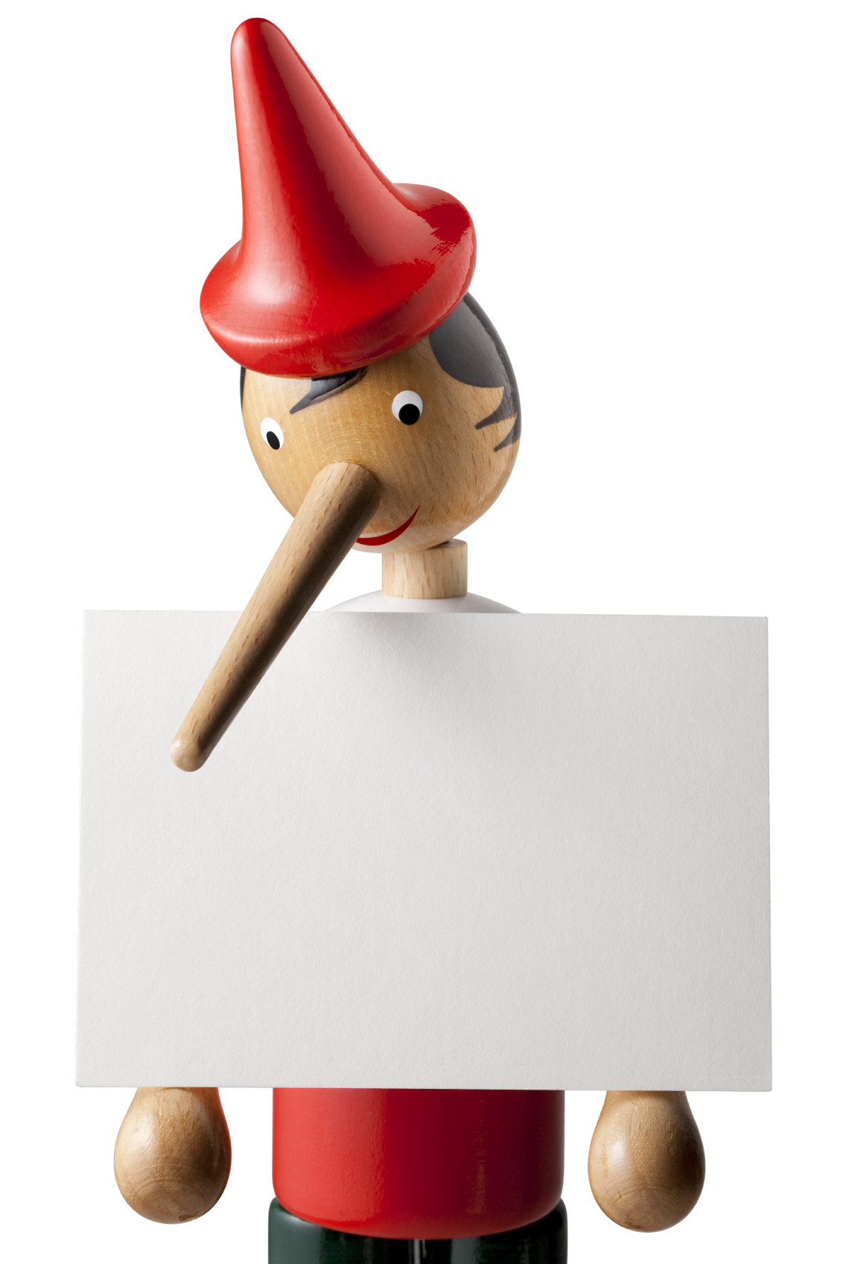
Be honest.
Notes:
Don’t lie, cheat or do anything to misrepresent yourself online. This goes without saying, but it’s amazing the number of people who do this. Don’t let that be you.

Slide 17

Give proper credit.
Cite Sources
Notes:
Never pass off someone else’s work as your own. If you include photos, videos, papers and research on your website or blog, make sure to provide attribution to the author or owner of the content.

Slide 18

Don’t give specific legal advice.
Only General ones
Notes:
You can provide general legal information and use social media as an educational tool. However, attorneys must be careful not to give legal advice on specific cases. Doing so could trigger an attorney-client relationship.

Slide 19

Be careful about who you friend.

Slide 20
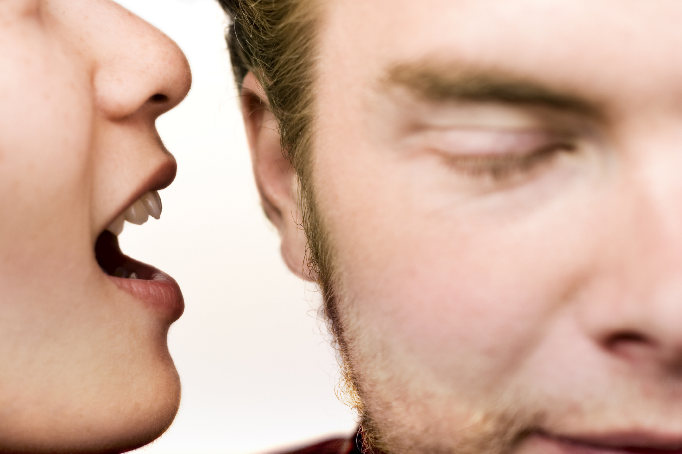
Don’t share confidential information.
Notes:
Don’t share information about your clients or about your company.

Slide 21


Disclose your relationships.
https://disclosurepolicy.org/
https://getcommandpost.com/
Notes:
If you ever receive free products or services to review on your blog or if you receive payment to endorse a company on your blog. The same is true for client and investor relationships. Cmp.ly is a tool that can help you with disclosures.

Slide 22
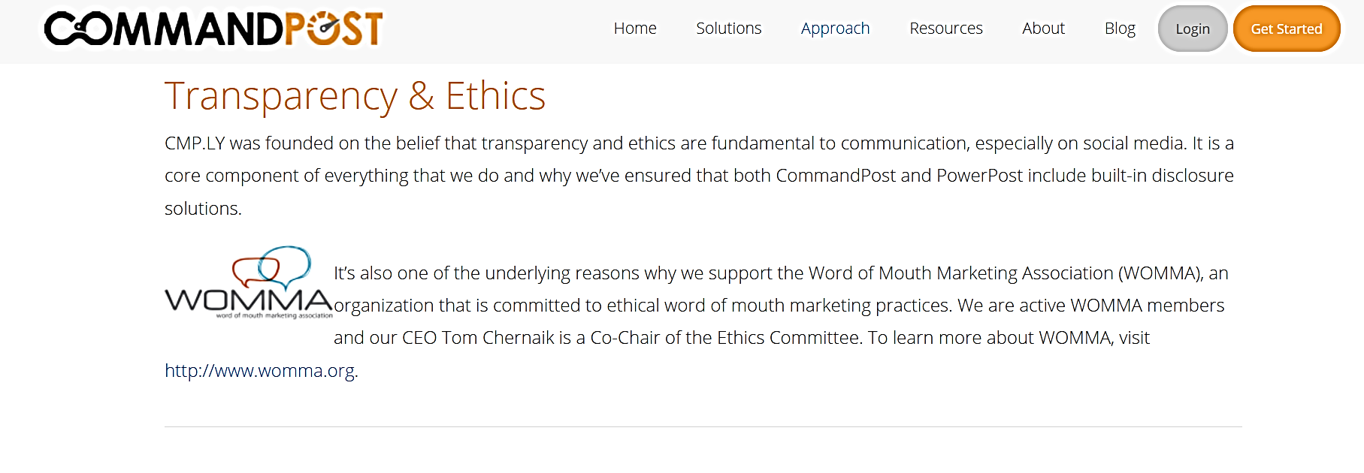
Disclose your relationships.
https://getcommandpost.com/

Slide 23
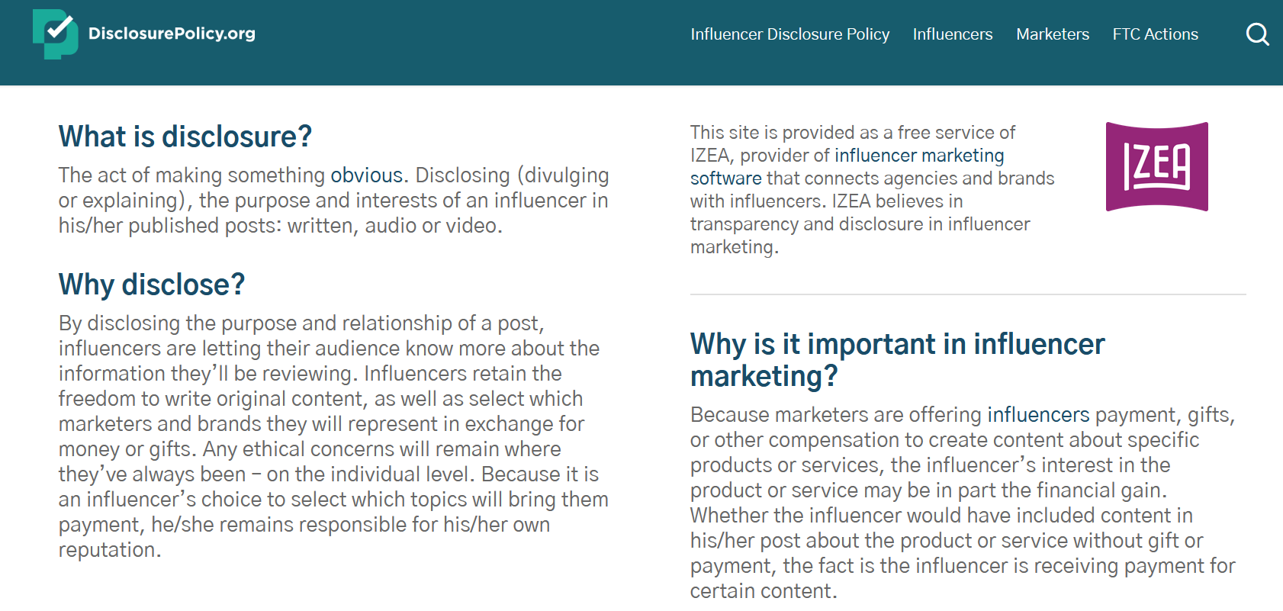
Disclose your relationships.

Slide 24

Use discretion.
استخدم السلطة التقديرية
Don’t post anything online that you’re not comfortable with the whole world seeing. Even with privacy settings, there’s still the possibility that content or photos will spread. Google never forgets. So, when in doubt, leave it out.
Google never forgets!

Slide 25
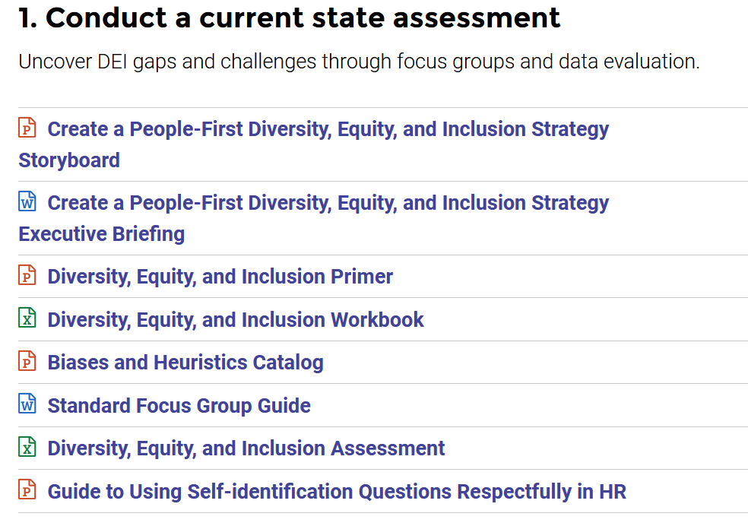
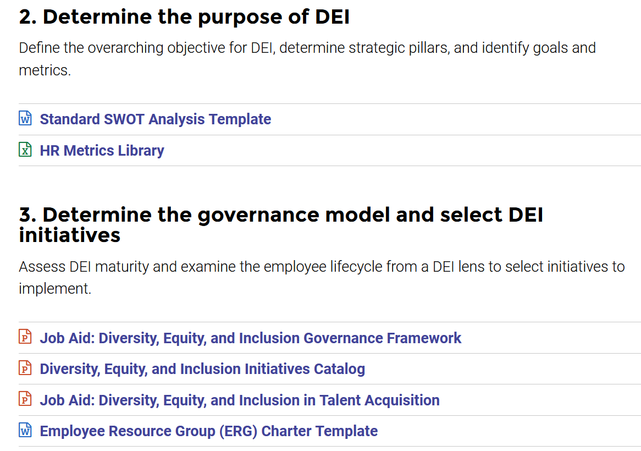
Lecture
01
Why do you need a social media policy for employees
Promote DEI (Diversity, Equity, & Inclusion)
Have a look
https://hr.mcleanco.com/research/ss/create-a-people-first-diversity-equity-and-inclusion-strategy
Live Session

Slide 26
Lecture
01
Understanding copyright and creative commons
Types creative commons
https://creativecommons.org/licenses/?lang=en
How to start?
https://creativecommons.org/share-your-work/
Live Session

Slide 27
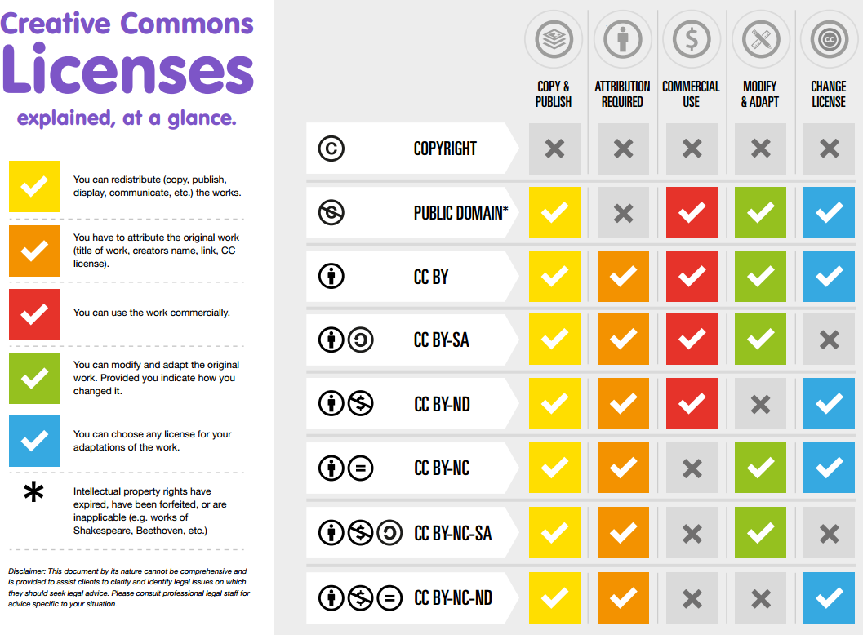
Lecture
01
Understanding copyright and creative commons
Live Session

Slide 28
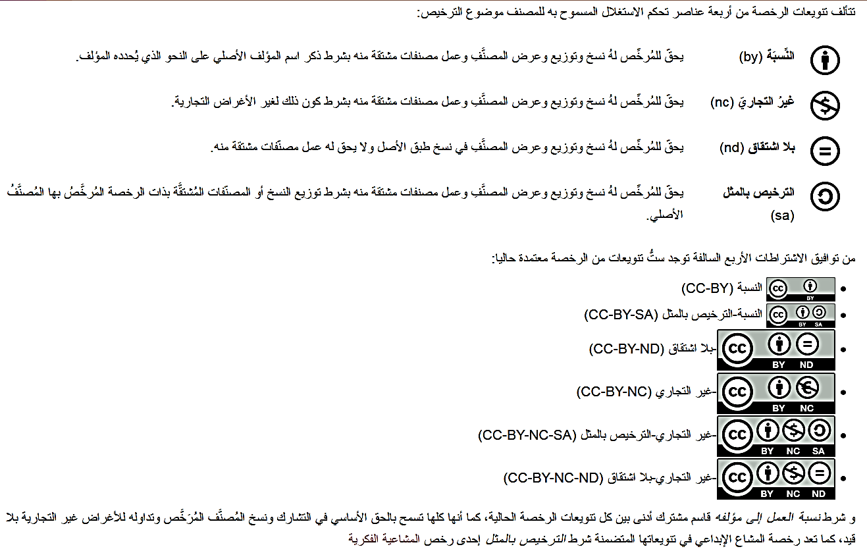
Lecture
01
Understanding copyright and creative commons
Live Session

Slide 29
Lecture
01
Understanding copyright and creative commons
Live Session
Types of Creative Commons licenses
Here are the different types of CC license you might find online. As you read them, keep in mind that marketing is very clearly a commercial purpose.
Attribution-NonCommercial-No Derivatives (CC BY-NC-ND): This license means you can copy and redistribute an image – but you cannot modify it, and you cannot use it for commercial purposes. And, as the license name implies, you must provide attribution.
Attribution-No Derivatives (CC BY-ND): You can copy and distribute the image, including for commercial purposes, but you can’t modify it. So, for example, you can’t add overlay text, crop, or apply filters. Attribution is required.

Slide 30
Lecture
01
Understanding copyright and creative commons
Live Session
Types of Creative Commons licenses
Attribution NonCommercial-ShareAlike (CC BY-NC-SA): You can use the image and adapt it into something new. However, you cannot use it for commercial purposes, and you have to share your modified work with the same type of CC license and provide attribution.
Attribution-NonCommercial (CC BY-NC): Same as the above, but without the requirement to use the same CC license on modified work.
Attribution-ShareAlike (CC BY-SA): You can use the image and adapt it into something new. You can use it for commercial purposes, but you have to share your modified work with the same type of CC license and provide attribution.

Slide 31
Lecture
01
Understanding copyright and creative commons
Live Session
Types of Creative Commons licenses
Attribution (CC BY): Basically the only requirement is to provide attribution.
Public domain/No copyright: If a creator has waived all their rights, or the copyright has expired, the work enters the public domain. In Creative Commons, this is listed as CC0 1.0 Universal (CC0 1.0). This is the license to look for if you want non-copyrighted work.
The safest options when looking for images for social media marketing are attribution-only and CC0 1.0 public domain licenses. Remember, any license that includes the word “attribution” means that you must give credit to the creator.

Slide 32


Thank You

