Slide 1




DIGITAL MARKETING STRATEGY
Prepared by
Dr. HEBA ZIAD
Lecture 5
www.midocean.ae

Slide 2
DIGITAL CONTENT STRATEGY
TABLE OF CONTENTS
What is Digital Content Marketing?
What is a Digital Content Marketing Strategy?
What is Content Marketing?
Content Marketing and its Importance
Why should you emphasize Digital Content Marketing?
How to Strategize Content Marketing to Increase Revenue?
How Can Content Marketing Drive Sales?
Best Channels for Content Marketing
How to Create a Content Strategy
What is the Relationship Between Seo and Content Marketing?
Top Insanely Useful Content Marketing Tools and How to Use Them?
How to Create a Basic Digital Content Marketing Strategy?
Best Digital Content Marketing Strategy is to Reach More Audience Through Guest Blogging Services/ Guest Posting Services
Final thoughts on digital content marketing for revenue enhancement?
www.midocean.ae

Slide 3

Chapter
Digital Content Marketing
01
What is Digital Content Marketing?
Digital content marketing uses any electronic medium to create and share content across the web. Content marketing is carried out to attract and convert the target audience by showing informative and relevant content that aligns with their personal interests.
www.midocean.ae

Slide 4

www.midocean.ae
What is a Digital Content Marketing Strategy?
A digital content marketing strategy is a part of an overall content strategy. It is implemented to increase website conversions through a set of customized content strategies.
A digital content marketing strategy is necessary for businesses to attract new customers by providing them informative, unique, and interesting content to read.
Chapter 05
What is a Digital Content Marketing Strategy?

Slide 5

www.midocean.ae
Digital content isn’t limited to written articles and blog posts but may include any form of interactive content, such as pictures, videos, infographics, audio files, and podcasts.
There are numerous ways to increase revenue through content marketing. The advent of digital technology has incepted umpteen content marketing tools.
The progress in digital marketing technology has made it obvious to have content marketing for a brand. However, most business marketers wonder how to increase content marketing revenue.

Slide 6
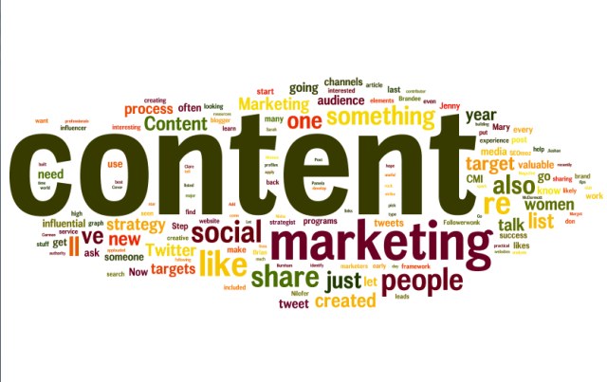
www.midocean.ae
Content marketing can be defined as “Online content marketing that involves innovative creation using online resources such as videos, images and media posts which promote and intend to highlight the products and services.”
Content marketing?

Slide 7

www.midocean.ae
What is Content Marketing?
Content marketing can be defined as a marketing program that revolves around creating, publishing, and distributing content for an audience.
Chapter 05

Slide 8

www.midocean.ae
content marketing helps in
content marketing is all about creating content for the right audience at the right time to intrigue them and bring them to your website.
It helps in making your brand visible to a broader audience. With so many options to create great content and an effective marketing strategy, content marketing is a perfect fit for almost all businesses, regardless of their niche.
Chapter 05
A niche market is the subset of the market on which a specific product is focused. The market niche defines the product features aimed at satisfying specific market needs, as well as the price range, production quality and the demographics that it is intended to target. It is also a small market segment.

Slide 9
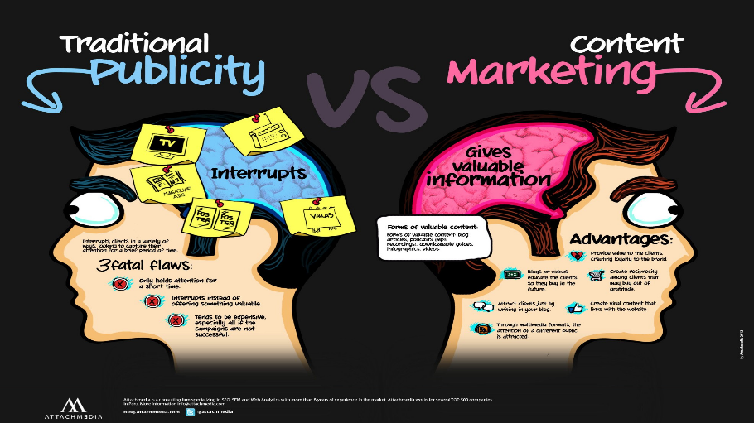
www.midocean.ae
Content Marketing and its Importance
Content Marketing is an effort that helps businesses- both small and big, to drive traffic to your website and rank higher in the Google search results.
It is a practical approach to building a genuine relationship with the target audience. This type of marketing works effectively for both B2B, as well as B2C businesses.
Chapter 05
Content Marketing and its Importance
Traffic is a count of the number of visitors to a website or web page

Slide 10
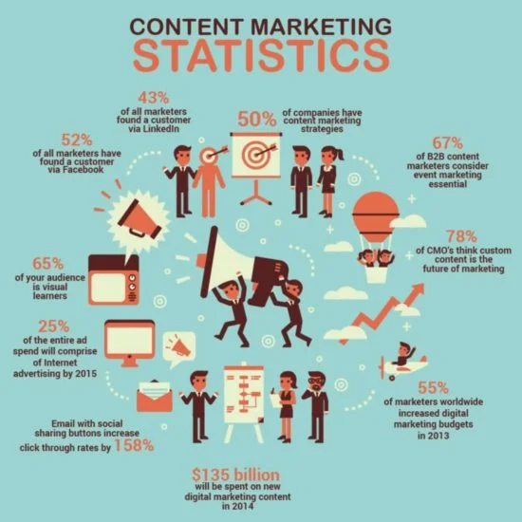
www.midocean.ae
Content Marketing and its Importance
Content
Marketing is an effort that helps businesses- both small and big, to drive traffic to your website and rank higher in the Google search results.
It is a practical approach to building a genuine relationship with the target audience. This type of marketing works effectively for both B2B, as well as B2C businesses.
If you can create a good piece of content that is engaging and provides relevant information to the reader, you’ll surely get massive traffic when the content gets around.
Ad ranking in Internet marketing is the position of an ad on the page. In paid search marketing,

Slide 11

www.midocean.ae
While content is static, what takes it to places on the internet is a content marketing strategy.
Offering engaging and exciting content and marketing it well gives you flexibility and enables your business to generate leads. Moreover, if you can generate leads, your business will generate revenue.
Chapter 05
content marketing is almost 62% cheaper than the other traditional ways of marketing.
Indeed it is less expensive, but it generates thrice the leads and six times higher conversion rates as compared to other methods.
Lead generation is the process of generating consumer interest for a product or service with the goal of turning that interest into a sale.

Slide 12
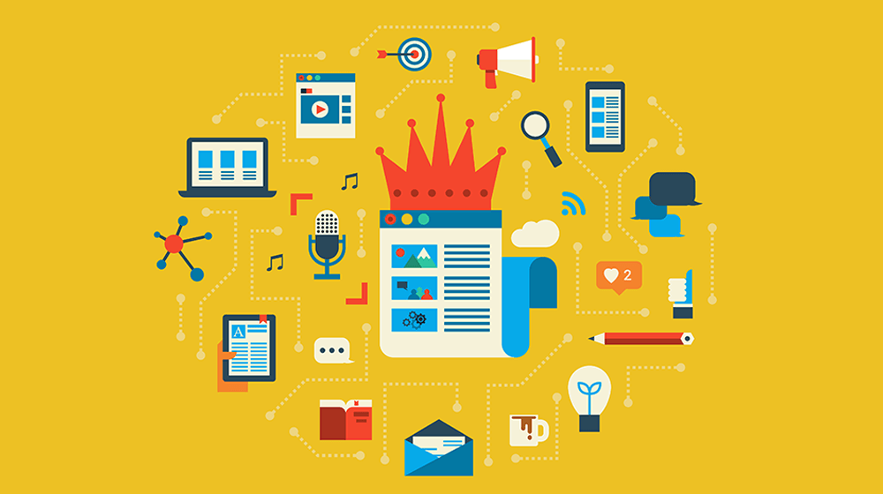
www.midocean.ae
The advancement in digital content marketing technology has influenced businesses to promote a company through traditional marketing.
They ought to go for online content marketing as well if they assert to be in the queue with other progressing companies.
Why should you emphasize Digital Content Marketing?
Chapter 05

Slide 13
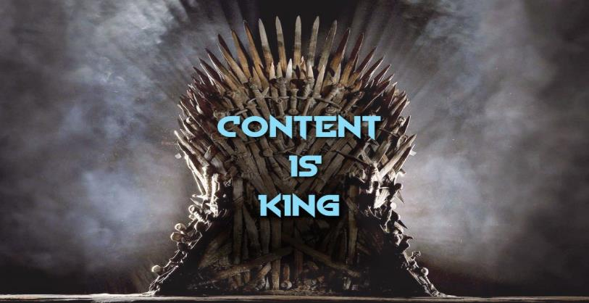
www.midocean.ae
Content marketing is a significant part to consider in any online marketing strategy. Most businesses have already realized the importance of hiring the best copywriting specialists and content marketers to promote their business.
According to an online survey, it is said that 37 percent of B2C (Business to Customer) marketers and 61 percent of B2B (Business to Business) marketers effectively involve themselves in content marketing.
Chapter 05
Content marketing can induce gob smacking results when executed correctly.
the copywriter will write and edit content for a variety of projects (including print, web, mobile, video, and social media), working closely with the account and design teams to brainstorm ideas, develop concepts, and articulate messaging.

Slide 14

www.midocean.ae
How to Strategize Content Marketing to Increase Revenue?
Chapter 05
1. Get to Know Your Crowd
2. Build a Creative and Reliably Best Content Marketing Strategy

Slide 15

www.midocean.ae
Once you have analyzed your potential target audience, you should create astounding content and figure out strategies to make it reach them.
Anchor your story: The best path to enhance your brand’s reach is by narrating the life story of your business.
You can start connecting with your audience by talking about your inception, how you started, the paths you took to succeed, what you believe in, and the moral values of your company.
Put these features before your campaign to clearly show the audience who you are as a brand or a business firm.
The reason is that depicting personal stories will induce the audience to connect with you personally, and the relationship built seems to be more than just products and services.

Slide 16
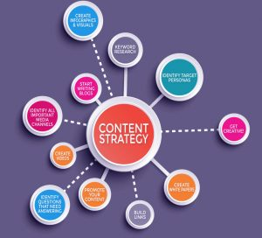
www.midocean.ae
The terrific content you wrote should be marketised. The best content marketing strategies may include:
Creating infographics and visuals.
Adding relevant videos in the content.
Creating white paper if official content is required.
Discover the target personas to target your reach.
Identify the relevant queries that suit your answers or your business can answer.
Identify the essential media channels to promote.
Create a blog and start writing blogs frequently.

Slide 17
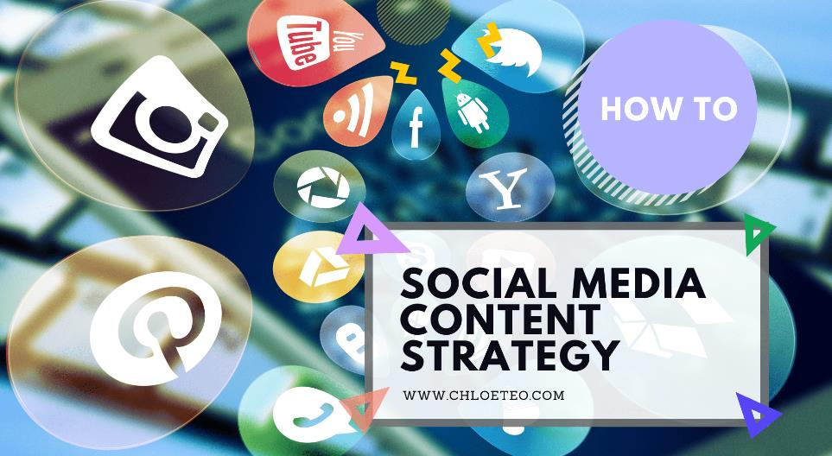
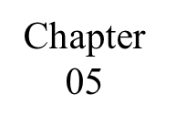
www.midocean.ae
3. Consistently boost your online content
In digital content marketing, simply blogging or publishing your content is half done. To reach a broader audience, you have to keep amplifying the content.
It is necessary to use social media to ensure that it is boosted. You can make use of SEO content marketing strategies too.
Blogging is simply publishing content regularly on website or blog,
A blog is an informational website consisting of discrete, often informal diary-style text entries. Posts are typically displayed in reverse chronological order so that the most recent post appears first, at the top of the web page.

Slide 18

www.midocean.ae
The best part of social ads is that you can direct your advertisements to the exact audience you intend to show them. If you have a target audience (which you do as you got buyer personas), you can be sure of content marketing promptly.
From now, your interest should be towards nourishing the audience into leads. You have clutched them – now it’s your duty to connect with them, grow the relationship and eventually sell your product to them. The key to all this is still with you because you have a strong buyer personas database.
A buyer persona is a semi-fictional representation of your ideal customer, based on market research and real data about your existing customers.

Slide 19
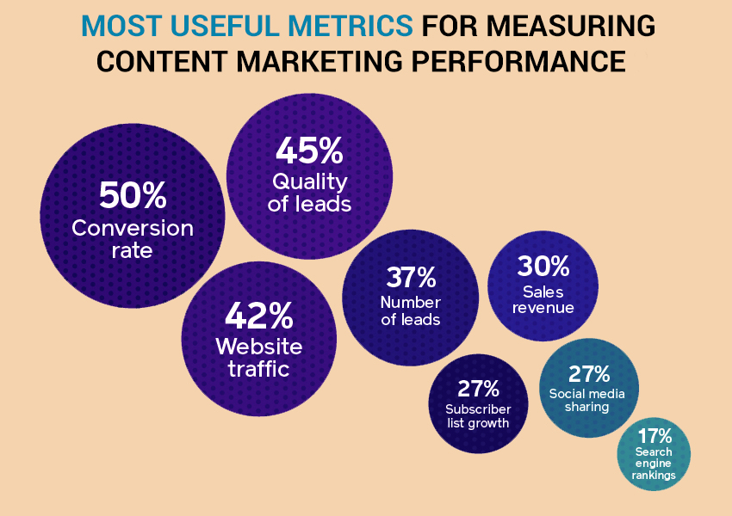
www.midocean.ae
4. Survey and Analyze the Performance of Digital Content Marketing
Use metrics to track and analyze the performances of your content in the market like most online content marketing companies do. Some of the essential metrics are the number of views, number of visits, shares, downloads, and leads generated.
With a CRM app, you can also survey the responses to the content as well. To boost the effectiveness of your content, try multivariate testing or A/B testing and determine the performance of the content, and do boost them as mentioned above.

Slide 20
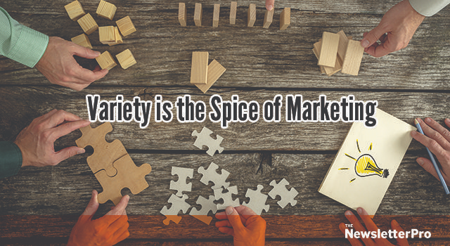
www.midocean.ae
5. Emphasize on Diversifying Content Marketing Along with Digital Content Marketing
Digital content marketing can furnish you with startling results. In fact, it’s a great way to escalate your business, but it never means that it can make loads of money from digital content marketing strategy alone.
You should build brand awareness, generate traffic to your sites, get leads and sales through numerous channels Email marketing, PPC marketing, social media marketing.
Display AdSense and SEO are also additional fields you must focus on. This is to make sure that your business keeps running even if sales from a channel dry up.
Chapter 05

Slide 21
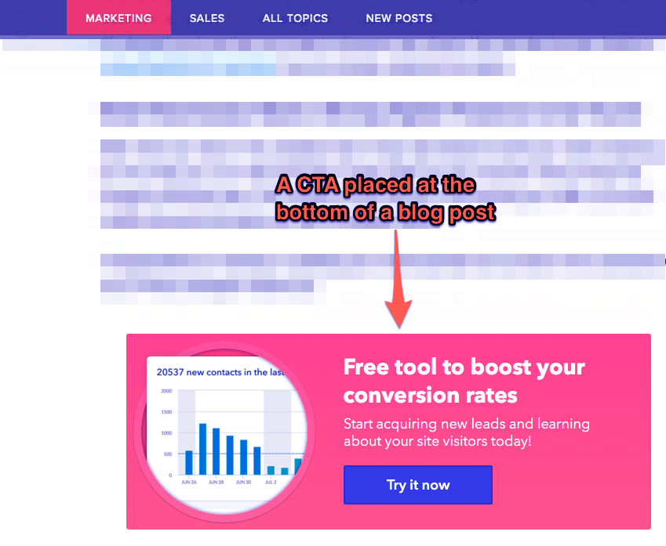
www.midocean.ae
6. Additional Key Features to Increase Revenue Through Digital Content Marketing
Add in CTA: Including a Call to Action is very important for your business. Every influential content should possess CTA; otherwise, there will be a loss of potential lead as he doesn’t know what to do next without it.
A call-to-action (CTA) overlay is an interactive element that appears over an ad and can help drive clicks to your website.
A call to action (CTA) is a term commonly used in marketing that refers to the next step the marketer wants their audience or customers to take. Advertisers in every industry use well-crafted CTAs to persuade potential customers and achieve their marketing objectives.

Slide 22

www.midocean.ae
Include site messaging and copy facilities:
One of the best paths to use content to reach a maximal number of audiences is to audit site copy. This would give you opportunities to reach out to the audience more clearly and effectively. Test and include the best site messaging and copy.
What is an audit copy ?
A copy audit is the process of going over your existing copy in a really detailed, “official” way to ensure your content is conveying the right message for your brand and business goals.

Slide 23
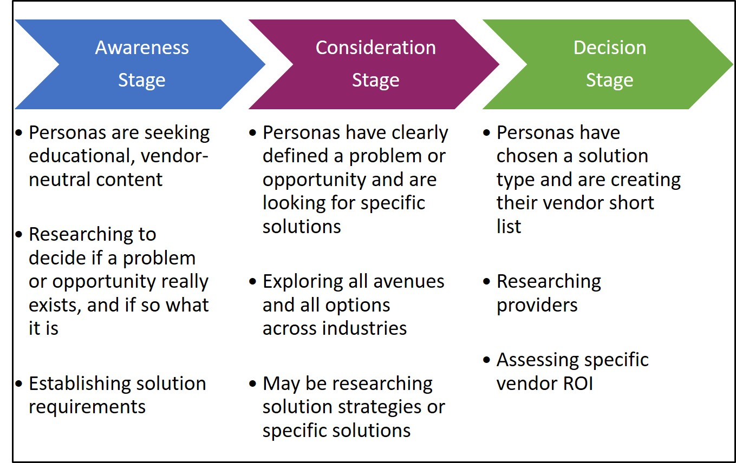
www.midocean.ae
7. Map the Created Content to Your Buyer’s Journey
There are three stages of a buyer’s journey that every business should know about:
Awareness
Comparison
Decision
Each of the three stages mentioned has its unique needs. For instance, the consumers who are in the awareness stage tend to look out for solutions for their problems.

Slide 24

www.midocean.ae
Consumers who are ready to purchase a specific product or opt for a particular service generally lookout for data to decide on which vendor to choose. If you map your content to each stage of your consumer’s journey, you can easily organize assets for sales.
Not only mapping the content helps you in organizing the assets, but it also helps you to find the gaps present in your content coverage.
You can easily identify and fill those gaps, which would help you reach the content marketing goals set for your business. Regardless of what outcomes you get, this process is essential for both sales and marketing.

Slide 25

www.midocean.ae
How Can Content Marketing Drive Sales?
Here, we will go through some guidelines that you can follow to boost sales through digital content marketing.
>> Receive as much organic and relevant traffic as you can
>> Convert your users into paying customers
the guiding steps that will help you utilize Advanced digital Content Marketing strategies and increase sales:
Chapter 05

Slide 26


www.midocean.ae
Step 1- Keyword research:
This step is essential, regardless of whether you’re an SEO expert or not. If you create content that is not interesting to your audience, then don’t count on sustainable traffic. If you have a new site, you can start using keywords with low competition ratings. Ensure that the keywords you choose will be used to find content that leads to your site. You also need to know the search intent and the traffic you will receive if you’re ranked on the first page of Google.

Slide 27
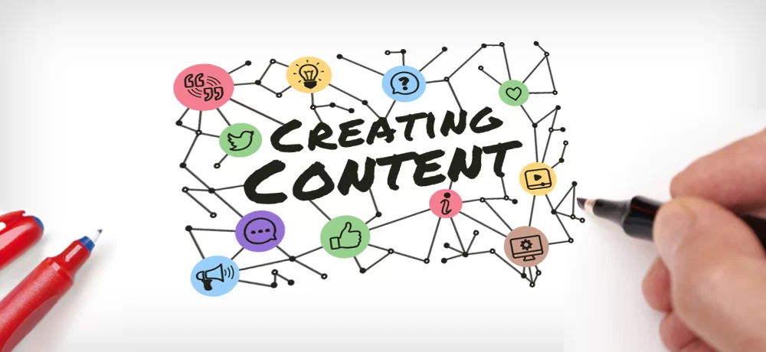
www.midocean.ae
Step 2- Create the Content:
Follow the format used by your competitors, especially if they have ranked well. This process is vital because Google tells you what people want to read when they search for your keywords.
To make your post stand out:
Create a title that isn’t generic.
Focus on covering the points that your competitors might have missed to give your content an edge over others.
Follow a crisp writing style and try writing in the second person so that your content sounds more engaging.

Slide 28

www.midocean.ae
Avoid writing in long paragraphs or using jargon. Instead, add bullet points wherever possible to make it easier for people to read.
Make the written content more interesting with images and videos. Add enough internal and external links within your content to keep users engaged.
After deciding on your content, look for additional keywords that will help you rank better.

Slide 29

www.midocean.ae
Step 3- Promote your content:
When creating SEO blog articles, you have to promote them to generate revenue. If you’ve planned an advanced content marketing strategy, then you should know that the goal is to get your content to as many people as possible.
You can market directly using relevant keywords and invest in interest-based ads that target the concerned audience. SEO will help your content rank, which will help with organic traffic from consumers who are willing to purchase your services.

Slide 30

www.midocean.ae
Receiving backlinks will help you promote your content, as well. Another effective way to promote your content is through influencer marketing. This strategy will enable you to reach more people by getting one person to share your material.
A backlink is a link from some other website to that web resource. A web resource may be a website, web page, or web directory. A backlink is a reference comparable to a citation
Influencer marketing is the collaboration of businesses and individuals with large and engaged online followings.

Slide 31
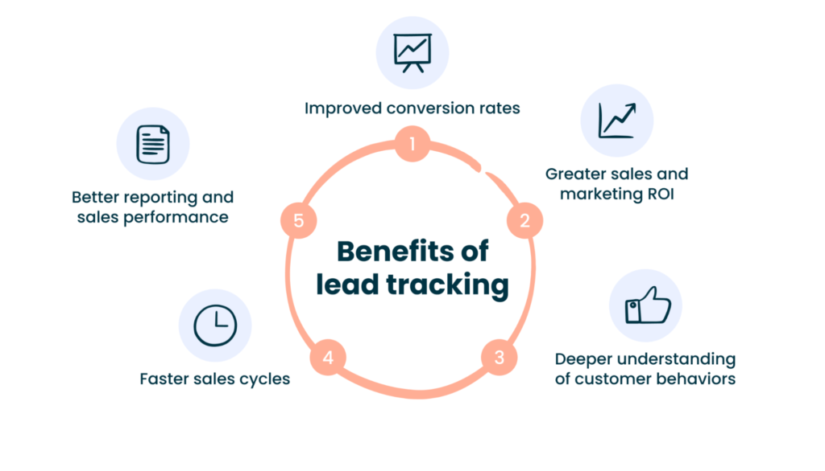
www.midocean.ae
Step 4- Drive sales by tracking your leads:
Tracking your content progress is essential. If you recognize that you’re not ranking despite all the marketing efforts, then you may want to reassess if your content is meeting the search intent of your audience.
Sales lead tracking is the process of determining the source and status of leads in the sales process. It involves monitoring where leads are in the sales funnel and knowing what action to take to move a lead to the next stage and eventually convert a lead into a sale.

Slide 32
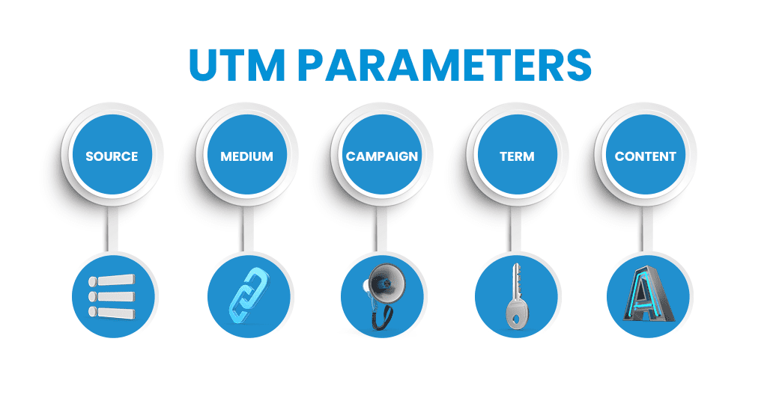
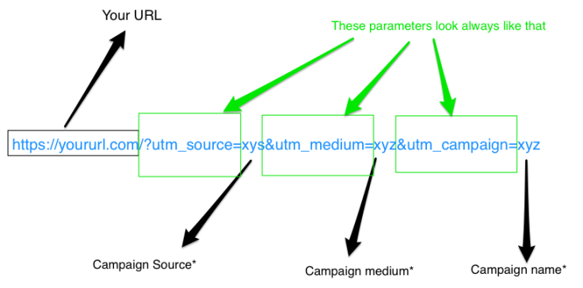
www.midocean.ae
It would help to review your old content again and update them. If you’re using advertising strategies, go for Google Analytics (ensure that the conversion tracking is set up) and UTM parameters.
UTM parameters are crucial because they track the tags you add to your content URL. It’s monitored in Google Analytics.
Once you follow the progress, you can eliminate components that are slowing you down and enhance the working points. Repeat this process, and you will see your sales statistics increase.
What are UTMs?
UTMs are tags that you can add to the end of a URL in order to track the source of traffic to your website. When someone clicks on a link with UTMs, those UTMs are added to the URL as query parameters.
Query parameters are pieces of information that are appended to the end of a URL. They provide additional information about a page or resource and help browsers and web servers communicate with each other.

Slide 33
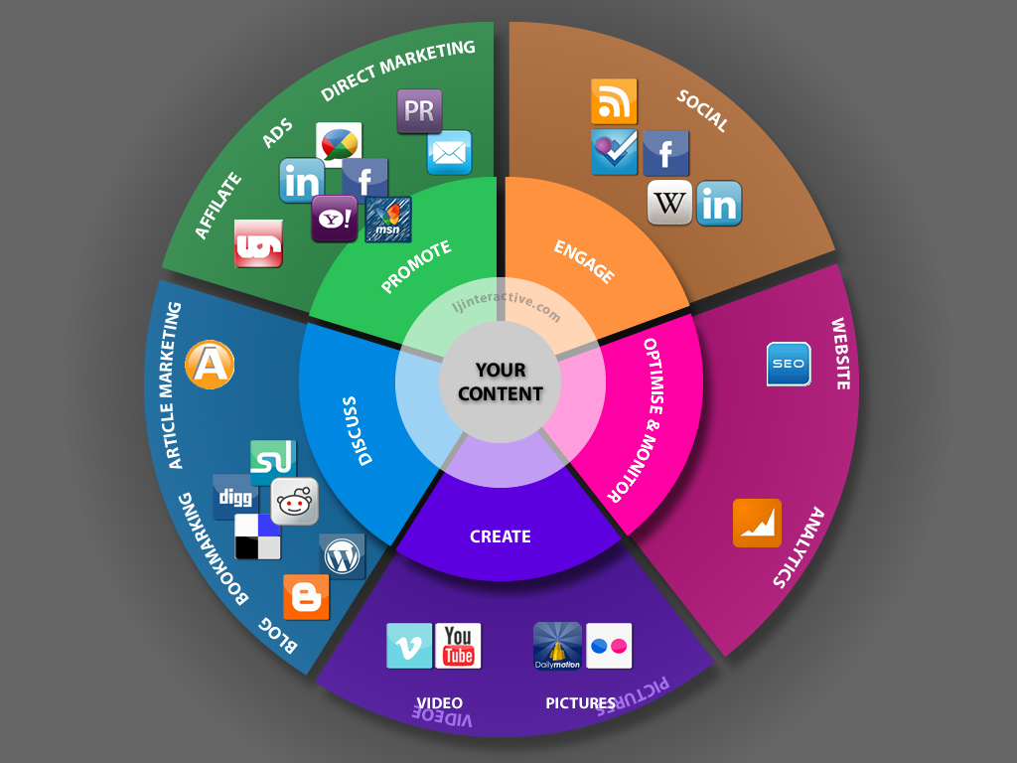
www.midocean.ae
Best Channels for Content Marketing
Finding the best channels to promote your content is as crucial as writing great content for your audience. If you don’t analyze the best channels to promote your content, the result won’t be much effective.
For example, if you want to share a whitepaper, the best platform for that would either be LinkedIn or Twitter, but if you want to share a video on the top ten apps for teenagers, your best platform to do so will be Facebook.
There are several content formats that you can follow to spread your business via various channels. These formats include Blog Posts, Infographics, Slide Share Decks, Quizzes, and many others.

Slide 34

www.midocean.ae
Some of the popular content formats are:
Blog posts/Guest blog posts
blog post must provide valuable, informative, and relevant content to your audience. Usually, it should have a word count of 1000 to 2000 words in length.
EBooks
EBooks are books available in a digital format and can be read on various electronic devices. These are lead tools that generate leads, and your potential customers can download them by submitting their contact information.

Slide 35
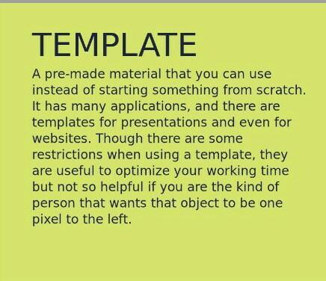
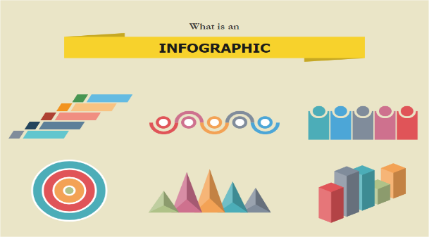

www.midocean.ae
Templates
A template is a pre-defined content format that helps in lead generation.
(A template is a form, mold or pattern used as a guide to make something.)
Infographics
With infographics, you can easily organize and visualize the data. This is useful for users in making the content more attractive and compelling.

Slide 36
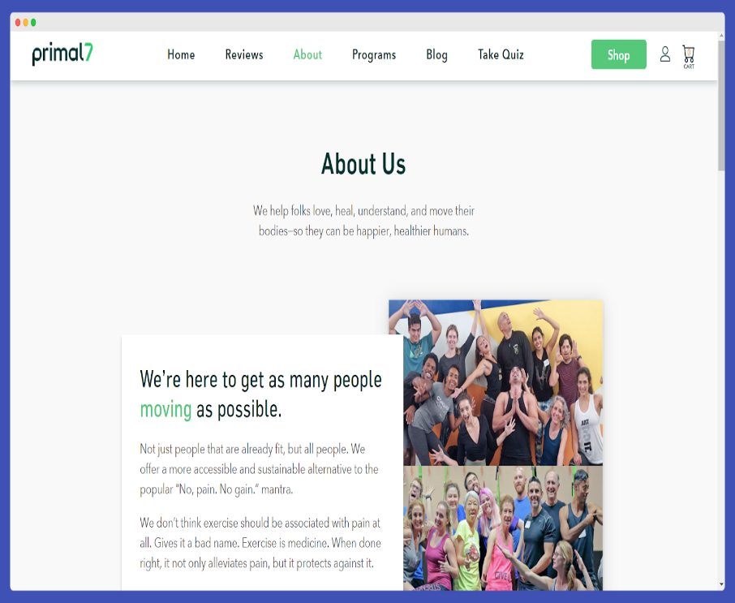
www.midocean.ae
Website pages
When the audience wants to explore a brand online, they first see the “About Us” section. You ought to be very careful while designing this page.
It should be crafted so that it hooks the audience to your site and gives them an overview of your company, its achievements, beliefs, mission, and vision.
Webinars
This is an excellent content marketing strategy that evolved in the digital technology space. It allows the audience to watch and hear the content they are interested in instead of reading it. This technique can even be linked to your blogs and similar topics.
An About Us page isn't just where you share the story of your brand. It's also where you tell your customer what you do for them and how you work to meet their needs in that area. It isn't so much “Here's what we're about,” but more like “Here's who we are, why we started, and what we can do for you.”

Slide 37

www.midocean.ae
Videos
This is one of the engaging formats that can be shared through social media all over the world.
Podcasts
Podcasts are audio recordings of dialogues between two or more people on a given topic.
With the benefits of podcasts offered, brands are slowly integrating this type of content into their overall marketing and branding strategy.
Other than the above-described formats, you can also create your content in formats like lists, guides, quizzes, FAQs, and much more.
What are podcasts ?
A podcast is an episodic series of digital audio or video files which a user can download to listen.

Slide 38
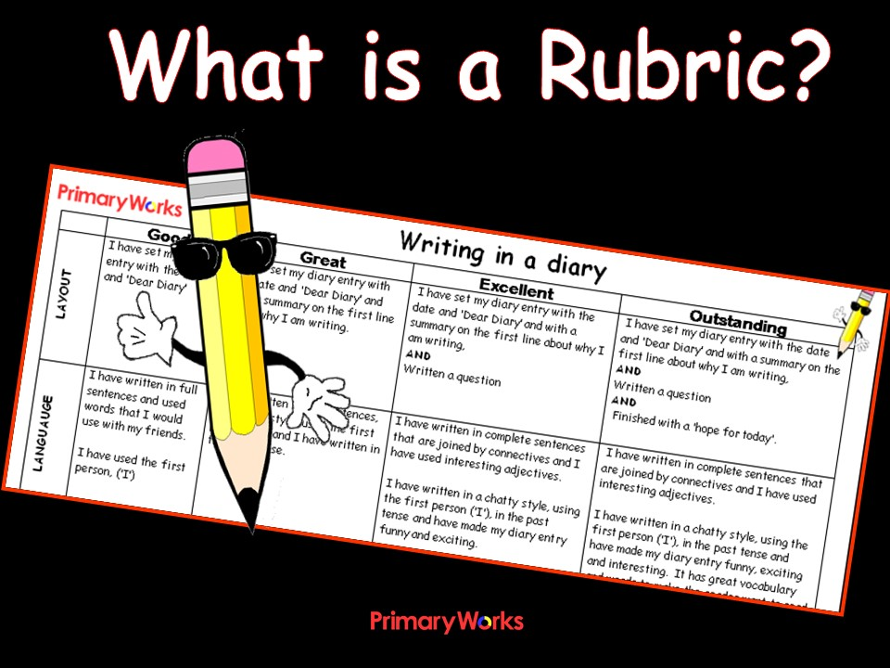

www.midocean.ae
Downloadable rubric
Online visitors are always up to grab free resources provided they sound interesting. To make them connect to you and be potential leads, you can permit them to download your content resources for free.
Advertise it on the page that the information can be downloaded freely, the traffic gets better in such cases.

Slide 39

www.midocean.ae
Produce online content marketing tactics as per customer pain points
Create content keeping in mind customers’ pain points, and try to use your content to resolve them. Every content can reach the maximum audience if it goes viral.
So, try creating content on trending topics.
In addition to this, if you’ll follow proper strategies, it would add more value to your content. However, while writing content, keep in mind that today’s audience gets bored quickly, so you must keep adding some exciting things.

Slide 40
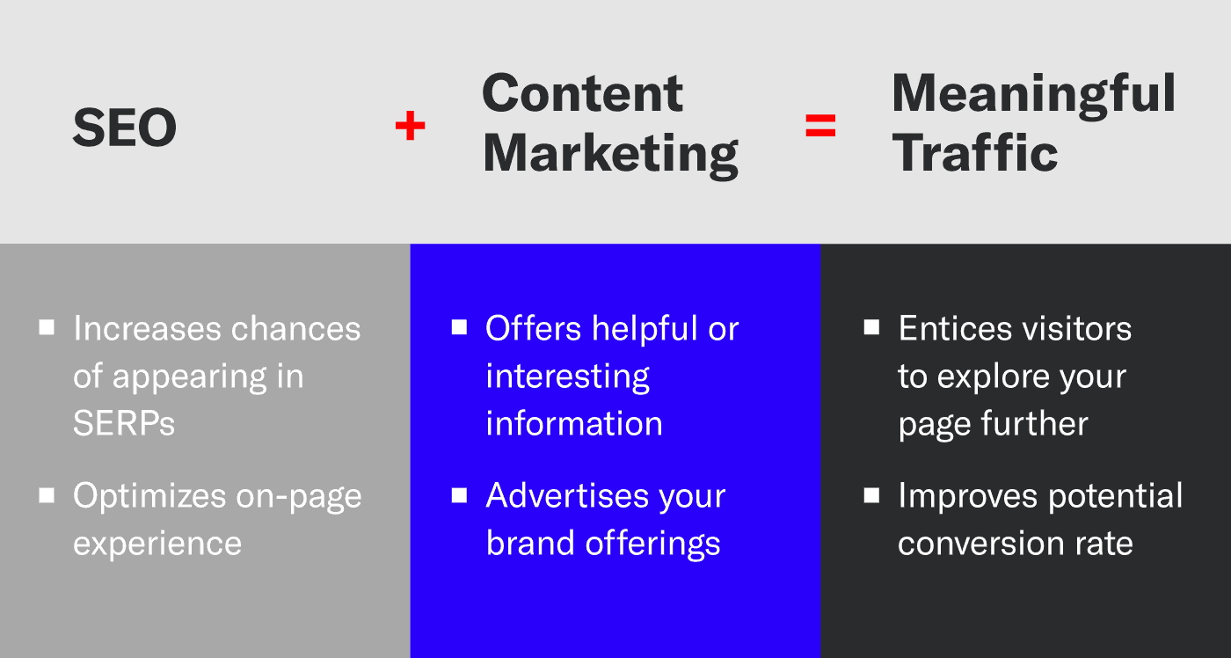
www.midocean.ae
What is the Relationship Between Seo and Content Marketing?
Advanced content marketing refers to the strategic distribution of online content like videos, audios, blogs, and infographics through various channels to generate or satiate the interest and awareness of the audience.
SEO and content marketing are interdependent as SEO demands specific requirements that are fulfilled through content marketing.
SEO needs content for optimization. Meanwhile, content marketing takes care of the demand by ensuring that the content produced is of high quality, has all the targeted keywords, and is written for the audience.
The success of SEO lies in getting continuous quality backlinks. Good content will automatically help you get backlinks from reputed sites.

Slide 41
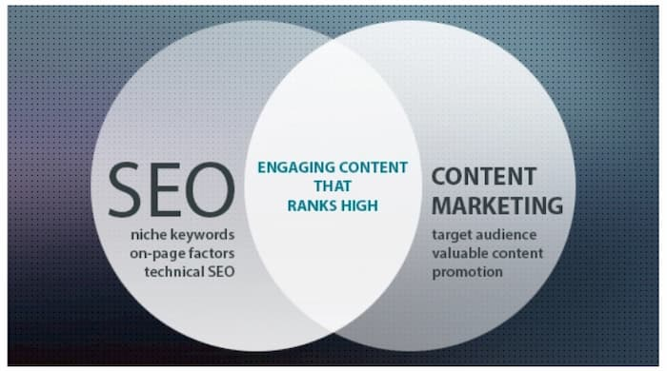
www.midocean.ae
SEO is not only limited to keywords and links, but it also includes proper metadata, meta tags, and having a strategic sitemap. Well, structured content will consist of the right tags in the right places and keyword-rich content that can be crawled easily and accessed by the target audience.
Advanced content marketing requires fresh and quality content to be produced regularly, which in turn, helps SEO by indexing these content and ranking high in the SERP. Consistent content marketing ensures that your SEO game is also top-notch.
As you can see from above, your SEO campaign will not be successful until you integrate an advanced content marketing strategy into it. The content that you produce won’t be of any value unless the people search for it and discover it, and to be discovered, you require a successful SEO plan.

Slide 42
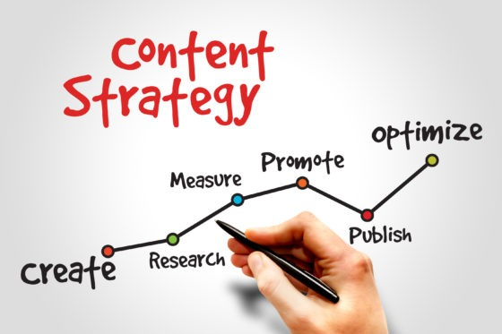
www.midocean.ae
How to Create a Content Strategy
To make your business successful, you need to market it effectively. The primary content strategy works in a proper chain, which is known as the framework plan of content. The framework plan is as follows-
Create Content
Optimize
Publish
Promote
Measure
Links
SEO
Social Media

Slide 43
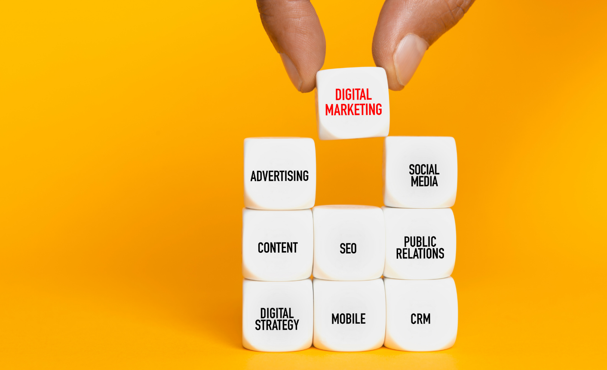
www.midocean.ae
How to Create a Basic Digital Content Marketing Strategy?
The points mentioned above are the best ways how you can use digital content marketing to generate revenue for your business. However, to implement and execute these techniques, you need to have a basic content marketing strategy in place.

Slide 44

www.midocean.ae
Determine your goal
Before developing a content marketing strategy, you need to define your goals on why you need them. You need to be sure about why you want to create a content marketing strategy.
Know your goals before you delve into developing a digital content marketing strategy for your business. This will help you in determining the best strategy for your needs.

Slide 45

www.midocean.ae
2. Find your target audience
After you determine your goals, you need to clearly define the target audience for the content that you create.
Especially, if you are new to content marketing, this is the most important thing that you need to do. Once you get to know your target audience, you can create content that can be more relevant and valuable content that is focused on the target audience.

Slide 46
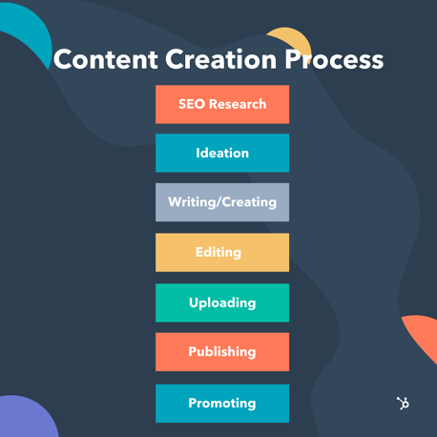
www.midocean.ae
3. Creating content
there is a lot of preparation needed before you can create content for your digital content marketing strategy. Once you go through all the points mentioned earlier, you are ready to create content.
However, creating content is not as easy as you might think it is. There are many things that you need to consider before creating any content.
You need extensive research to make sure that the content you create is authentic, reliable, and provides detailed information to the users.
You need to make sure that the content is unique and intriguing for the readers. This is probably the most important part of any digital content marketing strategy.
If you create content that is boring or unappealing for the readers, then all your content marketing strategies will turn out to be unsuccessful.

Slide 47
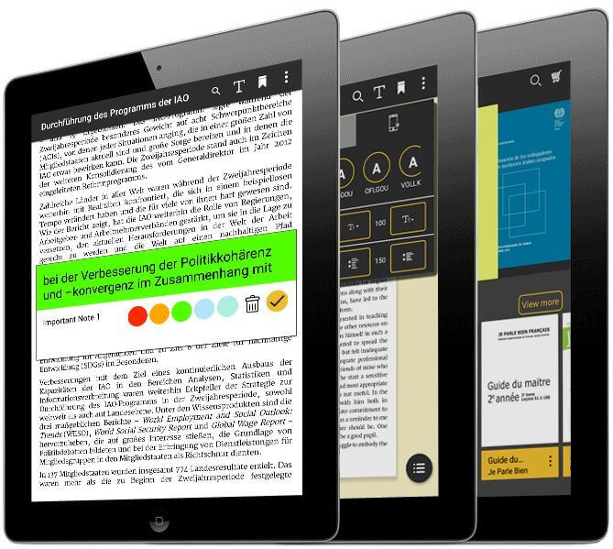
www.midocean.ae
4. Publish and distribute
The next part of your digital content marketing strategy involves publishing and marketing the content. These are very important because you cannot expect results unless the content you create is appropriately handled.
Once you have written the content, the first thing you need to do is publish it on your website or any other channel you wish.
Then you need to share the content through various channels, like social media. You can also use email marketing to share your content. This not only gets traffic to your content but also helps you in generating leads

Slide 48

www.midocean.ae
5. Take the help of professionals, you need to have a dedicated team, time, and resources. There are chances that you might not have them; this is when you can take professional help.
There are many content marketing services providers that you can find today who can take care of your content marketing needs without you needing to worry about things.

Slide 49

www.midocean.ae
Best Digital Content Marketing Strategy is to Reach More Audience Through Guest Blogging Services/ Guest Posting Services
Businesses use blogger outreach and guest posting as a method to reach a large audience. Apart from creating and posting content on their website, the companies guest post their content on sites.
Usually, companies choose sites that are powerful in their niche to develop thoughts. Also, they can increase the number of new potential customers to scale the business.

Slide 50

www.midocean.ae
Final thoughts on digital content marketing for revenue enhancement?
three reasons as to why brands/businesses incorporate content marketing.
The first point he states is to “Take advantage of existing consumer behaviors.”
The second point was, “It provokes conversions,”
and finally, “it evolves rooted emotional connections.”
Chapter 05

Slide 51

Chapter
summery OF CONTENTS
What is Digital Content Marketing?
What is a Digital Content Marketing Strategy?
What is Content Marketing?
Content Marketing and its Importance
Why should you emphasize Digital Content Marketing?
How to Strategize Content Marketing to Increase Revenue?
How Can Content Marketing Drive Sales?
Best Channels for Content Marketing
How to Create a Content Strategy
What is the Relationship Between Seo and Content Marketing?
Top Insanely Useful Content Marketing Tools and How to Use Them?
How to Create a Basic Digital Content Marketing Strategy?
Best Digital Content Marketing Strategy is to Reach More Audience Through Guest Blogging Services/ Guest Posting Services
Final thoughts on digital content marketing for revenue enhancement?
www.midocean.ae

Slide 52



Thank You

