Slide 1

Global Project Management
Lecture 7
Everyone’s Smart
University
PMG 661
Global Program and Project Offices

Slide 2

Global Program and Project Offices
Many international companies and partnerships aim to implement a worldwide standard for program and project management practices, and to align the methods and procedures of different companies, countries and organizational units working on the same program or project. Program and project offices can achieve these goals. This lecture reviews the different definitions and objectives of project and program offices, and the main services they provide to foster innovation and improve the effectiveness of global programs and projects.

Slide 3
Defining project offices
Defining project offices
Many companies and authors use the term project office and its derivatives to mean different things:

Slide 4
Defining project offices
The concept of a Project Support Office (PSO) is one of a central pool of skilled resources to provide the roles of Project Support, such as clerical support, configuration librarians and possibly PRINCE2® consultants to individual projects. (…) A PSO provides continuity of standards across all projects. The office can be the centre of expertise in the PRINCE2® method, any software packages used (such as planning and control software), configuration management and the quality review technique. (OGC, 2002).

Slide 5
Defining project offices
A Project Management Office (PMO) is an organizational unit to centralize and coordinate the management of projects under its domain. (…) A PMO oversees the management of projects, programs, or a combination of both. (…) The PMO focuses on the coordinated planning, prioritization and execution of projects and subprojects that are tied to the parent organization's or client’s overall business objectives. (PMI, 2004).

Slide 6
Defining project offices
The Project Management Office (PMO) (…) is the department or group that defines and maintains the standards of processes, generally related to project management, within the organization. The PMO strives to standardize and introduce economies of repetition in the execution of projects. The PMO is the source of documentation, guidance and metrics on the practice of project management and execution.

Slide 7
Defining project offices
This lecture employs the generic term ‘project offices’, the meaning of which can encompass the three definitions above:
A project office is an organizational unit composed of skilled professionals in project and program management, which centralizes, coordinates and oversees the management of portfolios, programs and projects in its domain. The project offices also define and maintain project management standards and methodologies, and are the keepers of the project documentation, templates and metrics.

Slide 8
Defining project offices
The project offices interact with all hierarchy levels of the company in different ways. Figure below illustrates the relationship between the organizational project office and four groups of stakeholders: the executive board, the program and project managers, the team members and the customers. The next sections will define the two main categories and types of project offices (Project Management Offices and Project Support Offices), and describe the exchange of information and the main services provided to these stakeholders (illustrated by the arrows in Figure).

Slide 9
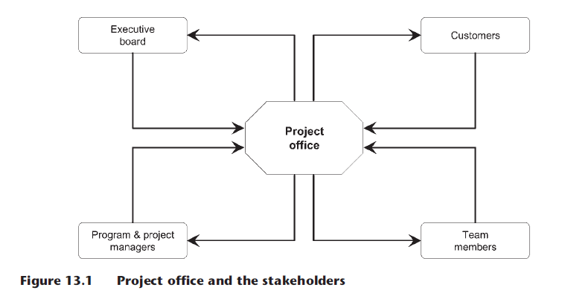
Defining project offices

Slide 10
Program or Project Management Offices (PMO)
The PMO is a permanent team directly linked to the organizational structure, coordinating the management of the portfolios, programs and projects of one company or organizational unit. The PMO team members can be distributed across various countries (Global PMO). Different types of PMO exist in international companies, depending on their hierarchical position and the main functions provided to the organisation: corporate, regional, functional and outsourced.

Slide 11
Program or Project Management Offices (PMO)
Corporate PMO Figure below – this type of project office provides portfolio management functions for the whole organization and focuses on collecting program and project information to establish priorities, allocate resources and decide on project initiation, continuation or termination. These decisions are taken together with the company executive board, in order to align the program and project execution to the corporate strategies.

Slide 12

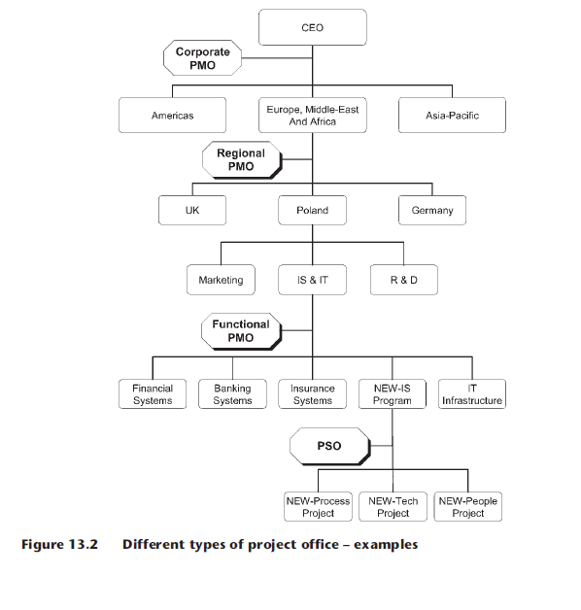
Program or Project Management Offices (PMO)

Slide 13
Program or Project Management Offices (PMO)
Regional PMO Figure above – international companies can opt to combine the administration, prioritization and ‘stage gate’ decisions for various global projects and programs according to their geographical locations. The regional PMO will perform these activities for a logical cluster of countries, grouped by different criteria such as geographical regions (for example, Americas or Asia-Pacific), cultural affinities (for example, Germanic, Arabic or Anglo-Saxon) or languages (for example, Spanish, Portuguese or English). The regional PMO can be subordinated to a corporate PMO, to regional directors, or both.

Slide 14
Program or Project Management Offices (PMO)
Functional PMO Figure above – the functional PMO centralizes the administration, prioritization and stage gates decisions for strategic projects and programs executed undthe responsibility of one functional area or division. The organization can have one functional PMO for each core department such as Information Systems, Marketing and Research and Development. The functional PMO can be subordinated to a corporate PMO, to functional directors, or both.

Slide 15
Program or Project Management Offices (PMO)
Outsourced PMO Figure below – a novel form of PMO consists of specialized companies providing services to smaller organisations that wish to benefit from the advantages of a centralized project office, with specialized individuals and reduced costs. Usually this form of PMO will focus on performing program and project management activities and providing consolidated information on the progress and status of the organization's programs, projects and portfolios.

Slide 16
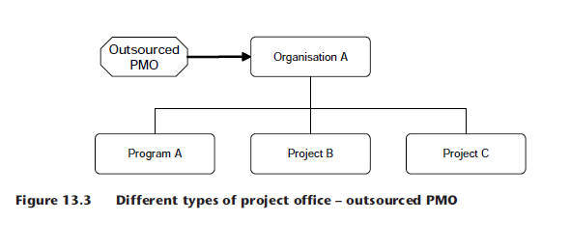
Program or Project Management Offices (PMO)

Slide 17
Program or Project Support Offices (PSO)
The project support office is a team directly linked to the program or project organization, providing support to the program and project managers on the use of tools, techniques, templates, reporting and knowledge management. The program or project life span will determine the duration of the PSO.

Slide 18
Program or Project Support Offices (PSO)
When attached to global programs and projects, the PSO can contain team members from the different organisations and countries (global PSO), to align processes, tools, methods and templates, and to facilitate the exchange of information across the various knowledge bases. This will also simplify the organization of meetings using different calendar systems and locations, and the collection of information from team members located in different places see Figure below.

Slide 19
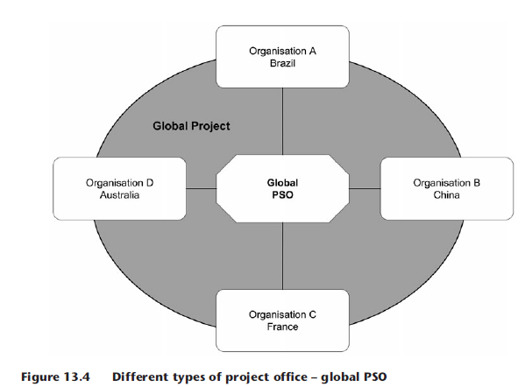
Program or Project Support Offices (PSO)

Slide 20
Features of global project offices
Global organisations can create project management offices to implement strategic control, balancing the centralisation and decentralisation needs of global projects and programs. Different subsidiaries and departments around the globe can propose different initiatives to the global PMO. Instead of defining the strategy, the global PMO will promote decentralisation and review, make suggestions, approve, coordinate, provide support and allocate resources to these initiatives.

Slide 21
Features of global project offices
The centralisation of knowledge will help to track the timescale, budget, quality and customer satisfaction levels of projects in different countries, and to manage the cross-dependencies between various local initiatives, global projects and global programs.

Slide 22
Features of global project offices
The main categories of services provided by the global project offices to local subsidiaries and other departments will now be described in more detail: knowledge management, management of portfolios, management of programs and projects and support to program and project managers.

Slide 23
PROJECT KNOWLEDGE MANAGEMENT SERVICES
Central lessons-learned database – global projects can benefit from past experiences of project teams that worked with the same countries, cultures, stakeholders or customers. The PMO can own the database and make sure that all project teams use and update the lessons-learned information.

Slide 24
PROJECT KNOWLEDGE MANAGEMENT SERVICES
Centralized configuration management – the PMO and PSO can make sure that the product configurations are consistent across various countries and organisations, by understanding the different policies and systems.

Slide 25
PROJECT KNOWLEDGE MANAGEMENT SERVICES
Centralized risk repository – the PSO can ensure all risks are tracked and followed up correctly by the global team members; the PMO can make sure the risks are managed consistently across the organization, and escalate ‘top ten’ risks for executive information and actions.

Slide 26
PROJECT KNOWLEDGE MANAGEMENT SERVICES
Centralized repository of project issues – the PSO can confirm that all issues are tracked and followed-up on time by the global team members; the PMO can ascertain that the issues are managed consistently across the organization, and escalate ‘top ten’ issues for executive information and actions.

Slide 27
PROJECT KNOWLEDGE MANAGEMENT SERVICES
Centralized repository of quality standards – the PMO and PSO can provide information for quality control processes and collect their results, making sure that the quality level is maintained within corporate standards for project deliverables executed by different companies and locations around the globe.

Slide 28
PROJECT KNOWLEDGE MANAGEMENT SERVICES
Project reporting – the PSO can produce the reports on the project metrics and progress, adapting them to other organizational unit formats, organizing translations into local languages and converting amounts to different currencies.

Slide 29
PROJECT KNOWLEDGE MANAGEMENT SERVICES
Information distribution – the PSO can distribute information such as the project performance metrics, risks, issues, achievements and changes to the stakeholders in various organisations and countries according to the project communications plan.

Slide 30
PROJECT KNOWLEDGE MANAGEMENT SERVICES
Scheduling database – the PSO can track the actual activity durations and the use of contingencies, classifying this information according to the company or country that executed each task, and working together with the PMO to make this information available for future projects.

Slide 31
PROJECT KNOWLEDGE MANAGEMENT SERVICES
Project dictionary – the global PSO can maintain a project dictionary that will help the stakeholders to translate the project terminologies to their own methods and standards. The PMO can perform the same task at an organizational or departmental level.

Slide 32
PORTFOLIO MANAGEMENT SERVICES
Identification and categorization of portfolio components – the corporate PMO can monitor new projects and programs being initiated in different organizational units and countries, and include them in the portfolio if they satisfy basic criteria such as geographical span, size and importance.

Slide 33
PORTFOLIO MANAGEMENT SERVICES
Evaluation and selection of components – the corporate PMO might evaluate the new initiatives and consolidate the information required by the decision-making process. The PMO can make recommendations to the executive managers or portfolio review board, who decide upon the prioritisation, acceptance or rejection of the programs and projects. The establishment of a corporate PMO to manage the portfolio helps to keep the mix of components aligned to the organisational strategy, by taking impartial decisions regarding programs and projects being requested by different countries or organisational units.

Slide 34
PORTFOLIO MANAGEMENT SERVICES
Prioritisation, balancing and allocation of resources – the corporate PMO can use the program and project characteristics (such as funding, risk level, return on investment and duration) to constantly monitor and revise the execution priorities. A project ranking can influence the allocation of resources, and may also determine the suspension or termination of certain programs and projects.

Slide 35
PORTFOLIO MANAGEMENT SERVICES
Portfolio reporting – the corporate PMO can collect the performance indicators from the various programs and projects, preparing consolidated reports that will inform the executive management of the overall performance of the portfolio, allowing strategic decisions that may affect the individual components.

Slide 36
PORTFOLIO MANAGEMENT SERVICES
Examples of information to be produced are project workload, health status, strategic opportunities and risks. The corporate PMO can organise translations between different languages and convert the monetary amounts to different currencies, when presenting the information to stakeholders across the globe.

Slide 37
PROGRAM AND PROJECT MANAGEMENT SERVICES
Program management – the regional, functional and outsourced PMOs can be responsible for the management of strategic or complex programs, executed or sponsored by their organizational units, and for making sure the benefits realization is attained. As an example, companies can group global program managers in the PMO, and give them responsibility for specific types of global programs.

Slide 38
PROGRAM AND PROJECT MANAGEMENT SERVICES
Project management – the regional, functional and outsourced PMO can be responsible for the management of strategic or complex projects executed or sponsored by their organizational units. When a project is initiated, the PMO can apply pre-defined selection criteria (such as cross-functional participation, costs, duration or risk level) to determine if a project manager from the PMO is required, or if the assignment of a project manager from the functional teams is recommended.

Slide 39
PROGRAM AND PROJECT MANAGEMENT SERVICES
Project recovery – when high deviations to project scope, cost, time, quality or customer satisfaction are foreseen, the PMO can assign a senior project manager to assess and recover the project. For example, a global PMO might identify that the reason for delays, conflicts and deviations is the poor communication between team members in different countries, and recommend a skilled project manager to provide coaching on the Global Project Management Framework©. The PMO can also take over the management of a project during long absences of the project manager.

Slide 40
SUPPORT TO PROGRAM AND PROJECT MANAGERS
Monitoring and health checks – the PMO can track the evolution of project metrics, and recommend remediation actions when critical variations are foreseen. The PMO can also perform health checks to assess the correct use of methodologies and global project management good practices, recommending the project managers to follow coaching or training sessions to correct the deviations.

Slide 41
SUPPORT TO PROGRAM AND PROJECT MANAGERS
Coaching and mentoring – the PMO can provide coaching and mentoring over distance (see Chapter 5), on project management methodologies, soft skills and the Global Project Management Framework.

Slide 42
SUPPORT TO PROGRAM AND PROJECT MANAGERS
Training – a corporate or regional PMO can organize external training sessions to leverage the project management skills from different organizational units and countries. A corporate PMO is also well placed for the coordination of internal training sessions on the company methodologies and good practices, fostering their adoption by all projects of the organization.

Slide 43
SUPPORT TO PROGRAM AND PROJECT MANAGERS
Establishing a career path – the corporate PMO can establish a career path for program and project managers, linking the professional experience, training and credentials with the complexity and size of the initiatives.

Slide 44
SUPPORT TO PROGRAM AND PROJECT MANAGERS
Corporate project management methodology, good practices and standards – the corporate PMO can investigate different methods, methodologies, good practices and standards from departments and external organisations across the globe, and consolidate them into a uniform set of corporate policies and processes.

Slide 45
SUPPORT TO PROGRAM AND PROJECT MANAGERS
Specific project management methodology, good practices and standards – the functional PMO can develop a set of policies and processes that are particular to their specific knowledge areas, which should complement (and not replace) the corporate standards. These practices must be understood and adopted by (or adapted to) customers, suppliers and partners involved in the project.

Slide 46
SUPPORT TO PROGRAM AND PROJECT MANAGERS
Global project management good practices and standards – the corporate PMO can guide the implementation of the Global Project Management Framework© in different organizational units across functions, regions and countries. The functional and regional PMOs can adapt the framework, by validating if the practices and recommendations comply with local cultures, ethics and rules, and making suggestions based on their own experience with global project management from different cultural and functional perspectives.

Slide 47
SUPPORT TO PROGRAM AND PROJECT MANAGERS
Collaborative tools and techniques – the PMO can coordinate the implementation of the collaborative technologies , the dissemination and publishing of the guidelines , champion their use and adoption, and provide support to other project and program managers. The corporate PMO can coordinate the deployment of standard tools across different departments, countries and regions, streamlining the communication across borders.

Slide 48
SUPPORT TO PROGRAM AND PROJECT MANAGERS
Project management tools and techniques – the corporate, functional and regional PMO can provide examples and support to foster the use and adoption of software tools, methods and procedures for standard estimating, planning and control.

Slide 49
SUPPORT TO PROGRAM AND PROJECT MANAGERS
Project management maturity – the PMO can coordinate the implementation of strategic programs to evaluate and increase the organization maturity on project management.

Slide 50
Resources:
Global Project Management
Communication, Collaboration and Management Across Borders
© Jean Binder 2007
Chapter 13

