Slide 1

PMG 506
Advanced Project Management
LECTURE 9
Everyone’s Smart
University
Budgeting, Estimating times and costs

Slide 2
PMG506
Advanced Project Management (APM)
Introduction:
Lecture 1 Introduction to APM and Initial Project Strategy
Lecture 2 Project Quality Management
Project planning
Lecture 6 Initial project coordination and the project Charter
Lecture 7 Starting the project plan: The WBS
Lecture 8 Project risk management
Lecture 9 Budgeting, Estimating times and costs
Project Initiation:
Lecture 3 Project Communication and team Management
Lecture 4 Managing conflicts and the art of communication
Lecture 5 Strategic Management and project selection
Project Integration
Lecture 10 Monitoring and Controlling
Lecture 11 PMOs and OPM
Lecture 12 Social and Professional Responsibility
Lecture 13 Open Discussion

Slide 3

PMG506 Advanced Project Management (APM)
Introduction:
Lecture 1 Introduction to APM and Initial Project Strategy
Lecture 2 Project Quality Management
Project planning
Lecture 6 Initial project coordination and the project Charter
Lecture 7 Starting the project plan: The WBS
Lecture 8 Project risk management
Lecture 9 Budgeting, Estimating times and costs
Project Initiation:
Lecture 3 Project Communication and team Management
Lecture 4 Managing conflicts and the art of communication
Lecture 5 Strategic Management and project selection
Project Execution
Lecture 10 Monitoring and information systems
Lecture 11 Project Control
Lecture 12 Project Auditing
Lecture 13 Project termination

Slide 4

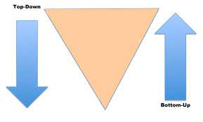
Learning Outcomes
By the end of this lecture, you will be able to:
Understand estimating project times and costs are the foundation for project planning and control.
Describe guidelines for estimating time, costs, and resources.
Describe the methods, uses, and advantages and disadvantages of top-down and bottom-up estimating methods.
Distinguish different kinds of costs associated with a project.

Slide 5
Overview
ID | Process | Definition | Process Group
6.1 | Plan Schedule Management | The process of establishing the policies, procedures, and documentation for planning, developing, managing, executing, and controlling the project schedule. | P
6.2 | Define Activities | The process of identifying and documenting the specific actions to be performed to produce the project deliverables. | P
6.3 | Sequence Activities | The process of identifying and documenting relationships among the project activities. | p
6.4 | Estimate Activity Durations | The process of estimating the number of work periods needed to complete individual activities with estimated resources. | P
6.5 | Develop Schedule | The process of analyzing activity sequences, durations, resource requirements, and schedule constraints to create the project schedule model for project execution, monitoring and controlling. | P
6.6 | Control Schedule | The process of monitoring the status of the project to update the project schedule and manage changes to the schedule baseline. | M&C

Slide 6
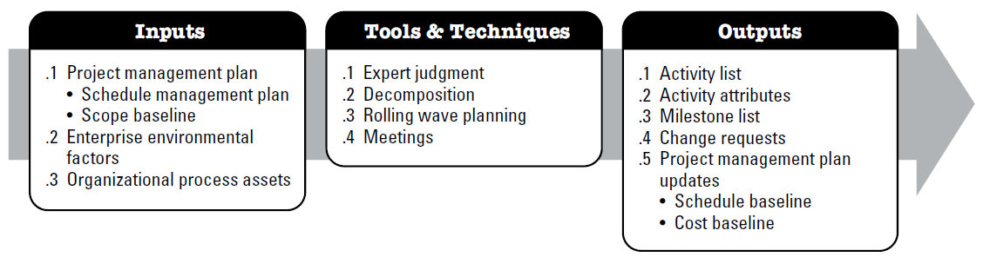
Define Activities
The process of identifying and documenting the specific actions to be performed to produce the project deliverables.
The key benefit of this process is that it decomposes work packages into schedule activities that provide a basis for estimating, scheduling, executing, monitoring, and controlling the project work.

Slide 7
The Work Breakdown Structure (WBS) [1/2]
WBS is the top level plan, out of which other plans cascade.
It summarizes in a hierarchy all the project’s
  Sub-projects
  Tasks
The WBS
  Allows breaking out sub-projects
  Helps visualize sequence of performance
  Allows break out of “work packages”.

Slide 8
The Work Breakdown Structure (WBS) [2/2]
Work packages are the logical building blocks of activities and are used for
  Estimating work
  Scheduling work
  Assigning work
  Controlling work

Slide 9
Elements and Level of WBS
WBS need to include
  Project Objective or Goal
Major Sub-projects
  Summary tasks for each milestone
  Detailed tasks/ work packages (measureable)

Slide 10
WBS Hierarchy
2.0
First Draft
2.1
Create recipes
2.1.1
Write up recipes using US Metrics
2.1.2
Test recipes for accuracy and taste
2.2
Write anecdote text
2.2.1
Collect anecdotes (10 per chapter)
2.1.3
Revise recipes
2.2.2
Write down anecdotes (no more than 6 lines each)
2.2.3
Incorporate Tosca’s revisions

Slide 11
WBS Rules of Thumb
A summary task must be broken down to a maximum of 8 work packages.
Work packages of less than ½ a man-day can be consolidated with higher level tasks
The 8/80 rule: If a task is shorter than 8 hours or longer than 80 hours, it needs to be adjusted.
Final rule: If breaking these rules of thumb makes it easier to plan or do the project, then disregard the rule.

Slide 12
Work Package Sequencing
Dependency Table
ID | Task | Predecessors | Resources Needed
1 | Write recipes |  | Tosca, Writer
2 | Test recipes | 1 | Chef, Asst. Chef, Tosca
3 | Revise recipes | 2 | Tosca, Writer, Chef, Asst. Chef
4 | Lay out pages | 3 | Graphic artist
5 | Take photos | 3 | Photographer, Food Stylist
6 | Write introduction |  | Writer

Slide 13
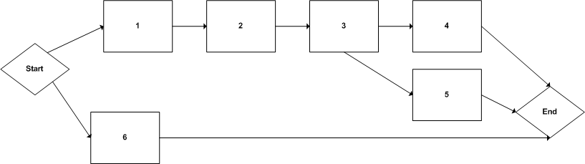
The Network Logic Diagram
Precedence Diagramming Method (PDM)

Slide 14
Review
Arrange these elements of a WBS into hierarchical order
  Summary Tasks
  Sub Project
  Work Packages
  Project Objective
Sequencing in which a task must be completed before the next task can begin is called
  Start to Finish
  Start to Start
  Finish to Finish
  Finish to Start
Which tool lists summary activities, and then breaks them down into detailed activities or work packages?
Which tool helps you visualize the dependency relationships among work packages?

Slide 15
The Scheduling Process
Estimating duration and effort for each work package.
Calculating the critical path, or set of activities which cannot be delayed, in order to accomplish project work on time.
Calculating activities which have float, or additional time, during which resources can be assigned to help accomplish Critical Path activities.

Slide 16
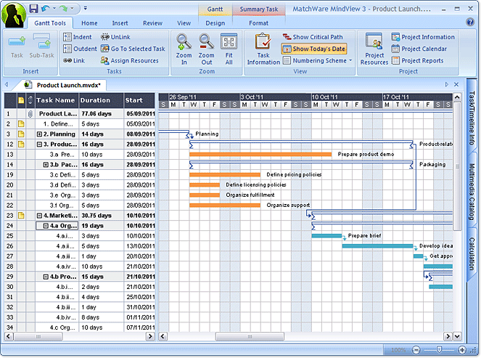
6B From Duration to Schedule
After calculating the Critical Path, use the network logic diagram and calculations and project them onto a calendar.
A Gant Chart is the best way to display the schedule information.

Slide 17
Work Package Sequencing
Mandatory Dependency
Discretionary Dependency
External Dependency

Slide 18
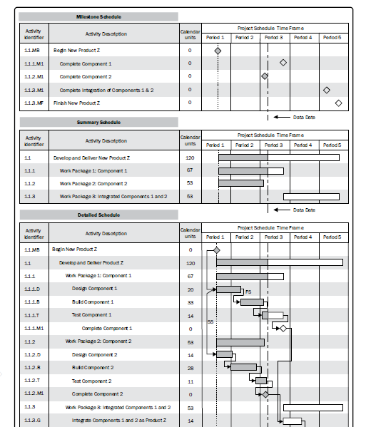
Review
Milestone charts
Bar Charts
Network Diagram

Slide 19
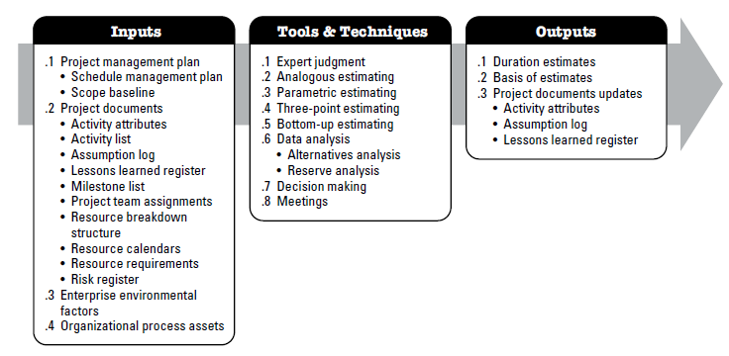
Estimate Activity Durations
The process of estimating the number of work periods needed to complete individual activities with estimated resources.
The key benefit of this process is that it provides the amount of time each activity will take to complete.

Slide 20
Estimate Activity Durations
Tools and Techniques
  Expert judgment: expertise in schedule development – estimating or discipline knowledge (SMEs)
  Analogous estimating: uses parameters from previous similar projects to estimate the same parameter (duration) for a future project
  A gross value estimating (adjusted for known differences)
  Less costly and time consuming – less accurate (limited amount of details)
  Parametric estimating: uses algorithm (statistical relationships) to calculate durations based on historical data
  Duration may be obtained by dividing the quantity of work by the crew production rate

Slide 21
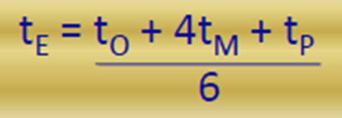
Estimate Activity Durations
Tools and Techniques
  Three- Point estimating (PERT): improving a single estimate by considering uncertainty and risk
  Optimistic (To): best case scenario
  Most likely (Tm): probable scenario
  Pessimistic (Tp): worst case scenario
  Bottom-Up estimating: estimating duration by aggregating the estimates of the lower level components of WBS
  monitor dependencies and overlap!!

Slide 22
Estimate Activity Durations
Tools and Techniques
  Data analysis
  Alternative analysis: comparing various options of resource skills, scheduling methods, tools and make-or- buy decisions
  Reserve analysis: determining the amount of contingency or management reserve needed to account for schedule uncertainty
  Decision making: PM asks the team to show their level of support to estimates (e.g. 1→5)
  Meetings: to discuss assumptions, concerns, risk, dependencies, decisions and actions that may affect duration estimates

Slide 23
Estimate Activity Durations
Outputs
  Duration estimates: quantitative assessments of the likely number of time periods that are required to complete an activity, a phase or a project
  single estimate or range (3 weeks ± 2days)
  Basis of estimates: additional details supporting the duration estimate ( basis of estimates – assumptions - risks –confidence level)
  Project documents updates: activity attributes – assumption log – lessons learned

Slide 24
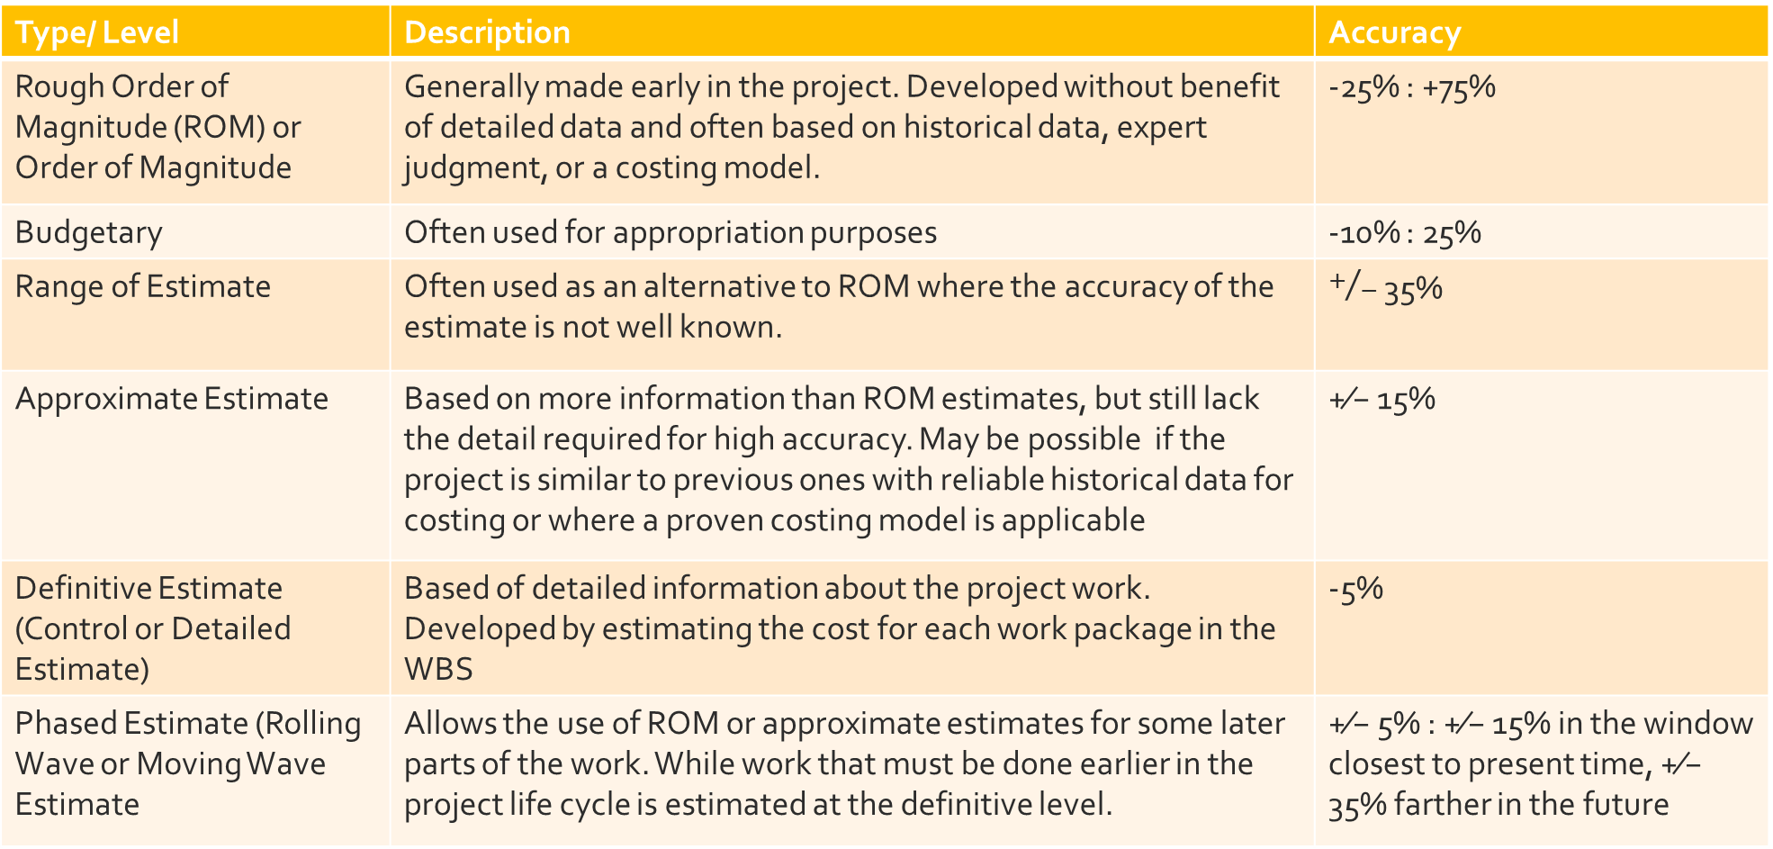
Types of Cost Estimates
Type/ Level | Description | Accuracy
Rough Order of Magnitude (ROM) or Order of Magnitude | Generally made early in the project. Developed without benefit of detailed data and often based on historical data, expert judgment, or a costing model. | -25% : +75%
Budgetary | Often used for appropriation purposes | -10% : 25%
Range of Estimate | Often used as an alternative to ROM where the accuracy of the estimate is not well known. | $+/−$ 35%
Approximate Estimate | Based on more information than ROM estimates, but still lack the detail required for high accuracy. May be possible if the project is similar to previous ones with reliable historical data for costing or where a proven costing model is applicable | +⁄− 15%
Definitive Estimate (Control or Detailed Estimate) | Based of detailed information about the project work. Developed by estimating the cost for each work package in the WBS | -5%
Phased Estimate (Rolling Wave or Moving Wave Estimate | Allows the use of ROM or approximate estimates for some later parts of the work. While work that must be done earlier in the project life cycle is estimated at the definitive level. | +⁄− 5% : +⁄− 15% in the window closest to present time, +⁄− 35% farther in the future

Slide 25
Time Estimates
Work Effort
Term | Definition
Task Time | The amount of labor or resource time it will take to do the activities in the task. Sometimes referred to as “work effort” or “billable hours”.
Duration Effort | The total time needed to complete the task, including waiting times. Sometimes referred to as “elapsed time”.

Slide 26
Analogous estimating
Advantages of Analogous Estimating | Disadvantages of Analogous Estimating
Quick | Less accurate
Activities need not be identified | Estimates are prepared with a limited amount of detailed information and understanding of the project
Less costly to create | Requires considerable experience to do well
Cost constraints created by management in project initiating give the project manager data to evaluate high-level project feasibility | There may be infighting to gain the biggest piece of the budget without being able to justify the need.
Overall project costs will be capped (for a project analogous estimate) | Extremely difficult for project with uncertainty
 | Does not take into account the difference between projects

Slide 27
Bottom-up estimating
Advantages of Bottom-up Estimating | Disadvantages of Bottom-up Estimating
More accurate | Takes time and expense to use this estimating technique
Gains buy-in from the team because the team creates estimates they can live with | Tendency for the team to pad estimates unless they understand the use of reserves
Based on a detailed analysis of the project | Requires that the project be defined and well understood before estimating begins
Provides a bassis for monitoring and controlling, performance measurement, and management | Requires time to break the project down into smaller pieces

Slide 28


Slide 29
What is Project Budget?
A plan for how you will spend money on each work package in a project.
  It estimates how much and when needed.
  It includes “contingency” or “management reserve” to cover unexpected expenses

Slide 30
From Cost Estimates to Budget [1/2]
Cost Element | Description | Formula
Labor | The cost of the people working on the project. Include expected overtime. May include overhead and fringe benefits, depending on the organization. Both formulae are shown at right | (Regular hours X hourly rate) +(Overtime hours X overtime rate) (Regular hours X hourly rate) + (Overtime hours X overtime rate) + (pro-rated overhead and fringe benefits)
Equipment | The purchase, lease or rental price and cost of usage | Purchase price Lease or rental price X time period

Slide 31
From Cost Estimates to Budget [2/2]
Cost Element | Description | Formula
Facilities | The cost of space to house your team, provide electric and phone service, etc. | Rental costs X time period Organizational burden rate X time period
Supplies | The consumables your team will use during the project | Estimated volume X (Cost + inflation adjustment)
Special Expenses | Specialized services, miscellaneous items, etc. | Estimated cost of service or item

Slide 32
Work Package Estimation Table
ID # | Task Description | Duration (Days) | Task Time | Predessors | Resources

Slide 33
Creating a Preliminary Budget 1/3
Converting Task Time Data to Cost Estimates
Review the two tables below. Follow the flow of data from one table to the next
ID | Task | Dur Time | Task Time | Predecessors | Resources
2 | Test recipes | 10 wks | 10 wks |  | Chef (10 wks, 50 hrs/ week) Asst. Chef (10 wks, 50 hrs/ week) Tosca (10 days)
3 | Photograph recipes | 2 wks | 1 wk |  | Photographer (5 days, 8 hrs/ day) Food stylist (10 day contract)

Slide 34
Creating a Preliminary Budget 2/3
In the Test Recipes work package, you expect to need an assistant chef for 10 weeks. You expect that the assistant chef will work 10 hours a day, from Monday to Friday. An assistant chef’s hourly rate is $20/hr for an 8 hour day. Standard Publishing’s overtime rate is time-and-a-half. Calculate the total labor cost estimate for the assistant chef’s work in this work package.
ID | Resource | Total Hrs | OT Hrs | Reg Rate | OT Rate | Total Cost
2 | Asst. Chef | 400 | 100
3 | Photographer | 40 | 0

Slide 35
Creating a Preliminary Budget 3/3
In the Photograph Recipes work package, you expect to need a professional photographer on a one-day-a-week basis, from 9 to 5, for 4 weeks. A professional photographer's hourly rate is $50/hr for an 8 hour day. What is the total labor estimate for the photographer?

Slide 36
Budget and Schedule Balancing
Cost and Time tradeoff
  Will adding overtime hours help? Or are the people stretched too thin already?
  Will adding additional people help? Or is this task in which adding additional people will complicate things to the point that time is not saved?
  What other costs am I adding? (for example, if I add an additional assistant chef, do I need additional kitchen facilities or equipment also?)
  Am I adjusting an activity that is on the Critical Path? If so, can the project survive with a lengthened schedule?
  Am I adding new costs by revising the schedule? (If I lengthen the schedule will additional equipment rental costs offset my labor cost savings?)
  Will these changes make it more difficult to meet quality goals?

Slide 37
Overview
Project cost management includes the processes involved in planning, estimating, budgeting, financing, funding, managing and controlling costs so that the project can be completed within the approved budget.
ID | Process | Definition | Process Group
7.1 | Plan Cost Management | The process of defining how the project costs will be estimated, budgeted, managed, monitored and controlled | P
7.2 | Estimate Costs | The process of developing an approximation of the monetary resources needed to complete project work. | P
7.3 | Determine Budget | The process of aggregating the estimated costs of individual activities or work packages to establish an authorized cost baseline. | P
7.4 | Control Costs | The process of monitoring the status of the project to update the project costs and manage changes to the cost baseline. | M&C

Slide 38
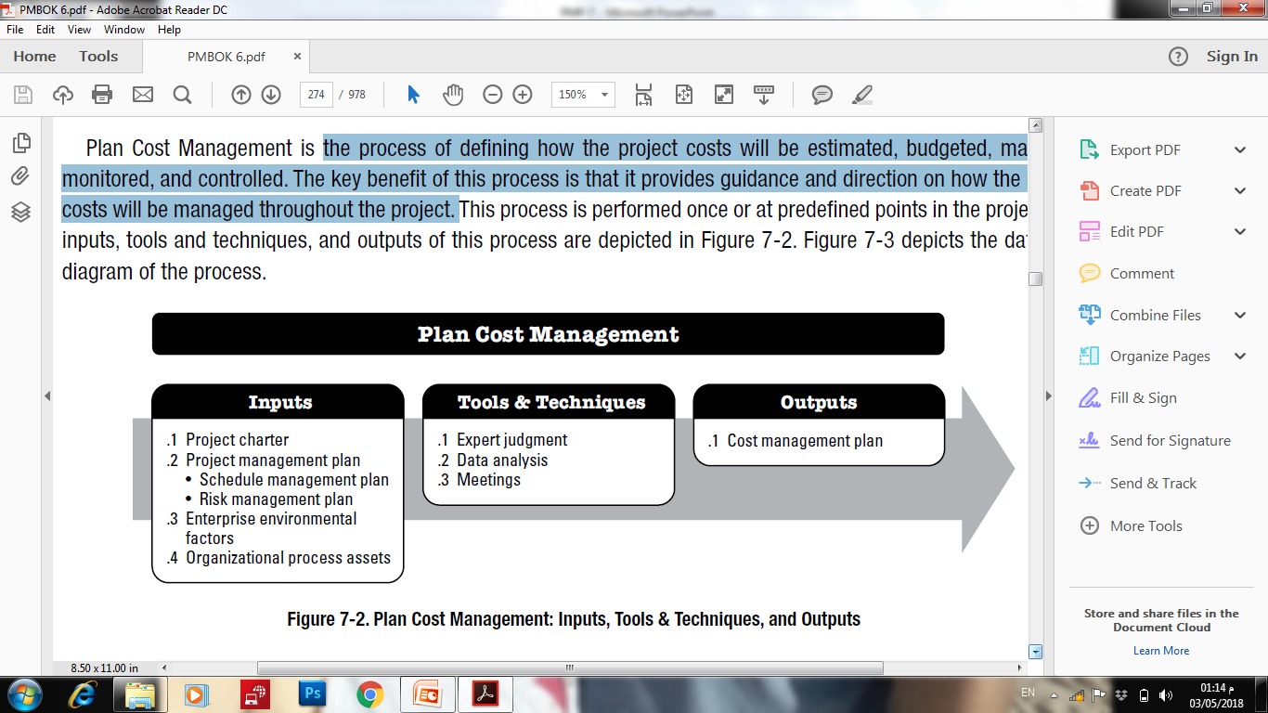
Plan Cost Management
The process of defining how the project costs will be estimated, budgeted, managed, monitored, and controlled.
The key benefit of this process is that it provides guidance and direction on how the project costs will be managed throughout the project.

Slide 39
Cost Categories
Type | Description | Example
Fixed Costs | Project costs that remain constant regardless to the phase or output. | Set‐up
Variable Costs | Project costs that vary in relation to the output. | Materials, supplies
Direct Costs | Costs that are directly attributable to the work of the project | Training, travel
Indirect Costs | Costs that are directly attributable to more than one project (overhead) | Taxes
Cost reserves | Amount of money needed above the estimate to reduce risk of overruns of project objectives to a level acceptable to the organization

Slide 40
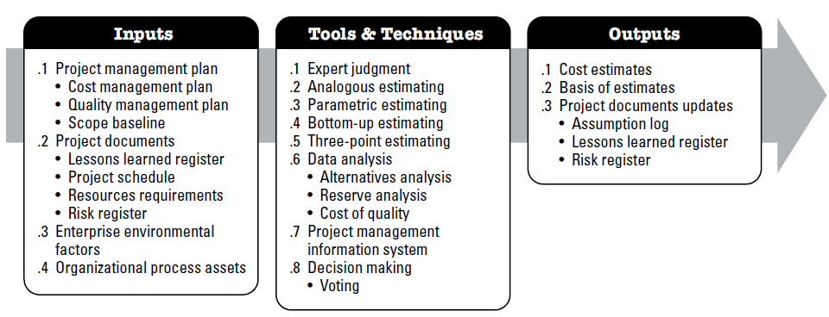
7.2 Estimate Costs
The process of developing an approximation of the cost of resources needed to complete project work.
The key benefit of this process is that it determines the monetary resources required for the project.

Slide 41
7.2 Estimate Costs
Tools and Techniques
  Expert judgment: previous similar projects – discipline – cost estimating
  Analogous estimating: gross value estimate of project cost based on historical data – less costly and time consuming – less accurate
  Parametric estimating: statistical relationship between historical data and cost estimate of project work (square meter in construction)
  Bottom-up estimating: the cost of activities or work packages is estimated in detail, then rolled up to higher levels (WBS !!)

Slide 42
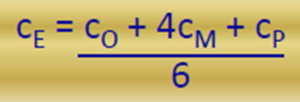
7.2 Estimate Costs
Tools and Techniques
  Three- point estimating:
  Data analysis:
  Alternative analysis: available cost options (cash vs. credit – make vs. buy)
  Reserve analysis: amount of money to account for uncertainty (risks)
  Contingency reserves (known risks) – Management reserves (unknown risks)
  Cost of quality: cost of conformance – cost of NON conformance
  Project management information system: spread sheets - software
  Decision making: voting to select cost options – improve accuracy

Slide 43
7.2 Estimate Costs
Outputs
  Cost estimates: quantitative assessments of the probable costs required to complete the project work and contingency amounts for identified risks:
  Labor, material, equipment, services, facilities, IT, funding charges, inflation allowance and reserves
  Basis of estimates: additional details supporting cost estimates (calculations, assumptions, constraints, risks and confidence level)
  Project documents updates:
  assumption log (updates) – lessons learned register
  – risk register (risk response costs)

Slide 44
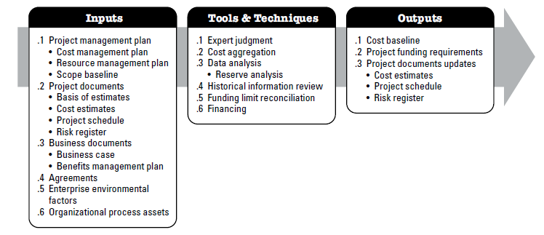
Determine Budget
The process of aggregating the estimated costs of individual activities or work packages to establish an authorized cost baseline.
The key benefit of this process is that it determines the cost baseline against which project performance can be monitored and controlled.

Slide 45
Determine Budget
Tools and Techniques
  Expert judgment: previous similar projects – financial principles - funding
  Cost aggregation: cost estimates are aggregated by work packages in using WBS, then for control accounts and ultimately for the entire project.
  Data analysis: management reserve analysis
  Historical information review: mathematical models to predict total cost
  Funding limit reconciliation : expenditure limits (monthly – quarterly)
  Financing: acquiring funding for the project

Slide 46
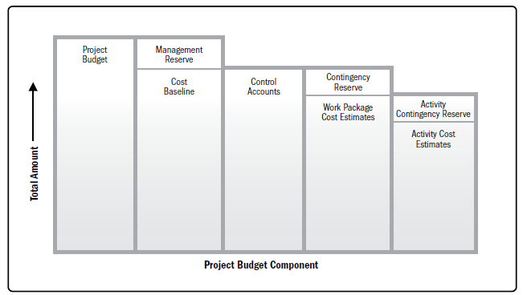
Determine Budget
Outputs
  Cost baseline: the approved version of the time-phased project budget , excluding any management reserves, which can only be CHANGED through formal change control procedure. It is used as a basis for comparison to actual results.
Project Budget Components

Slide 47
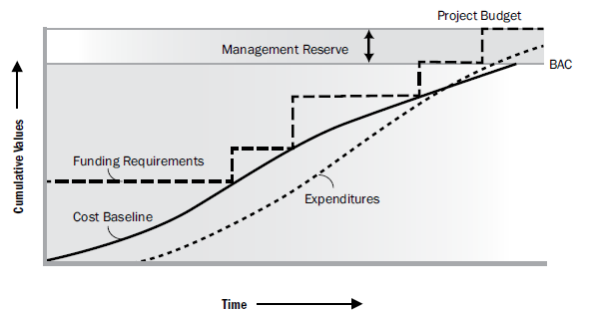
Determine Budget
Outputs
  Project funding requirements: projected expenditures + anticipated liabilities
  Project documents updates: cost estimates – project schedule – risk register

