Slide 1


Advanced Encryption Standard (AES)
Prepared by Dr. Sumaya Alkubaisi
FNT625
Cybersecurity Concepts
Lecture 7

Slide 2

Lecture
Learning Goals
7
By the end of this lecture, you will be able to:
Explain what AES is and why it became the global standard for symmetric encryption.
Understand the core structure of AES, including its main transformation steps used during encryption rounds.
Differentiate between AES-128, AES-192, and AES-256, and identify when each is used in practice.
Describe why DES became obsolete and how AES overcomes DES limitations.
Recognize where AES is applied in banking, FinTech, and digital payment systems to secure sensitive data.

Slide 3
Lecture
7
What is AES?
AES is a symmetric block cipher that:
Encrypts data in 128-bit fixed-size blocks.
Supports 128, 192, or 256-bit keys.
Performs multiple rounds of transformations to convert plaintext into ciphertext.
AES is based on strong mathematical structures (finite fields) rather than Feistel design, making it more secure and efficient.
AES was adopted in 2001 to replace DES and provide long-term security.

Slide 4
Lecture
Features of AES
7
AES provides:
High security: Resistant to known cryptographic attacks.
Flexibility: Multiple key lengths for different security needs.
Efficiency: Fast in both hardware and software.
Global standard: Used in banking, Wi-Fi security, VPNs, SSL/TLS, and cloud services.
AES is suitable for modern devices, from servers to smartphones and IoT.

Slide 5
Lecture
AES vs DES (Quick Comparison)
7
Feature | DES | AES
Block Size | 64-bit | 128-bit
Key Size | 56-bit | 128/192/256-bit
Structure | Feistel Network | Substitution-Permutation Network (SPN)
Security | Weak today | Very strong
Speed | Slow on software | Fast on both

Slide 6
Lecture
AES Basics & Parameters
7
AES Block and Key Sizes
AES processes data in 128-bit blocks.
It supports three key sizes:
  AES-128 → 128-bit key
  AES-192 → 192-bit key
  AES-256 → 256-bit key
Larger keys provide stronger security but with slightly more computation.

Slide 7
Lecture
AES Basics & Parameters
7
Number of Rounds
AES performs a series of repeated transformation rounds on the data:
  10 rounds for AES-128
  12 rounds for AES-192
  14 rounds for AES-256
Each round increases confusion and diffusion, making it harder for attackers to reverse the encryption without the key.

Slide 8
Lecture
AES High-Level Structure
7
AES performs the following steps during encryption:
1.Initial Round: AddRoundKey
2.Repeated Rounds:
SubBytes
ShiftRows
MixColumns
AddRoundKey
3.Final Round: (no MixColumns)
SubBytes → ShiftRows → AddRoundKey
This structured process provides strong security in each transformation layer.

Slide 9
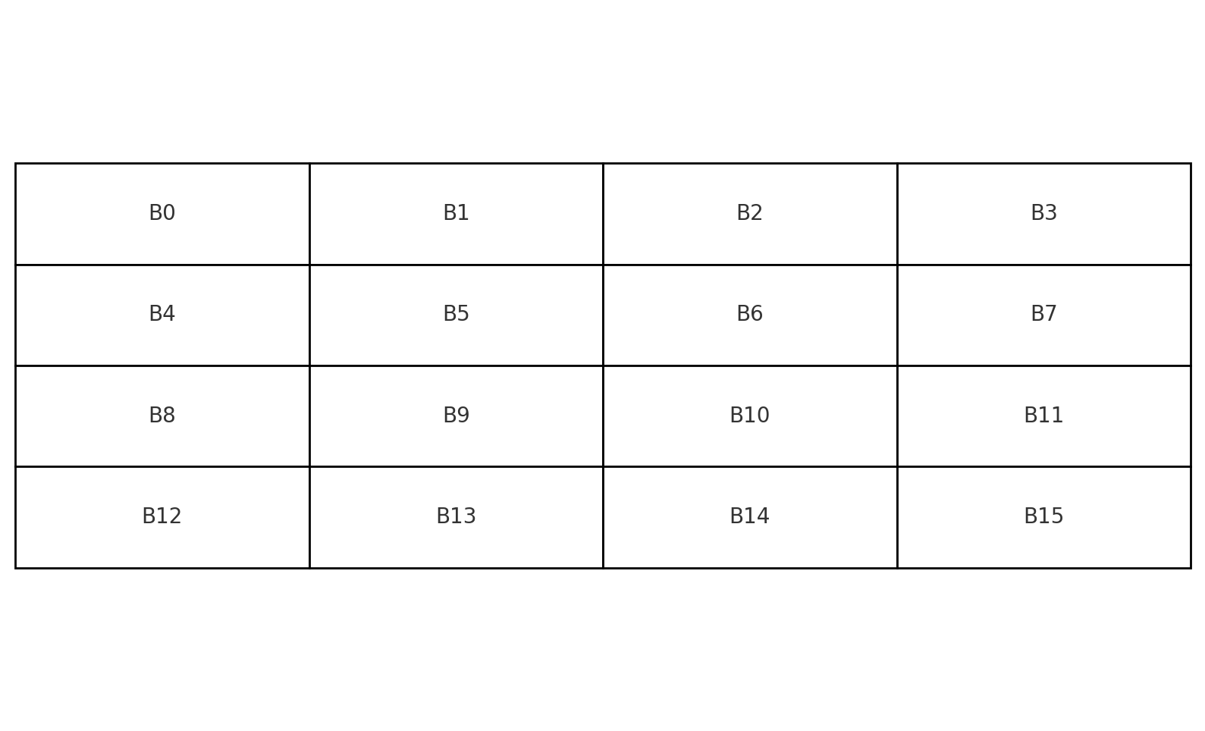
Lecture
The State Array (Core Concept)
7
AES does not operate directly on a long number.
Plaintext is arranged into a 4×4 byte matrix called the State (blocks of 128 bits = 16 bytes)
All AES transformations work on this State matrix throughout the encryption process.

Slide 10
Lecture
AES Data Flow Summary
7
AES encryption flows as:
Input Plaintext → State Matrix
Apply Initial Round
Apply Multiple Rounds (SubBytes, ShiftRows, MixColumns, AddRoundKey)
Apply Final Round
Output = Ciphertext (128 bits)
This gives a structured, repeatable, and reversible process for converting data securely.

Slide 11
Lecture
AES Round Transformations (Overview)
7
Each AES round applies four main transformations to the State:
SubBytes – Byte substitution for non-linearity (confusion)
ShiftRows – Row shifting to spread bytes (diffusion)
MixColumns – Mixes data within each column (diffusion)
AddRoundKey – XOR with key material (security binding to the key)
These four steps work together to make plaintext unrecognizable without the key.

Slide 12
Lecture
SubBytes (Concept)
7
A non-linear substitution step where each byte in the State is replaced using an S-Box (Substitution Box).
The S-Box is designed to resist cryptanalysis by introducing non-linearity.
Each input byte is replaced by a new byte according to a lookup table.
Purpose: Add confusion, making the relationship between plaintext and ciphertext complex.

Slide 13
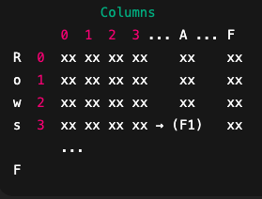
SubBytes (Example)
Lecture
7
Using a portion of the AES S-Box:
If a byte = 0x3A: (the input determines the lookup position)
Row = 3, Column = A (the value found there is 0xF1)
S-Box output = 0xF1
Example transformation:
Before SubBytes: 3A → After SubBytes: F1
This simple replacement is what makes AES resistant to linear attacks.

Slide 14
Lecture
ShiftRows (Concept)
7
A row-wise shifting of the State matrix to spread bytes across columns.
Rows are shifted left by different offsets:
  Row 0: No shift
  Row 1: Shift left by 1
  Row 2: Shift left by 2
  Row 3: Shift left by 3
Purpose: Increase diffusion and prevent alignment of bytes across rounds.

Slide 15
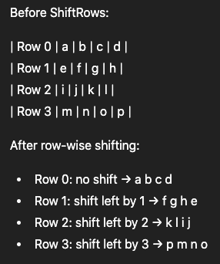
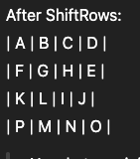
Lecture
ShiftRows (Example)
7
Now bytes originally in the same column are spread across different columns.

Slide 16
Lecture
MixColumns (Concept)
7
A column transformation where each column of the State is transformed using a fixed matrix.
Achieved using math over a finite field (GF(2⁸)).
This mixes each byte with others in the same column.
Purpose: Add strong diffusion across 4 bytes in each column.
Effect: Changing one byte in the input column affects all four bytes in the output column, giving AES strong diffusion.

Slide 17
Lecture
MixColumns (Simplified Example)
7
For one column bytes ( a, b, c, d):
Column before: [D4 BF 5D 30] → Column after: [04 66 81 E5]
How it works:
1.AES treats the column as a vector and multiplies it by a fixed 4×4 matrix in GF(2^8):
​02 03 01 01
01 02 03 01
01 01 02 03
01 01 02
2.Each new byte is computed as a combination of the original bytes using GF(2^8) multiplication (multiplies the corresponding byte modulo the irreducible polynomial) and XOR:
new_a=(02⋅a)⊕(03⋅b)⊕(01⋅c)⊕(01⋅d)
new_b=(01⋅a)⊕(02⋅b)⊕(03⋅c)⊕(01⋅d)
…and similarly for new_c and new_d.

Slide 18
Lecture
AddRoundKey (Concept)
7
The only step that directly uses the encryption key.
The State is XORed with a round key derived from the main key.
XOR ensures reversibility — applying the same key again reverses the effect.
Purpose: Bind encryption directly to the secret key.

Slide 19
Lecture
AddRoundKey (Example)
7
State byte: 0x3C
Round key byte: 0xA1
XOR result:
3C ⊕ A1 = 9D
This is done for all 16 bytes of the State matrix.
Without the correct round key, decryption is impossible.

Slide 20
Lecture
AES Initial Round (Round 0)
7
Before the first round begins, AES performs only:
AddRoundKey
The plaintext block is XORed with the initial round key.
This ensures that no plaintext bits enter the rounds unprotected.
This “pre-whitening” step immediately binds data to the key.

Slide 21
Lecture
AES Standard Round (Rounds 1 to Nr−1)
7
Each standard AES round (except the last) includes all four transformations:Nr = Number of rounds:
Step | Role
SubBytes | Adds non-linearity (confusion)
ShiftRows | Spreads bytes across rows (diffusion)
MixColumns | Mixes bytes within columns (diffusion)
AddRoundKey | XOR with the subkey (security)
10 (AES-128)
12 (AES-192)
14 (AES-256)

Slide 22
Lecture
AES Final Round (Last Round)
7
The last round removes MixColumns:
SubBytes
ShiftRows
AddRoundKey
Why skip MixColumns?
Prevents unnecessary mixing that would complicate correct decryption alignment.
Maintains a clean invertible structure.

Slide 23
Lecture
AES Encryption Process
7
AES-128 example (10 rounds):
Step | Applied
Round 0 | AddRoundKey
Rounds 1–9 | SubBytes → ShiftRows → MixColumns → AddRoundKey
Round 10 | SubBytes → ShiftRows → AddRoundKey
Every round increases confusion & diffusion until ciphertext appears statistically random.

Slide 24
Lecture
AES Decryption (Overview)
7
AES decryption reverses each step using inverse transformations:
Encryption Step | Decryption Step
SubBytes | InvSubBytes
ShiftRows | InvShiftRows
MixColumns | InvMixColumns
AddRoundKey | AddRoundKey (same XOR)
Note: AddRoundKey is the same for encryption & decryption because XOR is its own inverse.

Slide 25
Lecture
AES Decryption Reverse Rounds
7
Decryption applies the reversed order:
1.Final Round:
AddRoundKey
InvShiftRows
InvSubBytes
2.Rounds 1–9:
AddRoundKey
InvMixColumns
InvShiftRows
InvSubBytes
3.Initial: AddRoundKey (same logic)

Slide 26
Lecture
Key Expansion (Why Needed?)
7
AES does not use the original key directly in all rounds.
To strengthen security, AES derives a new key for each round — called Round Keys — using a process called Key Expansion.
Why is this important?
Prevents attackers from reversing the cipher with only 1 key.
Adds complexity so patterns do not repeat across rounds.
Ensures each encryption round behaves differently → stronger security.
In Simple Words: Key Expansion stretches the original key into many sub-keys to make AES harder to break.

Slide 27
What is Key Expansion? (Simple Overview)
Lecture
7
Key Expansion = a function that generates multiple Round Keys from the original key.
For AES-128:
Original Key Size: 128 bits
Round Keys Needed: 11 keys (1 for initial + 10 rounds)
Output: 44 “words” (each word = 4 bytes)
Concept Summary:
Original Key ➜ processed through small transformations ➜ produces new keys for every round.

Slide 28
Lecture
Key Expansion (Concept)
7
Key Expansion uses 3 core operations:
Operation | Description
RotWord | Cyclic shift of 4-byte word
SubWord | Applies S-Box to 4-byte word
Rcon | Adds round constants to introduce non-linearity
Process:
Original key = first round key
Next keys generated word-by-word using previous words

Slide 29
Lecture
Key Expansion (Concept)
7
Why these 3?
RotWord → mixes order (diffusion)
SubWord → adds nonlinearity (confusion)
Rcon → ensures each round key is unique
These small steps dramatically increase security.

Slide 30
Lecture
Example: Key Expansion Basics
7
AES-128 key = 16 bytes = 4 words (W0, W1, W2, W3)
AES-128 requires 44 words total (4 words × 11 round keys: 1 initial + 10 rounds)
So we need to generate 40 more words (W4 … W43) from the original 4 words.
Step1: Take the last word:
“Last word” means the previously generated word, initially this is the last word of the original key, i.e., W3.
result = W3

Slide 31
Lecture
Example: Key Expansion Basics
7
AES-128 key = 16 bytes = 4 words (W0, W1, W2, W3)
Step2: Apply RotWord:
Rotate bytes of the word left by 1 position: [a0 a1 a2 a3] → [a1 a2 a3 a0]
result: RotWord(W3)
Step3: Apply SubWord:
Substitute each byte using the AES S-box. This adds non-linearity.
result = SubWord(RotWord(W3))

Slide 32
Lecture
Example: Key Expansion Basics
7
AES-128 key = 16 bytes = 4 words (W0, W1, W2, W3)
Step4: XOR with Rcon:
Rcon is a round constant that changes each round.
result = result _{(step 3)} ⊕ Rcon1
Step5: XOR with previous word to form next word:
Here, “previous word” means the word 4 positions back in the key schedule (the word from the previous column of the key, not the last word you just rotated).
To generate W4: W4 = W0 ⊕ result
So the formula is: result = SubWord(RotWord(W3)) ⊕ Rcon1
W4 = W0 ⊕ result

Slide 33
Lecture
Why Did AES Replace DES?
7
DES (Data Encryption Standard) was used for many years, but as computers became faster, its 56-bit key became too small to resist brute-force attacks. Attackers could try all possible keys and break DES in a short time. AES was introduced to solve these weaknesses.
AES provides stronger security because it uses longer keys (128, 192, or 256 bits) and a more advanced encryption structure.
It is faster, more secure, and suitable for modern systems such as mobile banking, cloud computing, and internet payments.
In summary: DES became easy to break and outdated, while AES offers long-term, reliable, and high-performance protection for today’s data.

Slide 34
Lecture
AES vs DES (Conceptual Differences)
7
DES and AES are both symmetric encryption algorithms, but AES was designed as a modern replacement.
DES uses a 56-bit key and works on 64-bit data blocks, which limits its security and speed. While AES uses larger keys and operates on 128-bit blocks, providing stronger protection and better performance.
AES uses a more modern encryption design that is harder to attack with cryptographic techniques. It is secure against all known practical attacks, while DES can be broken using affordable hardware.
Because of this, DES is no longer recommended, and AES is now the global standard for securing sensitive information.

Slide 35
Lecture
AES-128 vs AES-192 vs AES-256 Security
7
AES comes in three key sizes: 128-bit, 192-bit, and 256-bit. All three are secure, but the longer the key, the harder it is to break.
AES-128 already offers very strong protection and is widely used for fast operations such as online banking.
AES-192 offers a middle-level option, providing stronger security than AES-128 with slightly more computation. It is used when extra security is needed without the full cost of AES-256.
AES-256 provides an even higher security margin and is preferred for long-term protection, such as securing stored financial records.

Slide 36
Lecture
7
How Secure Is AES Today?
AES is currently viewed as highly secure, no one has been able to break AES when it is implemented correctly.
It is trusted by governments, the military, banks, and global tech companies.
Any security problems usually come from weak passwords, poor key management, or incorrect implementation—not from the AES algorithm itself.
There is one future concern: quantum computing. A powerful quantum computer may reduce the time needed to try keys.
For this reason, security experts suggest using AES-256 for long-term data protection, as it offers stronger resistance to possible future quantum attacks.

Slide 37
Lecture
7
Where Banks Use AES
Banks use AES to protect financial information across many systems:
When customers log in to online or mobile banking, AES encrypts their personal data and transactions so that no one can read them if intercepted.
It also protects PIN codes and card information used at ATMs and payment terminals.
AES is used inside core banking databases to protect stored financial records, customer details, and transaction history.
International payment systems, including SWIFT messages, rely on AES to secure communication between banks.
In short, AES protects data while it is stored, transferred, or processed inside the banking environment.

Slide 38
Lecture
AES in FinTech and Digital Payments
7
FinTech services rely heavily on AES because it is fast, secure, and works across all platforms.
Mobile payment apps such as Apple Pay and Google Pay use AES to encrypt card details and payment tokens.
Digital-only banks and financial apps use AES to secure communication between users’ devices and their servers.
AES also protects private keys stored in crypto wallets, and cloud-based financial platforms use AES-256 to encrypt customer data stored on cloud servers.
For FinTech companies, AES is a perfect fit because it provides top-level security without slowing down digital services.

Slide 39
AES Application for Protecting Financial Data or Messages
Lecture
7
Objective: Understand how AES works to encrypt and decrypt data securely, such as bank card information or personal messages, in a practical and straightforward way, with a note that this can be implemented using Python.
Simplified Steps
1. Choose the data to protect
Example: Virtual card number: 1234-5678-9012-3456
Example: Short message: "Hello, how are you?"
2. Choose a secret key
The key is a word or combination of letters and numbers that only you know.
The key should be strong (e.g., 16 or 32 characters).
Python: The key can be created using encryption library functions such as:
Crypto.Random.get_random_bytes(n) in PyCryptodome
os.urandom(16) or os.urandom(32) in cryptography

Slide 40
Lecture
AES in FinTech and Digital Payments
7
3. Encrypt the data (Encryption)
The original data is converted into encrypted text that no one else can understand.
Example:
Original data: 1234-5678-9012-3456
After encryption → Encrypted text: F1A9D3B4C2E7...
Python: Encryption can be done using:
AES.new() in PyCryptodome
encryptor.update(plaintext) + encryptor.finalize() in cryptography
4. Transfer or store the encrypted data
The encrypted text can be safely sent over the internet or stored in a database.
Anyone intercepting it will not be able to understand it.

Slide 41
Lecture
AES in FinTech and Digital Payments
7
5. Decrypt the data (Decryption)
Use the same secret key to convert the encrypted text back into the original data.
Example:
Encrypted text: F1A9D3B4C2E7...
After decryption with the key → Original data: 1234-5678-9012-3456
Python: Decryption can be done using:
cipher.decrypt(ciphertext) in PyCryptodome
decryptor.update(ciphertext) + decryptor.finalize() in cryptography

Slide 42
Lecture
Recap
7
AES replaced DES because DES’s 56-bit key became too weak against modern brute-force attacks.
AES is a symmetric block cipher that encrypts data in 128-bit blocks and supports 128, 192, and 256-bit keys for different security levels.
The encryption process uses multiple rounds of transformation to ensure strong diffusion and confusion of data.
AES-128 is commonly used for fast data protection, while AES-256 is preferred for long-term and high-security needs, especially in financial systems.
AES is widely used in online banking, ATMs, mobile payments, FinTech apps, cloud banking, and digital wallets to ensure confidentiality and data protection.

Slide 43
Lecture
References
7
Stallings, W. Cryptography and Network Security, 8th Ed., 2023
NIST FIPS-197: Advanced Encryption Standard (AES), 2001
Khan, M. (2022). Cybersecurity Tools
Daemen & Rijmen. The Design of Rijndael, Springer, 2002
Recent Study: S. Chen (2023) – AES performance & security in modern systems

