Slide 1



Design Thinking
Prepared by Dr. Aya Mohamed
ENT 621
Master of Entrepreneurship (semester 2)
Lecture Three

Slide 2



In The Previous Lecture: Design Thinking
Topics
v
Detailed Convergent Vs Divergent Thinking in DT
Tips to get the most out of divergent & convergent exercises
The Meaning of Co-design
Unilever Case Study
Facilitate Design Thinking in Your Team
Process
Problem Space
Solution Space

Slide 3
In This Lecture: Design Thinking
Topics
v
Principles of Design Thinking
The process of Design Thinking
The Problem space- The solution space
The Design Thinking phases
How to plan a Design Thinking project
Examples of Design solutions using DT
Process
Problem Space
Solution Space

Slide 4
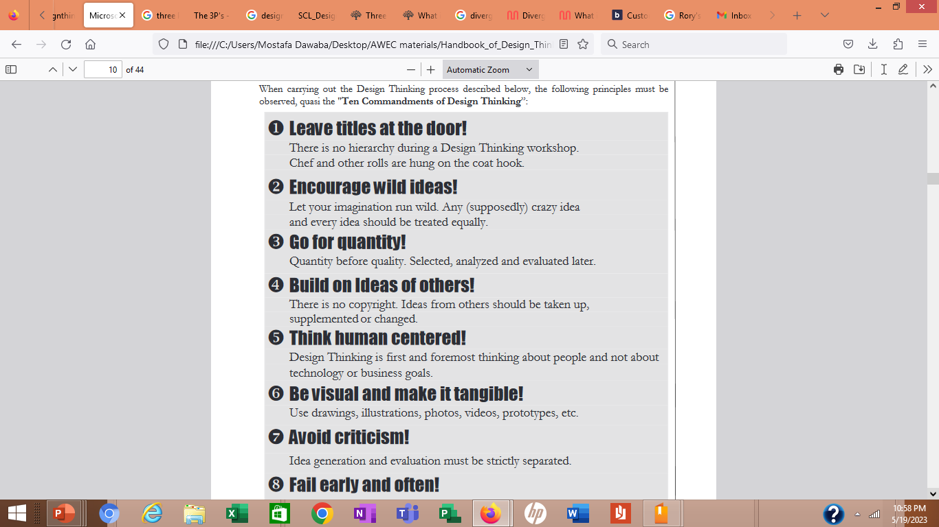
1-
Principles of Design Thinking
v

Slide 5
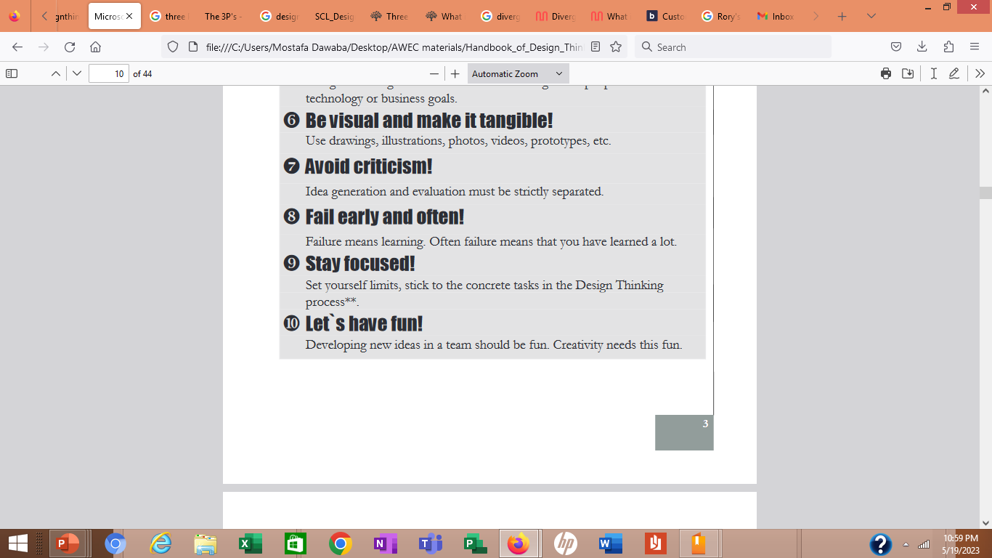
1-
Principles of Design Thinking
v

Slide 6
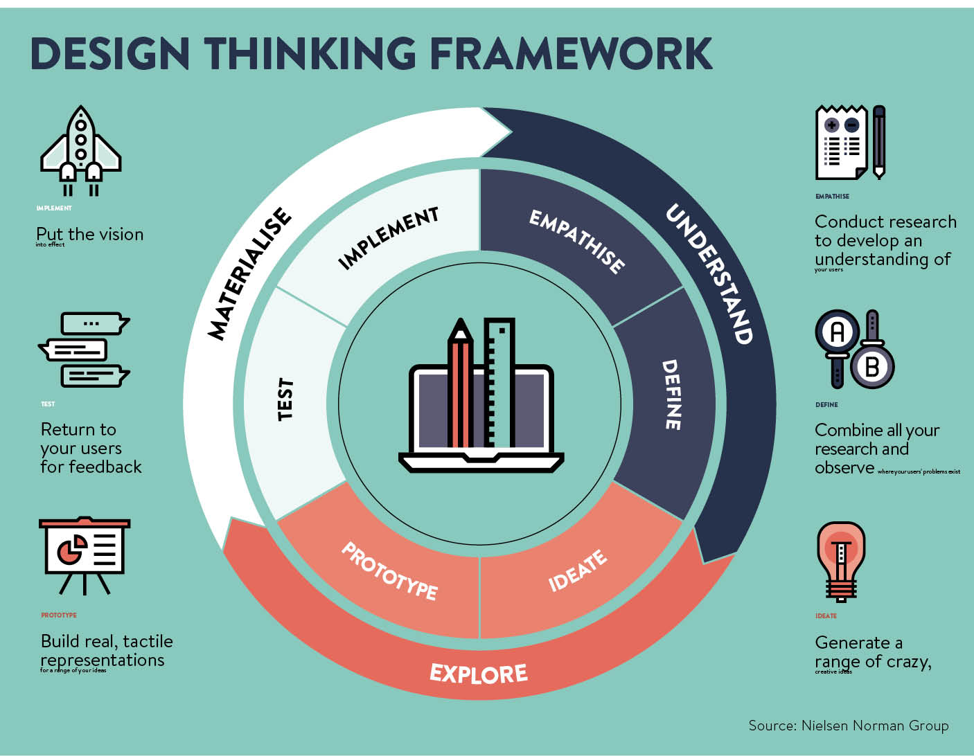
The Process of Design Thinking
2-
v

Slide 7
The Process of Design Thinking
2-
v
Even if the following process representation is shown sequentially, the process is strongly iterative, i.e.
there are numerous feedbacks to the previous phases in each phase.
The individual process steps should be completed quickly in order to learn fast through iteration loops according to the "fail early and often" principle or, if necessary, to be able to terminate the process completely.

Slide 8
The Process of Design Thinking
2-
v
Even if the following process representation is shown sequentially, the process is strongly iterative, i.e.
there are numerous feedbacks to the previous phases in each phase.
The individual process steps should be completed quickly in order to learn fast through iteration loops according to the "fail early and often" principle or, if necessary, to be able to terminate the process completely.
It is helpful to define concrete time budgets for the individual phases (in agile project management, this is referred to as Timeboxing)

Slide 9

Problem
Understand
Problem
Observing
Problem
Defining Problems

Slide 10
Problem
Understand
Problem
Observing
Problem
Defining Problems
Solution
Solution
Finding Ideas
Developing Prototype
Solution
Testing

Slide 11
Problem Space
Problem
Understand
Problem
Observing
Problem
Defining Problems
Solution
Solution
Finding Ideas
Developing Prototype
Solution
Testing
Problem space
Solution space

Slide 12
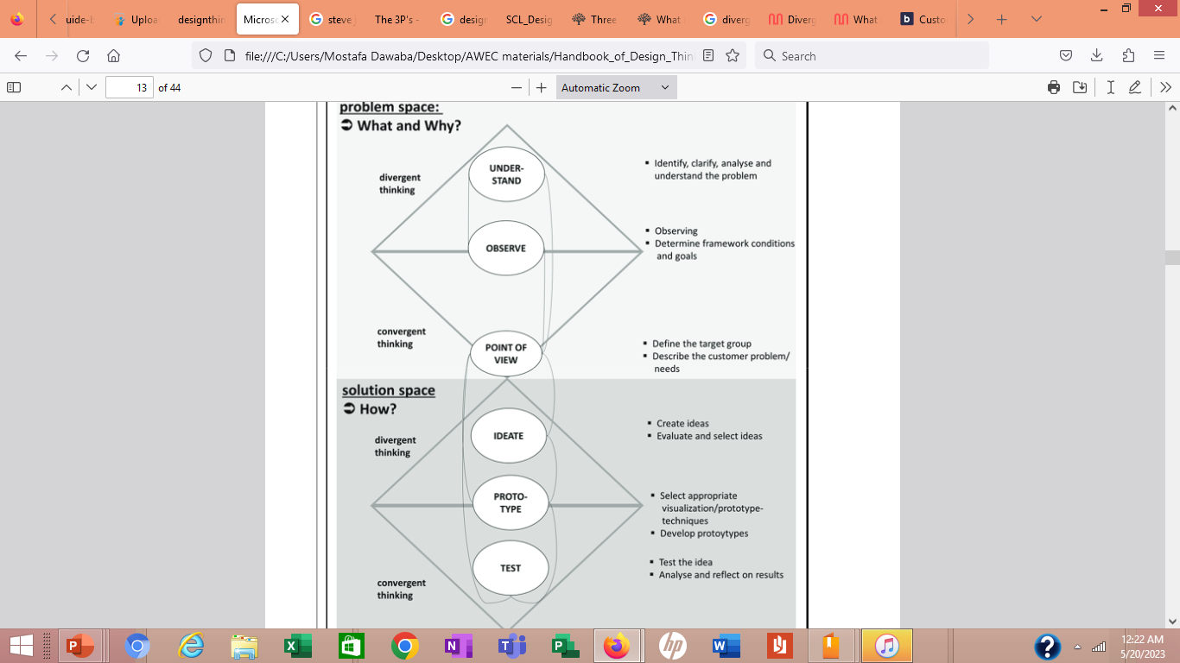

Slide 14
Design Thinking Phases
3-
v
Phase 1 “Understand“ (Understanding the Problem):
In the first phase it is first about developing an understanding for the challenge/the problem/the need or the requirement (problem understanding). It must be clarified who must be integrated into the process and which technical perspective (process organization) is necessary Finally, it must be clarified how the question can best be formulated so that the customer need/problem is defined in concrete terms.

Slide 15
Design Thinking Phases
3-
v
Phase 1 “Understand“ (Understanding the Problem):
In the first phase it is first about developing an understanding for the challenge/the problem/the need or the requirement (problem understanding). It must be clarified who must be integrated into the process and which technical perspective (process organization) is necessary Finally, it must be clarified how the question can best be formulated so that the customer need/problem is defined in concrete terms.
Phase 2 “Observe“:
In this phase, detailed research and on-site observations are carried out on the customer’s need/problem. Numerous methods can be used for this, such as interviews, written surveys, observations with recordings through photos or even videos. The results are the clarification of the general conditions, the exact definition of the target group and a comprehensive understanding of the customer and his needs and behaviors

Slide 16
Design Thinking Phases
3-
v
Phase 3 “Point-of-View“ (Define the problem):
After the observations, the findings should next be condensed to a single prototypical user whose problem/need is to be summarized in a clearly defined question.

Slide 17
Design Thinking Phases
3-
v
Phase 3 “Point-of-View“ (Define the problem):
After the observations, the findings should next be condensed to a single prototypical user whose problem/need is to be summarized in a clearly defined question.
Phase 4 “Ideate“ (Finding and selecting ideas):
It is only in this phase that the actual brainstorming process takes place. Here the creativity techniques can be used. Strictly separated from this, the ideas can then be analyzed in a customer-oriented manner in order to identify weak points, and a selection decision can be made on
the basis of an idea evaluation.

Slide 18
Design Thinking Phases
3-
v
Phase 5 „Prototype“ (Develop the prototype):
In this very important phase, ideas should be visualized as quickly as possible, made tangible, sketched, designed, modelled/simulated, etc. Following the technical field one can speak here of "Rapid Prototyping", whereby the prototype development applies decidedly not only to products, but also to services. A variety of methods for prototype development are available for this purpose.
.

Slide 19
Design Thinking Phases
3-
v
Phase 5 „Prototype“ (Develop the prototype):
In this very important phase, ideas should be visualized as quickly as possible, made tangible, sketched, designed, modelled/simulated, etc. Following the technical field one can speak here of "Rapid Prototyping", whereby the prototype development applies decidedly not only to products, but also to services. A variety of methods for prototype development are available for this purpose.
Phase 6 “Test“:
In this final phase, the ideas are to be further developed and tested through further experiments and customer feedback. In addition, important development, production and market issues have to be clarified.
In the process flow presented here, the actual implementation phase with the development of the idea to a marketable product/service would only follow afterwards.

Slide 20
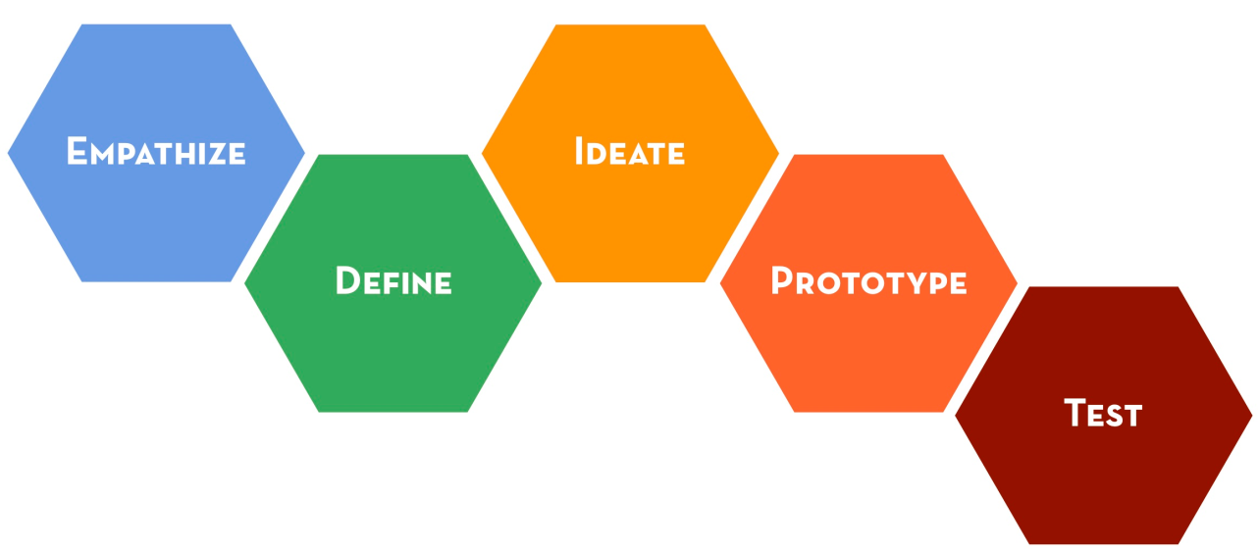
The design thinking process
The design thinking process basically involves five steps
Note: this is not a ‘waterfall’ model – this is an iterative and parallel process
Image from http://joeyaquino.wordpress.com/2012/05/23/want-a-crash-course-in-stanfords-design-thinking-here-it-is-for-free-pt-1-empathy/

Slide 21
Empathising
In order to empathise, we need to understand our users
  We need to research our market
Some of this can be done through web research, e.g. scaling the problem, gaining a foothold understanding of how users operate
However the real empathising starts in the context of ongoing dialogue with potential users
  ‘Why-bombing’
The ideal outcomes from this stage are surprises

Slide 22
Empathising
This leaves us with two key dimensions
Reading cases, forums, reviews, etc.
Market statistics and competitor analyses
Existing information
Interviews
Surveys
New information
Detailed view of users
Birds’ eye view of users

Slide 23
Empathising
This leaves us with two key dimensions
These are complimentary (most projects will include them all)
Reading cases, forums, reviews, etc.
Market statistics and competitor analyses
Existing information
Here you are trying to figure out the right questions – use observations and ‘why’ bombing
Here you are assuming you know the right questions to ask
Interviews
Surveys
New information
Detailed view of users
Birds’ eye view of users

Slide 24
Defining
List pain points, i.e. things that users complain about
List workarounds and awkward behaviours
Formalise these into a problem statement.
  This statement should:
    Make it clear whom the user is
    Aggregate smaller concerns into one larger issue
  This statement should NOT:
    Narrow the problem down in a way that lends itself towards specific solutions

Slide 25
Ideating
This stage is where your opportunity to flex your creative muscles comes in
Quantity is your friend! If you are struggling to come up with 20-30 ideas, then your problem statement was too restrictive
Abandon judgement – no idea is a bad idea as long as it fits with the needs identified in your problem statement
Visualise things! Get a pen and paper out (or whatever medium you find comfortable) and draw pictures, bubble-diagrams, etc.
  You can be surprised what jumps out when you can see what you’re thinking

Slide 26
Prototyping
Prototypes consist of anything from paper-based representations to fully functional websites
It allows three things
  You can figure out if and how your idea can be implemented
  It gives you a way of discussing things with users in a shared language, i.e. “is this what you meant?”
  Ideas can be tested with users
Types of Prototyping
  Low-Fidelity Prototyping
  High-Fidelity Prototyping

Slide 27
Testing
Testing serves two purposes
  To evaluate ideas
  To generate new ideas from users
With this in mind, a few tips:
  Test with users that are representative and appropriately critical
  Try to minimise users’ nerves/sense that they are being observed
  Prioritise key tasks (you can’t test everything)
  Present your task instructions in as natural a way as possible (but take care not to prompt people with these instructions)
  If users can’t do something, remind them it’s not their fault and that this is valuable to you
  Other than that, stay quiet!

Slide 28
How to plan a Design Thinking project
First, the goals for the Design Thinking project are to be defined derived from the company/innovation strategy and the expectations of all participants are to be clarified:
-- Should new ideas be found? If so, for what or for which search field
--Should concrete customer needs and/or certain patterns or trends be found among the customers in a specific subject area?
--Which goal is to be achieved by when?
--Which priorities are to be set in terms of content and time for the achievement of the goal?

Slide 29
How to plan a Design Thinking project
First, the goals for the Design Thinking project are to be defined derived from the company/innovation strategy and the expectations of all participants are to be clarified:
-- Should new ideas be found? If so, for what or for which search field
--Should concrete customer needs and/or certain patterns or trends be found among the customers in a specific subject area?
--Which goal is to be achieved by when?
--Which priorities are to be set in terms of content and time for the achievement of the goal?
--Which employees or which external participants (experts from practice and research, customers, suppliers, external parties from outside the industry) are to be involved from which areas/disciplines?
--Who will be responsible for project management or moderation?
--Where are the interfaces between the required disciplines?
--Which project budget is available for Design Thinking?

Slide 30
How to plan a Design Thinking project
Design Thinking is carried out as a project that involves internal staff as well as external participants from different disciplines.
The project team should consist of six to a maximum of
nine representatives from different areas (R&D, production, marketing and sales)

Slide 31
How to plan a Design Thinking project
Design Thinking is carried out as a project that involves internal staff as well as external participants from different disciplines.
The project team should consist of six to a maximum of
nine representatives from different areas (R&D, production, marketing and sales) or disciplines who contribute at least 50% of their working time (and are open to external ideas).
Different experience horizons and characters are also helpful to get the diversity necessary for Design Thinking

Slide 32
How to plan a Design Thinking project
The internal support in the company for the later implementation of the results from Design Thinking. The support of top management, which can be a decisive success factor, is also very helpful here.

Slide 33
How to plan a Design Thinking project
The internal support in the company for the later implementation of the results from Design Thinking. The support of top management, which can be a decisive success factor, is also very helpful here. The support can be seen concretely in the following activities:
Adequate resources for the project
If applicable, taking over patronage for the Design Thinking project
Desire for continuous reporting on the progress of the project
permanent internal and external communication about the strategic importance of DT
Member of the steering committee, if any
Personal participation in workshops
Recognition of the employees involved

Slide 34
Example 1: An MRI for Children
Designers at GE had designed a MRI machine for internally scanning patients for tissue damage, tumours, etc.
Some of these machines were for paediatrics wards (children)
Children found the machines terrifying, yet the scan only works if you hold completely still inside them

Slide 35
Example 1: An MRI for Children
Designers at GE had designed a MRI machine for internally scanning patients for tissue damage, tumours, etc.
Some of these machines were for paediatrics wards (children)
Children found the machines terrifying, yet the scan only works if you hold completely still inside them
  Up to 80% of children had to be sedated
The designers adopted a design thinking approach to try and understand the children’s journey, their feelings, and how they were building negative feelings
  Huge drop in sedation, huge increase in satisfaction

Slide 36
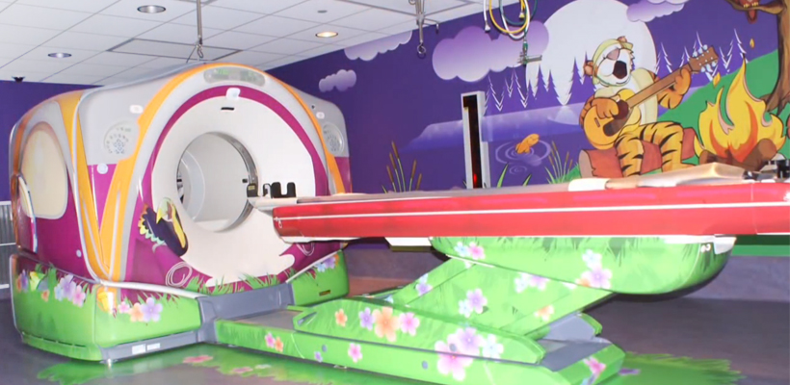
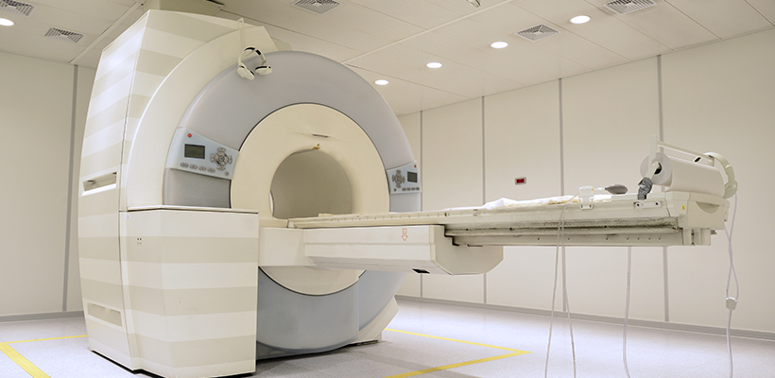
Example 1: An MRI for Children
Images from http://blog2.architech.ca/h/i/124542383-ge-transforms-mri-experience-with-design-thinking

Slide 37

Example 2: Radically Low-Cost Incubation
Image from http://leadershiplearning.org/blog/natalia-castaneda/2010-11-30/learning-and-having-fun-design-thinking

Slide 38
Conclusion:
problem-solving isn’t “one size fits all”
Overall, Design Thinking is a very comprehensive, user-oriented approach that systematically applies methods for observation, questioning and brainstorming as well as other moderation techniques in the individual phases in a process with numerous iteration loops

Slide 39
In This Lecture: Design Thinking
Wrap Up
v
Principles of Design Thinking
The process of Design Thinking
The Problem space- The solution space
The Design Thinking phases
How to plan a Design Thinking project
Examples of Design solutions using DT
Process
Problem Space
Solution Space

Slide 40


Thank You

