Slide 1


Principles of Accounting
Lecture 4
Prepared by:
Dr. Rasha B. AL Jerd
Subject code: MGM 227

Slide 2



Principles of
Accounting
MGM 227
Chapter 2:
Recording Business Transactions
Prepared by:
Dr. Rasha B. AL Jerd

Slide 3
Learning objectives:
1) Explain accounts as they relate to the accounting equation and describe common accounts.
2) Define debits, credits, and normal account balances using double-entry accounting and T-accounts.
3) Record transactions in a journal and post journal
entries to the ledger.
4) Prepare the trial balance and illustrate how to use the trial balance to prepare financial statements.
5) Use the debt ratio to evaluate business performance.

Slide 4


Slide 5
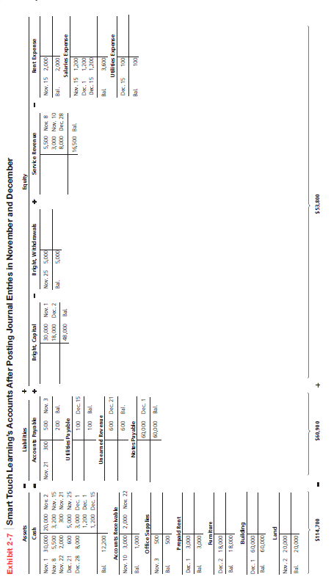


Slide 10
4
Prepare the trial balance and illustrate how to use the trial balance to prepare financial statements

Slide 11
What is The Trial Balance?
After the transactions are recorded in the journal and then posted to the ledger, a trial balance can be prepared. The trial balance summarizes the ledger by listing all the accounts with their balances—assets first, followed by liabilities, and then equity. trial balance is a useful summary of the accounts and their balances because it shows the balances on a specific date for all accounts in a company’s accounting system. Exhibit 2-10 is the trial balance of Smart Touch Learning at December 31, 2014.

Slide 12


Slide 16
5
Use the debt ratio to evaluate business performance

Slide 17
How DO you use The DEBT Ratio to Evaluate
Business Performance?
Previously you learned that evaluating a company’s return on assets (Net income / Average total assets) can help in determining how well a company is performing. In this chapter, you learn about another tool that can be used when reviewing financial statements. The debt ratio shows the proportion of assets financed with debt and is calculated by dividing total liabilities by total assets. It can be used to evaluate a business’s ability to pay its debts.

Slide 30

Demonstration of E2-16 & E2-17
The following transactions occurred for Mission Cable Services.
July 2 | Received $20,000 contribution from Thomas in exchange for Common Stock
4 | Paid utilities expense of $800.
5 | Purchased equipment on account, $4,200.
10 | Performed services for a client on account, $4,000.
12 | Borrowed $14,000 cash, signing a notes payable.
19 | Cash dividends of $1,000 were paid to stockholders.
21 | Purchased office supplies for $1,600 and paid cash.
27 | Paid the liability from July 5.
Requirements
E2-16. E2-17. | Journalize the transactions of Mission Cable Services. Include an explanation. 1. Open T-accounts for Mission Cable Services. 2. Compute the July 31 balance for each account.

Slide 31

Demonstration of E2-16 & E2-17-Req. 1
July 2 Received $20,000 contribution from Thomas in exchange for common stock.
Date | Accounts and Explanation | Debit | Credit
Jul. 2 | Cash | 20,000
 | Common Stock |  | 20,000
 | Issued common stock in exchange for cash.
Cash
Jul. 2 | 20,000
Common Stock
 |  | 20,000 | Jul. 2

Slide 32

Demonstration of E2-16 & E2-17-Req. 1
July 4 Paid utilities expense of $800.
Date | Accounts and Explanation | Debit | Credit
Jul. 4 | Utilities Expense | 800
 | Cash |  | 800
 | Paid utility expense.
Cash
Jul. 2 | 20,000 | 800 | Jul. 4
Utilities Expense
Jul. 4 | 800

Slide 33
Demonstration of E2-16 & E2-17-Req. 1
July 5 Purchased equipment on account, $4,200.
Date | Accounts and Explanation | Debit | Credit
Jul. 5 | Equipment | 4,200
 | Accounts Payable |  | 4,200
 | Purchased equipment on account.
Equipment
Jul. 5 | 4,200
Accounts Payable
 |  | 4,200 | Jul. 5

Slide 34

Demonstration of E2-16 & E2-17-Req. 1
July 10 Performed services for a client on account, $4,000.
Date | Accounts and Explanation | Debit | Credit
Jul. 10 | Accounts Receivable | 4,000
 | Service Revenue |  | 4,000
 | Performed services for client on account.
Accounts Receivable
Jul. 10 | 4,000
Service Revenue
 |  | 4,000 | Jul. 10

Slide 35

Demonstration of E2-16 & E2-17-Req. 1
July 12 Borrowed $14,000 cash, signing a notes payable.
Date | Accounts and Explanation | Debit | Credit
Jul. 12 | Cash | 14,000
 | Notes Payable |  | 14,000
 | Borrowed cash by signing note.
Cash
Jul. 2 | 20,000 | 800 | Jul. 4
12 | 14,000
Notes Payable
 |  | 14,000 | Jul. 12

Slide 36

Demonstration of E2-16 & E2-17-Req. 1
July 19 Cash dividends of $1,000 were paid to stockholders.
Date | Accounts and Explanation | Debit | Credit
Jul. 19 | Dividends | 1,000
 | Cash |  | 1,000
 | Paid cash dividends.
Cash
Jul. 2 | 20,000 | 800 | Jul. 4
12 | 14,000 | 1,000 | 19
Dividends
Jul. 19 | 1,000

Slide 37
Demonstration of E2-16 & E2-17-Req. 1
July 21 Purchased office supplies for $1,600 and paid cash.
Date | Accounts and Explanation | Debit | Credit
Jul. 21 | Office Supplies | 1,600
 | Cash |  | 1,600
 | Purchased office supplies with cash.
Cash
Jul. 2 | 20,000 | 800 | Jul. 4
12 | 14,000 | 1,000 | 19
 |  | 1,600 | 21
Office Supplies
Jul. 21 | 1,600

Slide 38
Demonstration of E2-16 & E2-17-Req. 1
July 27 Paid the liability from July 5.
Date | Accounts and Explanation | Debit | Credit
Jul. 21 | Accounts Payable | 4,200
 | Cash |  | 4,200
 | Paid cash on account.
Cash
Jul. 2 | 20,000 | 800 | Jul. 4
12 | 14,000 | 1,000 | 19
 |  | 1,600 | 21
 |  | 4,200 | 27
Accounts Payable
Jul. 27 | 4,200 | 4,200 | Jul. 5

Slide 39
Demonstration of E2-17-Req. 2
Cash
Jul. 2 | 20,000 | 800 | Jul. 4
12 | 14,000 | 1,000 | 19
 |  | 1,600 | 21
 |  | 4,200 | 27
Bal. | 26,400
Accounts Receivable
Jul. 10 | 4,000
Bal. | 4,000
Office Supplies
Jul. 21 | 1,600
Bal. | 1,600
Equipment
Jul. 5 | 4,200
Bal. | 4,200

Slide 40

Demonstration of E2-17-Req. 2
Accounts Payable
Jul. 27 | 4,200 | 4,200 | Jul. 5
 |  | 0 | Bal.
Notes Payable
 |  | 14,000 | Jul.12
 |  | 14,000 | Bal.
Common Stock
 |  | 20,000 | Jul. 2
 |  | 20,000 | Bal.
Dividends
Jul. 19 | 1,000
Bal. | 1,000

Slide 41


Demonstration of E2-17-Req. 2
Service Revenue
 |  | 4,000 | Jul.10
 |  | 4,000 | Bal.
Utilities Expense
Jul. 4 | 800
Bal. | 800

Slide 42



Thank You

