Slide 1




Social Media and Crises
Lecture 5
DGM 730
Creating the Right Tone of Communication
Prepared by
Dr. Doaa Rady

Slide 2

Lecture
05
Lecture outline
Creating the right tone of communication
Creating socially acceptable behavior
    Acceptable use policies (AUPs)
Factors to Consider Before Posting
Creating Social Media Messages
Creating a plan
    Crisis Communications plan
Activate your social media plan
سياسات الاستخدام المقبولة

Slide 3


بيومي فؤاد ومحمد سلام
Case Study

Slide 4

Lecture
04
Case Study

Slide 5

Lecture
04
Case Study

Slide 6

Lecture
04
Case Study

Slide 7

Lecture
04
Case Study

Slide 8

Lecture
04
Case Study

Slide 9

Lecture
04
Case Study

Slide 10
KFC Crisis
Case Study

Slide 11
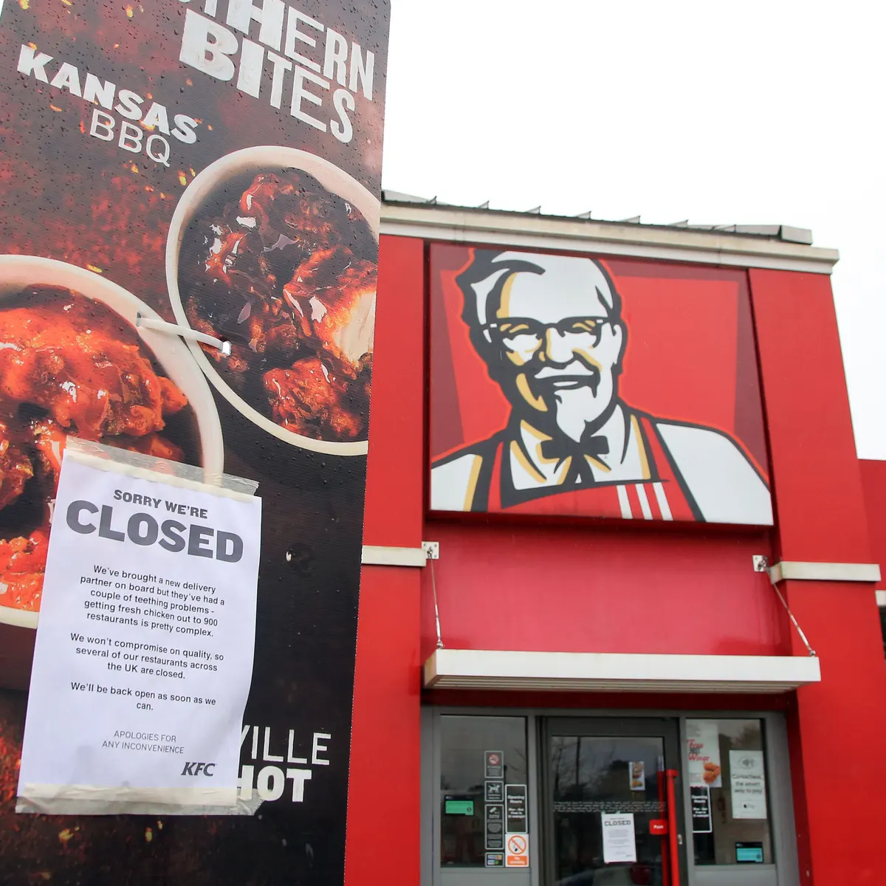
Lecture
04
Case Study
https://changemanagementinsight.com/kfc-crisis-management-case-study/

Slide 12

Creating socially
acceptable behavior

Slide 13
Lecture
05
Acceptable use policies (AUPs)
Acceptable use policies (AUPs) to manage social media use
Developing an AUP to cover social media
Start by expanding your company's existing acceptable use policies governing email and web communications
Clearly specify what is acceptable and what is inappropriate to post to social media sites
State what can be posted during business hours and outside of business hours (if indeed there is any difference). Where there is no differentiation, clearly state this in the policy
Let staff know that messages posted to social media sites will be monitored. This is vital

Slide 14
Lecture
05
Acceptable use policies (AUPs)
Acceptable use policies (AUPs) to manage social media use
Developing an AUP to cover social media
Review all privacy settings on social media sites that contain your corporate profile. Educate staff about privacy settings too. Opting for minimal settings can expose your network to malware directed at popular social media sites
Consider developing multiple AUPs for globally distributed staff, to cater for the laws of different countries
Once you have taken these first steps, technology then can be used to remind employees of their responsibilities to protect company reputation and information. Rulesets within your email and web content management can then be used to enforce the social media AUP

Slide 15
Lecture
05
Acceptable use policies (AUPs)
Acceptable use policies (AUPs) to manage social media use
Basic content filters that can be used to enforce your social media policies include:
Preventing the posting of inappropriate language or brand names to social media sites
Preventing inappropriate images from being posted
Blocking of incoming or outgoing file types over social media (e.g. Excel spreadsheets and databases)
Blocking access to dangerous websites, such as gambling sites, that are known to be hosting malware
Dividing websites into work-related and non work-related sites, to track usage
Dividing social media access by job description, to manage non work-related usage
منع نشر لغة أو أسماء تجارية غير لائقة على مواقع التواصل الاجتماعي

Slide 16
Lecture
05
Acceptable use policies (AUPs)
Acceptable use policies (AUPs) to manage social media use
Basic content filters that can be used to enforce your social media policies include:
Applying social media controls, such as read only rules on the corporate Facebook account, depending on employees' roles. Look for social network controls that can be set by network
Enforce AUP by allowing timed access to social media sites during working hours, to maintain productivity
Enforce AUP by allowing timed access to non-work related sites and webmail during lunch breaks, before 9am and after 5pm
Limit the installation of plug-ins such as games on social network sites, as these can impact productivity and network security. Look for social network controls that can be set by network
Read-only operations are all actions an end user might take that do not change application state in a meaningful way.
فرض سياسة الاستخدام المقبول (AUP) من خلال السماح بالوصول المحدد لمواقع التواصل الاجتماعي أثناء ساعات العمل، للحفاظ على الإنتاجية

Slide 17
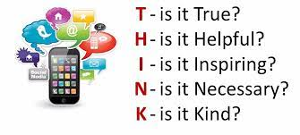
Factors to Consider Before Posting

Slide 18
Lecture
05
Factors to Consider Before Posting
Factors to consider before posting
  1. Identify the message goal
It is counterproductive نتائج عكسية to create social media messages that do not have a specific goal. Furthermore, social media message goals should reflect the organization’s overall mission. Message goals can include increasing brand awareness, creating a favorable perception of an organization, and convincing the audience to buy a product. The goal should be clearly articulated مفصلا بوضوح in the content. Also, select the social media platform that would be the most effective in accomplishing the message goal. Each social media tool has specific characteristics and audiences, which will affect whether the message goals are achieved.

Slide 19
Lecture
05
Factors to Consider Before Posting
Factors to consider before posting
  2. Identify the target audience
Similar to public relations writing, social media messages need to be targeted. After identifying the key audience, examine what they’re talking about: their interests, attitudes, and beliefs.
Social media content should reflect audience analysis research findings. As you tailor the content of the message to this audience, do not exaggerate attempts to be interesting or relevant. Because social media messages are audience centered, they’re not necessarily grounded in what you personally think is appealing.
The lack of attention to audience analysis can have serious consequences.

Slide 20
Lecture
05
Factors to Consider Before Posting
Factors to consider before posting
  3. Identify the organization’s social media approach
Communication choices should reflect organizational strategies. Wilson et al. (2011) identified four general ways in which companies use social media. They are determined by the “company’s tolerance for uncertain outcomes and the level of results sought”.
The “predictive practitioner” approach uses caution when sending out social media messages. Instead of launching a social media strategy that involves all departments in a company, only a specific department (example: marketing or human resources) uses its social media platforms. This allows more control of social media messaging and guarantees some level of certainty in accomplishing the stated objectives.
يستخدم نهج "الممارس التنبئي" الحذر عند إرسال رسائل وسائل التواصل الاجتماعي. يستخدم قسم معين فقط (على سبيل المثال: التسويق أو الموارد البشرية) منصات وسائل التواصل الاجتماعي الخاصة بها. وهذا يسمح بمزيد من التحكم في رسائل وسائل التواصل الاجتماعي ويضمن مستوى معينًا من اليقين في تحقيق الأهداف المعلنة.

Slide 21
Lecture
05
Factors to Consider Before Posting
Factors to consider before posting
  3. Identify the organization’s social media approach (Cont’d)
The “creative experimenter” approach accepts uncertainty and deploys small social media “experiments” to learn and improve overall business functions. Sometimes, businesses will take to Facebook or Twitter to receive feedback on products or business practices from internal (example: employees) or external (example: customers) audiences. The overall goal is to listen and learn from interactions; therefore, unpredictable results are accepted.
يقبل نهج "المجرب الإبداعي" عدم اليقين وينشر "تجارب" صغيرة على وسائل التواصل الاجتماعي لتعلم وتحسين وظائف العمل بشكل عام. في بعض الأحيان، تلجأ الشركات إلى Facebook أو Twitter لتلقي تعليقات حول المنتجات أو الممارسات التجارية من الجماهير الداخلية (على سبيل المثال: الموظفين) أو الجماهير الخارجية (على سبيل المثال: العملاء). الهدف العام هو الاستماع والتعلم من التفاعلات. ولذلك، يتم قبول النتائج غير المتوقعة.

Slide 22
Lecture
05
Factors to Consider Before Posting
Factors to consider before posting
  3. Identify the organization’s social media approach (Cont’d)
The “social media champion” approach takes strategies to a more advanced level. A designated team is in charge of the organization’s overall social media presence. The team also creates an official social media policy and guidelines for the organization. Larger social media projects typically use this strategy. Unlike the predictive practitioner strategy, this approach does not confine social media use to a particular department and considers social media messages across various functions.
يأخذ نهج "بطل وسائل التواصل الاجتماعي" الاستراتيجيات إلى مستوى أكثر تقدمًا. يتولى فريق معين مسؤولية التواجد الشامل للمنظمة على وسائل التواصل الاجتماعي. يقوم الفريق أيضًا بإنشاء سياسة وإرشادات رسمية لوسائل التواصل الاجتماعي للمنظمة. عادةً ما تستخدم مشاريع الوسائط الاجتماعية الأكبر حجمًا هذه الإستراتيجية. على عكس استراتيجية الممارس التنبؤية، لا يحصر هذا النهج استخدام وسائل التواصل الاجتماعي في قسم معين ويأخذ في الاعتبار رسائل وسائل التواصل الاجتماعي عبر وظائف مختلفة.

Slide 23
Lecture
05
Factors to Consider Before Posting
Factors to consider before posting
  3. Identify the organization’s social media approach (Cont’d)
The “social media transformer” strategy targets both internal and external audiences by launching large-scale projects that involve multiple departments. As with the social media champion approach, a team is devoted to planning, creating, and launching the organization’s social media projects. However, these projects are usually larger and more advanced than those using the social media champion approach. This strategy specifically considers how social media can influence business strategy, brand, and culture.
Organizations can use multiple approaches when designing a social media message. What is important is that they carefully consider their approach before posting any content to social media platforms.
تستهدف استراتيجية "محول وسائل التواصل الاجتماعي" كلا من الجماهير الداخلية والخارجية من خلال إطلاق مشاريع واسعة النطاق تشمل أقسامًا متعددة. كما هو الحال مع نهج بطل وسائل التواصل الاجتماعي. ومع ذلك، عادة ما تكون هذه المشاريع أكبر وأكثر تقدمًا من تلك التي تستخدم نهج بطل وسائل التواصل الاجتماعي. تأخذ هذه الإستراتيجية على وجه التحديد في كيفية تأثير وسائل التواصل الاجتماعي على استراتيجية العمل والعلامة التجارية والثقافة.

Slide 24
Lecture
04
Case Study
Heinz Influencer Marketing

Slide 25
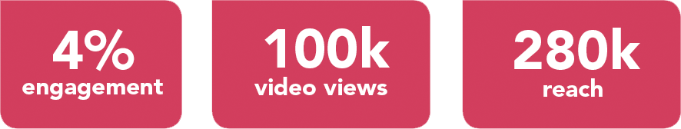
Lecture
04
Case Study
Heinz Influencer Marketing
Heinz aimed to create an online buzz, spark social conversations and talk-ability that Heinz has finally combined two of the nation’s best-loved sauces in Ketchup and Mayonnaise, to create the mouthwatering Saucy Sauce.
As part of the campaign, each influencer was asked to re-create a variety of their favourite food dishes in which they had to include Saucy Sauce. The content had to include key messages – but also be fun and engaging – whilst also delivering the overarching message that the launch of Saucy Sauce is bringing the nation what they have been waiting for.
This content was then shared across Instagram and Instagram Stories and during the campaign, the influencers were also tasked with engaging and interacting directly with their followers to help spark further social conversations.
Overall the social media content reached an audience of more than 280,000, with more than 100,000 video views and an average campaign engagement rate of 4%.
The campaign also sparked viral follower interaction around Saucy Sauce.

Slide 26

Creating Social Media Messages

Slide 27
Lecture
05
Creating Social Media Messages
Creating social media messages
The goal of creating social media messages is not only to reach your audience, but also to achieve an intended effect.
Proper grammar and punctuation are important in social media writing, as is accuracy.
A careless error could undermine the credibility of your brand. Here are a few other factors to consider when creating social media messages.
  Engagement, engagement, engagement
  Consistency
  Concise writing

Slide 28
Lecture
05
Creating social media messages
Engagement, engagement, engagement
More than many forms of communication, social media messages need to motivate the audience to engage with the content. Several strategies can encourage engagement, such as responding quickly to feedback from audience members, creating contests مسابقات, and inviting the audience to respond to a question. Including photos and videos in social media posts substantially increases engagement, as does integrating trending topics.
This requires careful consideration and research that will pay off if the trending hashtags are chosen wisely.
Hai Poke, a startup restaurant in Columbus, did this by tapping into the Pokemon Go craze in the summer of 2016. The restaurant launched a social media contest and created a fun, timely, interactive message.

Slide 29

Lecture
05
Creating social media messages
“Poké” social media campaign image from Hai Poké’s Facebook page.

Slide 30
Lecture
05
Creating social media messages
Consistency
The core message needs to be articulated across all social media platforms in a consistent way that conveys a unified voice صوت موحد.
The message also needs to reflect the brand image; in other words, it should reinforce the brand “feel” or personality.

Slide 31
Lecture
05
Creating social media messages
Concise writing
Similar to news writing, social media writing is straightforward. Because you’re competing against countless other messages in the social media sphere, you do not have much time and space to capture the audience’s attention.
This is especially the case with Twitter, with its current 140-character limit. You have to think carefully not only about what the message will say but how to say it in a concise manner that has the intended effect.

Slide 32
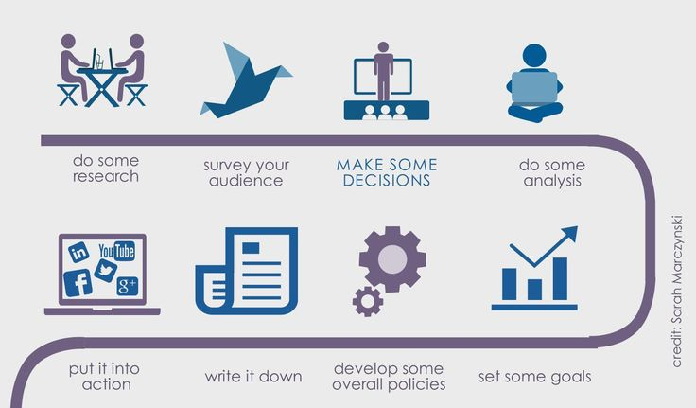
Creating a plan

Slide 33
Lecture
05
Crisis Communications Plan
Develop an Integrated Crisis Communications Plan
Create a crisis communications team
Be prepared for different crisis scenarios
Develop your crisis assessment criteria
List communication and notification steps
Determine account access, policies and procedures
Get team and leadership buy-in for your plan

Slide 34
Lecture
05
Crisis Communications Plan
Develop an Integrated Crisis Communications Plan
Create a crisis communications team
Crisis communications team leader (CCTL): Responsible for coordinating the team’s response, overseeing message development, scheduling crisis communications team meetings and facilitating approvals with senior leadership. This may be a senior communications leader within your organization.
Crisis communications coordinator (CCC): In the event of a larger crisis, this person will assist the CCTL with prioritizing the team’s responsibilities and project managing a response. They will liaise with all of the communications team leaders: social, PR, internal communication, investor relations, customer marketing, etc. This may be a communications manager from any discipline or your social team lead.

Slide 35
Lecture
05
Crisis Communications Plan
Develop an Integrated Crisis Communications Plan
Create a crisis communications team (Cont’d)
Final approver: This person is a high-ranking executive هو مسؤول تنفيذي رفيع المستوى and will provide final approval on all publicly disseminated information. They will also act as a spokesperson when necessary, whether in media statements or social content that’s part of your response.
Legal counsel: This team member’s role is straightforward—they provide legal advice on communication strategies and the business impact of a given situation, and they approve formal company statements and/or the company’s messaging.
IT and/or security: This person will coordinate any technology needed to manage the situation and lead the investigation of any physical security issues.
Of course, add other roles or executives from other functions as it applies to your organization. Your plan should include each team member’s name, role, contact information (work and home/personal) and who will serve as a backup if they are unavailable.

Slide 36
Lecture
05
Crisis Communications Plan
Develop an Integrated Crisis Communications Plan
2. Be prepared for different crisis scenarios
It’s impossible to know exactly what crises may come up. The way every company had to handle communications over the last few years differed between industries, locations, products and more.
That’s why it’s beneficial to you and your company to prepare for different potential crisis scenarios.
Identify what types of scenarios might emerge that could adversely impact your business. List the types of events that could cause each type of crisis, as well as the right member of your executive team to help your crisis communications team leader run point.

Slide 37
Lecture
05
Crisis Communications Plan
Develop an Integrated Crisis Communications Plan
2. Be prepared for different crisis scenarios (Cont’d)
Here’s an example of how you might list this information.
Type of crisis: Business reputation
Major product recall, failure or safety issueاستدعاء المنتج الرئيسي أو الفشل أو مشكلة السلامة
Point person الشخص المسئول : CEO, chief product officer or head of product development for that line of business
Leak of confidential informationتسرب معلومات سرية
Point person: CEO or officer responsible for the relevant area of the business
Controversial statements تصريحات مثيرة للجدلby leadership or employee (on social media or elsewhere)
Point person: CEO if C-level; CMO or head of communications otherwise
Offensive social media message رسالة مسيئة على وسائل التواصل الاجتماعي posted from brand account
Point person: CMO or head of communications

Slide 38
Lecture
05
Crisis Communications Plan
Develop an Integrated Crisis Communications Plan
2. Be prepared for different crisis scenarios (Cont’d)
Consider creating templates for social media posts you can use and adjust for each scenario. Speed is everything when it comes to communicating in a crisis. You don’t have to have all the information yet to put out a post that says, “We are currently investigating and will share more information as soon as we know more.” Brands that wait too long to respond to a crisis, or say nothing at all, appear indifferent or as if they have something to hide.
While crisis scenario planning may not be a pleasant exercise, doing it when your business isn’t at risk will give you one less worry in the event of an incident.

Slide 39
Lecture
05
Crisis Communications Plan
Develop an Integrated Crisis Communications Plan
3. Develop your crisis assessment criteriaتطوير معايير تقييم الأزمات الخاصة بك
The first step in managing a crisis is understanding what happened and the severity of the issue. Include a list of crisis levels and characteristics in your plan to help your team quickly ascertain the appropriate level of response when a crisis arises.
You might assign crisis severity levels ranging from level one (something that attracts very little attention) to level five (something that disrupts business and/or is an international news story). With this guidance, you can begin any crisis communications response planning by gathering the following information. This allows your crisis team leader to quickly identify the appropriate level and response.

Slide 40
Lecture
05
Crisis Communications Plan
Develop an Integrated Crisis Communications Plan
3. Develop your crisis assessment criteria (Cont’d)
  What happened and where?
  When did it happen?
  Who is involved?
  How did it happen?
  What is planned in response?
  How many people does this affect?
  How many people are aware?
  An offensive Tweet may only rate a level one and require a smaller team with an appropriately scaled down response—but if social media alerts you to a dangerous product problem or food poisoning cases from one of your restaurants, you might be ringing the four- or five-alarm bell.

Slide 41
Lecture
05
Crisis Communications Plan
Develop an Integrated Crisis Communications Plan
4. List communication and notification steps
  In this section of your plan, lay out what the internal chain of communication looks like when you need to activate your plan. Generally this would begin when a member of your crisis communications team is first informed of a potential crisis. They would notify the crisis communications team leader, and it would continue from there, depending on the type and severity of the crisis.
  This can also include best practices for how the crisis communications team will stay in touch while managing the situation. For example, establish a daily stand-up meeting and create a temporary Slack channel or Meta Workplace Group that you’ll use for real-time communication.

Slide 42
Lecture
05
Crisis Communications Plan
Develop an Integrated Crisis Communications Plan
4. List communication and notification steps (Cont’d)
  Several types of common internal communication :
  Informational communications: These give employees context and insight into what is happening. الاتصالات المعلوماتية: تمنح الموظفين سياقًا ورؤية ثاقبة لما يحدث.
  Actionable communications: These share next steps needed from employees, from reminders to keep information confidential to reaching out to customers.
  الاتصالات القابلة للتنفيذ: تشارك هذه الخطوات التالية المطلوبة من الموظفين، بدءًا من التذكيرات للحفاظ على سرية المعلومات ووصولاً إلى التواصل مع العملاء.
  Status update: These give employees an ongoing debrief on what is happening, as the situation unfolds.
  تحديث الحالة: يمنح هذا للموظفين استخلاصًا مستمرًا لما يحدث، مع تطور الوضع.
  Having a point person for employees helps keep conversations focused and reduces the risk of people turning to others or share information they shouldn’t.

Slide 43
Lecture
05
Crisis Communications Plan
Develop an Integrated Crisis Communications Plan
5. Determine account access, policies and procedures
  Who has the password to your organization’s Twitter account? What’s the two-step verification code for accessing your Instagram natively? Where do you respond if your main communications channels are compromised?
  As part of your social media governance model, you want to make sure others can securely have access to your core channels if you’re not able to assist. Build a central repository of policies, procedures and other documentation for an extra layer of security. That way you aren’t relying only on somebody’s memory in a high-pressure situation and you aren’t stalled if a team member can’t be reached.

Slide 44
Lecture
05
Crisis Communications Plan
Develop an Integrated Crisis Communications Plan
6. Get team and leadership buy-in for your planاحصل على تأييد الفريق والقيادة لخطتك
  The final step of creating a plan is making sure that the right people are aware and on board for their roles in managing a crisis. Share your plan with your direct manager and determine the best way to share with your organization’s leadership. Provide a window for feedback and, from there, make sure the plan is housed in an easy-to-access digital location like the policies and procedures section of your company’s intranet, central server or Wiki. Finally, review this plan on an annual basis to ensure your protocols and contact information remain up-to-date.

Slide 45

Activate your social media plan

Slide 46
Lecture
05
Activate your social media plan
Activate your social media plan
When it’s time to activate your plan, Remember, you’re prepared for this—which gives you a strong foundation and clear sense of next steps.
Now, your job is to find a resolution and put your audience at ease.
Remain flexible
A social media crisis communications plan, of course, should cover the most crucial steps, but your team should also feel empowered to take actions that best suit the challenge at hand. Just keep all stakeholders in the loop if you deviate from the established plan.
This flexibility extends to how you handle your scheduled social messages. Many brands have their social posts queued several days or weeks in advance to promote an ongoing campaign or to provide a signal boost to evergreen content. When an emergency hits, turn off any scheduled messages. It doesn’t reflect well on a business to share serious information about a product recall, then have a funny Tweet go out an hour later.

Slide 47
Lecture
05
Activate your social media plan
Activate your social media plan
2. Develop a message protocol document
A social media crisis communications plan, of course, should cover the most you work with other communications stakeholders or the rest of your social team to plan your response, an agreed-upon message protocol document will be an invaluable resource.
Focus your social approach on responding to your community’s questions and fostering a sense of connection. Through this approach, you can position your brand as a leader, a pillar of support and source of helpful information—especially for larger, non-brand-specific crises.
This document should outline:
Your brand’s position, stance or formal response
Your brand’s messaging strategy
Approved social media copy to publish
Approved social media messaging or 1:1 responses

Slide 48
Lecture
05
Activate your social media plan
Activate your social media plan
2. Develop a message protocol document
This document should be approved by the crisis communications team leader as well as your company’s legal team as needed. With your message protocol in place, you’ll be ready to communicate with your audience as soon as you get the green light.
Pro tip: Having pre-approved social media copy for FAQs you receive during a crisis—even if a response just includes a snippet of copy and a link to a page that offers more information—is crucial. In Sprout, the Asset Library simplifies collaborative publishing by making all of your pre-approved, go-to answers easy to find.

Slide 49
Lecture
05
Activate your social media plan
Activate your social media plan
3. Set up your social media crisis communications operations
Next, you’ll want to establish your social media management plan and processes. On social, you’ll need to consider several factors:
How you will publish information and which platforms to prioritize
Communications going out on other channels (e.g. customer emails) and timing
How you will manage and respond to inbound messages
What language you will use in outbound communications
Whether you will monitor any specific influencers amid the conversation
How you will assess the situation (at the outset and through the end) and provide insights to the rest of your crisis communications team

Slide 50
Lecture
05
Activate your social media plan
Activate your social media plan
4. Choose the right platforms
Depending on the crisis at hand and the field you’re in, different social platforms may be better for distributing your messages. Know where your core audience is—and it may not just be on the biggest platforms.
The social platforms of choice should also make sense for the situation: a fire at one of your facilities may require immediate notification on Facebook, Instagram and Twitter, whereas a response to an insensitive public comment about an employee might require messaging on LinkedIn and Facebook.

Slide 51
Lecture
05
Activate your social media plan
Activate your social media plan
5. Manage and engage with inbound messagesالرسائل الواردة
Using the message protocol document you’ve developed, you’ll know what types of messages you can and should respond to. But in order to find all of the relevant messages, you’ll also need to be able to surface posts where people aren’t tagging your brand.
To mitigate major issues before or as they arise, have a solid monitoring process in place.
In times of crisis, your brand’s inbound message volume will likely surge. Determine what kinds of tools can help you provide swift and appropriate responses to people reaching out. Consider implementing or updating a social media chatbot to help get your community answers and resources as quickly as possible. Just make sure your chatbot is updated to reflect the current situation and questions being asked.
Considering more than 75% of consumers expect a response from brands in less than 24 hours, speed matters.

Slide 52
Lecture
05
Activate your social media plan
Activate your social media plan
6. Assess big picture insights for company leadership
Use social listening to get a bird’s eye view of the situation, understand the trajectory of the crisis and identify what specific issues are driving negative sentiment.
One of the first things to do is set up a Listening Topic in Sprout or your tool of choice to access insights from aggregate social data. This will enable you to see how fluctuations in the volume of messages and sentiment about the issue, what moments in the social conversation caused inflection points and what specific messaging is or isn’t resonating with your audience.
With social listening, you can quickly export these insights as a report to share with your team and leadership. Doing this at the beginning of a crisis can inform a customer-centric messaging strategy and continuously empower you to adapt as the situation unfolds.

Slide 53
Lecture
05
Activate your social media plan
Activate your social media plan
7. Manage the aftermathإدارة العواقب
Whether you just went through a small hiccup or a major emergency, you should analyze your long-term audience response and the reaction over time on social. A comprehensive report that shows you impressions, shares, comments and sentiment, as well as internal metrics like average response time to critical questions, will help you to measure your success and outline areas for improvement moving forward.
Ideally, you will want to set the dates for what you measure so that you can compare your brand’s baseline performance at a normal time against how data points changed at the beginning, middle and end of a problem.

Slide 54
Lecture
05
Activate your social media plan
Activate your social media plan
7. Manage the aftermath
Major impacts of how a crisis was handled might not show up until much later in the form of decreased revenue or customer loss. But a social savvy organization can track customer sentiment in real time and use analytics to show how well a situation was handled. Remember that your success isn’t just about the numbers—it’s how well you connected with your audience.
After your brand has hopefully mitigated the crisis, you’ll also be able to report on the lifecycle of the situation and how your brand’s response changed the tone of the conversation. These insights will give your crisis communications team information to improve or build on your plan for the future. Just in case.

Slide 55
Lecture
05
Conclusion
Creating the right tone of communication
Creating socially acceptable behavior
    Acceptable use policies (AUPs)
Factors to Consider Before Posting
Creating Social Media Messages
Creating a plan
    Crisis Communications plan
Activate your social media plan

Slide 56
Lecture
05
Recommended Reference
Wedlock, B. C. (2012, May). (dissertation). The diffusion of social media in public relations: Use of social media in crisis response strategies. ProQuest. Retrieved May 2023, from https://www.researchgate.net/publication/295547824_The_Diffusion_of_Social_Media_in_Public_Relations_Use_of_Social_Media_In_Crisis_Response_Strategies.
Ward, C. A. (2011, June). Social Media and Crisis Communication: Are organizations using social media in times of crisis? (dissertation). SOCIAL MEDIA AND CRISIS COMMUNICATION: ARE ORGANIZATIONS USING SOCIAL MEDIA IN TIMES OF CRISIS? Retrieved May 2023, from https://cardinalscholar.bsu.edu/bitstream/handle/123456789/195041/WardC_2011-3_BODY.pdf?sequence=1.
Roberts, J. (n.d.). Creating social media messages. Writing for Strategic Communication Industries. https://ohiostate.pressbooks.pub/stratcommwriting/chapter/creating-social-media-messages/
Roberts, J. (n.d.). crafting-social-media. Writing for Strategic Communication Industries. https://ohiostate.pressbooks.pub/stratcommwriting/chapter/crafting-social-media/
Anstis, B. (2011, January 11). Socially acceptable - enforcing social media policies in the Workplace. HRZone. https://www.hrzone.com/talent/retention/socially-acceptable-enforcing-social-media-policies-in-the-workplace
From crisis to connection: How to build a Social Media Crisis Management strategy. Sprout Social. (2023, May 12). https://sproutsocial.com/insights/guides/social-media-crisis-management/#how-to-use-social-insights-to-inform-decision-making

Slide 57


Thank You

