Slide 1



Project Resources and Time Management
PMG 605
Lecture 9
Progress and Performance Measurement and Evaluation
Prepared by
Dr. Eng. Abdullah Jameel Halawany

Slide 2

Lecture
Session Outline
09
Progress and Performance Measurement and Evaluation
Structure of a Project Monitoring Information System
The Project Control Process
Monitoring Time Performance
Development of an Earned Value Cost/Schedule System
Developing a Status Report
Indexes to Monitor Progress
Forecasting Final Project Cost
9–2

Slide 3
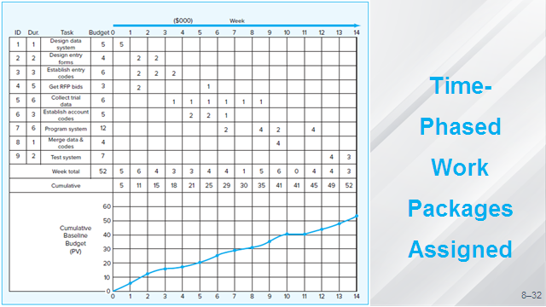
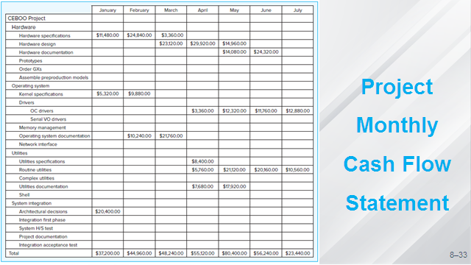
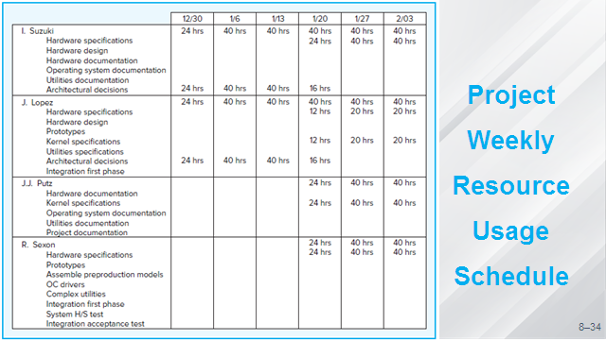
9–3

Slide 4
Lecture
09
Progress and Performance Measurement and Evaluation
Evaluation and control are part of every project manager’s job.
Large projects need some form of formal control.
Control holds people accountable, prevents small problems from escalating into large problems, and keeps focus.
Except for accounting controls, project control is not performed well in most organizations.
Control is one of the most neglected areas of project management.
Unfortunately, it is not uncommon to find resistance to control processes.
For effective control, the project manager needs a single information system to collect data and report progress on cost, schedule, and specifications
9–4

Slide 5
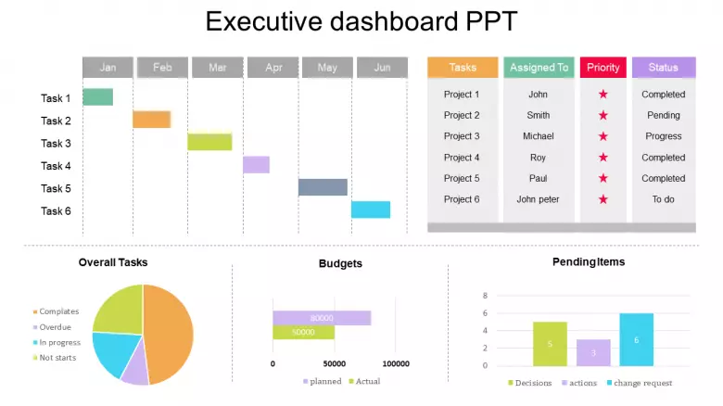
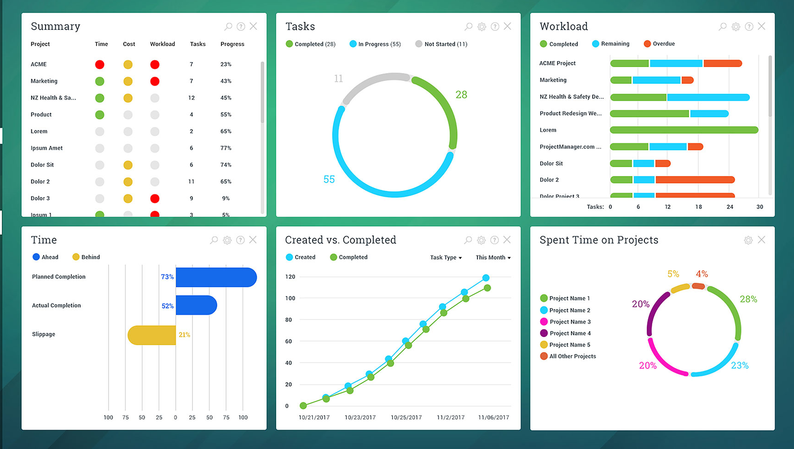
Progress and Performance Measurement and Evaluation
9–5

Slide 6
Structure of a Project Monitoring Information System
Lecture
08
Progress and Performance Measurement and Evaluation
PMG 605
Project Resources and Time Management
9–6

Slide 7
Lecture
09
Structure of a Project Monitoring Information System
Creating a project monitoring system involves determining
  What data to collect
  How, when, and who will collect the data
  How to analyze the data
  How to report current progress to management
9–7

Slide 8
Lecture
What Data Are Collected?
09
Data collected are determined by which metrics will be used for project control.
Typical key data collected are
  actual activity duration times,
  actual resource usage and rates,
  actual costs,
which are compared against planned times, resources, and budgets.
9–8

Slide 9
Lecture
What Data Are Collected?
09
Major portion of the monitoring system focuses on cost/schedule concerns
It is crucial to provide the project manager and stakeholders with data to answer questions such as:
  What is the current status of the project in terms of schedule and cost?
  How much will it cost to complete the project?
  When will the project be completed?
  Are there potential problems that need to be addressed now?
  What, who, and where are the causes for cost or schedule overruns?
  If there is a cost overrun midway in the project, can we forecast the overrun at completion?
9–9

Slide 10
Lecture
Collecting Data and Analysis
09
Will the data be collected by the project team, contractor, independent cost engineers?
Or will the data be derived electronically from some form of surrogate data such as cash flow, machine hours, labor hours, or materials in place?
Should the reporting period be one hour, one day, one week, or what?
Electronic means of collecting data have vastly improved data assembly, analysis, and dissemination.
Currently software have tools to analyze your customized collected data and present it in a form that facilitates monitoring the project, identifying sources of problems, and updating your plan.
9–10

Slide 11
Lecture
Reports and Reporting
09
Who gets the progress reports?
Different stakeholders and levels of management need different kinds of project information.
Senior management’s major interests are usually,
  “Are we on time and within budget?
  If not, what corrective action is taking place?”
The reports should be designed for the right audience.
9–11

Slide 12
Lecture
Reports and Reporting
09
A common topic format for progress reports follows:
Progress since last report
Current status of project
Schedule
Cost
Scope
Cumulative trends
Problems and issues since last report
Actions and resolution of earlier problems
New variances and problems identified
Corrective action planned
9–12

Slide 13
The Project
Control Process
Lecture
08
Progress and Performance Measurement and Evaluation
PMG 605
Project Resources and Time Management
9–13

Slide 14
Lecture
The Project Control Process
09
Control is the process of comparing actual performance against plan to identify deviations, evaluate possible alternative courses of actions, and take appropriate corrective action.
The project control steps for measuring and evaluating project performance are
Setting a baseline plan.
Measuring progress and performance.
Comparing plan against actual.
Taking action.
9–14

Slide 15
Lecture
Step 1: Setting a Baseline Plan
09
The baseline plan provides us with the elements for measuring performance.
The baseline is derived from the cost and duration information found in the work breakdown structure (WBS) database and time-sequence data from the network and resource scheduling decisions.
9–15

Slide 16
Lecture
Step 2: Measuring Progress and Performance
09
Qualitative measures such as meeting customer technical specifications and product function are most frequently determined by on-site inspection or actual use.
Time and budgets are quantitative measures of performance that readily fit into the integrated information system.
9–16

Slide 17
Lecture
Step 3: Comparing Plan against Actual
09
Because plans seldom materialize as expected, it becomes imperative to measure deviations from plan to determine if action is necessary.
Periodic monitoring and measuring the status of the project allow for comparisons of actual versus expected plans.
It is crucial that the timing of status reports be frequent enough to allow for early detection of variations from plan and early correction of causes.
9–17

Slide 18
Lecture
Step 4: Taking Action
09
If deviations from plans are significant, corrective action will be needed to bring the project back in line with the original or revised plan.
In some cases, conditions or scope can change, which, in turn, will require a change in the baseline plan to recognize new information.
9–18

Slide 19
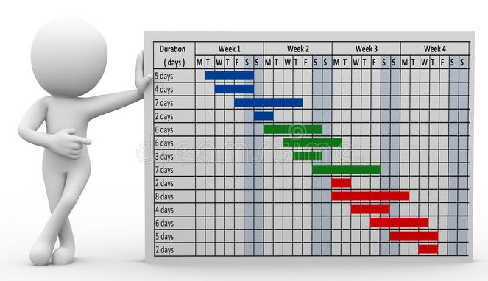
Monitoring Time Performance
Lecture
08
Progress and Performance Measurement and Evaluation
PMG 605
Project Resources and Time Management
9–19

Slide 20
Lecture
Monitoring Time Performance
09
A major goal of progress reporting is to catch any negative variances from plan as early as possible to determine if corrective action is necessary.
The project network schedule, derived from the WBS/OBS, serves as the baseline to compare against actual performance.
Tools used
  Tracking Gantt Chart
  Control Chart
  Milestone Schedules
9–20

Slide 21
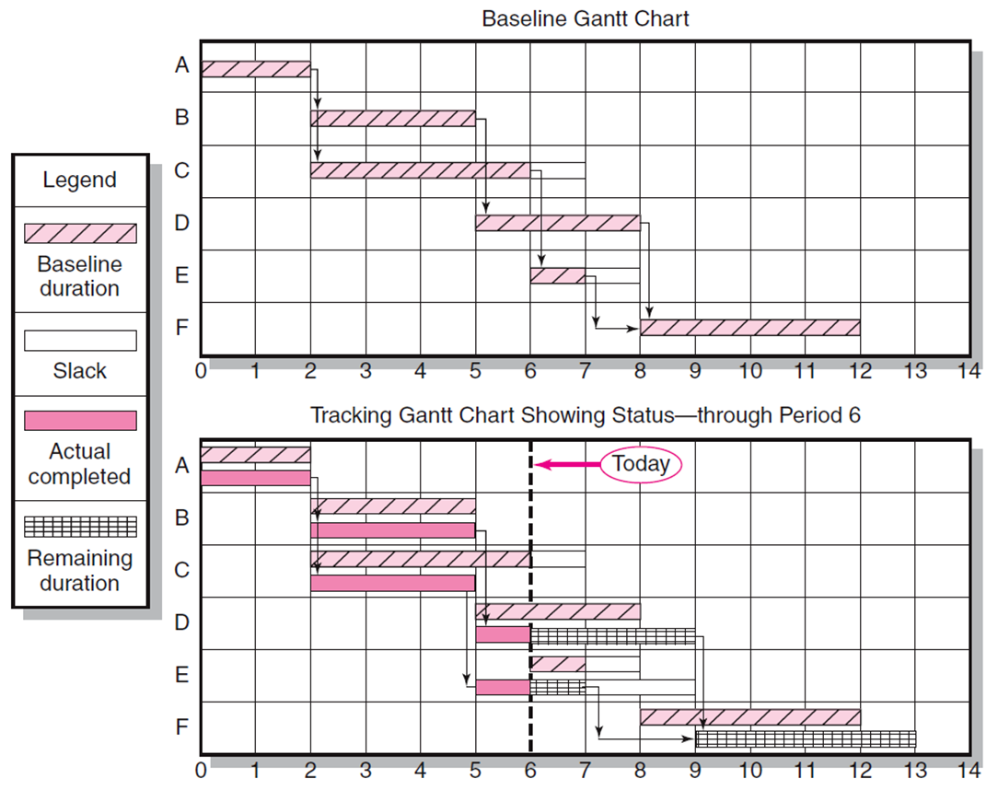
Tracking Gantt Chart
The most favored, used, and understandable.
9–21

Slide 22
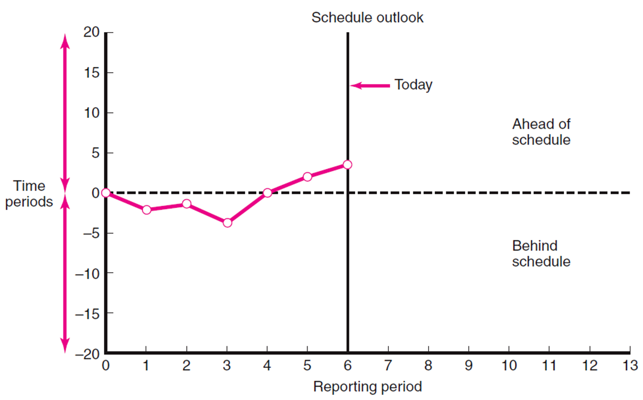
Lecture
Control Chart
09
The chart is used to plot the difference between the scheduled time on the critical path at the report date with the actual point on the critical path.
The figure shows the project was behind early in the project, the plot suggests corrective action brought the project back on track.
Control chart trends are very useful for giving warning of potential problems so appropriate action can be taken if necessary.
9–22

Slide 23
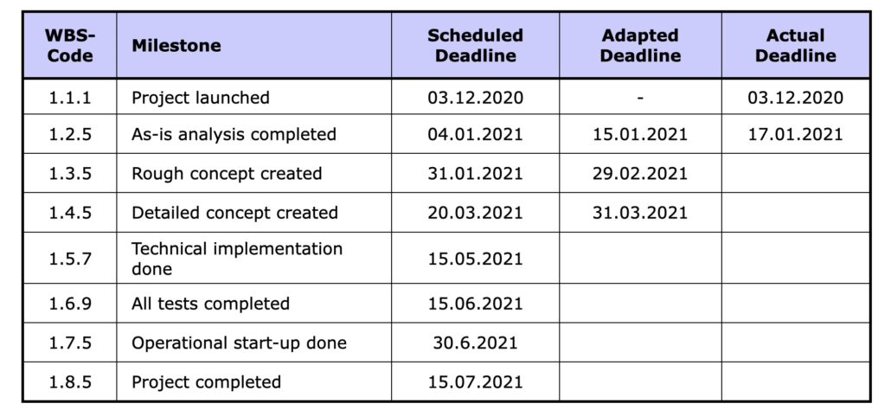
Lecture
Milestone Schedules
09
Stakeholders, whether it is senior management, the owner, or regulatory agencies often neither need or desire a detailed accounting of project progress.
Instead, their interests can be satisfied by reporting progress towards major project milestones.
Remember, milestones are significant project events that mark major accomplishments.
Project managers recognize the need to use
  A more macro schedule of significant deliverables to keep external stakeholders informed and
  A more detailed milestone driven schedule to manage and motivate the project team to achieve those deliverables.
9–23

Slide 24
Development of an
Earned Value (EV)
Cost/Schedule System
Lecture
08
Progress and Performance Measurement and Evaluation
PMG 605
Project Resources and Time Management
9–24

Slide 25
Lecture
Earned Value Cost/Schedule System
09
The earned value system starts with the time-phased costs that provide the project budget baseline, which is called the planned budgeted value (PV) of the work scheduled.
Given this time-phased baseline, comparisons are made with actual and planned schedule and costs using earned value.
The earned value approach provides the missing links not found in conventional cost-budget systems.
At any point in time, a status report can be developed for the project.
The earned value cost/schedule system uses several acronyms and equations for analysis.
9–25

Slide 26
Lecture
Glossary of Terms
09
EV | Earned value for a task is simply the percent complete times its original budget. Stated differently, EV is the percent of the original budget that has been earned by actual work completed
PV | The planned time-phased baseline of the value of the work scheduled. An approved cost estimate of the resources scheduled in a time-phased cumulative baseline
AC | Actual cost of the work completed. The sum of the costs incurred in accomplishing work.
CV | Cost variance is the difference between the earned value and the actual costs for the work completed to date where CV = EV – AC.
SV | Schedule variance is the difference between the earned value and the baseline line to date where SV = EV – PV.
BAC | Budgeted cost at completion. Total budgeted cost of the baseline or project cost accounts.
EAC | Estimated cost at completion.
ETC | Estimated cost to complete remaining work.
VAC | Cost variance at completion. VAC indicates expected actual over- or under-run cost at completion.
9–26

Slide 27
Lecture
Development of an EV Cost/Schedule System
09
Define the work using a WBS.
  Scope
  Work packages
  Deliverables
  Organization units
  Resources
  Budgets
Develop work and resource schedules.
  Schedule resources to activities
  Time-phase work packages into a network
Develop a time-phased budget using work packages included in an activity. Accumulate budgets (PV).
At the work package level, collect the actual costs for the work performed (AC). Multiply percent complete times original budget (EV).
Compute the schedule variance (EV-PV) and the cost variance (EV-AC).
9–27

Slide 28
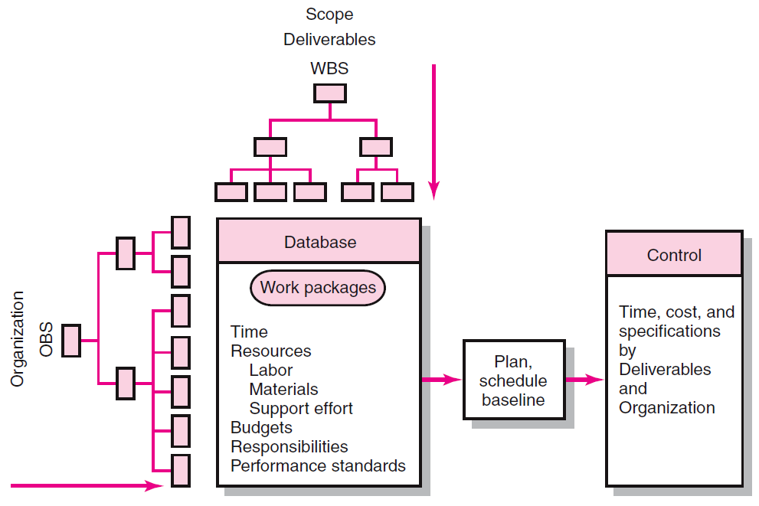
Project Management Information System Overview
9–28

Slide 29
Lecture
Project Management Information System Overview
09
The major reasons for creating a baseline are to monitor and report progress and to estimate cash flow.
Therefore, it is crucial to integrate the baseline with the performance measurement system.
9–29

Slide 30
Lecture
Percent Complete Rule
09
Percent Complete is the workhorse most commonly used.
Someone familiar with each task estimates what percent of the task has been completed or how much of the task remains.
When measuring percent complete in the monitoring phase of the project, it is common to limit the amount earned to 80 or 90 percent until the work package is 100 percent complete.
9–30

Slide 31
Lecture
Methods of Variance Analysis
09
The method for measuring accomplishments centers on Comparing Earned Value
  With the expected schedule value.
  With the actual costs.
These comparisons can be made at the project level or down to the cost account level.
Project status can be determined for the
  latest period,
  all periods to date,
  and estimated to the end of the project.
9–31

Slide 32
Lecture
Methods of Variance Analysis
09
Assessing Status of a Project Required data elements
  Data Budgeted cost of the work scheduled (PV)
  Budgeted cost of the work completed (EV)
  Actual cost of the work completed (AC)
Calculate schedule and cost variances
  A positive variance indicates a desirable condition,
  A negative variance suggests problems or changes that have taken place.
9–32

Slide 33
Lecture
Cost Variance (CV)
09
Indicates if the work accomplished using labor and materials costs more or less than was planned at any point in the project.
Should be reviewed carefully to isolate the cause to either labor or materials—or to both.
9–33

Slide 34
Lecture
Schedule Variance (SV)
09
Critical and non-critical activities are combined in the calculation.
Schedule variance measures progress in dollars rather than time units. Therefore, it is unlikely that any translation of dollars to time will yield accurate information telling if any milestone or critical path is early, on time, or late.
The only accurate method for determining the true time progress of the project is to compare the project network schedule against the actual network schedule to measure if the project is on time.
However, SV is very useful in assessing the direction all the work in the project is taking—after 20 or more percent of the project has been completed.
9–34

Slide 35
Lecture
Methods of Variance Analysis
09
EV = % completed * Original Budget
Cost Variance (CV) = EV – AC
Schedule Variance (SV) = EV – PV
9–35

Slide 36
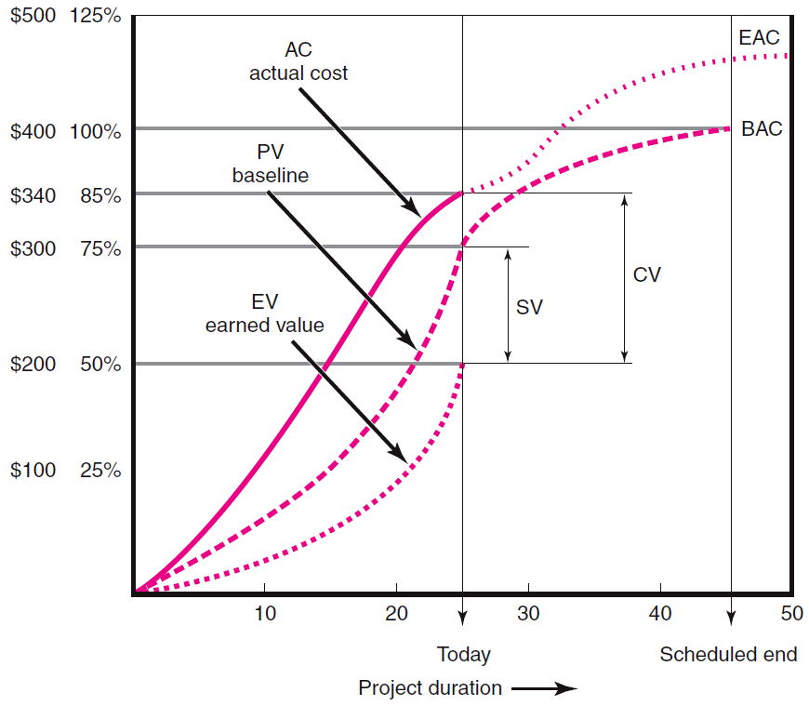
Cost/Schedule Graph
9–36

Slide 37
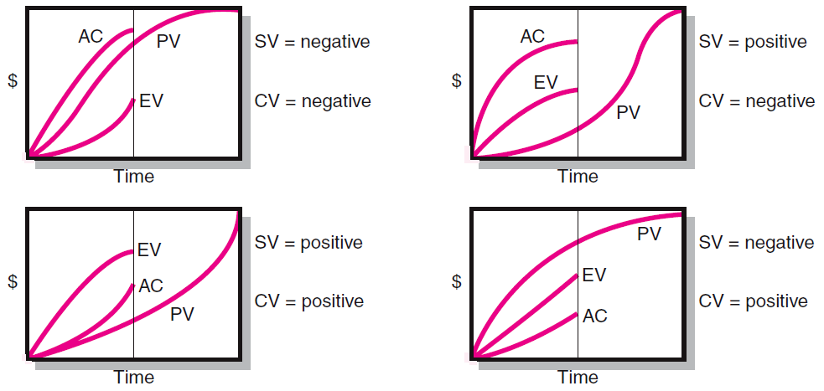
Suggests the project behind of schedule and over budget
Suggests the project may be ahead of schedule
Suggests the project behind of schedule
Suggests the project may be ahead of schedule and under budget
9–37

Slide 38
Developing a Status Report
Lecture
08
Progress and Performance Measurement and Evaluation
PMG 605
Project Resources and Time Management
9–38

Slide 39
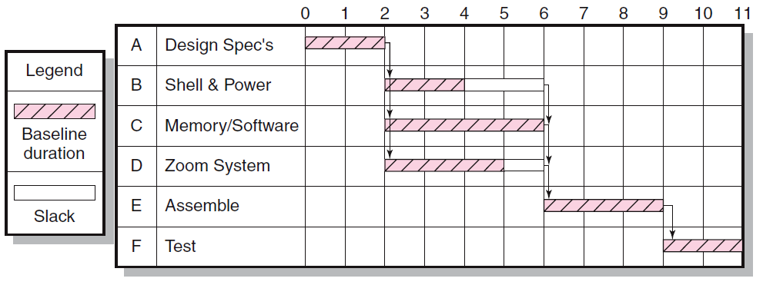
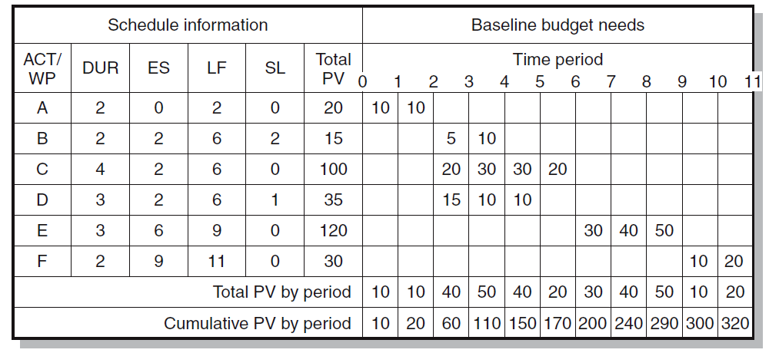
9–39

Slide 40
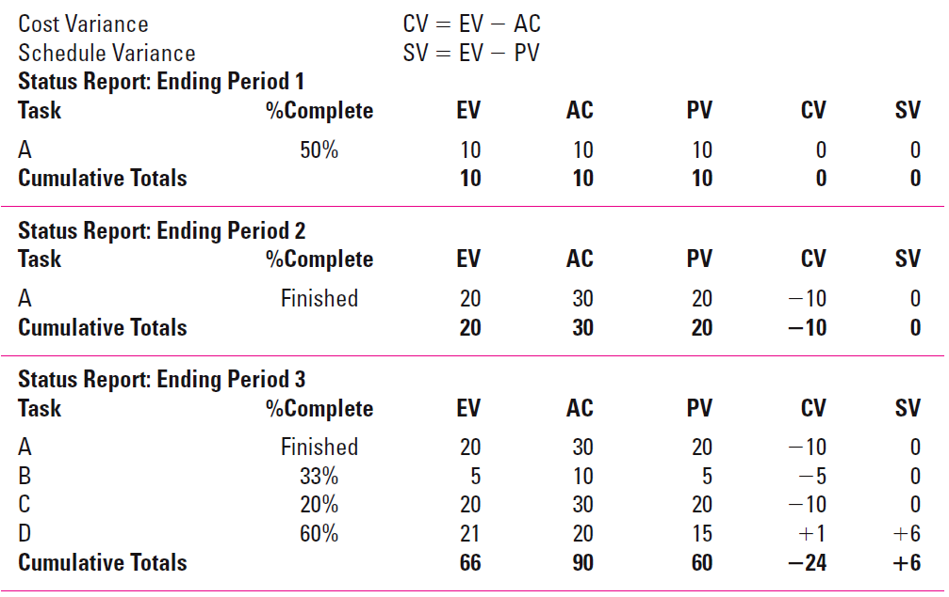
9–40

Slide 41
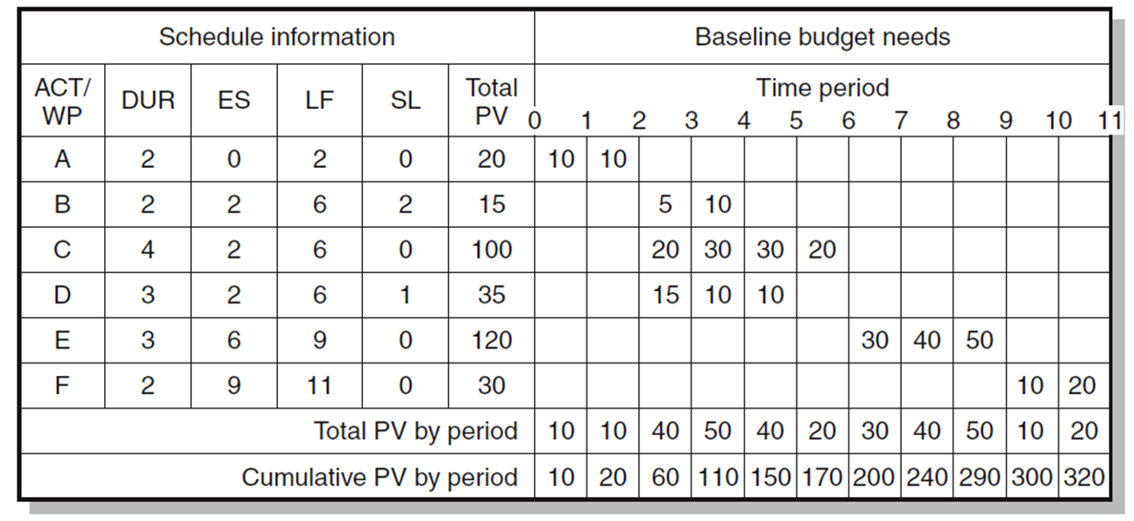
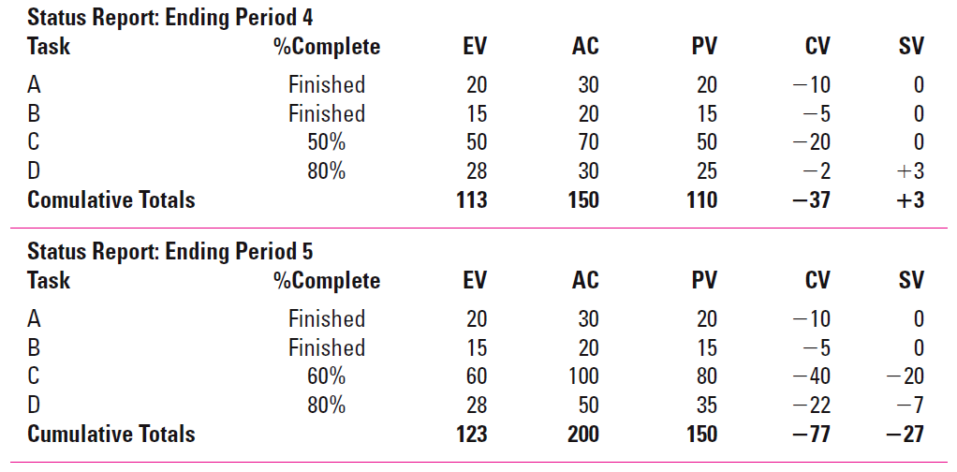
9–41

Slide 42
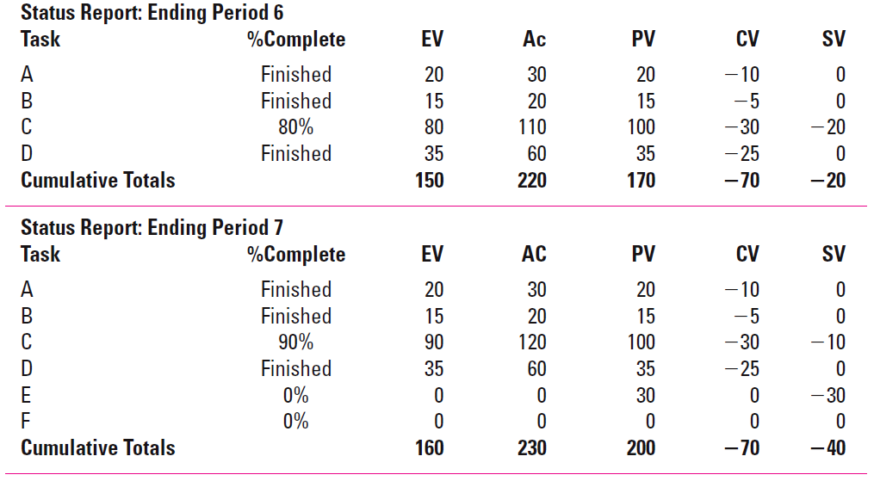
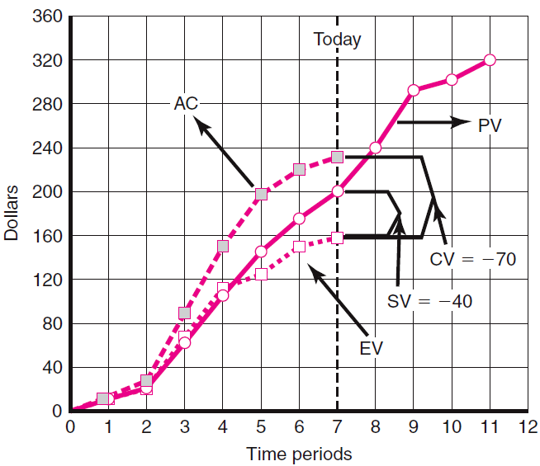
9–42

Slide 43
Indexes to Monitor Progress
Lecture
08
Progress and Performance Measurement and Evaluation
PMG 605
Project Resources and Time Management
9–43

Slide 44
Lecture
Indexes to Monitor Progress
09
Practitioners sometimes prefer to use schedule and cost indexes over the values of SV and CV, because indexes can be considered efficiency ratios.
Indexes are typically used at the cost account level and above.
9–44

Slide 45
Performance Indexes
Cost Performance Index
CPI = EV/AC
Scheduling Performance Index
SPI = EV/PV
Project Percent Complete Indexes
Percent Complete Index Budgeted Costs
PCIB = EV/BAC
Percent Complete Index Actual Costs
PCIC = AC/EAC
Indexes To Monitor Progress
9–45

Slide 46
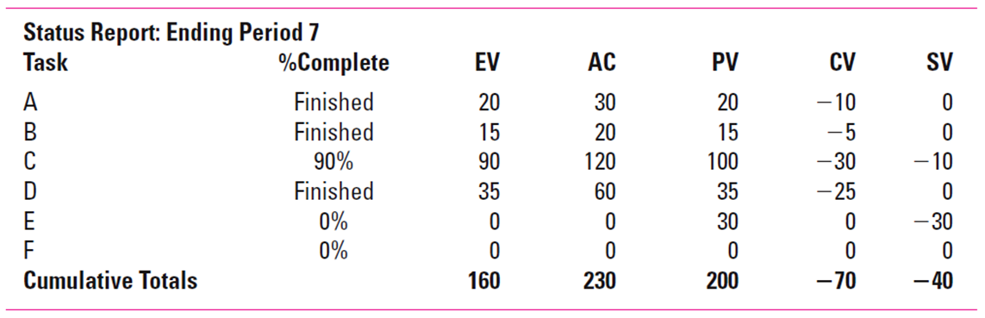
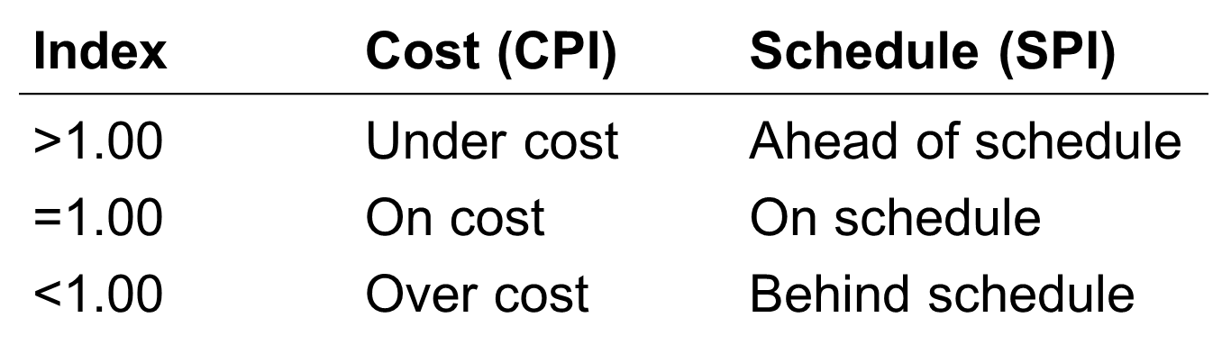
Lecture
Performance Indexes- Cost Performance Index (CPI)
09
Cost Performance Index (CPI) measures cost efficiency of the work accomplished to date
Most accurate, reliable, and stable
The CPI can provide an “early warning signal” as to cost overruns so that adjustments can be made to the budget or scope of a project
CPI = EV/AC = 160/230 = .7
9–46

Slide 47
Lecture
09
Performance Indexes- Scheduling Performance Index (SPI)
Scheduling Performance Index (SPI) measures scheduling efficiency to date
SPI = EV/PV = 160/200 = .8
9–47

Slide 48

Lecture
Project Percent Complete Indexes –
Percent Complete Index Budgeted Costs (PCIB)
09
This index is favored by many project managers when there is a high level of confidence in the original budget estimates (BAC).
PCIB = EV/BAC = 160/320 = .50 (50%)
Indicates the work accomplished represents 50 percent of the total budgeted (BAC) dollars to date.
9–48

Slide 49
Lecture
Project Percent Complete Indexes –
Percent Complete Index Actual Costs (PCIC)
09
This index assumes the actual costs-to-date and expected cost at completion are the most reliable for measuring project percent complete (EAC_{re}).
Example, at the end of period 7 the staff re-estimates that the EAC_{re} will be 575 instead of 320.
PCIC = AC/EAC_{re} = 230/575 = .40 (40%)
Some managers favor this index because it contains actual and revised estimates that include newer, more complete information.
9–49

Slide 50
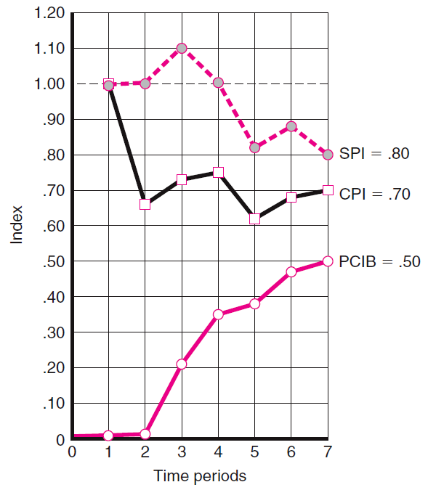
Lecture
Performance Indexes
09
9–50

Slide 51
Forecasting Final Project Cost
Lecture
08
Progress and Performance Measurement and Evaluation
PMG 605
Project Resources and Time Management
9–51

Slide 52
Lecture
Forecasting Final Project Cost
09
Basically, two methods used to revise estimates of future project costs.
Revised Estimated Cost At Completion (EAC_{re})
  Allows experts in the field to change original baseline durations and costs because new information tells them the original estimates are not accurate.
  Almost always used on smaller projects.
Forecasted Total Cost At Completion (EAC_{f})
  Used in large projects where the original budget is reliable.
9–52

Slide 53
Lecture
Revised Estimated Cost At Completion (EACre)
09
EAC_{re} = AC + ETC_{re}
Where
EAC_{re} = revised estimated cost at completion.
AC = cumulative actual cost of work completed to date.
ETC_{re} = revised estimated cost to complete remaining work.
9–53

Slide 54
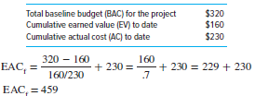
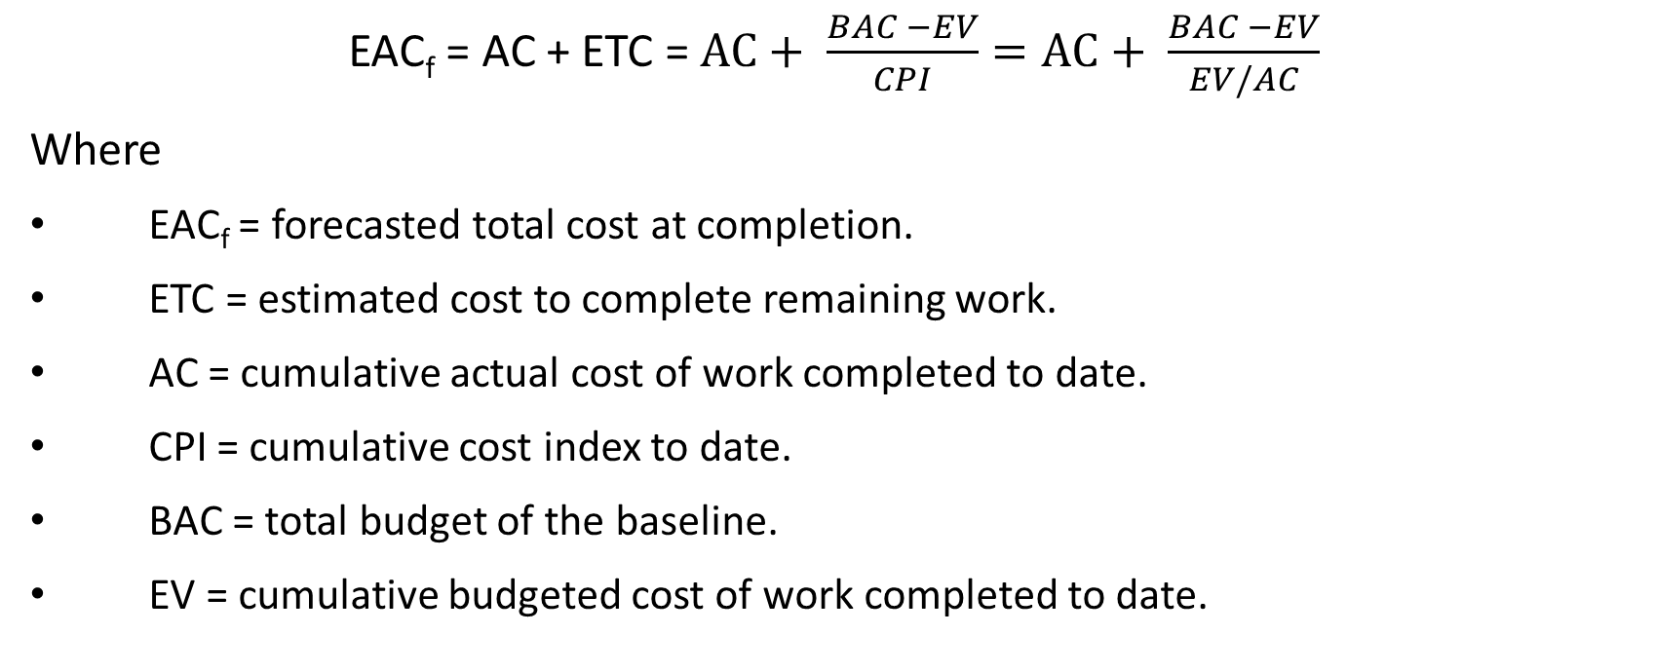
Lecture
Forecasted Total Cost At Completion (EACf)
09
EAC_{f} = AC + ETC = $AC+ \frac{BAC −EV}{CPI}=AC+ \frac{BAC −EV}{EV/AC}$
Where
EAC_{f} = forecasted total cost at completion.
ETC = estimated cost to complete remaining work.
AC = cumulative actual cost of work completed to date.
CPI = cumulative cost index to date.
BAC = total budget of the baseline.
EV = cumulative budgeted cost of work completed to date.
9–54

Slide 55
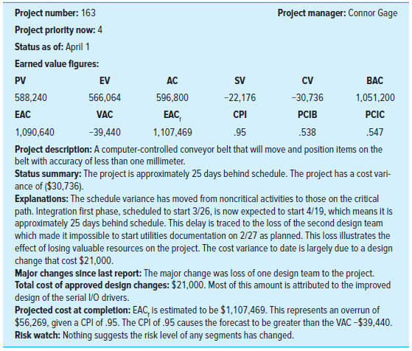
Monthly Status Report - Example
9–55

Slide 56
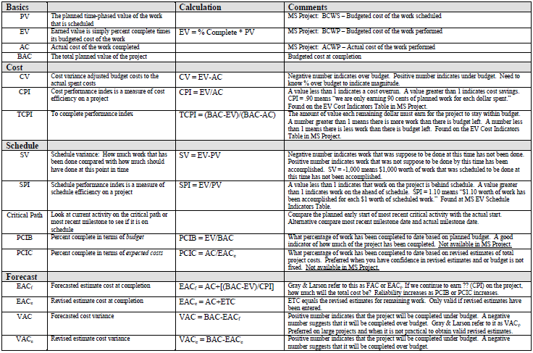
9–56

Slide 57
Summary of Today Session
Lecture
08
Progress and Performance Measurement and Evaluation
PMG 605
Project Resources and Time Management
9–57

Slide 58
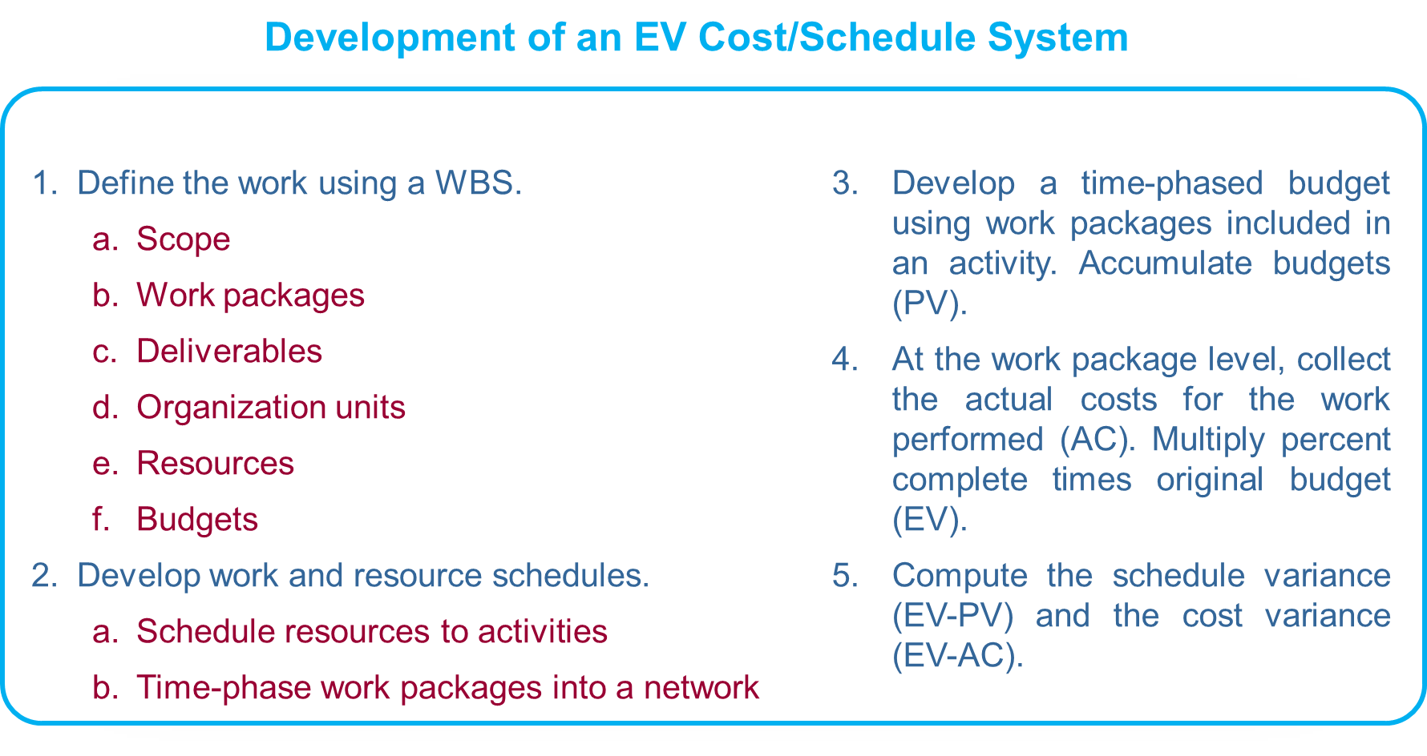
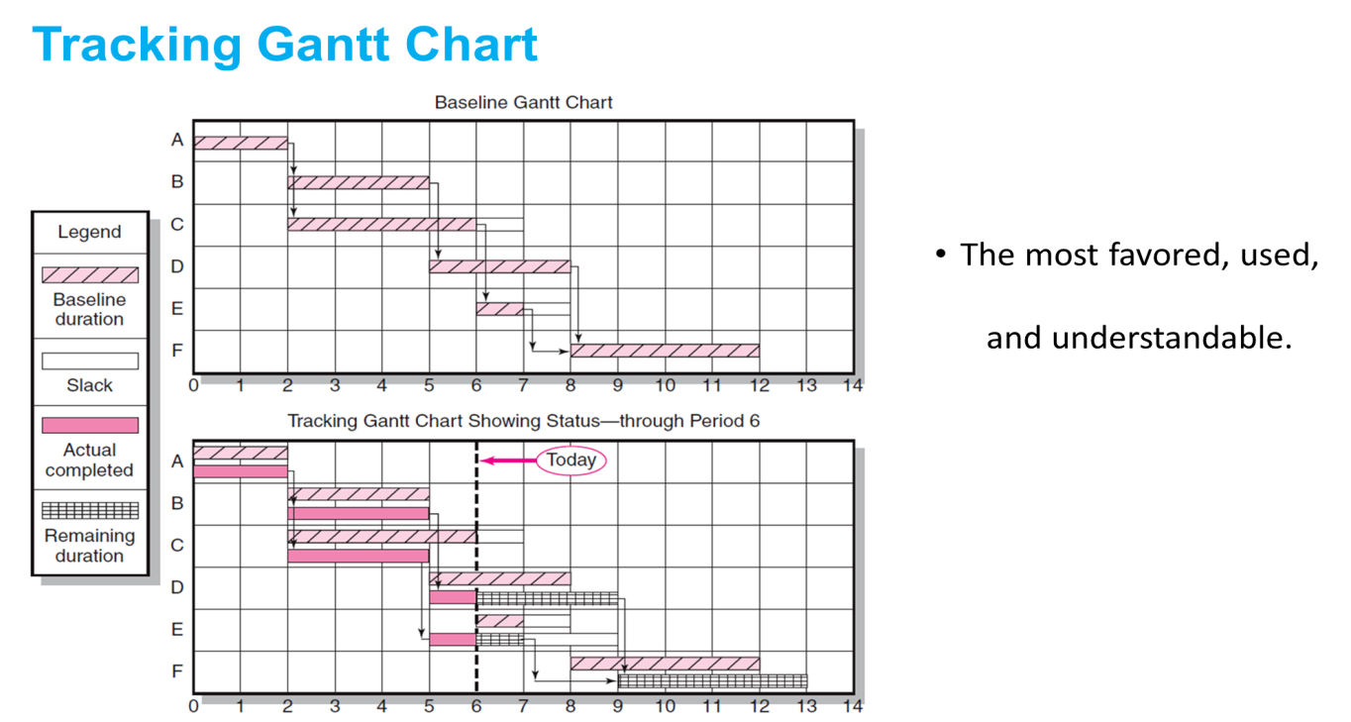
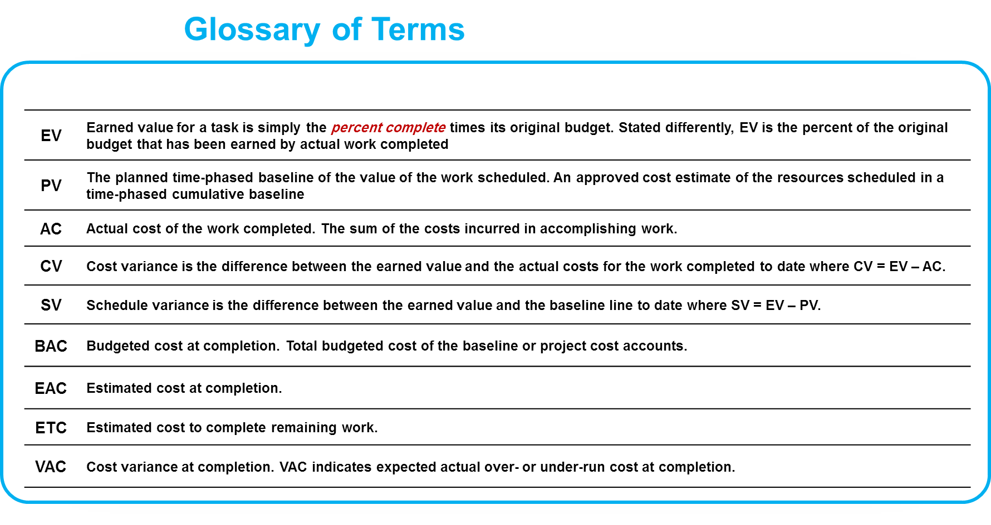
9–58

Slide 59
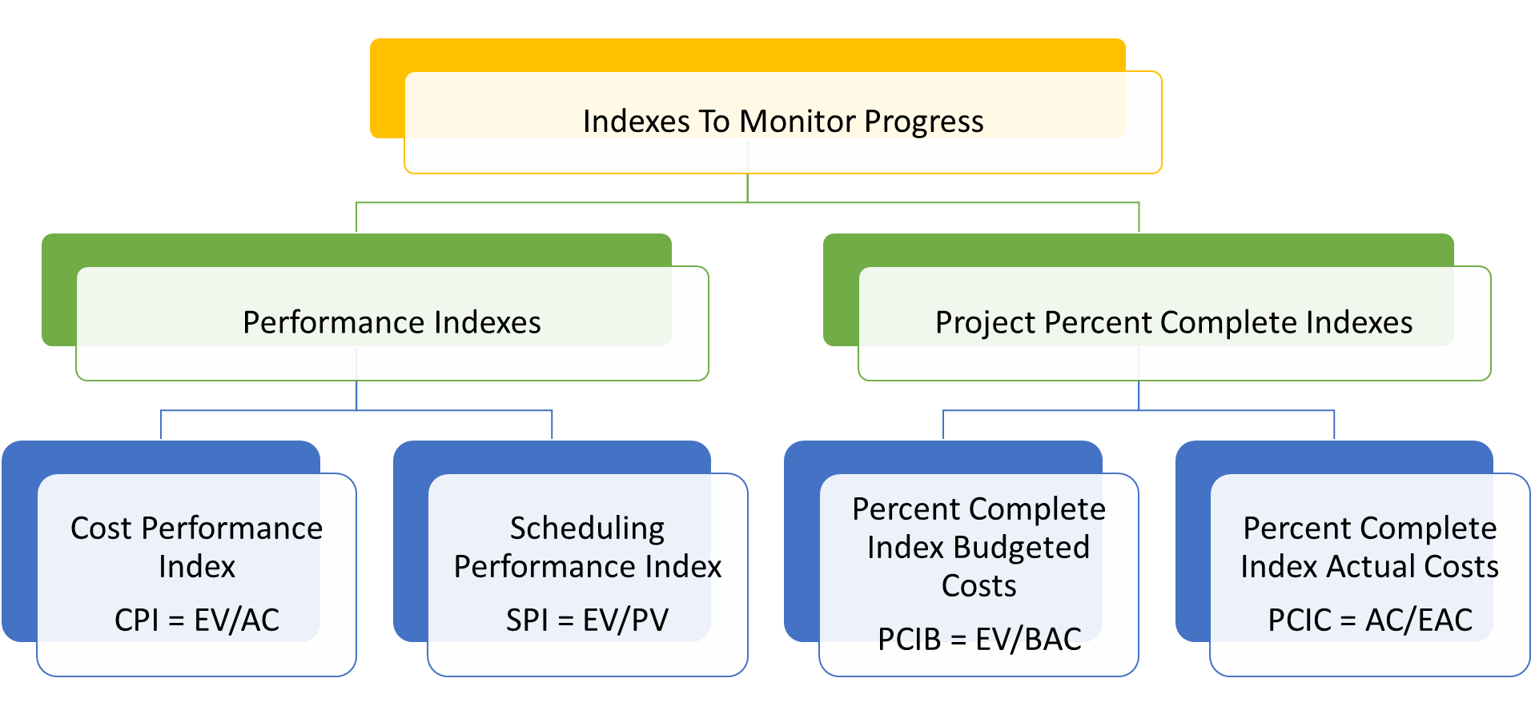
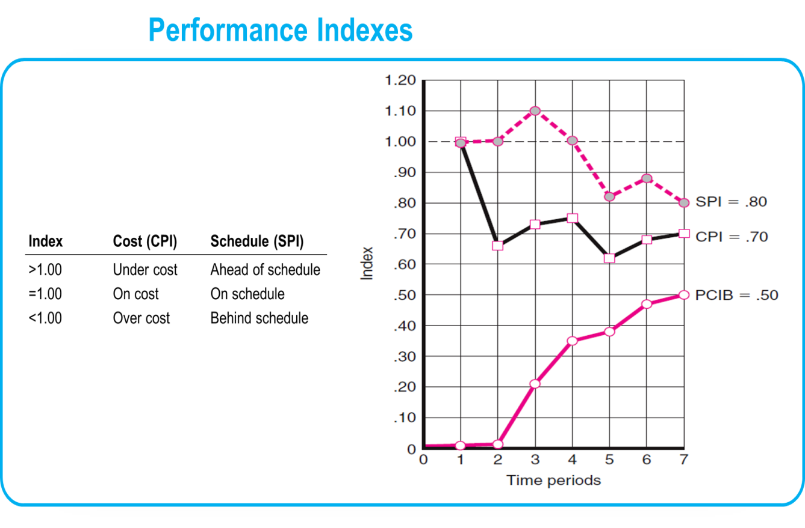
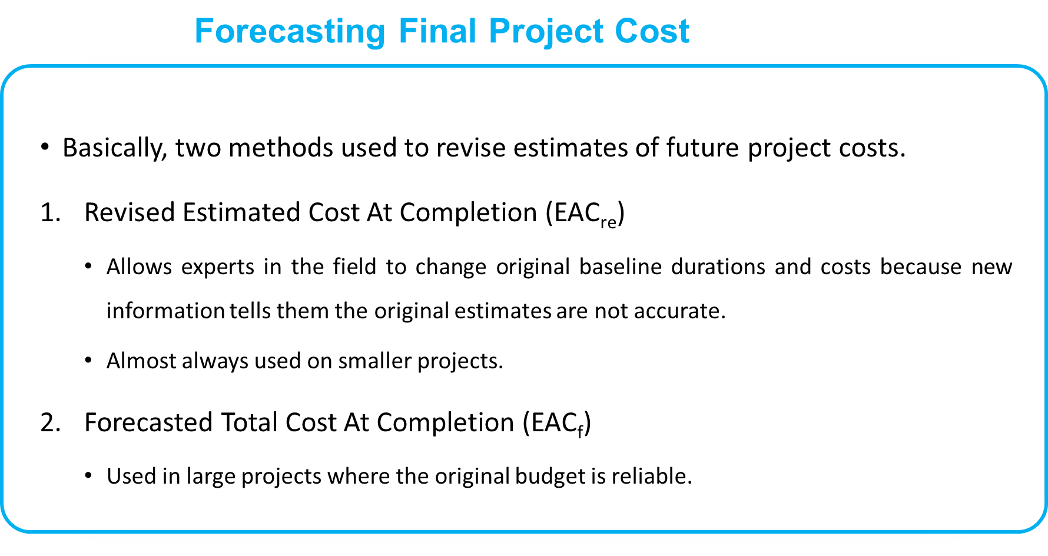
9–59

Slide 60
Resources
Project Management: The Managerial Process Fifth Edition. By: Erik W. Larson, Oregon State University, Clifford F. Gray, Oregon State University
9-60

Slide 61



Thank You

