Slide 1


Red Hat System Administration I
Dr. Eng. Gamal Selim
Lecture 01

Slide 2
Course Overview
Red Hat System Administration I (RH124) course is designed for IT professionals without previous Linux system administration experience
The course provides students with Linux administration competence by focusing on core administration tasks
This course will build the foundation for new Linux system administrators to efficiently and securely resolve configuration issues, integrate Red Hat Enterprise Linux with other existing systems, manage user and group administration, and use available storage solutions
Red Hat Linux Administration I
Lecture 01
Dr. Eng. Gamal Selim

Slide 3
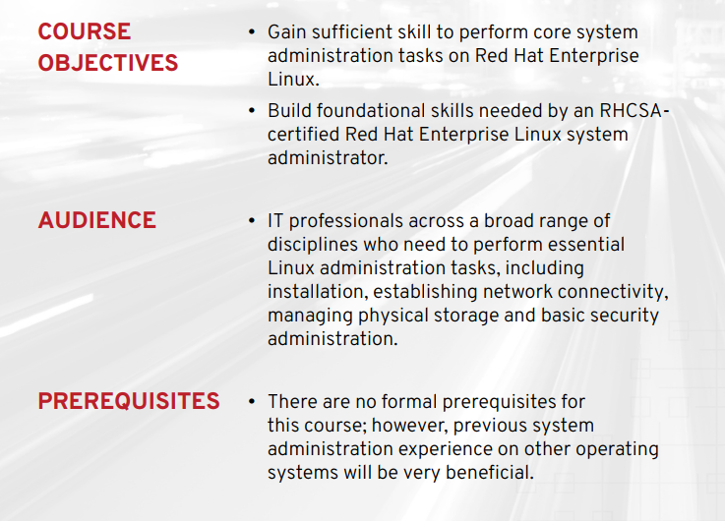
Red Hat Linux Administration I
Lecture 01
Dr. Eng. Gamal Selim

Slide 4
Table of Contents
Chapter 1: Get Started with Red Hat Enterprise Linux
Chapter 2: Access the Command Line
Chapter 3: Manage Files from the Command Line
Chapter 4: Get Help in Red Hat Enterprise Linux
Chapter 5: Create, View, and Edit Text Files
Red Hat Linux Administration I
Lecture 01
Dr. Eng. Gamal Selim

Slide 5
Table of Contents ..
Chapter 6: Manage Local Users and Groups
Chapter 7: Control Access to Files
Chapter 8: Monitor and Manage Linux Processes
Chapter 9: Control Services and Daemons
Chapter 10: Configure and Secure SSH
Red Hat Linux Administration I
Lecture 01
Dr. Eng. Gamal Selim

Slide 6
Table of Contents ..
Chapter 11: Manage Networking
Chapter 12: Install and Update Software Packages
Chapter 13: Access Linux File Systems
Chapter 14: Analyze Servers and Get Support
Chapter 15: Comprehensive Review
Red Hat Linux Administration I
Lecture 01
Dr. Eng. Gamal Selim

Slide 7
Chapter 1: Get Started with Red Hat Enterprise Linux
Red Hat Linux Administration I
Lecture 01
Dr. Eng. Gamal Selim

Slide 8
History of UNIX
The UNIX operating system found its beginnings in MULTICS, which stands for Multiplexed Operating and Computing System
In 1969 Ken Thompson wrote the first version of UNIX, called UNICS
Although the operating system has changed, the name stuck and was eventually shortened to UNIX
Red Hat Linux Administration I
Lecture 01
Dr. Eng. Gamal Selim

Slide 9
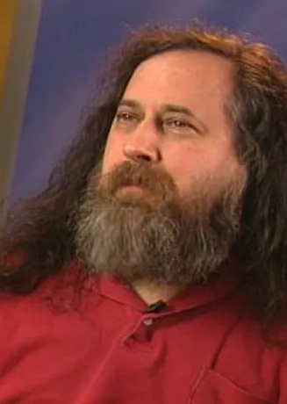
What is GNU?
GNU Project: Richard Stallman on September 27th 1983
The GNU Project was launched in 1984 to develop a complete Unix-like operating system which is free software: the GNU system
GNU's kernel isn't finished, so GNU is used with the kernel Linux. The combination of GNU and Linux is the GNU/Linux operating system, now used by millions

Slide 10

What is Linux?
Linux began in 1991 as a personal project by student called Linus Torvalds
Linux is a free and open-source operating system
It is based on the UNIX operating system

Slide 11
Why use Linux?
Linux is free and open source
Linux is very stable and reliable
Linux is secure
Linux is customizable
Linux is powerful
Red Hat Linux Administration I
Lecture 01
Dr. Eng. Gamal Selim

Slide 12

Linux Distributions

Slide 13
Chapter 2: Access the Command Line
Red Hat Linux Administration I
Lecture 01
Dr. Eng. Gamal Selim

Slide 14
Installation of RHEL 9
Red Hat Linux Administration I
Lecture 01
Dr. Eng. Gamal Selim

Slide 15
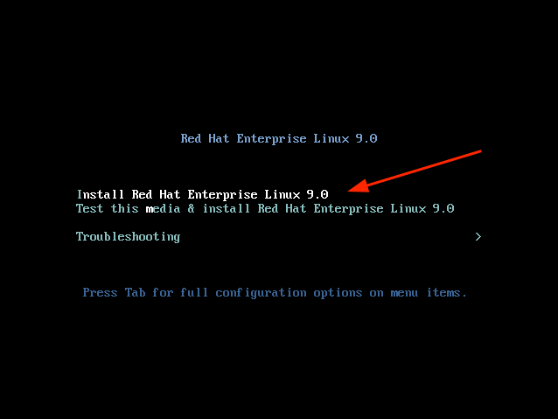
Step 1: Start RHEL 9 Installation
When the system reboots, you will get a black screen with the following options. To begin the installation, press ENTER on the first option ‘Install Red Hat Enterprise Linux 9.0’.
Red Hat Linux Administration I
Lecture 01
Dr. Eng. Gamal Selim

Slide 16
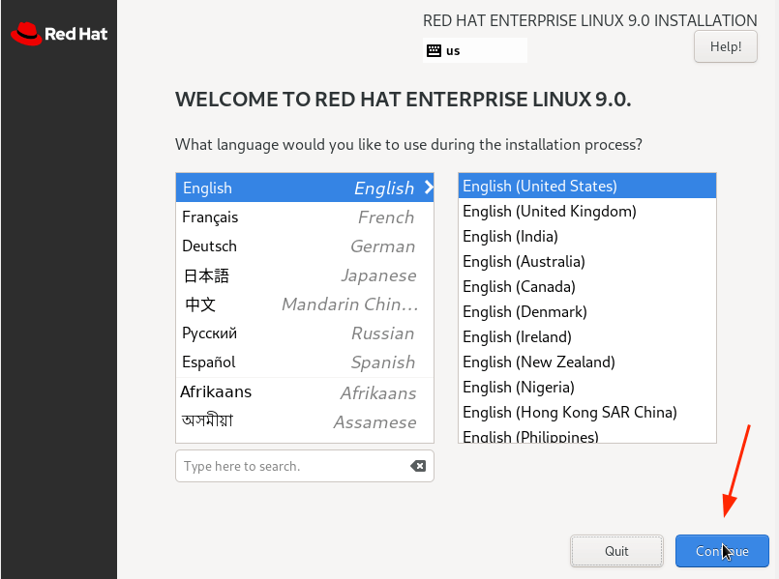

Slide 17
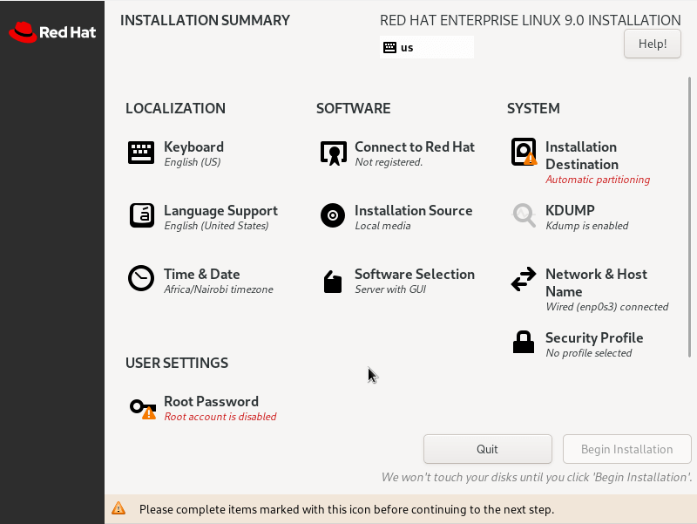
Step 2: Configure Partitioning
The next step presents you with an installation summary that is segmented into four sections:
LOCALIZATION
SOFTWARE
SYSTEM
USER SETTINGS
We will only focus on three items that are mandatory before proceeding with the installation – Installation Destination, Root Account, and Regular Account creation.
Red Hat Linux Administration I
Lecture 01
Dr. Eng. Gamal Selim

Slide 18
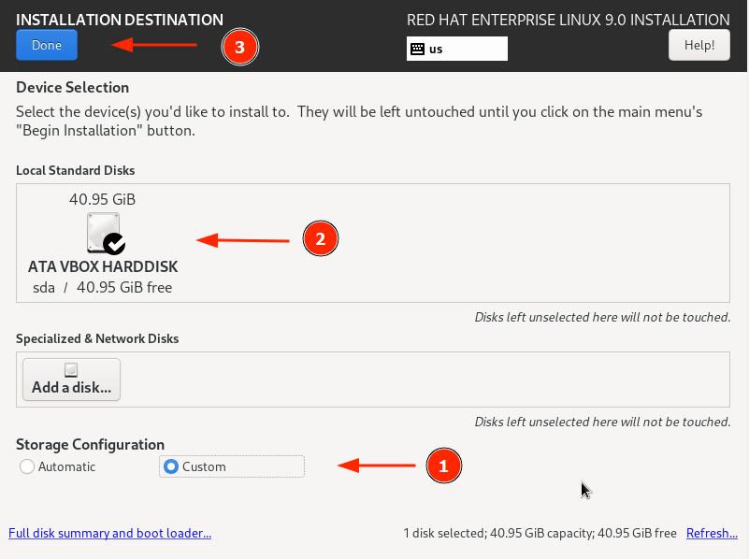
Red Hat Linux Administration I
Lecture 01
Dr. Eng. Gamal Selim

Slide 19
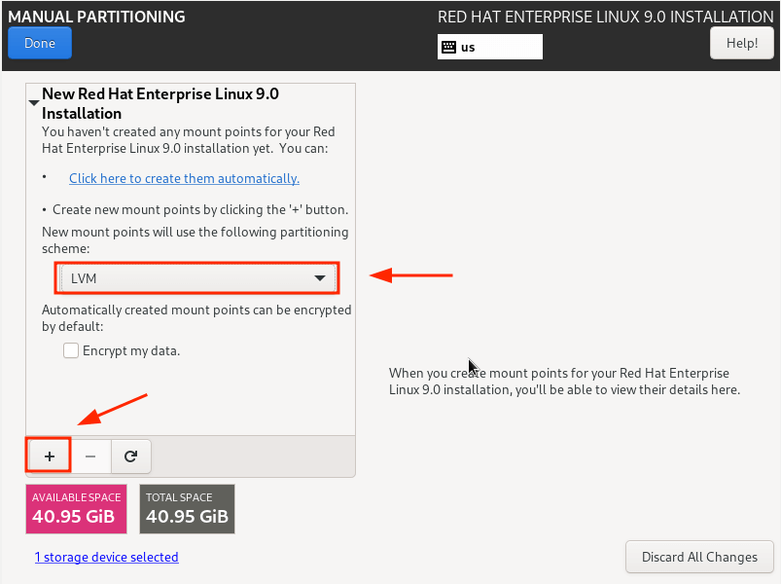
Red Hat Linux Administration I
Lecture 01
Dr. Eng. Gamal Selim

Slide 20
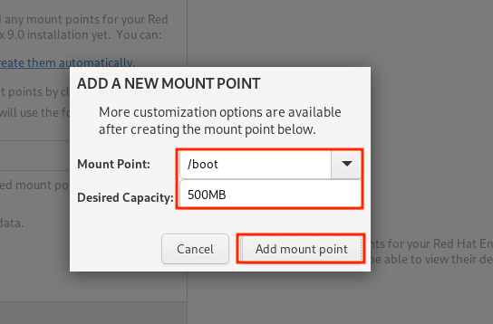
Red Hat Linux Administration I
Lecture 01
Dr. Eng. Gamal Selim

Slide 21
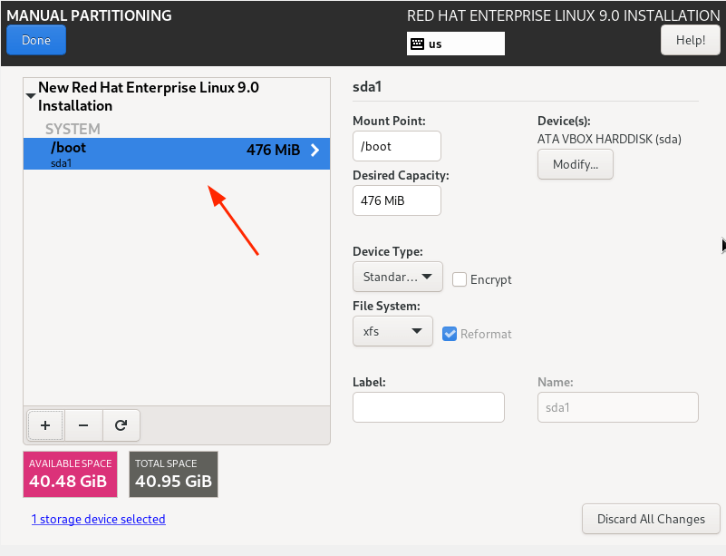
Red Hat Linux Administration I
Lecture 01
Dr. Eng. Gamal Selim

Slide 22
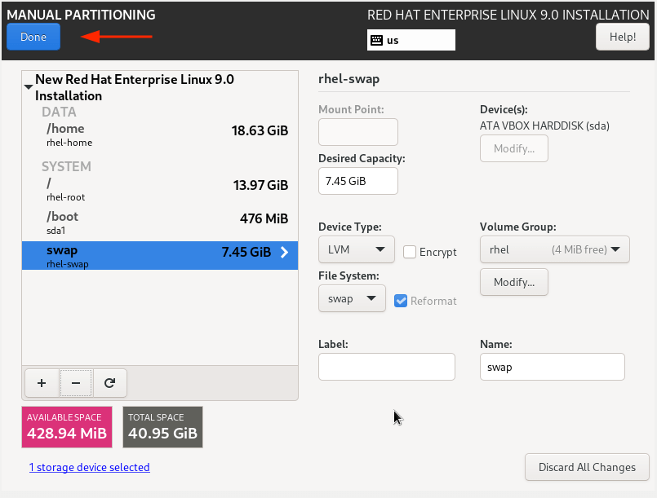
Red Hat Linux Administration I
Lecture 01
Dr. Eng. Gamal Selim

Slide 23
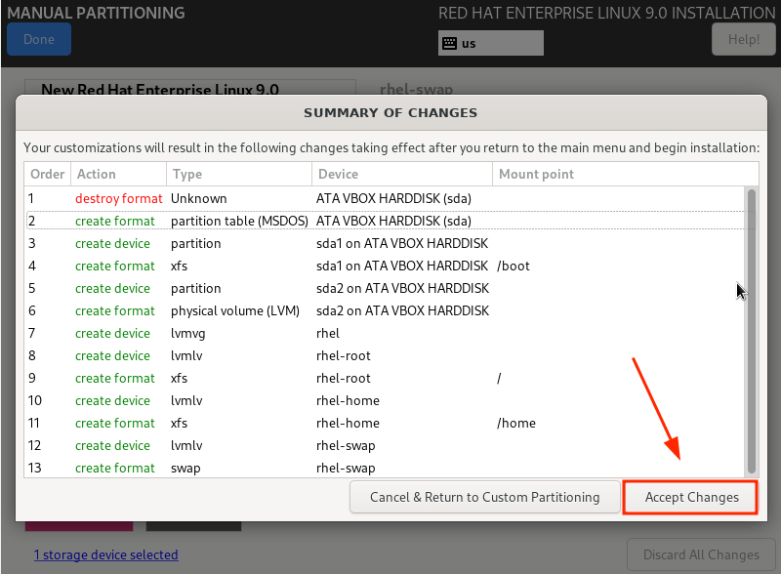
Red Hat Linux Administration I
Lecture 01
Dr. Eng. Gamal Selim

Slide 24
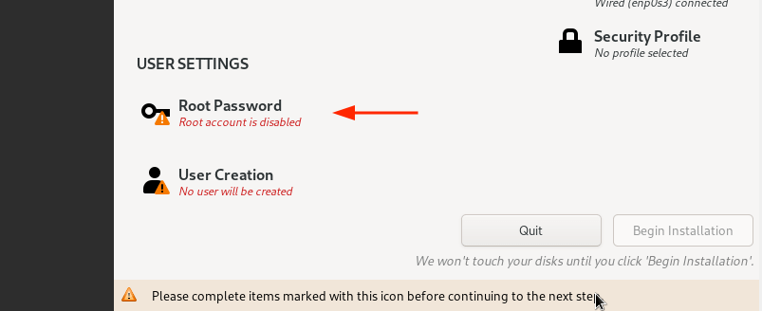
Red Hat Linux Administration I
Lecture 01
Dr. Eng. Gamal Selim

Slide 25
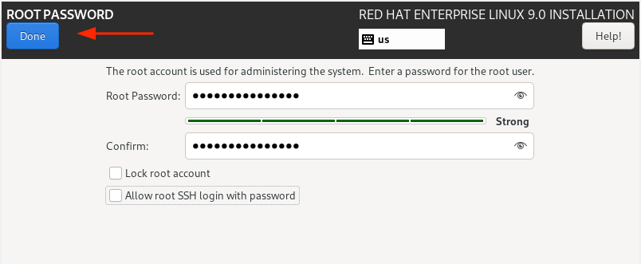
Red Hat Linux Administration I
Lecture 01
Dr. Eng. Gamal Selim

Slide 26
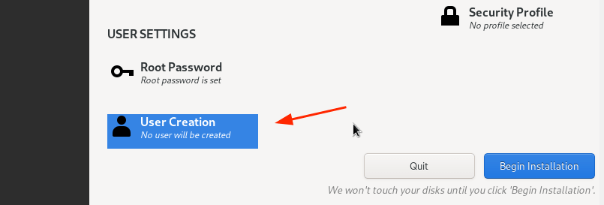
Red Hat Linux Administration I
Lecture 01
Dr. Eng. Gamal Selim

Slide 27
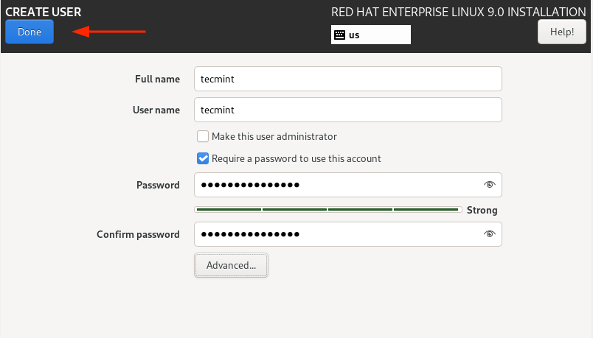
Red Hat Linux Administration I
Lecture 01
Dr. Eng. Gamal Selim

Slide 28
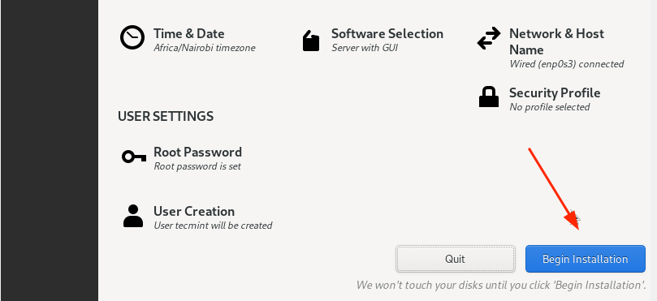
Red Hat Linux Administration I
Lecture 01
Dr. Eng. Gamal Selim

Slide 29
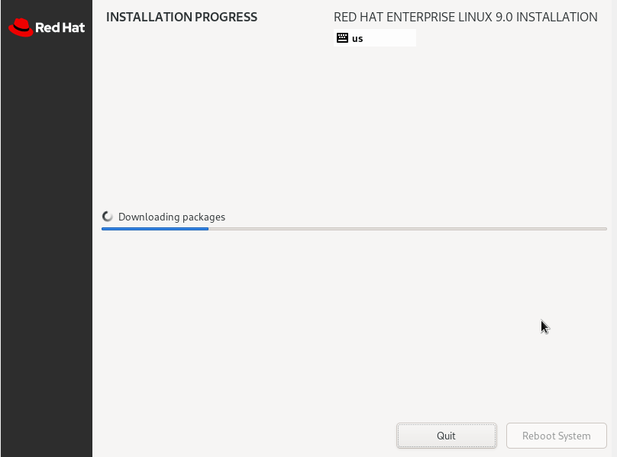
Red Hat Linux Administration I
Lecture 01
Dr. Eng. Gamal Selim

Slide 30
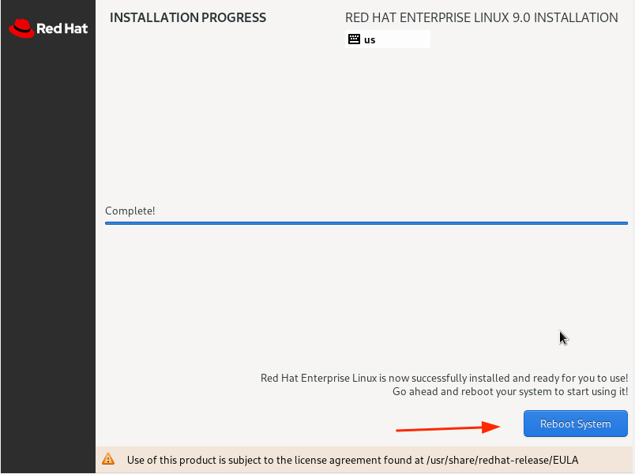
Red Hat Linux Administration I
Lecture 01
Dr. Eng. Gamal Selim

Slide 31
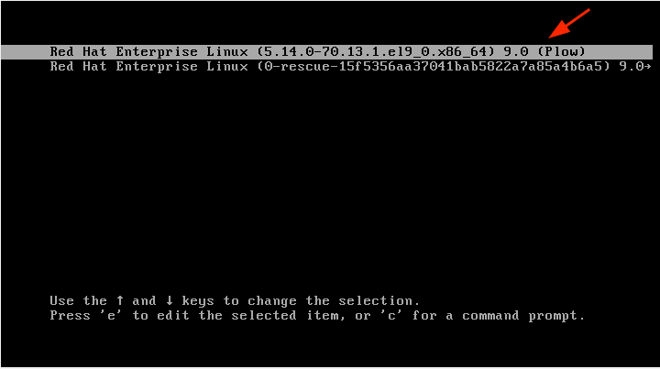
Red Hat Linux Administration I
Lecture 01
Dr. Eng. Gamal Selim

Slide 32
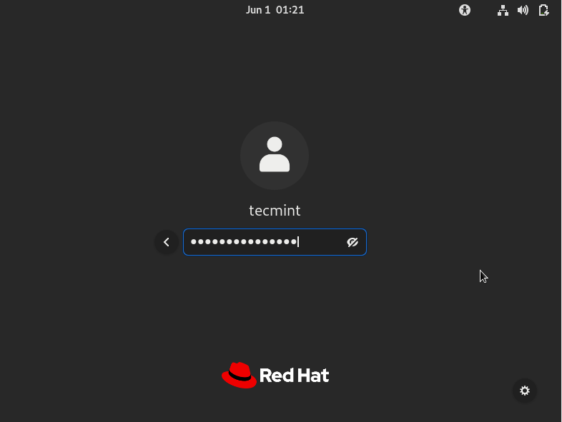
Red Hat Linux Administration I
Lecture 01
Dr. Eng. Gamal Selim

Slide 33
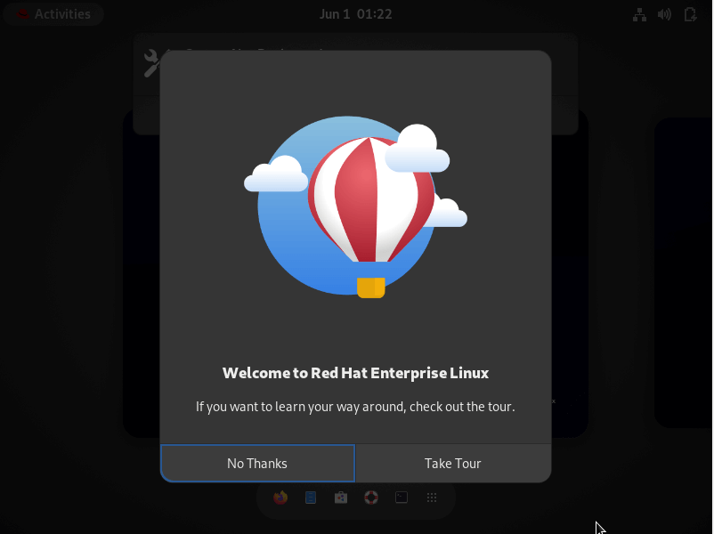
Red Hat Linux Administration I
Lecture 01
Dr. Eng. Gamal Selim

Slide 34
Introduction to the Bash Shell
A command line is a text-based interface that is used to input instructions to a computer system
The Linux command line is provided by a program called the shell
Many shell program variants have been developed over the years
Regular users:
[user@host ~]$
root user:
[root@host ~]#
Red Hat Linux Administration I
Lecture 01
Dr. Eng. Gamal Selim

Slide 35
Basic Command Syntax
Commands that are entered at the shell prompt have three basic parts:
  Command to run.
  Options to adjust the behavior of the command.
  Arguments, which are typically targets of the command.
Red Hat Linux Administration I
Lecture 01
Dr. Eng. Gamal Selim

Slide 36
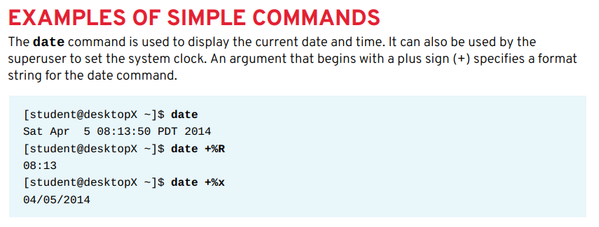
Red Hat Linux Administration I
Lecture 01
Dr. Eng. Gamal Selim

Slide 37
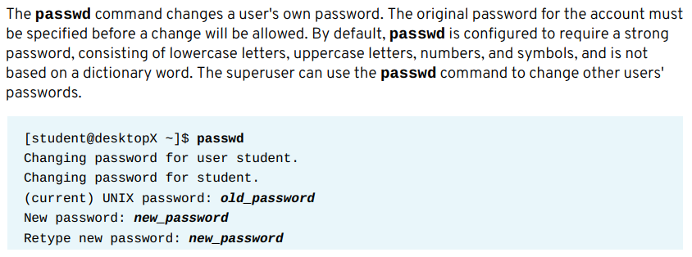
Red Hat Linux Administration I
Lecture 01
Dr. Eng. Gamal Selim

Slide 38
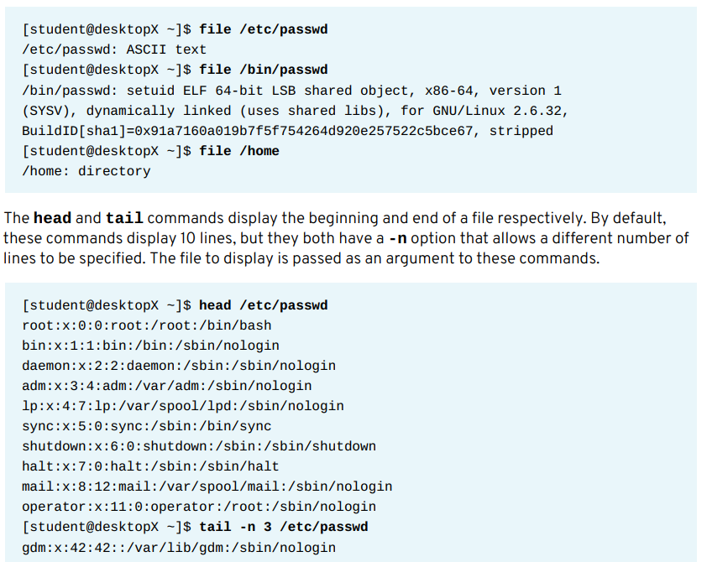
Red Hat Linux Administration I
Lecture 01
Dr. Eng. Gamal Selim

Slide 39
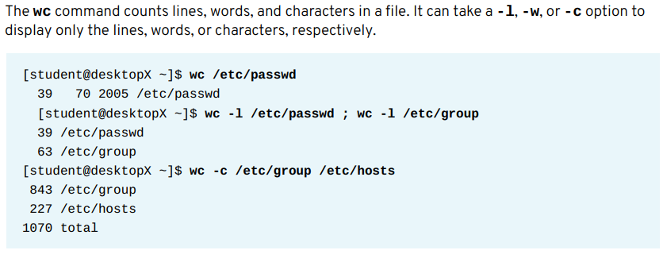
Red Hat Linux Administration I
Lecture 01
Dr. Eng. Gamal Selim

Slide 40
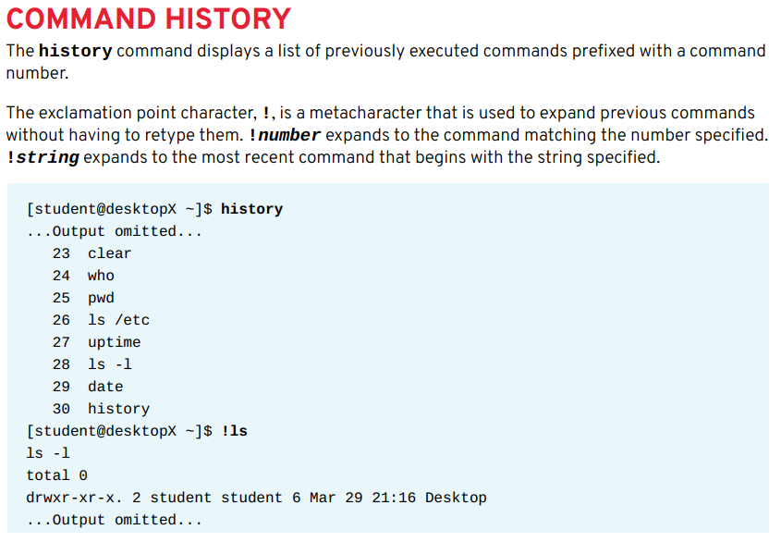
Red Hat Linux Administration I
Lecture 01
Dr. Eng. Gamal Selim

Slide 41
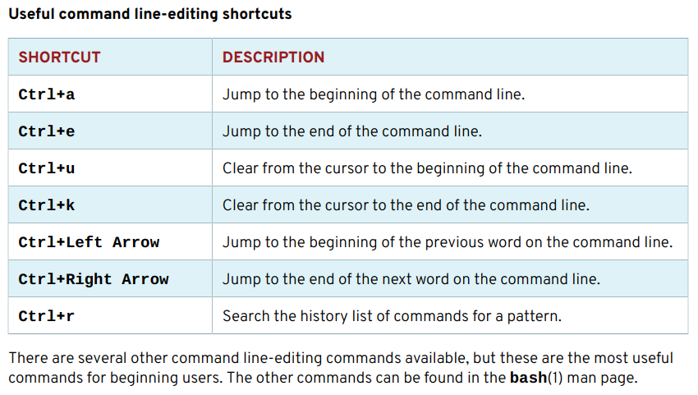
Red Hat Linux Administration I
Lecture 01
Dr. Eng. Gamal Selim

Slide 42


