Slide 1



Project Business
Analysis
PMG 461 – MGM 461
Lecture 8
Documenting Requirements
Prepared by
Eng. Ahmed Hussein, MBA, PfMP©, PMP©, CMP APMG

Slide 2
In Previous Lectures
Business Analysts elicit requirements from stakeholders using various qualitative and quantitative techniques.
Plan for business analysis plan and work plan before starting the analysis
Business Analyst Models requirement using a mix of the various modelling techniques
Requirements are engineered through elicitation, analysis, documentation, validation, and requirements management.
Contribute to identifying and engaging stakeholders.
8 – 2

Slide 3

Lecture
What we will cover
08
Business Requirements Document
Content of Requirements Document
Writing, Categorizing and Prioritizing Requirements
Peer Review and Version Control for Requirements Document
8 – 3

Slide 4


Requirements Document Overview
Lecture
08
8 – 4

Slide 5
Lecture
08
Requirements Documentation is done throughout the Requirements Engineering Process.
Requirement Elicitation
Requirements Analysis
Requirements validation
Requirements Documentation
Requirements Management
8 – 5

Slide 6
Lecture
Requirements Documentation
08
Requirements documentation encompasses the detailed articulation of how individual requirements align with the overarching business objectives of the project.
These requirements initially commence at a high-level, evolving into more detailed specifications as greater insight into project requirements is acquired.
8 – 6

Slide 7
Lecture
Purpose of Requirements Document
08
Defines solution for business opportunity or problem in sufficient details.
Basis for validating stakeholder needs
Input to Project Scope Definition
Main input to technical teams (design, development, and quality)
Basis for traceability, audit and verification
8 – 7

Slide 8
Lecture
Key Attributes
08
Unambiguous
  Requirements should be clearly defined, ensuring measurability and testability, thereby mitigating ambiguity in interpretation.
Traceability
  Each requirement should be traceable throughout the project lifecycle, enabling seamless tracking of its implementation and verification.
8 – 8

Slide 9
Lecture
Key Attributes
08
Completeness
  Include all necessary requirements, leaving no critical aspects unaddressed, ensuring comprehensive coverage of project needs.
Consistency and Stakeholder Acceptance
  Exhibit internal coherence while also aligning with the expectations and preferences of key stakeholders. Consensus and buy-in from stakeholders are imperative for project success.
8 – 9

Slide 10
How is Requirements Document used?
Lecture
08
Process
Output
Requirements Document
Define Scope
Scope Statement
Create WBS
WBS
Conduct Procurement
Contracts
8 – 10

Slide 11
Contents of Requirements Document
Lecture
08
8 – 11

Slide 12
Lecture
Variation in Documentation Formats
08
Requirements documentation formats span from simple listings, organized by stakeholder and priority, to elaborate structures including:
  Executive summaries for high-level overviews.
  Detailed descriptions offering in-depth insights into each requirement.
  Supplementary attachments providing additional context or supporting documentation.
8 – 12

Slide 13
Lecture
Variation in Documentation Formats
08
Requirements documentation should include “To Be” Solution, and may include “As Is” situation.
This diversity caters to varied project needs and accommodates stakeholders' preferences.
Such versatility enhances communication and aids in comprehensive understanding of project requirements across all involved parties.
8 – 13

Slide 14
Sample Requirements Document
in Agile Projects (Product Backlog)
Lecture
08
A prioritized list of all the work that needs to be done to complete the project.
Id | Backlog Item | Assigned to Sprint | Status | Size (In Story Points)
1 | Design |  | Open
2 | Coding |  | Open
3 | Add |  | Open
4 | Subtract |  | Open
5 | Multiply |  | Open
6 | Divide |  | Open
7 | Sin |  | Open
8 | Cos |  | Open
9 | Tan |  | Open
10 | Sec |  | Open
Id | Backlog Item | Assigned to Sprint | Status | Size (In Story Points)
11 | Csc |  | Open
12 | Cot |  | Open
13 | Polynomial |  | Open
14 | Rational |  | Open
15 | Exponential |  | Open
16 | Logarithmic |  | Open
17 | Radical |  | Open
18 | Mean |  | Open
19 | Median |  | Open
20 | Mode |  | Open
Id | Backlog Item | Assigned to Sprint | Status | Size (In Story Points)
21 | Std. Deviation |  | Open
22 | Variance |  | Open
23 | Count |  | Open
24
25
26
27
28
29
40
 |  |  | Total
8 – 14

Slide 15
Components of Requirements
Document (1 / 2)
Lecture
08
Introduction and Background
A description of the business situation and drivers for the project.
Solution
"To Be" process models to set the vision for new processes
"As Is" processes (if needed)
Function Models
Diagrams showing functionality
Examples:
Context Diagrams
clarify project objectives and scope of the work
ensure stakeholders are aware of the business context of the requirements
Use Case Diagrams
8 – 15

Slide 16
Components of Requirements
Document (2 / 2)
Lecture
08
Data Models
Provide higher level of details
Examples:
Requirements Catalogue
documenting each individual requirement
Examples:
Requirements Catalogue
Entity Relationship Diagrams
important for tracing and verification
Glossary:
Provides clear definitions so that requirements can be easily read, understood, and agreed.
Clarifies terminology used.
8 – 16

Slide 17
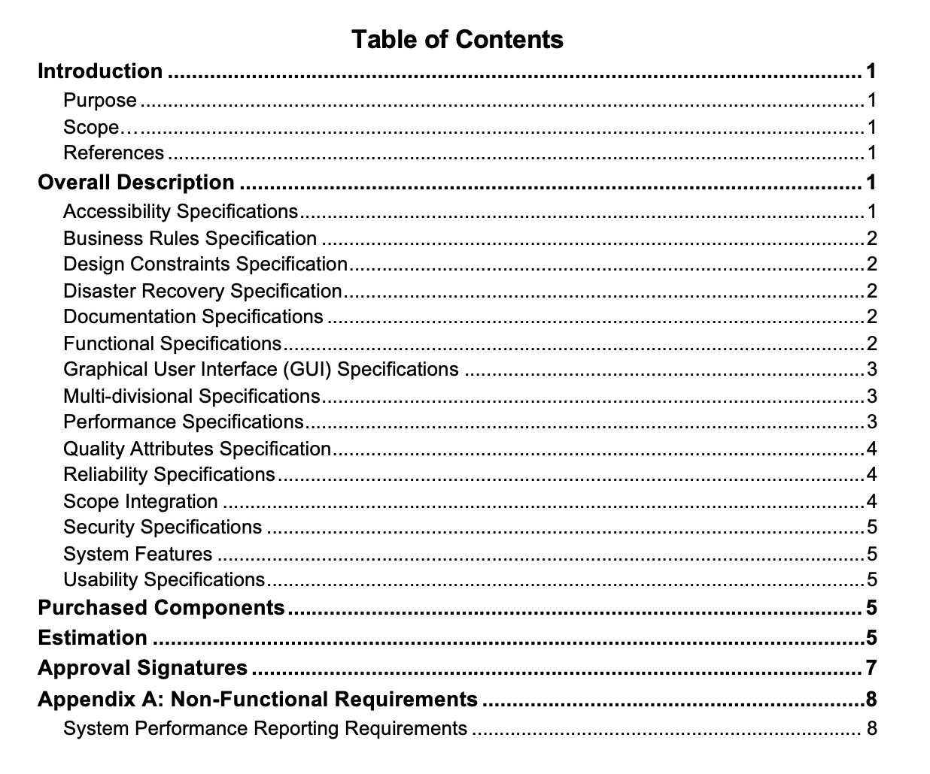
Sample Requirements Document
Table of Content
Lecture
08
8 – 17

Slide 18
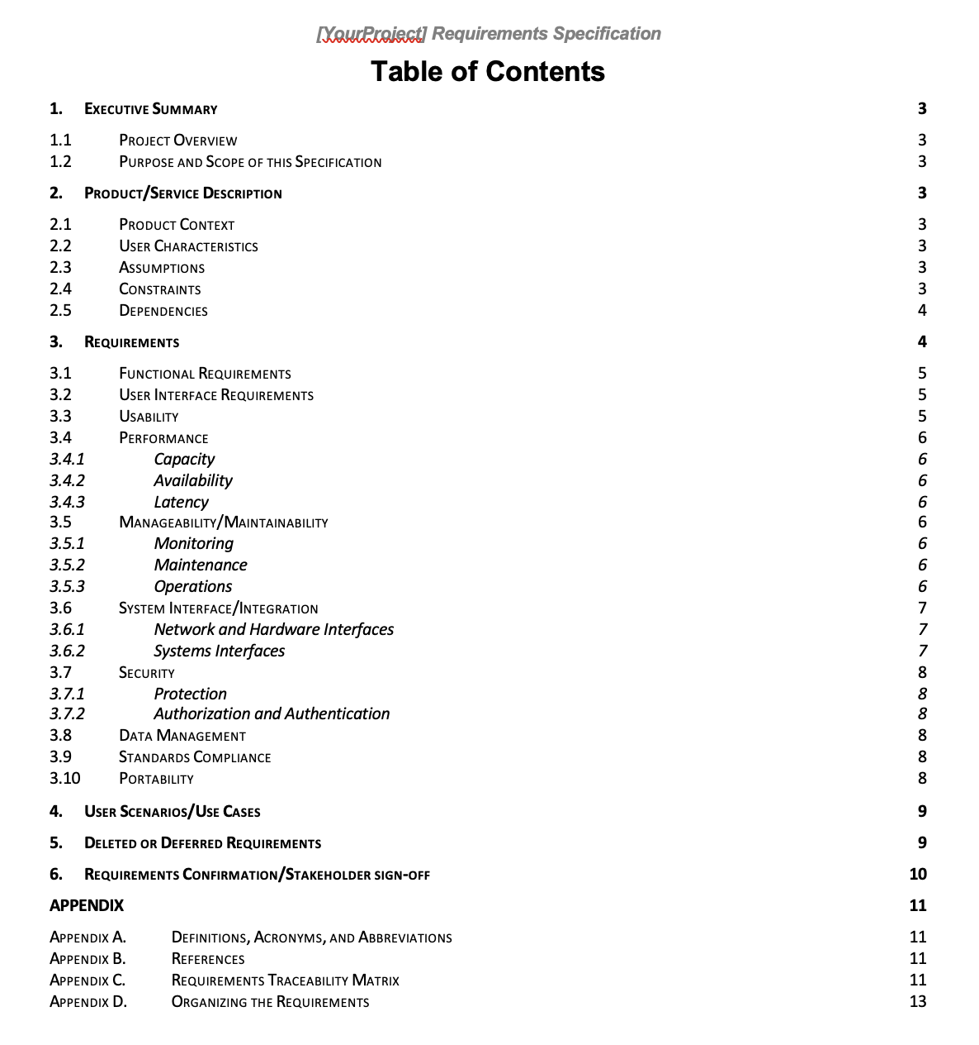
Sample Requirements Document
Table of Content
Lecture
08
8 – 18

Slide 19
Lecture
Business Requirement Document (BRD)
vs. Business Requirements Specifications (BRS)
08
Aspect | Business Requirements Document (BRD) | Business Requirements Specifications (BRS)
Definition | Outlines high-level business objectives, goals, and needs. | Translates high-level business needs into specific requirements.
Scope | Provides a broad overview of the business problem or opportunity. | Delves deeper into the specific functional requirements.
Audience | Stakeholders, executives, project sponsors. | Technical team (developers, designers, testers).
Content | Business objectives, current state analysis, desired future state, stakeholders, constraints, risks, assumptions. | Detailed functional requirements, user stories, use cases, acceptance criteria, data requirements.
Level of Detail | Focuses on 'what' rather than 'how'. | Provides granular view of 'how' the system should behave.
8 – 19

Slide 20
Writing, Categorizing and Prioritizing Requirements
Lecture
08
8 – 20

Slide 21

Lecture
SMART Requirements
08
Review and ensure ALL Defined requirements are SMART.
Example: Business Requirement for Operations: Reduce Order Processing time in operations from 2 hours to 30 min. by Dec. 2024
8 – 21

Slide 22
Lecture
Writing Requirements
08
Information should be transcribed into high-quality, well-formatted requirements to maximize their value to stakeholders and the project team.
Well-written requirements contribute to clarity, conciseness, and reduced conflict and confusion regarding project deliverables.
The structure and guidelines for documenting requirements depend on the selected project lifecycle.
8 – 22

Slide 23
Lecture
Writing Requirements
08
Requirements are typically documented in text format for developing business requirements documentation or solution requirements documents.
For projects following Agile lifecycle, requirements are often written in the format of user stories.
Regardless of the format, requirements can extend beyond text to include visual representations.
8 – 23

Slide 24
Lecture
Requirements Format
08
When the user clicks check button (condition), the system (subject) will (imperative) display (active verb) the inventory balance (object) allowing the user to buy the item (outcome).
Condition
Subject
Imperative
Active Verb
Object
Business rule (optional)
Output (optional)
8 – 24

Slide 25
Lecture
Requirements Format Example
08
When the structure is finished (condition), the workers (subject) will (imperative) move (active verb) the bricks beside the building (object) allowing Building of walls (outcome).
8 – 25

Slide 26
Lecture
Unambiguous Requirements
08
Clear and measurable
Avoids misunderstandings
Ambiguous | Unambiguous
the system will check the address field to be only alphanumeric and containing valid postal code. | 1.2.1 The system shall validate that: 1.2.1.1. Address field is alphanumeric 1.2.1.2 Postal code is entered 1.2.1.3 Postal code is valid
If store code entered does not match store codes on file, the system will display error message | 1.4.1 when store code entered, system will validate against store codes on file, and : - if store code matches, will move to next step, - If store code does not match, display “invalid store code”
8 – 26

Slide 27
Lecture
Consistent Requirements
08
No contradiction or redundancy.
Consistent language throughout the document
Inconsistent | Consistent
12.1.1 the Application will 17.2.3 the system should 19.1.4 the IT application will | 12.1.1 the IT Application System should 17.2.3 the IT Application System should 19.1.4 the IT Application System application should
8 – 27

Slide 28
Complete and Measurable Requirements
Lecture
08
More Information to make it more complete.
Being Specific and quantify information
Incomplete | Complete
The session should be terminated after some idle time. | The session should be terminated after 3 min. of idle time
The new production line capacity will be sufficient for 3 years. | The new production line capacity will be 500,000 tons which is sufficient for 3 years.
8 – 28

Slide 29
Lecture
Requirements Categorization
08
Business Requirements
Stakeholder Requirements
Solution Requirements
Transition Requirements
Product Requirements
Functional Requirements
Non-Functional Requirements
8 – 29

Slide 30
Lecture
Business Requirements
08
Business Goals, objectives
Constraints: budget, timescale, resources
Policies
Legal
Branding
Cultural
Language
Business Continuity
Examples:
All Documentation in Arabic (Language)
Need for Back up Site and installation (Business Continuity)
Design must be approved by risk department (Policies)
8 – 30

Slide 31
Lecture
Stakeholder Requirements
08
Needs of a stakeholder or a group of stakeholders
Sometimes to align with certain practice or standard followed by the stakeholder.
Examples:
Report requested by a certain department
Testing scenarios requested by a manager
Certain days to work on the project for a department
8 – 31

Slide 32
Lecture
Solution-Functional Requirements
08
Describe features and behaviors of the solution product.
Examples:
Features
Procedures and Processes
Fields and screens
Interfaces
8 – 32

Slide 33
Solution-Non-Functional Requirements
Lecture
08
Describe environmental conditions or qualities required by the solution product.
Examples:
Availability
Performance
Security Requirements
Access
Backup and Recovery
Maintenance
8 – 33

Slide 34
Lecture
Transition Requirements
08
Describe temporary capabilities to move from current state to future state.
Examples:
Training of IT personnel
Data Conversion
Dates and times to transition
8 – 34

Slide 35
Requirements Prioritization Schema
(MoSCoW)
Lecture
08
Defines how requirements will be prioritized.
Defined in Business Analysis Plan
Establishes prioritization rules
Done in workshops through:
  Voting
  Delphi Technique
Must Have (Mo)
Should HAVE (S)
Could Have (C)
Won’t Have (W)
8 – 35

Slide 36
Peer Review and Version Control for Requirements Document
Lecture
08
8 – 36

Slide 37
Lecture
Peer-Review
08
A structured evaluation process, where peers within the project team assess completeness, clarity, consistency, and correctness.
The aim is to identify errors, ambiguities, and discrepancies.
Ensures alignment with project objectives and stakeholder needs.
Leverages diverse perspectives and expertise within the team.
Facilitates constructive feedback and refinement before finalization.
Requirements Document
Peer Review
Present to Stakeholders for Validation and Approval
8 – 37

Slide 38
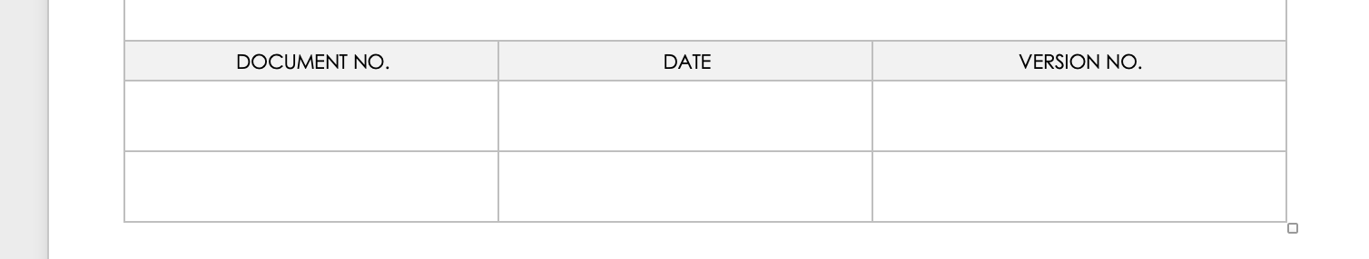
Lecture
Version Control
08
Version control ensures systematic management of changes in requirements documentation.
Vital for maintaining document integrity, consistency, and tracking revisions.
8 – 38

Slide 39
Lecture
Importance of Version Control
08
Facilitates collaboration
  Enables multiple team members to work on the document simultaneously.
Ensures traceability
  Tracks changes, allowing easy identification of who made specific edits and when.
Mitigates risks
  Helps prevent errors, conflicts, and loss of critical information.
8 – 39

Slide 40
Lecture
Best Practices for Version Control
08
Utilize dedicated version control software/tools.
1
Establish clear naming conventions for document versions.
2
Implement a review and approval process for changes.
3
Regularly back up documents to prevent data loss.
4
8 – 40

Slide 41
Lecture
Key Points
08
Requirements should be unambiguous, clear, consistent, and complete.
Requirements document as used to define Scope, WBS, and in contracts
Various formats for Requirements Document depending on project lifecycle and needs
Guidelines for writing, categorizing, and prioritizing requirements
Utilize Peer-review to refine document and implement version control.
8 – 41

Slide 42

For Discussion Panel:
Watch the video “Business Requirements Document BRD Tutorial & Template Walkthrough”
Download and Review “Business Requirements Document Template”
Reading, Chapter 10 “Documenting and Managing Requirements”
from textbook “Business Analysis” by James Cadle, Malcolm Eva, Keith Hindle, Debra Paul, 2nd edition
Lecture
08
For Discussion Panel and Next Lecture
8 – 42

Slide 43



Thank You

