Slide 1

MASTER'S THESIS
Plant Disease Detection Using
Deep Learning & AI Techniques
Mahmoud Al Ra'e | ID: 253001641 Hussein Mudeheg | ID: 253001186
Supervisor: Dr. Hager Saleh
College of Informatics | Midocean University, UAE
M.Sc. in Artificial Intelligence

Slide 2
Presentation Agenda
01
Background: AI, DL, CNN, ViT, IoT
02
Problem Statement
03
Related Work
04
Objectives & Contributions
05
Proposed Framework

Slide 3
Background: Core Technologies
Chapter 2
Artificial Intelligence (AI)
Deep Learning (DL)
CNN (Convolutional Neural Networks)
Enables machines to perform human-like tasks: learning, reasoning, decision-making. In agriculture: analyzes plant conditions, identifies diseases from images, and processes large datasets for early diagnosis.
Subset of AI using multi-layered neural networks. Automatically extracts hierarchical features without manual engineering. High efficiency in analyzing complex visual patterns in leaf images.
Leading DL model for image analysis. Learns spatial hierarchies of features. Architectures include VGG, ResNet, DenseNet, MobileNet — achieving >95% accuracy in plant disease tasks.
Transformer Model & ViT
Internet of Things (IoT)
Uses attention mechanisms instead of convolutions; captures global context. ViT divides images into patches, processes like words in a sentence. ~99% accuracy but requires large datasets.
Network of connected devices sharing real-time data. Cameras, sensors, drones monitor crops continuously. Combined with AI, enables real-time plant disease detection in smart farming systems.

Slide 4
Problem Statement
Chapter 1
30% - 40%
$220B
Early
AI
80%
Global Crop Loss
from Diseases
Annual Economic
Loss Worldwide
Detection is
Critical
Offers Scalable
Solution
Of human food
from plants
Farmers rely on personal experience / often inaccurate and subjective
Early disease cases are hard to detect visually
Many diseases appear similar and leading to frequent misdiagnosis
Varying field conditions (lighting, background, angles) complicate detection
Manual inspection is impractical for large scale farms
Need for an automated, fast and reliable AI-powered detection system

Slide 5
Related Work — Key Studies
Authors / Year
Model Used
Dataset
Accuracy
Key Focus
Too et al., 2019
DenseNet121
PlantVillage
~99.7%
Fine-tuning transfer learning across 38 disease classes
Chen et al., 2022
ViT-B/16
PlantDoc
~99%
ViT outperforms CNN in wild/real-world conditions
Islam et al., 2021
Dise-Efficient (EfficientNetV2)
PlantVillage + IP102
98–99%
Lightweight model for disease & pest identification
Talaat et al., 2026
CNN + IoT system
PlantVillage + Field
~97–99%
Real-time IoT-integrated disease monitoring
Aldakheel et al., 2024
YOLOv4
PlantVillage
mAP≈95%
Simultaneous detection & localization of disease regions
Duhan et al., 2025
RTR_Lite + MobileNetV2
Multi-dataset
~98%
Accurate & fast inference for mobile/edge deployment
Bhola & Kumar, 2025
CNN (VGG/ResNet/Inception)
Vegetable field
~92–93%
Early-stage vegetable disease detection from leaf images
Kheir et al., 2025
MobilePlantViT
Multi-crop
80–99%
Hybrid CNN+ViT balanced for mobile deployment

Slide 6
Related Work — Key Studies
Authors / Year
Model Used
Dataset
Accuracy
Key Focus
Castillo-Ossa & Corchado, 2025
EnConv (Enhanced CNN)
PlantVillage
~98–99%
Attention-enhanced CNN with improved interpretability
Real-Time Monitoring, 2024
CNN + VGG/DenseNet/MobileNet
PlantVillage + Camera
~95–97%
IoT-integrated real-time leaf disease detection system
CMI Constrained DL, 2024
CropLeafNet (ResNet+MobileNetV2)
PlantVillage
2–4% gain
Conditional mutual information for multi-disease detection
Rajput & Doddamani, 2024
BoVW + DSIFT + SVM/LightGBM
Pigeon Pea (custom)
~92–95%
Traditional feature extraction for pigeon pea diseases
Singh et al., 2020
Faster R-CNN / SSD
PlantDoc
Moderate
Real-world dataset — complex backgrounds & lighting
Tan & Le, 2019
EfficientNet (B0–B7)
PlantVillage
>99%
Balanced depth/width/resolution scaling for efficiency
He et al., 2016
ResNet (50/101/152)
ImageNet
High baseline
Residual learning with skip connections for deep networks

Slide 7
Objectives & Contributions
Chapter 1
SPECIFIC OBJECTIVES
GENERAL OBJECTIVE
O1
Apply & evaluate DL models: CNN, ViT, Swin Transformers
Develop an intelligent system for plant disease detection from leaf images using AI and Deep Learning.
The study aims to improve the accuracy and speed of disease diagnosis to support early detection and better crop management.
O2
Compare models on accuracy, efficiency & real-world suitability
O3
Test robustness under varying field conditions
KEY CONTRIBUTION
O4
Explore IoT integration for smart agriculture
A comprehensive comparison framework evaluating CNN based and Transformer based for plant disease detection, with real-world IoT integration bridging laboratory accuracy with practical field deployment.

Slide 8
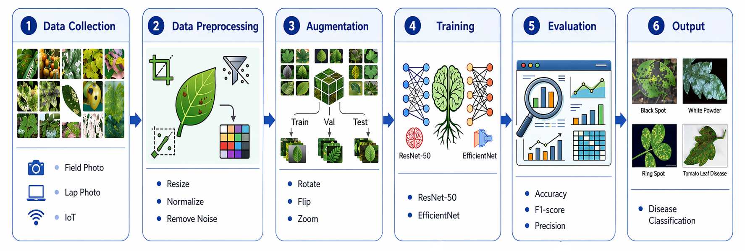
Proposed Framework
Methodology
Detection Models

Slide 9
Thank You

