Slide 1

Risk Registers
Lecture 9
Everyone’s Smart
University
PMG510
Risk Management

Slide 2

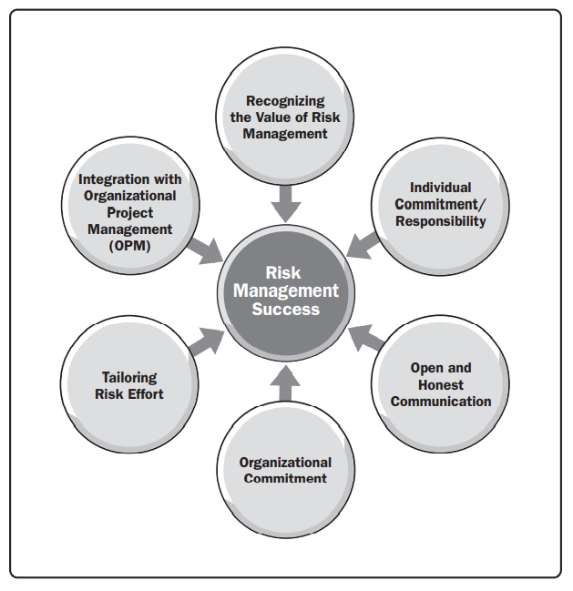
Key success factors for risk management

Slide 3


Plan Risk Responses
What is The objectives of project risk management?!
The objectives of project risk management are to increase the probability and/or impact of positive risks and to decrease the probability and/or impact of negative risks, in order to optimize the chances of project success.
Individual Risk
Threats
Overall Risk
Opportunities
IMPACT
PROBABILITY

Slide 4
Plan Risk Responses (cont.)
STRATEGIES FOR THREATS
Escalate. appropriate when a threat is outside the scope of the project. PM determines who should be notified about the threat and communicates the details to it.
Avoid. when the project team acts to eliminate the threat or protect the project from its impact. appropriate for high-priority threats with a high probability of occurrence and a large negative impact.
Transfer. shifting ownership of a threat to a third party to manage the risk
Mitigate. action is taken to reduce the probability of occurrence and/or impact of a threat.
Accept. acknowledges the existence of a threat, but no proactive action is taken, appropriate for low-priority threats.
STRATEGIES FOR OPPORTUNITIES
Escalate.
Exploit. The exploit strategy may be selected for high-priority opportunities where the organization wants to ensure that the opportunity is realized. by ensuring that it definitely happens, increasing the probability of occurrence to 100%
Share. Sharing involves transferring ownership of an opportunity to a third party so that it shares some of the benefit if the opportunity occurs.
Enhance. used to increase the probability and/or impact of an opportunity.
Accept. Accepting an opportunity acknowledges its existence but no proactive action is taken. This strategy may be appropriate for low-priority opportunities.

Slide 5
Risk Registers
Risk is an uncertain event that, if it occurs has a positive or negative effect on one or more project objectives
Risk Register is a Log file which works as a master database of all the risks ever captured and other related information like Qualitative Analysis, Quantitative Analysis and risk response planned with the owner.
There is No such standard as risk register template, it Based on organizations and industries, project managers should develop register as per there organization assets.

Slide 6
Common Risk Register attributes
Risk Identification
1. Risk ID – This is a unique identification number used to identify and track the risk in the risk register. If Resources is Category 8, then the first risk identified in this category has a unique ID of 8.1.
2. Risk Category – This is where you categorize your risk. Does it fall under the category of scope, time, cost, resources, environmental, or another key category? Using these categories helps tease out likely risks and groups them into relevant categories for future reference.
3. Risk Description – A brief description of the potential risk
Risk Analysis data
4. Project Impact – A description of the potential impact on the project as a result of the risk.
5. Likelihood – The estimated likelihood or probability that the risk will occur at some point and become a project issue. This can be qualitative: high, medium, or low; but it can also be quantitative if enough information is available.
6. Consequence – The potential consequence or impact of the risk if it did become a project issue. For our project, time is a fixed constraint, and so any risk that has the potential to significantly delay the project schedule has a “High” consequence.

Slide 7
Common Risk Register attributes
Risk Evaluation
7. Risk Rank – This is the magnitude or the level of the risk. It is a combination of likelihood and consequence. As they are both “High” in our example, then the risk rank is also “High.”
8. Risk Trigger – What are the triggers that would indicate the need to implement contingency plans? “If resource conflicts have not been resolved three weeks before the scheduled start date, then implement contingency plans.”
Risk Treatment
9. Prevention Plan – This is an action plan to prevent the risk from occurring.
10. Contingency Plan – This is an action plan to address the risk if it does occur.
11. Risk Owner – This is the person responsible for managing the risk and implementing the Prevention or Contingency Plans. 12. Residual Risk – This is the risk that remains after treatment is carried out. After treatment, we assess the residual risk level as “Low.”

Slide 8
Common Risk Register attributes
Risk Evaluation
7. Risk Rank – This is the magnitude or the level of the risk. It is a combination of likelihood and consequence. As they are both “High” in our example, then the risk rank is also “High.”
8. Risk Trigger – What are the triggers that would indicate the need to implement contingency plans? “If resource conflicts have not been resolved three weeks before the scheduled start date, then implement contingency plans.”
Risk Treatment
9. Prevention Plan – This is an action plan to prevent the risk from occurring.
10. Contingency Plan – This is an action plan to address the risk if it does occur.
11. Risk Owner – This is the person responsible for managing the risk and implementing the Prevention or Contingency Plans. 12. Residual Risk – This is the risk that remains after treatment is carried out. After treatment, we assess the residual risk level as “Low.”

Slide 9
Developing Risk management Unit
Train the risk team by apply the framework
Develop framework and templates
Sustain the operation and create the value
Develop governance model
Reporting and enhancing
Define the service boundaries

Slide 10
Case Study
Risk Identification
1. Risk ID
2. Risk Category
3. Risk Description
Risk Analysis data
4. Project Impact
5. Likelihood
6. Consequence
مشروع مترو الرياض
مشروع الهايبر لوب
مشروع مرآة للطاقة الشمسية
Risk Evaluation
https://www.youtube.com/watch?v=Pc4UWaL6nWQ
https://www.youtube.com/watch?v=samP9vrgmGg&t=78s
https://www.youtube.com/watch?v=SMlb_QboAxM
7. Risk Rank
8. Risk Trigger
Risk Treatment
9. Prevention Plan
10. Contingency Plan
11. Risk Owner
12. Residual Risk

Slide 11
Case Study
Risk Identification
1. Risk ID
2. Risk Category
3. Risk Description
Risk Analysis data
4. Project Impact
5. Likelihood
6. Consequence
Risk Evaluation
7. Risk Rank
8. Risk Trigger
Risk Treatment
9. Prevention Plan
10. Contingency Plan
11. Risk Owner
12. Residual Risk

