Slide 1



Dimensional Modeling
Prepared by Dr. Amjad Qtaish
DS601
Data Mining
Lecture 10

Slide 2




Lecture: #10
Dimensional Modeling
Dr. Amjad Qtaish
Faculty of Informatics
Midocean University
Data Mining (DS601)
www.midocean.ae

Slide 3
Chapter
Outline
10
    Dimensional Modeling
• Inmon versus Kimball Paradigm
• What is Dimensional Modeling?
• Why not Relational Modeling?
• Relational Model vs Dimensional Model
• Fact and Dimension Tables
Data Mining, Dr. Amjad Qtaish
3
www.midocean.ae

Slide 4
Chapter
Inmon versus Kimball Paradigm
10
• Two Models for Data Warehouses
– Imnon Model
– Kimball Model
• Inmon Model
– Consists of all databases and information systems in an
organization
– Also called the CIF (Corporate Information Factory)
– Defines overall database environment as:
• Operational
• Atomic data warehouse
• Departmental
• Individual
– The Warehouse is part of the bigger whole (CIF)
Data Mining, Dr. Amjad Qtaish
4
www.midocean.ae

Slide 5
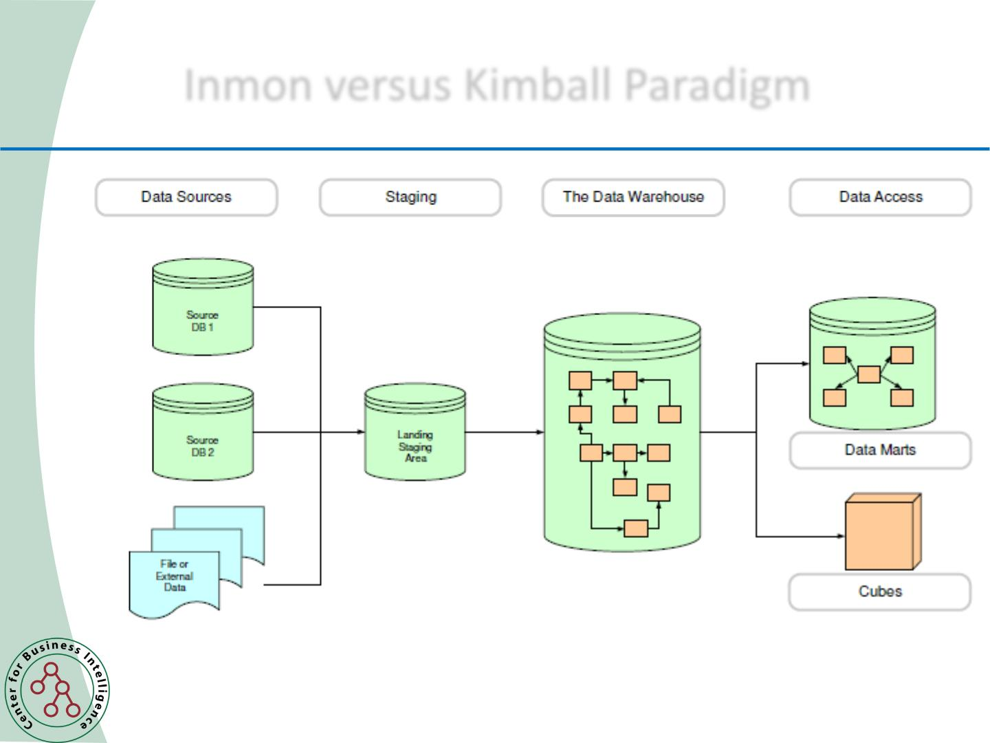
Chapter
Inmon versus Kimball Paradigm
10
Inmon Model
Data Mining, Dr. Amjad Qtaish
5
www.midocean.ae

Slide 6
Chapter
Inmon versus Kimball Paradigm
10
• Kimball Model
– The Dimensional Data Model
• Does not adhere to normalization theory
• Starts with tables
– Numeric Tables
– Context Tables
• User accessible
Data Mining, Dr. Amjad Qtaish
6
www.midocean.ae

Slide 7
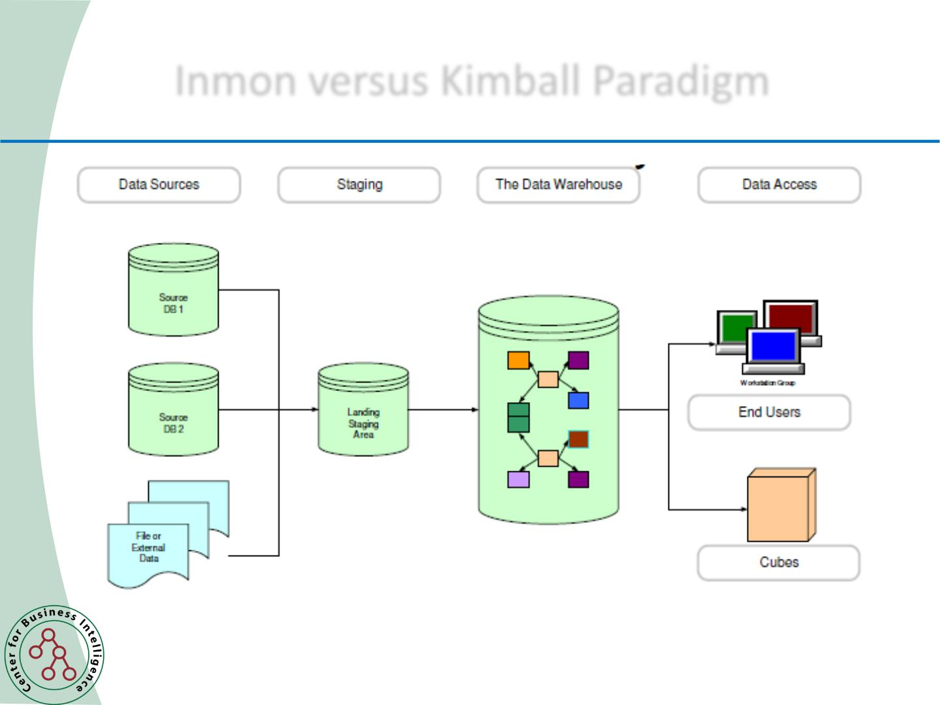
Chapter
Inmon versus Kimball Paradigm
10
Kimball Model
Data Mining, Dr. Amjad Qtaish
7
www.midocean.ae

Slide 8

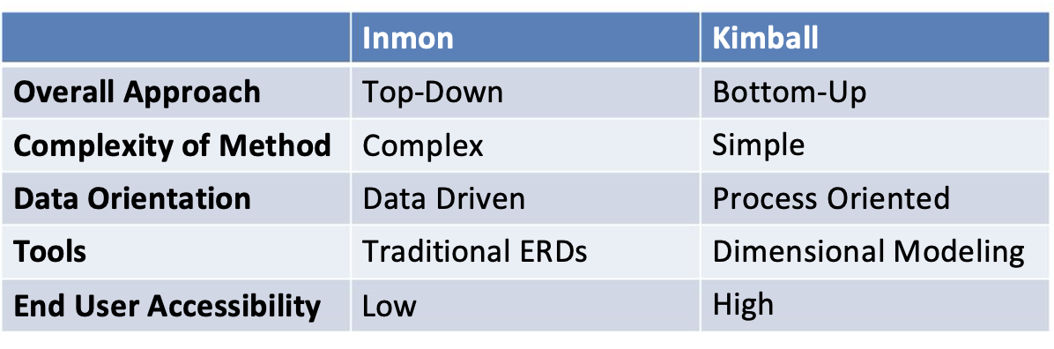
Chapter
Inmon versus Kimball Paradigm
10
Data Mining, Dr. Amjad Qtaish
8
www.midocean.ae

Slide 9
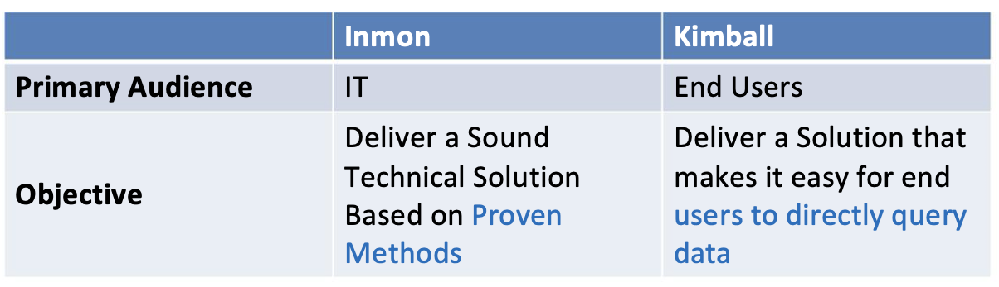
Chapter
Inmon versus Kimball Paradigm
10
Data Mining, Dr. Amjad Qtaish
9
www.midocean.ae

Slide 10
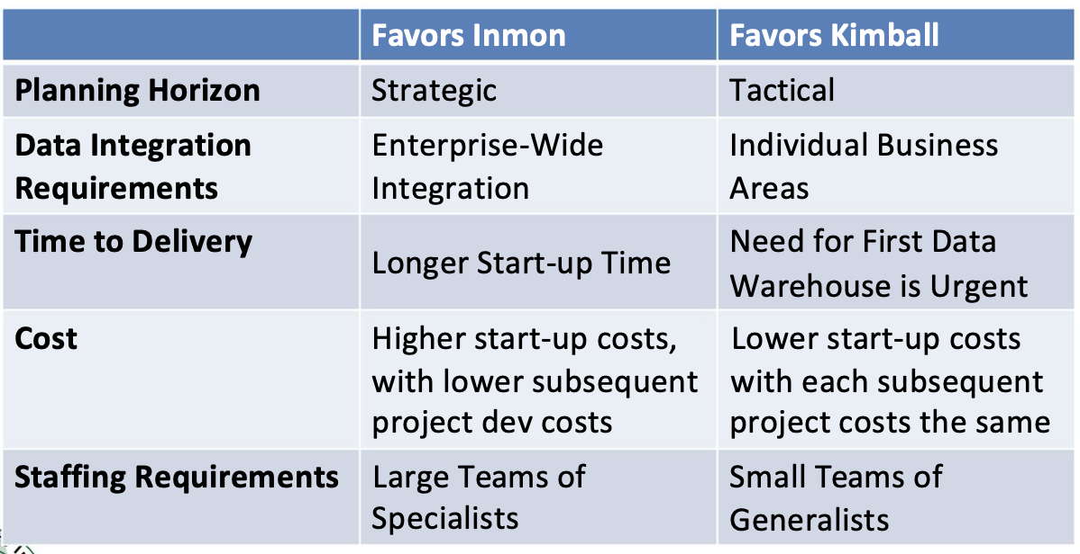
Chapter
Inmon versus Kimball Paradigm
10
Data Mining, Dr. Amjad Qtaish
10
www.midocean.ae

Slide 11
Chapter
Outline
10
    Dimensional Modeling
• Inmon versus Kimball Paradigm
• What is Dimensional Modeling?
• Why not Relational Modeling?
• Relational Model vs Dimensional Model
• Fact and Dimension Tables
Data Mining, Dr. Amjad Qtaish
11
www.midocean.ae

Slide 12
Chapter
What is Dimensional Modeling?
10
• Dimensional modeling is a logical design technique for
structuring data so such that
– It is intuitive for business users
– And delivers fast query performance.
• Widely accepted as the preferred approach for DW presentation.
• Simplicity is fundamental to usefulness.
• Allows software to easily navigate databases.
Data Mining, Dr. Amjad Qtaish
12
www.midocean.ae

Slide 13
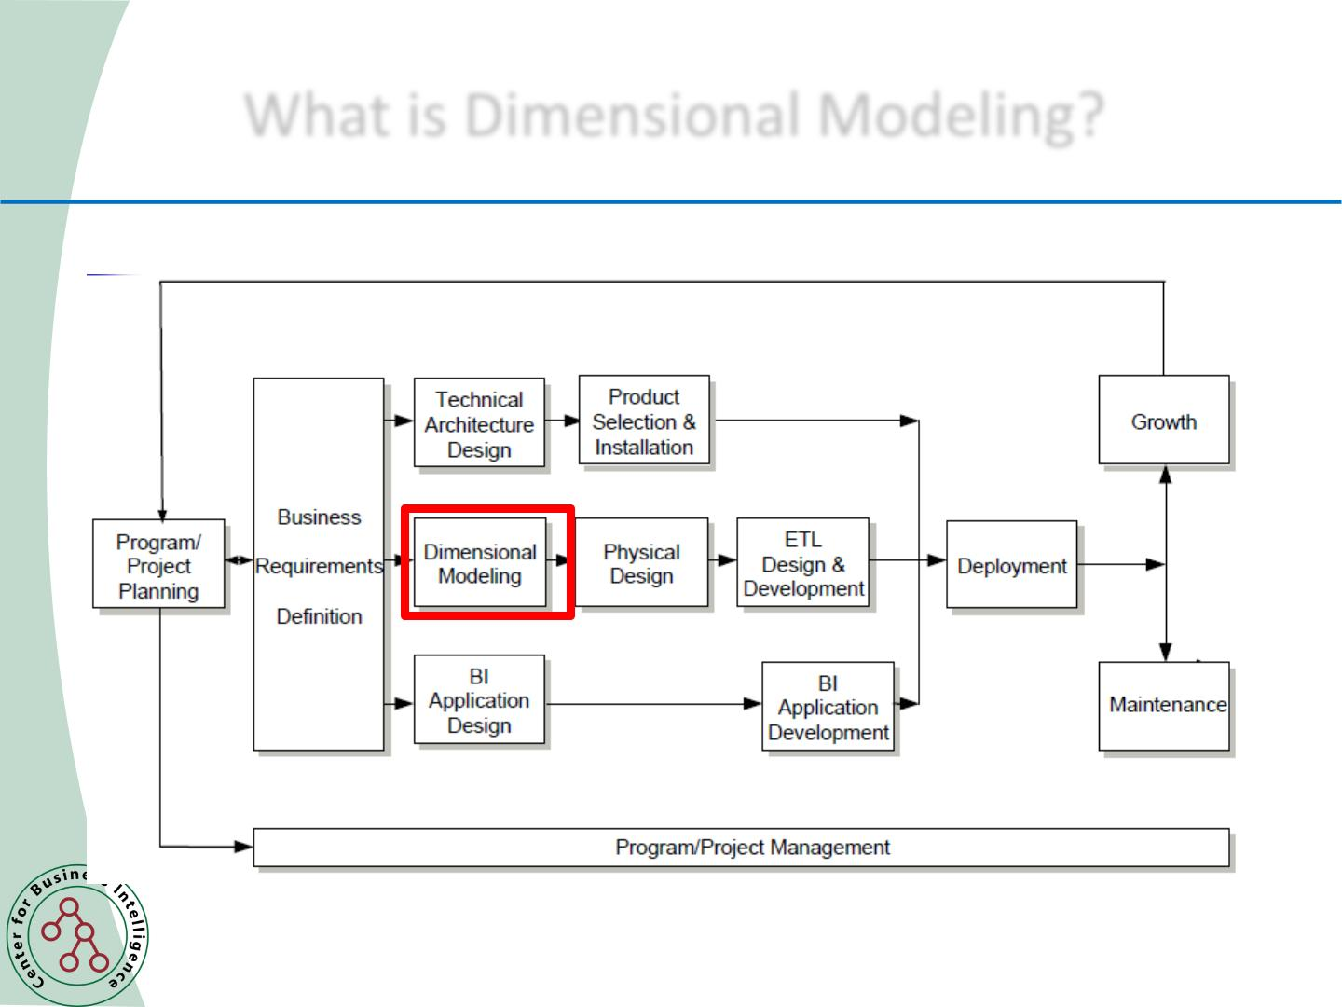
Chapter
What is Dimensional Modeling?
10
5.1 cm
The Kimball Lifecycle
Data Mining, Dr. Amjad Qtaish
13
www.midocean.ae

Slide 14
Chapter
What is Dimensional Modeling?
10
5.1 cm
• Divides world into measurements and context.
• Measurements are numeric values called facts.
• Context intuitively divided into clumps called dimensions.
• Dimensions describe the “who, what, where, when, w hy,
and how” of the facts.
• A dimensional model consists of a fact table containing
measurements surrounded by a halo of dimension tables
containing textual context.
• Known as a star join.
• Known as a star schema when stored in a relational
database (RDBMS).
Data Mining, Dr. Amjad Qtaish
14
www.midocean.ae

Slide 15
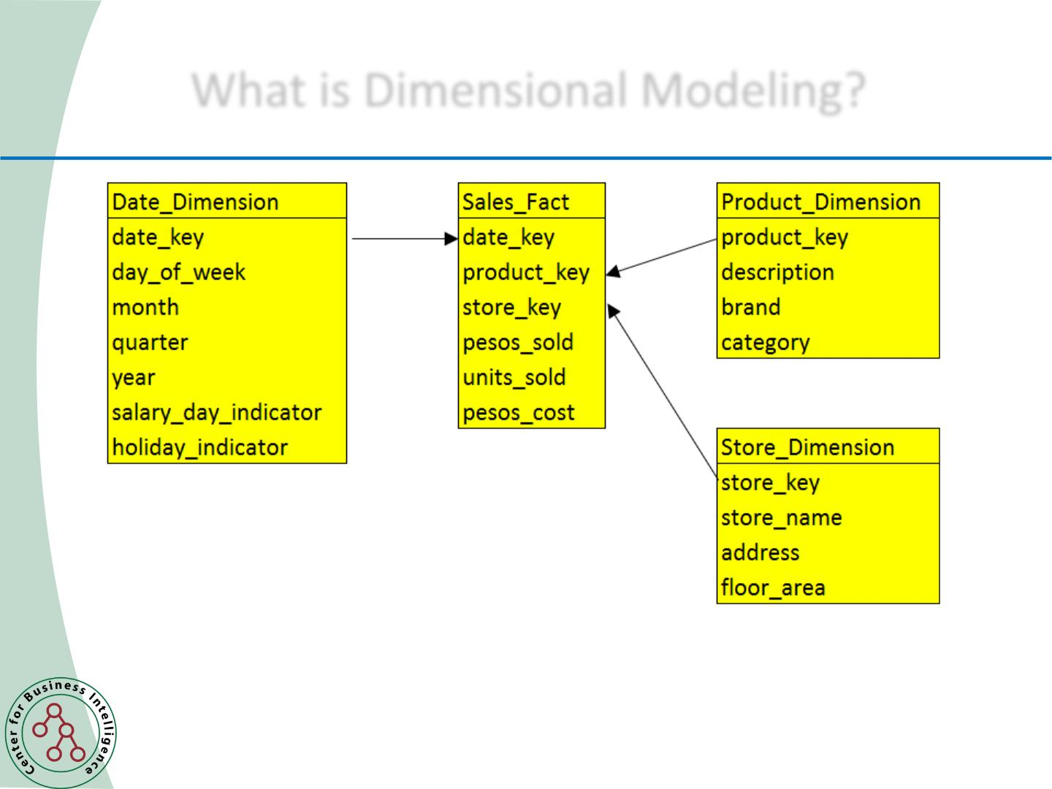
Chapter
What is Dimensional Modeling?
10
5.1 cm
Typical Dimensional Model
Data Mining, Dr. Amjad Qtaish
15
www.midocean.ae

Slide 16
Chapter
Standard SQL Query Template
10
5.1 cm
SELECT p.brand, sum(f.pesos_sold),
sum(f.units_sold)
FROM sales_fact f, product_dim p, date_dim d
WHERE f.productkey = p.productkey
and f.datekey = d.datekey
and d.quarter = ‘1 Q 2015’
GROUP BY p.brand
ORDER BY p.brand
Data Mining, Dr. Amjad Qtaish
16
www.midocean.ae

Slide 17
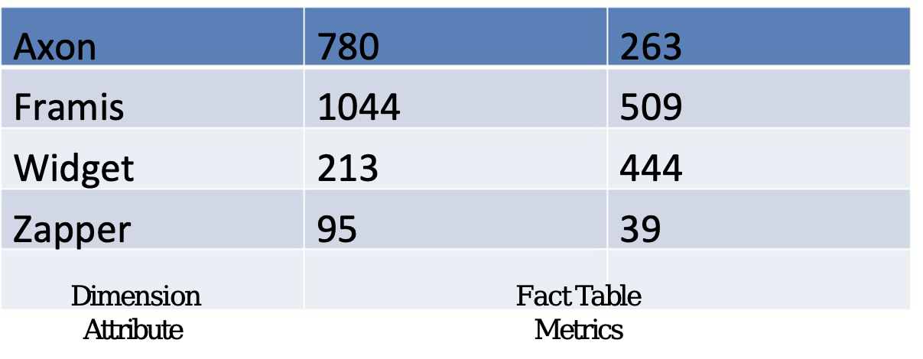
Chapter
Typical Dimensional Answer Set
10
5.1 cm
Data Mining, Dr. Amjad Qtaish
17
www.midocean.ae

Slide 18
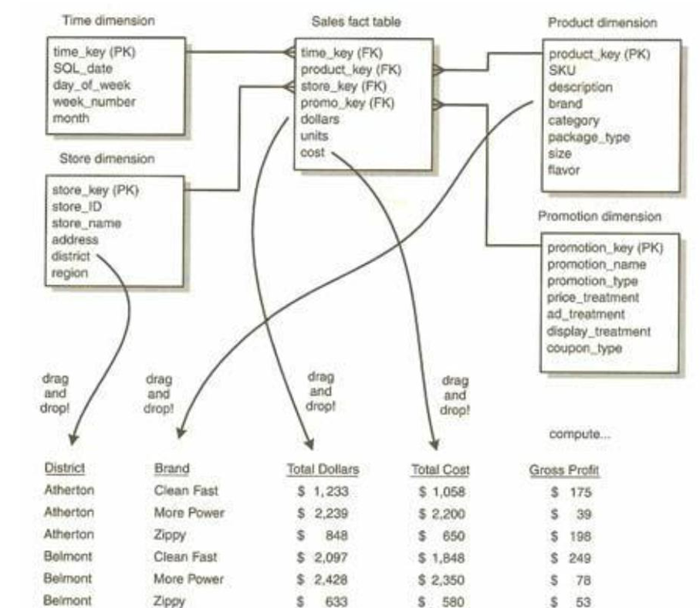
Chapter
Creating a Report by Drag and Drop
10
5.1 cm
Data Mining, Dr. Amjad Qtaish
18
www.midocean.ae

Slide 19
Chapter
Relating a Star Schema to a Report
10
5.1 cm
• Drilling down = “give me more detail” by adding a row
header (to an existing SQL request)
• Real drill down can mix hierarchical and non-hierarchical
attributes from all available dimensions
Data Mining, Dr. Amjad Qtaish
19
www.midocean.ae

Slide 20
Dimension Attributes Yield Interesting Results
Chapter
10
5.1 cm
• Dimension attributes are the source of most interesting
constraints
• Examples
– Slice sales by product category, by region, by barangay
– Analyze sales effectiveness on radio promotions via the AdType
attribute in Promotions dimension
Data Mining, Dr. Amjad Qtaish
20
www.midocean.ae

Slide 21
Chapter
Outline
10
    Dimensional Modeling
• Inmon versus Kimball Paradigm
• What is Dimensional Modeling?
• Why not Relational Modeling?
• Relational Model vs Dimensional Model
• Fact and Dimension Tables
Data Mining, Dr. Amjad Qtaish
21
www.midocean.ae

Slide 22
Chapter
Relational Modeling
10
5.1 cm
• Widely used method in most databases nowadays
• Data is divided into discrete entities
– each of which becomes a relational database table called an entity
• Models are shown in two forms – logical and physical
• Logical models are designed to be independent of any
particular RDBMS.
– The “tables” in a logical model are called entities. The “columns”
are called attributes.
• Physical models are derived from logical models but are
specific to a given RDBMS.
• Each entity has a unique identifier known as its primary key.
• The primary key consists of one or more attributes/columns.
Data Mining, Dr. Amjad Qtaish
22
www.midocean.ae

Slide 23
Chapter
Normalized Models
10
5.1 cm
• Designed to eliminate redundancies. Other than keys, each attribute
may appear in only one table.
• Design objective: a Third Normal Form (3NF) model.
• Modeling business processes results in numerous data entities/tables
and a spaghetti-like interweaving of relationships among them.
– Some ERP systems have tens of thousands of tables.
– Even a small model can be challenging.
Data Mining, Dr. Amjad Qtaish
23
www.midocean.ae

Slide 24
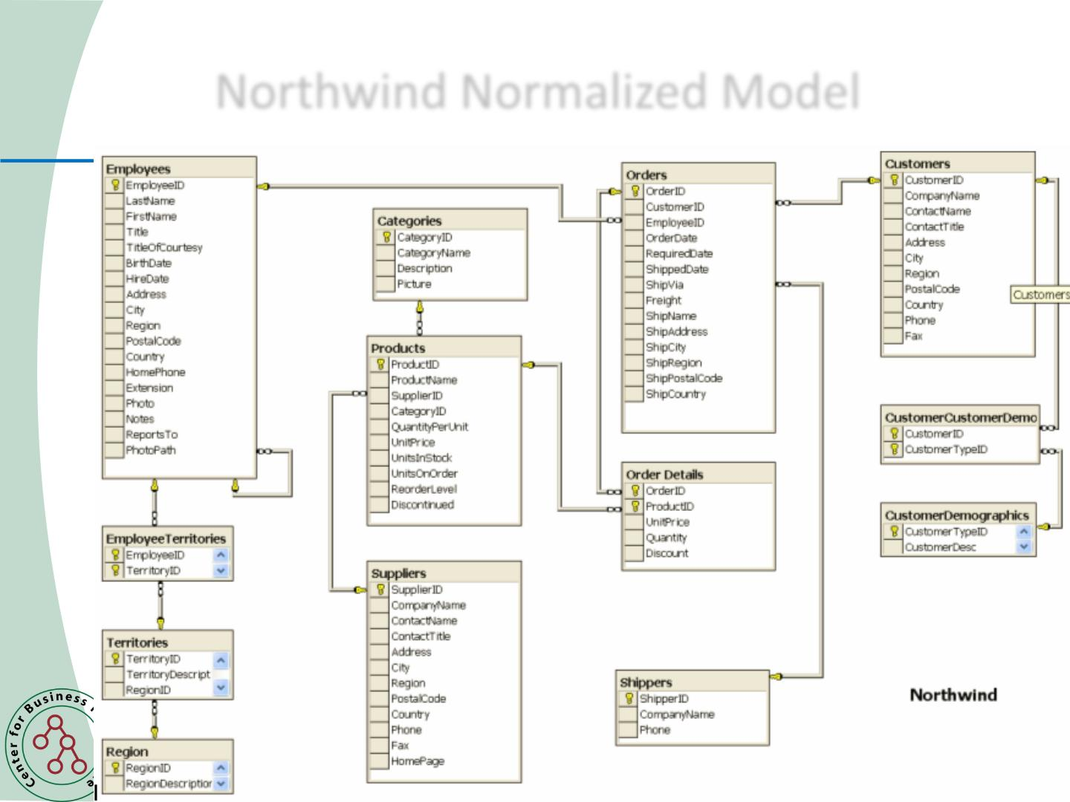
Chapter
Normalized Models
10
5.1 cm
Data Mining, Dr. Amjad Qtaish
24
www.midocean.ae

Slide 25
Chapter
Normalized Models
10
5.1 cm
Normalized Models NO Good for DW Systems
• Not usable by end-users – too complicated and confusing
• Not usable for DW queries – performance too slow (many
• Normalized models essential to good operational systems
– Excellent for capturing and understanding the business (rules)
• One PO, multiple Line Items
– Great for speed when processing individual transactions
Data Mining, Dr. Amjad Qtaish
25
www.midocean.ae

Slide 26
Chapter
Observations on Relational Models
10
5.1 cm
• Normalized models look very different from dimensional models
– Normalized models confuse business users
– Business users see their business in dimensional models
• Dimensional models may contain more content than normalized models
– History
– Enhanced with content from external sources
Data Mining, Dr. Amjad Qtaish
26
www.midocean.ae

Slide 27
Two Key Benefits of Dimensional Modeling à la Kimball
Chapter
10
5.1 cm
• Understandability
– Model must be easily understood by business users
– Yet represent complexities of the business
• Performance
– Fast response to queries that summarize millions of rows is essential
– Limiting models to single level joins rather than multi-level joins
– Denormalization has a significant impact on performance
Data Mining, Dr. Amjad Qtaish
27
www.midocean.ae

Slide 28
Chapter
Benefits of Dimensional Models
10
5.1 cm
• Predictable, Standard Framework
– Users recognize that this is “their business”
– Report writers, query tools, and user interfaces can be built into BI tools
– Makes user interfaces more understandable
– Makes processing more efficient
• Gracefully Extensible to Accommodate Change
– Existing tables can be changed by adding new data rows
• Data should not have to be reloaded
– No query tool or reporting tool has to be reprogrammed
– Old BI applications continue to run without yielding different results
Data Mining, Dr. Amjad Qtaish
28
www.midocean.ae

Slide 29
Chapter
Benefits of Dimensional Models
10
5.1 cm
• Star Join Schema is Symmetrical
– Every dimension is equivalent
– All dimensions symmetrically equal entry points to the fact table
• No concern about order in selecting tables
– Logical design can be done nearly independent of expected query patterns
• Future queries not thought of can be accommodated easily
– User interfaces, query strategies, and SQL generated are all symmetrical
• Standard Approaches for Common Modeling Situations
– Role-playing dimensions
• Sales Date versus Received Date
– Slowly changing dimensions
– Heterogeneous products
• Need to track lines of business together
• But each LOB product set is highly idiosyncratic
Data Mining, Dr. Amjad Qtaish
29
www.midocean.ae

Slide 30
Chapter
Benefits of Dimensional Models
10
5.1 cm
• Aggregate Management
– Aggregate tables are summary tables
• Example: monthly sales fact table with month dimension
– A sound aggregate strategy is essential to good performance and economic
processing
Data Mining, Dr. Amjad Qtaish
30
www.midocean.ae

Slide 31
Chapter
Outline
10
    Dimensional Modeling
• Inmon versus Kimball Paradigm
• What is Dimensional Modeling?
• Why not Relational Modeling?
• Relational Model vs Dimensional Model
• Fact and Dimension Tables
Data Mining, Dr. Amjad Qtaish
31
www.midocean.ae

Slide 32
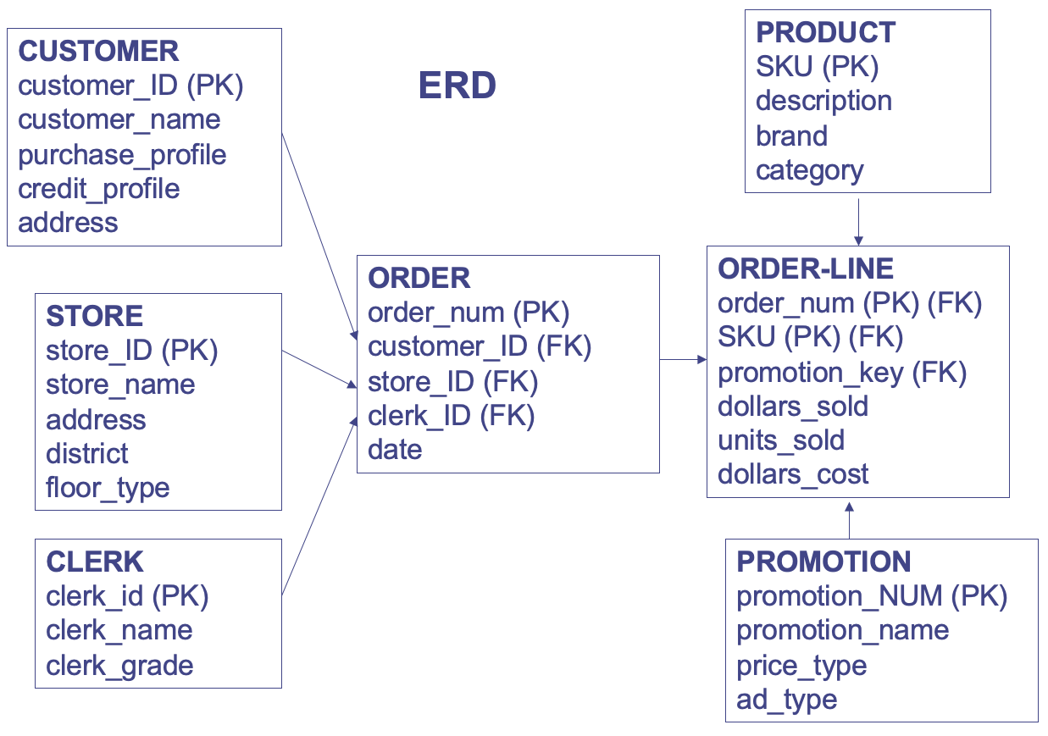
Chapter
Relational Model
10
5.1 cm
Data Mining, Dr. Amjad Qtaish
32
www.midocean.ae

Slide 33
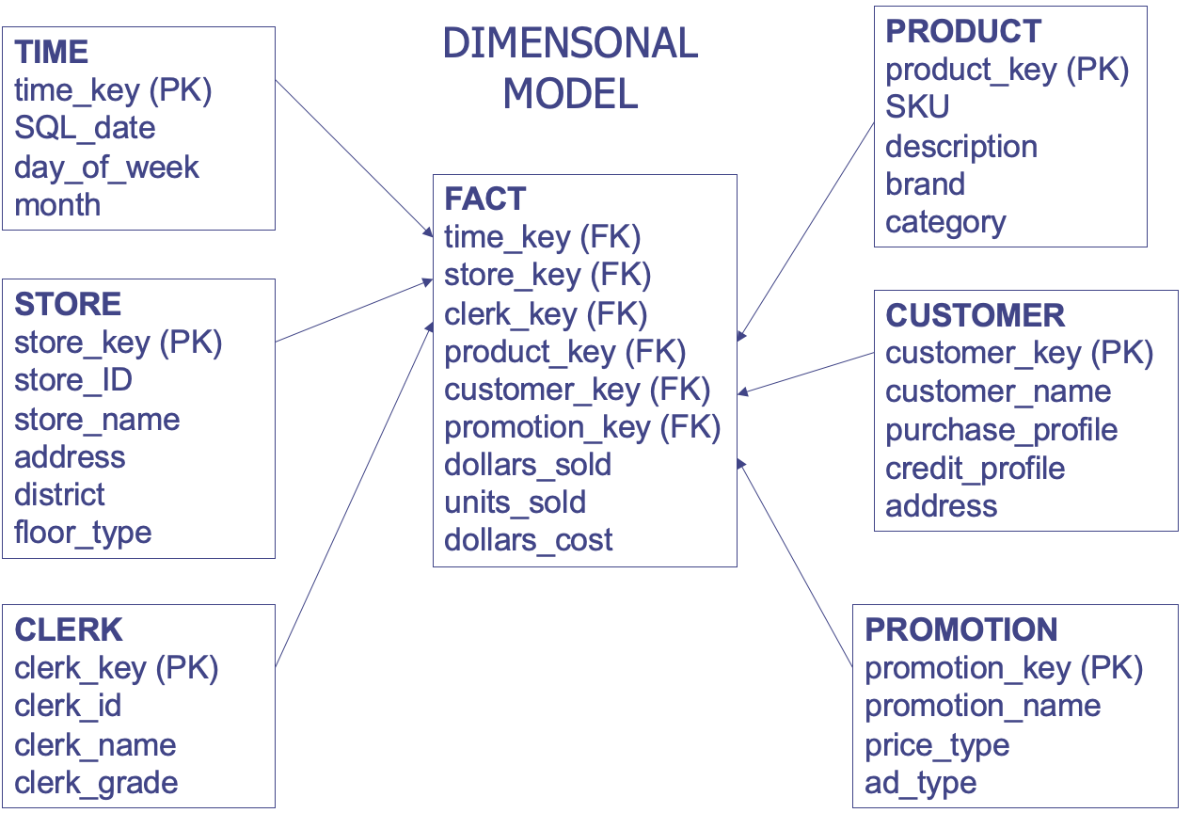
Chapter
Dimensional Model
10
5.1 cm
Data Mining, Dr. Amjad Qtaish
33
www.midocean.ae

Slide 34
Chapter
Relational Model vs. Dimensional Model
10
5.1 cm
Reltional Model Dimensional Model
One table per entity
Minimize data redundancy
Optimize update
The Transaction Processing Model
One fact table for data organization
Maximize understandability
Optimized for retrieval
The data warehousing model
Data Mining, Dr. Amjad Qtaish
34
www.midocean.ae

Slide 35
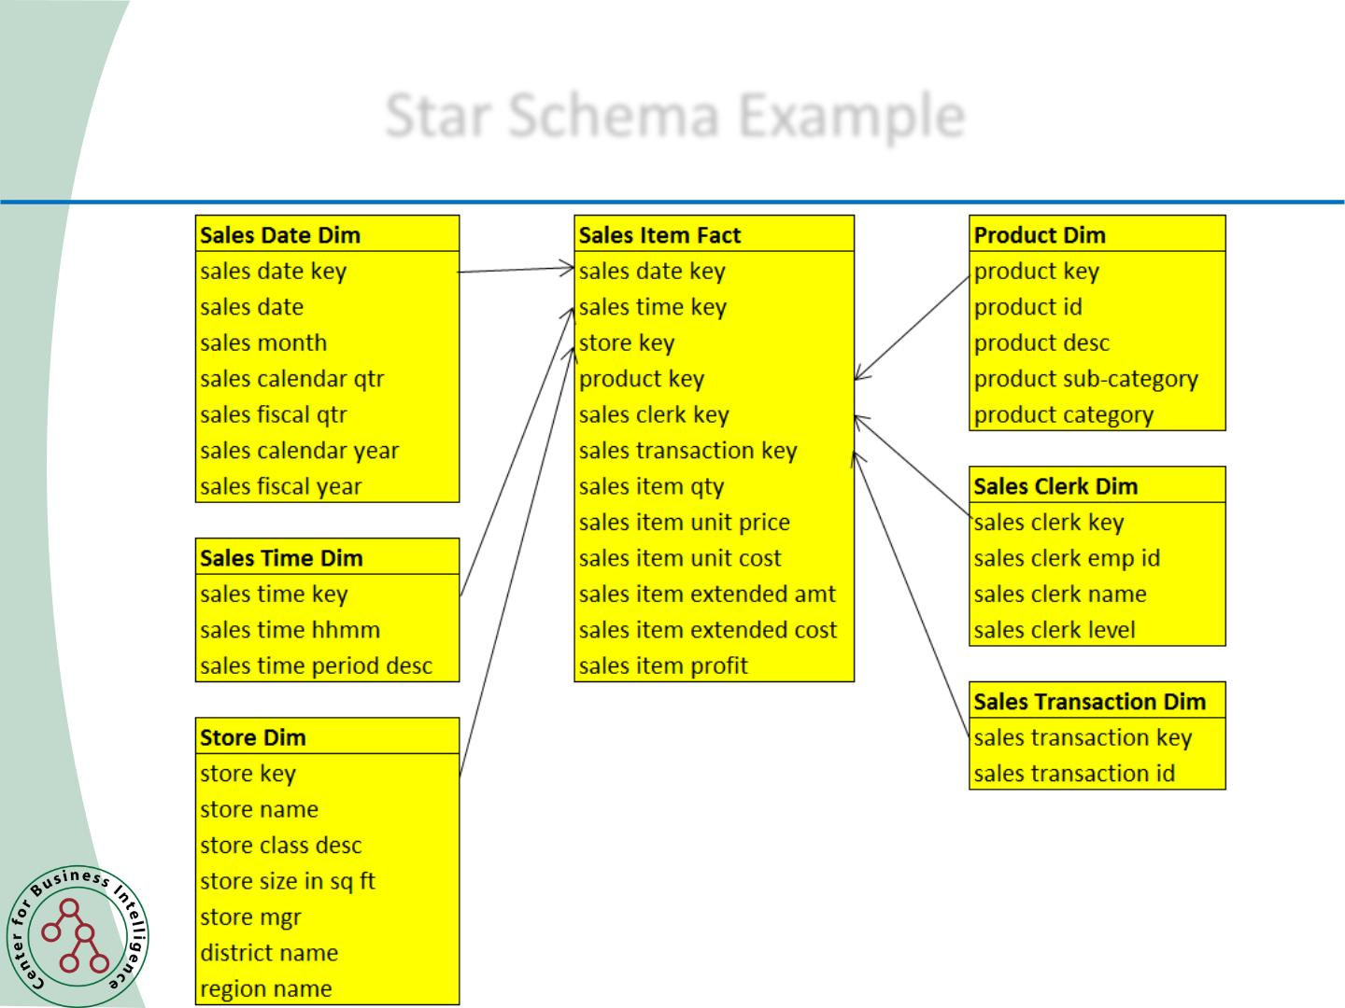
Chapter
Star Schema Example
10
5.1 cm
Data Mining, Dr. Amjad Qtaish
35
www.midocean.ae

Slide 36
Chapter
Outline
10
    Dimensional Modeling
• Inmon versus Kimball Paradigm
• What is Dimensional Modeling?
• Why not Relational Modeling?
• Relational Model vs Dimensional Model
• Fact and Dimension Tables
Data Mining, Dr. Amjad Qtaish
36
www.midocean.ae

Slide 37
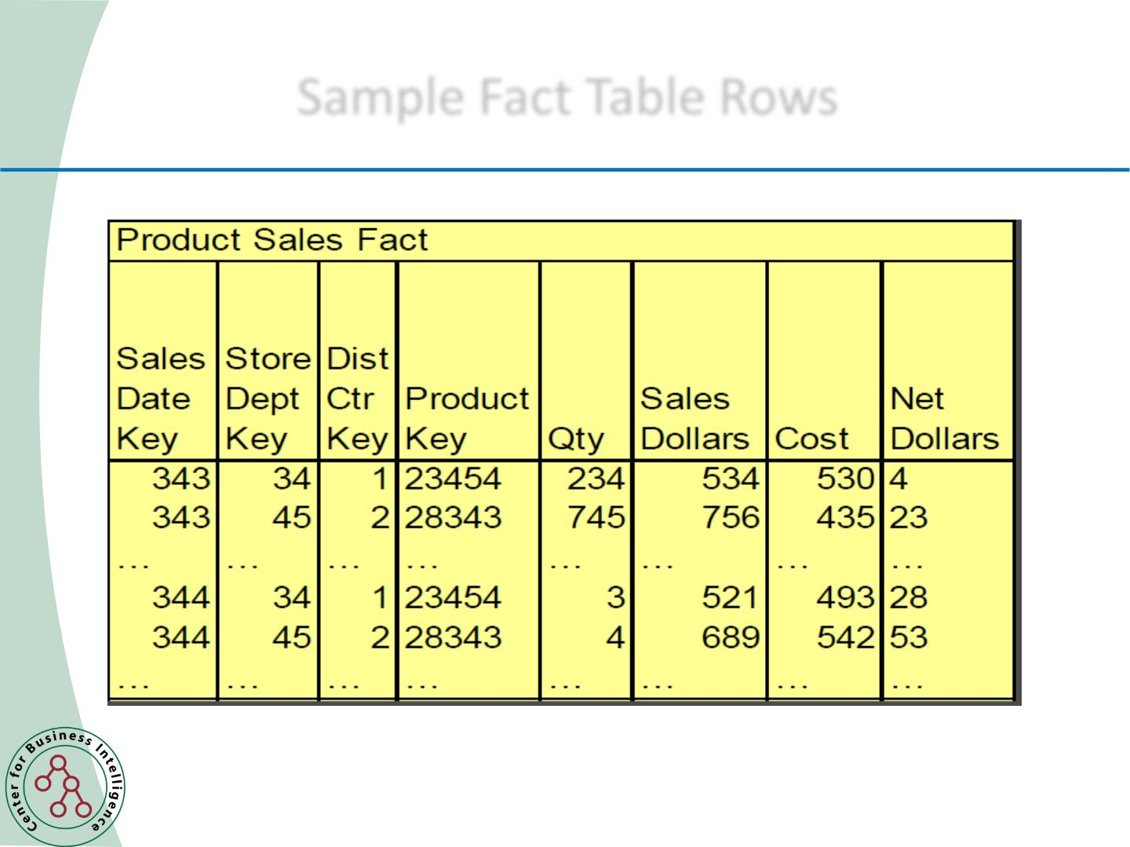
Chapter
Sample Fact Table Rows
10
5.1 cm
Data Mining, Dr. Amjad Qtaish
37
www.midocean.ae

Slide 38
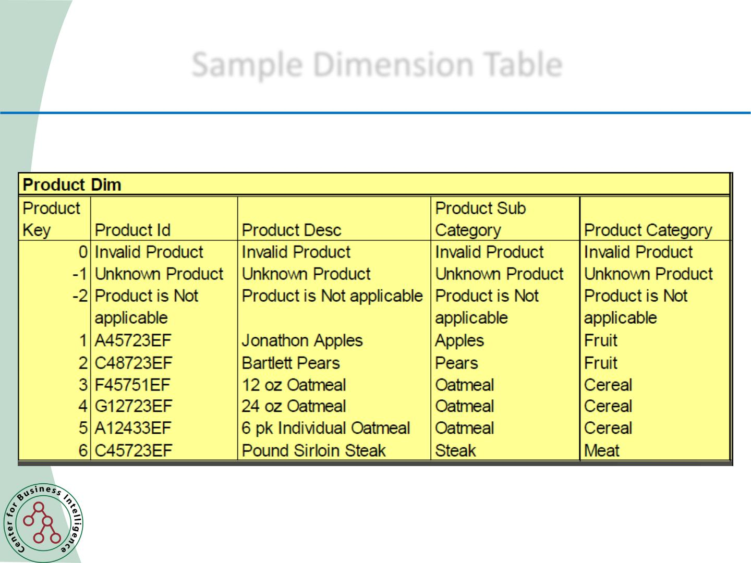
Chapter
Sample Dimension Table
10
5.1 cm
Data Mining, Dr. Amjad Qtaish
38
www.midocean.ae

Slide 39
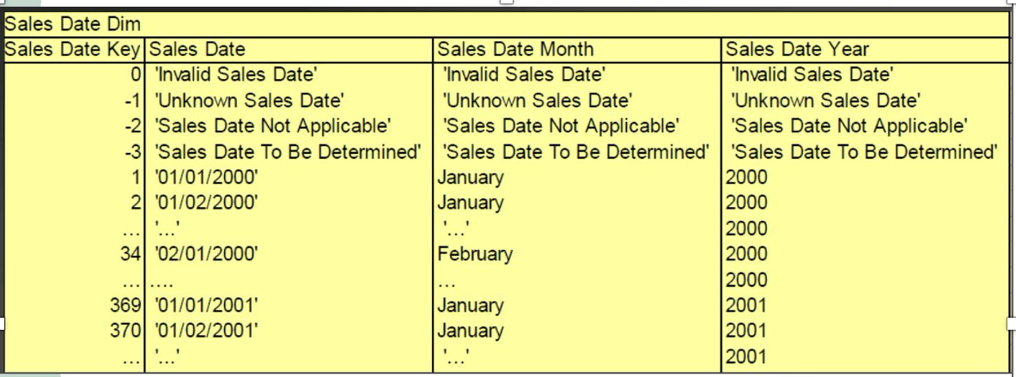
Chapter
Sample Dimension Table
10
5.1 cm
Data Mining, Dr. Amjad Qtaish
39
www.midocean.ae

Slide 40
Chapter
Sample Queries
10
5.1 cm
• Which stores sold the most of product category ‘ABC ’ last
week?
SELECT store, sum(sales_dollars)
FROM sales_fact sf, sales_date sd, product p
where last_week_ind = ‘Y’ AND
product_category = ‘ABC’ and <JOIN
Statements>
GROUP BY store having rank(sum(sales_ dollars))
<6
Data Mining, Dr. Amjad Qtaish
40
www.midocean.ae

Slide 41
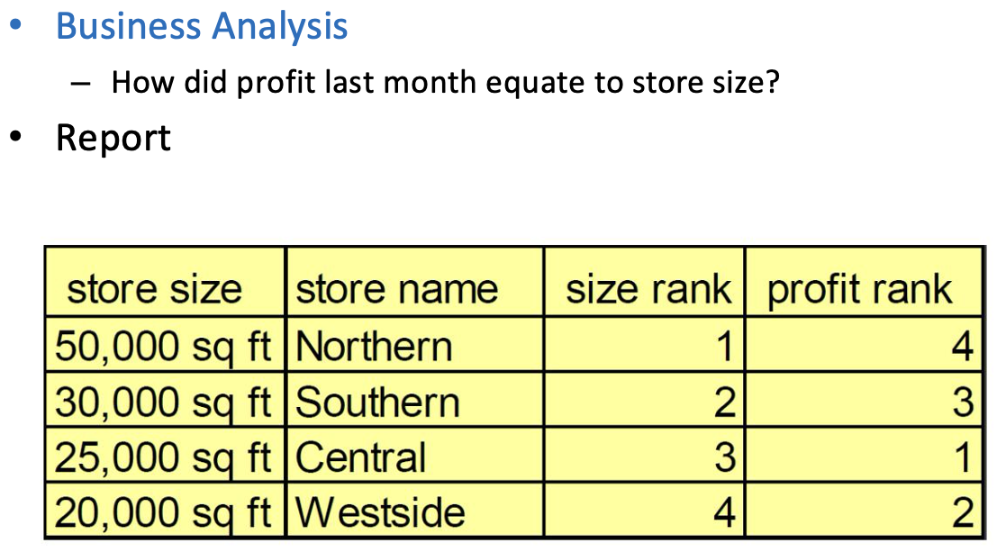
Chapter
Sample Report
10
5.1 cm
Data Mining, Dr. Amjad Qtaish
41
www.midocean.ae

Slide 42



Thank You

