Slide 1


Project Time Management
مقرر: إداره وقت المشروع
Prepared by Dr. Amira Elfekky
PMG 212
Lecture 4

Slide 2

Agenda
Basic Scheduling Concepts
Scheduling
Who is the Scheduler
Attributes of Planner/Scheduler
Importance of the Schedule
Scheduling Tools
Types of Schedules
The Checklist
The Schedule Board
Bar Chart
Look-Ahead Schedule
Linear Schedule
Advanced Scheduling Methods
Program Evaluation and Review Technique (PERT)
Tasks in Scheduling
CPM as a Management Tool
Scheduling Terminology
Relationships (Logic) – 4 Types

Slide 3
Agenda
Basic Scheduling Concepts
Scheduling
Who is the Scheduler
Attributes of Planner/Scheduler
Importance of the Schedule
Scheduling Tools
Types of Schedules
The Checklist
The Schedule Board
Bar Chart
Look-Ahead Schedule
Linear Schedule
Advanced Scheduling Methods
Program Evaluation and Review Technique (PERT)
Tasks in Scheduling
CPM as a Management Tool
Scheduling Terminology
Relationships (Logic) – 4 Types

Slide 4
Chapter
Purpose of Scheduling
04
Types of Schedules (Construction Projects)
Schedules explain what, when, where, and how long
Main tool to communicate the project plan
Helps teams plan crews, time, and performance
Provides a step-by-step guide through project activities
Allocates time required for each task
Defines overall project duration
Supports coordination among project team members
Acts as a foundation for project control

Slide 5
Chapter
Basic Scheduling Concepts
04
Types of Schedules (Construction Projects)
Schedules explain what, when, where, and how long
Main tool to communicate the project plan
Helps teams plan crews, time, and performance
Projects are broken into tasks or activities
Tasks represent actions needed to achieve deliverables
Activities may be sequential or simultaneous
Tasks are often interdependent
Task relationships define sequencing

Slide 6
Agenda
Basic Scheduling Concepts
Scheduling
Who is the Scheduler
Attributes of Planner/Scheduler
Importance of the Schedule
Scheduling Tools
Types of Schedules
The Checklist
The Schedule Board
Bar Chart
Look-Ahead Schedule
Linear Schedule
Advanced Scheduling Methods
Program Evaluation and Review Technique (PERT)
Tasks in Scheduling
CPM as a Management Tool
Scheduling Terminology
Relationships (Logic) – 4 Types

Slide 7
Chapter
Scheduling
04
Scheduling in project management is the listing of activities, deliverables, and milestones within a project.
A schedule usually includes a planned start and finish date, duration, and resources assigned to each activity.

Slide 8
Chapter
Scheduling
04
The 6 processes of time management in scheduling;
When people discuss the processes for building a schedule, they are usually referring to the first six processes of time management:
Plan schedule management
Define project activities
Sequence activities
Estimate resources
Estimate durations
Develop the project schedule

Slide 9
Chapter
Scheduling
04
Benefits of project scheduling in project management
Project scheduling provides the following benefits:
Assists with tracking, reporting, and communicating progress
Ensures everyone is on the same page with tasks, dependencies, and deadlines
Highlights issues and concerns, such as a lack of resources
Identifies task relationships
Monitors progress and identify issues early

Slide 10

Chapter
Scheduling
04

Slide 11
Agenda
Basic Scheduling Concepts
Scheduling
Who is the Scheduler
Attributes of Planner/Scheduler
Importance of the Schedule
Scheduling Tools
Types of Schedules
The Checklist
The Schedule Board
Bar Chart
Look-Ahead Schedule
Linear Schedule
Advanced Scheduling Methods
Program Evaluation and Review Technique (PERT)
Tasks in Scheduling
CPM as a Management Tool
Scheduling Terminology
Relationships (Logic) – 4 Types

Slide 12
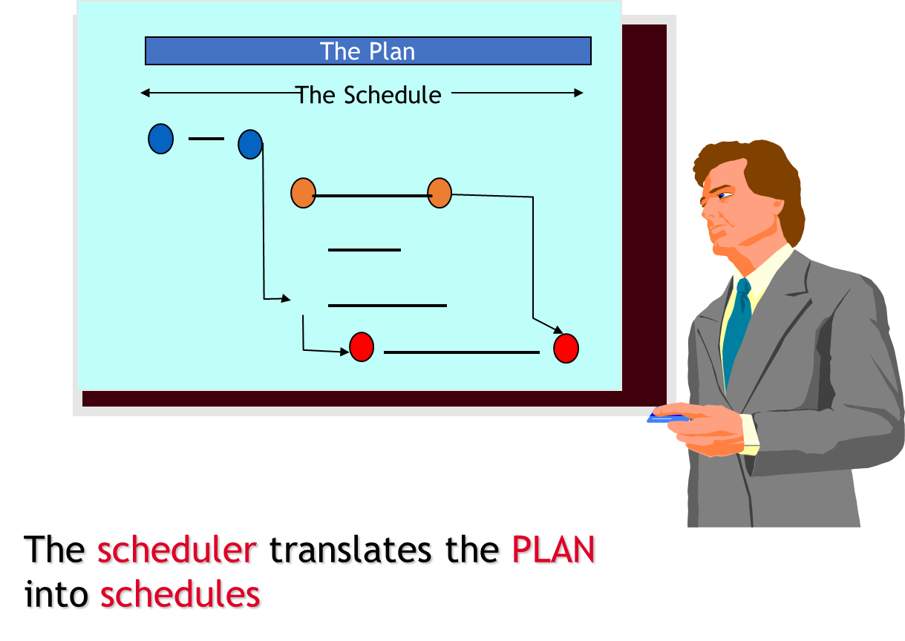
Chapter
Who is the Scheduler
04

Slide 13
Agenda
Basic Scheduling Concepts
Scheduling
Who is the Scheduler
Attributes of Planner/Scheduler
Importance of the Schedule
Scheduling Tools
Types of Schedules
The Checklist
The Schedule Board
Bar Chart
Look-Ahead Schedule
Linear Schedule
Advanced Scheduling Methods
Program Evaluation and Review Technique (PERT)
Tasks in Scheduling
CPM as a Management Tool
Scheduling Terminology
Relationships (Logic) – 4 Types

Slide 14
Chapter
04
Attributes of Planner/Scheduler
Possess PEOPLE skills!
  Exercise humility and salesmanship
  Exercise care when recommending various approaches
  Do not alienate the managing parties
  Ease off when needed
  Emphasize his/her role is to coordinate and integrate ideas and plans into a coherent project schedule.
امتلاك المهارات الشخصية (عدم الاعتماد على البرامج الحاسوبية)
  التحلي بمهارات التواصل بين أقسام المشروع
  العناية الشديدة عند التوصية بإستخدام أساليب مختلفة
  العمل على عدم نفور الأطراف ذات الصلة
  الحد من المشكلات عند الحاجة
  تنسيق ودمج الأفكار والخطط في جدول زمني متماسك

Slide 15
Agenda
Basic Scheduling Concepts
Scheduling
Who is the Scheduler
Attributes of Planner/Scheduler
Importance of the Schedule
Scheduling Tools
Types of Schedules
The Checklist
The Schedule Board
Bar Chart
Look-Ahead Schedule
Linear Schedule
Advanced Scheduling Methods
Program Evaluation and Review Technique (PERT)
Tasks in Scheduling
CPM as a Management Tool
Scheduling Terminology
Relationships (Logic) – 4 Types

Slide 16
Chapter
04
Importance of the Schedule
Standardized scheduling techniques motivates the project team to:
  Think through the entire project
  Predict a realistic project completion
  Recognize impacts of unexpected events

Slide 17
Chapter
Importance of the Schedule
04
Standardized scheduling techniques motivates the project team to:
  Identify claims or time extensions
  Coordinate interfaces and reduce conflicts
  Plan resource requirements and cash flow
  Serve as a record of the project’s progress
  Communication Tool

Slide 18
Chapter
04
Importance of the Schedule
  Tells you where you’ve been.
  Tells you where you are.
  But most importantly, it tells you where are you going!
Must have sufficient detail to control the project
  To much detail is cumbersome to maintain.
  Not enough detail and the analysis of the schedule is difficult.

Slide 19
Agenda
Basic Scheduling Concepts
Scheduling
Who is the Scheduler
Attributes of Planner/Scheduler
Importance of the Schedule
Scheduling Tools
Types of Schedules
The Checklist
The Schedule Board
Bar Chart
Look-Ahead Schedule
Linear Schedule
Advanced Scheduling Methods
Program Evaluation and Review Technique (PERT)
Tasks in Scheduling
CPM as a Management Tool
Scheduling Terminology
Relationships (Logic) – 4 Types

Slide 20
Chapter
04
Scheduling Tools
P6 (Primavera)
Microsoft Project Planner (MSP)
Suretrak (Primavera)
Milestones, etc.. - Bar Chart
TILOS- Linear Scheduling

Slide 21
Agenda
Basic Scheduling Concepts
Scheduling
Who is the Scheduler
Attributes of Planner/Scheduler
Importance of the Schedule
Scheduling Tools
Types of Schedules
The Checklist
The Schedule Board
Bar Chart
Look-Ahead Schedule
Linear Schedule
Advanced Scheduling Methods
Program Evaluation and Review Technique (PERT)
Tasks in Scheduling
CPM as a Management Tool
Scheduling Terminology
Relationships (Logic) – 4 Types

Slide 22
Chapter
Types of Schedules
04
Types of Schedules (Construction Projects)
Schedules explain what, when, where, and how long
Main tool to communicate the project plan
Helps teams plan crews, time, and performance
Types of Schedules (Construction Projects)
Schedules explain what, when, where, and how long
Main tool to communicate the project plan
Helps teams plan crews, time, and performance

Slide 23
Chapter
Types of Schedules
04
Types of Schedules (Construction Projects)
Schedules explain what, when, where, and how long
Main tool to communicate the project plan
Helps teams plan crews, time, and performance
1- The Checklist “Internal use, rarely shared externally”
Simple “To-Do List”
Used for very short-term planning
Ensures no task is forgotten
Easy to use – no tools or training needed
Limitations:
No task dependencies
No impact analysis if delays occur

Slide 24
Chapter
Types of Schedules
04
Types of Schedules (Construction Projects)
Schedules explain what, when, where, and how long
Main tool to communicate the project plan
Helps teams plan crews, time, and performance
2- The Schedule Board
Visual board showing tasks vs time
Crews or employees assigned by day/week
Usually displayed in offices or workshops
Limitations:
Difficult to reschedule
No performance tracking
Not distributed to all stakeholders

Slide 25
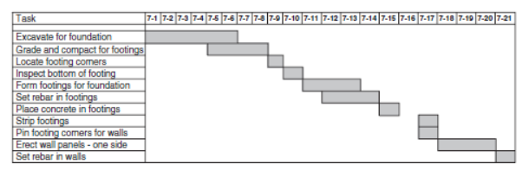
Chapter
Types of Schedules
04
Types of Schedules (Construction Projects)
Schedules explain what, when, where, and how long
Main tool to communicate the project plan
Helps teams plan crews, time, and performance
3- Bar Chart – Pros & Cons “Most common scheduling tool”
Advantages:
Easy to understand
Excellent for presentations
Clear “big picture”
Disadvantages:
No task dependencies
No critical vs non-critical tasks
Limited forecasting ability

Slide 26
Chapter
Types of Schedules
04
Types of Schedules (Construction Projects)
Schedules explain what, when, where, and how long
Main tool to communicate the project plan
Helps teams plan crews, time, and performance
4- Look-Ahead Schedule
Short-term detailed bar chart
Covers 2–3 weeks
Focuses on upcoming tasks and milestones
Used with CPM schedules

Slide 27
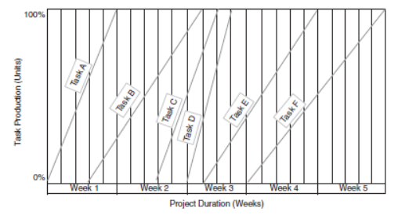
Chapter
Types of Schedules
04
Types of Schedules (Construction Projects)
Schedules explain what, when, where, and how long
Main tool to communicate the project plan
Helps teams plan crews, time, and performance
5- Linear Schedule (Line of Balance)
Used for linear projects (roads, runways, pipelines)
Work is repetitive along distance
Tracks progress vs time graphically
Also called Velocity Diagram

Slide 28
Agenda
Basic Scheduling Concepts
Scheduling
Who is the Scheduler
Attributes of Planner/Scheduler
Importance of the Schedule
Scheduling Tools
Types of Schedules
The Checklist
The Schedule Board
Bar Chart
Look-Ahead Schedule
Linear Schedule
Advanced Scheduling Methods
Program Evaluation and Review Technique (PERT)
Tasks in Scheduling
CPM as a Management Tool
Scheduling Terminology
Relationships (Logic) – 4 Types

Slide 29
Chapter
Advanced Scheduling Methods
04
Types of Schedules (Construction Projects)
Schedules explain what, when, where, and how long
Main tool to communicate the project plan
Helps teams plan crews, time, and performance
More sophisticated scheduling techniques
Used for complex projects
Common methods include PERT and CPM
Focus on uncertainty and dependencies
Support detailed project control

Slide 30
Agenda
Basic Scheduling Concepts
Scheduling
Who is the Scheduler
Attributes of Planner/Scheduler
Importance of the Schedule
Scheduling Tools
Types of Schedules
The Checklist
The Schedule Board
Bar Chart
Look-Ahead Schedule
Linear Schedule
Advanced Scheduling Methods
Program Evaluation and Review Technique (PERT)
Tasks in Scheduling
CPM as a Management Tool
Scheduling Terminology
Relationships (Logic) – 4 Types

Slide 31
Chapter
Program Evaluation and Review Technique (PERT)
04
Types of Schedules (Construction Projects)
Schedules explain what, when, where, and how long
Main tool to communicate the project plan
Helps teams plan crews, time, and performance
Commonly used in research and development
Accounts for uncertainty in task durations
Uses optimistic, most likely, and pessimistic estimates
Applies probability theory
Useful for high-risk tasks

Slide 32
Agenda
Basic Scheduling Concepts
Scheduling
Who is the Scheduler
Attributes of Planner/Scheduler
Importance of the Schedule
Scheduling Tools
Types of Schedules
The Checklist
The Schedule Board
Bar Chart
Look-Ahead Schedule
Linear Schedule
Advanced Scheduling Methods
Program Evaluation and Review Technique (PERT)
Tasks in Scheduling
CPM as a Management Tool
Scheduling Terminology
Relationships (Logic) – 4 Types

Slide 33
Chapter
Tasks in Scheduling
04
Types of Schedules (Construction Projects)
Schedules explain what, when, where, and how long
Main tool to communicate the project plan
Helps teams plan crews, time, and performance
Tasks consume time and resources
Each task has a defined start and finish
Tasks usually incur cost
Derived mainly from the estimate
Form the building blocks of the schedule

Slide 34
Chapter
Work Breakdown Structure (WBS)
04
Types of Schedules (Construction Projects)
Schedules explain what, when, where, and how long
Main tool to communicate the project plan
Helps teams plan crews, time, and performance
Breaks project into logical sections
Derived from the estimate
Organized into multiple levels
Moves from summary to detailed tasks
Improves planning and control

Slide 35
Chapter
Task Types
04
Types of Schedules (Construction Projects)
Schedules explain what, when, where, and how long
Main tool to communicate the project plan
Helps teams plan crews, time, and performance
Administrative activities
Procurement activities
Production activities
Each type affects the schedule differently
All may impact project completion

Slide 36
Chapter
Task Durations
04
Types of Schedules (Construction Projects)
Schedules explain what, when, where, and how long
Main tool to communicate the project plan
Helps teams plan crews, time, and performance
Duration is time between start and finish
Measured in workdays
Hours are too detailed for control
Weeks are often too broad
Workdays balance accuracy and usability

Slide 37
Agenda
Basic Scheduling Concepts
Scheduling
Who is the Scheduler
Attributes of Planner/Scheduler
Importance of the Schedule
Scheduling Tools
Types of Schedules
The Checklist
The Schedule Board
Bar Chart
Look-Ahead Schedule
Linear Schedule
Advanced Scheduling Methods
Program Evaluation and Review Technique (PERT)
Tasks in Scheduling
CPM as a Management Tool
Scheduling Terminology
Relationships (Logic) – 4 Types

Slide 38
Chapter
CPM as a Management Tool
04
Types of Schedules (Construction Projects)
Schedules explain what, when, where, and how long
Main tool to communicate the project plan
Helps teams plan crews, time, and performance
Provides baseline for time control
Links tasks through dependencies
Compares planned vs actual progress
Helps identify trends and risks
Supports informed decision-making

Slide 39
Chapter
04
Scheduling Methodology

Slide 40
Chapter
04
Critical Path Method
Item | Price
A | 100
B | 100
C | 100
D | 100
E | 100
F | 100
Sum | 600
The calculation of the earliest and latest start and finish dates of activities based on their duration's and relationships to other activities
a resource-utilization algorithm for scheduling a set of project activities

Slide 41
Chapter
Activities
04
The Basic element into which a project is subdivided for scheduling a network (CPM)
  Has a definable start and finish
  Consumes resources
  Is assignable
  Is measurable
  Is defined by a Work Package
  Is a Physical Task for Construction

Slide 42
Agenda
Basic Scheduling Concepts
Scheduling
Who is the Scheduler
Attributes of Planner/Scheduler
Importance of the Schedule
Scheduling Tools
Types of Schedules
The Checklist
The Schedule Board
Bar Chart
Look-Ahead Schedule
Linear Schedule
Advanced Scheduling Methods
Program Evaluation and Review Technique (PERT)
Tasks in Scheduling
CPM as a Management Tool
Scheduling Terminology
Relationships (Logic) – 4 Types

Slide 43
Chapter
04
Scheduling Terminology: Work Package
A group or number of Engineering/Construction Deliverables that will enable Procurement or Construction to accomplish a meaningful task. WP is the lowest level of a WBS.
  All of the Data Sheets & Specifications required for a Purchase Order.
  All of the Drawings & Details necessary to Locate, Excavate, Form and Pour a Foundation
  Earthwork
  Foundation
  Cabling

Slide 44
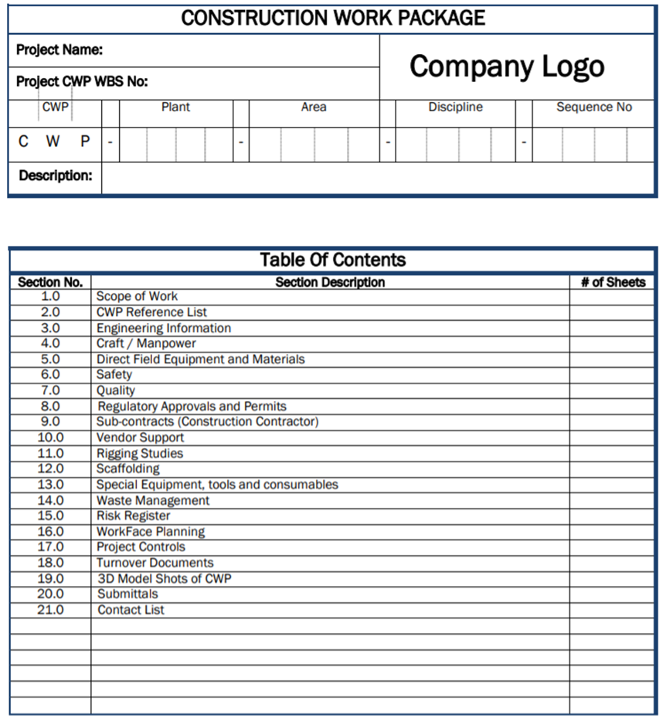
Scheduling Terminology:
Work Package Template
Chapter
04

Slide 45
Chapter
Scheduling Terminology: Milestone
04
Is a GOAL to be achieved.
    Can be either a Start or Finish Achievement
    Is a single point in Time
    Has no duration
    Has no resources
    Has a specific and unique Definition
    It is either YES or NO

Slide 46
Chapter
Scheduling Terminology
04
Predecessor = An activity that must occur before another activity. A predecessor activity controls the start or finish date of its successor(s). An activity can have multiple predecessors, each with a different relationship to it.
Successor = An activity that must occur after another activity. An activity can have multiple successors, each with a different relationship to it.

Slide 47
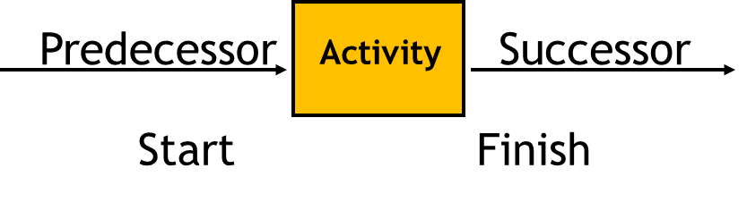
Chapter
Scheduling Terminology
Predecessor and Successor Synonymsمرادفات
04
Dependencies
Prerequisites
Interface requirements
Links
Logic relationships “To” and “From”
التابعين (الاعتماديين)
المتطلبات المسبقة
متطلبات الواجهة/الربط
الروابط
العلاقات المنطقية "إلى" و "من"

Slide 48
Agenda
Basic Scheduling Concepts
Scheduling
Who is the Scheduler
Attributes of Planner/Scheduler
Importance of the Schedule
Scheduling Tools
Types of Schedules
The Checklist
The Schedule Board
Bar Chart
Look-Ahead Schedule
Linear Schedule
Advanced Scheduling Methods
Program Evaluation and Review Technique (PERT)
Tasks in Scheduling
CPM as a Management Tool
Scheduling Terminology
Relationships (Logic) – 4 Types

Slide 49
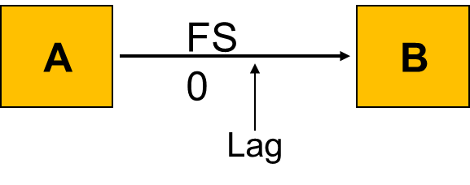
Chapter
04
Relationships (Logic) – 4 Types
  Finish to Start - FS - A relationship in which the predecessor activity must Finish before its successor activity can Start.

Slide 50
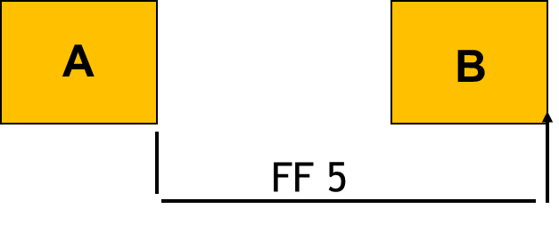
Chapter
04
Relationships (Logic) – 4 Types
  Finish to Finish - FF - A relationship in which the Finish of a successor activity depends on the Finish of its predecessor activity.

Slide 51
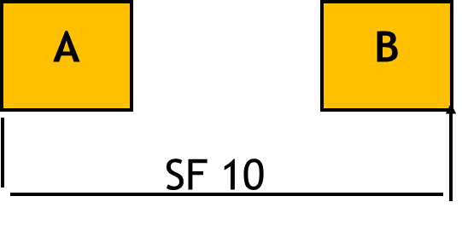
Chapter
04
Relationships (Logic) – 4 Types
  Start to Finish - SF - A relationship in which the Start of the predecessor activity controls the Finish of a successor activity. Not used

Slide 52
Chapter
04
Relationships (Logic) – 4 Types
  Start to Start - SS - A relationship in which the Start of the predecessor activity controls the Start of a successor activity .
A
B
SS 0

Slide 53



Thank You

