Slide 1

PMG510
Risk Management
Prepared by Dr. Ayman Elmaasarawy
scope of risk Management
Lecture 3

Slide 2

Lecture 2 Summery
Impact of risk on organizations:
Level of risk
Impact of hazard risks
Attachment of risks
Risk and reward
Attitudes to risk
Risk and triggers
Types of risks:
Timescale of risk impact
Four types of risk
Embrace opportunity risks
Manage uncertainty risks
Mitigate hazard risks
Minimize compliance risks

Slide 3
Lecture 3 Organization
Origins of Risk Management
Representation of Risk Management
Enterprise Risk Management
Levels of risk management sophistication
Principles of risk management
Implementing risk management
Project Risk Management Planning

Slide 4
Chapter 3 Scope of Risk Management
Organizations realized that purchasing insurance was insufficient if there was inadequate attention to the protection of property and people.
Insurance buyers therefore became concerned with the quality of property protection, the standards of health and safety, product liability issues and other risk control concerns
This combined approach to risk financing and risk control developed in Europe during the 1970s and the concept of total cost of risk became important.
As this approach became established, it also became obvious that there were many risks facing organizations that were not insurable. The tools and techniques of risk management were then applied to other disciplines
Origins of Risk Management:

Slide 5
Chapter 3 Scope of Risk Management
Origins of Risk Management:
Risk management is the set of activities within an organization undertaken to deliver the most favorable outcome and reduce the volatility or variability of that outcome.
Taking about Risk:
Risk management is not about controlling/mitigating risk out of existence.
If business is to perform, management must learn to take more risk and to accept failure.
To perform better than the rest, you must take greater risk, but it should be a calculated risk (the risk accepted is known, as is the likelihood and impact).
It is not acceptable to take risks unwittingly – the past practice of silo-based approaches for managing pockets of risk, leads to unclear responsibilities and a lack of visibility, thereby exposing the organization to unnecessary risk.

Slide 6
Chapter 4 Scope of Risk Management
Origins of Risk Management:
Definitions of risk management
Organization | Definition of risk management
ISO Guide 73 BS 31100 | Co-ordinated activities to direct and control an organization with regard to risk
Institute of Risk Management (IRM) | Process which aims to help organizations understand, evaluate and take action on all their risks with a view to increasing the probability of success and reducing the likelihood of failure
HM Treasury | All the processes involved in identifying, assessing and judging risks, assigning ownership, taking actions to mitigate or anticipate them, and monitoring and reviewing progress
London School of Economics | Selection of those risks a business should take and those which should be avoided or mitigated, followed by action to avoid or reduce risk

Slide 7
Chapter 4 Scope of Risk Management
Simple Representation of Risk Management:
Risk management has well-established stages that make up the risk management process.
These stages build into valuable risk management activities, each of which makes an important contribution
This basic explanation of the risk management process is referred to as the 8Rs and 4Ts of hazard risk management. The activities associated with risk management are as follows:
Recognition of risks | Rating of risks;
Ranking against risk criteria | Responding to significant risks; (Tolerate – Treat – Transfer – Terminate)
Resourcing controls; | Reaction (and event) planning;
Reporting of risk performance | Reviewing the risk management system

Slide 8
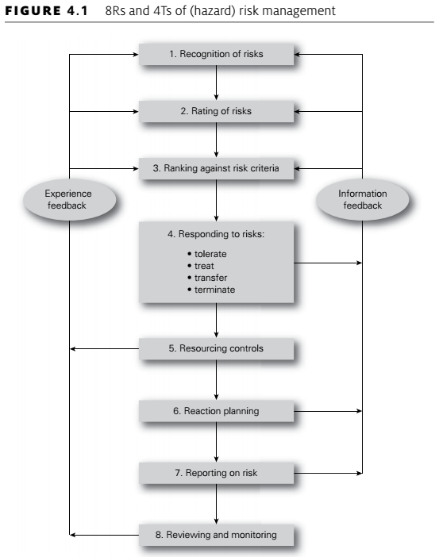
Chapter 4 Scope of Risk Management
Simple Representation of Risk Management:

Slide 9
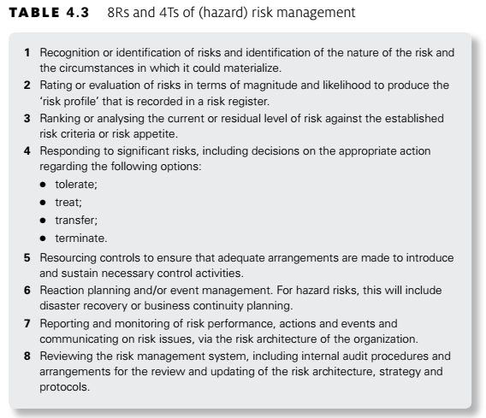
Chapter 4 Scope of Risk Management
Simple Representation of Risk Management:

Slide 10
Chapter 4 Scope of Risk Management
Enterprise Risk Management:
When an organization considers all of the risks that it faces and how these risks could impact its strategy, projects and operations, then the organization is embarking on an enterprise risk management approach.
The US risk management association, the Risk and Insurance Managers Society (RIMS) defines enterprise risk management as follows:
Enterprise Risk Management (‘ERM’) is a strategic business discipline that supports the achievement of an organization’s objectives by addressing the full spectrum of its risks and managing the combined impact of those risks as an interrelated risk portfolio.
An enterprise-wide approach has considerable advantages, because it analyses the potential for disruption to the overall stakeholder expectation.

Slide 11
Chapter 4 Scope of Risk Management
Enterprise Risk Management:
Health and safety, for example, is then viewed as a component in ensuring that staff are always available so that the overall operational core process will not be disrupted, rather than (or perhaps as well as) a separate hazard management issue.
ERM in the pharmaceutical industry
A good example of the ERM approach is the pharmaceutical industry. If a person is reliant on a particular medication, then it is vitally important that the medication is constantly available.
From the point of view of the pharmaceutical company, this means that a core process for the organization must be the ‘constant availability of medication’ process.
If the pharmaceutical company takes this approach, it will look at the risks that could affect this core process or stakeholder expectation on an enterprise-wide basis.
This will involve analysis of the supply chain, evaluation of manufacturing activities and analysis of the delivery arrangements. The overall question that needs to be answered is what could prevent the continuous supply of medication.
Risks to the continuous supply will include unavailability of ingredients, disruption to manufacturing activities, contamination of the product, breakdown in supply transportation arrangements and disruption to distribution.

Slide 12
Chapter 4 Scope of Risk Management
Levels of risk management sophistication:
At first, an organization may be unaware of the legal and contractual obligations that it faces. In that case, it will be necessary to inform the organization of its obligations in relation to the risk.
As the level of sophistication develops, the organization will become aware of the need to comply with obligations and the more general need for improved risk management. Once it is aware of obligations, there will be a need for the organization to reform in response to the hazard risks.
As the organization responds to the risk, it will seek to conform to the appropriate risk control standards.
After this stage, the organization may realize that there are benefits to be obtained from the risk. The organization will then have the ability to perform and view the risk as an opportunity risk, as illustrated in Figure 4.2.

Slide 13
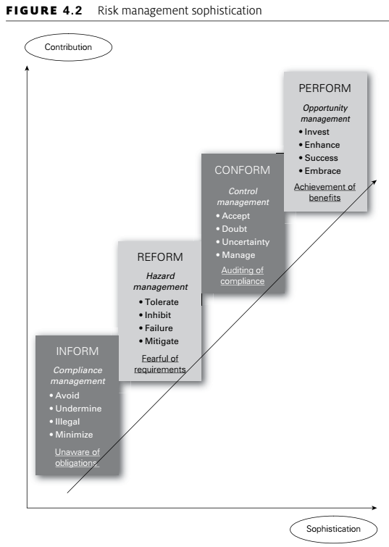
Chapter 4 Scope of Risk Management
Levels of risk management sophistication:

Slide 14
Chapter 4 Scope of Risk Management
Levels of risk management sophistication:
Although the four levels of risk management sophistication illustrated in Figure 4.2 represent an improved approach to risk management, there is a danger that organizations will become obsessed with risk management to the point that important decisions are not taken.
At this point, it may be said that too much attention and concern about risk and risk management will cause the organization to deform its operations.
In summary:
unaware of obligations – INFORM;
awareness of non-compliance – REFORM;
actions to ensure compliance – CONFORM;
achieve business opportunities – PERFORM;
inactivity caused by obsession – DEFORM

Slide 15
Chapter 4 Scope of Risk Management
Levels of risk management sophistication:
As the level of sophistication increases and risk management professionals become aware of the alternative approaches to risk management, they should value the contribution that can be made by other approaches.
The development in risk management approach can be summarized as follows:
Compliance management must not be undertaken in a fragmented manner, even if excellent standards of compliance are achieved.
Hazard management specialists may find that there has been a trend towards a desire to retain more insurable risks (and buy less insurance) as a result of a more holistic approach to risk management.
Control management specialists must not squeeze entrepreneurial spirit and effort out of the organization.
Strategic planners must recognize that risk management tools and techniques can contribute to better strategic decisions and the successful exploitation of business opportunities.

Slide 16
Chapter 5 Principles and aims of risk management
Principles of risk management:
Many of the lists of principles set out a description of what risk management activity should be and what it should achieve.
It is important to distinguish between what the risk management initiative has been set up to achieve and the nature of the risk management framework that will be put in place.
It is suggested that a successful risk management initiative (and framework) will be:
Proportionate to the level of risk within the organization;
Aligned with other business activities;
Comprehensive, systematic and structured;
Embedded within business procedures and protocols;
Dynamic, iterative and responsive to change.
This provides the acronym PACED and provides a very good set of principles that are the foundations of a successful approach to risk management within any organization.

Slide 17
Chapter 5 Principles and aims of risk management
Principles of risk management:
Principle | Description
Proportionate | Risk management activities must be proportionate to the level of risk faced by the organization.
Aligned | ERM activities need to be aligned with the other activities in the organization.
Comprehensive | In order to be fully effective, the risk management approach must be comprehensive.
Dynamic | Risk management activities must be dynamic and responsive to emerging and changing risks

Slide 18
Chapter 5 Principles and aims of risk management
Principles of risk management:
What it should deliver by risk management as listed below:
Mandatory obligations placed on the organization;
Assurance regarding the management of significant risks;
Decisions that pay full regard to risk considerations;
Effective and Efficient core processes
In many ways, the starting point for all risk management activities is to decide what the organization is seeking to achieve.
Table 5.2 sets out the possible purpose or motivation for a risk management initiative as mandatory, assurance, decision making and effective and efficient core processes (MADE2).
Core processes represent the activities of the organization and can be strategic, tactical, operational or compliance (STOC) in nature.

Slide 19
Chapter 5 Principles and aims of risk management
Principles of risk management:
The objectives for risk management provide the acronym MADE2 and this confirms that outputs from risk management will lead to less disruption to normal efficient operations, a reduction of uncertainty in relation to tactics and improved decisions in relation to evaluation and selection of alternative strategies.
In other words, a key part of risk management is improved organizational decision making.
The resources available for managing risk are finite and so the aim is to achieve an optimum response to risk, prioritized in accordance with an evaluation of the risks. Risk is unavoidable and every organization needs to take action to manage it in a way that it can justify to a level that is acceptable.
The appropriate range of responses will depend on the nature, size and complexity of the organization and the risks it faces.

Slide 20
Chapter 5 Principles and aims of risk management
Principles of risk management:
Objective | Description
Mandatory | The basic objective for any risk management initiative is to ensure conformity with applicable rules, regulations and mandatory obligations.
Assurance | The board and audit committee of an organization will require assurance that risk management and internal control activities comply with PACED.
Decision making | Risk management activities should ensure that appropriate risk-based information is available to support decision making.
Effective and efficient core processes | Risk management considerations will assist with achieving effective and efficient strategy, tactics, operations and compliance to ensure the best outcome with reduced volatility of results.

Slide 21
Chapter 5 Principles and aims of risk management
Implementing risk management:
There are a number of options when responding to hazard risks. These are often represented as the 4Ts of hazard risk management,
In summary, the options for responding to hazard risks are:
Tolerate;
Treat;
Transfer;
Terminate
The integrative approach to risk management accepts that the organization must tolerate certain hazard risks and must have an appropriate appetite for investment in opportunity risks.

Slide 22
Chapter 5 Principles and aims of risk management
Implementing risk management:
Risk management tools and techniques should be used to achieve the following:
Compliance management provides risk governance;
Hazard management makes outcomes less negative;
Control management reduces the range of possible outcomes;
Opportunity management makes outcomes more positive.

Slide 23
Chapter 5 Principles and aims of risk management
Implementing risk management:
Risk Management is not just the brakes
There is a popular question amongst risk managers: ‘why do cars have brakes?’ The answer offered is that they enable the car to go faster. This implies that risk management should be viewed as the brakes on the activities of the organization. This is a wholly negative view that presents risk management in an unfavorable light.
Risk management is also an enabler of operations, tactics and strategy. Therefore, it is worth revisiting the above question. To continue the metaphor, risk management should, in fact, be seen as all three pedals in a car. Risk management as the brakes mitigates operational hazards and helps the organization avoid disruption, thereby enhancing operational efficiency.
The clutch pedal is concerned with changing gear in a car in the same way as projects implement the tactics in an organization. Therefore, risk management is also the clutch pedal in that it helps assist with the successful management of tactical change and the reduction of the associated uncertainty, so that the organization can achieve successful change.
Finally, the accelerator helps the car go faster and risk management fulfils this function by helping the organization embrace strategic opportunities and seek rewards – thereby ensuring that the organization designs and successfully implements a strategy that delivers exactly what is required.

Slide 24
Chapter 5 Principles and aims of risk management
Implementing risk management:
Using the structure of the FIRM risk scorecard, an organization will be able to demonstrate the benefits that it has obtained from a risk management initiative.
It is likely that the following benefits will have been delivered to a theatre that has been pursuing a structured proactive enterprise risk management approach for about three years:
Financial benefits arising from better allocation of funds, monitoring of expenditure and reduced exposure to fraud;
Infrastructure benefits that have included fewer failures of the IT systems and reduced staff absence rates;
Reputational benefits from ethical sourcing policies and use of organic food in the restaurant, as well as successful niche productions in the theatre;
Marketplace benefits resulting in 89 per cent occupancy rates, up from 83 per cent three years ago, as well as increased spend in the theatre by patrons.

Slide 25
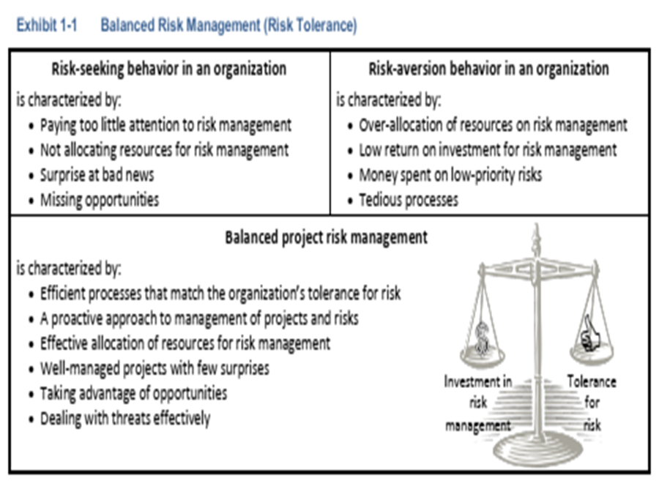
Planning Project Risk Management Guide
1- Project Risk Management Planning
Project risk management delivers a number of values to the project, including:
Recognizes uncertainty and provides forecasts of possible outcomes.
Produces better business outcomes through more informed decision making.
Has a positive influence on creative thinking and innovation.
Creates opportunities for improved project monitoring and control.
Can aide in addressing concerns with respect to overhead and time.
Contributes to project success.

Slide 26
Planning Project Risk Management Guide
1- Project Risk Management Planning
Project Risk Management Process
Risk management, as an integral part of project management, occurs on a daily basis.
With proactive risk management, we look at projects in a comprehensive manner and assess an document risks and uncertainty. The steps for risk management are provided below.
Risk Management Steps:
Risk Management Planning: Risk management planning is the systematic process of deciding how to approach, plan, and execute risk management activities throughout the life of a project. It is intended to maximize the beneficial outcome of the opportunities and minimize or eliminate the consequences of adverse risk events.
Identify Risk Events: Risk identification involves determining and documenting which risks can affect the project. It may be a simple risk assessment organized by the project team, or an outcome of a formal risk assessment process such as the Cost Estimate Validation Process, CEVP.

Slide 27
Planning Project Risk Management Guide
1- Project Risk Management Planning
3. Qualitative Risk Analysis: Qualitative risk analysis involves Project teams assessing identified risks for probability of occurrence and impact on project objectives. Teams may elicit assistance from subject matter experts or functional units to assess the risks in their respective fields. Risks are measured by their “quality” in words rather than quantified in numbers.
4. Quantitative Risk Analysis: Quantitative risk analysis is a way of numerically estimating the probability that a project will meet its cost and time objectives. Quantitative analysis is based on a simultaneous evaluation of the impacts of all identified and quantified risks.
5. Risk Response Risk response: involves developing options and determining actions to reduce threats or enhance opportunities to project objectives. Actions are identified and assigned to parties that take responsibility for the risk response. This process ensures each risk requiring a response has an “owner.” The Project Manager and the project team identify a strategy that is best for each risk, and then select specific actions to implement that strategy.

Slide 28
Planning Project Risk Management Guide
1- Project Risk Management Planning
6. Risk Monitoring & Control: Risk monitoring and control tracks identified risks, monitors residual risks, and identifies new risks—ensuring the execution of risk plans and evaluating their effectiveness in reducing risk. Risk monitoring and control is an ongoing process for the life of the project.
Much of project risk management relies on sound engineering judgment and knowing where to focus energy and resources. Knowing when to engage appropriate expertise is vital to good project risk management.
provides a helpful comparison between risk and objectives for various types of risk management. For this document we are interested in project risk management.

Slide 29
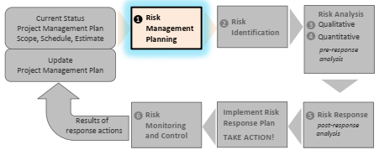
Project Risk Management Guide
1- Project Risk Management Planning

Slide 30
Planning Project Risk Management Guide
1- Project Risk Management Planning
The following table provides a helpful comparison between risk and objectives for various types of risk management. we are interested in project risk management
Type of Risk Management | Description | Sample Objectives
Generic | Risk: Any uncertainty that, if it occurs, would affect one or more objectives. | ----------------
Project Risk Management | Project Risk: Any uncertainty that, if it occurs, would affect one or more project objectives. | Time, cost, performance, quality, scope, client satisfaction.
Business Risk Management | Business Risk: Any uncertainty that, if it occurs, would affect one or more business objectives. | Profitability, market share, competitiveness, Internal Rate of Return (IRR), reputation, repeat work, share price.

Slide 31
Planning Project Risk Management Guide
1- Project Risk Management Planning
Type of Risk Management | Description | Sample Objectives
Safety Risk Management | Safety Risk: Any uncertainty that, if it occurs, would affect one or more safety objectives. | Low accident rate, minimal lost days, reduced insurance premiums, regulatory compliance.
Technical Risk Management | Technical Risk: Any uncertainty that, if it occurs, would affect one or more technical objectives. | Performance, functionality, reliability, maintainability.
Security Risk Management | Security Risk: Any uncertainty that, if it occurs, would affect one or more security objectives. | Information security, physical security, asset security, personnel security

Slide 32
Planning Project Risk Management Guide
1- Project Risk Management Planning
Taking Action:
The power of risk management is fully realized when a Project Manager takes action to respond to identified risks based on the risk analysis. Directed effort toward risks that can have significant impact to project objectives improves the odds of project success.
1- Inputs
The project scope, schedule, and estimate package should include the most current versions of the following items:
Project Summary
Detailed Scope of Work (commensurate with the level of development)
Project Cost Estimate (with Basis of Estimate completed)
o PE cost estimate
o ROW cost estimate
o Construction cost estimate
Previous Risk Analyses (if applicable)

Slide 33
Planning Project Risk Management Guide
1- Project Risk Management Planning
Project Management Plan
Project Schedule
o Overall project schedule
o Detailed construction schedule (commensurate to level of development)
QA/QC Status
Additional Information (as necessary)
2- Techniques and Tools
There are a number of techniques and tools to assist in project risk management. These tools and techniques provide scalability and flexibility so that project teams can match the tool with the specific needs of their projects. Often, the appropriate tool is determined by the size and complexity of the project.

Slide 34
Planning Project Risk Management Guide
1- Project Risk Management Planning
These tools include:
Project Management Guide
o Project Management Plan (fundamental for all projects)
o A qualitative risk matrix for smaller, simpler projects
o Risk planning, risk assessment, and risk management are integral
elements of project management
Risk Management Plan spreadsheet template (found on SAEO website)
Self-modeling tool for quantitative risk analysis

Slide 35
Planning Project Risk Management Guide
1- Project Risk Management Planning
3- Output:
Capital Program Management System (CPMS) data requirements per Policy Statement.
Project teams must provide specific data to the region program management office for inclusion in CPMS and the Transportation Executive Information System (TEIS).
The required data is:
Project scheduling data for the following milestone dates:
Project definition completion date
Date for the beginning of preliminary engineering
Completion date for the environmental document
Start date for the acquisition of right of way
Date of right of way certification
Project advertisement date
Date project is operationally complete (substantially complete)

Slide 36
Planning Project Risk Management Guide
1- Project Risk Management Planning
b. Date of estimate basis (e.g., “2018 $”)
Design cost estimate
Right of way cost estimate
Construction cost estimate
c. Midpoint for construction phases using the project award date and the operationally complete date.

Slide 37
Planning Project Risk Management Guide
1- Project Risk Management Planning
Statement of Policy:
Project Risk Management and Risk-Based Estimating
It is policy to conduct risk-based estimating workshops for all projects.
These workshops provide information to Project Managers that can help them control scope, cost, and schedule, and manage risks for all projects.
This policy reaffirms the requirement that a Risk Management Plan is a component of every Project Management Plan

Slide 38
Planning Project Risk Management Guide
1- Project Risk Management Planning
Project Risk Management Planning
Great project risk management requires good planning. Risk management must commence early in project development and proceed as the project evolves and project information increases in quantity and quality.
Plan to:
Identify, assess/analyze, and respond to major risks
Continually monitor project risks and response actions.
Conduct an appropriate number and level of risk assessments to update the Risk Management Plan and evolving risk profile for the project.
Consider the resources needed for project risk management and build them into the project development budget and schedule. Risk management activities, including events such as Cost Risk Assessment (CRA), Cost Estimate Validation Process (CEVP®), Value Engineering – Risk Assessment (VERA), or other meetings, need to be part of the project work plan and built into the project schedule and budget.

Slide 39
Planning Project Risk Management Guide
1- Project Risk Management Planning
The following figure illustrates how project information develops and evolves over time. With rising project knowledge comes an understanding that contending with some elements of the project will require significant additional resources.
These elements could involve: scope; environmental mitigation and permitting; rising cost of right of way as corridors develop in advance of the project; utilities; seismic issues; and other elements.
In the past, traditional estimating practices tended to produce “the number” for a project; but the single number masks the critical uncertainty inherent in a particular project. It implies a sense of precision beyond what can be achieved during planning, scoping, or early design phases.
We recognize that an estimate is more accurately expressed as a range, not as a single number. To determine an accurate estimate range for both cost and schedule, risk must be measured.

Slide 40
Planning Project Risk Management Guide
1- Project Risk Management Planning
Estimates are now composed of two components: the base cost component and the risk (or uncertainty) component. The base cost represents the cost that can reasonably be expected if the project materializes as planned.
The base cost does not include contingencies. Once the base cost is established, a list of risks is created of opportunities and threats, called a “risk register.” The risk assessment replaces general and vaguely defined contingency with explicitly defined risk events.
Risk events are characterized in terms of probability of occurrence and the consequences of each potential risk event.

Slide 41
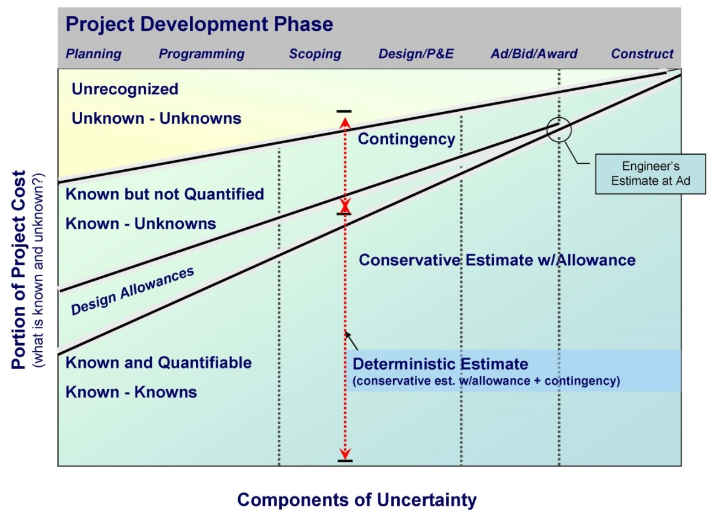
Planning Project Risk Management Guide
1- Project Risk Management Planning
Exhibit 1-5 Evolution of Project Knowledge Through Project Development

Slide 42
Planning Project Risk Management Guide
1- Project Risk Management Planning
Risk reviews are an integral part of budget development, with the intent that the
department makes informed decisions about risk tolerance.
It can be inferred that determined Enterprise Risk Management includes comprehensive project risk
management.
Project risk management is a major element in the Project Management Plan, which is required for all projects.
We, as stewards of the public trust, must endeavor to inform decision makers of the uncertainty and risk associated with the projects we develop.
We must understand risk tolerance and we must weigh the value of project decisions against project risks

Slide 43
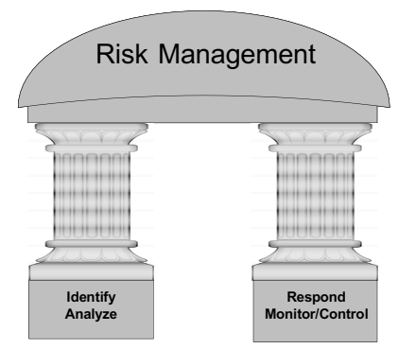
Planning Project Risk Management Guide
1- Project Risk Management Planning
We can think of risk management as two pillars.
They are: “IDENTIFY and ANALYZE” the risks, then, “RESPOND, MONITOR, and CONTROL” project risk.
Unless we incorporate the second pillar, we are not realizing the full value of risk management.
When preparing the Project Management Plan and work activities for our project, we must include both pillars of risk management

Slide 44
Planning Project Risk Management Guide
1- Project Risk Management Planning
How to Plan for Project Risk Management
Do you plan to manage risk for your project? YES! Then include risk management in your Project Management Plan.
Determine the level of risk assessment for your project (Exhibit 1-6).
2. Incorporate risk management activities into the project schedule (Exhibit 1-7).
3. Make risk management an agenda item for regularly scheduled project meetings.
4. Communicate the importance of risk management to the entire project team.
5. Establish the expectation that risk will be managed, documented, and reported.

Slide 45
Planning Project Risk Management Guide
1- Project Risk Management Planning
Tips for Risk Management Planning
Risk assessment planning should begin early. There is a minimum level of project knowledge needed to understand what is being assessed.
This varies depending on the point in project development at which the risk assessment is conducted (planning, scoping, design); hence, schedule risk assessments at appropriate times.
At a minimum there must be an understood project scope of work, associated project cost estimate – with a basis of estimate complete, and an estimated project schedule.
Allow time in the schedule for preparation activities; this includes review and QA/QC of project schedules and cost estimates at appropriate.

Slide 46
Planning Project Risk Management Guide
1- Project Risk Management Planning
Tips for Risk Management Planning
Allow a budget and time in the schedule for risk assessment, risk management, and risk response activities. Report on the status of project risk at regularly scheduled project meetings.
Know the organization’s tolerance for risk. Are Project Managers (and upper management) risk averse or risk seeking? How much risk is the organization willing to accept? Knowing the answers to these questions will help with risk management and contribute to the decision-making process when determining risk response actions.
Contact the Strategic Analysis and Estimating Office (SAEO) and discuss the possibility of coordinating or integrating project risk assessment with value engineering

Slide 47
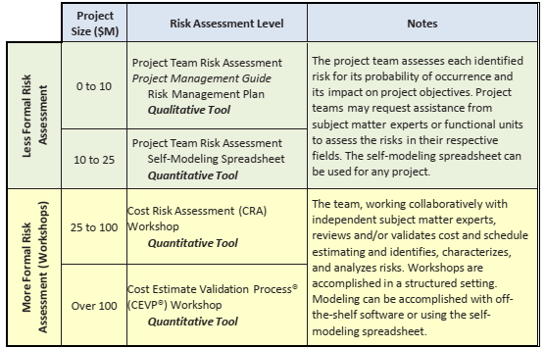
Planning Project Risk Management Guide
1- Project Risk Management Planning
Determine the Level of Risk Assessment

Slide 48
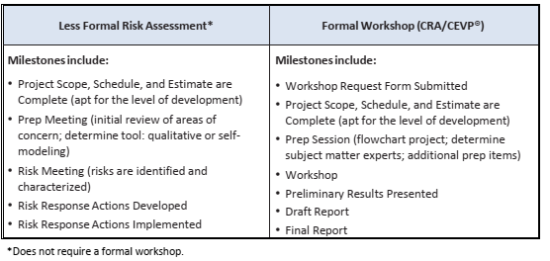
Planning Project Risk Management Guide
1- Project Risk Management Planning
Exhibit 1-6 Determine the Level of Risk Assessment
Include Risk Management Milestones in the Project Schedule

Slide 49
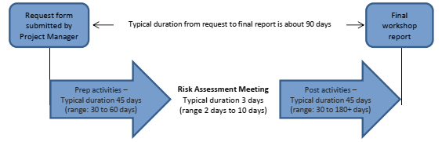
Planning Project Risk Management Guide
1- Project Risk Management Planning
Simplified Workshop Timeline

Slide 50
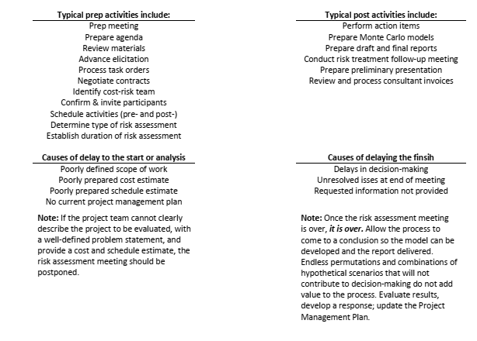
Planning Project Risk Management Guide
1- Project Risk Management Planning
Simplified Workshop Timeline

Slide 51
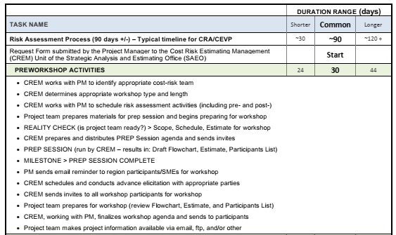
Planning Project Risk Management Guide
1- Project Risk Management Planning
Risk Management Schedule: With Workshop and Postworkshop Activities

Slide 52
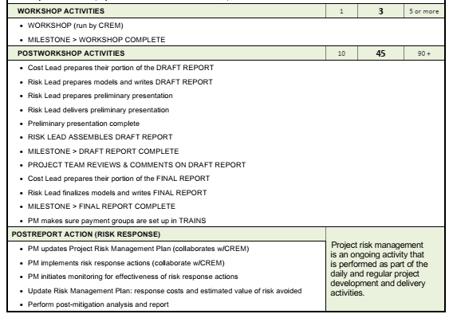
Planning Project Risk Management Guide
1- Project Risk Management Planning
Risk Management Schedule: With Workshop and Postworkshop Activities

Slide 53
Thanks

