Slide 1

MASTER THESIS PRESENTATION | MIDOCEAN UNIVERSITY
Early Prediction of Alzheimer’s Disease using Deep Learning and Data Fusion
By: Ahmed Naji Lutfi & Mohamed Amin Miqdad
Supervisor: Dr. Mohamed Essa
Collage of Informatics, Midocean University, Comoros

Slide 2


Agenda
1
Introduction
2
Problem statement
3
Related work
4
Research gap
5
Objective & Contribution
6
Methodology & Architecture
7
Results & Discussion
8
Conclusion & Future work

Slide 3
01 Introduction

Slide 4


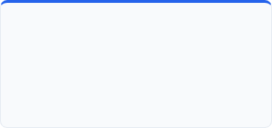



Section 1 : Introduction
Overview
Key Statistics
57 Million+
10 Million/yr
65% (2/3)
Global Patients Worldwide
Annual New Diagnoses
Female Prevalence Ratio
Living with dementia today (60-70% Alzheimer's). Projected to explode to 139 Million by 2050.
Every 3.2 seconds, someone in the world develops dementia, posing an urgent healthcare threat.
Nearly two-thirds of Alzheimer's patients are women. Lifetime risk at age 45 is 1 in 5 for women vs 1 in 10 for men.
65+ Years
$1.3 Trillion
75% Undiagnosed
Average Onset & Age Peak
Annual Economic Cost
Affects 1 in 9 people over 65 (rising to 33% at 85+). Early-onset dementia impacts over 3.9 Million people (ages 30-64).
7th leading cause of global mortality. Global healthcare costs projected to hit $2.8 Trillion by 2030.
Global Diagnostic Gap
Up to 75% of dementia cases remain unconfirmed until late stages, missing the critical window for intervention.

Slide 5
02 Problem Statement

Slide 6
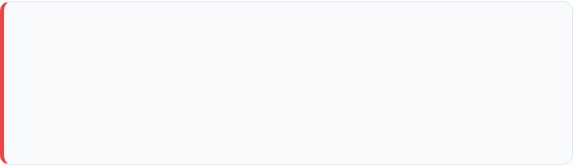

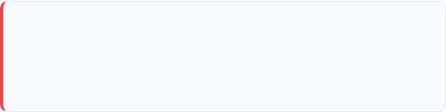

Problem Statement
1. Early Detection Bottleneck
2. Volumetric Spatial Integrity Loss
Structural brain shrink begins years before noticeable cognitive impairment manifests
Converting 3D brain scans into separate 2D images loses important information about how different parts connect across the scan.
This can make it harder to detect early changes and understand their location in the brain.
3. High Dimensionality Risks
4. Unimodal Limitations
Volumetric 3D MRI contains millions of voxels, causing severe overfitting if features are not efficiently extracted.
Relying only on brain scans may overlook important changes in memory, thinking, and overall cognitive function over time.
5. Multimodal Fusion Bottlenecks
Combining different types of data, such as 3D brain scans, memory test scores, and demographic information, in one neural network is still technically difficult. There is no standard way to combine these different types of data to make reliable early predictions.

Slide 7
03 Related Work

Slide 8
Related Work (Studies 1 to 5)
Study (Year) | Proposed Method | Accuracy | Main Limitations & Analysis
Muksimova et al. (2025) | CNN + LSTM | 94.00% | Fuses images only; completely lacks integration of clinical medical records.
Li et al. (2025) | CNN + Transformer | 93.04% | Struggles with precise MCI-to-AD intermediate stage prediction.
Bricaud & Masala (2026) | Hybrid ConvNeXtV2-L | 91.07% | MRI-only; lacks integration of clinical medical records.
Bekhet et al. (2025) | 1D CNN + Random Forest | > 90.0% | No simultaneous fusion; relies on 2D slice images.
Zhang, Y., et al. (2023) | GNN framework | 92.00% | High computational cost requiring both MRI + PET scans.

Slide 9
Related Work (Studies 6 to 10)
Study (Year) | Proposed Method | Accuracy | Main Limitations & Analysis
Helaly et al. (2021) | E2AD2C (CNN & VGG19) | 97.00% | High power requirement for 3D scans; images-only modality.
Warren & Moustafa (2026) | 3D CNN with XAI | 90.00% | Very small sample size; lacks global validation.
Wang, J., et al. (2024) | ResNet + Attention Conv | 93.44% | High computational cost requiring both MRI + PET scans.
Alsubaie et al. (2026) | BiFPN3DViT (3D CNN+ViT) | 92.10% | MRI-only; lacks integration of clinical medical records.
Ahmed et al. (2023) | Deep CNN | 93.86% | MRI-only; lacks Explainable AI (XAI) tools.

Slide 10
Related Work (Studies 11 to 15)
Study (Year) | Proposed Method | Accuracy | Main Limitations & Analysis
Lu et al. (2022) | Transfer (Inception-ResNet) | 94.50% | MRI-only; data mostly from Western populations.
Khalid et al. (2026) | CNN & Random Forest | 94.00% | Processes images and clinical data separately; lacks unified fusion.
Sheikh et al. (2025) | EfficientNetV2B0 & XAI | 88.00% | 2D images only; lacks integration of clinical medical records.
Ghosh et al. (2023) | Federated & MobileNet | 95.24% | 2D images only; lacks integration of clinical medical records.
Abbasian & Hammond (2024) | 3D CNN | 81.80% | MRI-only; lacks clinical data integration.

Slide 11
04 Research gaps

Slide 12
Main Research Gaps
Gap 1: Single-Modality Bias
• Existing models use MRI-only data without considering use of cognitive MMSE scores, may lead to errors in MCI diagnosis.
Gap 2 : PET Cost & Radiation
• Multimodal models rely on expensive PET scans with radioactive tracers, limiting accessibility.
Gap 3: 2D Slice Information Loss
• Converting 3D brain images into 2D slices loses information about areas deep in the brain and their 3D structure and location.
Gap 4: 'Black-Box' Medical Risk
• Deep learning models rarely explain their decisions, creating trust issues for doctors.
Gap 5: Lack of End-to-End Unified Multimodal Fusion
• Studies that incorporate both imaging and clinical data often process them through separate, isolated models (e.g., CNN for images and Random Forest for clinical data) rather than integrating them into a single which prevent to update their weights together through backpropagation. This makes it harder to connect brain structure changes with clinical cognitive decline at the same time.

Slide 13
05 Objectives & Contribution

Slide 14
Objectives
Objectives & Contributions
Build a dual-stream deep learning architecture for joint spatial and tabular feature extraction.
Develop a Multimodal Fusion pipeline integrating 3D sMRI, MMSE cognitive scores, and demographics.
Enhance early multi-class diagnostic accuracy across NC, MCI, and AD stages.
Predict future disease progression based on the patient’s current data.
Incorporate Explainable AI (XAI) to provide clinicians with transparent visual reasoning.

Slide 15

Objectives & Contributions
Contributions
1. Multimodal AI-Based Diagnosis
2. Efficient 3D Spatial Feature Extraction
Develop a deep learning framework integrating MRI images and clinical data for improved Alzheimer’s diagnosis.
Implement and compare computer vision models, including CNN,Vgg-16 and 3D ResNet-18, for classification performance.
3. Zero False Negative Rate
4. Clinical Transparency via XAI
Achieved 100% Recall (FN=0) for Alzheimer's Disease (AD) cases, ensuring no diseased patient is incorrectly classified as healthy.
Validated model decisions via 3D Grad-CAM, providing doctors with visual heatmaps highlighting hippocampal degeneration.

Slide 16
06 Methodology & Architecture
Proposed framework ,ADNI Dataset and 3D Preprocessing Pipeline

Slide 17
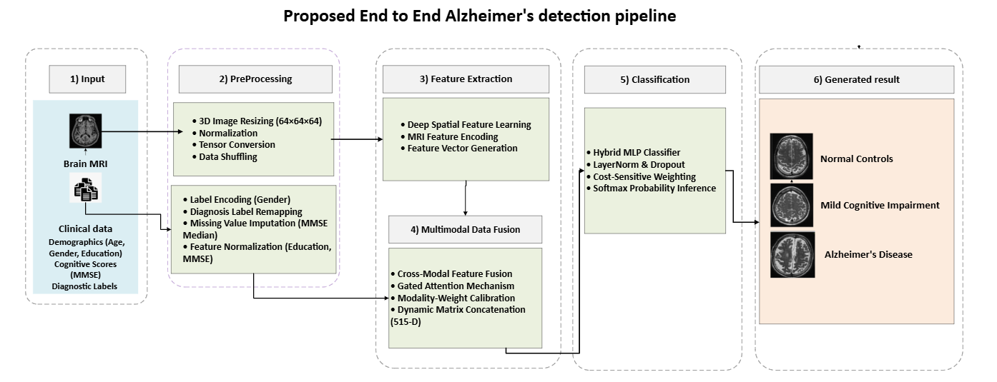
Methodology & Architecture
Overview
Proposed Framework and Dataflow

Slide 18
Methodology & Architecture
Overview
Imaging Stream: Processes 3D sMRI tensors (64×64×64) via pretrained 3D ResNet-18 to generate a 512-D spatial feature embedding.
Clinical Stream: Encodes gender, normalized education, and MMSE scores into a 3-D structured feature vector.
Feature Fusion: Concatenates visual and clinical embeddings into a unified 515-D representation.
Classification Module: Dense MLP classifier with Layer Normalization, 40% Dropout, and Softmax activation.

Slide 19
Methodology & Architecture
Dataset Profile
Alzheimer's Disease Neuroimaging Initiative (ADNI)
Globally recognized benchmark dataset.
Matched 3D sMRI scans and clinical records.
Cohort No (1971)
Class Distribution:
- Normal Control (NC): 479 subjects
- MCI (MCI): 766 subjects
- Alzheimer's Disease (AD): 726 subjects
1,971
Total ADNI Subject Scans
Total ADNI Subject Scans
(NC: 479 | MCI: 766 | AD: 726)

Slide 20
Methodology & Architecture
Dataset Partitioning
Medical Group (Diagnosis) | Data Split | Number of Patients (N)
Normal Control (NC) | Training (70%) | 335
Normal Control (NC) | Validation (15%) | 72
Normal Control (NC) | Testing (15%) | 72
MCI (MCI) | Training (70%) | 536
MCI (MCI) | Validation (15%) | 115
MCI (EMCI) | Testing (15%) | 115
Alzheimer's (AD) | Training (70%) | 508
Alzheimer's (AD) | Validation (15%) | 109
Alzheimer's (AD) | Testing (15%) | 109
Total Cohort | Cumulative | 1971
1,379 (70%)
269 (15%)
296 (15%)
Total ADNI Subject Scans
Training Set
Validation Set
Test Set
We handled dataset imbalance at three levels: at the loss level using Class-Weighted Cross-Entropy, at the data level using Stratified Splitting, and at the evaluation level by tracking Macro F1-Score and ROC-AUC.

Slide 21
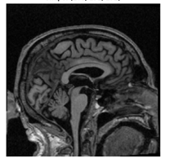
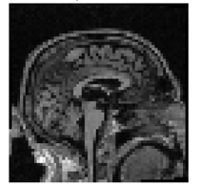
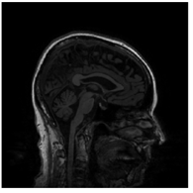
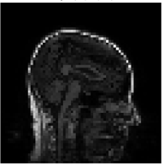
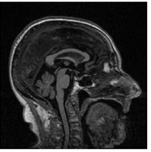
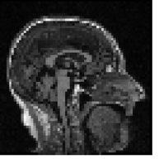
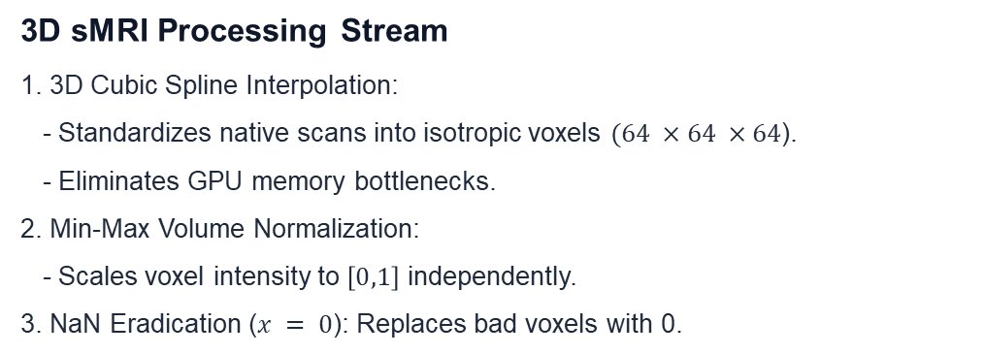
Methodology & Architecture
Data Preprocessing Pipelines
3D sMRI Processing Stream
1. 3D Cubic Spline Interpolation:
- Standardizes native scans into isotropic voxels $(64 ×64 ×64$).
- Eliminates GPU memory bottlenecks.
2. Min-Max Volume Normalization:
- Scales voxel intensity to $\left[0,1\right]$ independently.
3. NaN Eradication ($x = 0$): Replaces bad voxels with 0.
Before
After

Slide 22
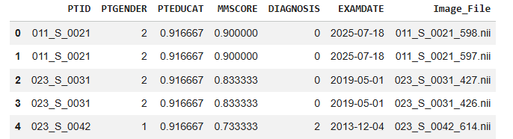
Methodology & Architecture
Data Preprocessing Pipelines
Clinical Metadata Stream
1. Missing Score Imputation:
- Replaces missing Mini-Mental State Examination (MMSE) values using diagnostic group medians.
- Calculated strictly on training set to avoid leakage.
2. Feature Normalization:
- Binary gender encoding (Male=1, Female=0).
- Min-Max scaling for Age, Education, and MMSE scores

Slide 23
Methodology & Architecture
Training Protocol
Parameter | Baseline 3D-CNN | 3D VGG-16 | 3D ResNet-18 | Proposed Fusion Framework
Hardware Platform | NVIDIA GPU | NVIDIA GPU | NVIDIA GPU | NVIDIA GPU
Framework / CUDA | PyTorch + CUDA | PyTorch + CUDA | PyTorch + CUDA | PyTorch + CUDA
Training Epochs | 20 Epochs | 20 Epochs | 20 Epochs | 20 Epochs
Batch Size | 32 | 32 | 32 | 32
Optimization Model | Adam | Adam | Adam | Adam
Initial Learning Rate | 1e-4 | 1e-4 | 1e-4 | 1e-4
LR Scheduler | None | None | StepLR (step=7, γ=0.1) | StepLR (step=7, γ=0.1)
Regularization | BatchNorm + 20% Dropout | BatchNorm + 30% Dropout | BatchNorm + 40% Dropout | LayerNorm + 40% Dropout
Loss Function | Cross-Entropy | Cross-Entropy | Cross-Entropy | Class-Weighted Cross-Entropy

Slide 24
07 Result & Discussion
Architecture evolution and Multimodal Fusion Framework

Slide 25
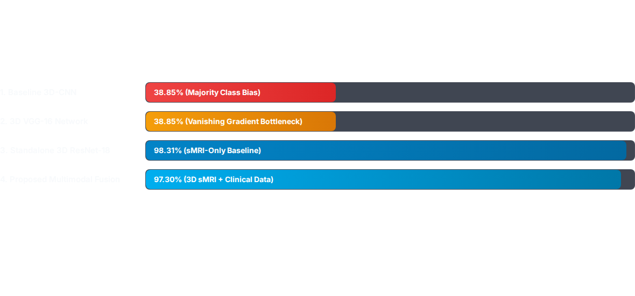
Methodology & Architecture
Architectures evaluation progress overview
* Residual connections resolved gradient degradation, while multimodal fusion integrated key clinical indicators for reliable decision boundaries.

Slide 26
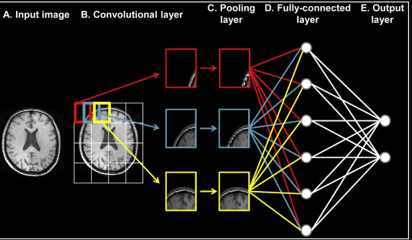
Result & Discussion
Baseline 3D-CNN
1. Baseline 3D-CNN
Extend traditional CNN models to process 3D volumetric MRI brain scans.
Use 3D convolutional layers to extract spatial features from MRI volumes.
Apply 3D Max-Pooling to reduce spatial dimensions and improve feature representation.
Establish a baseline model for volumetric feature extraction and Alzheimer’s classification.
Limited network depth may reduce the ability to learn high-level features and affect classification performance.

Slide 27
Result & Discussion
Baseline 3D-CNN Results
1. Baseline 3D-CNN
Achieved an initial testing accuracy of 38.85%.
Extracted basic spatial features from 3D MRI volumes but showed limited learning capability.
Exhibited a strong bias toward the EMCI class, predicting all test samples as EMCI.
Failed to correctly classify NC and AD classes, resulting in zero precision and recall.
Confusion matrix analysis confirmed the model’s inability to distinguish between classes.
Training curves showed minimal improvement, indicating insufficient feature learning from MRI data.
Class | Precision | Recall | F1-Score | Support
Normal Control (NC) | 0.00% | 0.00% | 0.00% | 72
Mild Cognitive Impairment (MCI) | 38.85% | 100.00% | 55.96% | 115
Alzheimer (AD) | 0.00% | 0.00% | 0.00% | 109
Accuracy | — | — | 38.85% | 296
Macro Avg | 12.95% | 33.33% | 18.65% | 296
Weighted Avg | 15.09% | 38.85% | 21.74% | 296

Slide 28
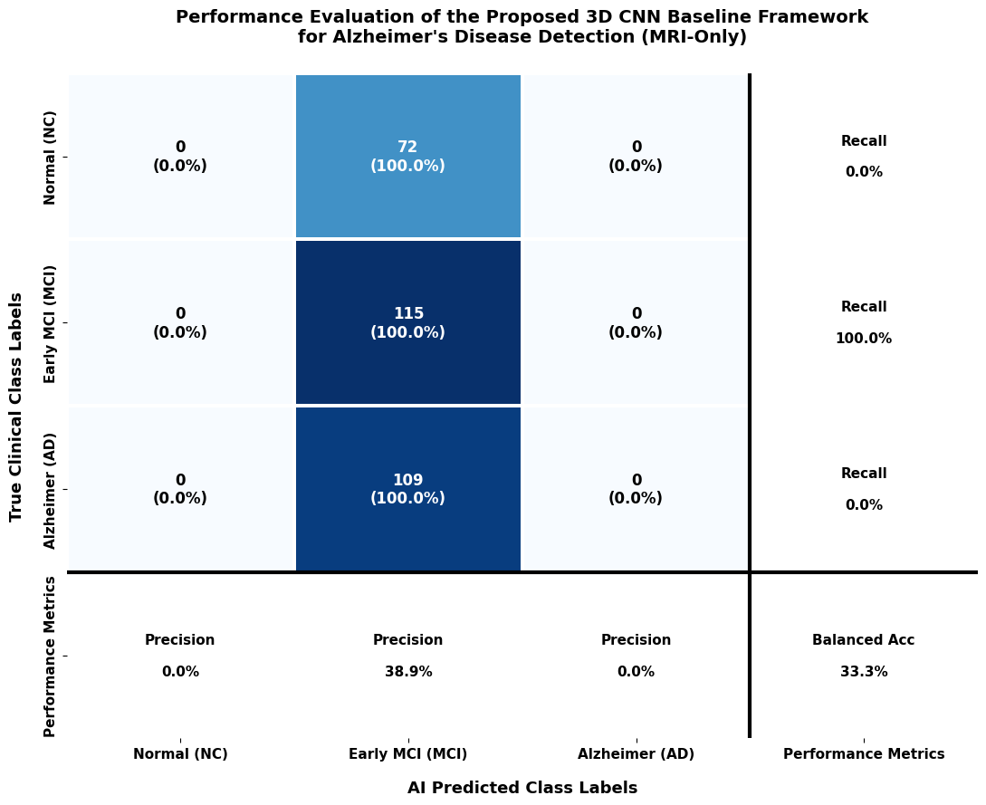
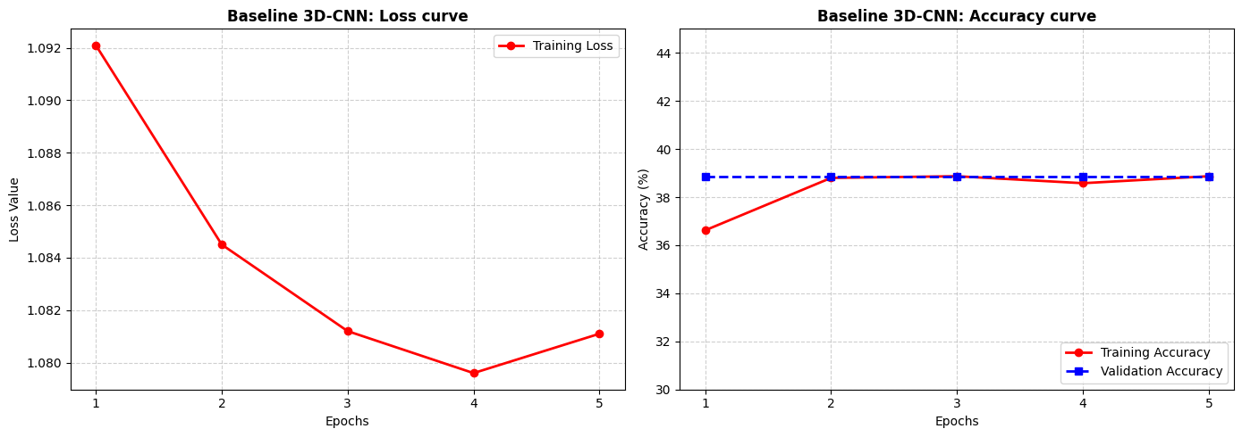
Result & Discussion
Baseline 3D-CNN Confusion matrix & Training curves
1. Baseline 3D-CNN confusion matrix and training curves
Confusion matrix analysis confirmed the model’s inability to distinguish between classes.
Training curves showed minimal improvement, indicating insufficient feature learning from MRI data.

Slide 29
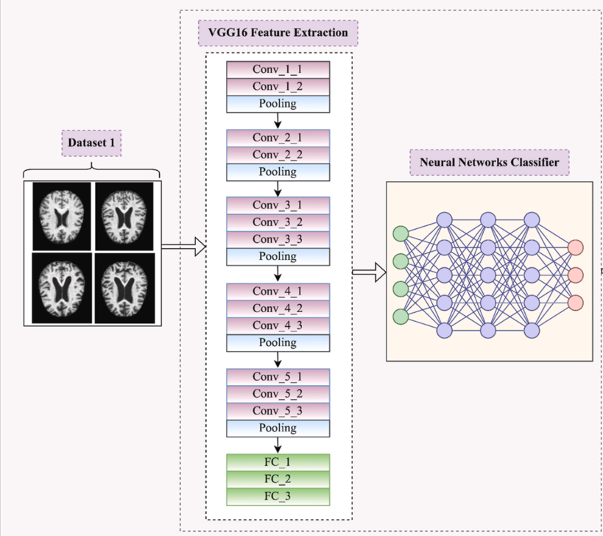
Result & Discussion
VGG-16
2.VGG-16
Develop a deeper architecture inspired by VGG networks for 3D MRI feature extraction.
Use multiple 3×3×3 convolutional layers to capture complex spatial patterns.
Learn hierarchical representations of structural brain changes from MRI volumes.
Increase network depth to improve feature learning and classification capability.
Face optimization challenges due to the vanishing gradient problem in deeper networks.
Experience difficulty in training and become limited by local optimal solutions during validation.

Slide 30
Result & Discussion
VGG-16 Results
2.VGG-16 results
Increased network depth to improve feature extraction from 3D MRI volumes.
Learned more complex spatial features using repeated convolutional layers.
Lack of skip connections caused gradient propagation problems during training.
Deeper layers became difficult to optimize, limiting model performance.
Testing accuracy remained unchanged at 38.85%.
The model did not achieve improvement compared with the baseline 3D-CNN.
Class | Precision | Recall | F1-Score | Support
Normal Control (NC) | 0.00% | 0.00% | 0.00% | 72
Mild Cognitive Impairment (MCI) | 38.85% | 100.00% | 55.96% | 115
Alzheimer (AD) | 0.00% | 0.00% | 0.00% | 109
Accuracy | — | — | 38.85% | 296
Macro Avg | 12.95% | 33.33% | 18.65% | 296
Weighted Avg | 15.09% | 38.85% | 21.74% | 296

Slide 31
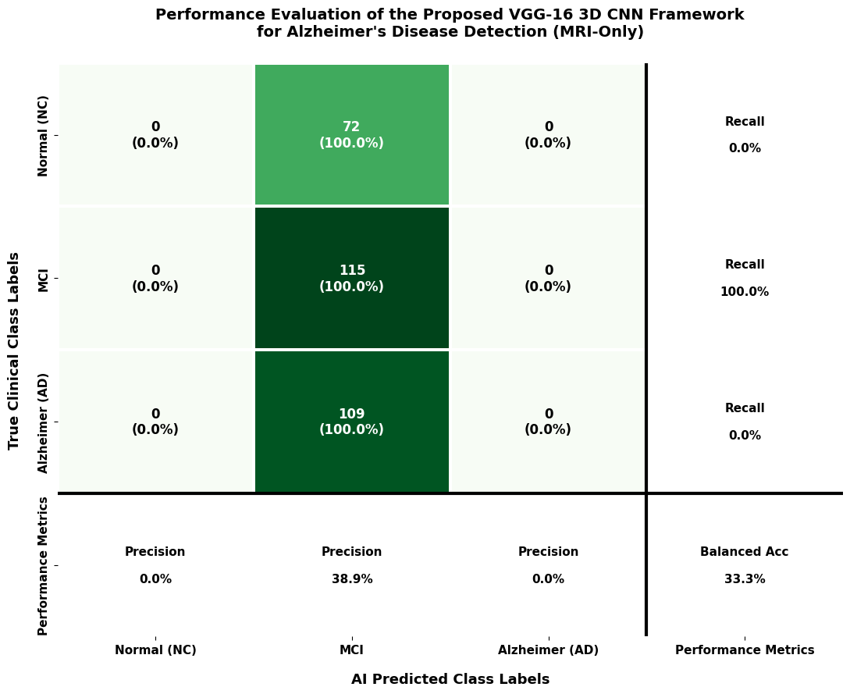
Result & Discussion
VGG-16 Confusion matrix
2.VGG-16 Confusion matrix
The model predicted all 296 test samples as the EMCI class.
Failed to correctly identify Normal Control (NC) and Alzheimer’s Disease (AD) cases.
Achieved a low precision of 38.9% and balanced accuracy of 33.3%.
Results indicate strong class bias and limited ability to distinguish between different Alzheimer’s stages.

Slide 32
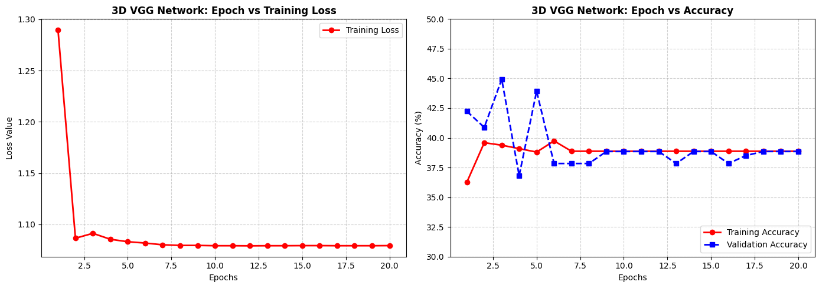
Result & Discussion
VGG-16 Training curves
2.VGG-16 Training Curve Analysis:
Training loss decreased initially, then remained nearly constant at 1.079 throughout training.
Accuracy improved during the first few epochs and then stabilized at approximately 38.8%.
The model showed limited learning progress and failed to improve further.
Performance limitations were likely caused by optimization issues, such as vanishing gradients.

Slide 33
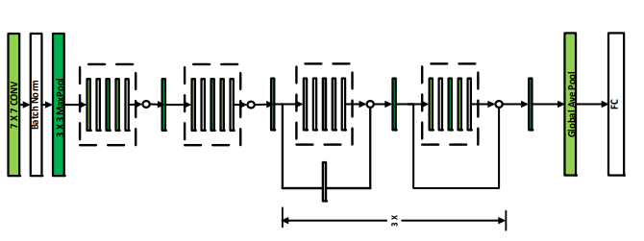
Result & Discussion
ResNet-18
ResNet-18 Architecture
Adopt a 3D ResNet-18 model to overcome the vanishing gradient problem and improve classification performance.
Use residual skip connections to enhance gradient flow and stabilize deep network training.
Enable deeper feature learning from 3D MRI volumes without significant optimization difficulties.
Extract high-level volumetric features from MRI scans using a pretrained 3D ResNet-18 backbone.
Generate compact MRI feature representations for integration with other data modalities.
Prepare extracted MRI features for the multimodal fusion stage with clinical data.

Slide 34
Result & Discussion
ResNet-18 Results
ResNet-18 Results
Achieved a significant improvement in testing accuracy, reaching 98.31%.
Residual connections improved training stability and feature learning.
Pretrained convolutional weights enhanced the extraction of informative MRI features.
Generated effective 512-dimensional visual feature representations for classification.
Demonstrated superior performance compared with previous CNN-based architectures.
Class | Precision | Recall | F1-Score | Support
Normal Control (NC) | 98.59% | 97.22% | 97.90% | 72
Mild Cognitive Impairment (MCI) | 99.12% | 97.39% | 98.25% | 115
Alzheimer's Disease (AD) | 97.32% | 100.00% | 98.64% | 109
Accuracy | — | — | 98.31% | 296
Macro Average | 98.34% | 98.20% | 98.26% | 296
Weighted Average | 98.33% | 98.31% | 98.31% | 296

Slide 35
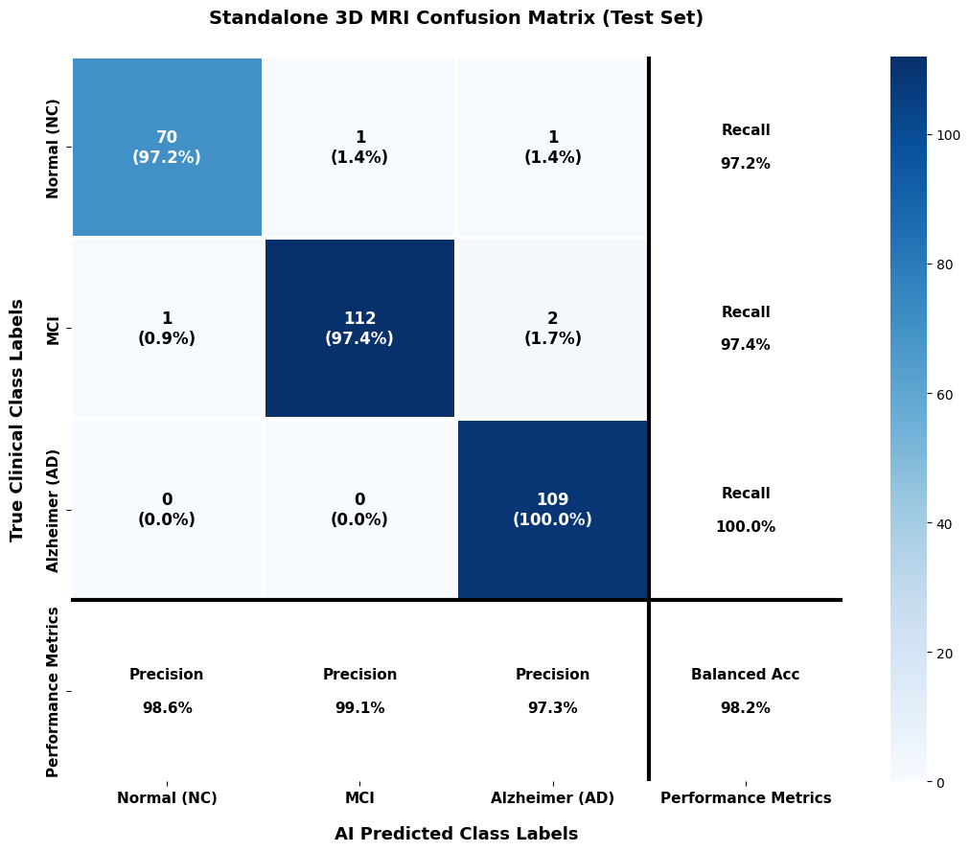
Result & Discussion
ResNet-18 Confusion matrix
ResNet-18 Confusion Matrix Analysis
Successfully classified the majority of test samples across all three classes.
Correctly identified 70 NC, 112 MCI, and 109 AD cases.
Only 4 out of 292 test samples were misclassified.
Demonstrated strong classification capability and improved class discrimination.
Confirmed the effectiveness of the 3D ResNet-18 model for Alzheimer’s disease classification.

Slide 36
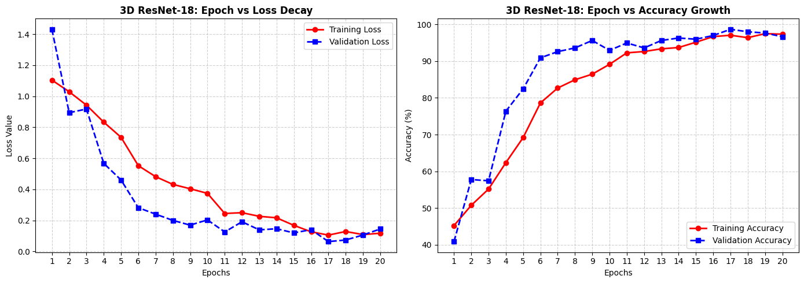
Result & Discussion
ResNet-18 Training curves
ResNet-18 Training Curve Analysis
Training and validation loss decreased consistently toward zero.
The model achieved stable learning without signs of overfitting.
Residual connections improved gradient flow and training stability.
The network learned robust and meaningful features from MRI data.

Slide 37
Result & Discussion
Multimodal Data Fusion Model
Develop a multimodal deep learning framework combining MRI and clinical-cognitive information for Alzheimer’s diagnosis.
Overcome limitations of single-modality models by integrating complementary data sources.
Extract high-level MRI features using a pretrained 3D ResNet-18 backbone.
Process clinical features (gender, education level, and MMSE score) to generate clinical representations.
Combine MRI and clinical features using a late fusion strategy.
Use an MLP classifier with class-balanced weighting for final multi-class prediction (NC, MCI, and AD).
Create a unified feature representation that captures both brain structural changes and clinical characteristics.
Improve diagnostic accuracy through comprehensive multimodal learning.

Slide 38
Result & Discussion
Multimodal Data Fusion model results
Multimodal result
Achieved the high performance with 97.30% testing accuracy.
Combined 3D MRI features with clinical information to improve diagnostic representation.
Integrated clinical features, including normalized MMSE scores, to enhance classification capability.
Improved discrimination between the three diagnostic categories (NC, MCI, and AD).
Demonstrated the effectiveness of multimodal fusion compared with image-only models.
Class | Precision | Recall | F1-Score | Support
Normal Control (NC) | 98.55% | 94.44% | 96.45% | 72
Mild Cognitive Impairment (MCI) | 97.37% | 96.52% | 96.94% | 115
Alzheimer (AD) | 96.46% | 100.00% | 98.20% | 109
Accuracy | — | — | 97.30% | 296
Macro Avg | 97.46% | 96.99% | 97.20% | 296
Weighted Avg | 97.32% | 97.30% | 97.29% | 296

Slide 39
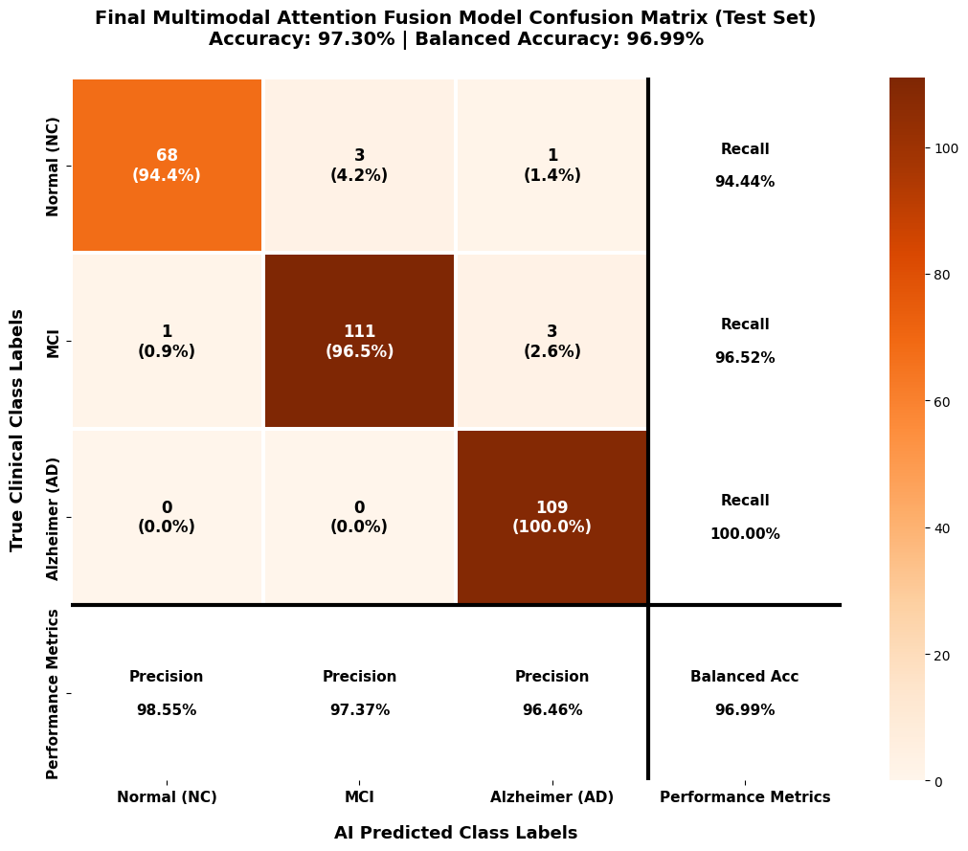
Result & Discussion
Multimodal Data Fusion model results
Multimodal Confusion Matrix Analysis
Achieved an overall testing accuracy of 97.30%.
Correctly classified 68/72 NC subjects and 111/115 MCI cases.
Successfully identified all 109 AD cases with 100% recall.
Achieved a 0% False Negative Rate (FNR) for Alzheimer’s Disease detection.
Demonstrated high reliability in distinguishing between NC, MCI, and AD categories.
Confirmed the effectiveness of combining MRI and clinical features for accurate diagnosis.

Slide 40
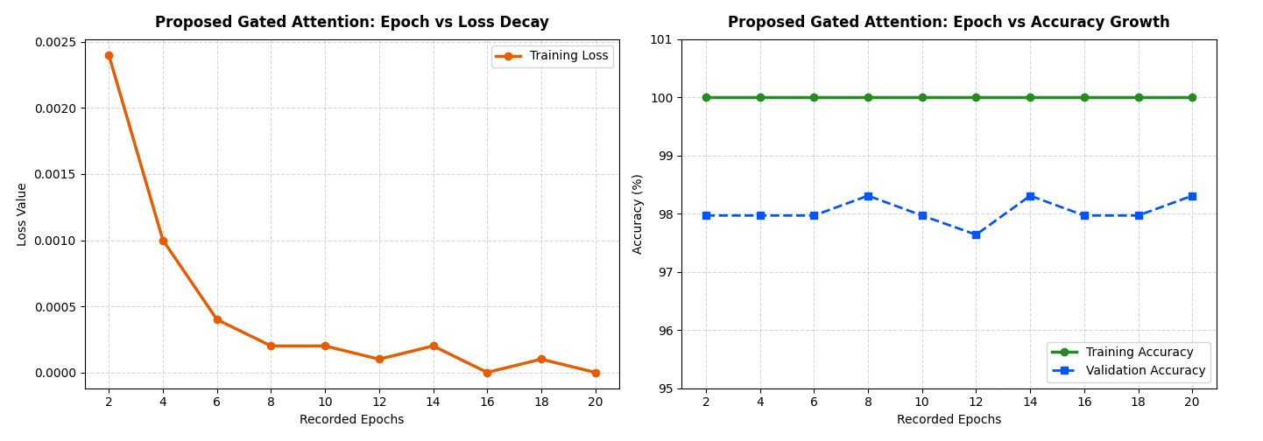
Result & Discussion
Multimodal Data Fusion model results
Multimodal Training Curve Analysis
Training loss decreased rapidly to nearly zero (0.0000), indicating effective optimization.
Training accuracy reached 100% across the training epochs.
Validation accuracy remained stable between 97.6% and 98.3%.
The model demonstrated strong generalization with no significant overfitting.
Results confirm the stability and effectiveness of the proposed multimodal framework.

Slide 41
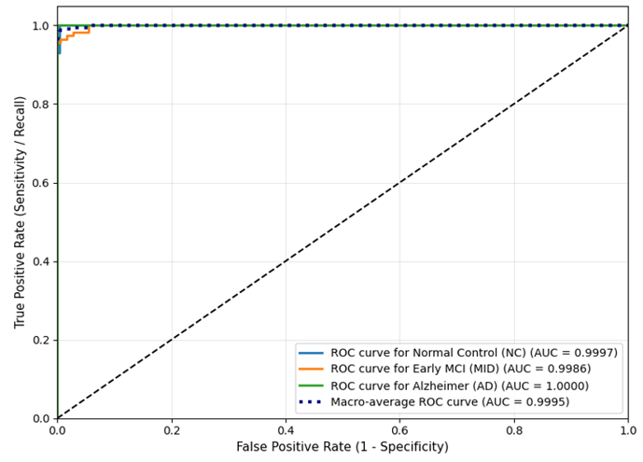
Result & Discussion
Multimodal Data Fusion Framework AUC
Multimodal Fusion Framework AUC Analysis :
Achieved excellent class separation across all diagnostic categories.
Obtained high AUC scores:
  NC: 0.9997
  MCI: 0.9986
  AD: 1.0000
Achieved a macro-average AUC of 0.9995.
Demonstrated outstanding sensitivity and precision for automated Alzheimer’s disease diagnosis.
Confirmed the robustness of the proposed multimodal fusion model in distinguishing between classes.
100.0%
AD Recall
(Zero False Negatives)
0.9995
Macro AUC
(Class Separation)

Slide 42
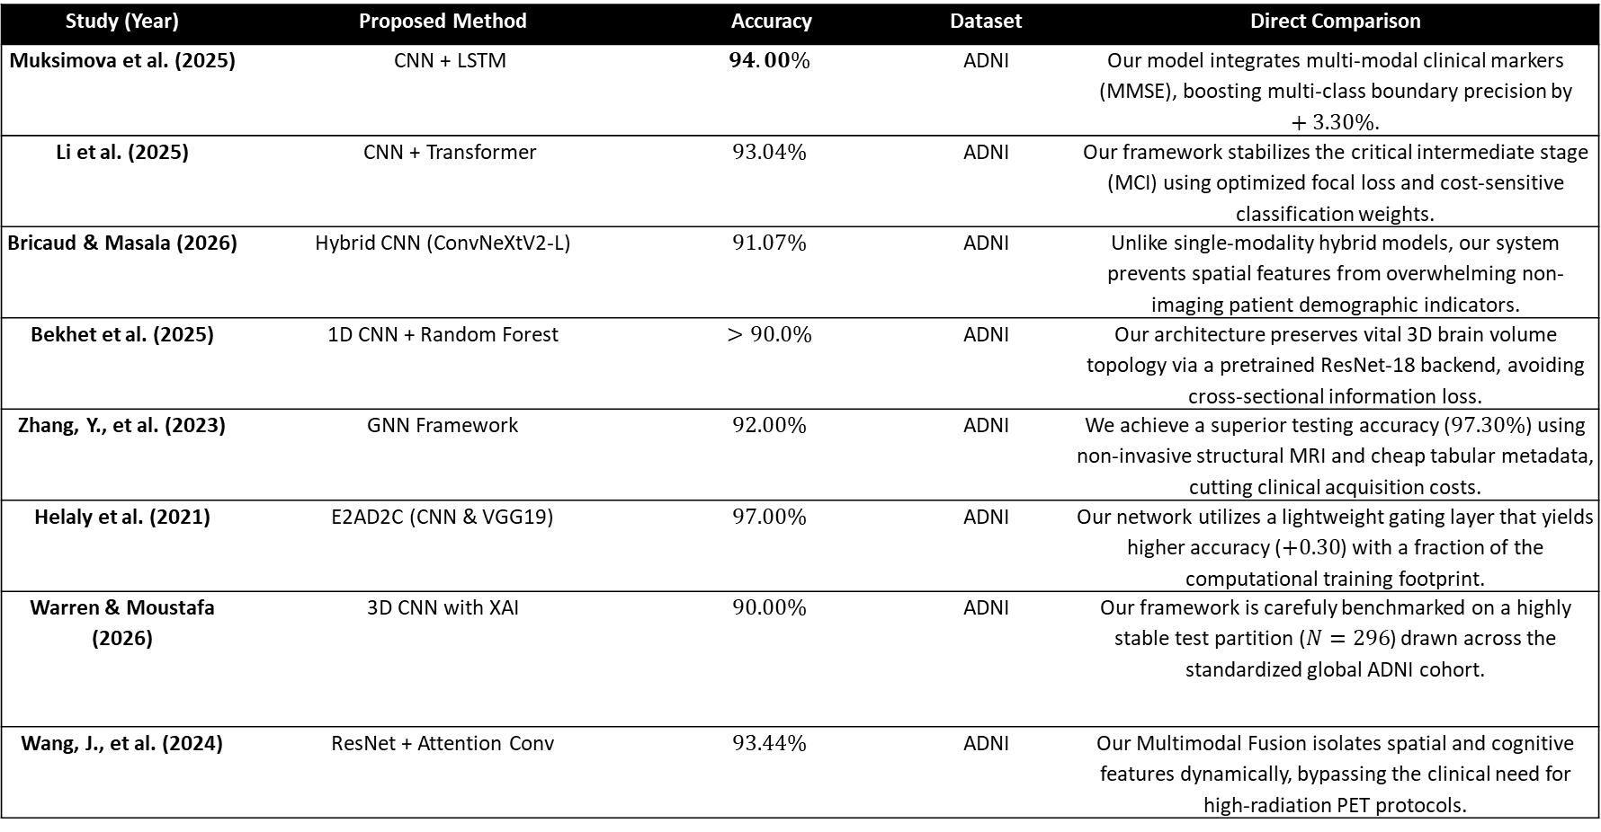
Result & Discussion
Comparison With Related Work (1 to 8)
Study (Year) | Proposed Method | Accuracy | Dataset | Direct Comparison
Muksimova et al. (2025) | CNN + LSTM | $$94.00\%$$ | ADNI | Our model integrates multi-modal clinical markers (MMSE), boosting multi-class boundary precision by $+3.30\%$.
Li et al. (2025) | CNN + Transformer | $$93.04\%$$ | ADNI | Our framework stabilizes the critical intermediate stage (MCI) using optimized focal loss and cost-sensitive classification weights.
Bricaud & Masala (2026) | Hybrid CNN (ConvNeXtV2-L) | $$91.07\%$$ | ADNI | Unlike single-modality hybrid models, our system prevents spatial features from overwhelming non-imaging patient demographic indicators.
Bekhet et al. (2025) | 1D CNN + Random Forest | $$>90.0\%$$ | ADNI | Our architecture preserves vital 3D brain volume topology via a pretrained ResNet-18 backend, avoiding cross-sectional information loss.
Zhang, Y., et al. (2023) | GNN Framework | $$92.00\%$$ | ADNI | We achieve a superior testing accuracy ($97.30\%$) using non-invasive structural MRI and cheap tabular metadata, cutting clinical acquisition costs.
Helaly et al. (2021) | E2AD2C (CNN & VGG19) | $$97.00\%$$ | ADNI | Our network utilizes a lightweight gating layer that yields higher accuracy ($+0.30$) with a fraction of the computational training footprint.
Warren & Moustafa (2026) | 3D CNN with XAI | $$90.00\%$$ | ADNI | Our framework is carefuly benchmarked on a highly stable test partition ($N=296$) drawn across the standardized global ADNI cohort.
Wang, J., et al. (2024) | ResNet + Attention Conv | $$93.44\%$$ | ADNI | Our Multimodal Fusion isolates spatial and cognitive features dynamically, bypassing the clinical need for high-radiation PET protocols.

Slide 43
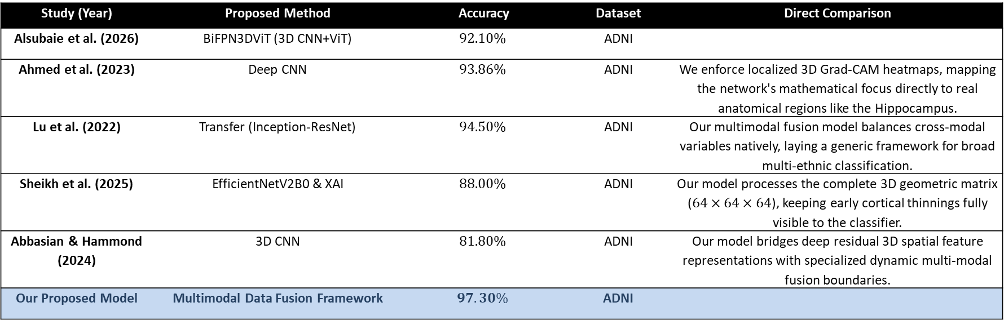
Result & Discussion
Comparison With Related Work (9 to 13)
Study (Year) | Proposed Method | Accuracy | Dataset | Direct Comparison
Alsubaie et al. (2026) | BiFPN3DViT (3D CNN+ViT) | $$92.10\%$$ | ADNI
Ahmed et al. (2023) | Deep CNN | $$93.86\%$$ | ADNI | We enforce localized 3D Grad-CAM heatmaps, mapping the network's mathematical focus directly to real anatomical regions like the Hippocampus.
Lu et al. (2022) | Transfer (Inception-ResNet) | $$94.50\%$$ | ADNI | Our multimodal fusion model balances cross-modal variables natively, laying a generic framework for broad multi-ethnic classification.
Sheikh et al. (2025) | EfficientNetV2B0 & XAI | $$88.00\%$$ | ADNI | Our model processes the complete 3D geometric matrix ($64×64×64$), keeping early cortical thinnings fully visible to the classifier.
Abbasian & Hammond (2024) | 3D CNN | $$81.80\%$$ | ADNI | Our model bridges deep residual 3D spatial feature representations with specialized dynamic multi-modal fusion boundaries.
Our Proposed Model | Multimodal Data Fusion Framework | $$97.30\%$$ | ADNI

Slide 44
08 Conclusions & Future Work
Summary of Scientific Achievements, Impact, and Future Research Directions

Slide 45
Conclusions & Future Work
Conclusions
Evaluated all models under identical experimental settings using the ADNI testing dataset.
Baseline 3D-CNN: Achieved 38.85% accuracy with limited feature learning.
3D VGG: Increased network depth but showed no performance improvement due to optimization challenges.
3D ResNet-18: Significantly improved classification performance, reaching 98.31% accuracy.
Proposed Multimodal Fusion Framework: Combined MRI and clinical data, achieving 97.30% accuracy and a 0.9995 macro-average AUC.
Correctly identified all Alzheimer's Disease (AD) cases (0 False Negatives).
3D Grad-CAM provided visual explanations by highlighting important brain regions.
Results demonstrate the effectiveness of multimodal learning for Alzheimer's disease diagnosis.

Slide 46
Conclusions & Future Work
Future Research Directions
1. Multi-Cohort Validation
Test framework on external datasets (OASIS, AIBL) for cross-population robustness.
2. 3D Tissue Segmentation
Integrate Swin UNETR or nnU-Net models for exact hippocampal volume loss calculation.
3. Longitudinal Forecasting
Model temporal patient MRI scans taken over years to predict MCI conversion to full AD.
4. Federated Learning
Implement multi-hospital collaborative model training without sharing private patient data.

Slide 47
THANK YOU!
Questions & Academic Discussion
By: Ahmed Naji Lutfi & Mohamed Amin Miqdad
Supervisor: Dr. Mohamed Essa
Collage of Informatics, Midocean University, Comoros

