Slide 1
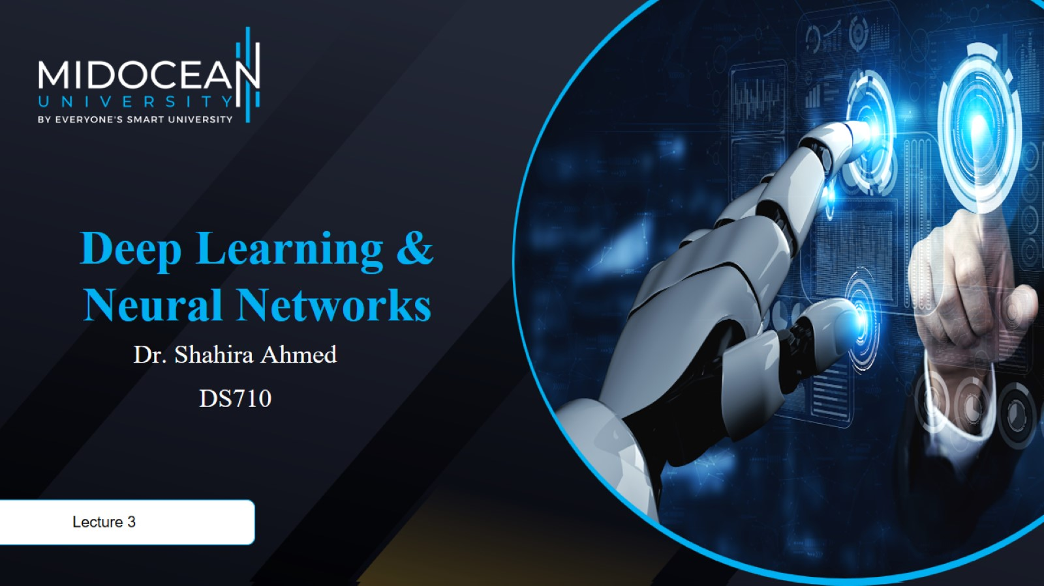

Slide 2


Slide 3
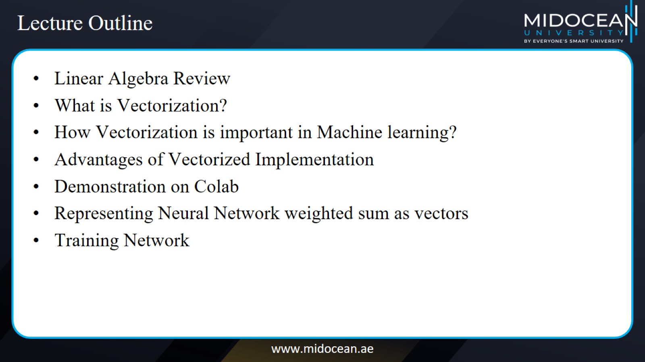
Lecture Outline

Slide 4
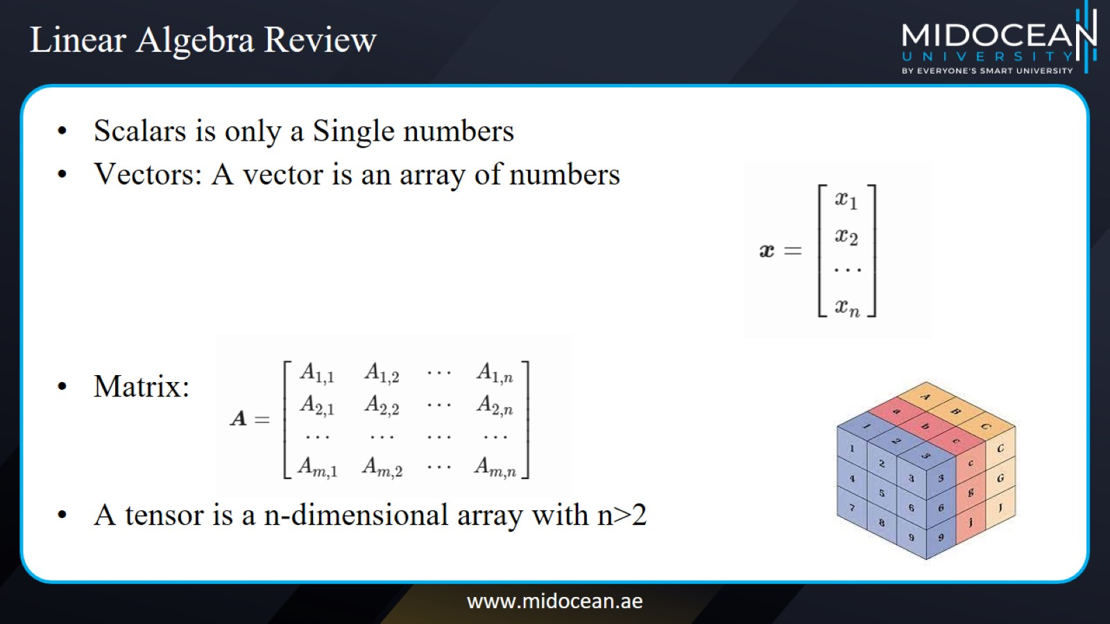
Linear Algebra Review

Slide 5
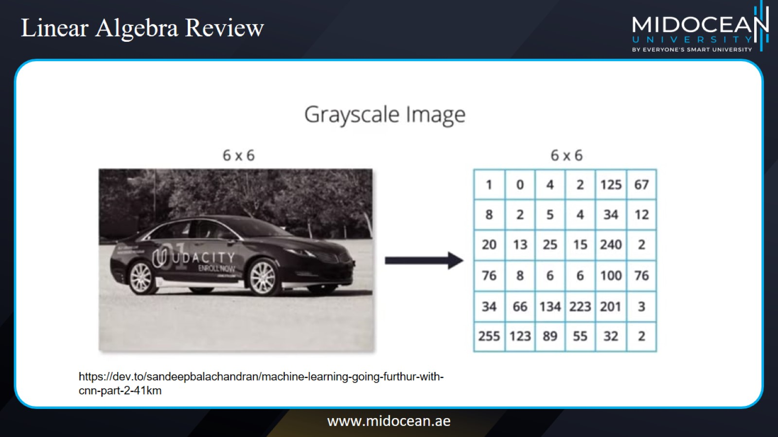
Linear Algebra Review

Slide 6
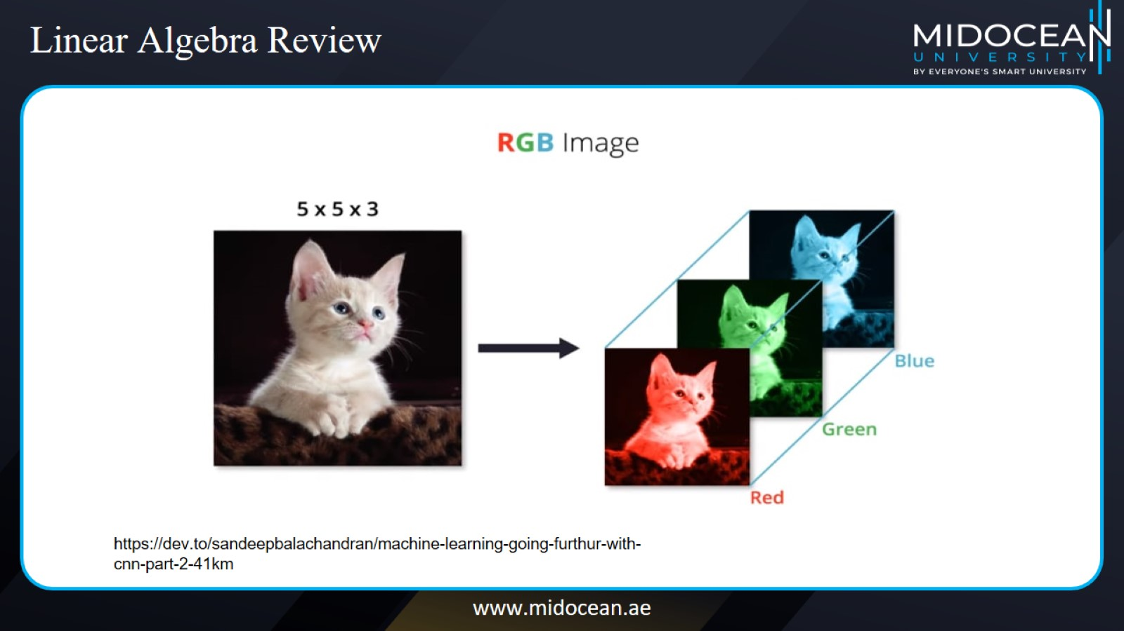
Linear Algebra Review

Slide 7
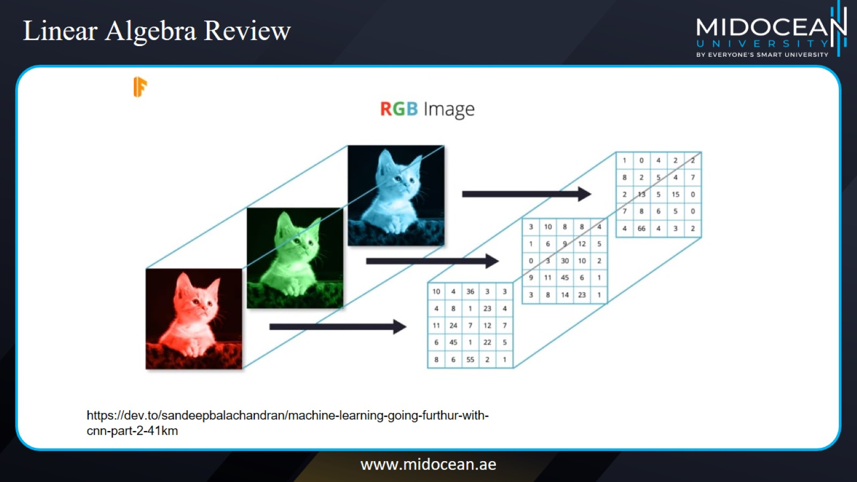
Linear Algebra Review

Slide 8
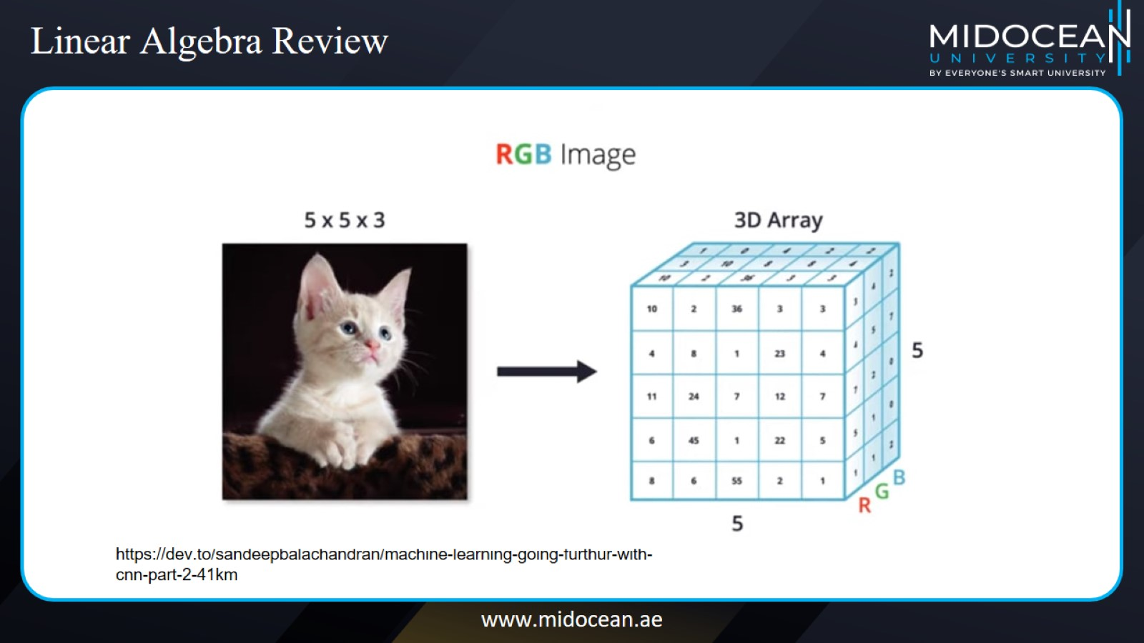
Linear Algebra Review

Slide 9
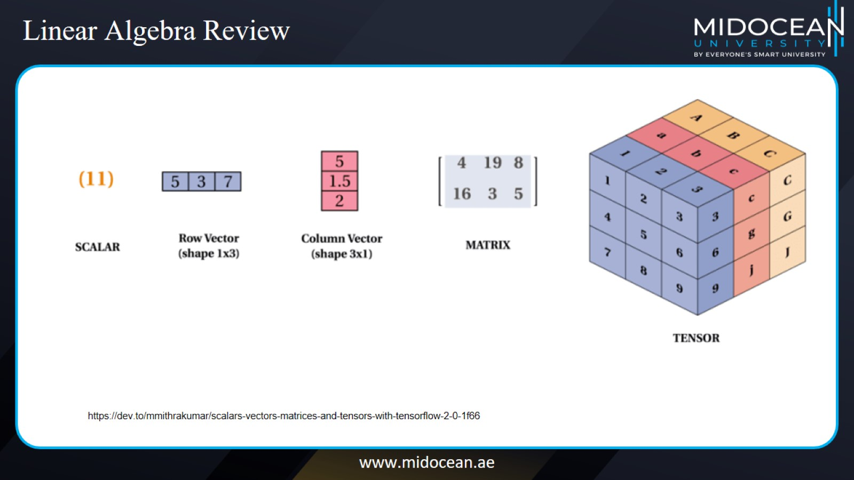
Linear Algebra Review

Slide 10
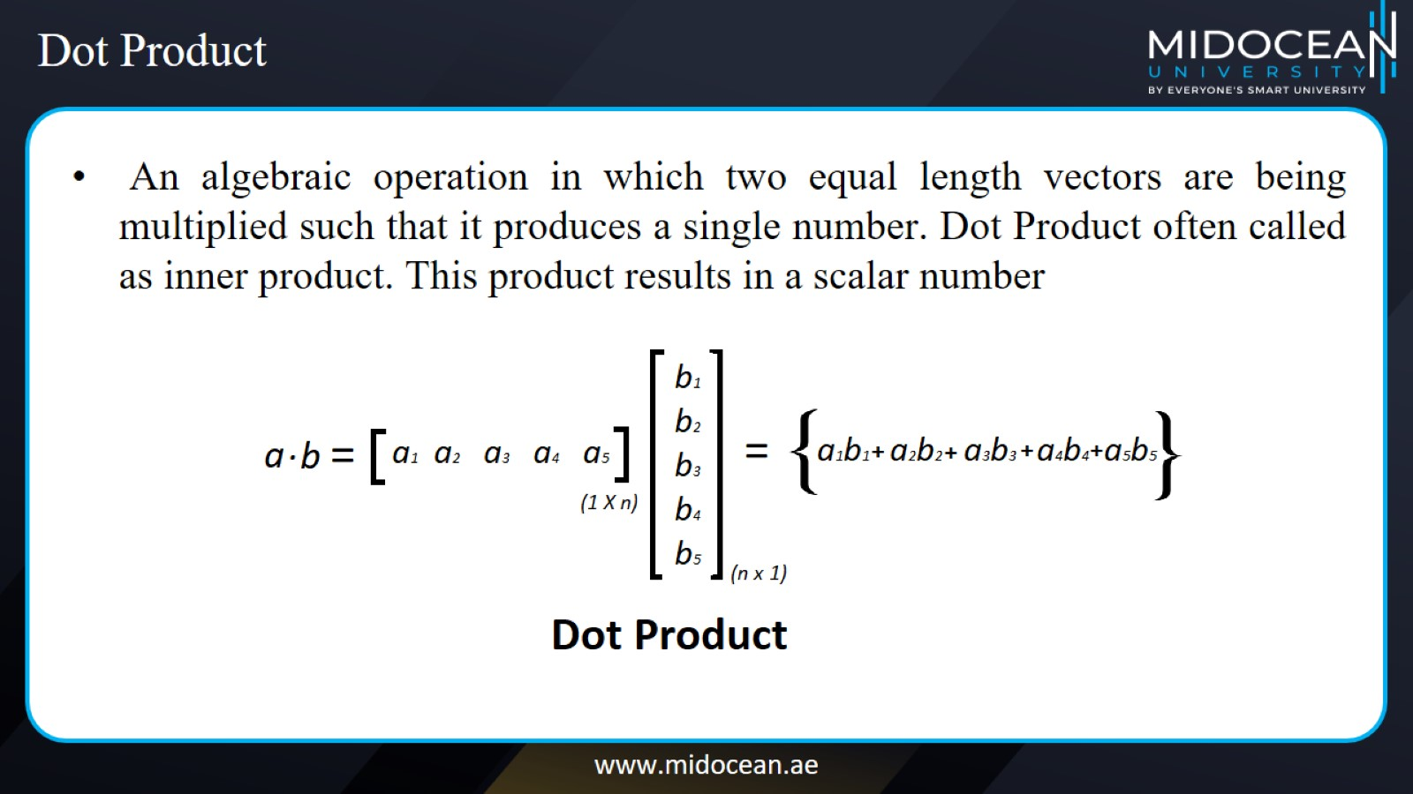
Dot Product

Slide 11
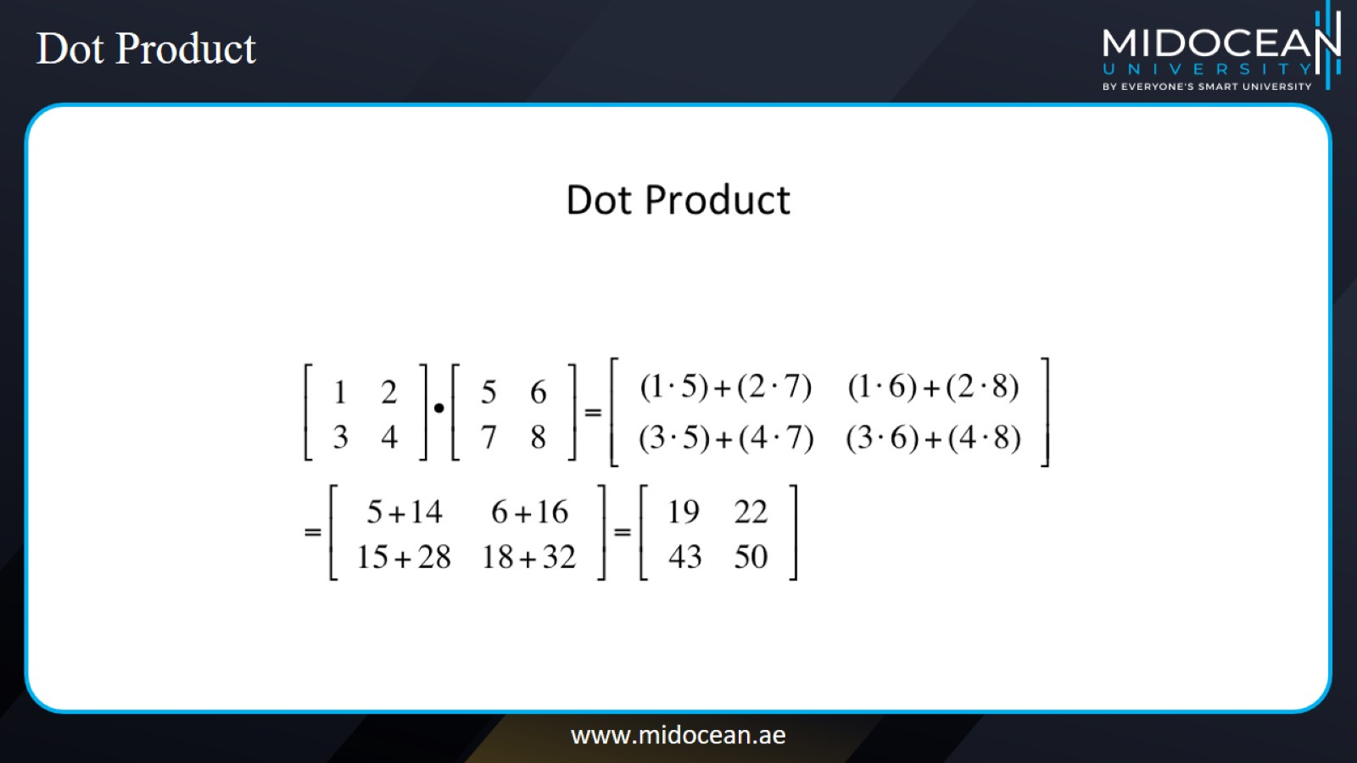
Dot Product

Slide 12
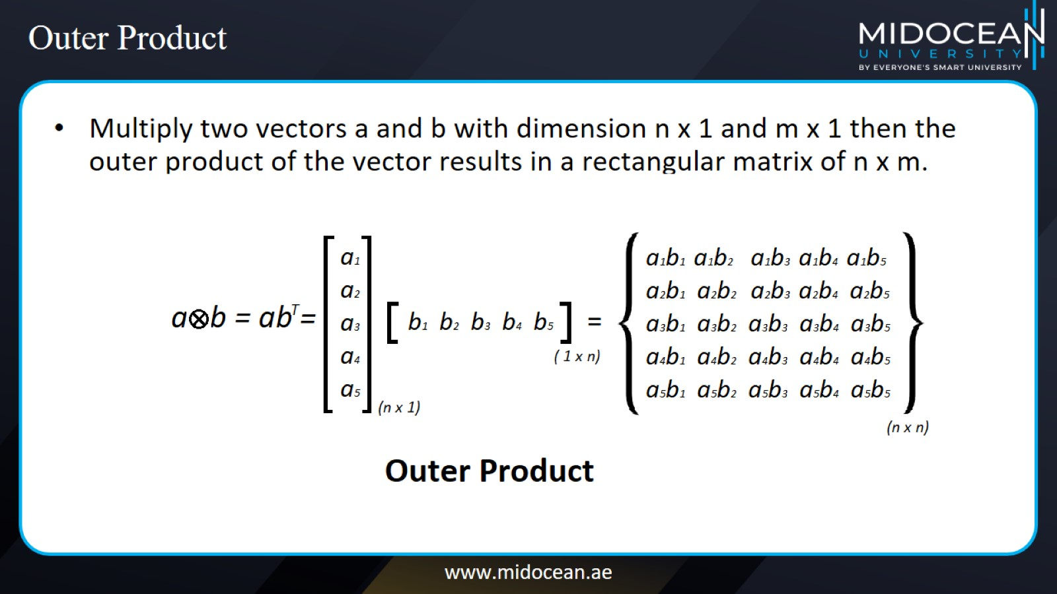
Outer Product

Slide 13
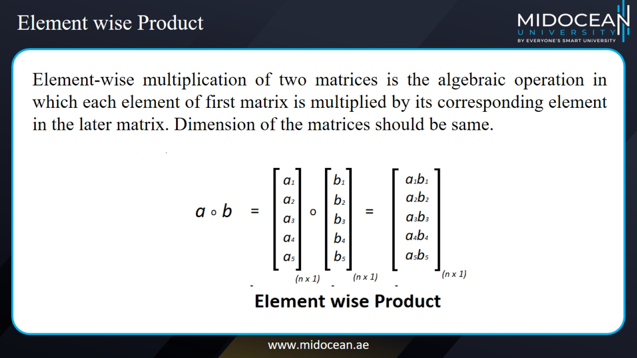
Element wise Product

Slide 14
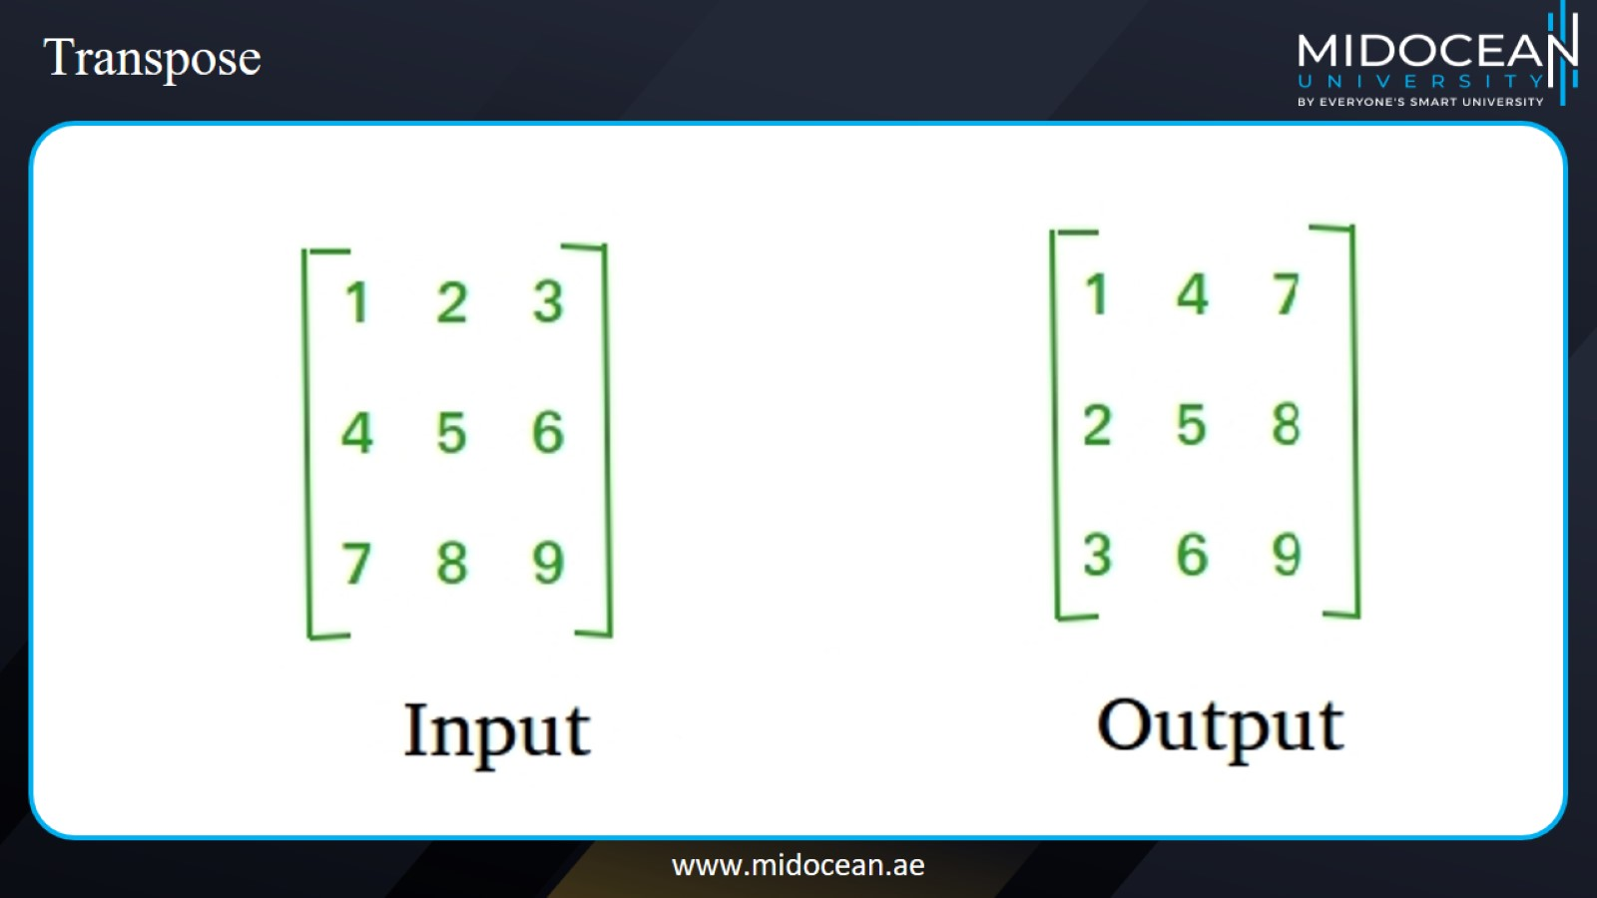
Transpose

Slide 15
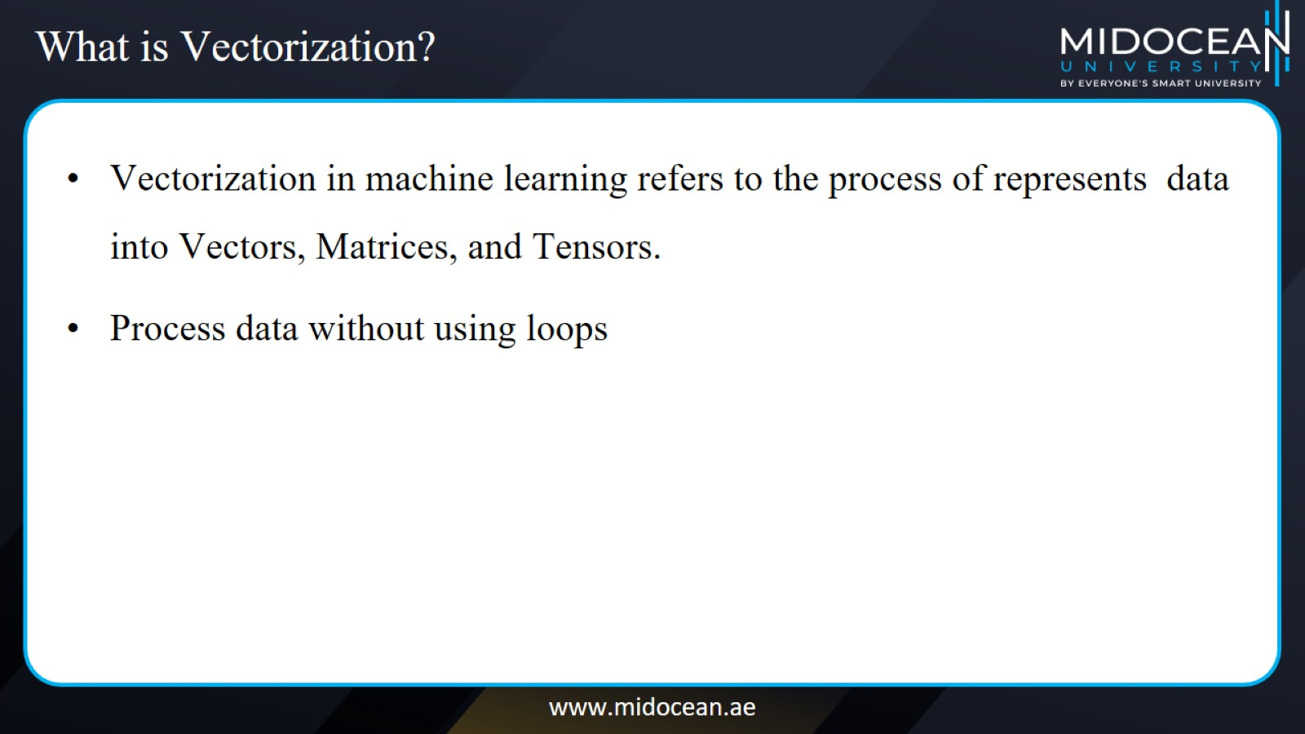
What is Vectorization?

Slide 16
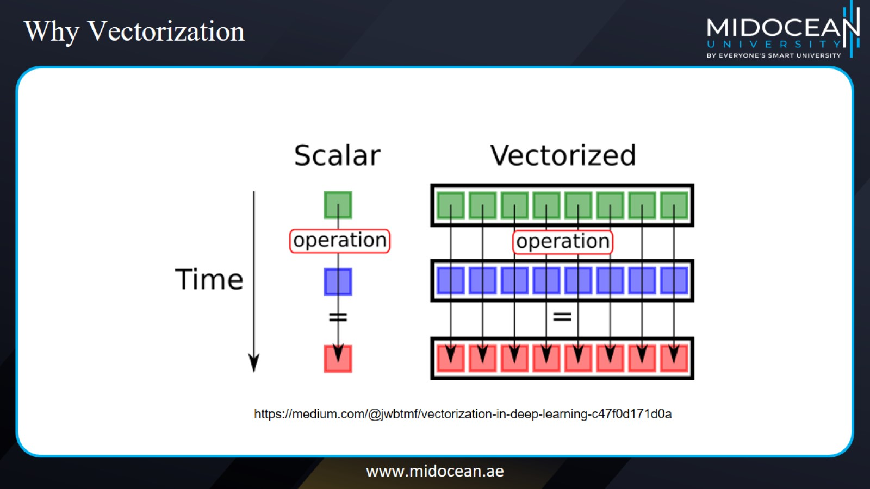
Why Vectorization

Slide 17
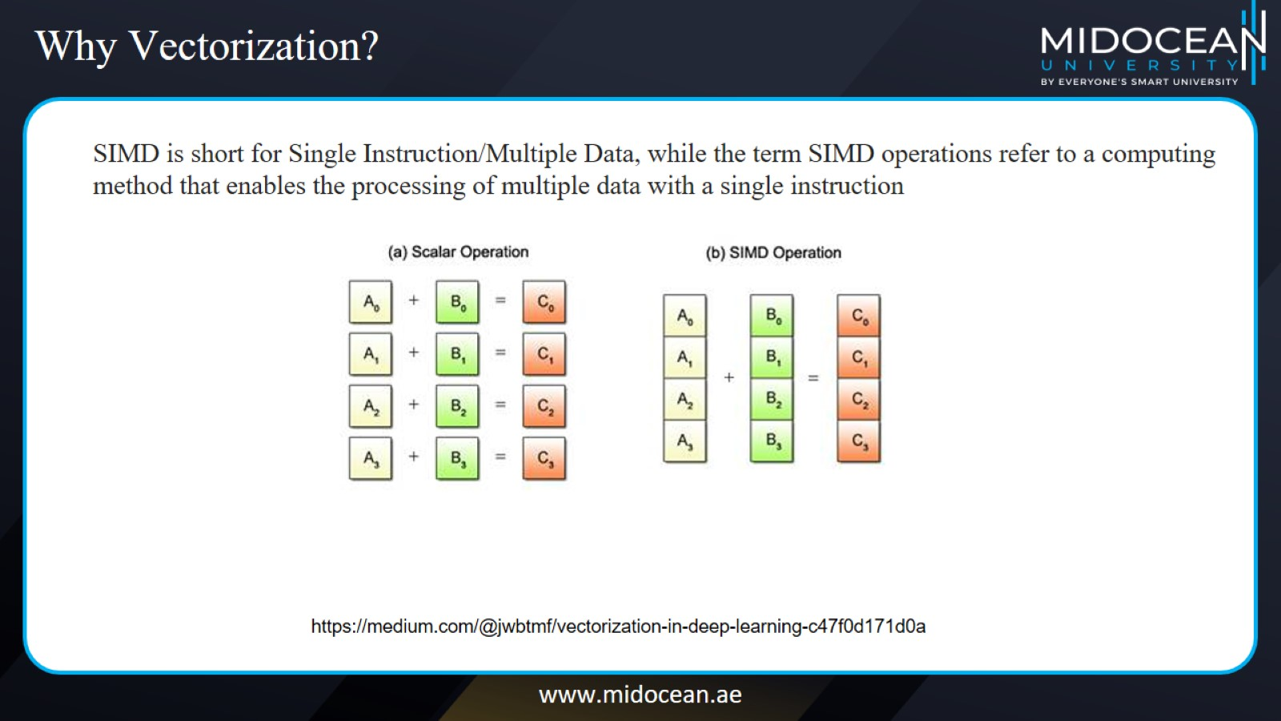
Why Vectorization?

Slide 18
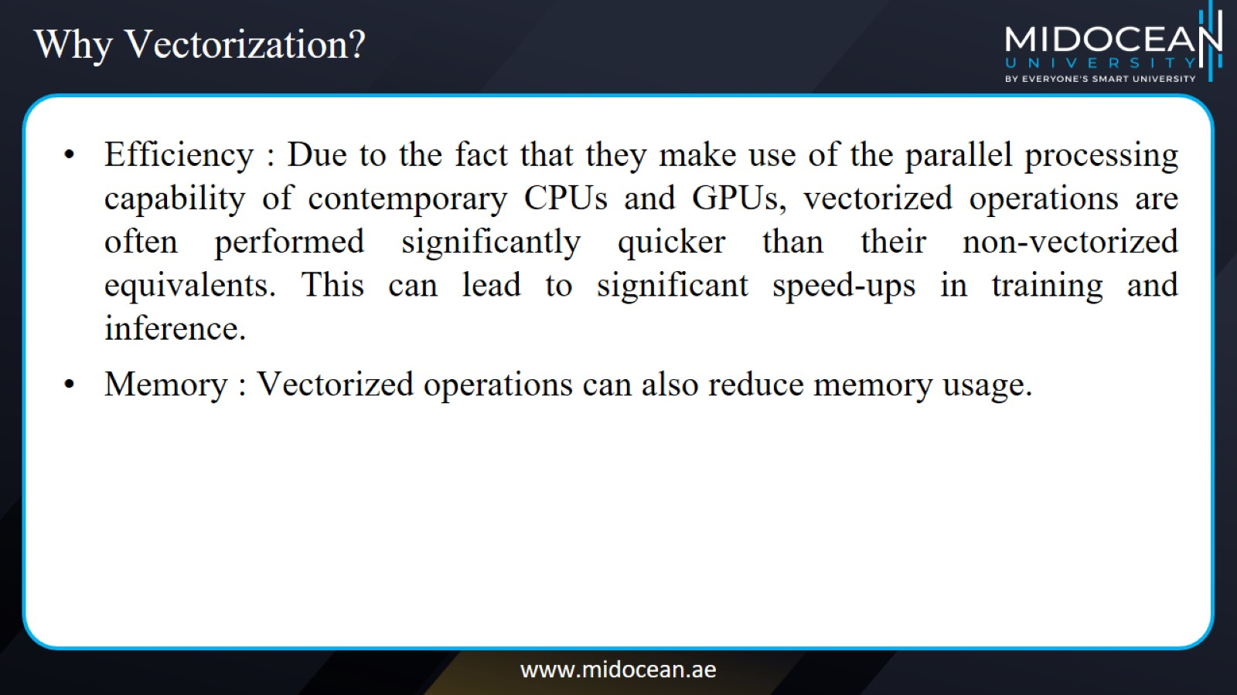
Why Vectorization?

Slide 19
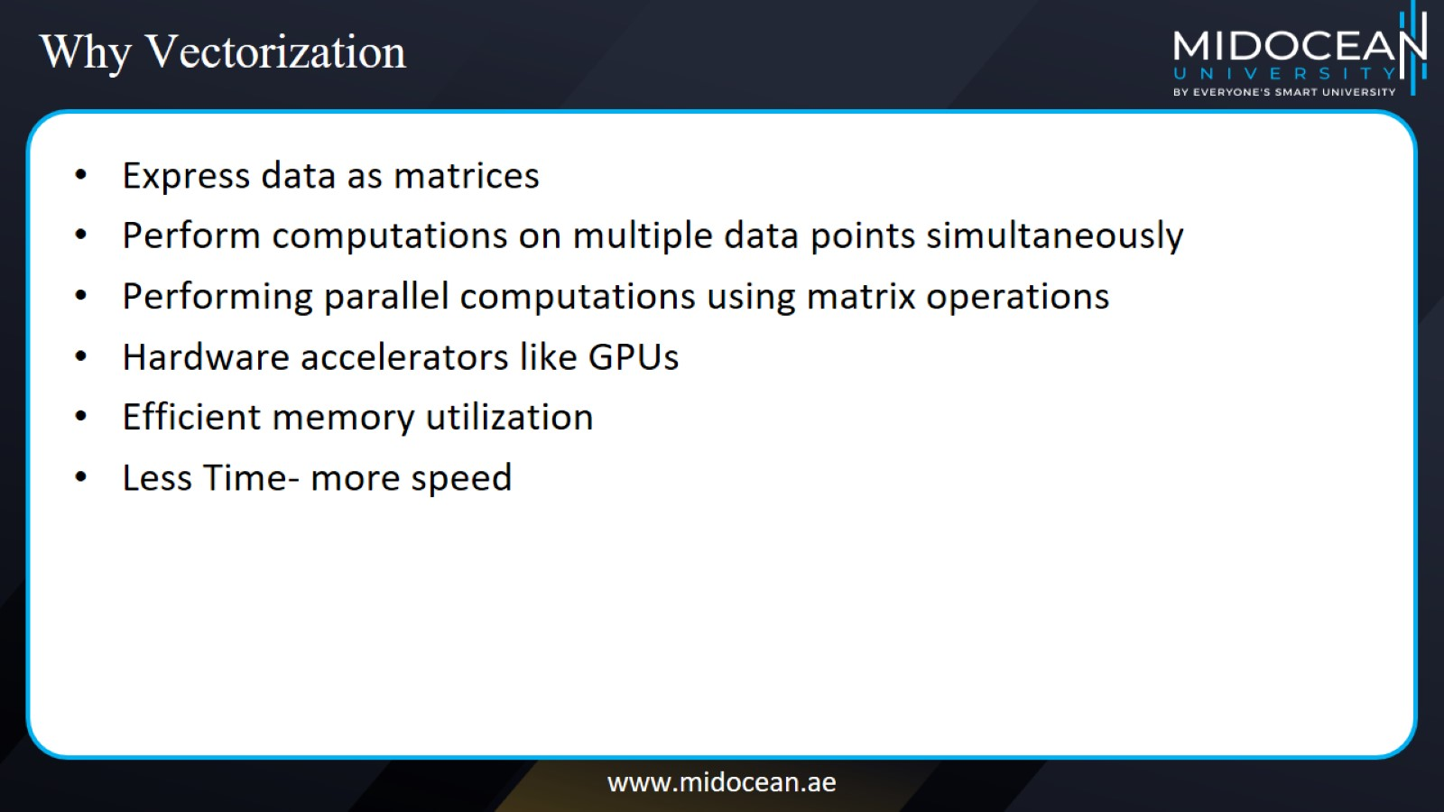
Why Vectorization

Slide 20
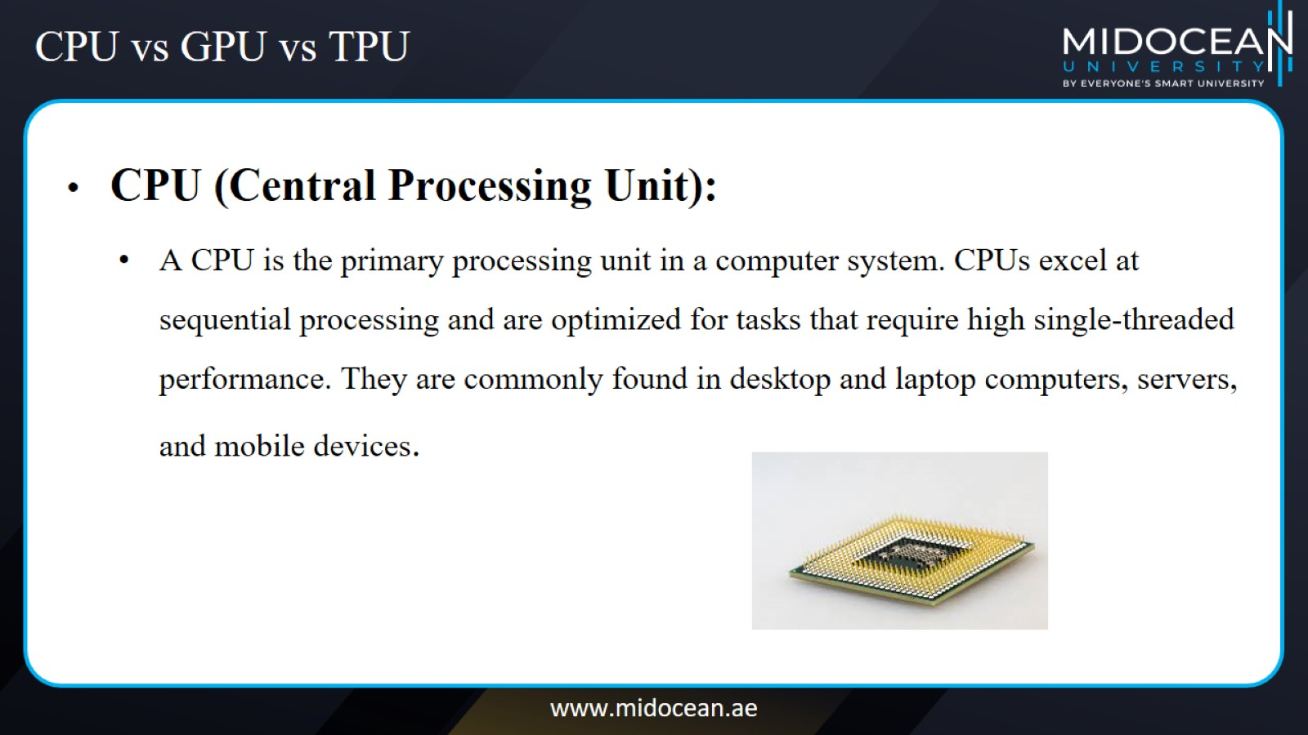
CPU vs GPU vs TPU

Slide 21
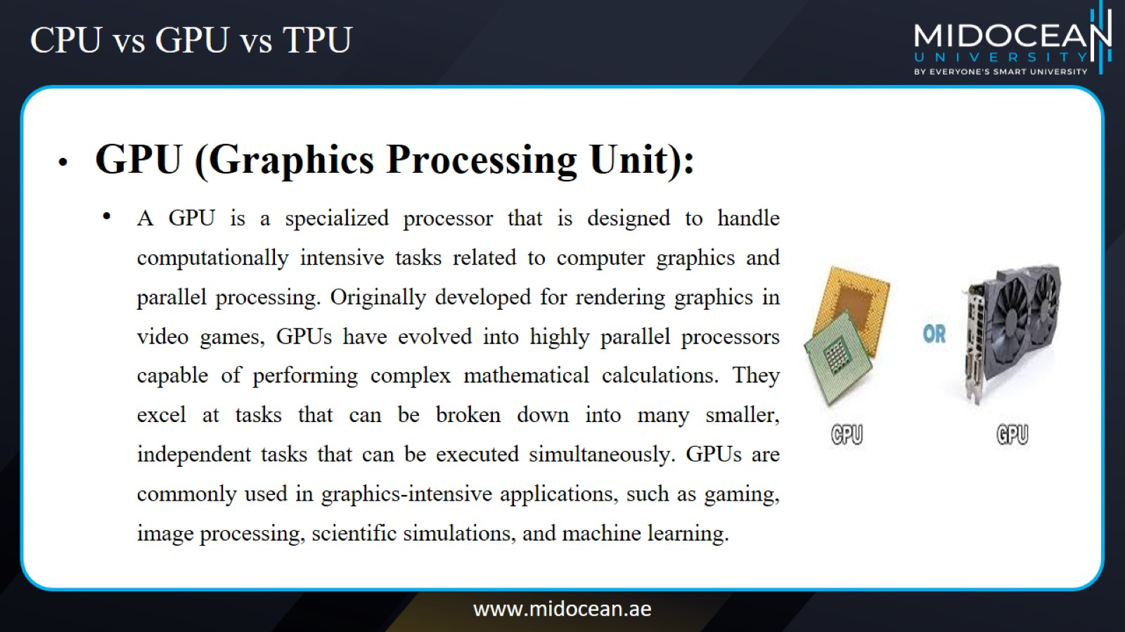
CPU vs GPU vs TPU

Slide 22
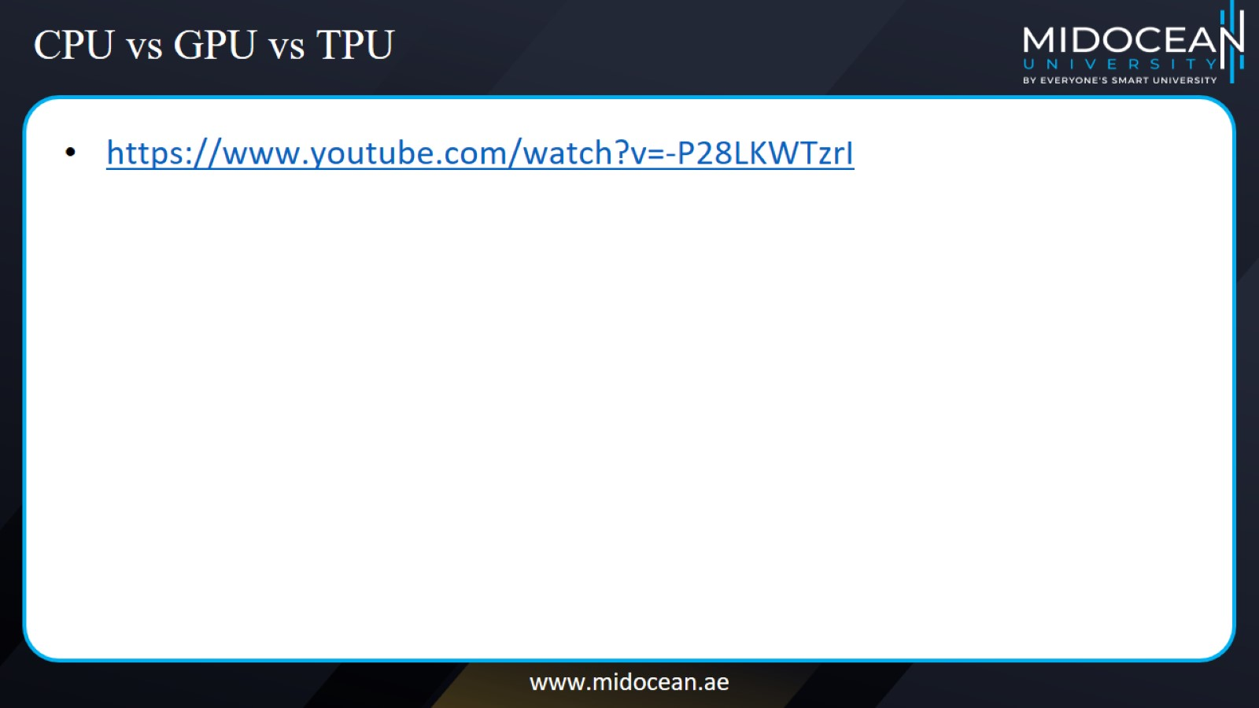
CPU vs GPU vs TPU

Slide 23
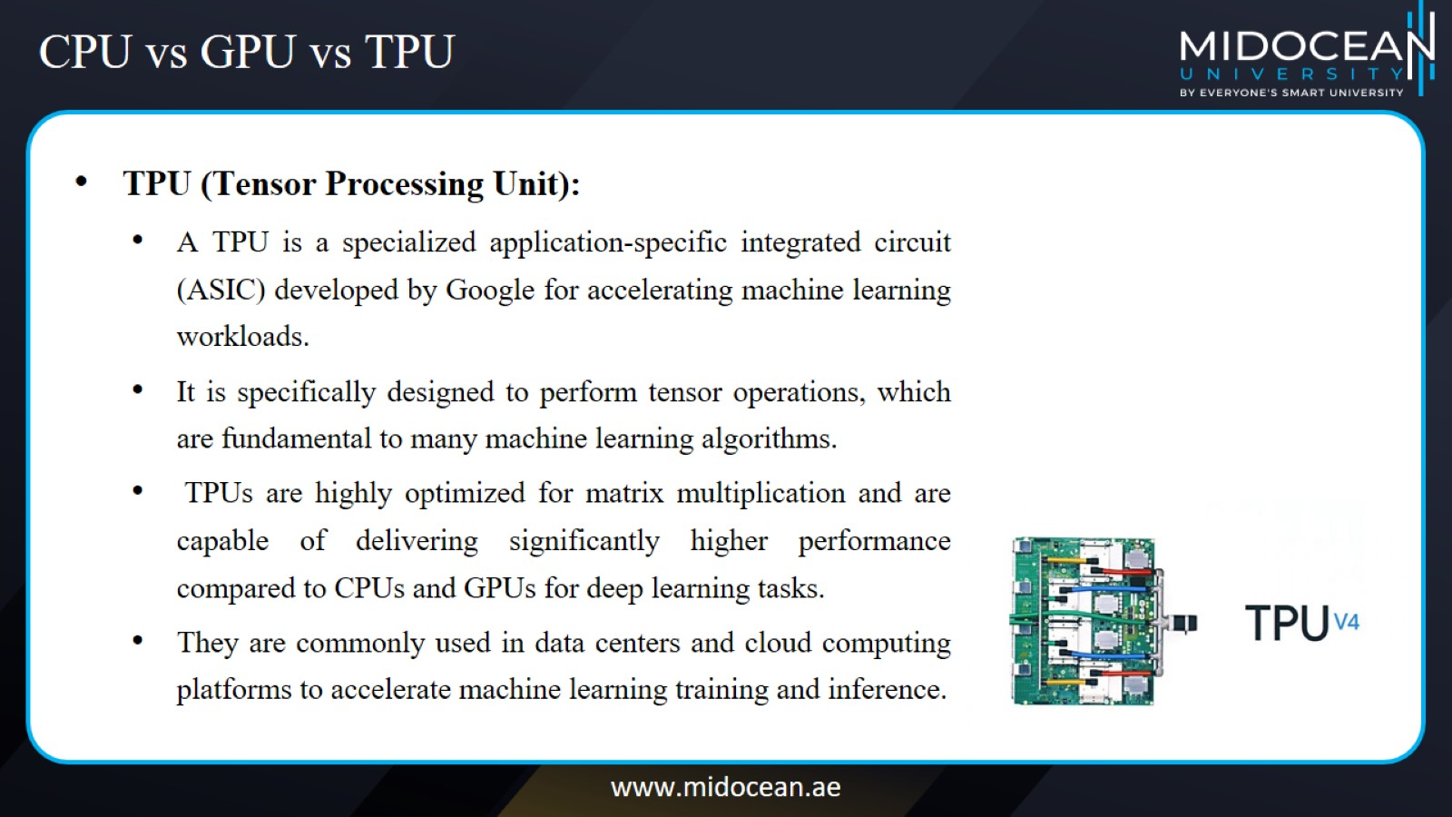
CPU vs GPU vs TPU

Slide 24
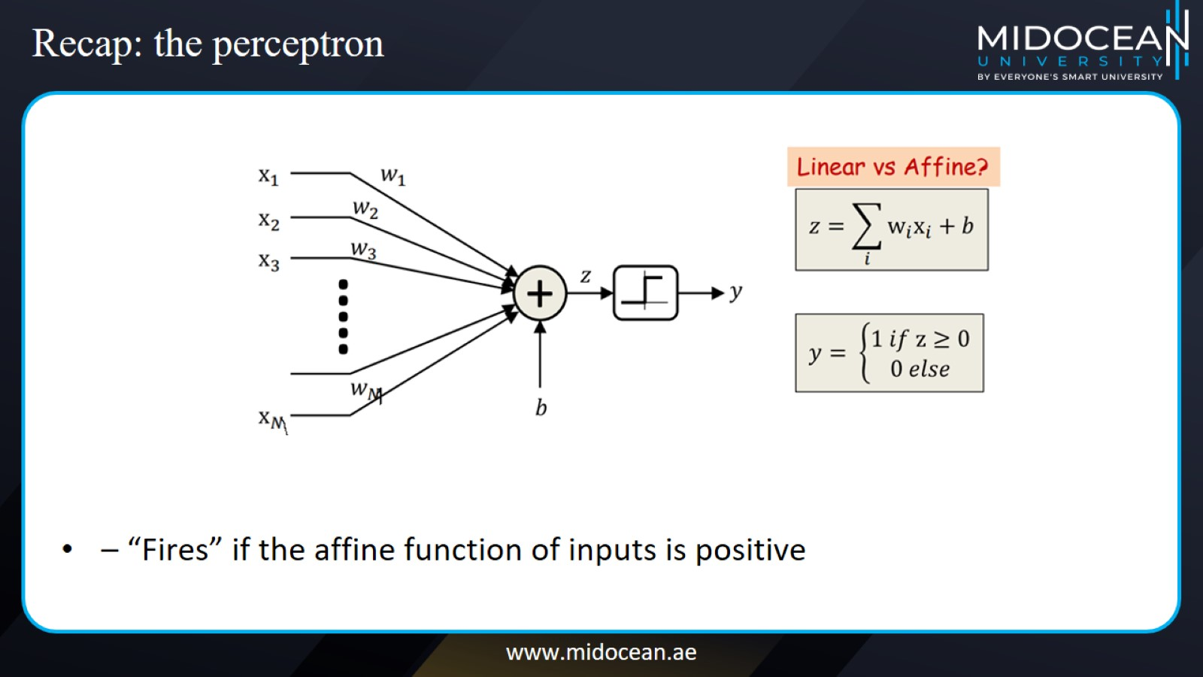
Recap: the perceptron

Slide 25
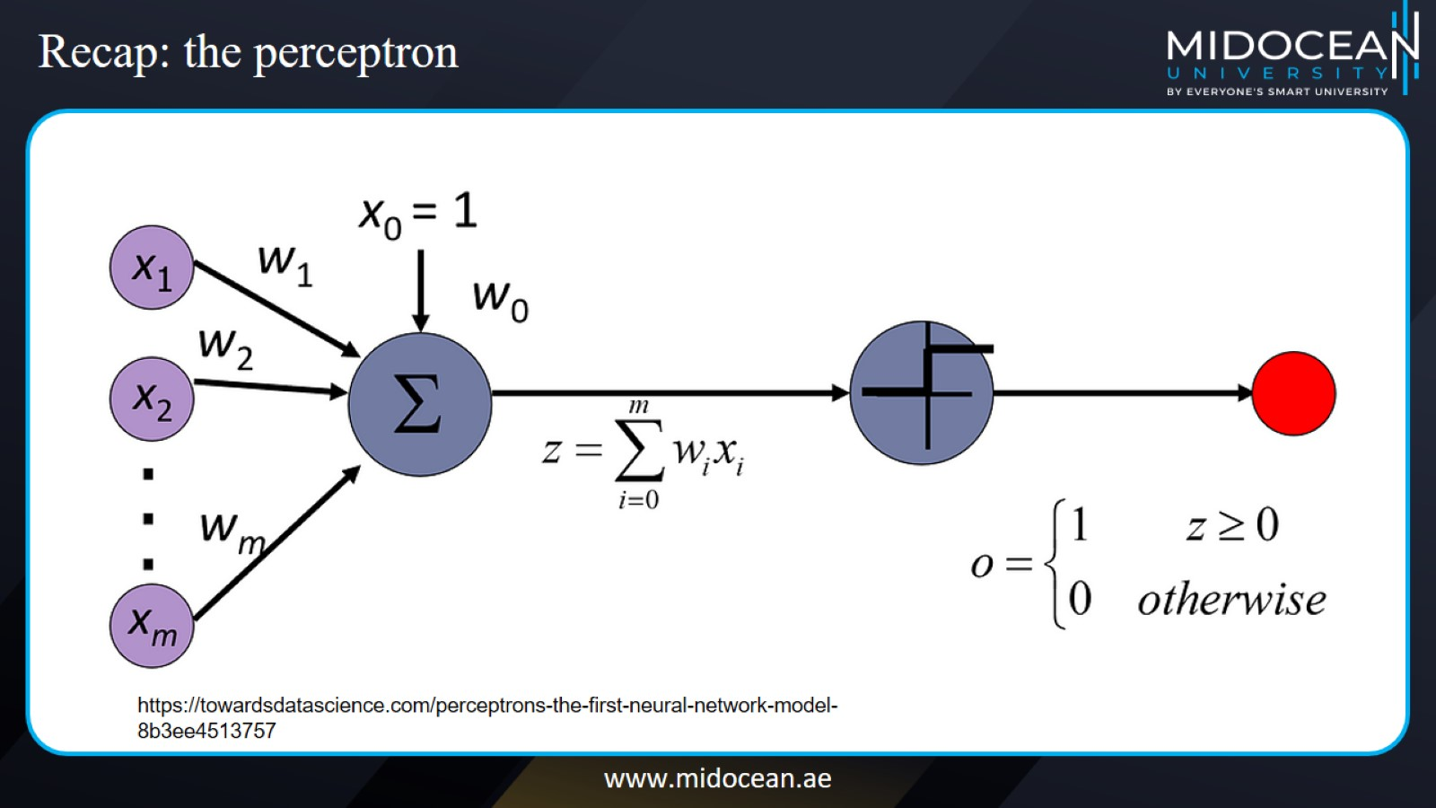
Recap: the perceptron

Slide 26
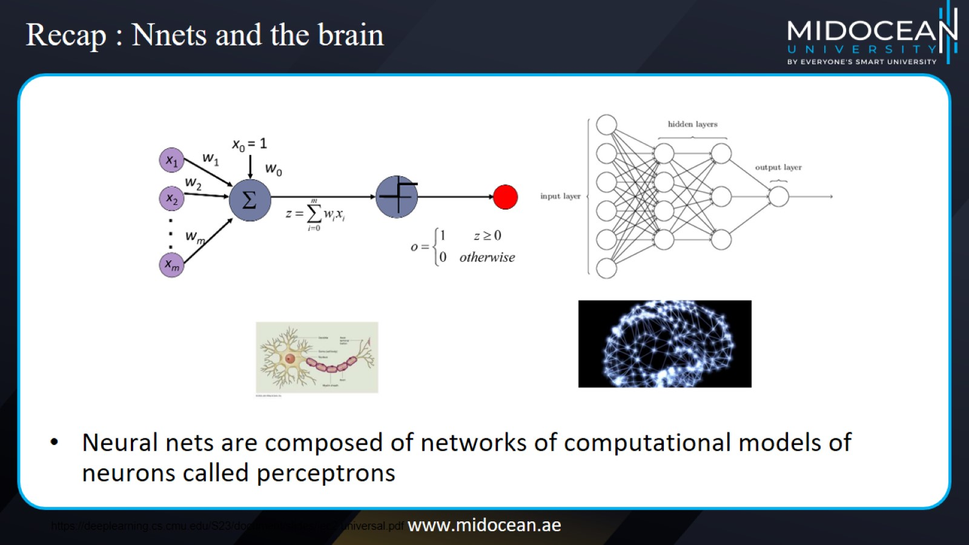
Recap : Nnets and the brain

Slide 27
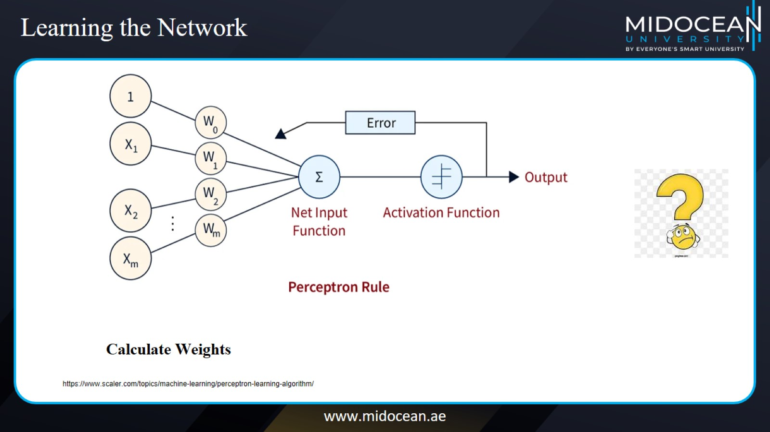
Learning the Network

Slide 28
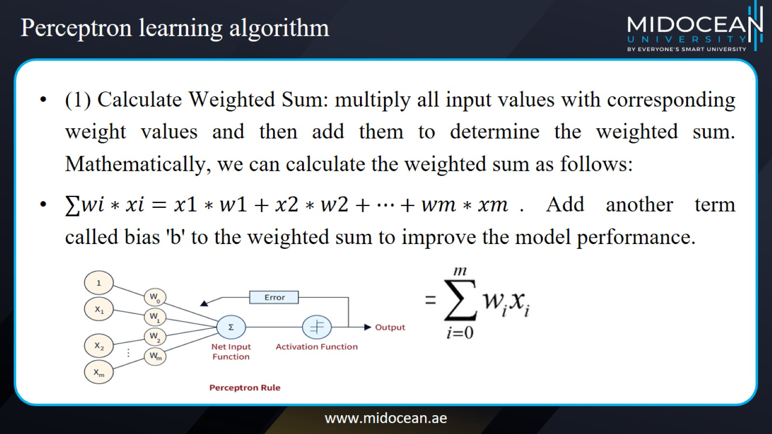
Perceptron learning algorithm

Slide 29
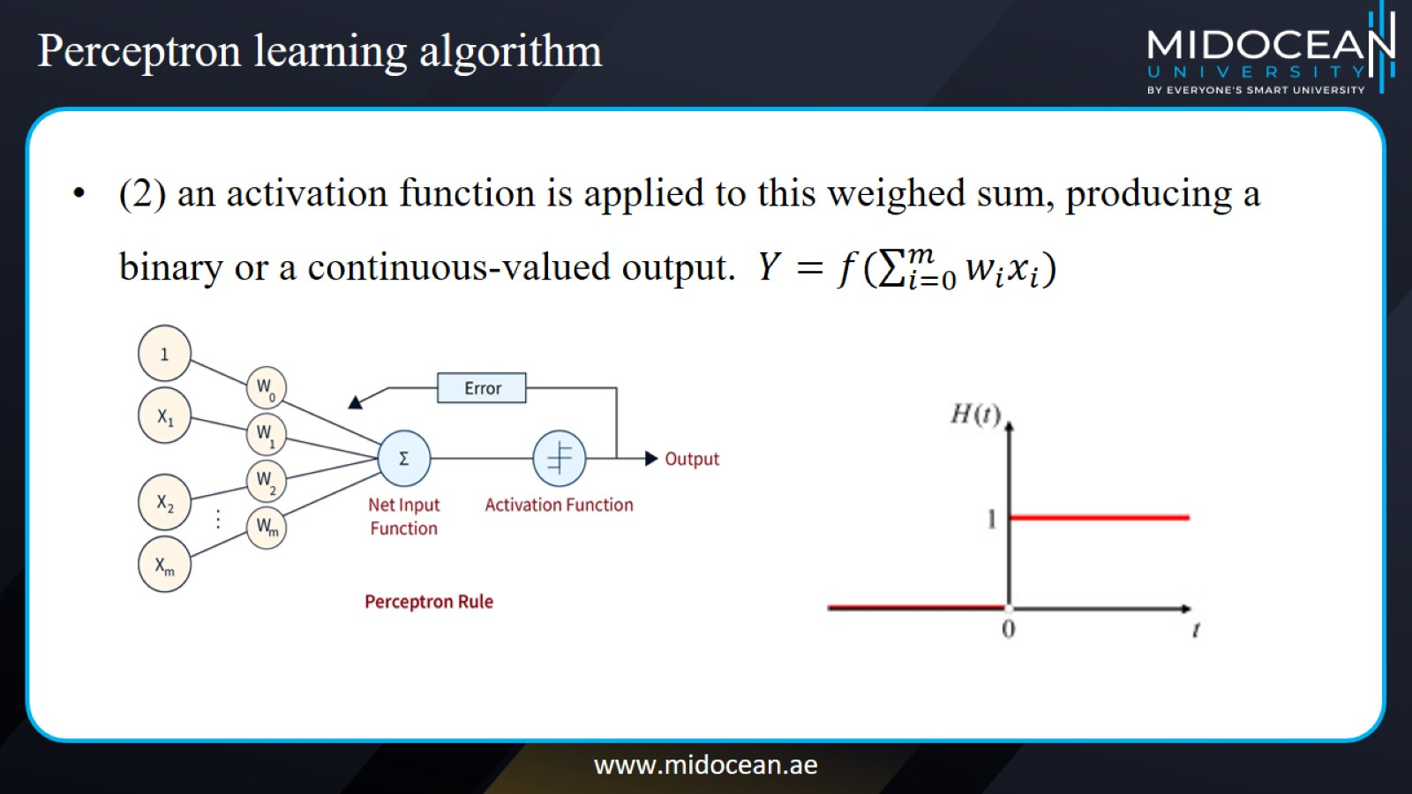
Perceptron learning algorithm

Slide 30
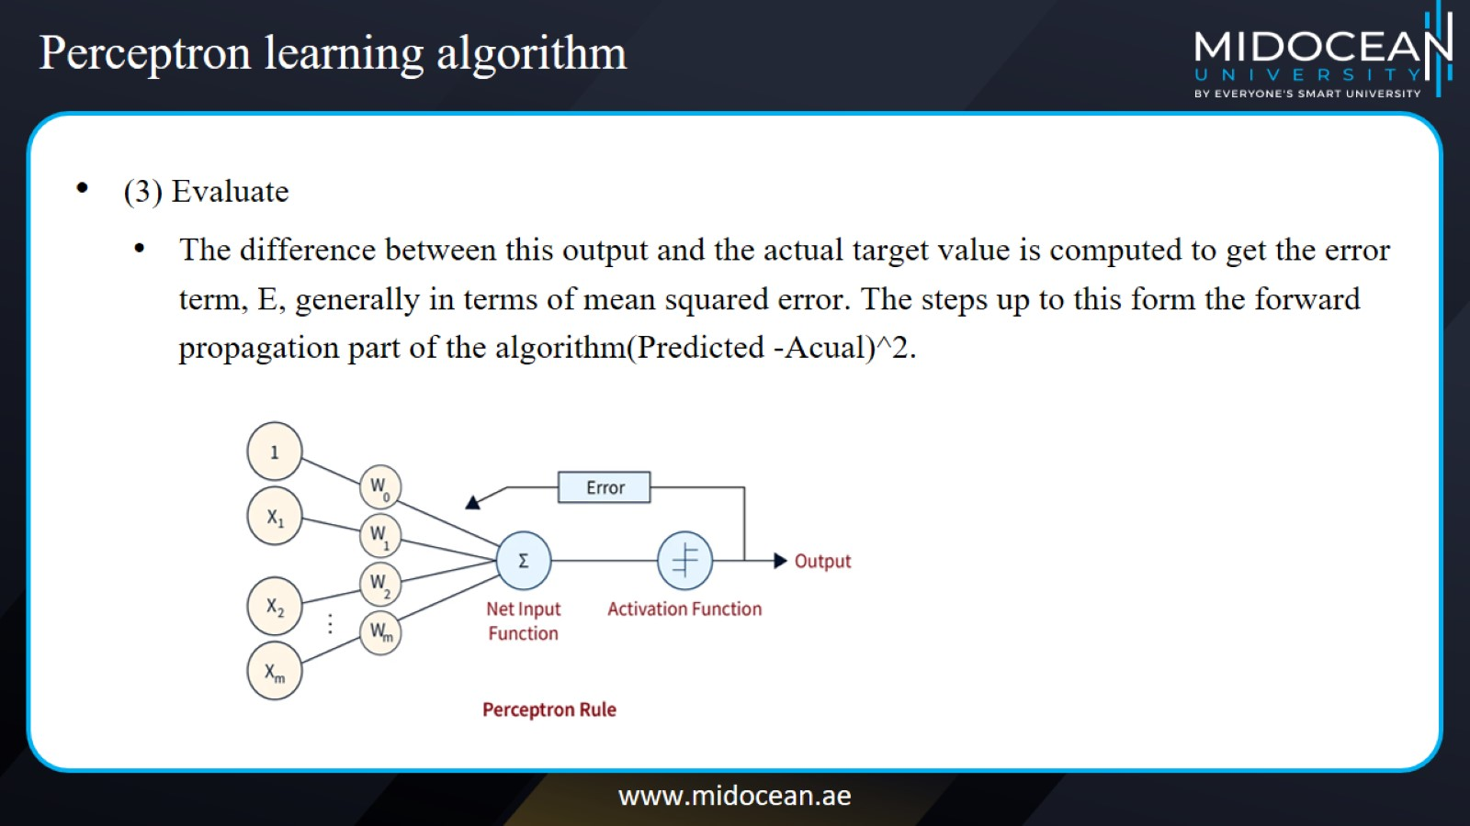
Perceptron learning algorithm

Slide 31
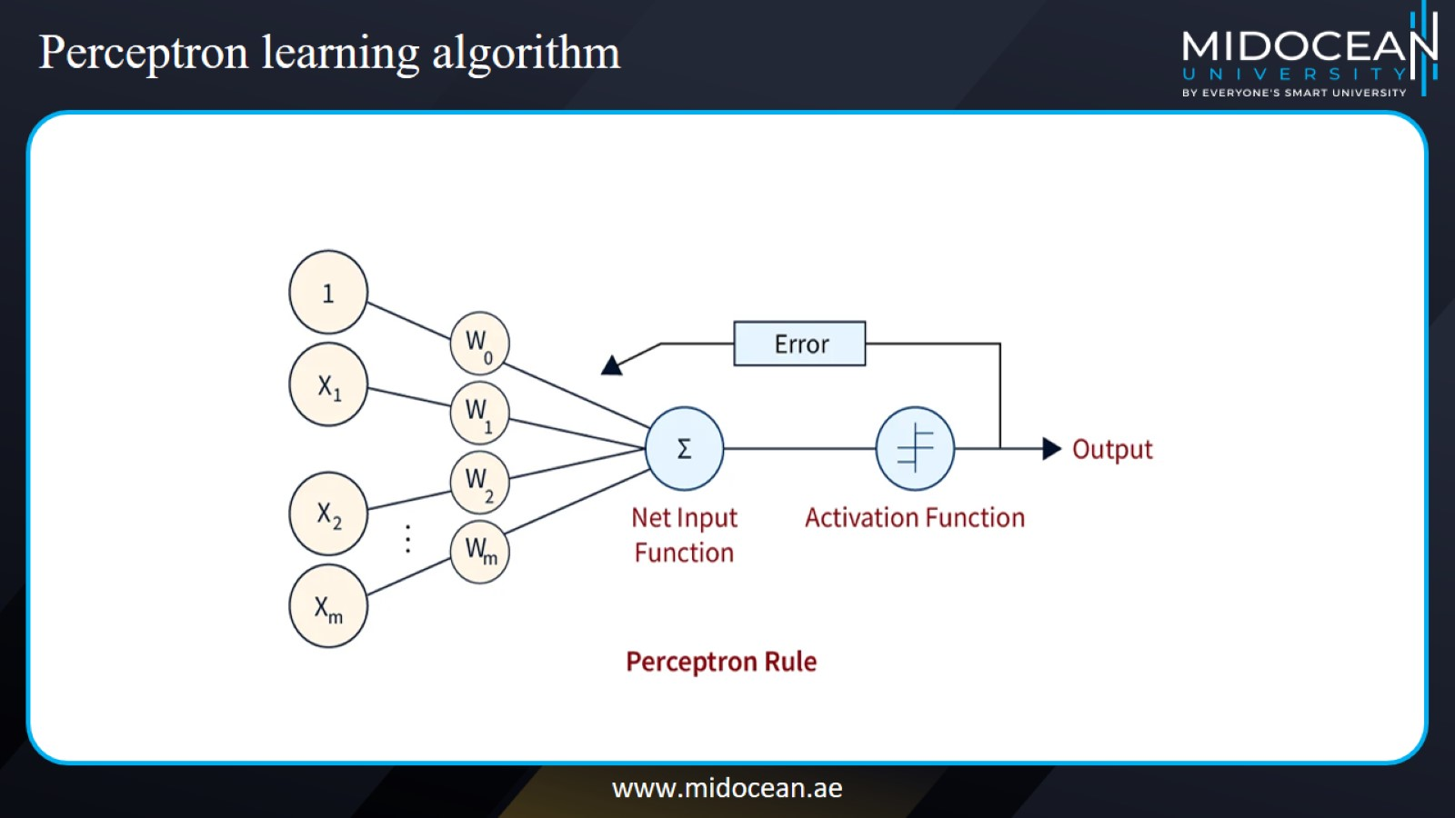
Perceptron learning algorithm

Slide 32
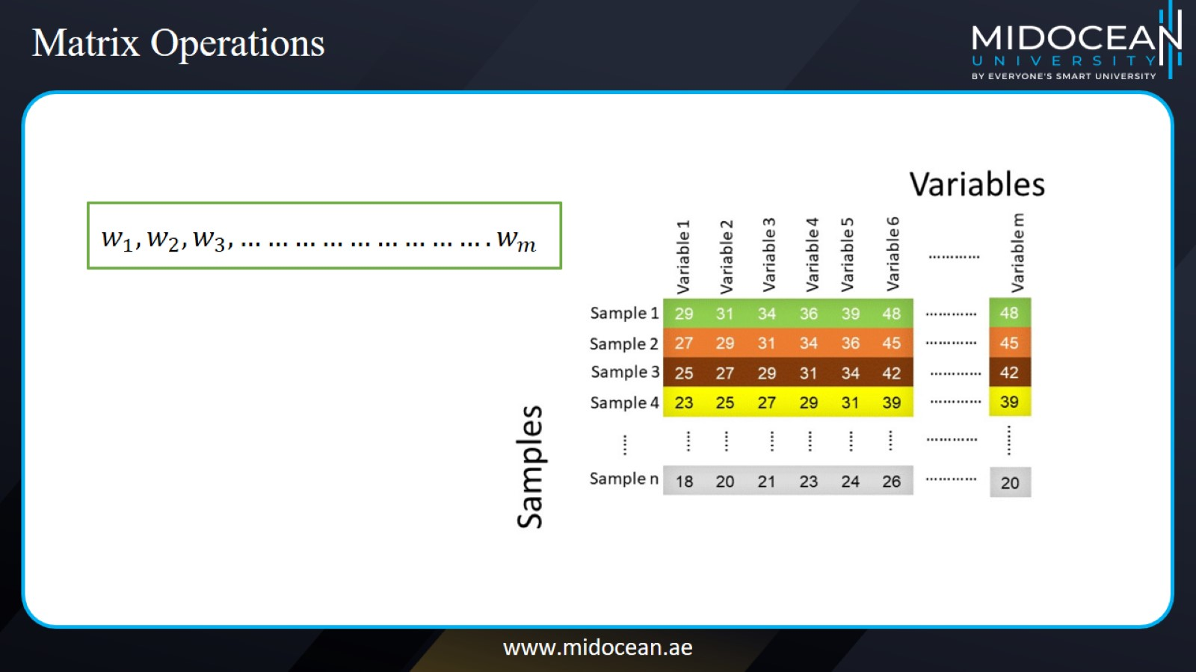
Matrix Operations

Slide 33
Matrix Operations

Slide 34
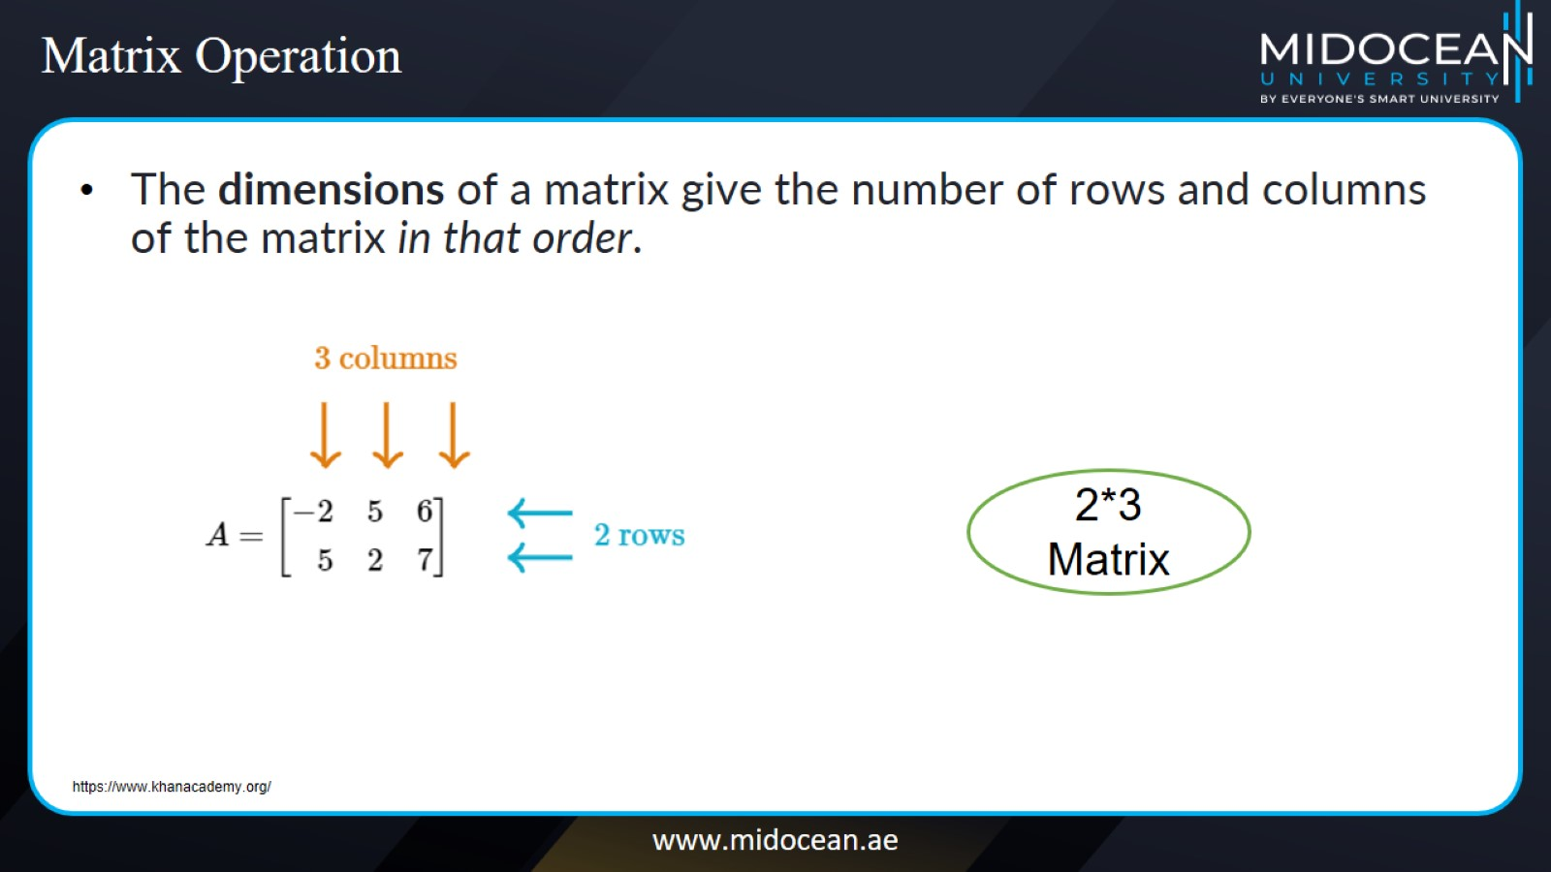
Matrix Operation

Slide 35
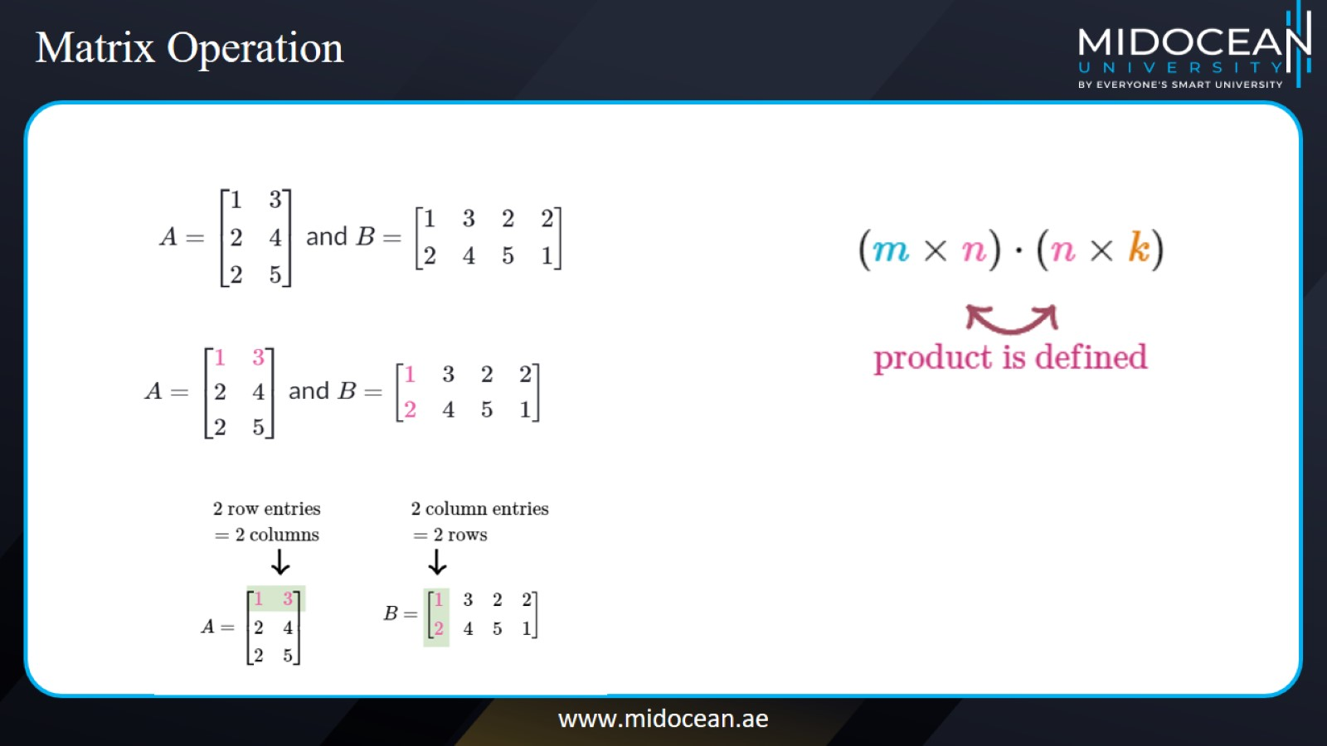
Matrix Operation

Slide 36
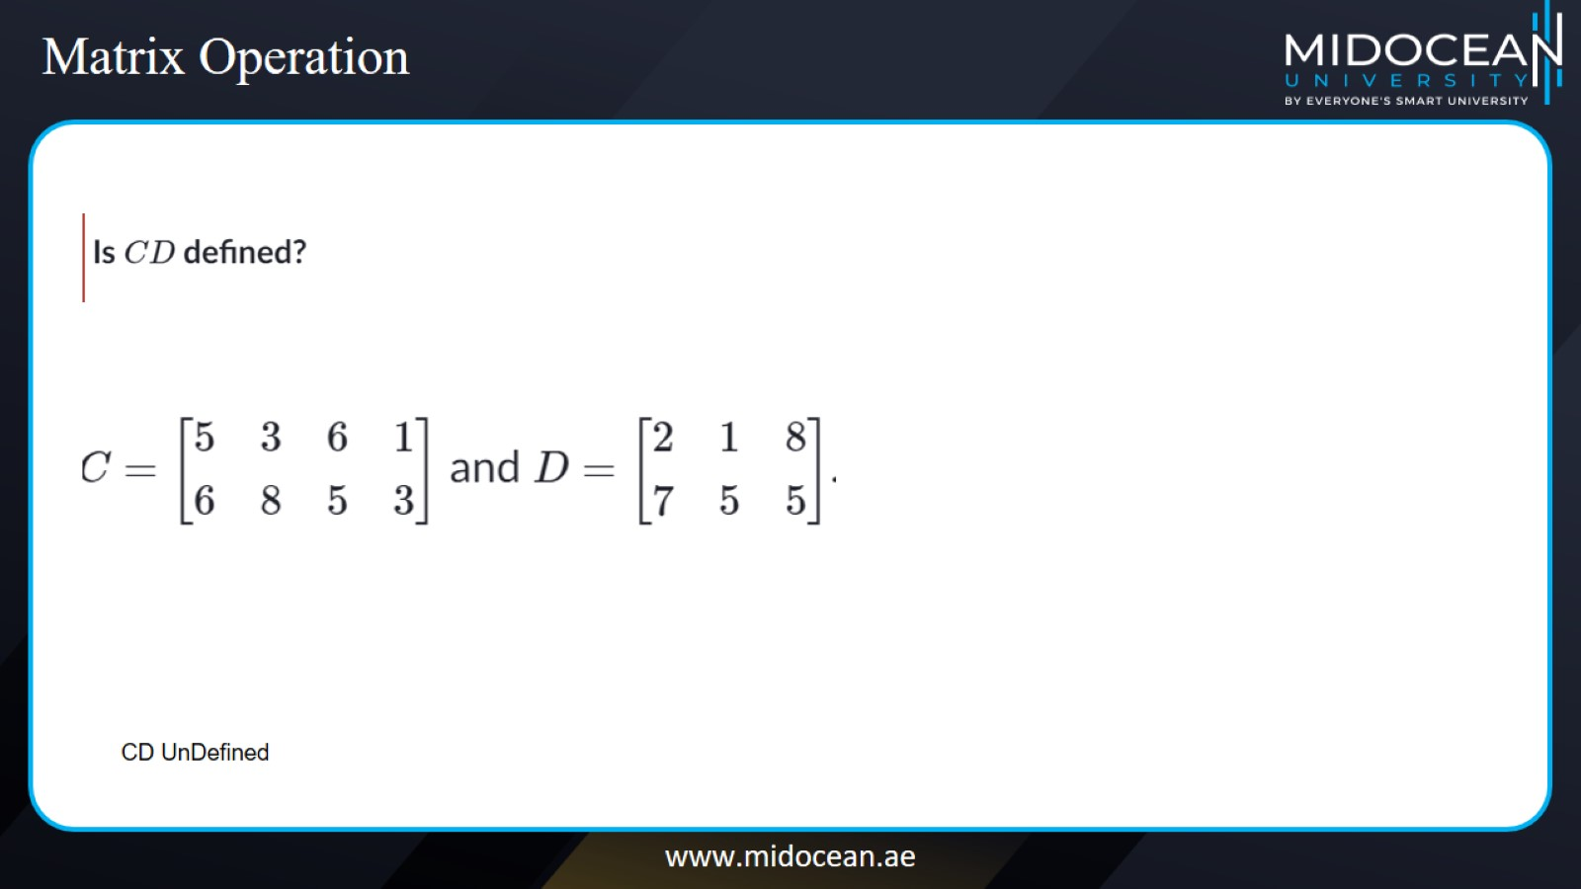
Matrix Operation

Slide 37
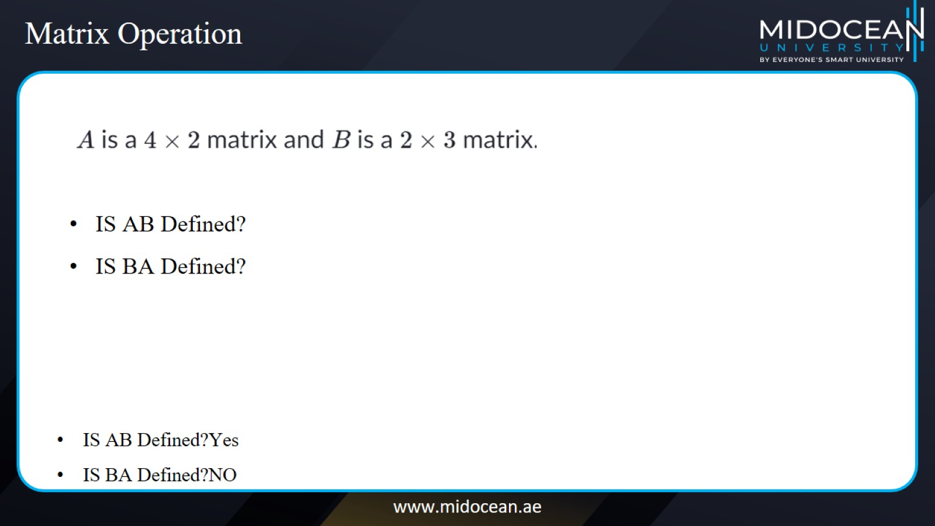
Matrix Operation

Slide 38
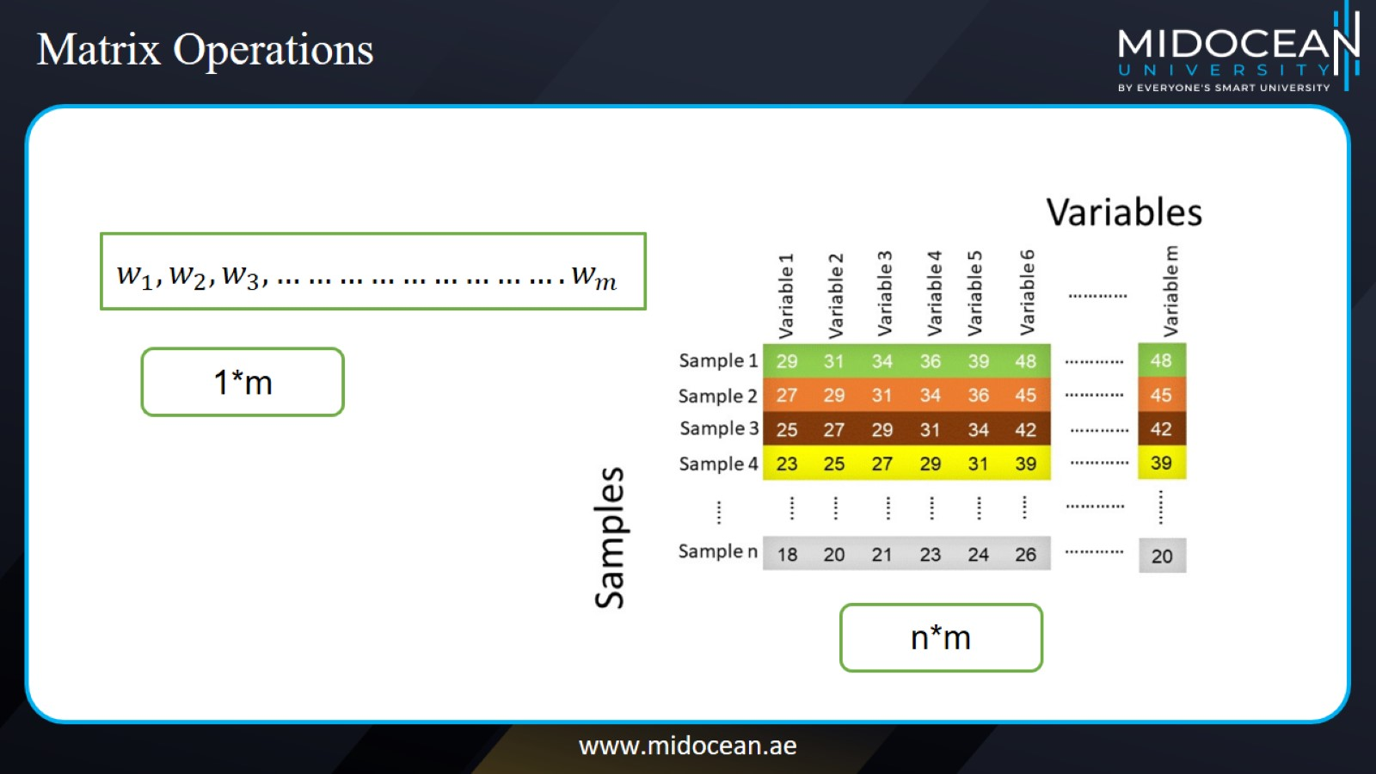
Matrix Operations

Slide 39
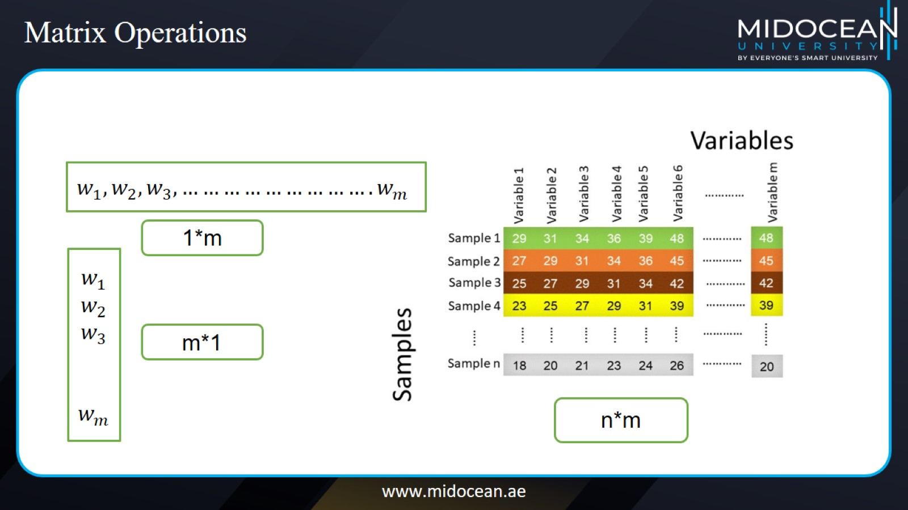
Matrix Operations

Slide 40
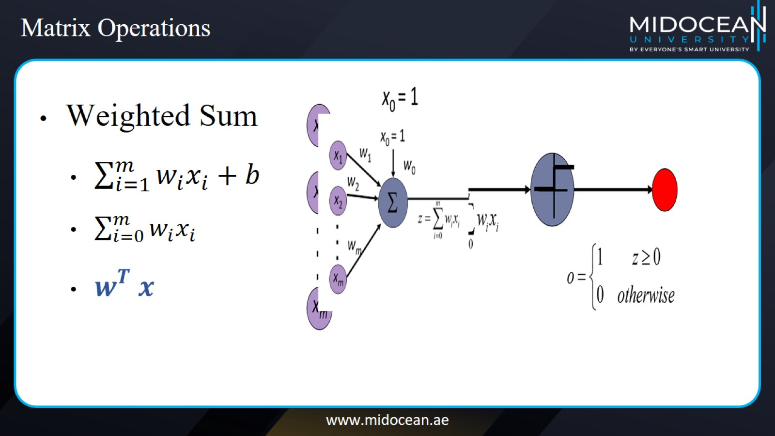
Matrix Operations

Slide 41

Learning the Network

Slide 42
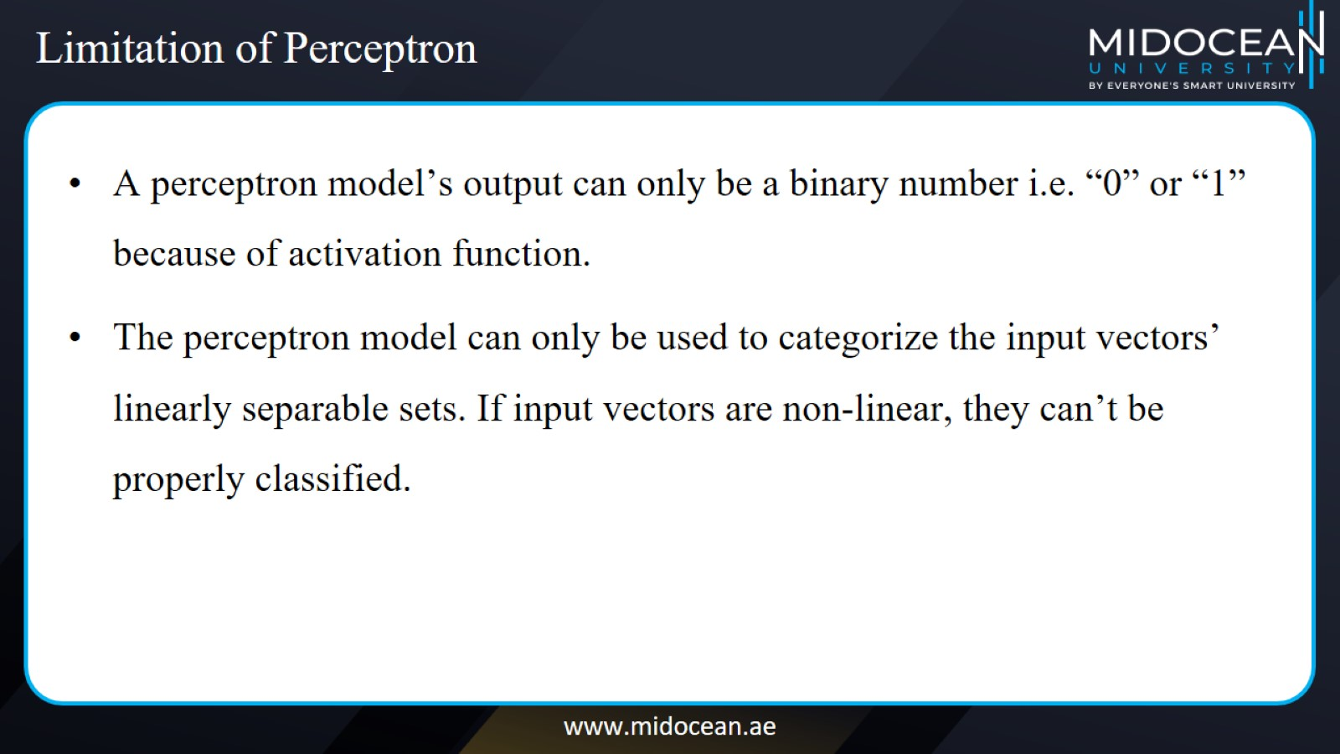
Limitation of Perceptron

Slide 43
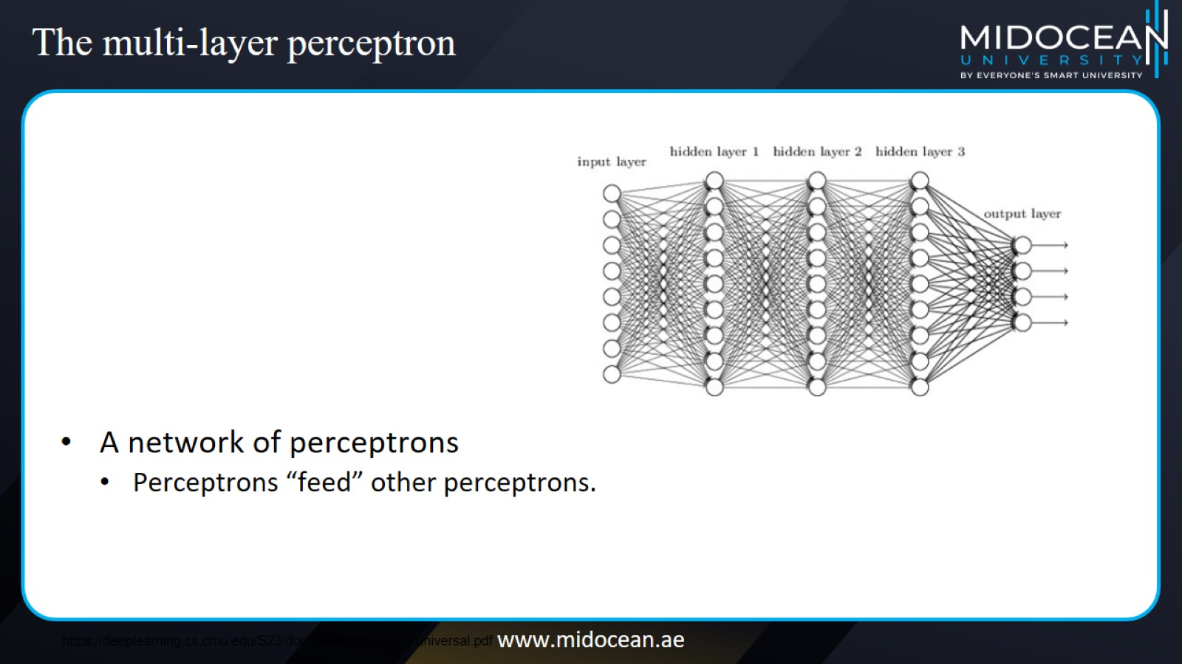
The multi-layer perceptron

Slide 44
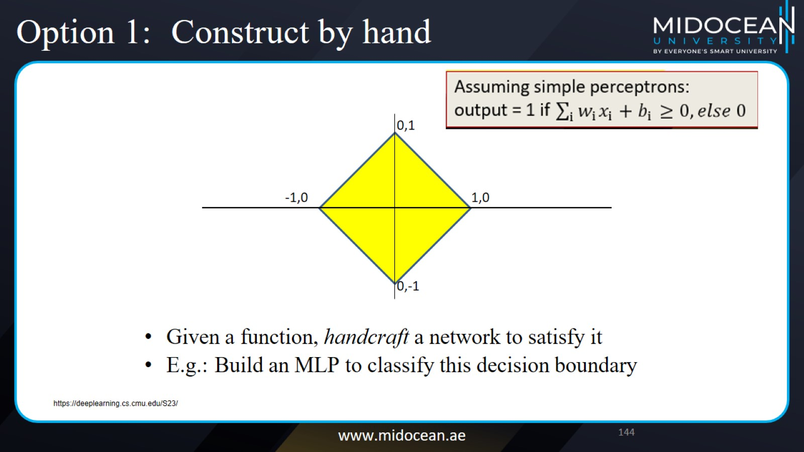
Option 1: Construct by hand

Slide 45
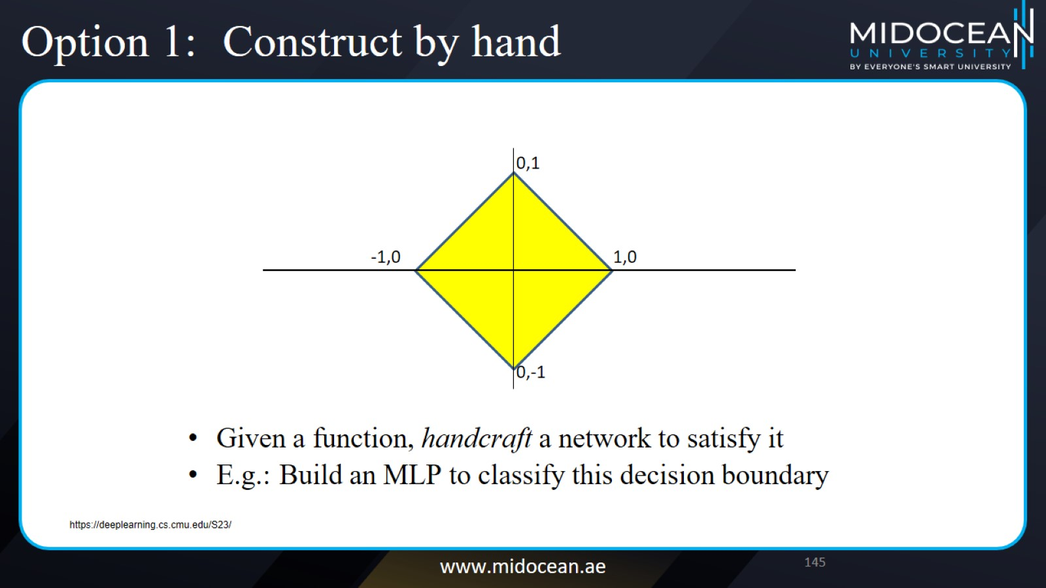
Option 1: Construct by hand

Slide 46
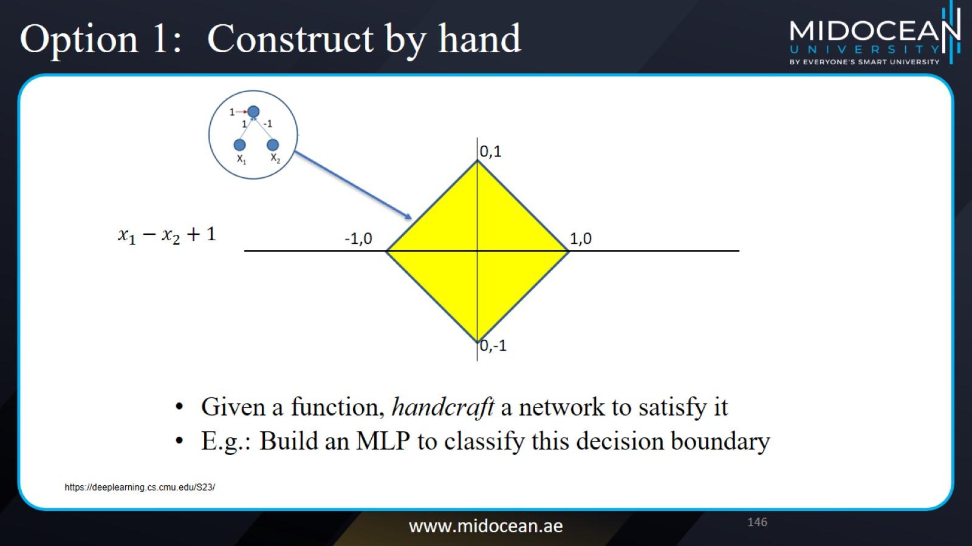
Option 1: Construct by hand

Slide 47
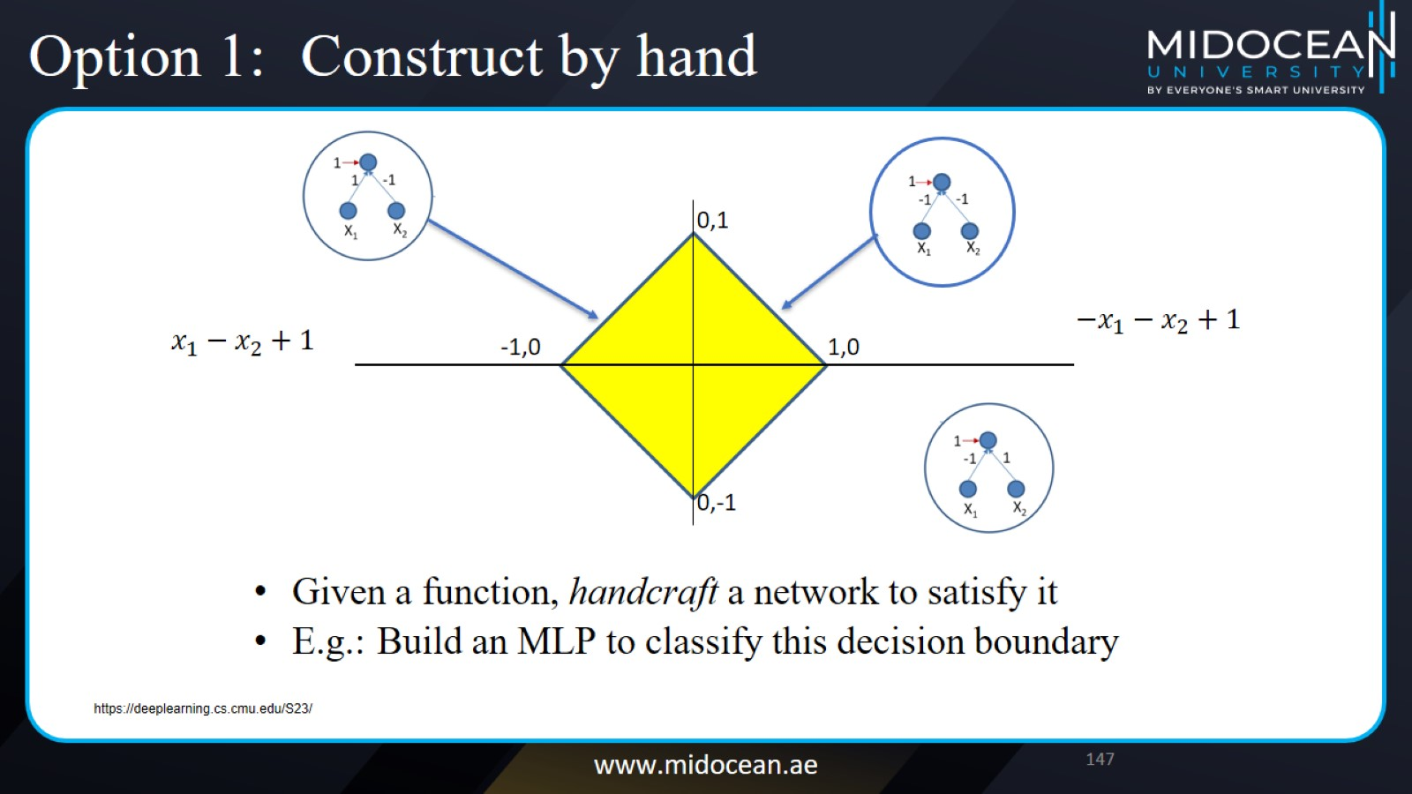
Option 1: Construct by hand

Slide 48
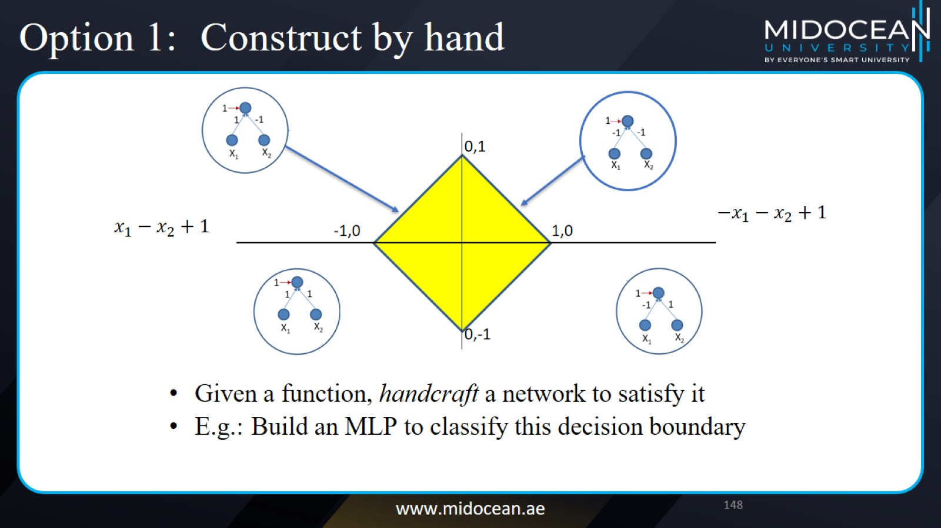
Option 1: Construct by hand

Slide 49
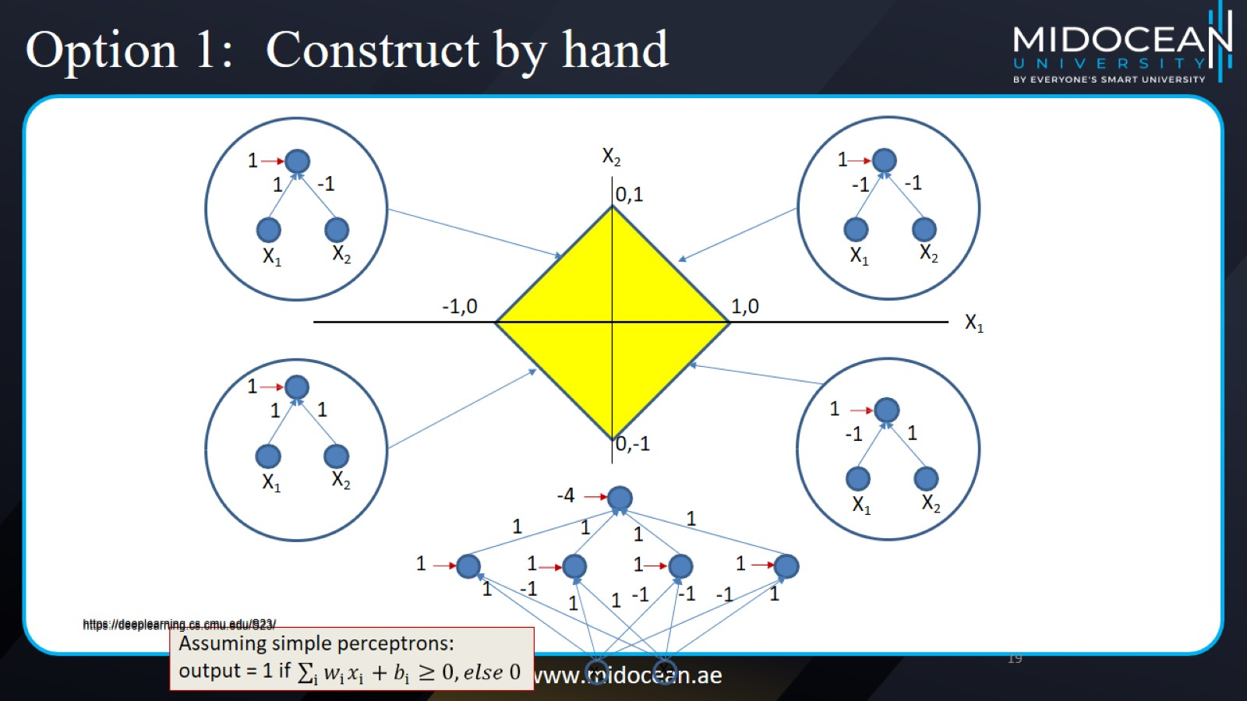
Option 1: Construct by hand

Slide 50
Option 1: Construct by hand

Slide 51
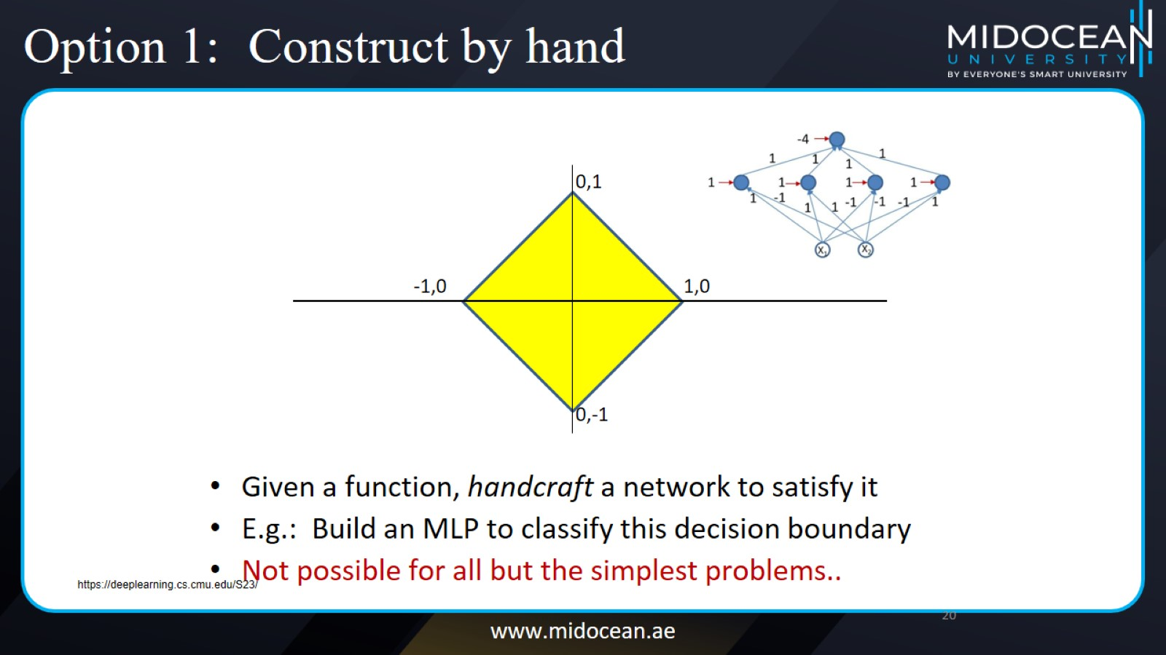
Option 1: Construct by hand

Slide 52
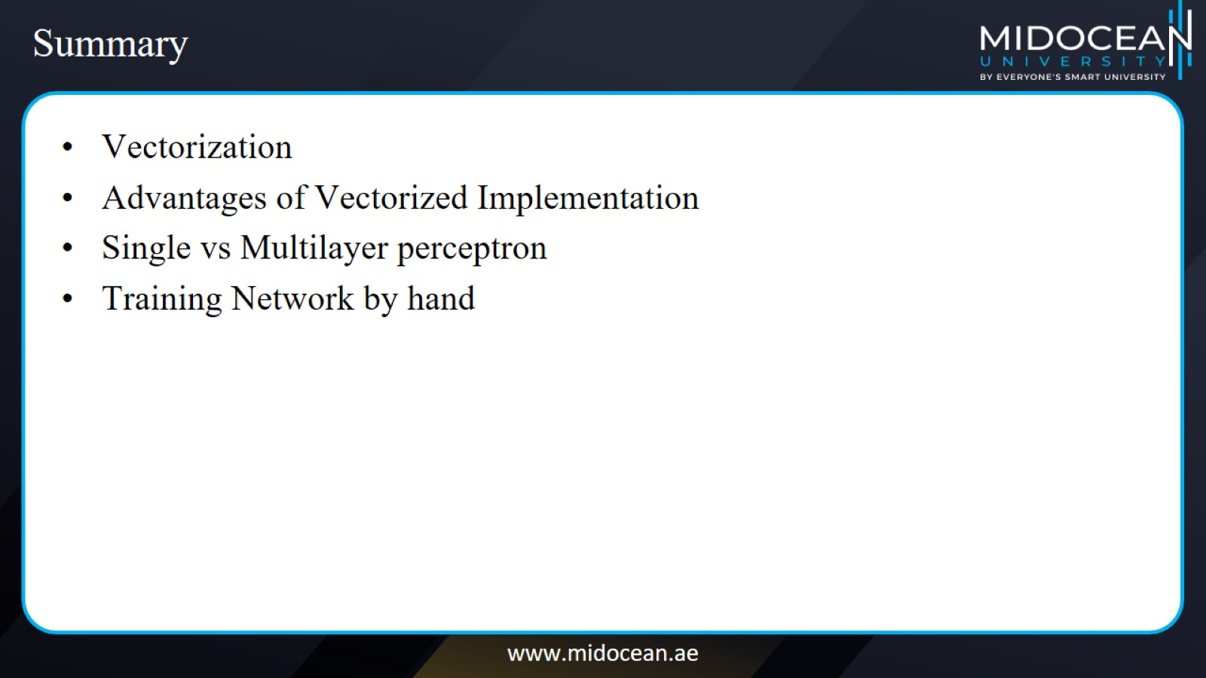
Summary

Slide 53


