Slide 1

MGM 112
Introduction to Economics
Prepared by Dr. Maryem ZORGUI
Lecture 8
The Market Structures:
Perfect and Imperfect Competition

Slide 2


Slide 3
Syllabus
I. The Market Structures
II-The market structures based on the number of sellers
III- The market structures based on the number of sellers
IV-Market Structures: Examples in the Real World

Slide 4
I- The Market Structures
I- The Market Structures
Basically, when we hear the word market, we think of a place where goods are being bought and sold.
In economics, market is a place where buyers and sellers are exchanging goods and services with the following considerations such as:
Types of goods and services being traded
The number and size of buyers and sellers in the market
The degree to which information can flow freely

Slide 5
I- The Market Structures
The market structure depends upon the degree of competition prevailing in the market.
How much is to be produced and at what price is to be sold are the two decisions taken by an individual firm or producer.
Both of these are affected by the market structure.

Slide 6
I- The Market Structures
The nature of the commodity determines the market structure: the commodity may be either homogeneous or identical and heterogeneous or differentiated.
Also, The number of buyers and sellers or few sellers and large buyers or mutual interdependence of buyers and seller also determine the market structure.
From the viewpoint of competition the types of market structures in economics are the following:
  Perfect Competition
  Imperfect Competition

Slide 7
II- The Market structures based on the number of sellers
II- The Market structures based on the number of sellers
II-1- Perfect (Pure) Competition
A market structure where a large number of buyers and sellers selling homogeneous product and the price is determined by the industry.
English economists believe that there is perfect competition while American economist supports the concept of pure competition.
In pure competition, there is a lack of elements there are certain elements in existence.

Slide 8
II- The Market structures based on the number of sellers
Perfect competition prevails when the demand for the output of each product is perfectly elastic.
*This entails first, that number of sellers is large, so that the output of any other seller is a negligible smaller portion of the total output of the commodity.
*and second, that buyers are all alike in respect of their choice between rival sellers so that the market is perfect.

Slide 9
II- The Market structures based on the number of sellers
Perfect Market is a market situation which consists of a very large number of buyers and sellers offering a homogeneous product. Under such condition, no firm can affect the market price. Price is determined through the market demand and supply of the particular product, since no single buyer or seller has any control over the price.
Perfect Competition is built on two critical assumptions:
  The behavior of an individual firm
  The nature of the industry in which it operates

Slide 10
II- The Market structures based on the number of sellers
Perfect Competition cannot be found in the real world. For such to exist, the following conditions must be observed and required:
A large number of sellers
Selling a homogenous product
No artificial restrictions placed upon price or quantity
Easy entry and exit
All buyers and sellers have perfect knowledge of market conditions and of any changes that occur in the market
Firms are “price takers”

Slide 11
II- The Market structures based on the number of sellers
        The firm is assumed to be a price taker
        The industry is characterized by freedom of entry and exit
II-1-1- Characteristics of perfect competition
There are very many small firms
All producers of a good sell the same product
There are no barriers to enter the market
All consumers and producers have ‘perfect information’
Firms sell all they produce, but they cannot set a price
No Transport Cost Absence of Artificial Restrictions

Slide 12
II- The Market structures based on the number of sellers
II-1-2-Short run analysis of perfect competition
The firm’s objective is to produce the level of output that will maximize profit
Some inputs are variable and therefore fixed costs arise regardless whether the firm is operating or not
Since the firm is a price taker, it has no control on the price of a product

Slide 13
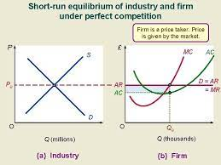
II- The Market structures based on the number of sellers
II-1-3- Short run equilibrium under perfect competition
Efficiency of short run equilibrium
In an exchange economy, a competitive equilibrium is
Pareto efficient.
In a competitive equilibrium p=C marg in short run so no firm can sell
an extra unit at a price that covers its short run marginal cost.
Short run marginal cost is the market value of the variable
inputs needed to produce the extra unit of output, so in an
equilibrium it is not possible to sell another unit at a price that
covers the market value of the inputs needed to produce
that unit.
Notes:
Pareto is an Italian economist who represents the second generation of the Neoclassical Revolution. Pareto efficiency, or Pareto optimality, is an economic state where resources cannot be reallocated to make one individual better off without making at least one individual worse off..

Slide 14
II- The Market structures based on the number of sellers
II-1-4- Long run analysis of perfect competition
All inputs and costs of production are variable
The firm can build most appropriate scale of plant to produce the optimum level of output.
A rough measure of the consumers' gains from trade is the area under the demand curve and above the price, indicated by the light purple area in the figure below: this area is called the consumers' surplus.
A measure of the gain to the producers is the difference between their revenue and their variable cost (since fixed cost is fixed!); this measure is called the producers' surplus.

Slide 15
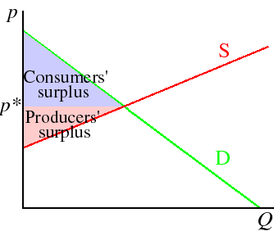
II- The Market structures based on the number of sellers
The total variable cost is the area under the supply function
(which is the marginal cost function) up to the equilibrium
output; so the producers' surplus is equal to the area
between the supply function and the price,
indicated by the pink area in the following figure.
The sum of consumers' surplus and producers' surplus is
a measure of the total gains from trade in equilibrium.
As you can see, it is maximized in a competitive equilibrium.

Slide 16
II- The Market structures based on the number of sellers
Does Perfect Competition Exist in the Real World?
Perfect competition is an imaginary an unrealistic market structure and it is called a Myth because of the following reasons:
Lack of a Large number of Buyers and Sellers Restrictions on Entry and Exit of Firms Existence of Artificial Restrictions Lack of Homogenous Product No Perfect Knowledge of Market Condition | 6. Absence of Perfect Mobility of Factors of Production 7. Presence of Transport Cost 8. Existence of Non-Price Competition 9. Price Differences

Slide 17
II- The Market structures based on the number of sellers
II-2-Imperfect market
In economic theory, imperfect competition is a type of market structure showing some but not all features of competitive markets.
The Forms of imperfect competition include:
  Monopolistic
  Monopoly Competition
  Oligopoly
  monopsony
  oligopsony

Slide 18
II- The Market structures based on the number of sellers
On the basis of definitions of Imperfect competition we can say that the following are the salient features of imperfect competition:
A small number of buyers and sellers. 2.Ignorance or laziness of buyers and sellers. 3.Product differentiation. 4.The difference in prices. | 5.Non-price competition or advertisement and sales promotion. 6.Highly transport costs. 7.Other factors prevailing in the market namely Trademark, the behavior of sellers, credit facility, home delivery and repair services, guarantee, samples, etc..

Slide 19
II- The Market structures based on the number of sellers
II-2-1- Monopoly
It’s a situation where there is only one seller of goods or services.
A pure monopolist, therefore, is a firm producing a product which has no effective substitutes through the products of any other form effective in the sense that even though the monopolist may be making abnormal profits, other firms cannot encroach on these profits by producing substitute commodities which might and entice purchases away from the product of the monopolist.
Thus, a Monopoly market structure is that where there is a single seller of a commodity having full control over its supply and there is no close substitute.

Slide 20
a-Key Features of Monopoly Market Structure
There is only one producer or seller of goods and only one provider of services in the market.
New firms find extreme difficulty in entering the market. The existing monopolist is considered giant in its field or industry
There are no available substitute goods or services so that it is considered unique.
It controls the total supply of raw materials in the industry and has no control over price.
It owns a patent or copyright.
Its operations are under economies of scale

Slide 21
II- The Market structures based on the number of sellers
b-Classifications of Monopoly:
Monopolies are classified according to circumstances they arise from, that is,
cost structure of the industry, possibly the result of law, or by other means.
Natural Monopoly: It is a market situation where is a single firm can supply the entire market due to the fundamental cost structure of the industry. | Legal Monopoly: It is sometimes called as de jure monopoly, a form of monopoly which the government grants to a private individual or firm over the product or services. | Coercive Monopoly: It is a form of monopoly whose existence as the sole producer and distributor of goods and services is by means of coercion (legal or illegal), so that most of the time it violates the principle of free market just to avoid competition.

Slide 22
II- The Market structures based on the number of sellers
c-Short run analysis of Monopoly
A monopolist is considered a price maker, since he is the sole seller of a product that has no close substitute in the market.
d-Long run analysis of Monopoly
In the long-run, all inputs and costs are variable, and the monopolist can make his optimal scale of plant to make the best level of output.

Slide 23
II- The Market structures based on the number of sellers
II-2-2- Oligopoly
Oligopoly is also known as the competition among law.
Oligopoly, in which a market is run by a small number of firms that together control the majority of the market share.
Features of Oligopoly Market Structure:
1.Importance of Advertising and 2-Selling Cost 2.Interdependence 3.Group Behaviour 4.A Small Number of Sellers 5. Strong Composition | 6. Homogeneous Product 7. Heterogeneous Oligopoly 8. Barriers to Entry of Firms 9. Lack of Uniformity 10. Price War 11. Demand Curve

Slide 24
a-Classification of Oligopoly
Pure or Perfect Oligopoly If the firms produce homogeneous products. | Imperfect or Differentiated Oligopoly If the firms produce differentiated products. | Collusive Oligopoly If the firms cooperate with each other in determining price or output or both | Non-collusive Oligopoly If firms in an oligopoly market compete with each other

Slide 25
II- The Market structures based on the number of sellers
b-Types of organisation of Oligopoly:
Cartel is a formal agreement among oligopolists to set-up a monopoly price, allocate output, and share profit among members.
Collusion is a formal or an informal agreement among oligopolists to adopt policies that will restrict or reduce the level of competition in the market.

Slide 26
II- The Market structures based on the number of sellers
c- The Duopoly
A market where there are two sellers or producers of a product is called do a Duopoly: it’s a special case of Oligopoly.
They have a complete hold over the supply of that product. A product of both the sellers is Homogeneous and the prices are also the same.
Both the firms are interdependent and they try to keep the same price.

Slide 27
II- The Market structures based on the number of sellers
If a seller of the commodity lowers the price then the other seller is forced to reduce its price because customers will prefer to purchase the cheaper commodity.
Both the sellers have to think about the possible impact when they are taking independent decisions relating to price and prediction.
In order to maximize the profits of each, they may form an association or can share the market and can charge high prices for the customers.
It will lead to the exploitation of the customers.

Slide 28
II- The Market structures based on the number of sellers
II-2-3- Monopolistic competition
Market situation in which there are many sellers producing highly differentiated products.
Monopolistic competition is also perfect competition plus product differentiation.
Product differentiation gives each monopolistic competitor some market power, since each competitor can raise price slightly without losing all its customers.

Slide 29
II- The Market structures based on the number of sellers
a-Characteristics of Monopolistic Concurrence:
A large number of buyers and sellers in a given market act independently.
There is a limited control of price because of product differentiation. ▪ Sellers offer differentiated products or similar but not identical products.
New firms can enter the market easily. However, there is a greater competition in the sense that new firms have to offer better features of their products.
Economic rivalry centers not only upon price but also upon product variation and product promotion.

Slide 30
II- The Market structures based on the number of sellers
Thus, Monopolistic competition is a market situation in which there are many sellers of a particular product, but the product of each seller is in some way differentiated in the minds of consumers from the product of every other seller.
Monopolistic competition is the market structure in which there is co-existence of competition and Monopoly to some degree.

Slide 31
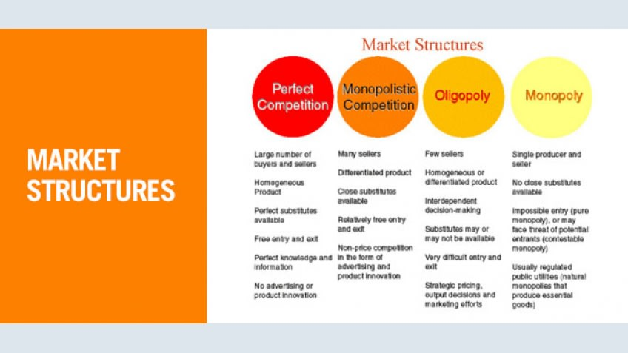
II- The Market structures based on the number of sellers

Slide 32
Thus, there are two extremes of market structure:
* On the one hand, we have perfect competition or pure competition and
* monopoly on the other hand.
Between these two extremes we have imperfect competition consisting of monopolistic competition, oligopoly (and duopoly).

Slide 33
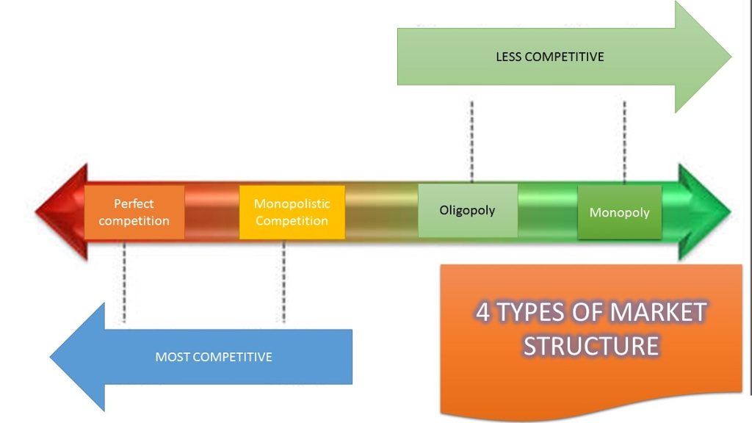

Slide 34
III- The Market structures based on the number of buyers
III- The Market structures based on the number of buyers
Market structure is also based on the number of buyers. It may be of the following types:
III-1- Perfect Competition
A market with a large number of buyers and sellers and very similar products, .
III-2- Monopsony
A market where there is a single bar of a commodity or service is called Monopsony.

Slide 35
III- The Market structures based on the number of buyers
III-3- Oligopsony
A market structure in which there are few buyers of a product the market is called Oligopsony.
These buyers can influence the price in the market by an agreement of association.
A special case of Oligopsony is Duopsony.
A of market where there are two buyers of a commodity or product is called Duopsony market.

Slide 36

IV-Market Structures: Examples in the Real World

Slide 37
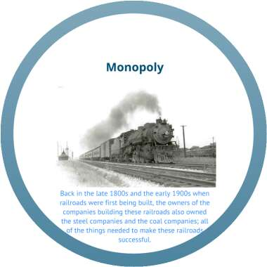
IV-Market Structures: Examples in the Real World

Slide 38


Slide 39
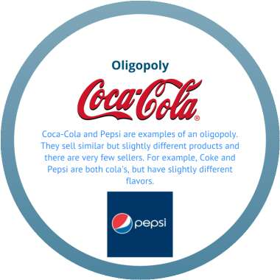
IV-Market Structures: Examples in the Real World

Slide 40


Slide 41
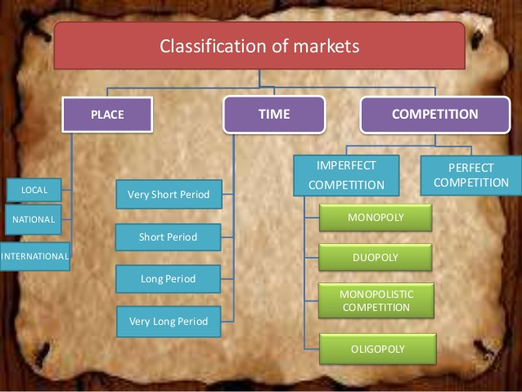
CLASSIFICATION OF MARKET STRUCTURES

Slide 42
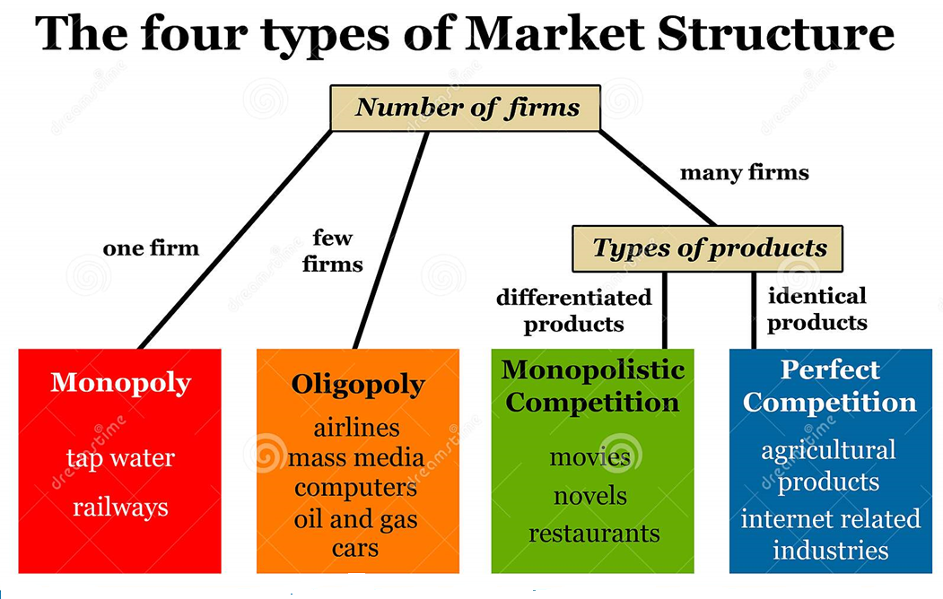

Slide 43
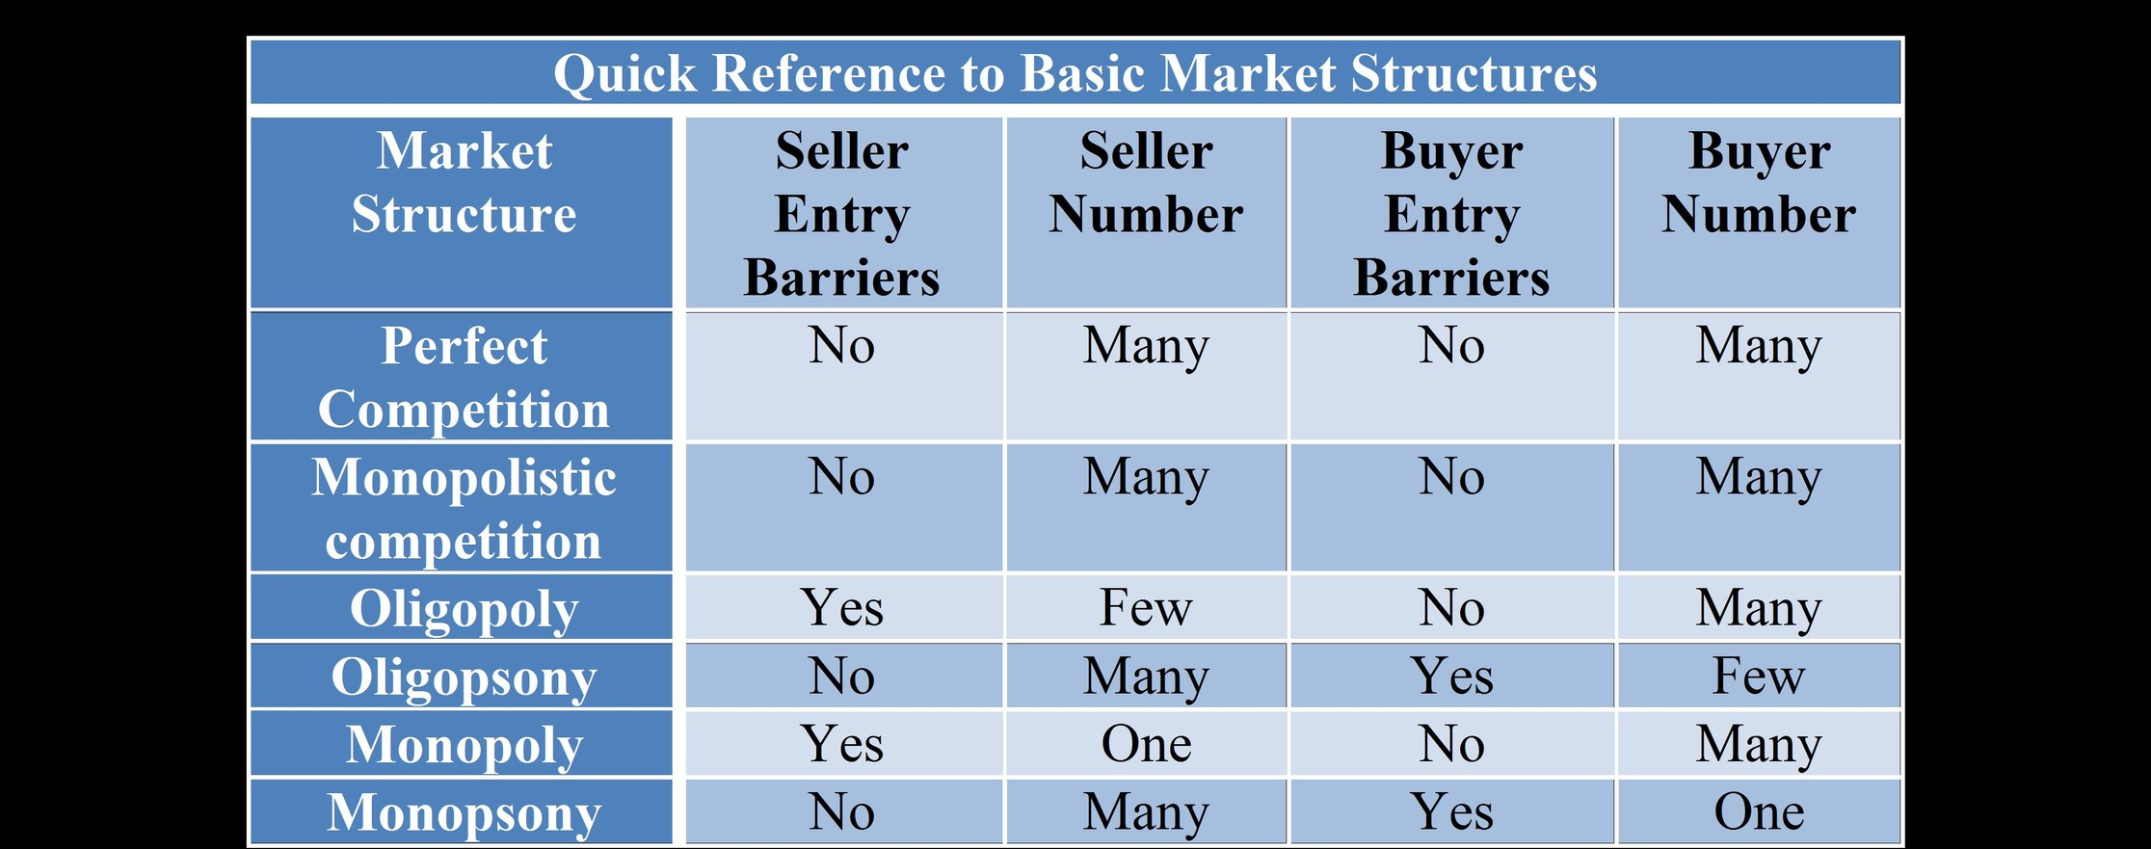

Slide 44


Slide 45


