Slide 1


Storage Technologies
IT403
Prepared by
Dr. Ahmed El-Douh
Lecture 2

Slide 2



Storage Technologies
Lecture 2
IT403
ICT Architecture and Storage Technologies for AI, Big Data and Cloud
Prepared by
Dr. Ahmed El-Douh

Slide 3
Objectives
Upon completion of this module, you will be able to:
  Understand the development trends of ICT.
  Understand what is the Cloud, Big Data and AI.
  Learn about storage technologies and its application in the Cloud.
  Learn about storage technologies and its application in AI and Big Data.

Slide 4
Chapter
Outlines
02
ICT Technologies Development Trends
What is ICT ?
Features of ICT
Storage Architecture Development
Characteristics of Storage in Intelligence Era
Cloud Computing
The Era of Big Data
Changes In Storage Technologies

Slide 5


Chapter
02
ICT Technologies Development Trends

Slide 6
IT and CT
Information Technology (IT) involves technologies for collecting, processing, transmitting, and applying information. It includes three main components: sensors, computing, and communication.
Communication Technology (CT) focuses on transmitting and exchanging information quickly, accurately, securely, and reliably between people.
Information Technology (IT) consist of basic information collection, information processing, information transmission (communication), and information application. The purpose of Communication Technology (CT) is also to serve IT.

Slide 7

New Industrial Revolution Requires New ICT
Cloud
Big Data
Social
IoT
CPS
Mobility

Slide 8
Chapter
02
Features of ICT

Slide 9
Features of ICT
Speed: Fast collection, processing, and transfer of information.
Flexibility: Access data anytime, anywhere.
Cost Reduction: Lower expenses with higher efficiency.
Easy Communication: Simplifies interaction between people and organizations.
Wide Application: Essential in education, healthcare, banking, and business.

Slide 10
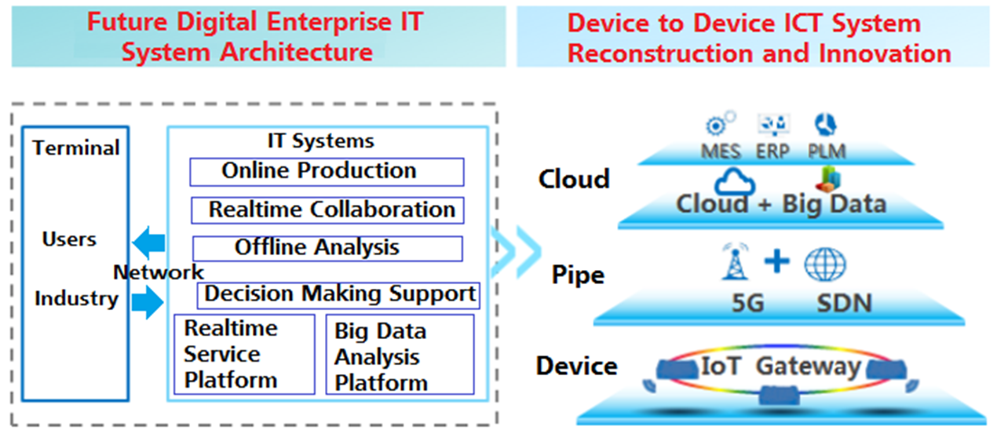
Features of ICT

Slide 11
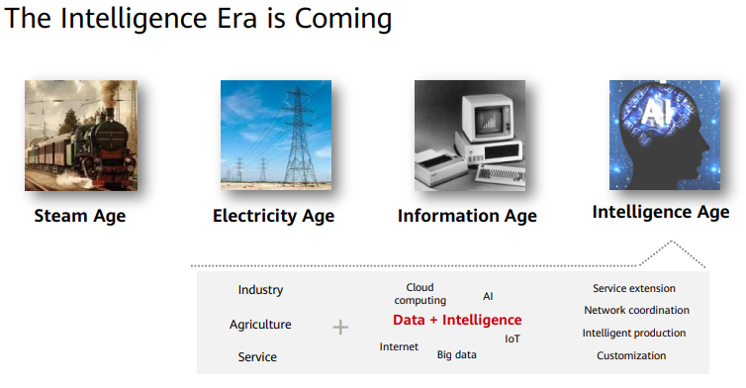
ICT Becoming The Engine of Transformation for Traditional Industry

Slide 12
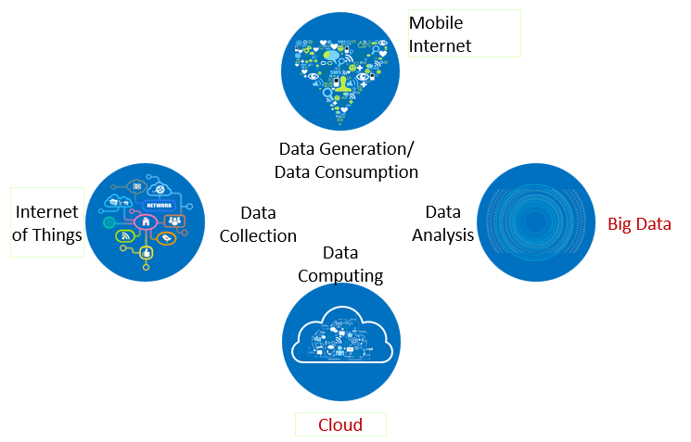
4 Biggest IT Trends That Are Rebuilding The World
Mobile Internet: Access to the internet through mobile devices, connecting billions of users worldwide.
Big Data: Extremely large datasets that require advanced tools to store, process, and analyze.
Internet of Things (IoT): Network of connected devices that collect and share data.
Cloud Computing: Online platforms that provide storage, processing, and services over the internet.
Mobile Internet: 7 billion mobile users, which is near to the total population on Earth. 78% CAGR of data growth and the total number of smart phones in the world (1.82 billion) has exceed the number of PC (1.78 billion).
Internet of Things: Social Business and Social Media changed the people’s way of life. 86% of enterprises are developing their business in social media sites.

Slide 13
Chapter
02
Characteristics of Storage in Intelligence Era

Slide 14
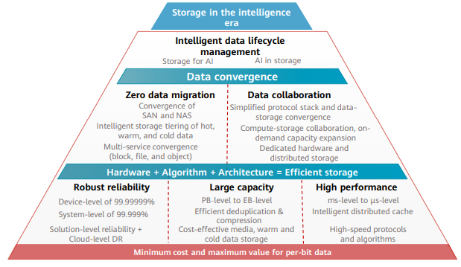
Characteristics of Storage in Intelligence Era

Slide 15
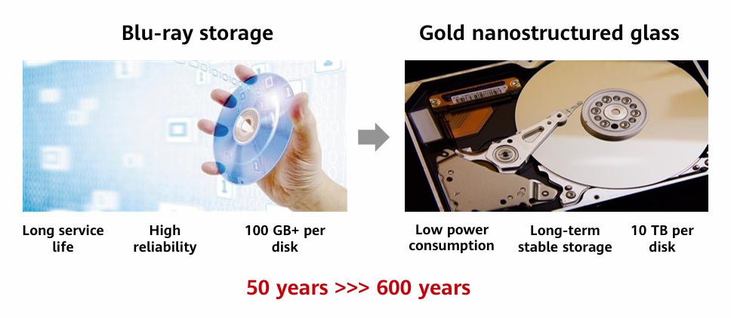
Optical Storage Technology

Slide 16
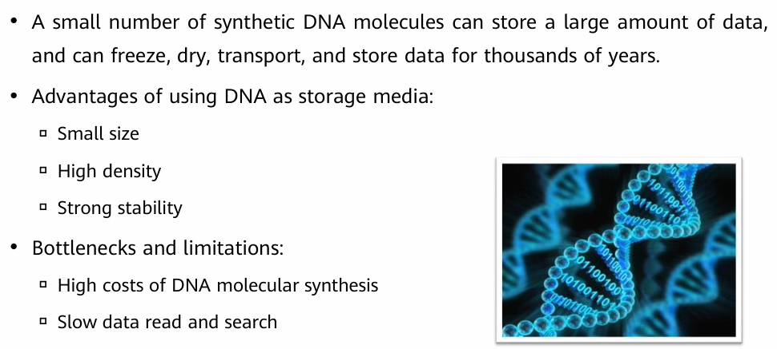
DNA Data Storage

Slide 17
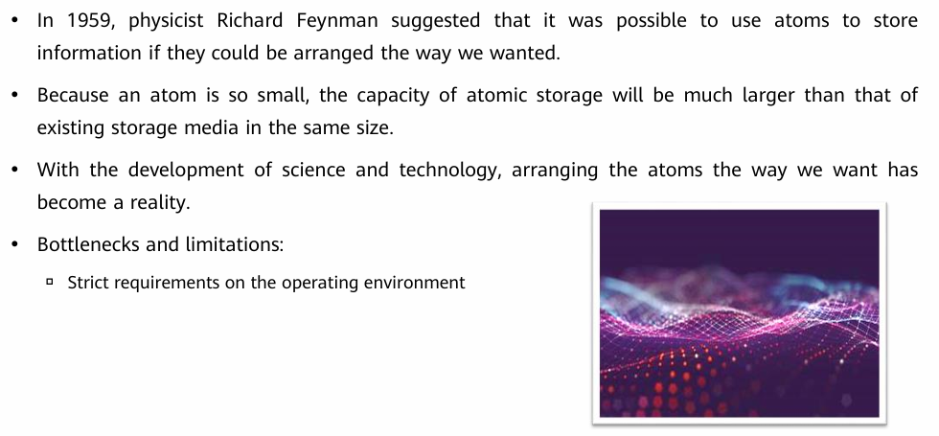
Atomic Storage

Slide 18
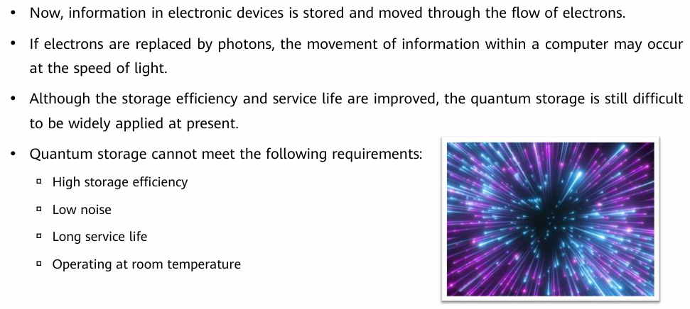
Quantum Storage

Slide 19
Chapter
02
Cloud Computing

Slide 20
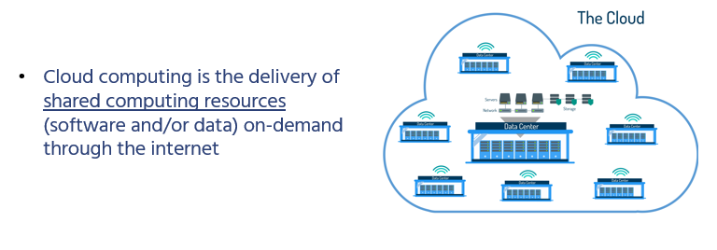
Cloud Computing

Slide 21
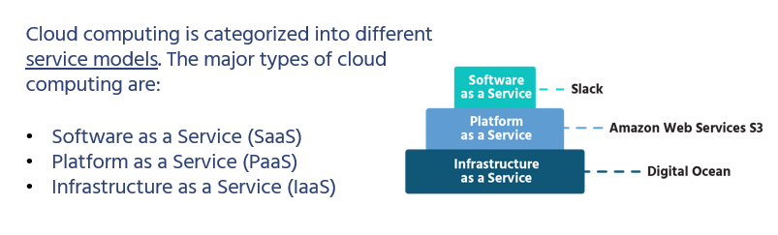
Types of Cloud Computing
SaaS :Using ready-made applications over the internet without the need to install them, such as Gmail and Google Docs.
PaaS: Providing an environment and tools for developers to build and run applications without managing the underlying infrastructure.
IaaS: Providing computing resources such as servers and storage over the internet with full control for the user.

Slide 22
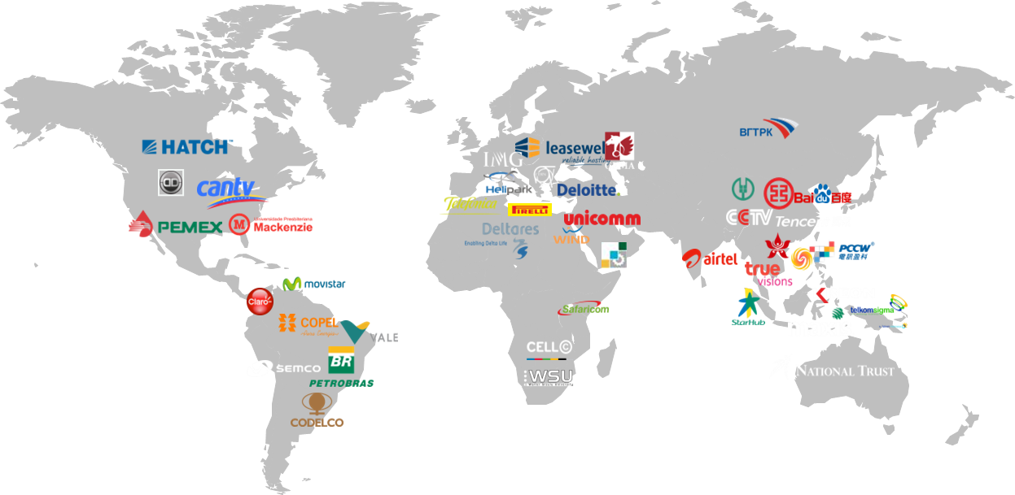
Cloud Data Center is Everywhere
660+ Data Centers are built globally, in which 255+ are Cloud Data Centers.

Slide 23
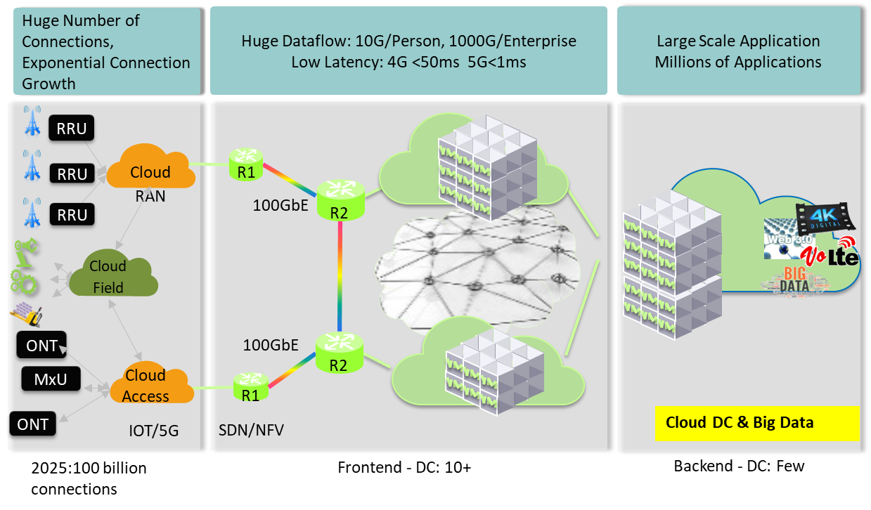
Positioning and Function of the Cloud in ICT Industry Layout

Slide 24
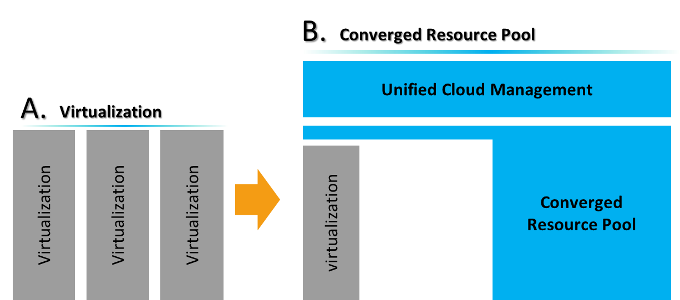
Migration of Traditional Businesses to the Cloud Platform (1)
Virtualization refers to running multiple operating systems on a computer system simultaneously.
Infrastructure:
Interconnection and evolution of existing networks.
Security isolation and security protection.
Building a differentiated resource pool that is able to satisfy different business needs.
Management:
Management of existing resource pools.
Unified management of virtualized and physical resources.
Set resource pool management standard practices, standardized use of resources.
Migration of services:
Smooth migration of old physical machines and data.
Smooth migration of virtual machines and data.

Slide 25
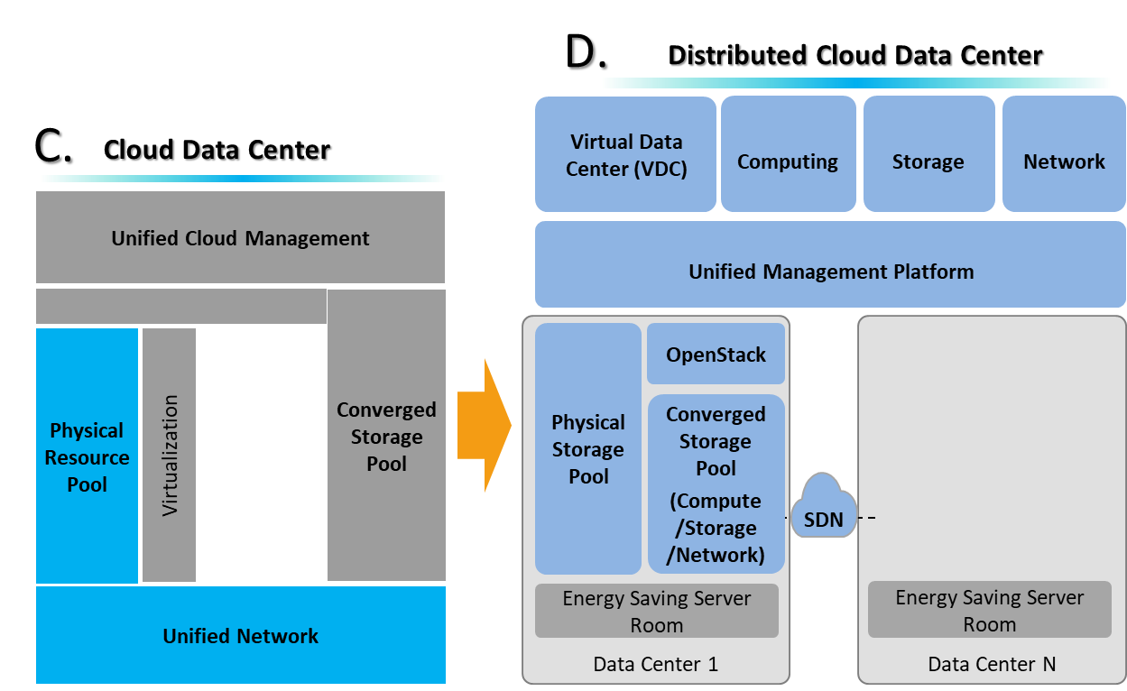
Migration of Traditional Businesses to the Cloud Platform (2)
Software-defined networking (SDN) is an approach to designing, building, and managing networks that makes the network more flexible and agile, enabling it to support the virtualized server and storage infrastructure of modern data centers.
OpenStack is a cloud operating system that manages large pools of compute, storage, and networking resources in a data center through a dashboard, which allows administrators to control these resources while enabling users to provision them via a web interface.

Slide 26
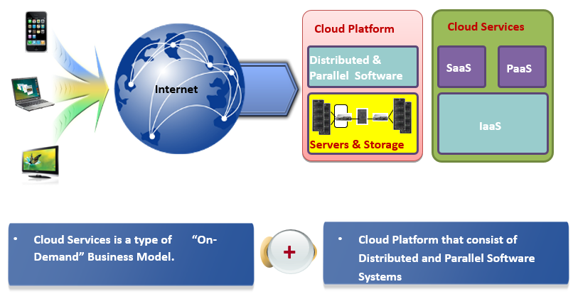
Cloud computing is the Unification of Business Model and Technological Concepts
In a narrow sense, storage refers to the physical storage media with redundancy,
tion, and migration functions, such as floppy disks, CDs, DVDs, disks, and
even tapes.
• In a broad sense, storage refers to a portfolio of solutions that provide
information access, protection, optimization, and utilization for enterprises. It is
the pillar of the data-centric information architecture.
The “on-demand” business model is a business model where services are obtained based on the customer’s demand, and corresponding payments are collected for the services offered to the customers.

Slide 27
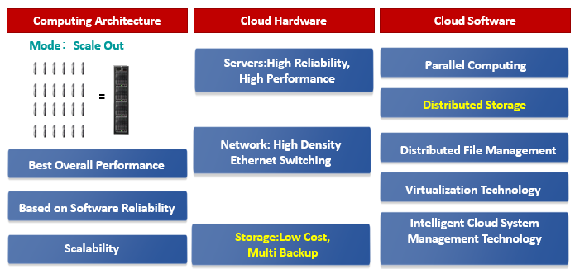
Key Technologies of the Cloud

Slide 28
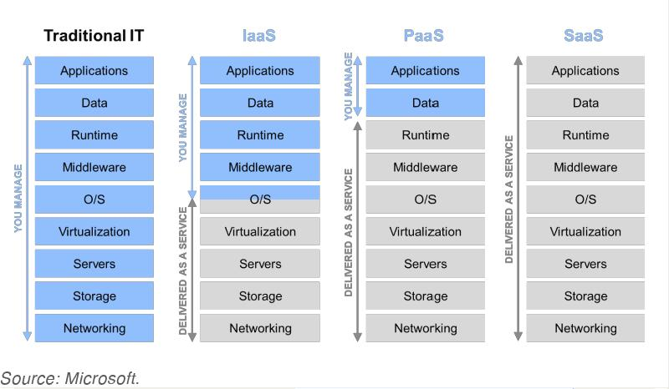
Cloud Service Models
Apps
Data
Execution Environment
Middleware
Software
OS
Virtualization
Platform
Servers
Infrastructure
Network
Storage

Slide 29
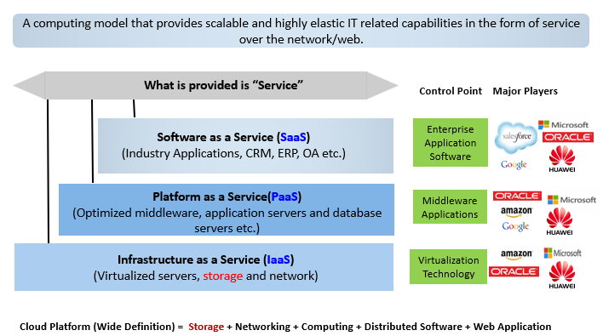
Service is the Essence of the Cloud

Slide 30
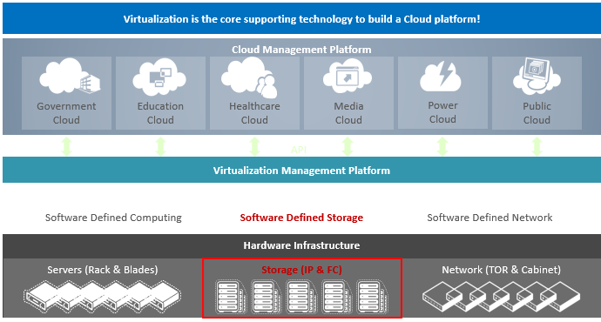
The Key Technology of the Cloud - Virtualization
Definition of Virtualization: Abstraction and isolation management technology towards physical resources in order to achieve the purpose of the highest utilization rate of the physical resources.
Types of Cloud Deployment:
Private Cloud: Enterprise-owned independent cloud infrastructure.
Public Cloud: Cloud infrastructure owned by cloud service providers that provides cloud service to the public or enterprises.
Hybrid Cloud: A combination of private and public cloud infrastructure through dedicated connection technologies to achieve data and application sharing.

Slide 31
Chapter
02
The Era of Big Data

Slide 32
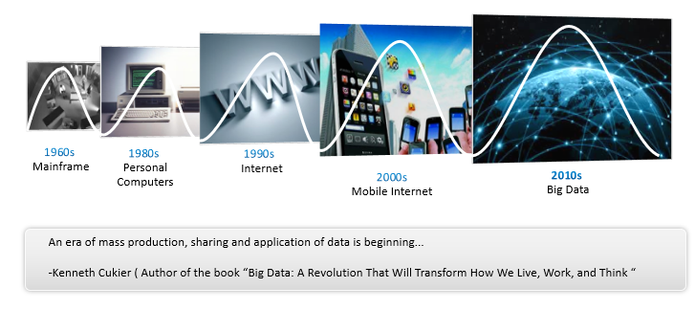
The Era of Big Data Is Here

Slide 33
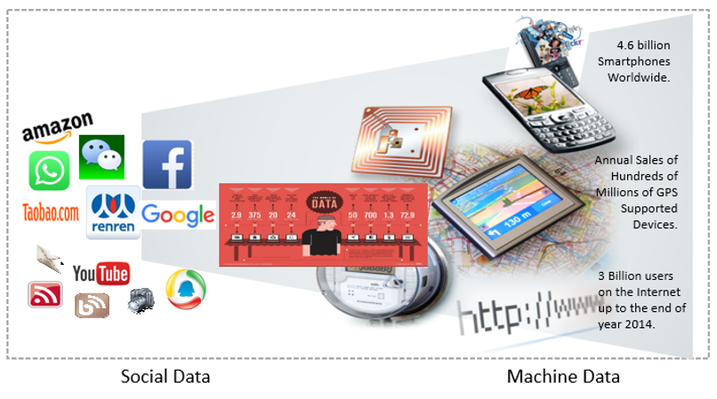
Where Does Big Data Comes From?

Slide 34
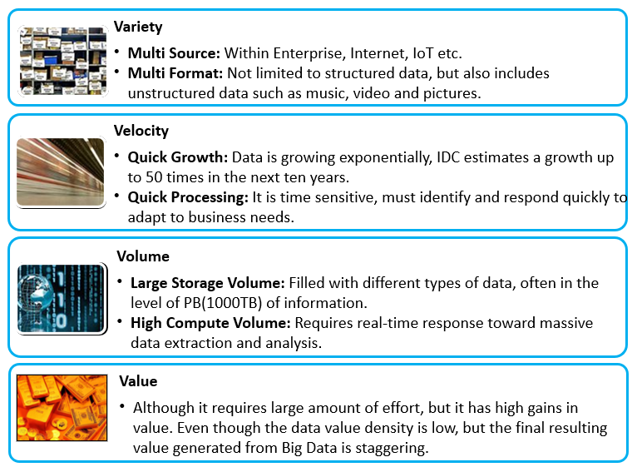
What is Big Data?
Big data: is a massive, high-growth and diversified information asset that requires new processing models for greater decision-making, insight, and process optimization capabilities.
Big data challenges include capturing data, data storage, data analysis, search, sharing, transfer, visualization, querying, updating and information privacy.
The dimensions to big data is known as Volume, Variety, Velocity and Value.

Slide 35
Technological Architecture of Big Data
App/Presentation
Value
Data Visualization
Data Analysis
Data Mining, Business Intelligence, Data Search
Big Data Analysis Technologies
Velocity
Parallel Computing (Batch or Flow Computing)
Data Processing
Big Data Storage Technologies
Unstructured: Distributed File / Object.
Semi-structured: NoSQL databases.
Structured: Distributed databases.
Data Storage
Volume
Data Collection
Variety
Heterogeneous Data Convergence.
ETL (Extract, Transform, Load) Process Optimization.
Data Sources:
A typical big data processing system can be divided into 5 layers: Data Collection, Data Storage, Data Processing, Data Analysis and Application or Presentation of Data.
The data types and models of Big Data:
Unstructured Data: refers to data that is not easily presented in the form of a database or 2D logical charts, including all the formats of office files, text, pictures, XML, charts, images, music, and video.
Semi-structured Data refers to the data that sits between structured data and unstructured data (such as sound and images). HTML files can be considered as semi-structured data.
Structured data: refers to data that can be stored within databases and represented or visualized in the form of a 2D logical chart.

Slide 36
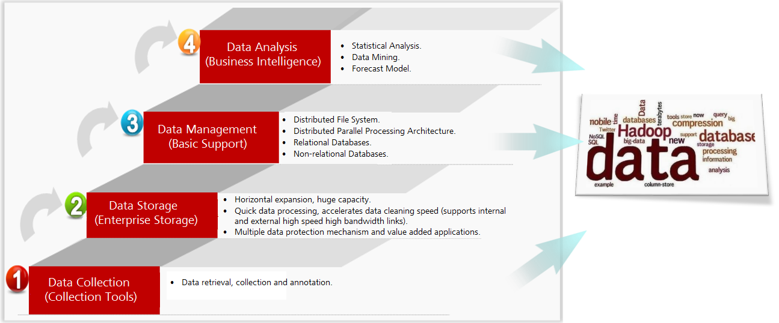
Big Data Processing Requires Wide Range of Technical Support
The process of processing big data is basically the same as the process of general data processing, which includes the four process of data collection, data storage, data management and data analysis.
The data collection process refers to collecting the required data for subsequent analysis through various sources.
The data storage process refers to the transmission and storage of data that was collected in the earlier process.
Data management builds on data storage by further organizing and refining the stored data. It enables more precise data segmentation and generates metadata, which makes future data analysis faster and more efficient.
The data analysis process refers mainly to the utilization of analysis methods, models, and tools to analyze the data and getting a final analysis result that satisfies the common analytical needs.

Slide 37
Chapter
02
Changes In Storage Technologies

Slide 38
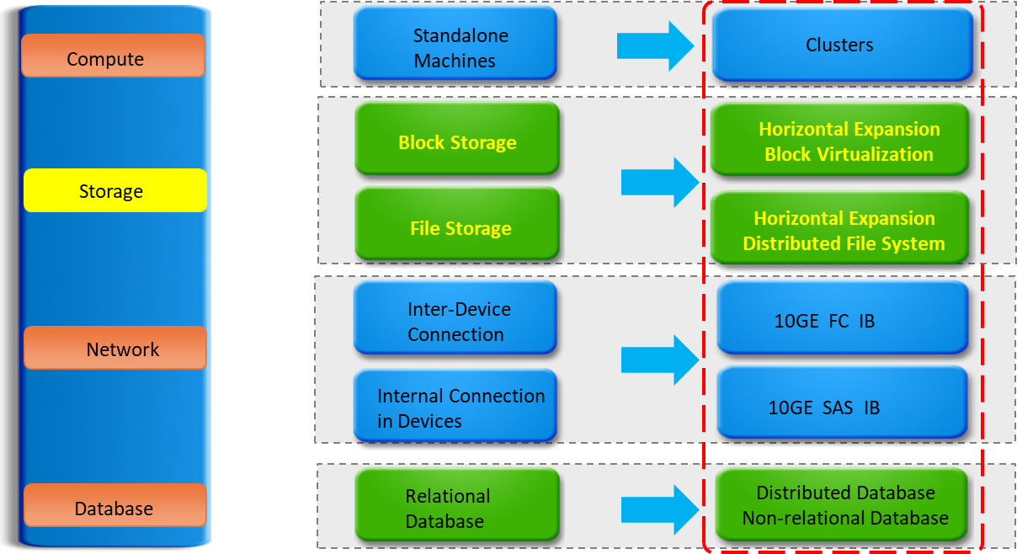
Changes In Storage Technologies

Slide 39
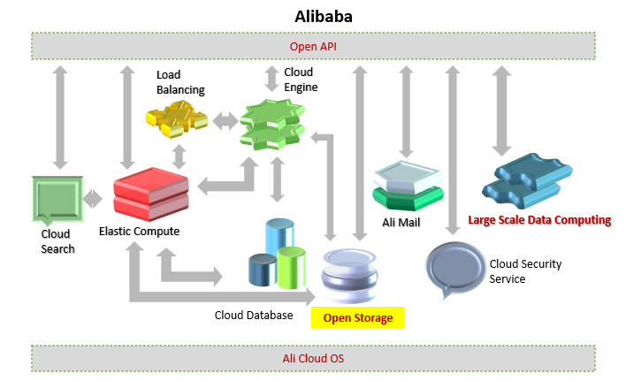
Deep Convergence of Big Data and the Cloud

Slide 40
Summary
  We explored the ICT architecture that supports AI, Big Data, and Cloud.
  Understood the evolution of data: from mainframes to the Era of Big Data.
  Learned about the sources of Big Data and its four dimensions (Volume, Variety, Velocity, Value).
  Discussed Big Data architecture: Collection, Storage, Processing, Analysis, and Presentation.
  Highlighted storage technology changes that enable scalability and performance.
  Saw how Cloud Computing empowers Big Data through flexibility, virtualization, and scalability.
  Case study: Alibaba as an example of deep convergence of Big Data and Cloud.

Slide 41



Thank You

