Slide 1


Communication skills
Prepared by Dr. Merna Emad
Lecture 10

Slide 2
Section 2
Leadership theories
Leadership communication strategies
Lecture
Section 1
Definition of Leadership
The 6 Types of Power

Slide 3
Section one

Slide 4
Definition of Leadership

Slide 5
Leadership
Leaders are Born??
The most commonly held belief about leaders is that they are born. Those who support this reasoning say that for someone to be a leader, they must be born with the attributes that will make them a leader.
The word "leadership" can bring to mind a variety of images. For example:
A political leader, personal cause.
An explorer, cutting a path through the jungle for the rest of his group to follow.
An executive, developing her company's strategy to beat the competition.

Slide 6

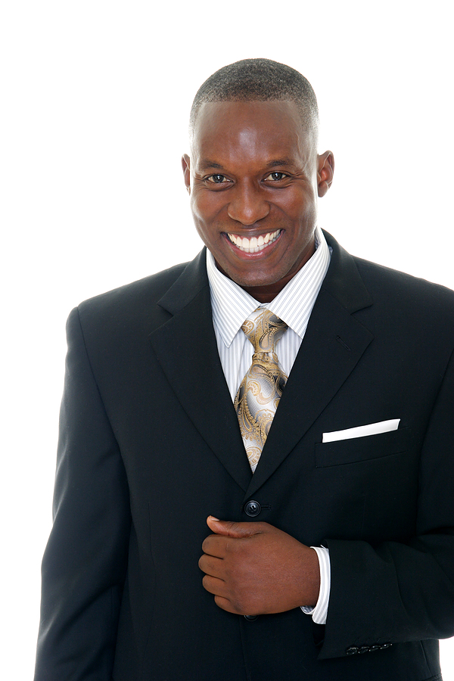

Slide 7
Leadership
Although leaders may possess some desirable personality traits, be charismatic, be born into a family of leaders, or have a job title such as manager or executive, true leadership is not defined by any of these things. Let us explore each of these more closely for a better understanding of why they don’t equal leadership.
Some important definitions
The world "charisma" comes from the Greek word for "gift." Charisma is better thought of as a skill that enhances leadership effectiveness by dint of a superior ability to influence others to change their initial positions, perspectives, or opinions, not by the way the leaders look like.

Slide 8
Definition Leadership
Some important definitions
Leadership is “a dynamic relationship based on mutual influence and common purpose between leaders and collaborators in which both are moved to higher levels of motivation and moral development as they affect real, intended change”.

Slide 9
Definition Leadership
According to this definition, change is dependent on a dynamic relationship, mutual influence, and a common purpose.
As you have already learned, you cannot have a dynamic relationship without effective communication. In addition, mutual influence and common purpose both rely on two-way communication. Furthermore, having leaders and collaborators, as opposed to leaders and followers, again implies the need for effective communication.
Leadership is not a trait. A trait is a distinguishing characteristic or quality that is part of individual character; traits are often seen as inborn or genetically based.

Slide 10
The 6 Types of Power

Slide 11
The 6 Types of Power
Utilizing Power
Status is a person’s rank or position in an organization. Typically, the superior (supervisor/employer) is the higher-status person and the subordinate (employee) is the lower-status person. Typically, people who hold a higher status have more years of experience, training, knowledge, and rank than do those with lower statuses (this may not always be the case).
For example, a doctor has the leadership title and status over the nursing staff. This title and status hold true even if the doctor is right out of medical school and the nursing staff is full of veteran nurses with years of experience and hands-on training.
Job title is about status, but as we discussed in the preceding section, job title does not equal leadership. True leadership is about power.

Slide 12
The 6 Types of Power
Imagine a job you’ve had where your boss got things done in the office by utilizing a series of rewards and punishments. Now, think of someone you’ve worked with who influenced others by being an expert in his field. Finally, envision a manager who inspired action because of her reputation.
By understanding these different types of power, effective managers and leaders can learn to use the positive ones to leverage greatest impact, while avoiding the negative types ones that are frequently the standard go-to’s.
Let's explore French and Raven's bases of power in two groups – positional and personal.

Slide 13
The 6 Types of Power
Positional Power Sources
Legitimate Power
Legitimate power is based on a position of authority. The manager has legitimate power over the department budget and employee schedules. Although a position or job title may give someone legitimate power, it doesn’t mean that person exercises that power.
Coercive Power
This type of power also often presents problems and is often abused. More, it frequently causes severe dissatisfaction and often resentment.
Threats and punishments are very common coercive tools, and typically employed by weak managers and people of authority who have underdeveloped skill sets. This type of power is most frequently seen in people accused of being a bully.

Slide 14
The 6 Types of Power
Personal Power Sources
Relying on positional forms of power alone often results in cold, technocratic, and oftentimes dictatorial power relationship. To effectively influence people on human terms, personal power sources must be employed.
Expert power
Expert power is based on one’s superior expertise in a specific field.
Someone who uses their knowledge and skills to enable others and resolve situations yields a very powerful form of power, or influence, over others.
This power is not derived from coercive or authoritarian means, but ones of respect, trust, and admiration. And when those power sources are harnessed, people are naturally motivated to follow this type of leadership.

Slide 15
The 6 Types of Power
Personal Power Sources
Referent power
It comes from one person liking and respecting another, and identifying with her in some way. Celebrities have referent power, which is why they can influence everything from what people buy to which politician they elect. In a workplace, a person with referent power often makes everyone feel good, so he tends to have a lot of influence.
Referent power can be a big responsibility, because you don't necessarily have to do anything to earn it. So, it can be abused quite easily. Someone who is likeable, but who lacks integrity and honesty, may rise to power – and use that power to hurt and alienate people as well as to gain personal advantage.
Relying on referent power alone is not a good strategy for a leader who wants longevity and respect. When it is combined with expert power, however, it can help you to be very successful.

Slide 16
The 6 Types of Power
Positional Power Sources
Informational Power
Having control over information that other people want or need is a powerful position to be in. Knowing who will be fired, what the financial reports say, how the executive team will respond to a recent crisis, or why HR has been so distant lately are all examples of informational power.
Reward power
Anyone who can offer positive or negative reinforcements has power. So the staff member who can process your paperwork quickly versus slowly and the administrative assistant who can choose to squeeze you in or make you wait for a meeting with the boss both have coercive and reward power.

Slide 17
Section Two

Slide 18
Leadership Theories

Slide 19
Leadership theories
Imagine yourself at a fork in the road. Each path before you represents a different choice you could make as a leader. If you select the wrong path, you may never find your way. If you select the right path, you will still have a journey ahead of you, but your chances for success will improve dramatically.
Each leadership theory discussed in this section will help you select the right path for communicating as a leader given your team, your task, your situation, and your vision. Let’s begin by reviewing various leadership theories developed through the years.

Slide 20
Leadership theories
Trait Theories
Trait theories argue that effective leaders share a number of common personality characteristics, or "traits."
Early trait theories said that leadership is an innate, instinctive quality that you do or don't have. Thankfully, we've moved on from this idea, and we're learning more about what we can do to develop leadership qualities within ourselves and others.
Trait theories help us identify traits and qualities (for example, integrity, empathy, assertiveness, good decision-making skills, and likability) that are helpful when leading others. However, none of these traits, nor any specific combination of them, will guarantee success as a leader.

Slide 21
Leadership theories
Behavioral Theories
Behavioral theories focus on how leaders behave. For instance, do leaders dictate what needs to be done and expect cooperation? Or do they involve their teams in decision-making to encourage acceptance and support?
In the 1930s, Kurt Lewin developed a framework based on a leader's behavior. He argued that there are three types of leaders:
1.Autocratic leaders make decisions without consulting their teams. This style of leadership is considered appropriate when decisions need to be made quickly, when there's no need for input, and when team agreement isn't necessary for a successful outcome.
2.Democratic leaders allow the team to provide input before making a decision, although the degree of input can vary from leader to leader. This style is important when team agreement matters, but it can be difficult to manage when there are lots of different perspectives and ideas.
3.Laissez-faire leaders don't interfere; they allow people within the team to make many of the decisions.

Slide 22
Leadership theories
Contingency Theories
The contingency theory of leadership supposes that a leader’s effectiveness is contingent on whether or not their leadership style suits a particular situation. According to this theory, an individual can be an effective leader in one circumstance and an ineffective leader in another one. To maximize your likelihood of being a productive leader, this theory posits that you should be able to examine each situation and decide if your leadership style is going to be effective or not. In most cases, this requires you to be self-aware, objective and adaptable.
For instance, when you need to make quick decisions, which style is best according to each situation? When you need the full support of your team, is there a more effective way to lead in every situation? Should a leader be more people-oriented or task-oriented? These are all questions that contingency leadership theories try to address.

Slide 23
Leadership theories
Transformational Theories
Transformational leaders are the type of leaders who bring change in the individuals and the organizational structure. They increase the motivation, morale, and performance of the followers.
Characteristics of a Transformational Leader
There are 4 typical characteristics that outline or form the basis of transformational leaders.
Inspirational Motivation – This is the very basic quality of the transformational leaders. Their vision is consistent, tethered to the end goal. The manager helps in setting a compelling vision with meaning to challenge oneself. Motivates to work together as a team.
Individual Consideration – Leaders are in a way a mentor to the team. Correcting the mistakes and failures with encouragement and support, rewarding and recognizing the achievements, talents and knowledge are the essential parts of being a transformational leader. The leaders take the decisions that always end as a boon for his team and be of support.

Slide 24
Leadership theories
Transformational Theories
Characteristics of a Transformational Leader
There are 4 typical characteristics that outline or form the basis of transformational leaders.
Idealized Influence – Transformational leaders follow the method of practice what they preach. He follows the principles and regulations strictly on his own before that is set out for the team. Being the role model, if he follows what he lays the team as well will follow. This will win the trust, loyalty and respect from the followers, which will take the team a long way.
Intellectual Stimulation – Bringing out the innovativeness and creativity among the team members is one of the characteristics. Cultivating authentic creativity and troubleshooting the problems innovatively just to see the outcome/solution in a different perspective from the member’s side. The failure in bringing out the required solution is not ridiculed or blamed. This is seen as a practice to see the readiness in the team.

Slide 25
Leadership communication strategies

Slide 26
Leadership communication strategies
Communication strategies for hiring quality employees:
When hiring opportunities occur, it is incredibly important that you, as the leader, participate in every stage of the hiring process. It is also important to get the rest of the team involved.
When hiring opportunities occur, it is incredibly important that you, as the leader, participate in every stage of the hiring process. It is also important to get the rest of the team involved.
Once the position has been advertised, the interview questions must be drafted. You may or may not be responsible for drafting the questions, but as the leader, you should always review the questions, giving your input and ultimately your approval.

Slide 27
Leadership communication strategies
Describe ways to lead effective teams:
You should facilitate a discussion about the opportunities this new position creates and what the team really needs. This may be the time when some current team members shift their duties, allowing them to put some of their underutilized skills to work. It also might be the time to add new skills to the team.
As the team evaluates which skills will be needed, make certain that people skills and attitude are part of the conversation. As a professional, you should not only pay attention to your own people skills and attitude—you should also pay attention to the people skills and attitudes of those hired into your team.
Excellent leaders involve the team so that they, too, can share in the leadership, which will make your job more manageable.
As the leader, you must create a “follow up and follow through” norm within your team. To begin enacting this norm, send out an e-mail thanking the team members for their participation in a recent meeting, state the homework to which each team member has agreed, and remind them of the next meeting time.

Slide 28
Leadership communication strategies
Identify strategies for dealing with difficult people:
In addition to the team player and the star, the negative members of your organizational family may include the following: the bully, the sniper, the drama queen, the slacker, the vampire, the grump, the roadblock to change, the distracter, and the patient.
Taking steps to improve an employee’s work attitude and learning to deliver constructive criticism may help you to deal with some of the difficult people you may encounter in the workplace.

Slide 29
Leadership communication strategies
Provide feedback as a means to motivate team members:
A good leader understands employees’ duties, workloads, constraints, and goals, because he or she is open to giving and receiving feedback.
A leader with professional excellence understands how to use feedback to mentor stars as well as to turn difficult family members into team players.
You must provide constant feedback, praising those employees who meet expectations and reprimanding those who fail to meet them. You must follow through, which can mean a bonus, a reprimand, or termination.

Slide 30
Leadership communication strategies
Discuss ways to manage your public image:
To excel as a leader with professional excellence, you must take time to reflect on your public image.
Impression management is a self-monitoring technique meant to help you put the KEYS process into action.
Verbal and nonverbal communication that conveys professional excellence also Contributes to your public image.

Slide 31

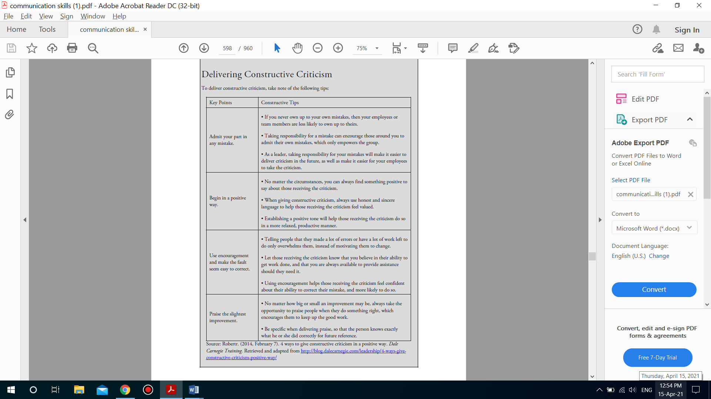

Slide 32



Thank You

