Slide 1


Project Cost
Management
Prepared by
Dr. Hoda Metwally
PMG 213
Lecture 4

Slide 2



Project Cost
Management
Lecture 4
PMG 213
Prepared by
Dr. Hoda Metwally
www.midocean.ae

Slide 3

Lecture 4
Project Cost
Management
Prepared by:
Dr. Hoda Metwally
www.midocean.ae

Slide 4

Design phases
All elements of any given project are not designed at the same time; different elements are started earlier, and some proceed faster than others and include additional levels of detail. There are five major design phases that most built environment projects experience. In some cases, programming and conceptual design may be combined into one phase for a total of four phases. These design phases influence all of the other introductory construction management topics discussed including delivery, procurement,

Slide 5
contracting, and pricing methods differently with respect to when the contractor estimates the project and when and how the contractor is chosen and begins their cost accounting processes.
The design phases include:
* Programming,
* Conceptual design,
* Schematic design (SD),
Design development (DD), and
Construction documents (CDs).
Additional design definition and detail is added at each of these levels which allow the contractor to develop more accurate estimates and reduce contingencies. Ideally this additional detail also reduces the client’s risks. Budget estimates and negotiation with a construction manager/general contractor is more common early in the design process, whereas the traditional delivery method and bid procurement process matches up best at the completion of the last phase, construction documents.

Slide 6
Pricing
There are several methods for pricing contracts used in the construction industry but four are the most prevalent and others are hybrids of these four. The choice of which to use on any particular project is made by the owner after analyzing the risk associated with the project and deciding how much of the risk to assume and how much to pass on to the contractor. Contractors want compensation for risk they assume and usually do so with increased fees or estimating contingencies.
The most common pricing methods include:
* Lump sum (LS),
* Unit price,
* Cost plus fixed fee or cost plus percentage fee, and
* Cost-plus with a guaranteed maximum price (GMP).

Slide 7
Lump sum, or stipulated sum contracts are awarded on the basis of a single lump sum estimate for a specified scope of work.
Unit-price contracts are utilized for heavy-civil projects when the exact quantities of work cannot be defined. The designer estimates the quantities of work, and the contractor submits unit prices for each work item. The actual installed quantities required are multiplied by the bid unit prices to determine the final contract price but only after project completion

Slide 8

. Cost-plus contracts are used when the complete scope of work cannot be defined. All of the contractor’s project-related costs are reimbursed by the owner, and a fee is paid to cover profit and contractor home office overhead. This is also known as a time and materials contract.
A guaranteed-maximum-price contract (GMP) is a cost-plus contract in which the contractor agrees not to exceed a specified cost.

Slide 9
Project owners choose which method they want their contractors to price a project for a variety of reasons, including :
the completeness of the design,
the complexity of the project,
and the owner’s experience in managing construction projects.
Each of these pricing models also has a significantly different effect on jobsite cost accounting.

Slide 10
Construction contracts
The construction contract is the most important construction document. It has significant impacts on how costs are accounted for, especially in an open-book contract. It is a legal document that describes the rights and responsibilities of the parties, for example, the owner and the general contractor. Five things must be aligned for a contract to exist:
* An offer to perform a service,
* An acceptance of the offer,
* Some conveyance, i.e. transfer of a completed building for money,
* A legal agreement, and
* Only authorized parties can sign the agreement, for example the officer-in-charge or chief executive officer (OIC or CEO).

Slide 11
The intent of the contractual agreement and the contract documents describe the completed project and the terms and conditions the parties (usually the project owner and the general contractor) must adhere to in order to accomplish the work. There typically is not a detailed description of the sequence of work or the means and methods to be used by the contractor in completing the project. The contractor is expected to have the professional expertise required to understand the contract documents and select appropriate subcontractors and qualified craftsmen, materials, and equipment to complete the project safely and achieve the specified quality requirements.

Slide 12
For example, the contract documents will specify the dimension and sizes of structural steel columns and beams.
The contract documents usually include at least the following management five essential elements. They are listed here in what had been considered a relative order of precedence, but today most see them as complementary; all of these documents must work together:
1. The contract agreement,
2. Special or supplemental conditions,
3. General conditions,
4. Technical specifications, and
5. Drawings.

Slide 13
The terms and conditions of the relationship between the primary parties are defined solely within the contract documents. These documents should be read and completely understood by the contractor before deciding to pursue a project. They also form the basis for creating a project estimate and schedule. To manage a project successfully, the project manager must understand the organization of the contract documents and the contractual requirements for his or her project .This knowledge is essential if the PM has any expectation of satisfying the expectations of his or her company executives as well as that of the project owner. The contract agreement itself is either a generic standard template or a specially prepared document to suit a specific project owner or a specific project. Most government agencies use standard formats for developing construction contract documents.

Slide 14
Governmental agencies typically have standardized general conditions and contract language. Many private owners use contract formats developed by the government and other contractor associations.
Contracts should not be signed until they have been subjected to a thorough legal review. This is to ensure that the documents are legally enforceable in the event of a disagreement and that there is a clear, legal description of each party’s responsibilities.
Standard contract agreements have typically been developed by attorneys and have been tested in the legal system and deemed fair to the parties that willfully execute them.

Slide 15
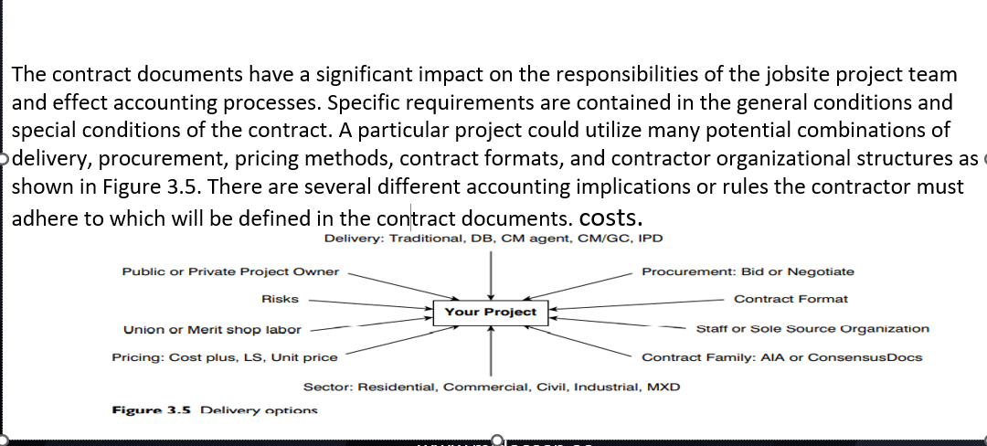

Slide 16
Introduction to estimating

Slide 17
Introduction:
Cost is one of the most critical project attributes that must be controlled by the project manager (PM), superintendent, and cost engineering team. Project costs are estimated to develop a construction budget within which the project team must build the project.
Cost estimating is the process of collecting, analyzing, and summarizing data in order to prepare an educated projection of the anticipated cost of a project. All project costs are estimated in preparing bids for lump sum or unit-price contracts and negotiating the guaranteed maximum price (GMP) on cost-plus contracts. This project budget is the first step and becomes the basis for the cost control system.

Slide 18
When possible, the PM, cost engineer, and superintendent should be responsible for developing the estimate or at a minimum, work as integral members of the estimating team. Their individual inputs regarding constructability and their personal commitments to the final estimate are essential to assure not only the success of the estimate, but also the ultimate success of the project.
One of the first assignments for the estimating team is to develop a responsibility list and to schedule the estimate. The estimating process should be scheduled for each project beginning with the dates for the pre-bid or pre-proposal conference and finishing when the bid or proposal is due. With these milestones established, a short bar-chart schedule should be developed which shows each step and assigns due dates to the estimating tasks depicted in the Estimating Process Figure 4.1.

Slide 19
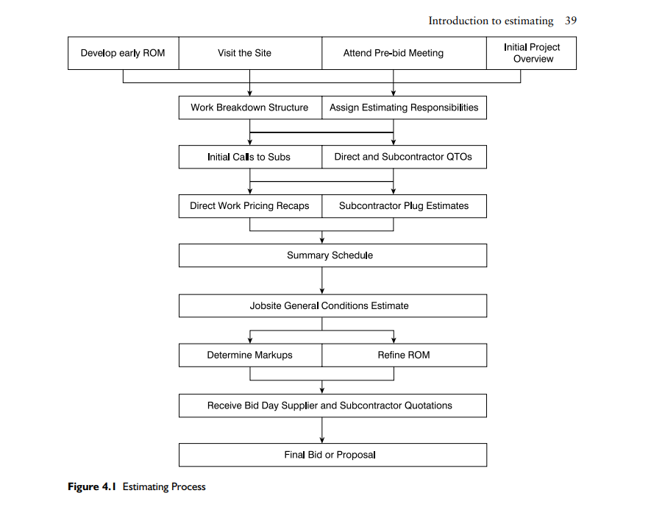

Slide 20
Types of cost estimates
Many outside of the construction industry view all contractors’ estimates the same, in that they are all ‘firm bids’ and all contractor-produced estimates are completely detailed and accurate. This of course is a misconception and largely dependent upon document completion. There are several different types of cost estimates.
Conceptual cost estimates are developed using incomplete project documentation,
while detailed cost estimates are prepared using complete drawings and specifications.
Semi-detailed cost estimates are used for guaranteed maximum price contracts and have elements of both conceptual and detailed estimates. The estimating strategy or approach is different with each of the three main types of estimates and the level of detail will differ as well. The accuracy of an estimate is directly proportional to the accuracy of the documents and the time spent on preparing an estimate also follows those same lines. All estimates have major elements or cost categories, some of which require a more detailed effort .

Slide 21
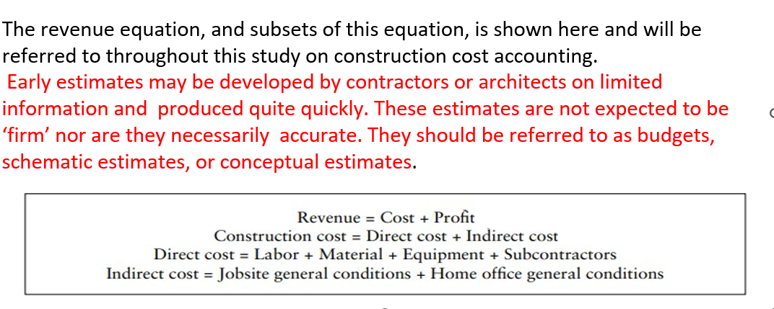

Slide 22
Revenue = Cost + Profit
Example:
12,000,000 =10,000,000 +2,000,000
Profit = Revenue – Cost
2,000,000 =12,000,000 - 10,000,000

Slide 23
Budgets are the least accurate estimate type and should carry substantial contingencies, such as 10–20%. Budgets are also developed only by seasoned estimators, whereas the junior estimator or cost engineer will assist with quantity take- offs (QTOs) associated with detailed lump sum bid estimates. A contractor will also develop an early and quick budget from even a detailed set of drawings as soon as they come through the door. This estimate is referred to as a ROM estimate and is utilized to determine if the project is the right size for the contractor to pursue and which of its estimating or management staff would be best suited to work on the subsequent detailed estimate. Another early estimate prepared by the project owner, which is often a real estate developer, is a pro forma.
A detailed estimate takes the longest time to prepare, costs the contractor the most in personnel resources to complete, and produces the most accurate final figure. Usually drawings and specifications which are 90–95% complete are associated with detailed estimates. This would be consistent with completion of the construction document (CD) design phase.

Slide 24
Detailed estimates are required for projects which are lump sum bid, such as for a public waste water treatment plant.
Although lump sum bids are customarily associated with public works projects, clients on privately financed projects may also solicit lump sum bids during a slow economy. In a busy economy though, project owners may only interest contractors with negotiated requests for proposals.
Clients soliciting lump sum bids are primarily interested in just the bottom-line price and assume all contractors can deliver the project with comparable levels of quality, schedule, and safety.
The detailed estimate process includes quantity take-offs, pricing recaps, early subcontractor plug estimates, jobsite general conditions, competitive subcontractor and supplier quotations, and markup choices.

Slide 25
Guaranteed maximum price estimates and resultant guaranteed maximum price (GMP) contracts are a hybrid of budgets and detailed estimates.
GMPs are often prepared on negotiated projects after completion of the design development (DD) phase.
Detailed estimates
Revenue = Construction cost + Profit
Construction cost = Direct cost + Indirect cost
Direct cost =
Labor + Material + Equipment + Subcontractors
Indirect cost
= Jobsite general conditions + Home office general conditions
for scopes which have been adequately designed and specified, such as structural concrete and steel, utilizing measured quantities and unit prices. Subcontractor plugs or allowances are included for areas not yet designed

Slide 26
Work breakdown structure
The process of developing an estimate was illustrated in Figure 4.1. The first step of gathering information is the foundation for the process. As the estimator proceeds through the process, information continues to be analyzed and summarized and refined, until eventually there is only one price left, the final estimate or bid. The work breakdown structure (WBS) for the project is an early outline of the significant work items that will have associated cost or schedule considerations. This includes scopes of work such as concrete walls, exterior paving, ceramic tile, electrical, etc. Before detailed take-offs and pricing are prepared, the estimator should develop this general picture of all of the work that will be included on the WBS. One of the first steps in the estimating process is to perform a brief document overview. The estimator should slowly leaf through the drawings and specifications and develop a good understanding of the type of project and the building systems that are included. The estimator should not start quantifying or pricing any work items until this overview is complete.

Slide 27
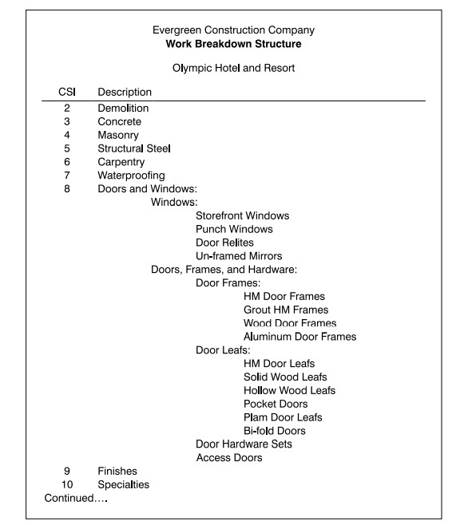

Slide 28
general contractors may perform with their own direct crews include: concrete formwork, structural steel ,carpentry, doors, and specialties.These are scopes of work often installed direct by the GC’s carpenters, and ironworkers. Decisions regarding which scopes of work to self-perform and which to subcontract are based on several criteria:
Subcontractors will be used if the specialized tradesmen needed are not employed
by the GC.
The reason subcontractors are also known as specialty contractors is that they specialize in a specific scope of work, such as windows, and should be expected to know that work better than would other contractors.
If there are problems with the quality of installation, a subcontractor is required to
repair the work without increase in cost to the GC.

Slide 29
* The subcontractor may have estimated a fixed price which is less than what the GC has estimated therefore the subcontractor would be absorbing the pricing risk.
*Subcontractors may have craftsmen and equipment available and the GC does not.
*There are risk mitigation arguments on both sides as to which, the subcontractor or the GC, can perform the work faster, safer, cheaper, and with better quality than the other.
Another tool the construction team might utilize at this stage is a project item list, which is essentially a work breakdown structure with columns indicting direct labor and material from that of subcontractors. A live Excel version of the project item list is included on the resource. After the estimator, project manager, and superintendent have decided which scopes of work to subcontract, subcontractors should be notified about the project.

Slide 30
Today this is likely done electronically with an invitation to bid and an access code to drawing files. It is a good idea to have the subcontractors working to assist with the estimate in parallel with the general contractor developing its own estimates for self- performed work. When subcontractors are notified they will ask the estimator questions regarding specifications, quantities, and materials.
The cost engineer or estimator should be informed at that time about specific subcontractor scopes but should be cautious about providing too much detail to the subcontractor. General contractors do not want to place themselves in the position that subcontractors have based their prices solely on information the GC estimators have given them. Each subcontractor should develop a completely independent estimate. The work breakdown structure, if properly developed including sufficient detail and cost codes, can also function as a preliminary ‘bill-of-materials’ from which the superintendent and cost engineer can issue short-form purchase orders and place material orders.

Slide 31
Quantity take-off
After the work breakdown structure is developed, the estimator takes material quantities directly off the drawings. The estimator prepares quantity take-offs by conducting detailed measurements and counts of each item of work that the team selected to be self-performed. The take-off process is a time-consuming step in the estimating process as shown in Figure 4.1, and is a crucial step in preparing any detailed construction estimate. The quantity take-off process starts with the work items that will be constructed first, the foundations. This is typical for commercial or civil or residential projects. This order will accomplish several tasks. First, it will force the estimator to think like the builder – the foundations are built before the floor systems. This is also why it is important to have the superintendent involved early in the estimate creation.

Slide 32
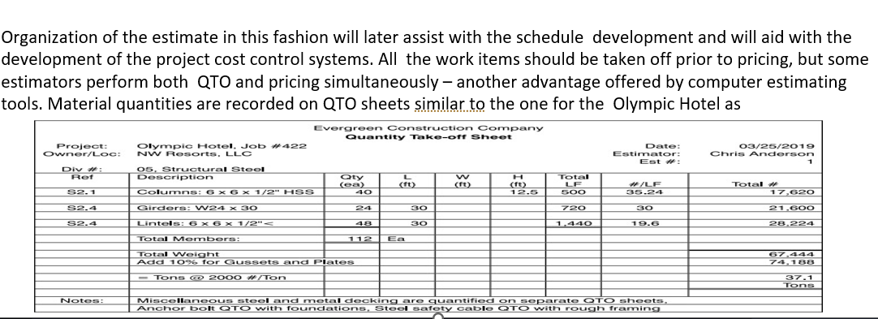

Slide 33
Counted and measured quantities of materials must be mathematically converted to purchasable units that match up with standard unit pricing. For example, concrete is measured in length multiplied times width multiplied times height or thickness or depth which produces cubic feet. Likewise structural steel is purchased by the ton.
Quantity take-off sheets for subcontracted work are prepared similarly, but by system or assembly and need not be as detailed as that of the general contractor’s direct work. For example, the GC will take-off sheetrock walls, including metal studs and taping, by the square foot .

Slide 34
There is no one exact estimate for any project but some estimates are more correct than others.
Pricing recapitulation sheets (recaps) are developed for each system, that is utilized. The estimator should not start pricing until all of the materials have been taken off and recorded on the quantity sheets. After all of the quantity take-off has been completed, the estimator should begin pricing labor and direct materials. All of the recapped material quantities are circled or highlighted and brought forward from the QTOs and entered onto the pricing recap sheets.

Slide 35
Contractors can only estimate how many hours it will take to perform a task; there are no rules and they can only manage, not control, actual field productivity.
Labor productivity is estimated as man- hours (MH) per unit of work, such as 10 MHs per door. This is referred to as unit man- hours or UMH. This system allows for fluctuation of labor rates, geographic variations, and time.
Appropriate wage rates can be applied for the specific project.
The best source of labor productivity is from the estimator’s in-house database.

Slide 36
Each estimator or contractor should develop their own database from previous estimates and as-built labor history. It is important to round calculated man-hours off on the pricing recap sheets.
The wage rates that get applied are determined by the company, location, union agreements (if applicable), and the type of work to be performed. Public construction project wage rate values may also be governed by prevailing wage rates which are established by the Department of Labor.

Slide 37
Some estimators will use crew wage rates which combine journeymen with foremen with apprentices. This often averages out at the journeyman’s wage and is a common and acceptable practice.
Some will use blended wage rates which factor carpenters and laborers and cement masons and ironworkers all together. Others will use loaded wage rates which combine bare wages (that which the craftsman receives) with labor burden.

Slide 38
Price quotations should be received in writing on the supplier’s letterhead. Many material quotes are received electronically. Other sources of material prices include in- house historical costs or previous estimates. Historical prices are not as reliable as current quotes, but it is better than leaving an item blank. The third choice for material prices are databases or reference guides.

Slide 39
Pricing subcontracted work
The best source of subcontractor pricing is from subcontractors. They are the ones who will ultimately be required to sign a contract and guarantee performance of an established scope of work for a fixed amount of compensation. Subcontractors are invited to bid on a project as one of the early steps in the estimating process. Just as general contractors market to project owners, they should also treat past, current, and future subcontractors with respect so that they receive complete and competitive future bids. Some subcontractors may also provide GCs with early budgets for their scopes as place-holders until bid day quotes are refined.

Slide 40



Thank You

