Slide 1

Probability and Statistics
Prepared by Dr.Israa Lewaa
Lecture 4
STA 201
Discrete Probability Distributions

Slide 2

Chapter
04
Discrete Probability Distributions
4.1 Probability Distributions
4.2 Binomial Distributions
4.3 More Discrete Probability Distributions

Slide 3
Chapter
04
Discrete Probability Distribution
Distinguish between discrete random variables and continuous random variables
Construct a discrete probability distribution and its graph
Determine if a distribution is a probability distribution
Find the mean, variance, and standard deviation of a discrete probability distribution
Find the expected value of a discrete probability distribution

Slide 4
Chapter
04
Section 4.1: Probability Distributions
Random Variable
Represents a numerical value associated with each outcome of a probability distribution.
Denoted by x
Examples
  x = Number of sales calls a salesperson makes in one day.
  x = Hours spent on sales calls in one day.

Slide 5
Chapter
04
Discrete Random Variable
Discrete Random Variable
Has a finite or countable number of possible outcomes that can be listed.
Example:
  x = Number of sales calls a salesperson makes in one day.
x
0
1
2
3
4
5

Slide 6
Chapter
04
Continuous Random Variable
Continuous Random Variable
Has an uncountable number of possible outcomes, represented by an interval on the number line.
Example:
  x = Hours spent on sales calls in one day.
x
0
1
2
3
…
24

Slide 7
Chapter
04
Example: Random variable
Decide whether the random variable x is discrete or continuous.
x = The number of stocks in the Dow Jones Industrial Average that have share price increases on a given day.
Solution:
Discrete random variable (The number of stocks whose share price increases can be counted.)
x
0
1
2
3
…
30

Slide 8
Chapter
04
Example: Random variable
Decide whether the random variable x is discrete or continuous.
x = The volume of water in a 32-ounce container.
Solution:
Continuous random variable (The amount of water can be any volume between 0 ounces and 32 ounces)
x
0
1
2
3
…
32

Slide 9
Chapter
04
Discrete Probability Distribution
Discrete probability distribution
Lists each possible value the random variable can assume, together with its probability.
Must satisfy the following conditions:
In Words In Symbols
The probability of each value of the discrete random variable is between 0 and 1, inclusive.
The sum of all the probabilities is
0 ≤ P (x) ≤ 1
ΣP (x) = 1

Slide 10
Chapter
04
Constructing a Discrete Probability Distribution
Let x be a discrete random variable with possible outcomes x₁, x₂, … , x_{n}.
Make a frequency distribution for the possible outcomes.
Find the sum of the frequencies.
Find the probability of each possible outcome by dividing its frequency by the sum of the frequencies.
Check that each probability is between 0 and 1 and that the sum is 1.

Slide 11
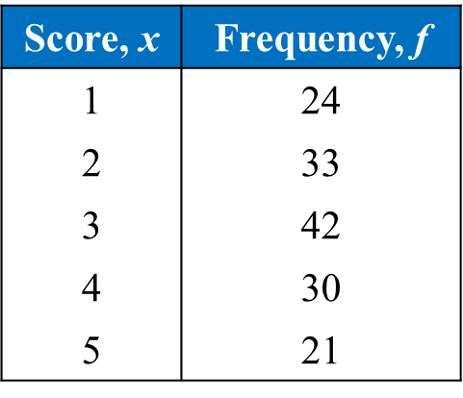
Chapter
04
Example: Constructing a Discrete Probability Distribution
An industrial psychologist administered a personality inventory test for passive-aggressive traits to 150 employees. Individuals were given a score from 1 to 5, where 1 was extremely passive and 5 extremely aggressive. A score of 3 indicated neither trait. Construct a probability distribution for the random variable x.

Slide 12
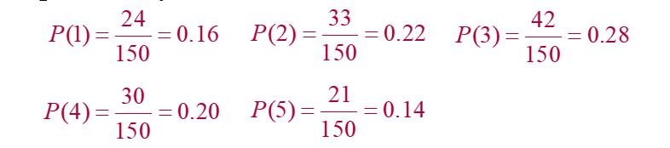
Chapter
04
Solution: Constructing a Discrete Probability Distribution
Divide the frequency of each score by the total number of individuals in the study to find the probability for each value of the random variable.
Discrete probability distribution:
x | 1 | 2 | 3 | 4 | 5
P(x) | 0.16 | 0.22 | 0.28 | 0.20 | 0.14

Slide 13
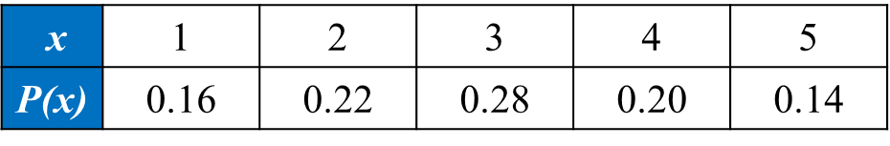
Chapter
04
Solution: Constructing a Discrete Probability Distribution
This is a valid discrete probability distribution since
Each probability is between 0 and 1, inclusive,
0 ≤ P(x) ≤ 1
The sum of the probabilities equals 1,
ΣP(x) = 0.16 + 0.22 + 0.28 + 0.20 + 0.14 = 1

Slide 14
Chapter
04
Constructing a Discrete Probability Distribution
Histogram
Because the width of each bar is one, the area of each bar is equal to the probability of a particular outcome.

Slide 15
Chapter
04
Mean, Variance and standard deviation
for probability Distribution
Mean of a discrete probability distribution μ = ΣxP(x)
Each value of x is multiplied by its corresponding probability and the products are added. Also, mean is known as ( Expected Value ).
Variance of a discrete probability distribution σ² = Σ(x – μ)²P(x)
Standard deviation of a discrete probability distribution

Slide 16
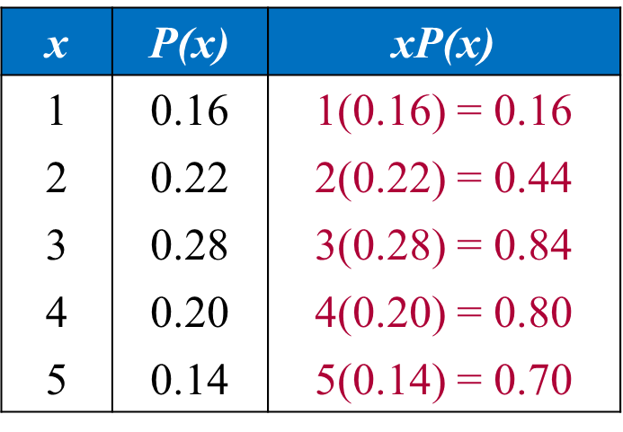
Chapter
04
Example
The probability distribution for the personality inventory test for passive-aggressive traits is given.
Find the mean ( Expected value)
Find Variance and Standard deviation
Solution:
μ = ΣxP(x) = 2.94

Slide 17
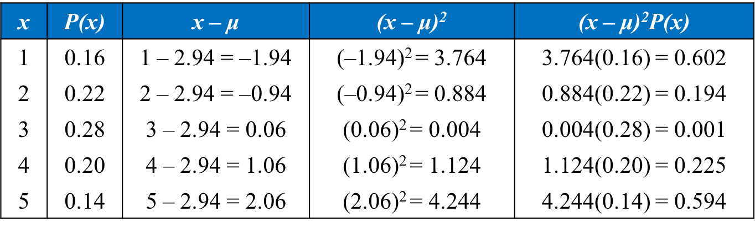
Chapter
04
Mean, Variance and standard deviation
Variance
σ² = Σ(x – μ)²P(x) = 1.616
standard deviation

Slide 18
Chapter
04
Section 4.2 Objectives
Determine if a probability experiment is a binomial experiment
Find binomial probabilities using the binomial probability formula
Find binomial probabilities using technology and a binomial table
Graph a binomial distribution
Find the mean, variance, and standard deviation of a binomial probability distribution

Slide 19
Chapter
04
Binomial Experiments
The experiment is repeated for a fixed number of trials, where each trial is independent of other trials.
There are only two possible outcomes of interest for each trial. The outcomes can be classified as a success (S) or as a failure (F).
The probability of a success P(S) is the same for each trial.
The random variable x counts the number of successful trials.

Slide 20
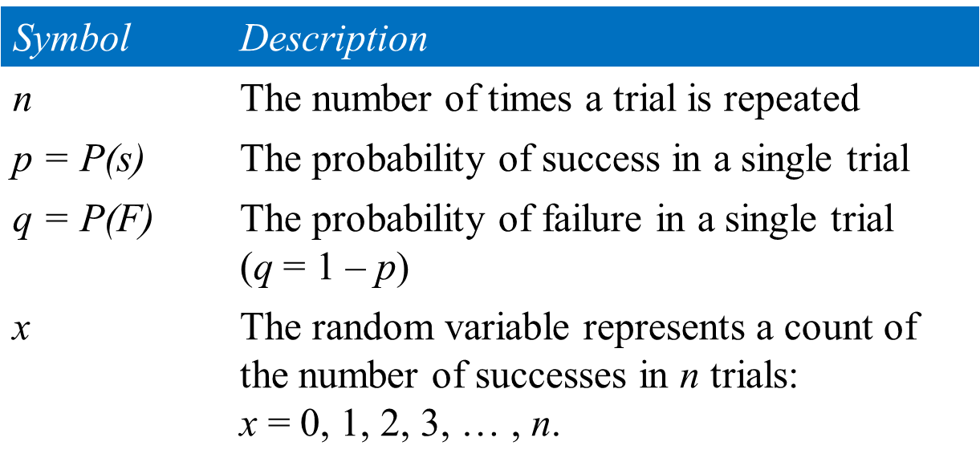
Chapter
04
Notation for Binomial Experiments

Slide 21
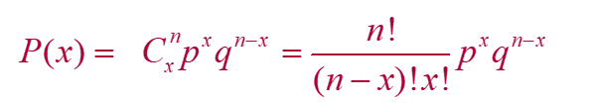
Chapter
04
Binomial Probability Formula
Binomial Probability Formula
The probability of exactly x successes in n trials is
n = number of trials
p = probability of success
q = 1 – p probability of failure
x = number of successes in n trials

Slide 22
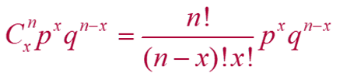
Chapter
04
Example:
Microfracture knee surgery has a 75% chance of success on patients with degenerative knees. The surgery is performed on three patients. Find the probability of the surgery being successful on exactly two patients.
Solution:
n=3 p= 75% = 0.75 q = 1- 0.75 = 0.25

Slide 23
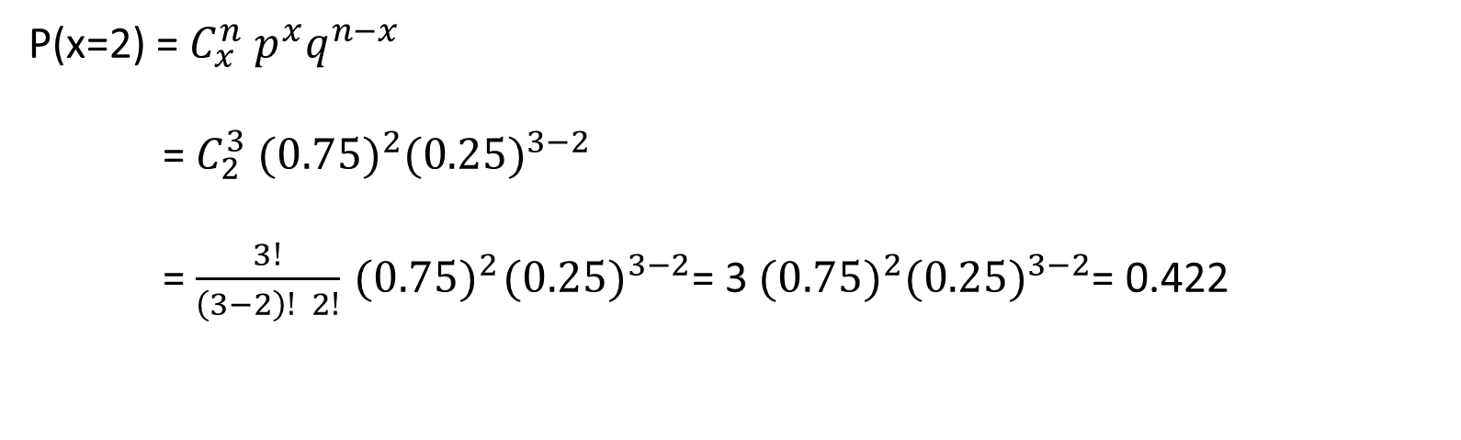
Chapter
04
Solution of Example
P(x=2) = $C_{x}^{n}{ p}^{x}q^{n−x}$
= $C_{2}^{3}{ (0.75)}^{2}{(0.25)}^{3−2}$
= $\frac{3!}{\left(3−2\right)! 2!}{ (0.75)}^{2}{(0.25)}^{3−2}$= 3${ (0.75)}^{2}{(0.25)}^{3−2}$= 0.422

Slide 24
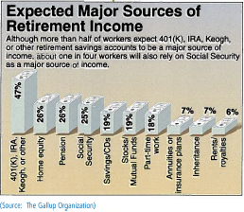
Chapter
04
Example
In a survey, workers in the U.S. were asked to name their expected sources of retirement income. Seven workers who participated in the survey are randomly selected and asked whether they expect to rely on Social Security for retirement income and found it equal to 25%. Create a binomial probability distribution for the all values.

Slide 25
Chapter
04
Solution
25% of working Americans expect to rely on Social Security for retirement income.
n = 7, p = 0.25, q = 0.75, x = 0, 1, 2, 3, 4, 5, 6, 7
P(x = 0) = ₇C₀(0.25)⁰(0.75)⁷ = 1(0.25)⁰(0.75)⁷ ≈ 0.1335
P(x = 1) = ₇C₁(0.25)¹(0.75)⁶ = 7(0.25)¹(0.75)⁶ ≈ 0.3115
P(x = 2) = ₇C₂(0.25)²(0.75)⁵ = 21(0.25)²(0.75)⁵ ≈ 0.3115
P(x = 3) = ₇C₃(0.25)³(0.75)⁴ = 35(0.25)³(0.75)⁴ ≈ 0.1730
P(x = 4) = ₇C₄(0.25)⁴(0.75)³ = 35(0.25)⁴(0.75)³ ≈ 0.0577
P(x = 5) = ₇C₅(0.25)⁵(0.75)² = 21(0.25)⁵(0.75)² ≈ 0.0115
P(x = 6) = ₇C₆(0.25)⁶(0.75)¹ = 7(0.25)⁶(0.75)¹ ≈ 0.0013
P(x = 7) = ₇C₇(0.25)⁷(0.75)⁰ = 1(0.25)⁷(0.75)⁰ ≈ 0.0001

Slide 26
Chapter
04
Example
A survey indicates that 41% of women in the U.S. consider reading their favorite leisure-time activity. You randomly select four U.S. women and ask them if reading is their favorite leisure-time activity. Find the probability that at least two of them respond yes.
Solution:
n = 4, p = 0.41, q = 0.59
At least two means two or more.
Find the sum of P(2), P(3), and P(4).

Slide 27
Chapter
04
Solution
P(x = 2) = ₄C₂(0.41)²(0.59)² = 6(0.41)²(0.59)² ≈ 0.351094
P(x = 3) = ₄C₃(0.41)³(0.59)¹ = 4(0.41)³(0.59)¹ ≈ 0.162654
P(x = 4) = ₄C₄(0.41)⁴(0.59)⁰ = 1(0.41)⁴(0.59)⁰ ≈ 0.028258
P(x ≥ 2) = P(2) + P(3) + P(4)
≈ 0.351094 + 0.162654 + 0.028258
≈ 0.542

Slide 28
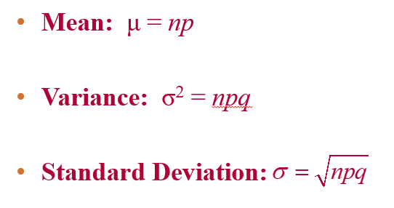
Chapter
04
Mean, Variance and standard deviation for Binomial Distribution

Slide 29
Chapter
04
Example
In Pittsburgh, Pennsylvania, about 56% of the days in a year are cloudy. Find the mean, variance, and standard deviation for the number of cloudy days during the month of June. (Source: National Climatic Data Center)
Solution: n = 30, p = 0.56, q = 0.44
Mean: μ = np = 30∙0.56 = 16.8
Variance: σ² = npq = 30∙0.56∙0.44 ≈ 7.4
Standard Deviation:

Slide 30
Chapter
04
4.3 More Discrete Probability Distributions
Find probabilities using the geometric distribution
Find probabilities using the Poisson distribution

Slide 31
Chapter
04
Geometric distribution
Geometric distribution
A discrete probability distribution.
Satisfies the following conditions:
  1- A trial is repeated until a success occurs.
  2- The repeated trials are independent of each other.
  3- The probability of success p is constant for each trial.
4- The probability that the first success will occur on trial x is
P(x) = p(q)^{x – 1}, where q = 1 – p.

Slide 32
Chapter
04
Example
From experience, you know that the probability that you will make a sale on any given telephone call is 0.23. Find the probability that your first sale on any given day will occur on your fourth or fifth sales call.
Solution:
P(sale on fourth or fifth call) = P(4) + P(5)
Geometric with p = 0.23, q = 0.77, x = 4, 5

Slide 33
Chapter
04
Solution
P(4) = 0.23(0.77)^{4–1} ≈ 0.105003
P(5) = 0.23(0.77)^{5–1} ≈ 0.080852
P(sale on fourth or fifth call) = P(4) + P(5)
≈ 0.105003 + 0.080852
≈ 0.186

Slide 34
Chapter
04
Poisson distribution
A discrete probability distribution.
Satisfies the following conditions:
  The experiment consists of counting the number of times an event, x, occurs in a given interval.
  The interval can be an interval of time, area, or volume.
  The probability of the event occurring is the same for each interval.
  The number of occurrences in one interval is independent of the number of occurrences in other intervals.

Slide 35
Chapter
04
Poisson distribution
Conditions continued:
  The probability of the event occurring is the same for each interval.
The probability of exactly x occurrences in an interval is
where e ≈ 2.71818 and μ is the mean number of occurrences

Slide 36
Chapter
04
Example
The mean number of accidents per month at a certain intersection is 3. What is the probability that in any given month four accidents will occur at this intersection?

Slide 37
Chapter
04
Solution
Solution:
Poisson with x = 4, μ = 3

Slide 38
Chapter
03
Chapter Summary
Mean of a discrete probability distribution = Expected value = μ = ΣxP(x)
Variance of a discrete probability distribution σ² = Σ(x – μ)²P(x)
Standard deviation of a discrete probability distribution

Slide 39
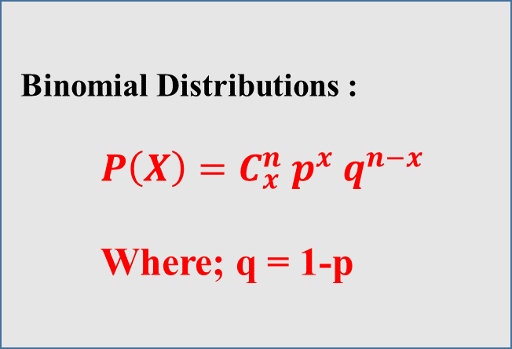
Chapter
03
Chapter Summary
Binomial Distributions :
$P\left(X\right)=C_{x}^{n} p^{x} q^{n−x}$
Where; q = 1-p

Slide 40
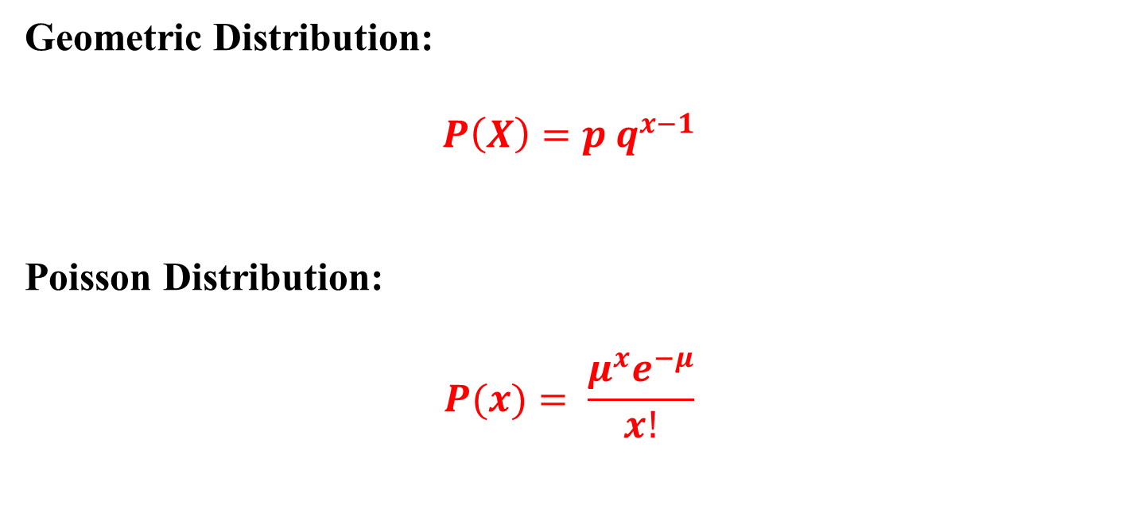
Chapter
04
Chapter Summary
Geometric Distribution:
$$P\left(X\right)=p q^{x−1}$$
Poisson Distribution:
$$P(x)= \frac{μ^{x}e^{−μ}}{x!}$$

