Slide 1

Project Fundamentals
Understanding the work at hand
Chapter 2
Everyone’s Smart
University
PMG511
Project Leadership
Dr.Sara Adel

Slide 2

Learning Outcomes:
2.1 What is a Project?
2.2 Project Life Cycle and the project Phases.
2.3 Organizational Structure.
2.5 Process Models.
2.6 Quality Project.
2.7 Project Outcomes.
2.8 Summary and Conclusions.
2.9 Self Assessment.
Dr.Sara Adel
Notes:
Corresponds to chapter 2, pages 25-77 of the Project Team Leadership and Communication book. ISBN: 9781732378902 (Softcover), 9781732378919 (Hardcover). These slides may only be posted or used in conjunction with the book in a training or classroom environment. Key terms (pages 74-75) are often italicized on the slides.
Outline:
What is a Project
Project Phases
Project Functions
Projects can Vary in Size and Scale
Organizational Structures
Functional
Project-Focused
Matrix
Organizational Values and Needs
Process
Plan-focused model
Cyclical model
Change-focused model
Quality
Project Quality
Product and Process Quality
Quality as a Balancing Act
The Project Triangle
Project Outcomes (The Layered Approach)
Goals, Scope Statements, Requirements/Specifications
Project Kickoff Meeting
Project Plan
Summary and Conclusion
Learning Objectives
2.1 What is a Project?
Define 'project,' identifying 2 defining features
List 4 project phases and 1 additional element
Recognize the interactions between projects/phases and the product lifecycle
2.2 The Project Environment
Identify 3 types of organizations in the context of how projects are organized
Recognize strengths and weaknesses of each of the 3 organizational types
2.3 Values, Needs, and Process
Recall factors influencing the values and needs of a project, team, or organization
List 3 fundamental process models and summarize the strengths and weaknesses of each
Recognize varying levels of detail/abstraction in documented processes
2.4 Quality and The Project Triangle
Define 'quality,' identifying 4 main aspects/concerns
Give examples of elements that are 'cost of quality' and 'cost of poor quality' in a project
Label the project triangle's 4 components
Relate examples of each project triangle component and the relationships between them
2.5 Defining Project Outcomes: A Layered Approach
Relate the concept of project goals, including examples of such
Relate the concept of project scope statements, including examples of such
Relate the concept of project requirements/specifications, including examples of such
Describe ‘the layered approach’ to project outcome definition
2.6 The Project’s Early Stages
Identify the primary objectives of a project kickoff meeting
List the essential elements of a basic project plan
2.7 Chapter Tool: Planning Project Quality
Relate basic steps for determining a project’s quality objectives
Associated Class Activities: (Separate Slides)
One Product, Multiple Projects (10 minutes, section 2.1)
Propose multiple projects within a single product’s life cycle
Organizational Culture and Structure (10 minutes, sections 1.5 and 2.2)
Analyze the cultural norms and organizational structures of multiple industries
‘Rolling Your Own’ Process (10-15 minutes, section 2.3)
Analyze a scenario and construct a basic process
Understanding Quality (10-15 minutes, section 2.4)
Develop scenario-specific quality-related elements of consideration
Layering Project Outcomes (10-15 minutes, section 2.5)
Construct scenario-specific goals, scope statements, and specifications/requirements
Outlining the Project Plan (10-15 minutes, section 2.6)
Design a project plan outline

Slide 3
2.1 What is a Project?
Dr.Sara Adel
Notes:
Corresponds to section 2.1, pages 25-30 of the Project Team Leadership and Communication book.

Slide 4

What is a Project?
Project based on a business need or opportunity.
Often explored and initiated by the Project Sponsor(s), who writes or approves the Project Charter.
Has the following features:
  A defined beginning and end.
  Unique goals and outcomes.
  Typically requires team members with varied skills.
Contrasts with Operational Work, which is repetitive ‘business as usual’
Dr.Sara Adel
Notes:
Corresponds to section 2.1, pages 25-30 of the Project Team Leadership and Communication book.

Slide 5
2.2 Project Life Cycle and the project Phases
Dr.Sara Adel
Notes:
Corresponds to chapter 2, pages 25-77 of the Project Team Leadership and Communication book. ISBN: 9781732378902 (Softcover), 9781732378919 (Hardcover). These slides may only be posted or used in conjunction with the book in a training or classroom environment. Key terms (pages 74-75) are often italicized on the slides.
Outline:
What is a Project
Project Phases
Project Functions
Projects can Vary in Size and Scale
Organizational Structures
Functional
Project-Focused
Matrix
Organizational Values and Needs
Process
Plan-focused model
Cyclical model
Change-focused model
Quality
Project Quality
Product and Process Quality
Quality as a Balancing Act
The Project Triangle
Project Outcomes (The Layered Approach)
Goals, Scope Statements, Requirements/Specifications
Project Kickoff Meeting
Project Plan
Summary and Conclusion
Learning Objectives
2.1 What is a Project?
Define 'project,' identifying 2 defining features
List 4 project phases and 1 additional element
Recognize the interactions between projects/phases and the product lifecycle
2.2 The Project Environment
Identify 3 types of organizations in the context of how projects are organized
Recognize strengths and weaknesses of each of the 3 organizational types
2.3 Values, Needs, and Process
Recall factors influencing the values and needs of a project, team, or organization
List 3 fundamental process models and summarize the strengths and weaknesses of each
Recognize varying levels of detail/abstraction in documented processes
2.4 Quality and The Project Triangle
Define 'quality,' identifying 4 main aspects/concerns
Give examples of elements that are 'cost of quality' and 'cost of poor quality' in a project
Label the project triangle's 4 components
Relate examples of each project triangle component and the relationships between them
2.5 Defining Project Outcomes: A Layered Approach
Relate the concept of project goals, including examples of such
Relate the concept of project scope statements, including examples of such
Relate the concept of project requirements/specifications, including examples of such
Describe ‘the layered approach’ to project outcome definition
2.6 The Project’s Early Stages
Identify the primary objectives of a project kickoff meeting
List the essential elements of a basic project plan
2.7 Chapter Tool: Planning Project Quality
Relate basic steps for determining a project’s quality objectives
Associated Class Activities: (Separate Slides)
One Product, Multiple Projects (10 minutes, section 2.1)
Propose multiple projects within a single product’s life cycle
Organizational Culture and Structure (10 minutes, sections 1.5 and 2.2)
Analyze the cultural norms and organizational structures of multiple industries
‘Rolling Your Own’ Process (10-15 minutes, section 2.3)
Analyze a scenario and construct a basic process
Understanding Quality (10-15 minutes, section 2.4)
Develop scenario-specific quality-related elements of consideration
Layering Project Outcomes (10-15 minutes, section 2.5)
Construct scenario-specific goals, scope statements, and specifications/requirements
Outlining the Project Plan (10-15 minutes, section 2.6)
Design a project plan outline

Slide 6

Project Life Cycle and the project Phases
Most projects need to be broken down into a logical sequence of ‘phases’, known as The project life cycle.
A project life cycle is a collection of project phases that defines:
  What work will be performed in each phase?
  What deliverables will be produced and when?
  Who is involved in each phase?
  How management will control and approve work produced in each phase?
A deliverable is a product or service produced or provided as part of a project.
Dr.Sara Adel
Notes:
Corresponds to chapter 2, pages 25-77 of the Project Team Leadership and Communication book. ISBN: 9781732378902 (Softcover), 9781732378919 (Hardcover). These slides may only be posted or used in conjunction with the book in a training or classroom environment. Key terms (pages 74-75) are often italicized on the slides.
Outline:
What is a Project
Project Phases
Project Functions
Projects can Vary in Size and Scale
Organizational Structures
Functional
Project-Focused
Matrix
Organizational Values and Needs
Process
Plan-focused model
Cyclical model
Change-focused model
Quality
Project Quality
Product and Process Quality
Quality as a Balancing Act
The Project Triangle
Project Outcomes (The Layered Approach)
Goals, Scope Statements, Requirements/Specifications
Project Kickoff Meeting
Project Plan
Summary and Conclusion
Learning Objectives
2.1 What is a Project?
Define 'project,' identifying 2 defining features
List 4 project phases and 1 additional element
Recognize the interactions between projects/phases and the product lifecycle
2.2 The Project Environment
Identify 3 types of organizations in the context of how projects are organized
Recognize strengths and weaknesses of each of the 3 organizational types
2.3 Values, Needs, and Process
Recall factors influencing the values and needs of a project, team, or organization
List 3 fundamental process models and summarize the strengths and weaknesses of each
Recognize varying levels of detail/abstraction in documented processes
2.4 Quality and The Project Triangle
Define 'quality,' identifying 4 main aspects/concerns
Give examples of elements that are 'cost of quality' and 'cost of poor quality' in a project
Label the project triangle's 4 components
Relate examples of each project triangle component and the relationships between them
2.5 Defining Project Outcomes: A Layered Approach
Relate the concept of project goals, including examples of such
Relate the concept of project scope statements, including examples of such
Relate the concept of project requirements/specifications, including examples of such
Describe ‘the layered approach’ to project outcome definition
2.6 The Project’s Early Stages
Identify the primary objectives of a project kickoff meeting
List the essential elements of a basic project plan
2.7 Chapter Tool: Planning Project Quality
Relate basic steps for determining a project’s quality objectives
Associated Class Activities: (Separate Slides)
One Product, Multiple Projects (10 minutes, section 2.1)
Propose multiple projects within a single product’s life cycle
Organizational Culture and Structure (10 minutes, sections 1.5 and 2.2)
Analyze the cultural norms and organizational structures of multiple industries
‘Rolling Your Own’ Process (10-15 minutes, section 2.3)
Analyze a scenario and construct a basic process
Understanding Quality (10-15 minutes, section 2.4)
Develop scenario-specific quality-related elements of consideration
Layering Project Outcomes (10-15 minutes, section 2.5)
Construct scenario-specific goals, scope statements, and specifications/requirements
Outlining the Project Plan (10-15 minutes, section 2.6)
Design a project plan outline

Slide 7



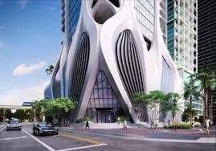

Project Life Cycle (PLC)
Different project managers or leaders choose different PLC’s, depending on the nature of the task i.e. Engineering, software development etc.
Dr.Sara Adel

Slide 8
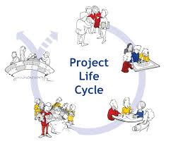
Project Phases
In the early phases of a project life cycle:
  Resource needs are usually lowest.
  The level of uncertainty (risk) is highest.
  Project stakeholders have the greatest opportunity to influence the project.
In the middle phases of a project life cycle:
  The certainty of completing a project increases.
  More resources are needed.
In the final phase of a project life cycle:
  The focus is on ensuring that project requirements were met.
  The sponsor approves completion of the project.
Dr.Sara Adel

Slide 9
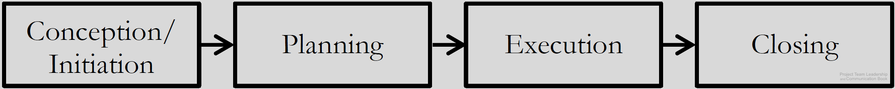
Project Phases:
Conception/Initiation Phase
  Research conducted, leadership chosen, goals and requirements established.
Planning Phase
  Detailed plans drafted and documented.
Execution Phase
  Plans are implemented, intended result of project takes shape.
Closing Phase
  Results handed off, lessons learned collected.
Dr.Sara Adel
Diagram: Malachowsky, Samuel. Project Team Leadership and Communication. Lintwood Press. 2018. p. 27.
Project Management Institute. A Guide to the Project Management Body of Knowledge – Fifth Edition. Project Management Institute Inc. p. 42. 2013.
Notes:
Corresponds to pages 27-28 of the Project Team Leadership and Communication book.

Slide 10
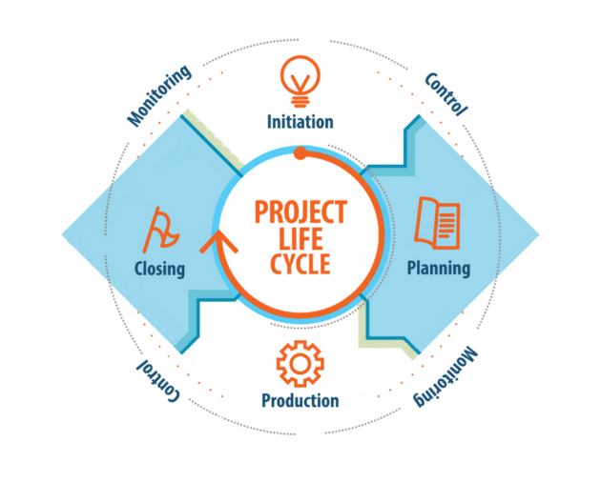
Dr.Sara Adel
Notes:
Corresponds to pages 27-28 of the Project Team Leadership and Communication book.

Slide 11
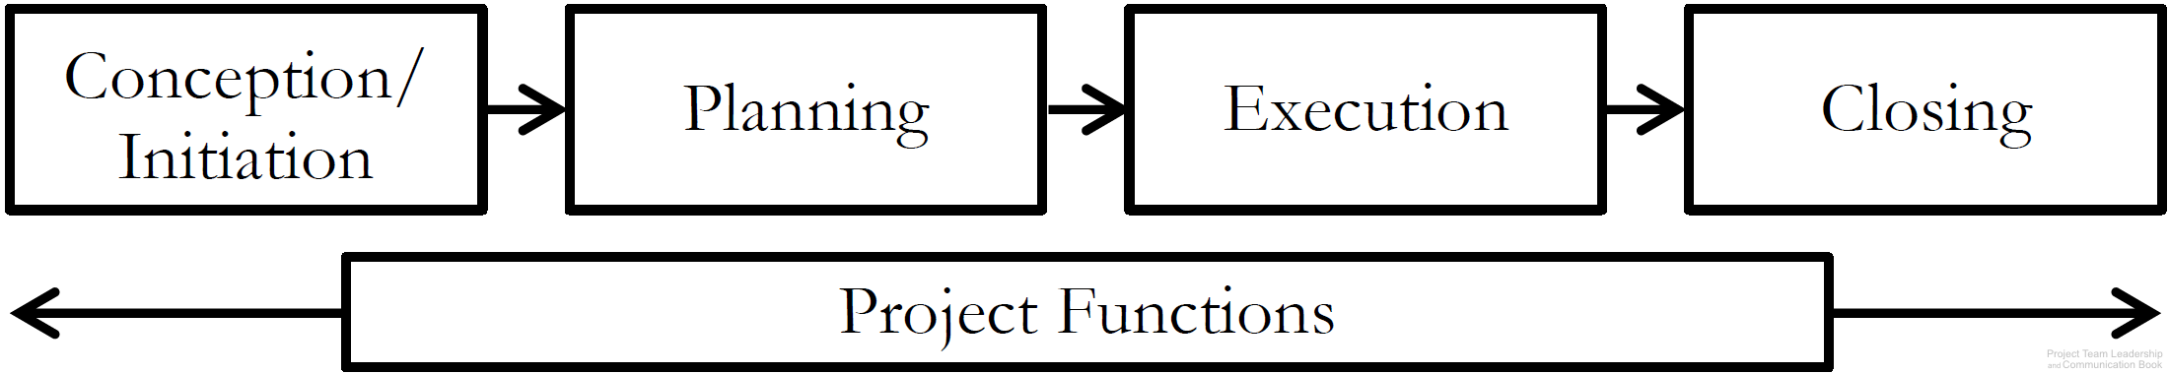

Project Functions
Unlike individual phases, Project Functions don’t occur at one point in time – they require continuous attention and/or action:
  Risk and Issue Management.
  Quality Management.
  Communications Management.
  Project Management itself!
Dr.Sara Adel
Diagram: Malachowsky, Samuel. Project Team Leadership and Communication. Lintwood Press. 2018. p. 28.
Project Management Institute. A Guide to the Project Management Body of Knowledge – Fifth Edition. Project Management Institute Inc. p. 42. 2013.
Notes:
Corresponds to pages 28-29 of the Project Team Leadership and Communication book.
Risk and issue management is covered in the book on page 97.
Quality Management/Assurance is covered in the book in this chapter, page 43.
Communications Management is the subject of chapter 5, pages 149-178.

Slide 12
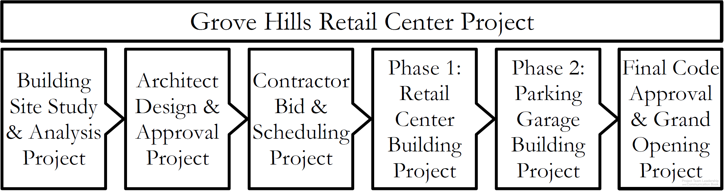
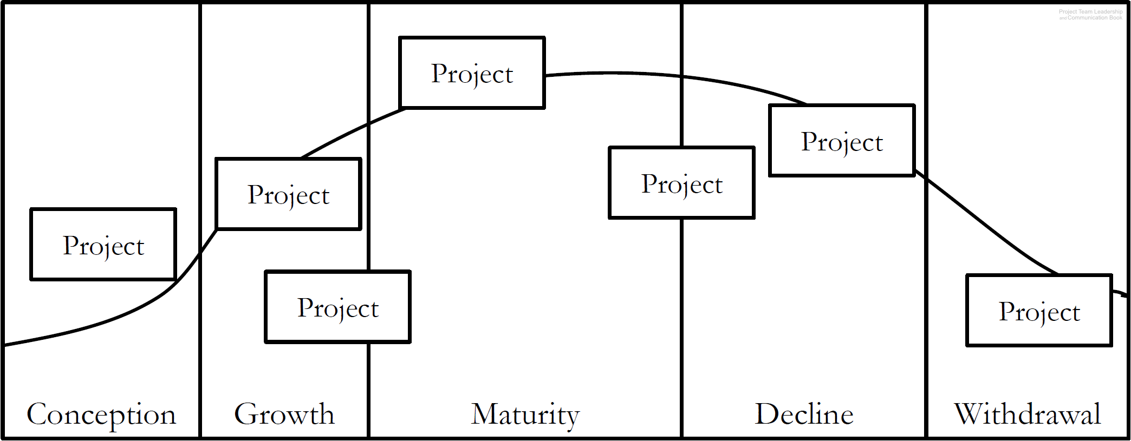
Projects Can Vary in Size and Scale
A large project can have multiple sub-projects
A project life cycle includes projects in every phase
Dr.Sara Adel
Diagrams: Malachowsky, Samuel. Project Team Leadership and Communication. Lintwood Press. 2018. p. 29, 30.
Project Management Institute. A Guide to the Project Management Body of Knowledge – Fifth Edition. Project Management Institute Inc. p. 42. 2013.
Notes:
Corresponds to pages 29-30 of the Project Team Leadership and Communication book.
Product life cycle project examples: Marketing, setting up machinery, ramping up production, etc.

Slide 13
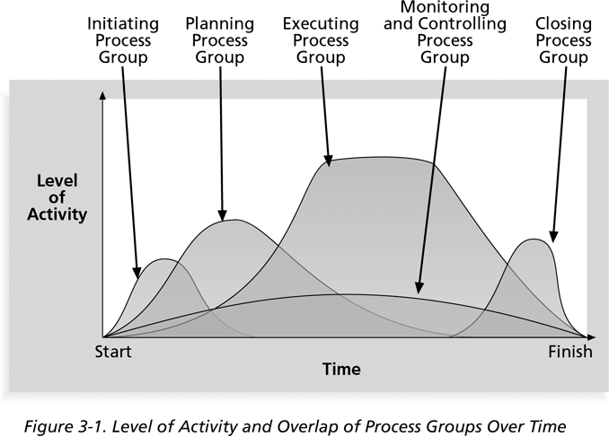
Level of Activity and Overlap of Process Groups Over Time during the project lifecycle
Dr.Sara Adel

Slide 14
Project Life Cycle
(PLC)
Dr.Sara Adel
Notes:
Corresponds to chapter 2, pages 25-77 of the Project Team Leadership and Communication book. ISBN: 9781732378902 (Softcover), 9781732378919 (Hardcover). These slides may only be posted or used in conjunction with the book in a training or classroom environment. Key terms (pages 74-75) are often italicized on the slides.
Outline:
What is a Project
Project Phases
Project Functions
Projects can Vary in Size and Scale
Organizational Structures
Functional
Project-Focused
Matrix
Organizational Values and Needs
Process
Plan-focused model
Cyclical model
Change-focused model
Quality
Project Quality
Product and Process Quality
Quality as a Balancing Act
The Project Triangle
Project Outcomes (The Layered Approach)
Goals, Scope Statements, Requirements/Specifications
Project Kickoff Meeting
Project Plan
Summary and Conclusion
Learning Objectives
2.1 What is a Project?
Define 'project,' identifying 2 defining features
List 4 project phases and 1 additional element
Recognize the interactions between projects/phases and the product lifecycle
2.2 The Project Environment
Identify 3 types of organizations in the context of how projects are organized
Recognize strengths and weaknesses of each of the 3 organizational types
2.3 Values, Needs, and Process
Recall factors influencing the values and needs of a project, team, or organization
List 3 fundamental process models and summarize the strengths and weaknesses of each
Recognize varying levels of detail/abstraction in documented processes
2.4 Quality and The Project Triangle
Define 'quality,' identifying 4 main aspects/concerns
Give examples of elements that are 'cost of quality' and 'cost of poor quality' in a project
Label the project triangle's 4 components
Relate examples of each project triangle component and the relationships between them
2.5 Defining Project Outcomes: A Layered Approach
Relate the concept of project goals, including examples of such
Relate the concept of project scope statements, including examples of such
Relate the concept of project requirements/specifications, including examples of such
Describe ‘the layered approach’ to project outcome definition
2.6 The Project’s Early Stages
Identify the primary objectives of a project kickoff meeting
List the essential elements of a basic project plan
2.7 Chapter Tool: Planning Project Quality
Relate basic steps for determining a project’s quality objectives
Associated Class Activities: (Separate Slides)
One Product, Multiple Projects (10 minutes, section 2.1)
Propose multiple projects within a single product’s life cycle
Organizational Culture and Structure (10 minutes, sections 1.5 and 2.2)
Analyze the cultural norms and organizational structures of multiple industries
‘Rolling Your Own’ Process (10-15 minutes, section 2.3)
Analyze a scenario and construct a basic process
Understanding Quality (10-15 minutes, section 2.4)
Develop scenario-specific quality-related elements of consideration
Layering Project Outcomes (10-15 minutes, section 2.5)
Construct scenario-specific goals, scope statements, and specifications/requirements
Outlining the Project Plan (10-15 minutes, section 2.6)
Design a project plan outline

Slide 15
1-Initiation Process
Dr.Sara Adel

Slide 16

1-Project Initiation :
Determine the nature and scope of the project. If this stage is not performed well, it is unlikely that the project will be successful in meeting the business’ needs.
The key project controls needed here are an understanding of the business environment and making sure that all necessary controls are incorporated into the project. Any deficiencies should be reported and a recommendation should be made to fix them.
Every organization has its own variations of what documents are required to initiate a project. It’s important to identify the project need, stakeholders, and main goals.
Dr.Sara Adel

Slide 17
Initiation Breakdown Process:
Select Project Manager.
Determine company culture and existing systems.
Collect processes, procedures and historical information.
Divide large projects into phases.
Identify stake-holders.
Document business need.
Determine project objectives.
Document assumptions and constraints.
Develop project charter.
Develop preliminary project scope statement.
Dr.Sara Adel

Slide 18
2-Planning process
Dr.Sara Adel

Slide 19

2- Project Planning
The main purpose of project planning is to guide execution.
To plan time, cost and resources adequately to estimate the work needed and to effectively manage risk during project execution. As with the Initiation process group, a failure to adequately plan greatly reduces the project's chances of successfully accomplishing its goals.
Every knowledge area includes planning information.
Key outputs included in the project include:
  A team contract.
  A scope statement.
  A work breakdown structure (WBS).
  A project schedule, in the form of a Gantt chart with all dependencies and resources entered.
  A list of risks (part of a risk register).
Dr.Sara Adel

Slide 20
Planning Breakdown process
Determine how you will do planning – part of management plans.
Create project scope statement.
Determine team.
Create activity list.
Create network diagram.
Estimate resource requirements.
Estimate time and cost.
Determine critical path.
Develop Schedule.
Developer budget.
Determine quality standards, processes and metrics.
Determine roles and responsibilities.
Determine communications requirements.
Risk identification, qualitative and quantitative risk analysis and response planning.
Determine what to purchase.
Prepare procurement documents.
Finalize the “how to execute and control” aspects of all management plans.
Create process improvement plan.
Gain formal approval.
Hold kick-off meeting.
Dr.Sara Adel

Slide 21
3-Execution process
Dr.Sara Adel

Slide 22
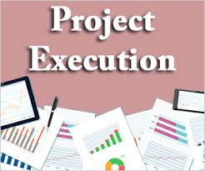
3- Project Executing
Project execution usually takes the most time and resources.
Executing consists of the processes used to complete the work defined in the project management plan to accomplish the project's requirements.
Execution process involves coordinating people and resources, as well as integrating and performing the activities of the project in accordance with the project management plan.
The deliverables are produced as outputs from the processes performed as defined in the project management plan.
Project managers must use their leadership skills to handle the many challenges that occur during project execution.
the executing processes and outputs. Many project sponsors and customers focus on deliverables related to providing the products, services, or results desired from the project.
Dr.Sara Adel

Slide 23
Execution Breakdown processes
Acquire final team.
Select Sellers.
Request seller responses.
Use work authorization system.
Hold progress meetings.
Give recognition and rewards.
Team building.
Follow processes.
Continuous improvement.
Implement approved changes, defect repair, preventive and corrective actions.
Send and receive information.
Recommend changes and corrective actions.
Complete product scope.
Execute the PM plan.
Dr.Sara Adel

Slide 24
4- Project Monitoring and Controlling process
Dr.Sara Adel

Slide 25

4- Project Monitoring and Controlling
Involves measuring progress toward project objectives, monitoring deviation from the plan, and taking corrective action to match progress with the plan.
Monitoring and controlling consists of those processes performed to observe project execution so that potential problems can be identified in a timely manner and corrective action can be taken, when necessary, to control the execution of the project.
The key benefit is that project performance which observed and measured regularly to identify variances from the project management plan.
Affects all other process groups and occurs during all phases of the project life cycle.
Outputs include performance reports, requested changes, and updates to various plans.
Dr.Sara Adel

Slide 26
Monitoring and controlling Breakdown processes
Measure against the performance measurement baselines.
Measure according to the management plans.
Determine variances and if they warrant corrective action or a change.
Scope verification.
Configuration management.
Recommend changes, defect repair, preventive and corrective actions.
Integrated change control.
Approve changes, defect repair, preventive and corrective actions.
Risk audits.
Use issue logs.
Facilitate conflict resolution.
Measure team member performance.
Report on performance.
Create forecasts.
Administer contracts.
Dr.Sara Adel

Slide 27
5-Project Closing process
Dr.Sara Adel

Slide 28
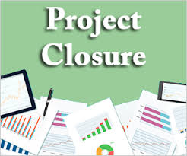
4- Project Closing
Closing includes the formal acceptance of the project and the ending. And also it include the administrative activities like archiving of the files and documenting lessons learned.
Involves gaining stakeholder and customer acceptance of the final products and services.
Even if projects are not completed, they should be formally closed in order to reflect on what can be learned to improve future projects.
Outputs include project archives and lessons learned, which are part of organizational process assets.
Most projects also include a final report and presentation to the sponsor or senior management.
Dr.Sara Adel

Slide 29
Closing Breakdown processes
Develop closure procedures.
Complete contract closure.
Confirm work is done to requirement.
Gain formal acceptance of the product.
Final performance reporting.
Index and archive records.
Update, lessons learned and knowledge base.
Release resources.
Dr.Sara Adel

Slide 30
Project Life Cycle - Ideal v Typical
Initiation Planning Execution and control Closing
Cost and staffing level
time
Dr.Sara Adel

Slide 31
Project Life Cycle - Ideal v Typical
The Red curve shows that the project is delayed in finishing.
The area under the curve represents the spend on the project – the red curve spent much more.
If the project is rushed, do you think that the quality if the outputs or deliverables will be good?
Dr.Sara Adel

Slide 32

Example of delayed Project:
Planned - 1959 to 1963 (4 years)
- $7 million
Actual - 1959 to 1973 (14 years)
- $100 million
The Opera House under construction in 1965.
Dr.Sara Adel

Slide 33
2.3 Organizational Structure
Dr.Sara Adel

Slide 34


What is organization?
Organization is the structural framework of duties and responsibilities required through a social unit of people, systematically structured and managed to meet a need or to pursue a commen and collective goals on a continuing basis.
Dr.Sara Adel

Slide 35
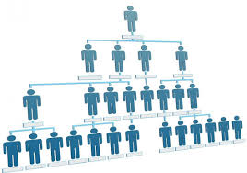
What is organization structure?
Is a system that outlines how certain activities are directed in order to achieve the goals of an organization. These activities can include rules, roles, and responsibilities.
Dr.Sara Adel

Slide 36

Why do we need organizational structure in a project?
To determines the relationships, functions and positions and subdivides and delegates roles, responsibilities and authority to carry out any defined tasks. It determines how information flows between levels within the company.
Dr.Sara Adel

Slide 37
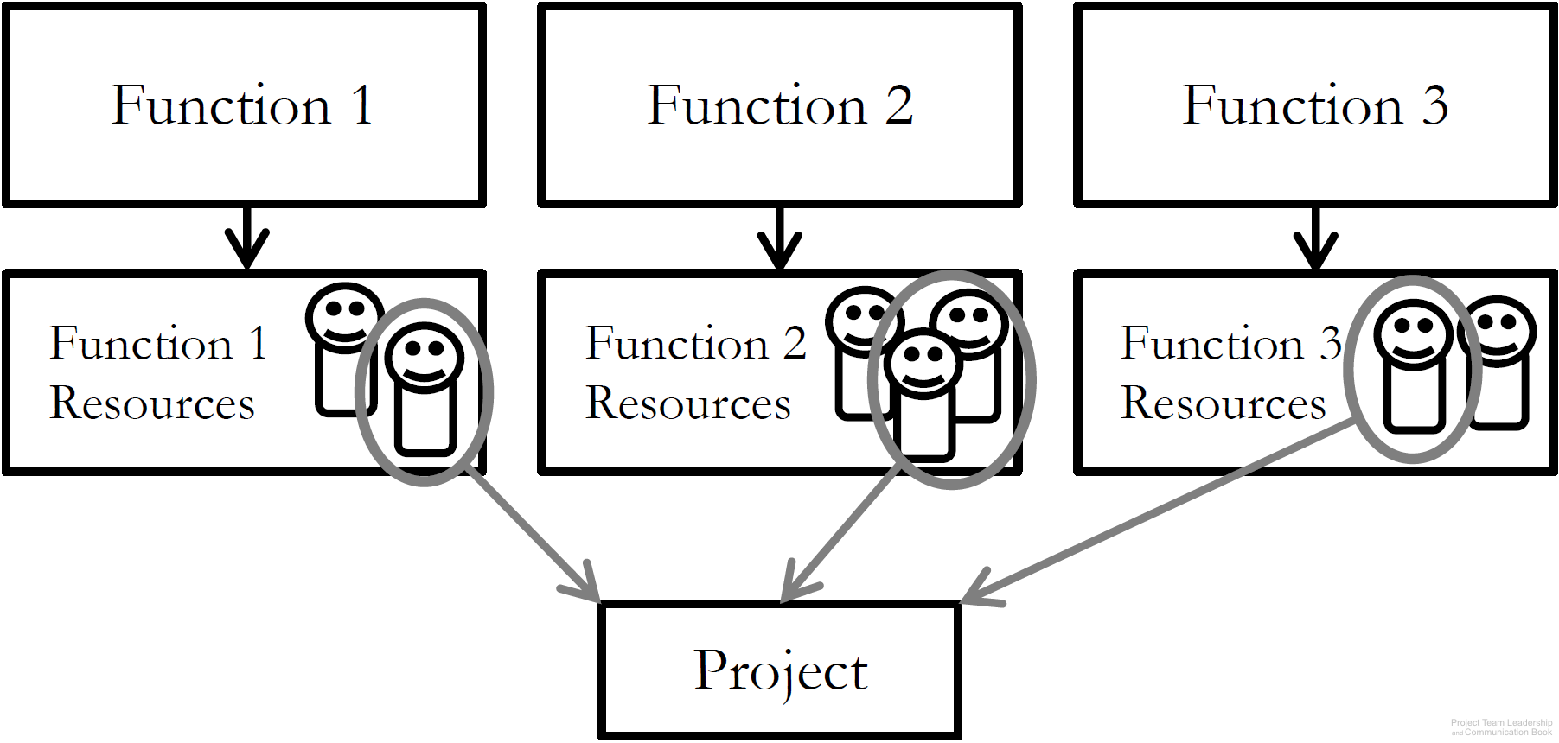
1-Functional Organizational Structure
‘Classic’ organizational structure
Organization made up of functional
‘silos’ (HR, Sales, Marketing, etc.)
Project teams consist of resources
from multiple departments
Strengths: resource redundancy
Weaknesses: resources don’t report to project leader, functional managers may not be supportive of project
Dr.Sara Adel
Diagram: Malachowsky, Samuel. Project Team Leadership and Communication. Lintwood Press. 2018. p. 31.
Project Management Institute. A Guide to the Project Management Body of Knowledge – Fifth Edition. Project Management Institute Inc. p. 21-22. 2013.
Notes:
Corresponds to pages 30-32 of the Project Team Leadership and Communication book.

Slide 38
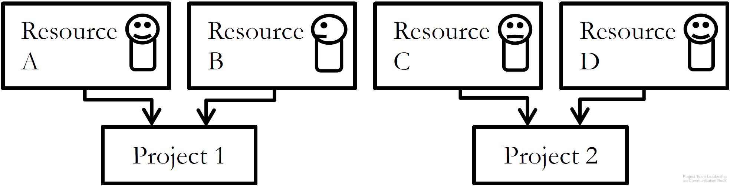
2- Project-Focused (Flattening) Organizational Structure
‘Flat’ organizational structure
Organization made of project
leads and resources, with few ‘layers’ (few management level).
Project teams consist of resources
specifically recruited/assigned to that project
Strengths: Autonomy/freedom/self-direction, no functional managers
Weaknesses: Resources are tempted to join other projects ‘jump ship’ to retain employment, projects must ‘stand on their own’, competition between projects for resources
Dr.Sara Adel
Diagram: Malachowsky, Samuel. Project Team Leadership and Communication. Lintwood Press. 2018. p. 33.
Project Management Institute. A Guide to the Project Management Body of Knowledge – Fifth Edition. Project Management Institute Inc. p. 21-22. 2013.
Notes:
Corresponds to pages 33-34 of the Project Team Leadership and Communication book.

Slide 39
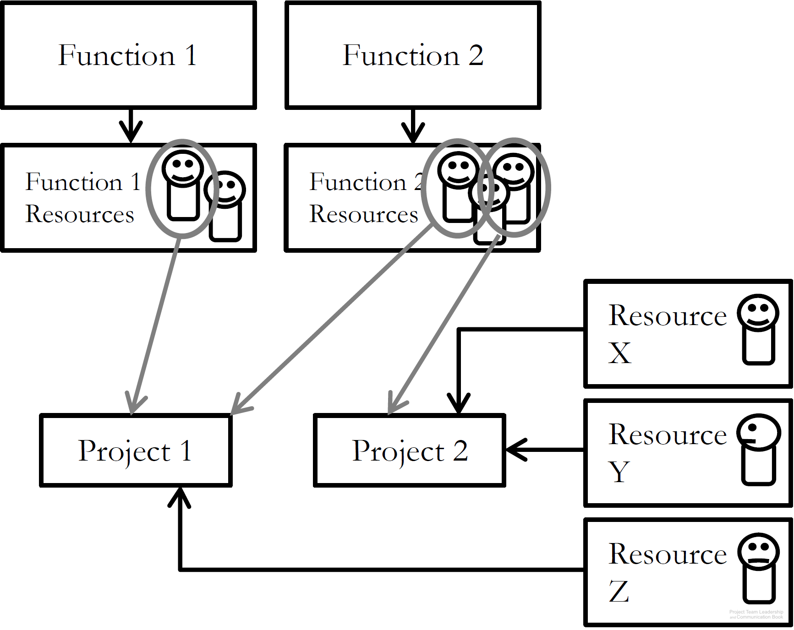
3- Matrix Organizational Structure
‘Strong’ or ‘weak’ matrix depending on ratio of Functional to Project-Focused aspects
Resources are often external contractors
Strengths: compatible with older, ‘classic’ orgs, can be adjusted as needed.
Weaknesses: some resources may feel more detached from project than others, significant increase in number of stakeholders.
Dr.Sara Adel
Diagram: Malachowsky, Samuel. Project Team Leadership and Communication. Lintwood Press. 2018. p. 35.
Project Management Institute. A Guide to the Project Management Body of Knowledge – Fifth Edition. Project Management Institute Inc. p. 21-22. 2013.
Notes:
Corresponds to pages 34-35 of the Project Team Leadership and Communication book.

Slide 40
2.4 Organizational Values and Needs
Dr.Sara Adel

Slide 41

Organizational Values and Needs
Similar to the concept of culture, organizations have defining characteristics:
  How customers are treated (input, visibility into inner workings)
  Risk tolerance and preferred schedule certainty
  Experience level of personnel and management
And these can highlight certain needs. For example:
  The need for extremely clear requirements/specifications vs. the need for stakeholder input .
  The need for a clear schedule vs. the need for a responsive project.
  The need for many or few project artifacts (documentation).
Dr.Sara Adel
Notes:
Corresponds to pages 36-37 of the Project Team Leadership and Communication book.
The next 3 slides cover 3 basic process structures each of which emphasize certain needs over others.

Slide 42
2.5 Process Models
Dr.Sara Adel

Slide 43

Process in Organizations
Process are actually much less abstract (they’re more exact) in organizations
It is the “The project life cycle”.
Dr.Sara Adel
Notes:
Corresponds to pages 42-43 of the Project Team Leadership and Communication book.

Slide 44
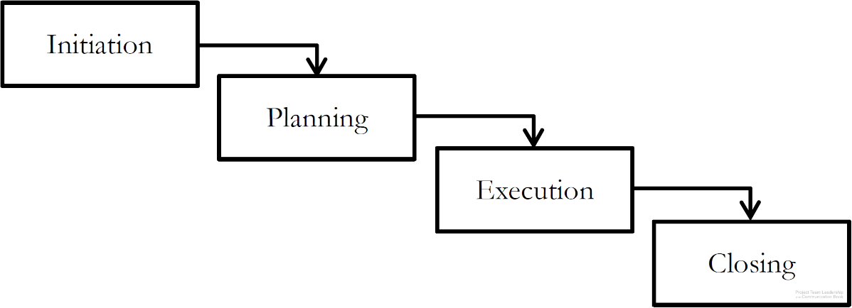
1-Plan-Focused Process Models
Each step must be
completely done before
the next can be begun
Plans are made for each step, then
executed ‘waterfall’ style
Strengths: high, schedule certainty, easy to understand, straightforward, time-tested
Weaknesses: does not handle uncertainty/change well, stakeholder visibility can be poor (only changes of phase)
Dr.Sara Adel
Diagram: Malachowsky, Samuel. Project Team Leadership and Communication. Lintwood Press. 2018. p. 37.
Project Management Institute. A Guide to the Project Management Body of Knowledge – Fifth Edition. Project Management Institute Inc. p. 44-46. 2013.
Notes:
Corresponds to pages 37-38 of the Project Team Leadership and Communication book.
The book (page 38) and website contain additional diagrams such as a ‘sub-projects’ illustration and a standardized (between the three types) graphic of strengths and weaknesses.

Slide 45
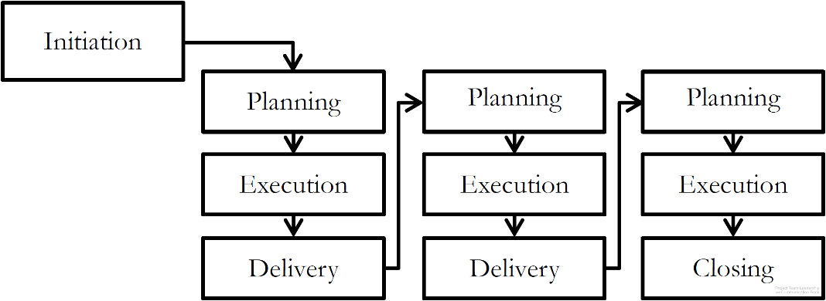
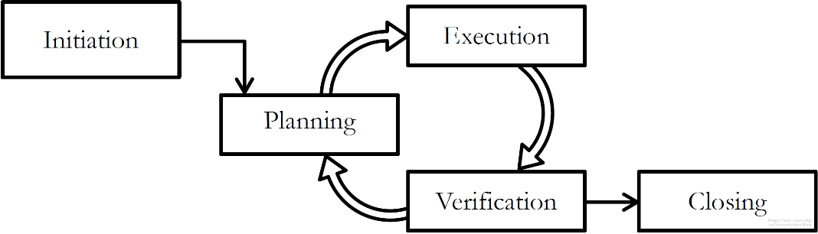
2- Cyclical Process Models
Projects cycle through delivery or feedback phases
Plans are made a little-at-a-time
Strengths: stakeholder visibility is often higher than Plan-Focused
Weaknesses: can be difficulty to know when to stop, requires strong disciplined leadership or can get out of control
Incremental Process Model
Iterative Process Model
Dr.Sara Adel
Diagrams: Malachowsky, Samuel. Project Team Leadership and Communication. Lintwood Press. 2018. p. 39.
Project Management Institute. A Guide to the Project Management Body of Knowledge – Fifth Edition. Project Management Institute Inc. p. 44-46. 2013.
Notes:
Corresponds to pages 38-40 of the Project Team Leadership and Communication book.
The book (page 40) and website contain an additional diagram, a standardized (between the three types) graphic of strengths and weaknesses.

Slide 46
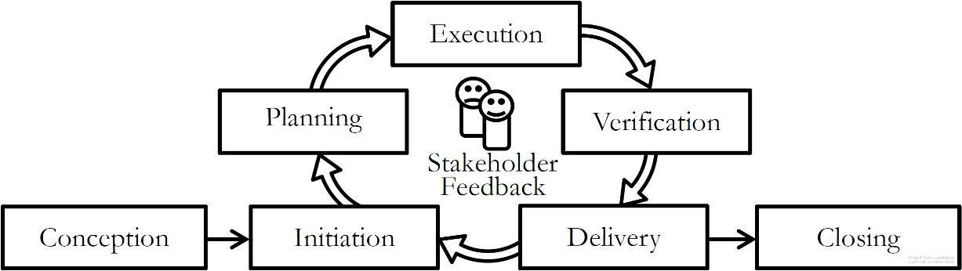
3- Change-Focused Process Models
Responsiveness to change and
stakeholder input is the most
important aspect
Similar to Cyclical Process Models
Requires experienced, disciplined leaders and team members
Strengths: stakeholder visibility is high (they’re consulted frequently), responds well to changing market conditions or circumstances
Weaknesses: can ‘go on forever’ if stakeholders are uncertain or conditions keep changing, requires frequent customer interactions
Dr.Sara Adel
Diagram: Malachowsky, Samuel. Project Team Leadership and Communication. Lintwood Press. 2018. p. 40.
Project Management Institute. A Guide to the Project Management Body of Knowledge – Fifth Edition. Project Management Institute Inc. p. 44-46. 2013.
Notes:
Corresponds to pages 40-41 of the Project Team Leadership and Communication book.
The book (page 41) and website contain an additional diagram, a standardized (between the three types) graphic of strengths and weaknesses.
The appendix of the book (Agile: The Future of Projects?, pages 195-222) covers the most well-known change focused process models: Agile/Scrum.

Slide 47
2.6 Quality Project
Dr.Sara Adel

Slide 48
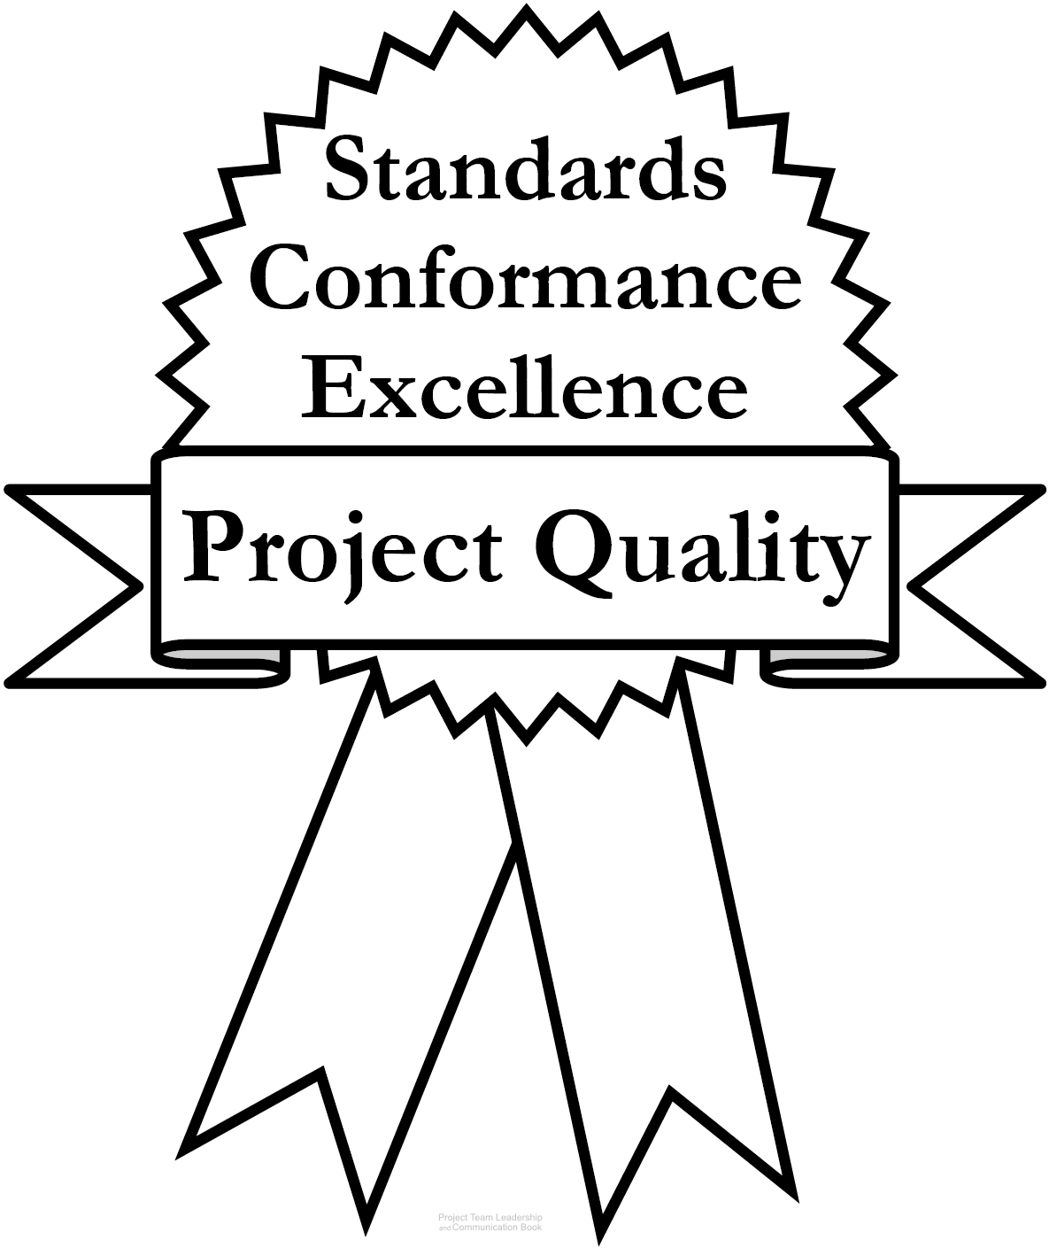
Project Quality
Quality is hard to define; most agree there are
three main aspects:
  Standards defined by the industry, organization, or team.
  Conformance to the requirements, specifications, and
  commitments inherent to the project.
  Excellence, the need to go beyond strictly meeting basic
  requirements/specifications. Thinking about elements such
  as the user’s perspective, maintenance, long-term cost, etc.
A fourth element can’t be ignored, though:
  Perception – do stakeholders have an appropriate, well-informed view of the project? Are communications appropriate? Is the team acting professionally?
Diagram: Malachowsky, Samuel. Project Team Leadership and Communication. Lintwood Press. 2018. p. 44.
Crosby, P.B. Completeness: Quality for the 21st century. Plume. p. 45. 1992.
Dr.Sara Adel
Notes:
Corresponds to pages 43-45 of the Project Team Leadership and Communication book.
The chapter tool, entitled Planning Project Quality includes a step-by-step process for determining what aspects of quality are important to a project or organization. Elements from this are present on the next slide.

Slide 49
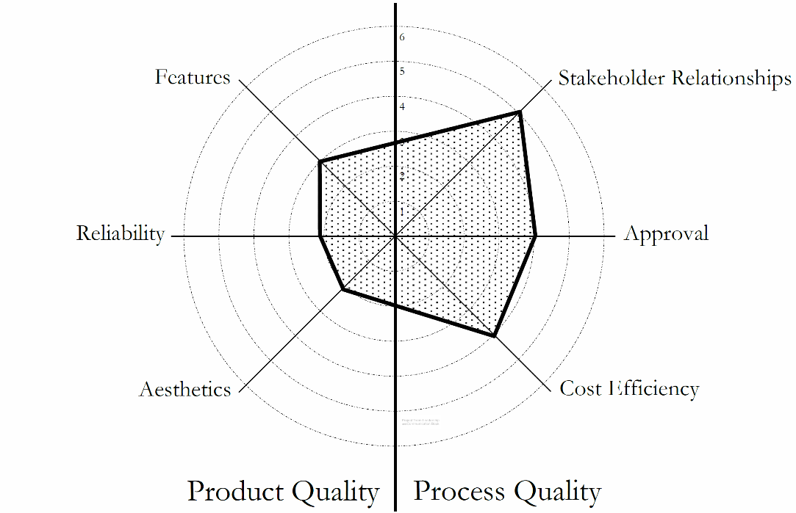
Product and Process Quality
Product Quality relates to what the project is trying to produce
  Examples include: Features, performance, durability, reliability, resources consumed
Process Quality relates to the team’s planning and execution of the project
  Examples include: Timeliness, safety, compliance, responsiveness to customer
Both must be addressed, balance must be achieved
‘Radar Chart’ Showing Balance/Prioritization of Quality in a Project
Dr.Sara Adel
Diagram: Malachowsky, Samuel. Project Team Leadership and Communication. Lintwood Press. 2018. p. 71.
Notes:
Corresponds to section 2.7, pages 69-72 of the Project Team Leadership and Communication book.

Slide 50
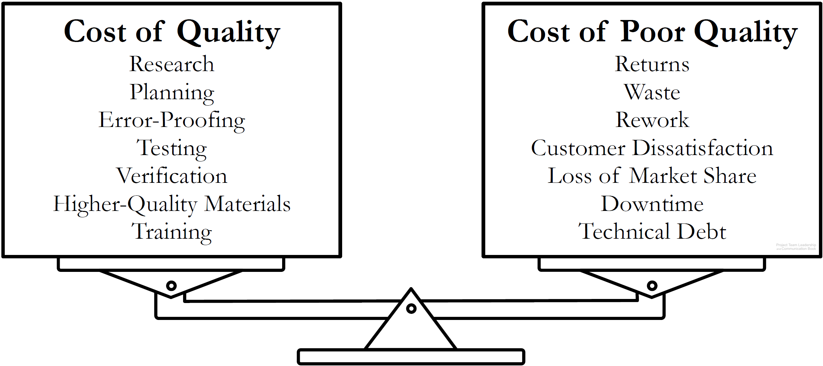
Quality is a Balancing Act
Projects must balance the cost of quality with the cost of poor quality.
Determining where that balance lies requires teams to think about future implications of their actions.
Diagram: Malachowsky, Samuel. Project Team Leadership and Communication. Lintwood Press. 2018. p. 46.
Feigenbaum, Armand V. Total Quality Control, Harvard Business Review November 1956, p. 34.
Dr.Sara Adel
Notes:
Corresponds to pages 45-46 of the Project Team Leadership and Communication book.
The chapter tool, entitled Planning Project Quality includes a step-by-step process for determining what aspects of quality are important to a project or organization.
Technical debt is explained on page 46.

Slide 51
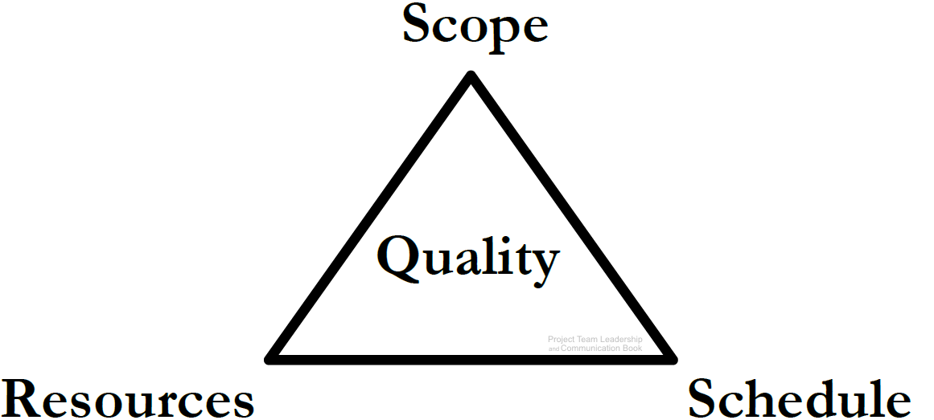
Projects are a Balancing Act, The Project Triangle
Resources: The budget, materials, wages, etc.
Schedule: The time expended.
Scope: What is and isn’t included in the project outcomes.
Quality: can relate to any or all of the three.
Balance: More scope requires more resources, more schedule, or both. Faster project means less scope/more resources, etc.
Dr.Sara Adel
Diagram: Malachowsky, Samuel. Project Team Leadership and Communication. Lintwood Press. 2018. p. 46.
Notes:
Corresponds to pages 46-50 of the Project Team Leadership and Communication book.

Slide 52
2.7 Project Outcomes
Dr.Sara Adel

Slide 53
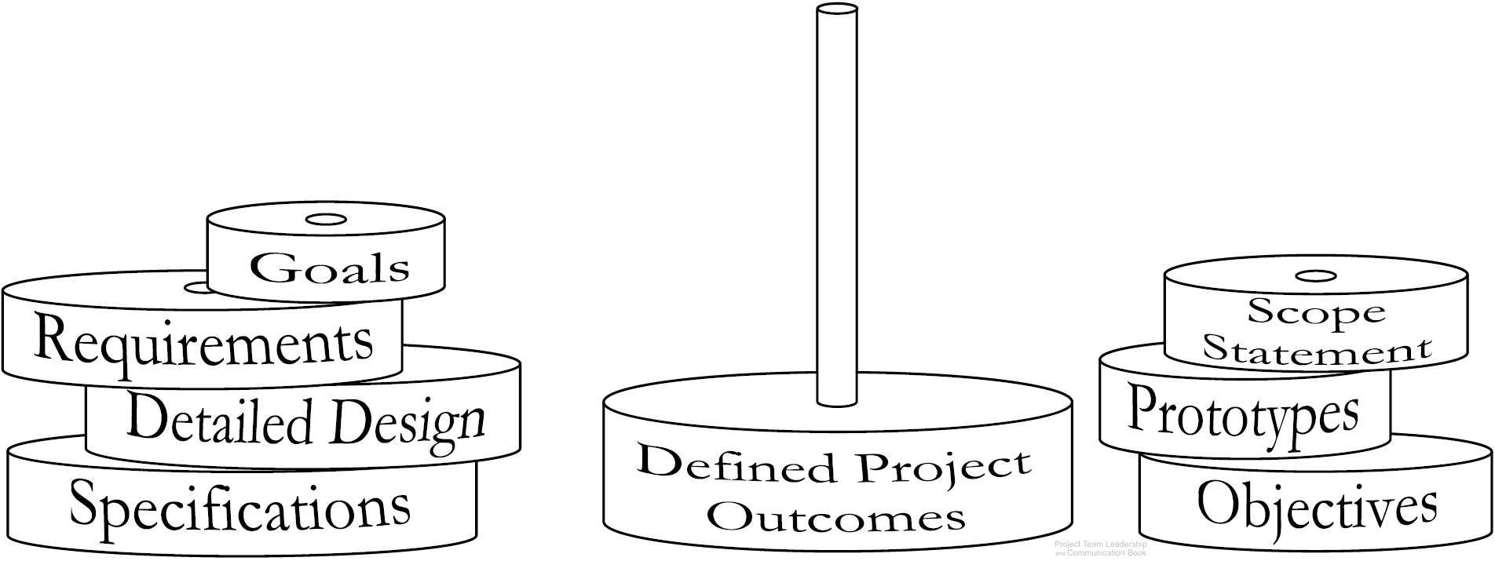
Defining Project Outcomes
Defining the projects outcomes, or deliverables often requires multiple artifacts (documents).
  Specific artifacts can vary by industry, organization, or team
Dr.Sara Adel
Diagram: Malachowsky, Samuel. Project Team Leadership and Communication. Lintwood Press. 2018. p. 59.
Notes:
Corresponds to section 2.5, pages 51-61 of the Project Team Leadership and Communication book.
The book (page 53) and website contain an additional diagram which illustrates the abstract to exact nature of defining artifacts.
The next slide contains three artifact types.

Slide 54

1- Project Goal Statements
Goals – The overarching outcomes of the project.
High-level: What the project is trying to achieve.
Measurable: It should be clear when the goal is or isn’t met.
Achievable: Within the capability of the resources/time available.
Dr.Sara Adel
Notes:
Corresponds to section 2.5, pages 51-61 of the Project Team Leadership and Communication book.
Goals, pages 51-53. Sample goals on page 52.

Slide 55

2- Project Scope Statements
Scope Statements – What is and isn’t included in the project?
A list of major deliverables.
A basic strategy.
Constraints, assumptions, and external dependencies.
Often in the form of paragraphs with ‘bullets’.
Dr.Sara Adel
Notes:
Corresponds to section 2.5, pages 51-61 of the Project Team Leadership and Communication book.
Scope Statements, pages 53-56. Sample scope statements on pages 55-56.

Slide 56

3- Project Requirements / Specifications
Requirements and/or Specifications – Details for what’s expected.
Non-ambiguous.
Reader should know exactly what’s needed.
Functional (the outcomes) and non-functional (limits such as schedule, safety, etc.)
Dr.Sara Adel
Notes:
Corresponds to section 2.5, pages 51-61 of the Project Team Leadership and Communication book.
Requirements and Specifications, pages 57-58. Sample requirements/specifications on page 57.

Slide 57
Project Kicking Off Meeting
The ‘Project Kickoff Meeting’ is designed to:
Establish the project and begin the work.
Introduce team members and stakeholders to each other, and define roles/responsibilities.
Share clear goals and objectives, define what success means to the team.
Choose/share tools, meeting times, etc.
Begin foundational work on the project plans.
Dr.Sara Adel
Notes:
Corresponds to pages 61-63 of the Project Team Leadership and Communication book.

Slide 58
2.8 Summary and Conclusions
Dr.Sara Adel

Slide 59
Summary and Conclusions
Projects are unique and time limited, and vary from organization to organization (size, length, etc.).
What is the project phases and project lifecycle?
Organizational structures, values, and needs have very significant effects on projects and how they’re carried out.
Quality (the cost of quality and the cost of poor quality) and the Project Triangle represent a constant give-and-take balancing act.
Project outcomes are defined in layers, which can include goals, objective, requirements/ specifications.
Project kickoff meetings and creating the project plan are often the initial steps in any project.
Dr.Sara Adel
Notes:
Corresponds to section 2.8, page 73 of the Project Team Leadership and Communication book. Summarizes chapter 2 and these slides.

Slide 60
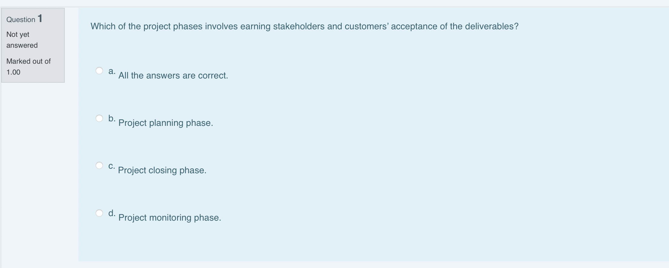
Dr.Sara Adel

Slide 61
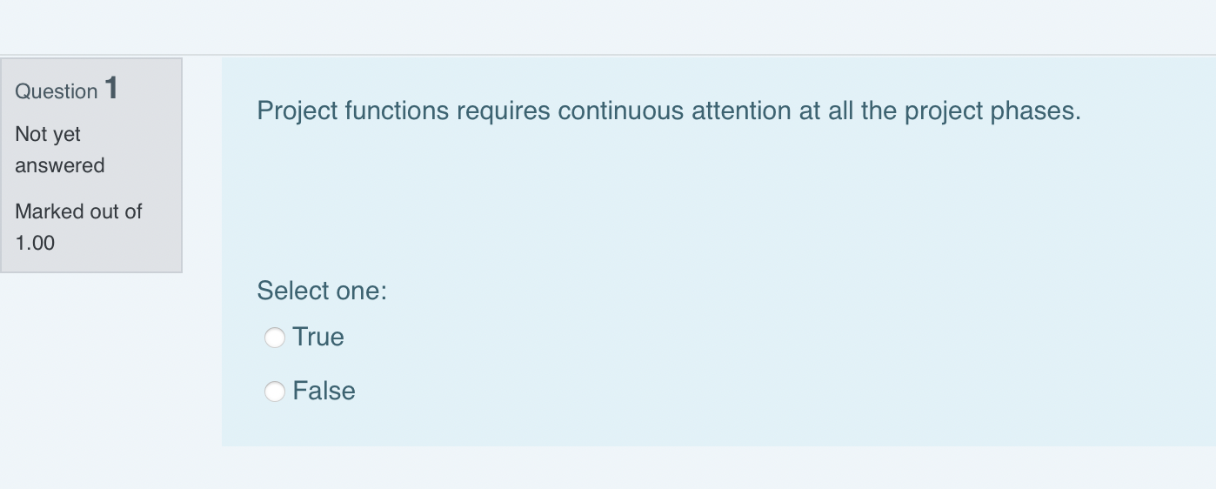
Dr.Sara Adel

Slide 62
2.9 Self Assessment.
Dr.Sara Adel
Notes:
Chapter 2 includes several additional support elements which could become classroom activities or discussion elements.
The Project Plan outlined on pages 63-69 could be the basis for a group assignment in which teams create project plans for a real or fictional project.
The chapter tool, entitled Chapter Tool: Planning Project Quality (section 2.7, pages 69-72) is designed to help readers systematically determine what elements of quality are important to their project, team, or organization.
There are quite a few key terms defined on pages 74-75.
Review questions cover most of the chapter (pages 75-76, answers on page 223).
The exercises on pages 76-77 are designed to allow readers to apply and extend what they’ve learned.

Slide 63

Self Assessment
1- List 10 successful projects around you from any of the following industries:
Automobile Manufacturing Agriculture Banking Software Development Defense Contractors Canned Food Manufacturing | Health Care Music Production Publishing/Printing University Education Venture Capital and Investment
Dr.Sara Adel

Slide 64
Self Assessment
2- Think about your own project, organize a teams of 3-4 and consider the following :
Your project phases, structure of organization, the values and needs, goals/objectives, basic scope statement, specifications/requirements and the project quality.
Dr.Sara Adel

Slide 65
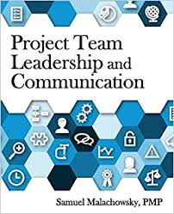
Resources:
Project Team Leadership and Communication by Samuel Malachowsky, 2018.
Dr.Sara Adel

Slide 66
THANKS!
Dr.Sara Adel

