Slide 1




IT111 - Introduction to Information Technology
Bachelor of Science in Information Technology
Eng. Eman Hamdy
Lecture 2 - Numbering Systems

Slide 2


Lecture
Objectives
02
Upon successful completion of this course, students should be able to:
Understand the concept of number systems.
Describe the decimal, binary, hexadecimal and octal system.
Convert a number in binary, octal or hexadecimal to a number in the decimal system.
Convert a number in the decimal, octal and hexadecimal system to a number in binary
Find the number of digits needed in each system to represent a particular value.
IT111 - Introduction to Information Technology
Lecture 02 – Learning Outcome
Eng. Eman Hamdy

Slide 3

1-The decimal system (base 10)
Lecture
02
The word decimal is derived from the Latin root decimal. In this system the base b = 10 and we use ten symbols.
The symbols in this system are often referred to as decimal digits or just digits.
S = {0, 1, 2, 3, 4, 5, 6, 7, 8, 9}
IT111 - Introduction to Information Technology
Eng. Eman Hamdy

Slide 4
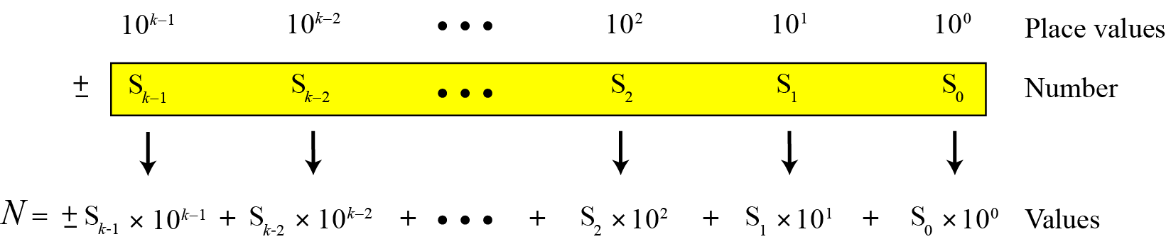
Lecture
02
Integer Number
IT111 - Introduction to Information Technology
Eng. Eman Hamdy

Slide 5
Lecture
02
Integer Number Example
The following shows the place values for the integer +224 in the decimal system.
IT111 - Introduction to Information Technology
Eng. Eman Hamdy

Slide 6
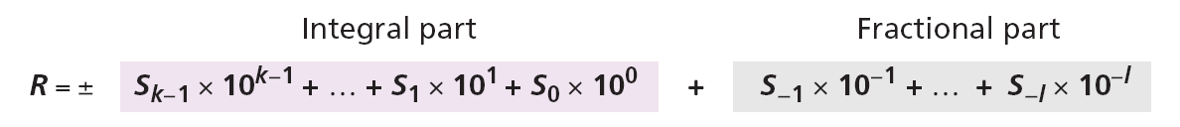
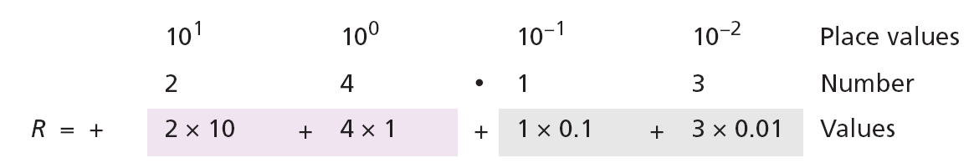
Lecture
02
Reals Number
The following shows the place values for the real number +24.13.
IT111 - Introduction to Information Technology
Eng. Eman Hamdy

Slide 7
2-The binary system (base 2)
Lecture
02
In this system the base b = 2 and we use only two symbols,
S = {0, 1}
The symbols in this system are often referred to as binary digits or bits (binary digit).
IT111 - Introduction to Information Technology
Eng. Eman Hamdy

Slide 8
Lecture
02
binary system (Example)
The following shows that the number (11001)₂ in binary is the same as 25 in decimal. The subscript 2 shows that the base is 2.
The equivalent decimal number is N = 16 + 8 + 0 + 0 + 1 = 25.
IT111 - Introduction to Information Technology
Eng. Eman Hamdy

Slide 9
Lecture
02
Reals Number (binary system)
The following shows that the number (101.11)₂ in binary is equal to the number 5.75 in decimal.
IT111 - Introduction to Information Technology
Eng. Eman Hamdy

Slide 10
3-The Hexadecimal system (base 16)
Lecture
02
In this system the base b = 16 and we use sixteen symbols to represent a number. The set of symbols is
S = {0, 1, 2, 3, 4, 5, 6, 7, 8, 9, A, B, C, D, E, F}
Note that the symbols A, B, C, D, E, F are equivalent to 10, 11, 12, 13, 14, and 15 respectively. The symbols in this system are often referred to as hexadecimal digits.
IT111 - Introduction to Information Technology
Eng. Eman Hamdy

Slide 11
Lecture
02
Hexadecimal system(Example)
The following shows that the number (2AE)₁₆ in hexadecimal is equivalent to 686 in decimal.
The equivalent decimal number is N = 512 + 160 + 14 = 686.
IT111 - Introduction to Information Technology
Eng. Eman Hamdy

Slide 12
4-The Octal system (base 8)
Lecture
02
In this system the base b = 8 and we use eight symbols to represent a number. The set of symbols is
S = {0, 1, 2, 3, 4, 5, 6, 7}
IT111 - Introduction to Information Technology
Eng. Eman Hamdy

Slide 13
Lecture
02
Octal system(Example)
The following shows that the number (1256)₈ in octal is the same as 686 in decimal.
Note that the decimal number is N = 512 + 128 + 40 + 6 = 686.
IT111 - Introduction to Information Technology
Eng. Eman Hamdy

Slide 14
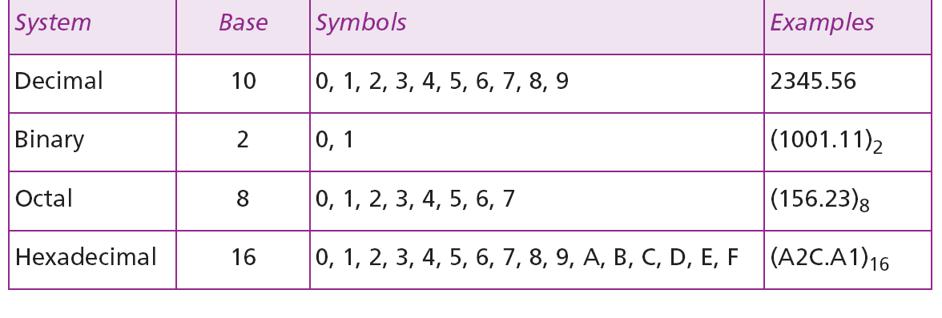
Lecture
02
summary of the four positional number systems
summary of the four positional number systems discussed in this chapter.
IT111 - Introduction to Information Technology
Eng. Eman Hamdy

Slide 15
Lecture
02
Any Base to Decimal Conversion
Binary Decimal
The column weights of binary numbers are powers of two that increase from right to left beginning with 2⁰ =1:
…2⁵ 2⁴ 2³ 2² 2¹ 2⁰.
For fractional binary numbers, the column weights are negative powers of two that decrease from left to right:
2² 2¹ 2⁰. 2⁻¹ 2⁻² 2⁻³ 2⁻⁴ …
IT111 - Introduction to Information Technology
Eng. Eman Hamdy

Slide 16
Lecture
02
Any Base to Decimal Conversion (Example)
Binary Decimal
The decimal equivalent of a binary number can be determined by multiplying each bit by its corresponding weight and then add the values of all.
2⁵ 2⁴ 2³ 2² 2¹ 2⁰. 2⁻¹ 2⁻²
Example
Convert the binary number 100101.01 to decimal.
32 16 8 4 2 1 . ½ ¼
* * * * * * * *
1 0 0 1 0 1. 0 1
Solution
Start by writing the column weights; then add the weights that correspond to each 1 in the number. 37.25
37.25
32+0+0 +4 +0+ 1 +0 +¼ =
IT111 - Introduction to Information Technology
Eng. Eman Hamdy

Slide 17
Lecture
02
Any Base to Decimal Conversion (Example)
Binary Decimal
Example
Convert the binary number 1101.11 to decimal.
Solution
Start by writing the column weights; then add the weights that correspond to each 1 in the number.
2³ 2² 2¹ 2⁰. 2⁻¹ 2⁻²
8 4 2 1 . ½ ¼
1 1 0 1. 1 1
8 + 4 +0 +1 + 1/2+1/4 =
13.75
IT111 - Introduction to Information Technology
Eng. Eman Hamdy

Slide 18
Lecture
02
Any Base to Decimal Conversion (Example)
Binary Decimal
(111001.011)₂ = (51.375)₁₀
(1*2⁵)+ (1*2⁴)+ (1*2³ )+ (1*2⁰ )+(1*2⁻²)+(1*2⁻³ )= 51.375
(10100.0101)₂ = (20.3125 )₁₀ (1*2⁴)+(1*2²)+(1*2⁻²)+(1*2⁻⁴)=20.3125
Binary |  |  | 1 | 1 | 1 | 0 | 0 | 1 | 0 | 1 | 1
weight | 2⁷ | 2⁶ | 2⁵ | 2⁴ | 2³ | 2² | 2¹ | 2⁰ | 2⁻¹ | 2⁻² | 2⁻³ | 2⁻⁴
Value | 128 | 64 | 32 | 16 | 8 | 4 | 2 | 1 | 0.5 | 0.25 | 0.125 | 0.0625
Binary |  |  |  | 1 | 0 | 1 | 0 | 0 | 0 | 1 | 0 | 1
weight | 2⁷ | 2⁶ | 2⁵ | 2⁴ | 2³ | 2² | 2¹ | 2⁰ | 2⁻¹ | 2⁻² | 2⁻³ | 2⁻⁴
Value | 128 | 64 | 32 | 16 | 8 | 4 | 2 | 1 | 0.5 | 0.25 | 0.125 | 0.0625
IT111 - Introduction to Information Technology
Eng. Eman Hamdy

Slide 19
Lecture
02
Any Base to Decimal Conversion (Example)
Octal Decimal
Example
Convert the octal number 174.1 to decimal.
Solution
Start by writing the column weights; then add the weights that correspond to each number.
8² 8¹ 8⁰. 8⁻¹
64 8 1 . 1/8
1 7 4. 1
64+56+4 +1/8=
124.125
IT111 - Introduction to Information Technology
Eng. Eman Hamdy

Slide 20
Examples
Lecture
02
Convert the following Octal to Decimal by using the sum-of-weighted method
Ex1) 272
(2*8²)+(7*8¹)+(2*8⁰)= 186
Ex2) 61
(6*8¹)+(1*8⁰)= 49
Ex3) 126
(1*8²)+(2*8¹)+(6*8⁰)= 86
8² 8¹ 8⁰
Octal Decimal
8¹ 8⁰
8² 8¹ 8⁰
IT111 - Introduction to Information Technology
Eng. Eman Hamdy

Slide 21
Lecture
02
Any Base to Decimal Conversion (Example)
Hexadecimal Decimal
Example
Convert the hexadecimal number A01.3 to decimal.
Solution
Start by writing the column weights; then add the weights that correspond to each number.
16² 16¹ 16⁰. 16⁻¹
256 16 1 . 1/16
10 0 1. 1
2561.0625
2560+0+1 +1/16=
IT111 - Introduction to Information Technology
Eng. Eman Hamdy

Slide 22
Examples
Lecture
02
Convert the following Octal to Decimal by using the sum-of-weighted method
Ex1) B02
(11*16²)+(0*16¹)+(2*16⁰)= 2818
Ex2) EC
(14*16¹)+(12*16⁰)= 236
Ex3) 296
(2*16²)+(9*16¹)+(6*16⁰)=662
Hexadecimal Decimal
16² 16¹ 16⁰
16¹ 16⁰
16² 16¹ 16⁰
IT111 - Introduction to Information Technology
Eng. Eman Hamdy

Slide 23
Examples
Lecture
02
Decimal to Binary Conversion
Decimal to Binary Conversion
sum-of-weighted
repeated division by 2.
Choose largest weight <= the given number to convert
Subtract the given number from the weight
Repeat step 1 & 2 till the subtraction results =0
Divide the whole number by 2
Check if there is a reminder put 1
Repeat the division processes for the whole number till the division results reaches 0.5
IT111 - Introduction to Information Technology
Eng. Eman Hamdy

Slide 24
Examples
Lecture
02
Convert the following decimal numbers to binary by using the sum-of-weighted method
Decimal Binary
Choose the largest weight <= 186 → 128
Subtract 186- 128=58
Put 1 under the weight that has been chosen (128)
Choose the largest weight <= 58 → 32
Put 1 under the weight that has been chosen (32)
Subtract 58-32 =26
Choose the largest weight <= 26 → 16
Put 1 under the weight that has been chosen (16)
Subtract 26-16 =10
Choose the largest weight <= 10 → 8
Put 1 under the weight that has been chosen (8)
Subtract 10-8 =2
Choose the largest weight <= 2 → 2
Put 1 under the weight that has been chosen (2)
Subtract 2-2 =0
Put 0s under the other weights in between till weight (2⁰)
Done
Output = 10111010
weight | 2⁷ | 2⁶ | 2⁵ | 2⁴ | 2³ | 2² | 2¹ | 2⁰
Value | 128 | 64 | 32 | 16 | 8 | 4 | 2 | 1
Output |  |  |  | 1 | 0 | 0 | 0 | 1
Choose the largest weight <= 17 → 16
Subtract 17- 16=1
Put 1 under the weight that has been chosen (16)
Choose the largest weight <= 1 → 1
Put 1 under the weight that has been chosen (1)
Subtract 1-1 =0
Put 0s under the other weights in between till weight (2⁰)
Done
Output = 10001
IT111 - Introduction to Information Technology
Eng. Eman Hamdy

Slide 25
Examples
Lecture
02
Convert the following decimal numbers to binary by using the sum-of-weighted method
Conversion from decimal to binary :
Weight | Value
20 | 1
21 | 2
22 | 4
23 | 8
24 | 16
25 | 32
26 | 64
27 | 128
convert from binary to decimal: Sum of weights method
1)Sum of weights method :
Examples :
(234)10 = ( )2
128 64 32 16 8 4 2 1
1 1 1 0 1 0 1 0
10010100
(148)10 = ( )2
128 64 32 16 8 4 2 1
1 0 0 1 0 1 0 0
11101010
IT111 - Introduction to Information Technology
Eng. Eman Hamdy

Slide 26
Examples
Lecture
02
Convert the following decimal numbers to binary by using the sum-of-weighted method
(467)10 = ( )2
256 128 64 32 16 8 4 2 1
1 1 1 0 1 0 0 1 1
(23)10 = ( )2
128 64 32 16 8 4 2 1
0 0 0 1 0 1 1 1
111010011
10111
IT111 - Introduction to Information Technology
Eng. Eman Hamdy

Slide 27
Examples
Lecture
02
Convert the following decimal numbers to binary by using the division by 2
Conversion from decimal to binary using the division by 2 :
a) 17 c) 186
R
8.5 1
4 0
2 0
1 0
0.5 1
R
93 0
46.5 1
23 0
11.5 1
5.5 1
2.5 1
1 0
0.5 1
2 17
2 8
2 4
2 2
2 1
2 186
2 93
2 46
2 23
2 11
2 5
2 2
2 1
10001
10111010
Stopping Condition
Result : 10001
Result : 10111010
Stopping Condition
IT111 - Introduction to Information Technology
Eng. Eman Hamdy

Slide 28
Examples
Lecture
02
Convert the following Hexadecimal numbers to binary
Hexa-decimal | Binary
0 | 0000
1 | 0001
2 | 0010
3 | 0011
4 | 0100
5 | 0101
6 | 0110
7 | 0111
8 | 1000
9 | 1001
A | 1010
B | 1011
C | 1100
D | 1101
E | 1110
F | 1111
Hexadecimal Binary
Note: Every digit in Hexa-decimal has to represented by 4 bits
in Binary as the maximum digit in Hexa-decimal (F=15) represented by (1111) in binary
Ex1) (61)₁₆ = ()₂
Ex2) (E0C)₁₆ = ()₂
0110 0001
1110 0000 1100
IT111 - Introduction to Information Technology
Eng. Eman Hamdy

Slide 29
Examples
Lecture
02
Convert the following Hexadecimal numbers to binary
Hexadecimal Binary
What is the binary equivalent of (24C)₁₆?
Solution
Each hexadecimal digit is converted to 4-bit patterns:
2 → 0010, 4 → 0100, and C → 1100
The result is (001001001100)₂.
IT111 - Introduction to Information Technology
Eng. Eman Hamdy

Slide 30
Examples
Lecture
02
Convert the following Octal numbers to binary
Octal Binary
Octal number can easily be converted to binary by expanding each digit into 3 bits at a time
Example
Express107₈ in binary:
Solution
001 000 111₂
IT111 - Introduction to Information Technology
Eng. Eman Hamdy

Slide 31
Examples
Lecture
02
Convert the following Octal numbers to binary
Octal Binary
Octal number can easily be converted to binary by expanding each digit into 3 bits at a time
What is the binary equivalent of for (24)₈?
Solution
Write each octal digit as its equivalent bit pattern to get
2 → 010 and 4 → 100
The result is (010100)₂.
IT111 - Introduction to Information Technology
Eng. Eman Hamdy

Slide 32
Numbering system
Lecture
02
Decimal | Binary | Octal | Hexadecimal
0 | 0000 | 0 | 0
1 | 0001 | 1 | 1
2 | 0010 | 2 | 2
3 | 0011 | 3 | 3
4 | 0100 | 4 | 4
5 | 0101 | 5 | 5
6 | 0110 | 6 | 6
7 | 0111 | 7 | 7
8 | 1000 |  | 8
9 | 1001 |  | 9
10 | 1010 |  | A
11 | 1011 |  | B
12 | 1100 |  | C
13 | 1101 |  | D
14 | 1110 |  | E
15 | 1111 |  | F
Numbering System | Base | Digits Range
Binary | 2 | 0,1
Octal | 8 | 0-7
Decimal | 10 | 0-9
HexaDecimal | 16 | 0-9 ,A,B,C,D,E,F
IT111 - Introduction to Information Technology
Eng. Eman Hamdy

Slide 33

Thank you

