Slide 1

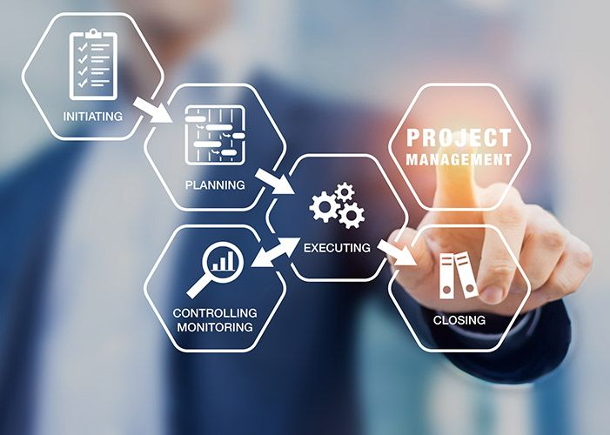
Project Management Technologies
Project management in a nutshell (Cont.)
Prepared by Dr. Majid Saad
PMG 312
Lecture 2

Slide 2



Project Management Technologies
Lecture 2
PMG 312
Prepared by
Dr. Prepared by Dr. Majid Saad
www.midocean.ae

Slide 3
AGENDA
Project requirements definition​
Workshop​
Brainstorming​
Decision logic table​
RACI charting​
Understanding the project business case​
www.midocean.ae

Slide 4
Introduction
Project management in a nutshell
Methodology
Project life cycle
Project requirements definition
Understanding the project business case
Project ranking matrix
How to evaluate and prioritize IT project proposals
Quality management
Sponsor and supplier agreements
Microsoft Project 2010
Challenging
www.midocean.ae

Slide 5

Project requirements definition
One of the major issues in starting the project is getting good requirements!
Project requirements are the further breakdown of the client’s deliverables that are described in detail.
www.midocean.ae

Slide 6

Project requirements definition​
This process cannot be done in a vacuum, and the requirements collecting process is mostly the client’s or shareholder’s responsibility.
It is the responsibility of the PM to facilitate this requirements collecting process and there are many techniques (or combination of) for doing this.
www.midocean.ae

Slide 7
Project requirements definition​
The following are some of the popular techniques that are used for this collecting process.
Workshops
Brainstorming (Brown paper; Process chart)
Decision logic table
RACI charting
www.midocean.ae

Slide 8

Workshop
The PM could have designed workshops with the stakeholders and subject matter experts to gather the detailed requirements, which usually enhance user participation, expediting development and improving the quality of the specifications.
www.midocean.ae

Slide 9

Workshop
These workshops have a set of detailed agenda to eliminate uncertainties between parties and help improve communication between all parties.
www.midocean.ae

Slide 10

Workshop
A popular workshop process is joint application design (JAD), which is a group meeting-based process for requirements collection
JAD is usually more effective in small, clearly defined projects and less effective in large complex projects.
www.midocean.ae

Slide 11
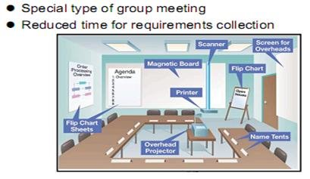
Workshop
www.midocean.ae

Slide 12
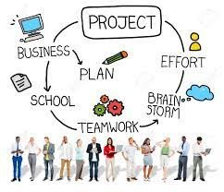
Brainstorming
A requirement gathering is a group brainstorming exercise that needs to be facilitated by the PM.
The group consists mostly of the clients or shareholders.
www.midocean.ae

Slide 13
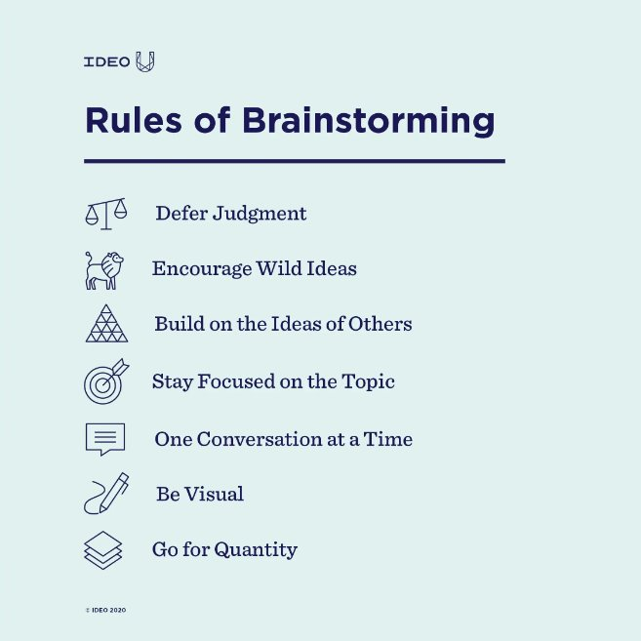
Brainstorming
www.midocean.ae

Slide 14
Brainstorming
It is always smart if the PM sends surveys along with the project’s charter to key stakeholders to list their requirements or have individual interviews with the key stakeholders before the brainstorming session(s) begins to save time and have a more effective meeting.
www.midocean.ae

Slide 15
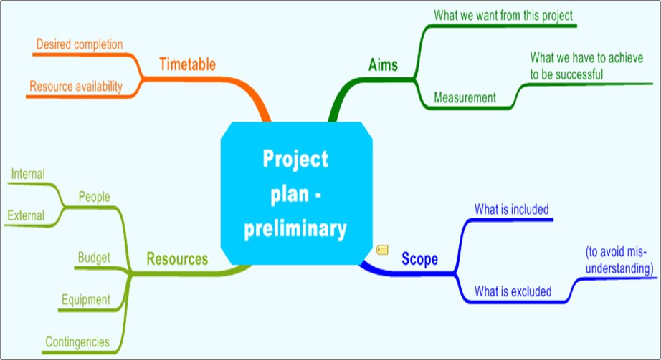
Brainstorming
www.midocean.ae

Slide 16
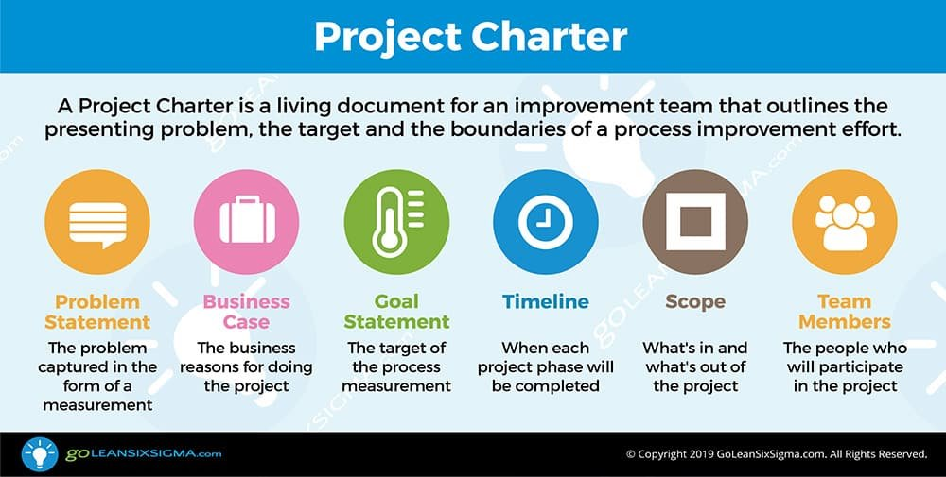
Brainstorming
www.midocean.ae

Slide 17
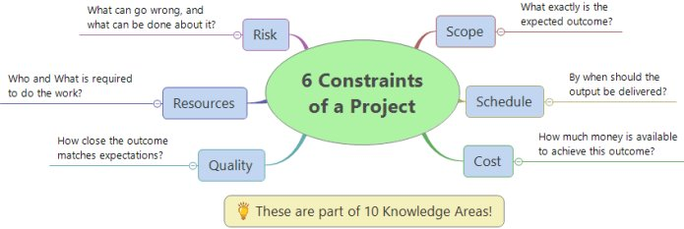
Brainstorming
Brainstorming should also include the areas of assumptions, constraints, and potential risks.
As for risk identification, the group could look at risks from past projects.
www.midocean.ae

Slide 18
Brainstorming
The following are some techniques that could be used during the brainstorming session:
Brown paper
Process chart
www.midocean.ae

Slide 19
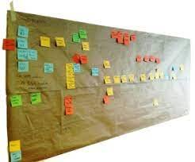
A- Brown paper
Brown paper is a form of flow-charting used to capture a complete process for evaluation (e.g., finding ways to streamline the system)
Including highlights of key activities, interfaces, documentation, data sources, strengths, and problems.
www.midocean.ae

Slide 20
A- Brown paper
Brown papers are generally used in the “as-is” and “to-be” model definition phases of a project.
They can also be used to develop “should-be” and “could-be” models for evaluation.
www.midocean.ae

Slide 21







A- Brown paper (Material needed)
Materials needed:
Brown paper (e.g., 3 feet by 5 feet)
Post-it notes of two different colors (e.g., yellow and blue)
Masking tape
Ruler
Pencils
Master color markers
Flipchart
www.midocean.ae

Slide 22
A- Brown paper (How it works?)
Use the yellow Post-it notes on the top half of the brown paper(s) to define the “as-is” process steps and have the users review and validate the flow.
Next, look for problems or flaws in the process and brainstorm on ways that steps in the process can be reduced, eliminated, or simplified.
Using the blue Post-it notes on the bottom half of the brown paper(s), develop a new and improved “to-be” process while using the strengths from the “as-is” process.
www.midocean.ae

Slide 23
A- Brown paper (How it works?)
Main components:
“as-is” process
Problems/ how can be reduced, eliminated, or simplified.
“to-be” process
The strengths from the “as-is” process.
www.midocean.ae

Slide 24
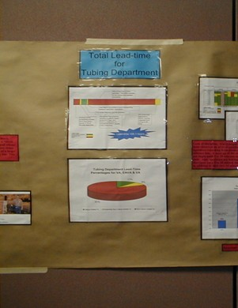
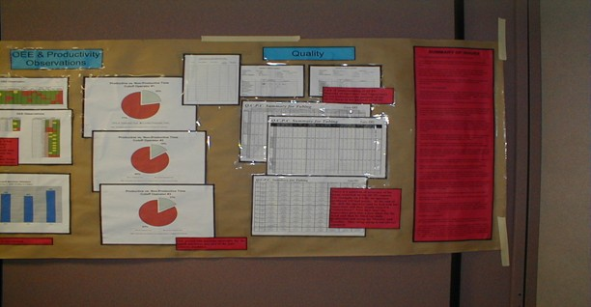
A- Brown paper (How it works?)
www.midocean.ae

Slide 25
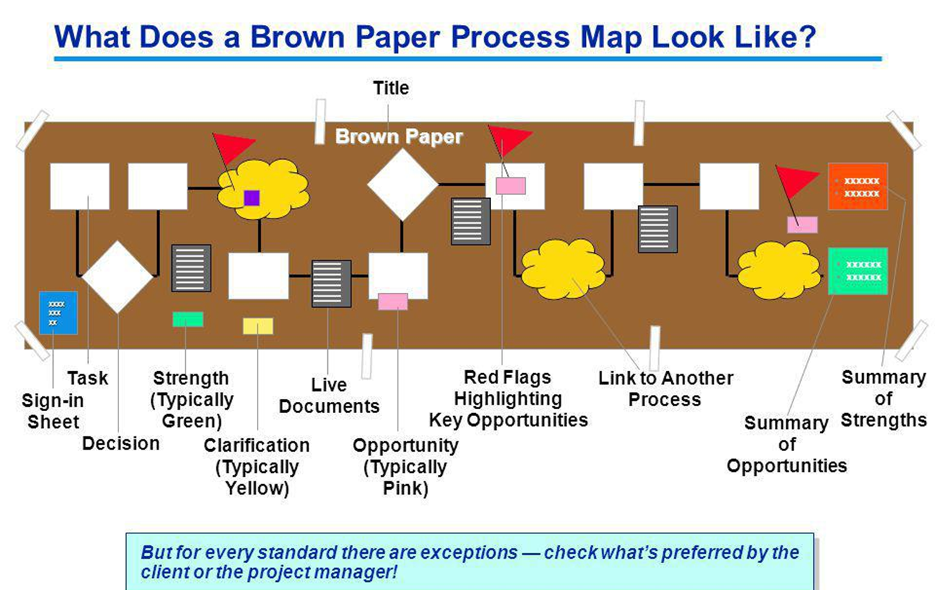
www.midocean.ae

Slide 26
A- Brown paper (Advantage)
It is important to gather the right people to develop a model of the process or system under evaluation.
Another advantage in having the users involved in this exercise is that you usually will get “buy in” and support from them on changing the process.
A feeling of ownership is important to users!
www.midocean.ae

Slide 27
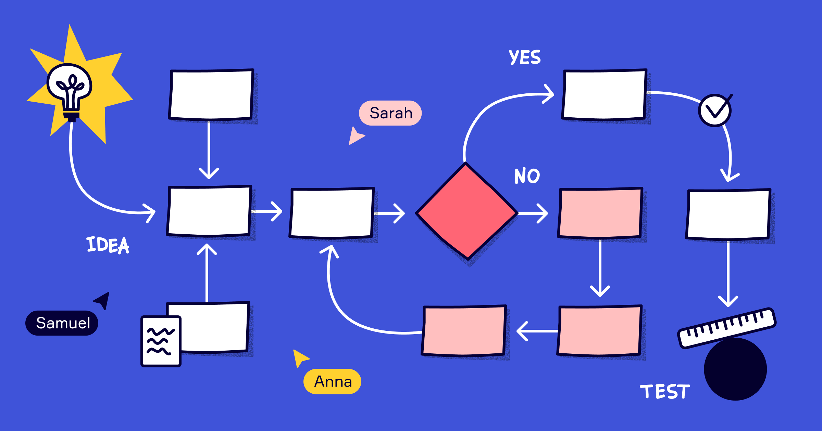
B- Process chart
If you want to learn in detail what happens in a situation involving a document, request, material, or even the actions of a person, consider using a process chart.
www.midocean.ae

Slide 28
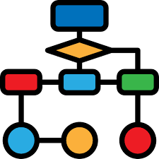
B- Process chart
The process chart documents the detailed steps of the flow and categorizes the type of action taken.
www.midocean.ae

Slide 29
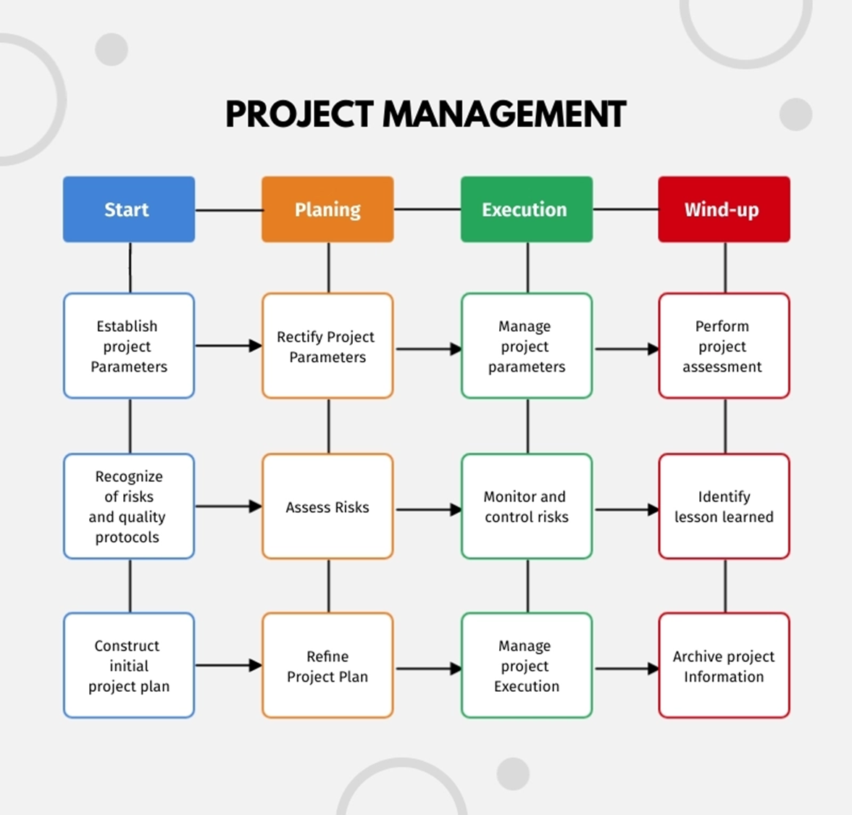
www.midocean.ae

Slide 30
B- Process chart
The Process Flow chart provides a visual representation of the steps in a process.
Flow charts are also referred to as Process Mapping or Flow Diagrams.
www.midocean.ae

Slide 31
B- Process chart
Constructing a flow chart is often one of the first activities of a process improvement effort, because of the following benefits:
Gives everyone a clear understanding of the process
Helps to identify non-value-added operations
Facilitates teamwork and communication
Keeps everyone on the same page
www.midocean.ae

Slide 32
B- Process chart
With this information, you can analyze the process for potential improvements.
To add value, you should try to reduce a complex process to its lowest common denominator to a series of simple steps to save time and reduce costs.
.
www.midocean.ae

Slide 33
B- Process chart
There are many symbols used to construct a process chart; the more common symbols are shown below:
Operation
Transportation
Inspection
Delay
Storage
www.midocean.ae

Slide 34
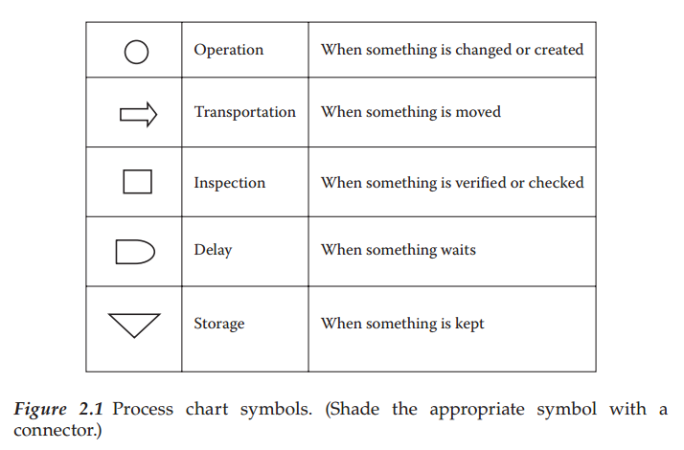
B- Process chart
www.midocean.ae

Slide 35
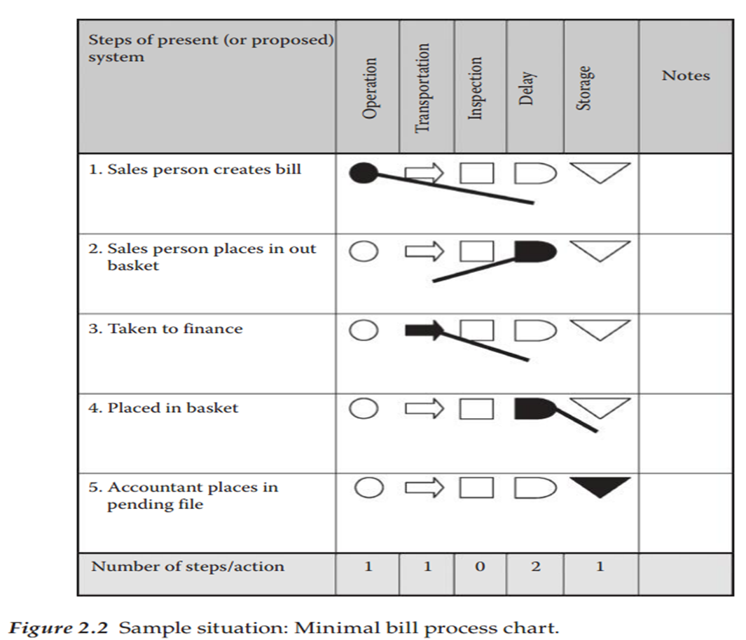
B- Process chart (Example 1)
www.midocean.ae

Slide 36
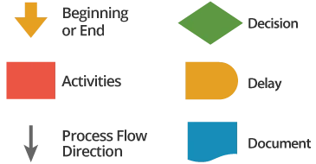
B- Process chart (Example 2)
There are many other symbols used to construct a process chart;
www.midocean.ae

Slide 37
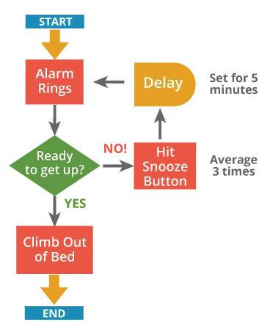
B- Process chart (Example 2)
The following is an example of a very simple flow chart for the process of getting out of bed in the morning:
www.midocean.ae

Slide 38
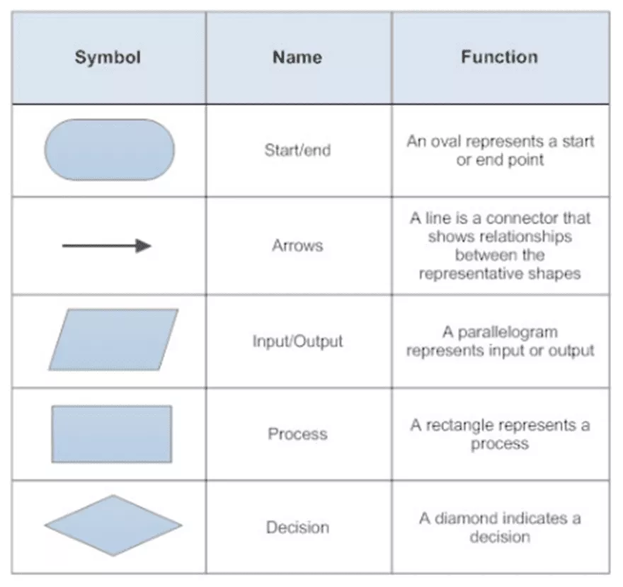
Flow chart (Will be discussed later)
www.midocean.ae

Slide 39

Decision logic table
A decision logic table (DLT) is a documentation technique that can display an entire situation visually, with all alternatives shown side by side.
If you do not use a DLT, you may miss some alternatives that you never thought of which could sink your project.
www.midocean.ae

Slide 40

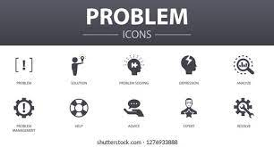
Decision logic table
The following describes the characteristics of a DLT, which increases team communication:
Displays all the elements of a problem.
Shows all the conditions affecting the solution.
Reveals all the relationships that exist among the defined conditions.
Indicates which action is appropriate for each set of circumstances.
Illustrates the IF (condition) and THEN (conclusion or action) concept.
www.midocean.ae

Slide 41
Decision logic table
A decision table lists the various values for all the factors that influence some aspect of a system’s behavior and indicates the expected system actions in response to each combination of factors.
www.midocean.ae

Slide 42

Decision logic table
These factors can be shown either as statements with possible answers of true or false, as questions with possible answers of yes or no, or as conditions that can have two or more possible values.
www.midocean.ae

Slide 43
Decision logic table (Example)
As an illustration, let’s consider a chemical tracking system that I worked on once. This system managed the inventories of chemicals in a large company’s research labs.
It allowed scientists to request new chemicals, tracked the location and status of individual chemical containers, provided health and safety information, and so forth.
www.midocean.ae

Slide 44
Decision logic table (Example)
Whether or not the chemical tracking system should accept a request for a new chemical from an individual depends on four factors:
Whether the user who is creating the request is authorized to request the chemical.
Whether the chemical is available either in the chemical stockroom or from a vendor.
Whether the chemical is on the list of hazardous chemicals that require special training in safe handling.
Whether the user who is creating the request has been trained in handling this type of hazardous chemical.
www.midocean.ae

Slide 45
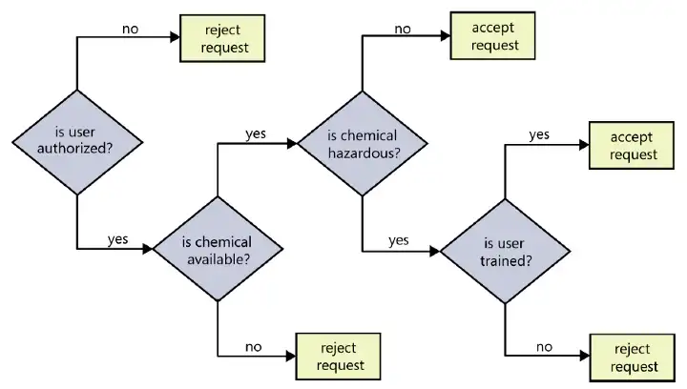
Decision Tree (Example)
www.midocean.ae

Slide 46
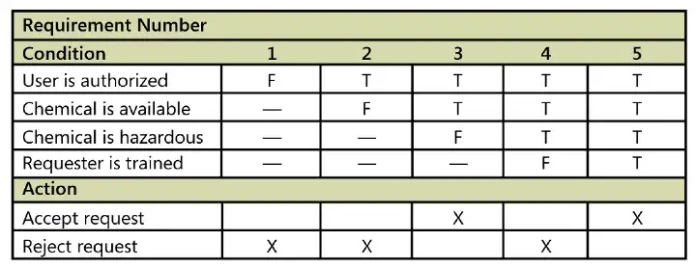
Decision Tree (Example)
The table shows that only five distinct functional requirements arise from the various combinations.
It’s always nice when a problem turns out to be smaller than you thought it was.
The decision table is a compact and efficient way to communicate the outcome of these various logic combinations unambiguously.
www.midocean.ae

Slide 47
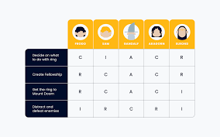
RACI charting
Responsible, Accountable, Consult and Inform (RACI) charting is an effective means of analyzing and assigning roles and responsibilities.
www.midocean.ae

Slide 48
RACI charting
It correlates functional roles or individuals to their level of participation in an activity by assigning codes for responsibility, accountability, and communication interfaces.
www.midocean.ae

Slide 49
RACI charting
Establishing participation for each activity, for all roles, by assigning codes as described below:
R (responsible)—The individual working on the activity (the doer)
A (accountable)—The individual with yes/no authority; approval or veto power (Note: If two or more A’s exist, this could be a sign of problems.)
C (consult)—The individual must be consulted prior to action; two-way communication occurs
I (inform)—The individual receives one-way communication and will use the information or take subsequent action
www.midocean.ae

Slide 50
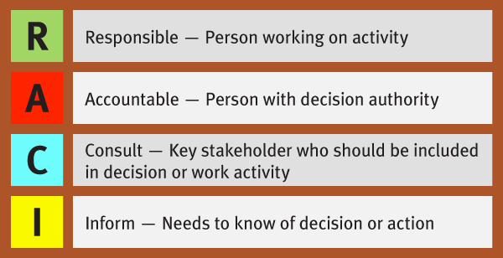
RACI charting
www.midocean.ae

Slide 51
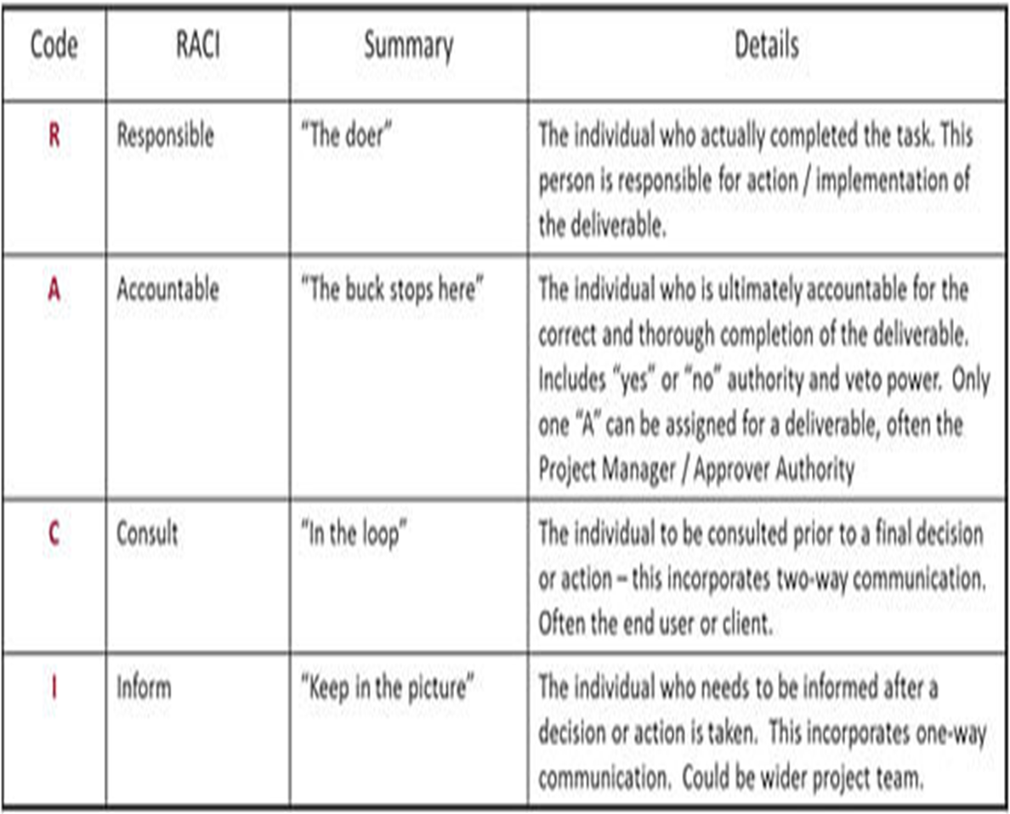
RACI charting
www.midocean.ae

Slide 52
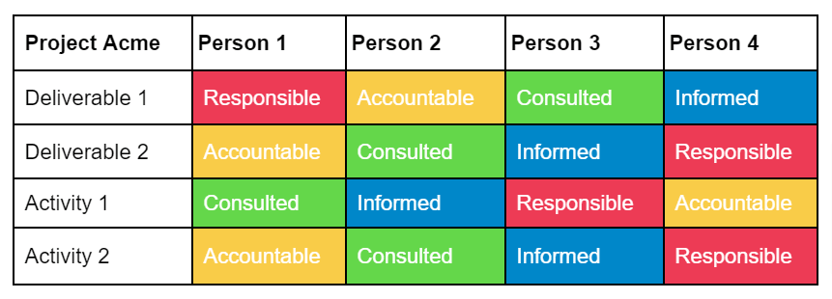
RACI charting
www.midocean.ae

Slide 53
RACI charting
It is a quick means of bringing redundancies and misunderstandings to light, so that better communication can occur.
www.midocean.ae

Slide 54
Traditional RACI charting
Steps to complete a chart include (Traditional RACI Matrix):
Selecting a business process to be analyzed.
Listing all of the activities associated with that process in the lefthand column of the chart.
Identifying all functional roles associated with the process and listing them in the top row on the chart.
www.midocean.ae

Slide 55
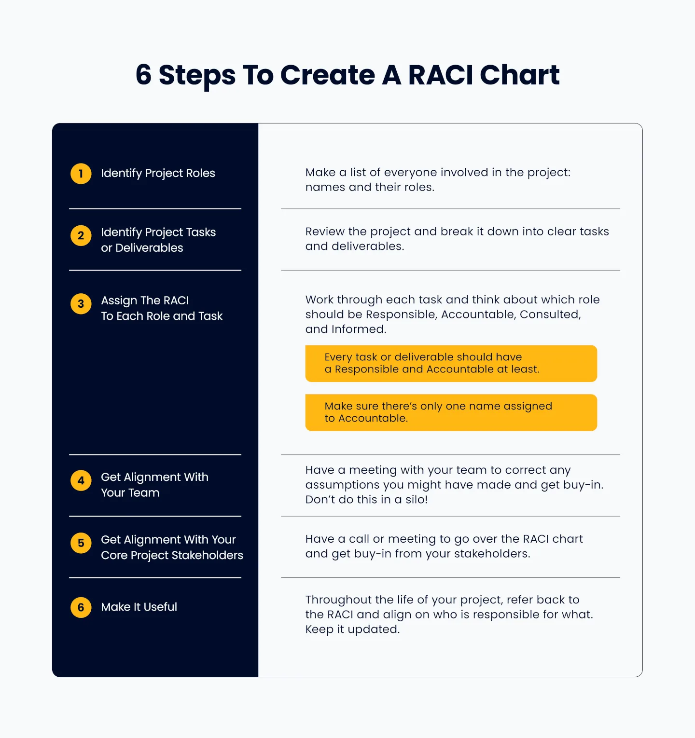
Recent RACI charting
https://thedigitalprojectmanager.com/projects/raci-chart-made-simple/
www.midocean.ae

Slide 56
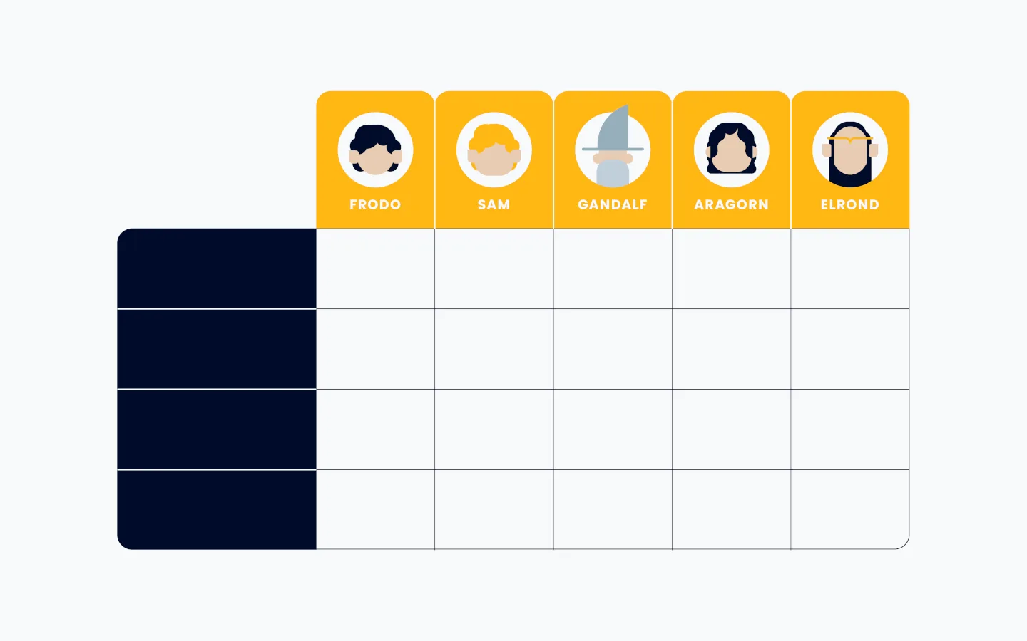
Recent RACI charting
Steps to complete a chart (Modern RACI)include:
Think about who is involved. First, the table listing out the names at the top. This highlights the first thing to decide when creating a RACI: do you list roles or specific people?
Traditionally, you should define the functional roles along the top. However, there are cases when using names is better, and that’s often my preference.
www.midocean.ae

Slide 57

RACI charting
Step 2: Identify Project Tasks Or Deliverables
Review the project and break it down into clear tasks and deliverables.
Put these down the left-hand column of your chart.
www.midocean.ae

Slide 58
RACI charting
Step 3: Assign The RACI To Each Role And Task
Work through each task and think about the different roles and what they should be responsible for.
Every task or deliverable should have Responsible and Accountable at least.
Make sure there is only one role or name assigned to Accountable—this is really important.
Think carefully about who should be Consulted whilst the task is ongoing, and who should be Informed once the task is complete.
www.midocean.ae

Slide 59
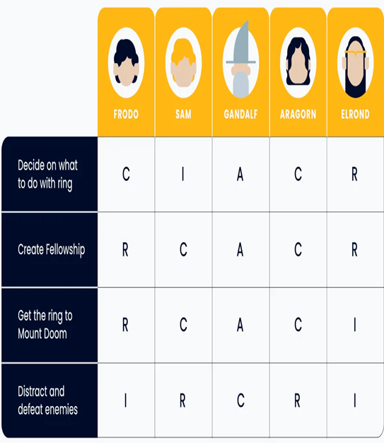
RACI charting
Step 4: Agree on This With Your Team
Step 5: Agree on This With The Core Project Stakeholders
Step 6: Make It Useful Throughout The Life Of The Project
www.midocean.ae

Slide 60
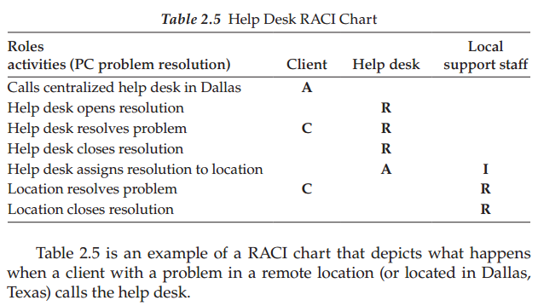
RACI charting(Example)
www.midocean.ae

Slide 61
Understanding the project business case
From many recent studies, the major reason for project failures is not the specifics of what went wrong, but rather the lack of procedures, methodology, and standards for managing the project.
The PM who is asked to manage a project with no methodology, standards, procedures, and processes will have a difficult time keeping the project under control and has a high probability of being unsuccessful.
www.midocean.ae

Slide 62
Understanding the project business case
Also keep in mind that technical oriented projects have unusually high degrees of uncertainty for the following reasons:
Technology is changing every 6–12 months—new programming languages, new interface mechanisms, hardware platforms, tools, and version compatibility issues
Immature methodologies
www.midocean.ae

Slide 63
Understanding the project business case
Resource turnover is high—new teams for each project
No standard benchmarks for abilities/skill levels of resources
Dependencies on customer for good requirements and project plan task completions
Fast-changing business environment
www.midocean.ae

Slide 64
Understanding the project business case
Unfortunately, most projects have no linkage to corporate strategy (i.e., a set of short- and long-range goals), which remains revolutionary thinking in many corporations today.
So, in ranking a new project request, you should ask: does this project have any linkage to your corporate strategy? If it does, there is a high probability that you want to execute this project.
Also, if the new project request has nothing to do with your corporate strategy, there is a much lower probability that you would execute the project.
www.midocean.ae

Slide 65
Understanding the project business case
Going this way shows maturity in your project management process and adds more overall long-term value to your organization.
Another advantage of linking projects to your corporate strategy is having more executive support in gaining resources and needed budget monies.
In summary, projects need to have more of a business focus that is aligned to strategic business goals!
www.midocean.ae

Slide 66
Conclusion
The goal of Project Management is to deliver an Information System that is acceptable to Users and is developed on time and within budget
A good methodology encompasses standard policies, processes, and procedures that incorporate a suite of tools and techniques to help guide the process through its life cycle in an efficient, consistent, and repeatable manner.
Project requirements are the further breakdown of the client’s deliverables that are described in detail.
This process cannot be done in a vacuum, and the requirements collecting process is mostly the client’s or shareholder’s responsibility.
It is the responsibility of the PM to facilitate this requirements collecting process and there are many techniques (or combination of) for doing this.
Projects need to have more of a business focus that is aligned to strategic business goals!
www.midocean.ae

Slide 67




Thank You

