Slide 1


Design Thinking
Prepared by Dr. Aya Mohamed
ENT 621
Master of Entrepreneurship
Lecture 7

Slide 2

In The Previous Lecture: Design Thinking
Topics
v
4 Ways to Get Started with Design Thinking
The power of Empathy
The Power of Observation
The power of User Interviewing
Empathy
Observation
Interviewing

Slide 3
In This Lecture: Design Thinking
Topics
v
4 Ways to Get Started with Design Thinking
The Empathy Map
Customer persona
Types of personas
Why do we need a personas ?
Tips for customer personas
Empathy
Persona
Map

Slide 4

EMPATHY MAP
Empathy Maps help synthesize your team’s collective knowledge about your users as a group, bringing you closer to a common understanding of who they are.
You can use empathy mapping to refresh your team’s understanding before an important decision, or to quickly collect your data directly after an observation session.
Empathy Mapping is best treated as an ongoing activity. As your understanding grows and evolves, revisit the activity periodically.

Slide 5
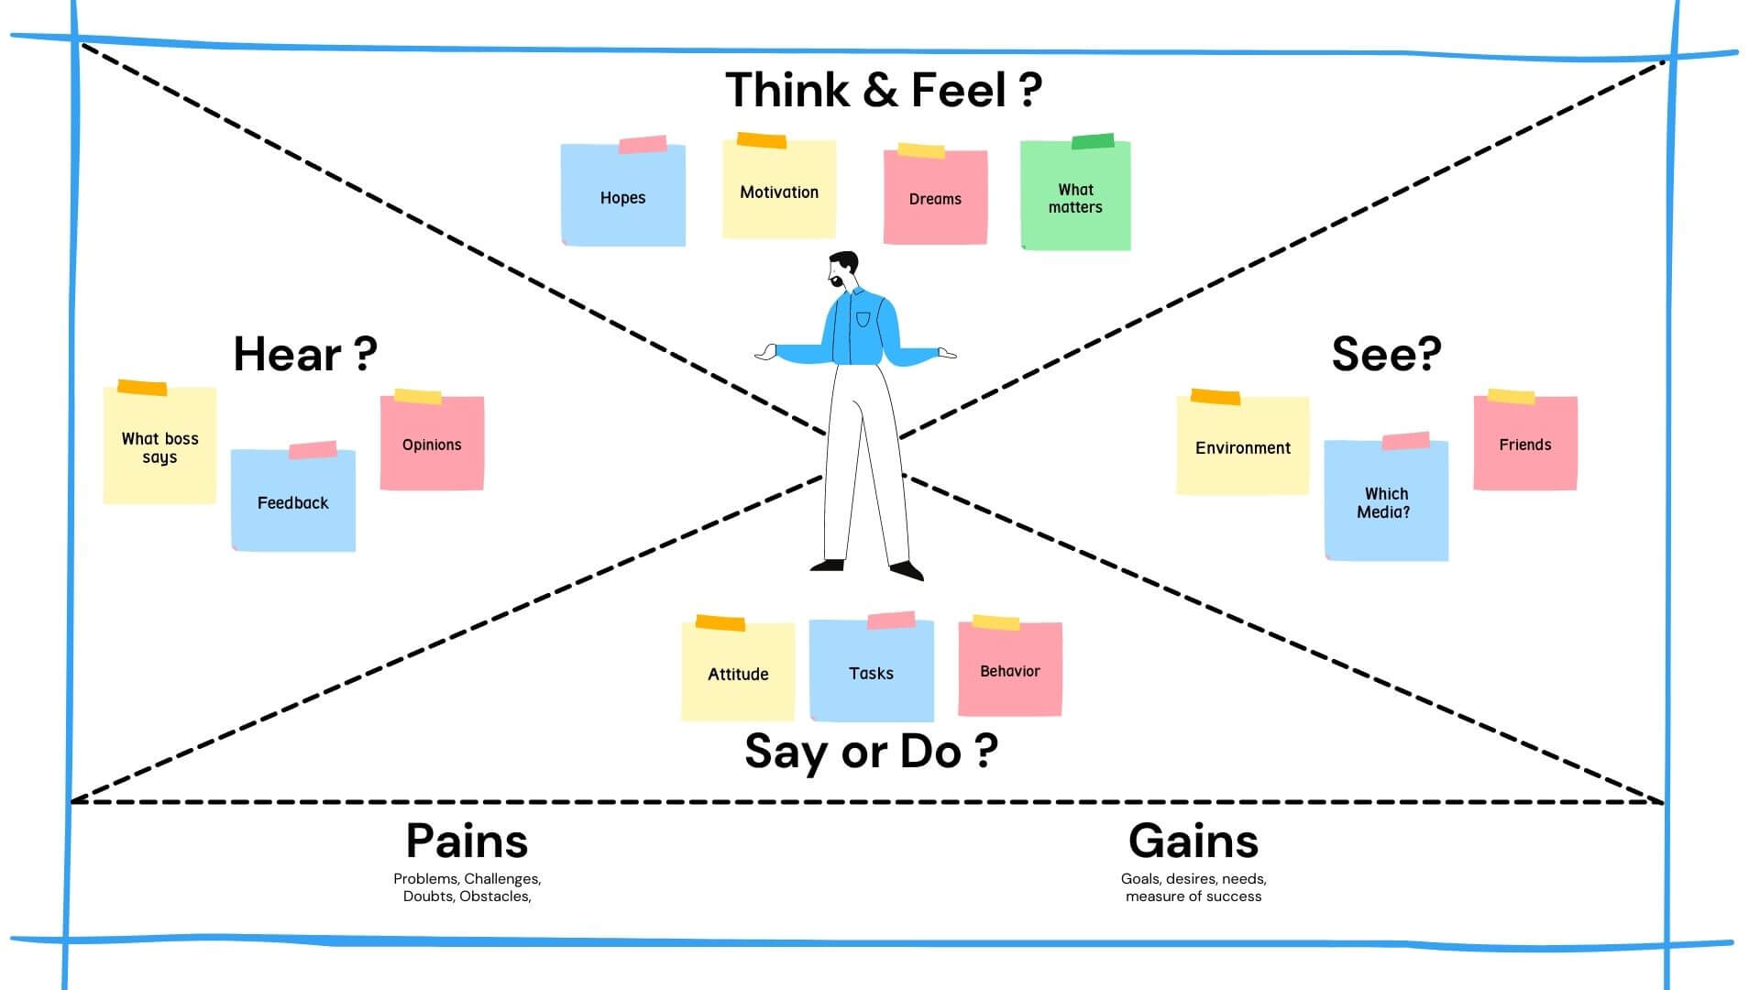


Slide 6
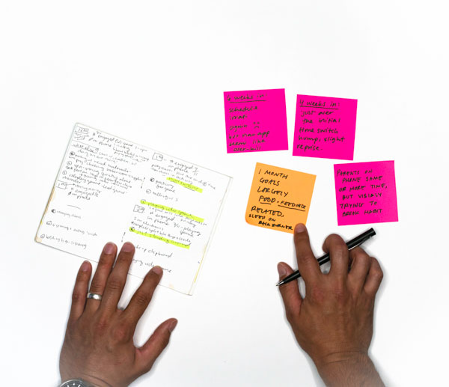
EMPATHY MAP
1. Come prepared with observations
Empathy mapping is only as reliable as the data your bring to the table, so make sure you have defensible data based on real observations (for example, from an interview or contextual inquiry). When you can, invite users or Sponsor Users to participate.

Slide 7
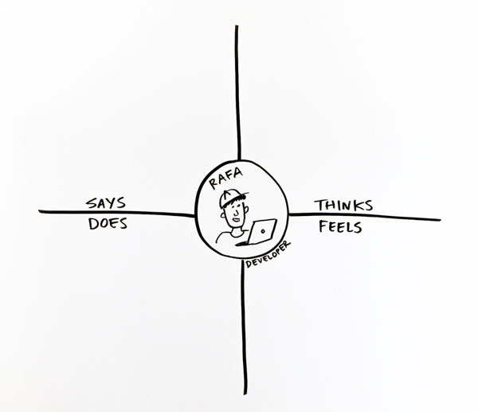
EMPATHY MAP
2. Set up the activity
Draw a grid and label the four essential quadrants of the map: Says, Does, Thinks, and Feels. Sketch your user or stakeholder in the center. Give them a name and brief description of who they are and what they do

Slide 8
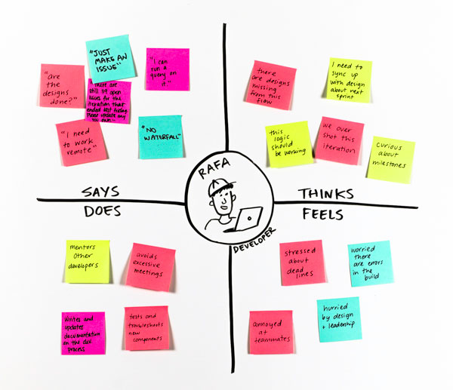
EMPATHY MAP
3. Capture observations
Have everyone record what they know about the user or stakeholder. Use one sticky note per observation. Place it on the appropriate quadrant of the map.

Slide 9
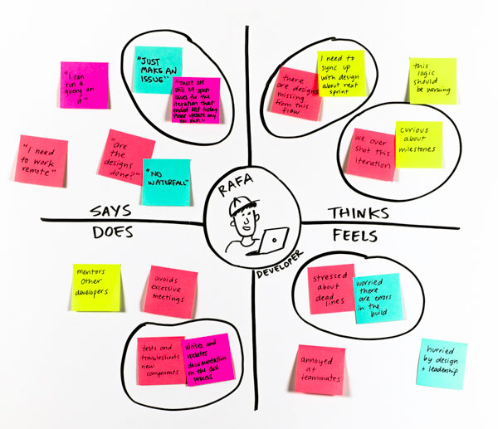
EMPATHY MAP
4. Find patterns and identify unknowns
Within each quadrant, look for similar or related items. If desired, move them closer together. As you do, imagine how these different aspects of your user’s life really affect how they feel. Can you imagine yourself in their shoes?

Slide 10
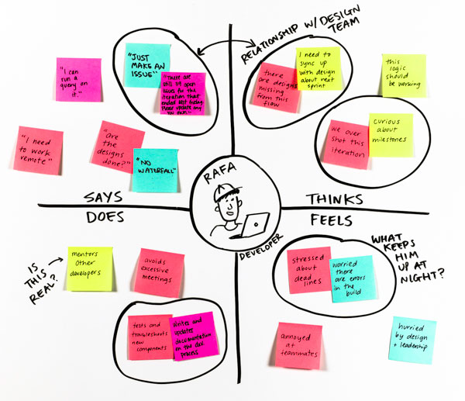
EMPATHY MAP
5. Playback and discuss
Label anything on the map that might be an assumption or a question for later inquiry or validation. Look for interesting observations or insights. What do you all agree on? What surprised you? What’s missing? Make sure to validate your observations with a user or Sponsor User if they weren’t involved in the activity.

Slide 11
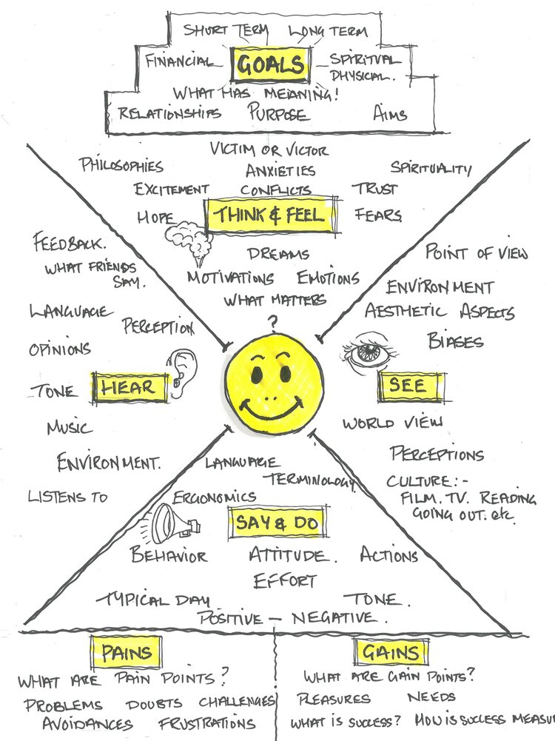


EMPATHY MAP
Empathy Mapping is a simple but effective tool used to visualize user/consumer/ target market attitudes and behaviors. By making the map visual and directing the inquiry at a specific target we are able to build a much better picture of our market. It’s often the case that these kinds of maps can reveal where we have gaps in our existing data and where we have made assumptions.

Slide 12
Customer Personas
What is a persona?
A persona is a fictional profile that represents a group of people –such as users, potential customers, or employees– as well as their mindsets, their needs and behavior patterns.
It is created to help design teams better understand and empathize with their target audience.
Personas are typically based on research data and insights gathered from real users through interviews, observations, and other research methods.

Slide 13
Customer Personas
Personas help to give a team a shared understanding of their customers and are a valuable basis for journey mapping and stakeholder mapping, as well as many other tools.
TYPES OF PERSONAS
Personas can be classified into various types based on their characteristics and attributes.
Common categorizations are based on demographic information (such as age, gender, or occupation), psychographic information (such as emotions and values), behavioral information (such as browsing habits or purchase history).

Slide 14

Customer Personas
TYPES OF PERSONAS
Customer persona
Customer personas represent the different target customer groups of your business. Different customer personas allow you to gain a better understanding for your customer segments and let you target them appropriately. A customer is not necessarily a buyer persona, just think of a customer that is using a free software without paying for it.

Slide 15

Customer Personas
TYPES OF PERSONAS
Buyer persona
Buyer personas represent the different types of actual buyers of your products, so the persons who make the decision about the purchase. Different buyer personas can show different motivations for their purchase, also they might differ in their purchasing power and purchase history. A buyer persona is not necessarily the user of your product, for example when a company buys software for their employees.

Slide 16

Customer Personas
TYPES OF PERSONAS
User persona
User personas represent the different types of actual end-users of your product. The person using your product does not necessarily have to be the same person as the one buying your product, just think of adults buying toys for their children

Slide 17

Customer Personas
TYPES OF PERSONAS
Website (User) persona
Website user personas represent the different types of users visiting your website. In contrast to user and buyer personas, a website user does not necessarily interact with your product, maybe they only read your online content

Slide 18
Customer Personas
How many of these “fictional profiles” should you create?
The answer differs from organization to organization and from project to project,
A rule-of-thumb guideline: you will probably need between three to seven core customer personas. It’s unlikely that you’ll have less than three different target groups. It is however likely that you won’t really use personas in your work if you’d have more than seven of them. You simply wouldn’t really remember them.
Besides your core personas, you can have many more extreme case personas to test ideas from rather extreme points-of-view

Slide 19
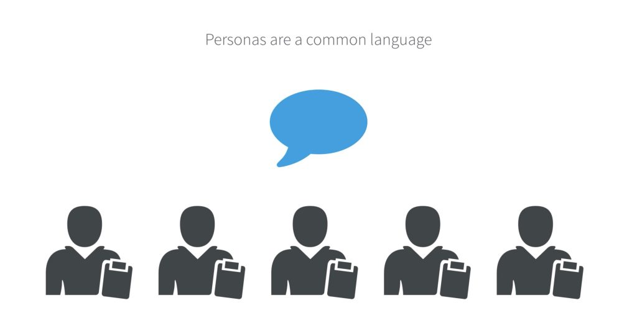
Customer Personas
Why do we need a persona?
1-CREATING EMPATHY
2-GETTING A TEAM ON THE SAME PAGE
3-TESTING WITH PERSONAS
Use personas to test your ideas for new or improved products, services, or features.
Working with personas helps to create empathy, get a common understanding of your customers and test ideas.

Slide 20
Customer Personas
How to create a persona?
A persona is generally defined like a real person. It usually has a name, description, and characteristics. Define which background (education, job position) your persona has, to make the description even more precise.
Describe both the person as a human being (background story, personality, interests, etc.) and as a stakeholder in context of a service ecosystem (needs, expectations, etc.)

Slide 21
Customer Personas
How to do customer persona research?
Use the following online tools if you already have them
Facebook analytics -Google analytics
Google search console -LinkedIn analytics
LinkedIn Company Page analytics -Twitter page insights
Youtube analytics -Instagram analytics
CRM Database (Cluster or profile analysis to identify buying groups)
You may also explore other qualitative research methods:
Surveys
Interviews
Focus groups

Slide 22
Customer Personas
Information to include in personas
When creating personas, there are a few key pieces of information that you'll want to include:
Name
Description
Demographics (age, gender, location, etc.)
Customer needs
Motivations
Pain points
Their journey through your customer cycle

Slide 23
Customer Personas
key points a basic persona profile:
Profile picture: Use an authentic photo that expresses your persona’s character.
Name: Give the persona a name that matches your target group. Choose a name that reflects your persona’s heritage and social environment. Try to make it real – your team might have to live with this name for longer.
Quote: This could describe your persona’s attitude in one sentence. Ask yourself: What would help team members to empathize with this fictional person?
Occupation: Where does your persona work? What does she do (status)? Add information about the company (e.g. size, type, etc.) and her career (goals).

Slide 24
Customer Personas
key points a basic persona profile:
Description: There is not one recipe to describe a persona. Use this field to describe further stories and characteristics. What does a typical day look like? What are favorite places to go?
Add additional information, such as expectations, education, hobbies, interests, motivations etc. This will always depend on the focus of your project. For example, it might be interesting to add a section for favorite channels and devices if you’re looking to improve your cross-channel communication. Or it might be interesting to name past experiences if you’re trying to optimize a journey to personas who have made use of your service in the past

Slide 25
Customer Personas
key points a basic persona profile:
Slider: On this one dimensional scale you can visualize characteristics from high to low or whatever specification you prefer to use. Here we used technological affinity in order to show that Anna is a very tech savvy person who prefers digital versions of tickets, boarding passes etc.
Mood images: Enrich your persona with contextual photos of their lives. What does their home or work place look like? What’s in their purse? What are their hobbies? Humans are brilliant at understanding and empathizing with images and will have an easy time grasping a persona’s personality.
Icon and color:. The small stripes on the icon mark that this is a persona – other than a simple stakeholder with no further characteristics

Slide 26

Persona Name
BACKGROUND:
Basic details about persona’s role
Key information about the persona’s company
Relevant background info, like education or hobbies
DEMOGRAPHICS:
Gender
Age Range
HH Income (Consider a spouse’s income, if relevant)
Urbanicity (Is your persona urban, suburban, or rural?)
IDENTIFIERS:
Buzz words
Mannerisms
You can find this information by administering online surveys of your target audience.

Slide 27
Persona Name
GOALS:
Persona’s primary goal
Persona’s secondary goal
CHALLENGES:
Primary challenge to persona’s success
Secondary challenge to persona’s success
HOW WE HELP:
How you solve your persona’s challenges
How you help your persona achieve goals
Conduct interviews with your target audience to learn about their goals and challenges in more detail.

Slide 28
Persona Name
REAL QUOTES:
Include a few real quotes – taken during your interviews – that represent your persona well. This will make it easier for employees to relate to and understand your persona.
COMMON OBJECTIONS:
Identify the most common objections your persona will raise during the sales process.
Identifying common objections will help your sales team be better prepared during their conversations.

Slide 29
Persona Name
MARKETING MESSAGING:
How should you describe your solution to your persona?
ELEVATOR PITCH:
Make describing your solution simple and consistent across everyone in your company.
Establishing your messaging prepares your entire organization to convey the same message.
Including a real photo from Creative Commons or iStockphoto helps everyone envision the same person.

Slide 30
Tips for customer persona
#1 Personas need to be updated. You should always be conducting research, talking to your users and questioning your personas. As technology and trends tend to change from time time, your personas will also do so!
#2 Spread it all. Personas should be shared with everybody in your company in order to make the best out of your data!
#3 Keep it short and simple. All information about your persona should be summarized on 1 page! Any member of your team should be able to look at this document and absorb all the main information in a few minutes.
#4 Work online. A persona software helps to collaborate with geographically dispersed teams and quickly iterate on personas

Slide 31
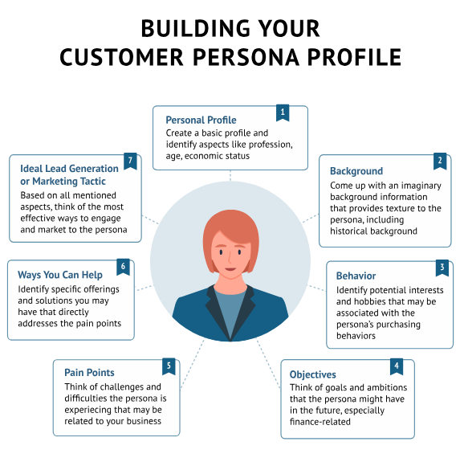

Slide 32
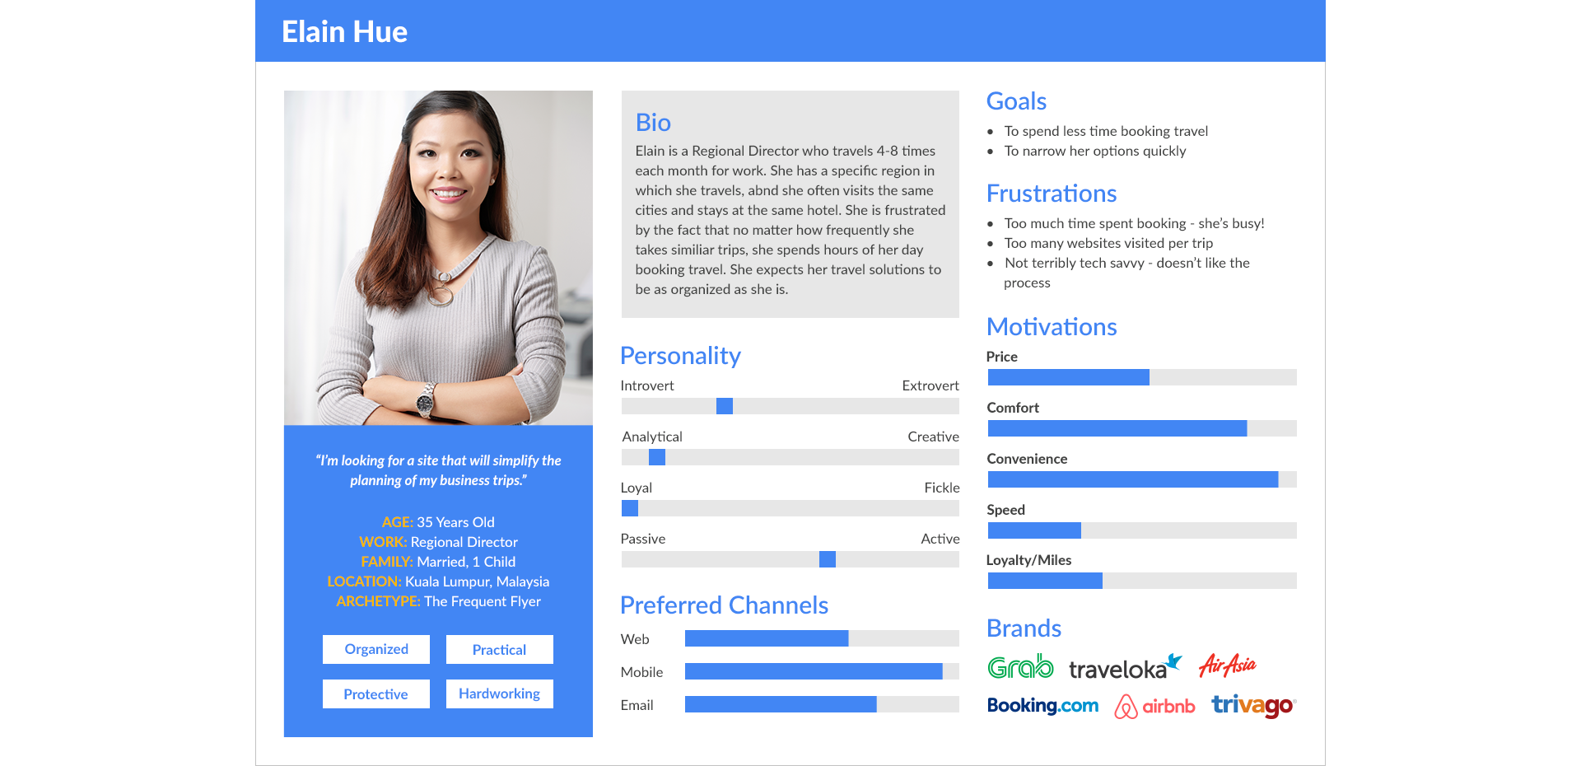

Slide 33
4 Ways to Get Started with Design Thinking
2. Build Scrappy Prototypes to Learn About Unmet Needs
You don’t need lots of time or resources to prototype. Begin with pen and paper or other accessible resources, like a slide deck, to mock up ideas and get feedback that will help you better understand the needs of your customers before investing in production.
Imagine that you worked with a large media firm undergoing a big reorganization. The team prototyped possible changes to the organizational structure by using constraints to create 6-week experimental teams. The goal was not for the teams to succeed necessarily, but for the company to gain some learnings that could inform a better structure

Slide 34
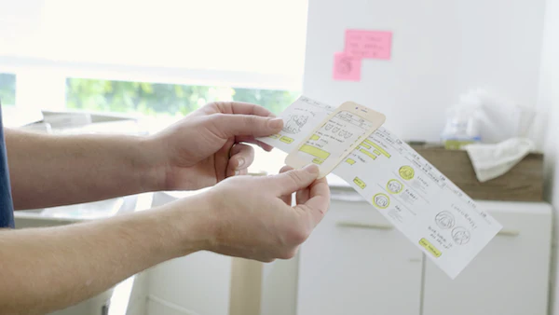
Very Easy Prototyping

Slide 35
4 Ways to Get Started with Design Thinking
3. Turn Problems into Questions
When presented with a problem, resist the urge to find a solution right away. Shift your mindset to instead ask a question that might get you closer to the root of the challenge or support an incremental improvement.
Take the example of an IDEO team who was working with a company struggling with retention. Instead of focusing on improving retention rates, they asked, How can we make a better employee experience? By refocusing on the real human needs, they uncovered insights that were better able to drive toward a solution.

Slide 36
4 Ways to Get Started with Design Thinking
4. Use Research to Understand the Past, Present, and Future
lots of different research techniques to generate insights around the needs of people including, but not limited to, observation, interviewing, immersive empathy, and exploring extreme users.
Generally, the type of research you can do falls into three buckets:
Generative Research: Used to identify new opportunities and explore needs.
Evaluative Research: Used to gather feedback on experiments and help you iterate forward.
Validating Research: Traditional market research intended to help you understand what is currently happening.
Generative and evaluative research are focused on the future and new ideas, while validating research is centered around what is occurring in the present. Balance your research approach to focus on what’s happening now and what could be in the future.

Slide 37
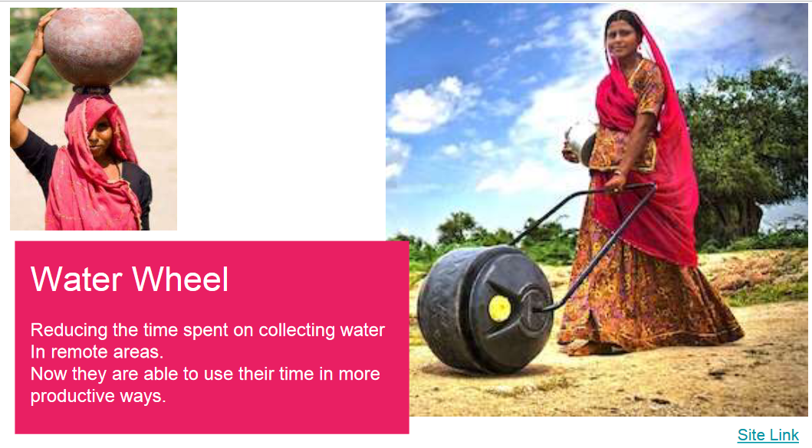

Slide 38
Conclusion:
The Empathy Map = The Human Centered Design
It is impossible to design anything without deciding (by assumption and correctly or not) without having someone in mind who cares about the solution.
Empathy Maps are usually used at the beginning of a design/problem-solving process and are usually kept alive by constantly revisiting and revising.

Slide 39
In This Lecture: Design Thinking
Wrap up
v
4 Ways to Get Started with Design Thinking
The Empathy Map
Customer persona
Types of personas
Why do we need a personas ?
Tips for customer personas
Empathy
Persona
Mapping

Slide 40



Thank You

