Slide 1



Security Information &
Security Overview
Lecture 1
HCIA-Security
Prepared by
Dr. Abdelrhman Ahmed

Slide 2
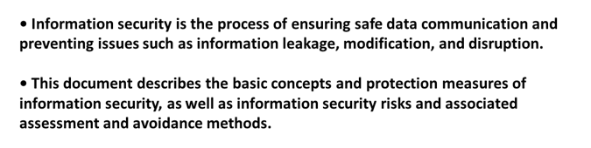
Chapter
Forward
01

Slide 3
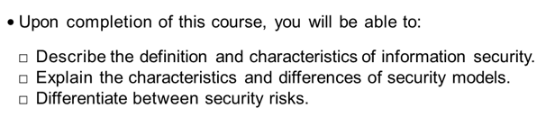
Chapter
01
Objective

Slide 4
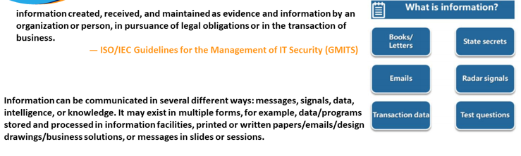
Chapter
01
Information

Slide 5
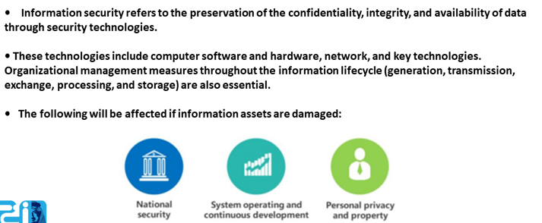
Chapter
Information Security
01

Slide 6
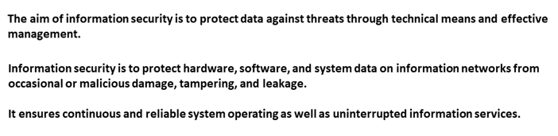
Chapter
Information Security Continuous
01

Slide 7
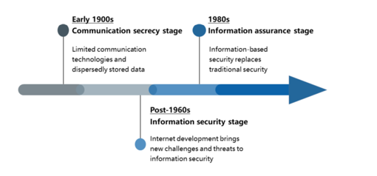
Chapter
Information Security Development
01

Slide 8
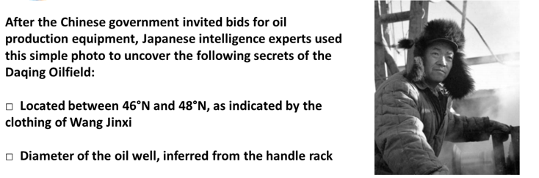
Chapter
Photo or Information Leakage?
01

Slide 9
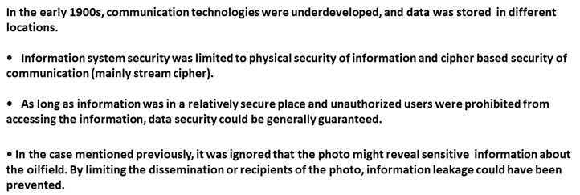
Chapter
01
Communication Security

Slide 10
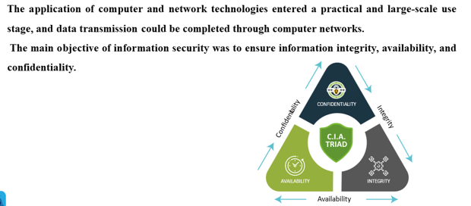
Chapter
01
Information Security Period

Slide 11
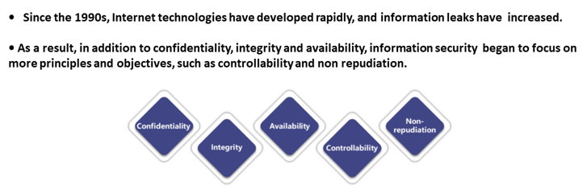
Chapter
Information Security Stage
01

Slide 12
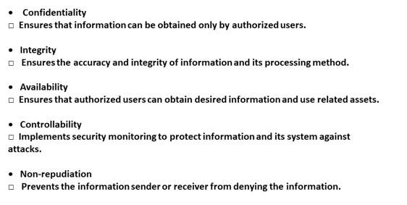
Chapter
Information Security Stage
01

Slide 13
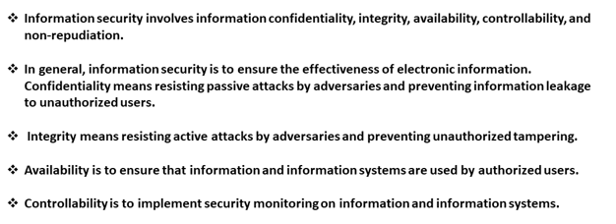
Chapter
Information Security Stage
01

Slide 14
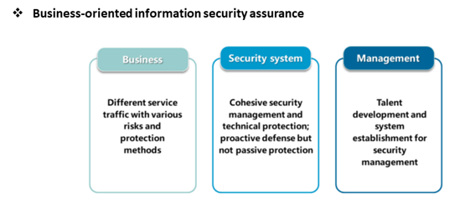
Chapter
01
Information Assurance Stage

Slide 15
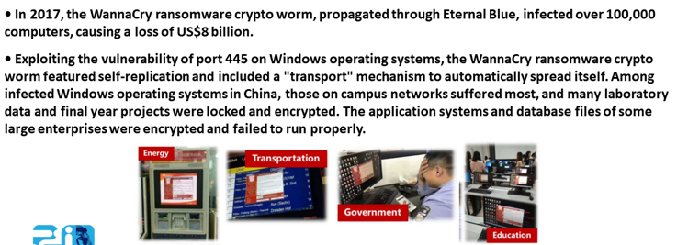
Chapter
01
Case - WannaCry

Slide 16
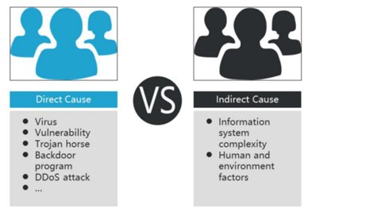
Chapter
What are the Causes of Such Attacks?
01

Slide 17
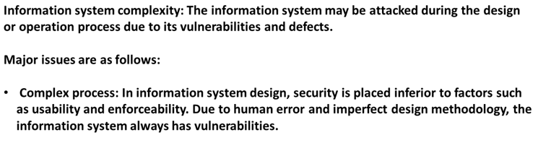
Chapter
What are the Causes of Such Attacks? Cont.
01

Slide 18
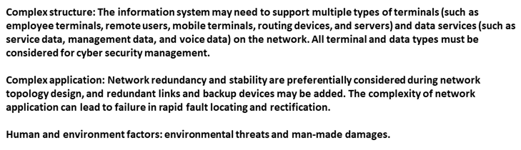
Chapter
What are the Causes of Such Attacks? Cont.
01

Slide 19
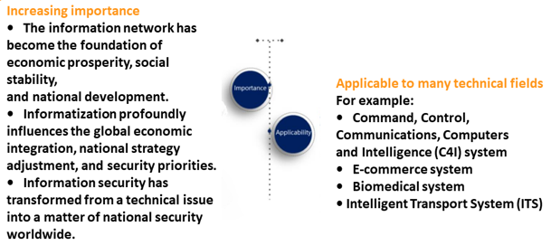
Chapter
Significance of Building Information Security
01

Slide 20



Thank You

