Slide 1

Marketing Management
MGM612
Dr. Magdy alhaj
Consumer Buyer Behavior

Slide 2

Chapter-5
Learn outcomes
After studying this chapter, you should be able to:
Define the consumer market and construct a simple model of consumer buyer behavior
Name the four major factors that influence consumer buyer behavior
List and understand the major types of buying decision behavior and the stages in the buyer decision process

Slide 3
Chapter-5
Model of Consumer Behavior
Consumer behavior
Reflects totality of consumer’s decisions with respect to the acquisition, consumption, and disposition of goods, services, time, and ideas by (human) decision-making units (over time).
Consumer buyer behavior
refers to the buying behavior of final consumers—individuals and households who buy goods and services for personal consumption
Consumer market
refers to all of the personal consumption of final consumers

Slide 4
Chapter-5
Consumer Behavior Involves Attitudes Towards
Products
Services
Activities
People
Ideas

Slide 5
Chapter-5
Model of Consumer Behavior
Marketing stimuli consists of the 4 Ps
Product
Price
Place
Promotion
Other stimuli include:
Economic forces
Technological forces
Political forces
Cultural forces

Slide 6
Chapter-5
Characteristics Affecting Consumer Behavior
Cultural Factors
Social Factors
Personal Factors
Psychological Factors

Slide 7
Chapter-5
Characteristics Affecting Consumer Behavior
Cultural Factors
  Buyer’s culture
  Buyer’s subculture
  Buyer’s social class
Social Factors
  Reference groups
  Family
  Roles and status

Slide 8
Chapter-5
Characteristics Affecting Consumer Behavior
Personal Factors
  Age and life-cycle stage
  Economic situation
  Lifestyle
  Personality and self-concept
Psychological Factors
  Motivation
  Perception
  Learning
  Beliefs and attitudes

Slide 9
Characteristics Affecting Consumer Behavior
Chapter-5
Cultural Factors
Culture is the learned values, perceptions, wants, and behavior from family and other important institutions

Slide 10
Chapter-5
Characteristics Affecting Consumer Behavior
Cultural Factors
Subculture are groups of people within a culture with shared value systems based on common life experiences and situations
Hispanic
African American
Asian
Mature consumer

Slide 11
Chapter-5
Characteristics Affecting Consumer Behavior
Cultural Factors
Social classes are society’s relatively permanent and ordered divisions whose members share similar values, interests, and behaviors
Social class is measured by a combination of occupation, income, education, wealth, and other variables

Slide 12
Characteristics Affecting Consumer Behavior
Chapter-5
Social Factors
Groups
Membership groups have a direct influence and to which a person belongs
Aspirational groups are groups to which an individual wishes to belong
Reference groups are groups that form a comparison or reference in forming attitudes or behavior
Opinion leaders are people within a reference group with special skills, knowledge, personality, or other characteristics that can exert social influence on others

Slide 13
Chapter-5
Characteristics Affecting Consumer Behavior
Social Factors
  Family is the most important consumer-buying organization in society
  Social roles and status are the groups, family, clubs, and organizations to which a person belongs that can define role and social status

Slide 14
Chapter-5
Characteristics Affecting Consumer Behavior
Personal Factors
Personal characteristics
Age and life-cycle stage
Economic situation
Lifestyle
Personality and self-concept

Slide 15
Chapter-5
Characteristics Affecting Consumer Behavior
Personal Factors
Age and life-cycle stage
Occupation affects the goods and services bought by consumers
Economic situation includes trends in:
Personal income
Savings
Interest rates

Slide 16
Chapter-5
Characteristics Affecting Consumer Behavior
Personal Factors
Lifestyle is a person’s pattern of living as expressed in his or her psychographics
Measures a consumer’s (activities, interests, and opinions) to capture information about a person’s pattern of acting and interacting in the environment

Slide 17
Chapter-5
Characteristics Affecting Consumer Behavior
Personal Factors
Personality and Self-Concept
  Personality refers to the unique psychological characteristics that lead to consistent and lasting responses to the consumer’s environment

Slide 18
Chapter-5
Characteristics Affecting Consumer Behavior
Personal Factors
Personality and Self-Concept
  Brand personality refers to the specific mix of human traits that may be attributed to a particular brand
  Self-concept refers to people’s possessions that contribute to and reflect their identities

Slide 19
Chapter-5
Characteristics Affecting Consumer Behavior
Psychological Factors
Motivation
Perception
Learning
Beliefs and attitudes

Slide 20
Chapter-5
Characteristics Affecting Consumer Behavior
Psychological Factors
Motivation
A motive is a need that is sufficiently pressing to direct the person to seek satisfaction
Motivation research refers to qualitative research designed to probe consumers’ hidden, subconscious motivations

Slide 21
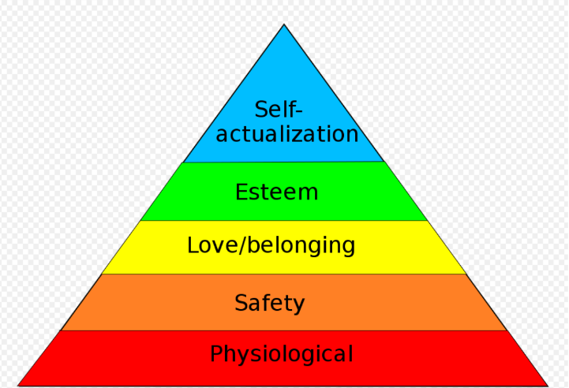
Chapter-5
Characteristics Affecting Consumer Behavior
Psychological Factors
Abraham Maslow’s Hierarchy of Needs
People are driven by particular needs at particular times
Human needs are arranged in a hierarchy from most pressing to least pressing
  Psychological
  Esteem
  Social(love/belonging
  Safety
  Self-actualization

Slide 22
Chapter-5
Characteristics Affecting Consumer Behavior
Psychological Factors
Perception is the process by which people select, organize, and interpret information to form a meaningful picture of the world from three perceptual processes
Selective attention
Selective distortion
Selective retention

Slide 23
Chapter-5
Characteristics Affecting Consumer Behavior
Psychological Factors
Learning is the changes in an individual’s behavior arising from experience and occurs through interplay of:
Drives
Stimuli
Cues
Responses
Reinforcement

Slide 24
Chapter-5
Characteristics Affecting Consumer Behavior
Psychological Factors
Beliefs and Attitudes
Attitudes describe a person’s relatively consistent evaluations, feelings, and tendencies toward an object or idea
Belief is a descriptive thought that a person has about something based on:
Knowledge
Opinion
Faith

Slide 25
Chapter-5
Types of Buying Decision Behavior
Complex buying behavior
Dissonance-reducing buying behavior
Habitual buying behavior
Variety-seeking buying behavior

Slide 26
Chapter-5
Types of Buying Decision Behavior
Complex Buying Behavior
When consumers are highly motivated in a purchase and perceive significant differences among brands
Purchasers are highly motivated when:
Product is expensive
Product is risky
Product is purchased infrequently
Product is highly self-expressive

Slide 27
Chapter-5
Types of Buying Decision Behavior
Dissonance-reducing buying behavior occurs when consumers are highly involved with an expensive, infrequent, or risky purchase, but see little difference among brands
Post-purchase dissonance occurs when the consumer notices certain disadvantages of the product purchased or hears favorable things about a product not purchased

Slide 28
Chapter-5
Types of Buying Decision Behavior
Habitual buying behavior occurs when consumers have low involvement and there is little significant brand difference
Variety-seeking buying behavior occurs when consumers have low involvement and there are significant brand differences

Slide 29
Chapter-5
The Buyer Decision Process
Five stages in the buyer decision process
Need recognition
Information search
Evaluation of alternatives
Purchase decision
Post-purchase behavior

Slide 30
Chapter-5
The Buyer Decision Process
Need Recognition
Need recognition occurs when the buyer recognizes a problem or need triggered by:
Internal stimuli
External stimuli

Slide 31
Chapter-5
The Buyer Decision Process
Information Search
Information search is the amount of information needed in the buying process and depends on the strength of the drive, the amount of information you start with, the ease of obtaining the information, the value placed on the additional information, and the satisfaction from searching

Slide 32
Chapter-5
The Buyer Decision Process
Information Search
Sources of information:
Personal sources—family and friends
Commercial sources—advertising, Internet
Public sources—mass media, consumer organizations
Experiential sources—handling, examining, using the product

Slide 33
Chapter-5
The Buyer Decision Process
Evaluation of Alternatives
Evaluation of alternatives is how the consumer processes information to arrive at brand choices

Slide 34
Chapter-5
The Buyer Decision Process
Purchase Decision
The purchase decision is the act by the consumer to buy the most preferred brand
The purchase decision can be affected by:
Attitudes of others
Unexpected situational factors

Slide 35
Chapter-5
The Buyer Decision Process
Post-Purchase Decision
The post-purchase decision is the satisfaction or dissatisfaction the consumer feels about the purchase
Relationship between:
Consumer’s expectations
Product’s perceived performance

Slide 36
Chapter-5
The Buyer Decision Process
Post-Purchase Decision
The larger the gap between expectation and performance, the greater the consumer’s dissatisfaction

Slide 37
Chapter-5
The Buyer Decision Process
Post-Purchase Decision
Customer satisfaction is a key to building profitable relationships with consumers—to keeping and growing consumers and reaping their customer lifetime value

Slide 38
Chapter-5
The Buyer Decision Process for New Products
Stages in the Adoption Process
Awareness
Interest
Evaluation
Trial
Adoption

Slide 39
Chapter-5
Consumer Behavior Across International Borders
Differences can include:
Values
Attitudes
Behaviors
The question for marketers is whether to adapt or standardize the marketing

