Slide 1


Creative and Scientific Thinking
Prepared by Prof. Shereen Taie
CRE252
Information Technology Department
Lecture 9

Slide 2




Creative and Scientific
Thinking
Lecture 9
CRE252
Information Technology Department
Prepared by
Prof. Shereen Taie
www.midocean.ae

Slide 3
Learning Objectives:
Decision making
Decision making steps
Types of decisions
Techniques for decision making
Chapter
04
www.midocean.ae

Slide 4
Decision Making
Chapter
04
www.midocean.ae

Slide 5
WHY DO WE NEED TO MAKE GOOD DECISIONS?
To achieve your goals.
To avoid mistakes.
“No one makes the right decision every time. But by developing your decision-making skills, you can increase your success rate!“
Chapter
04
www.midocean.ae

Slide 6

Chapter
04
Decision Making Definition
www.midocean.ae

Slide 7
Decision Making Definition
Is a task you perform when there are different things you can do and you pick one of them.
Remember: you make lots of decisions everyday
Chapter
04
www.midocean.ae

Slide 8
Decision Making Steps:
Some decisions are easy like what to eat in breakfast??? what to wear?
﻿﻿Some decisions are difficult like_choosing a career, changing a job
﻿﻿In every situation you have to search for....How to make right decisions??
Chapter
04
www.midocean.ae

Slide 9
Decision Making Steps:
Example:
﻿﻿Ronnie wants a new phone. Unfortunately, the one she wants costs 1500, and she has only 1000. She wonders she will get the rest of money?
Chapter
04
www.midocean.ae

Slide 10
Chapter
04
Decision Making Steps
www.midocean.ae

Slide 11
Decision Making Steps:
Relax
Say something positive
Identify the problem
What are the choices
Chapter
04
www.midocean.ae

Slide 12
Decision Making Steps:
5. Consider the consequences of your solutions
6. What is important
7. Make the decision
Chapter
04
www.midocean.ae

Slide 13
Decision Making Steps:
Step 1: Relax
Step 2: Say something positive
I Can do this
I Can deal with this
This gives you confidence and makes you feel good about yourself.
Chapter
04
www.midocean.ae

Slide 14
Decision Making Steps:
3. Identify the problem
Try to search out actual problem
Ronnie does not have enough money to buy the phone.
Chapter
04
www.midocean.ae

Slide 15
Decision Making Steps:
Step 4: What are your choices ????
Think of all the possible solutions
Come up with list of possible solutions
  Save her money until she has enough money
  Borrow money from her parents or friends
  Buy a cheaper phone
Chapter
04
www.midocean.ae

Slide 16
Decision Making Steps:
Step 5: Consider the consequences of your
solutions
List both the negative and positive consequences
  Assess the positive aspects of each proposed solution
  Assess the negative aspects of each proposed solution
Chapter
04
www.midocean.ae

Slide 17
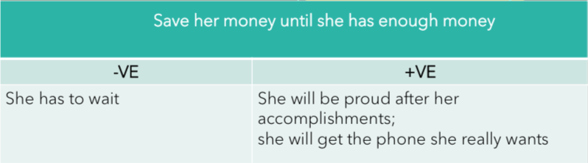

Decision Making Steps:
5. Consider the consequences of your solutions:
Chapter
04
www.midocean.ae

Slide 18
Decision Making Steps:
Step 6: What is important to you ????
Getting the phone she really wants??
Getting the phone right away?
Not borrowing money
choose what is important
Chapter
04
www.midocean.ae

Slide 19

Decision Making Steps:
Step 7: Make the decision
Ronnie decided to wait in order to save some more money for phone
Chapter
04
www.midocean.ae

Slide 20
Chapter
04
Types of decisions
www.midocean.ae

Slide 21
Types of Decisions:
Programmed Decisions
According to decision structure
Programmability
Non-programmed Decisions
Certainty
According to Certainty
Uncertainty
Uncertainty
Chapter
04
www.midocean.ae

Slide 22
Types of Decisions: Programmed:
Programmed decisions:
Are highly routine decisions
Deals with frequently occurring situations.
Chapter
04
www.midocean.ae

Slide 23
Types of Decisions: Programmed:
Example:
Monthly salary payment, absence of employees.
Chapter
04
www.midocean.ae

Slide 24
Types of Decisions: Non-Programmed:
Non-Programmed decisions:
Decisions about a novel problem.
Situations for Non-programmed decisions are unique
Chapter
04
www.midocean.ae

Slide 25
Types of Decisions: Non-Programmed:
Non-Programmed decisions:
Example:
Opening a new branch for the company, decrease sales
Chapter
04
www.midocean.ae

Slide 26
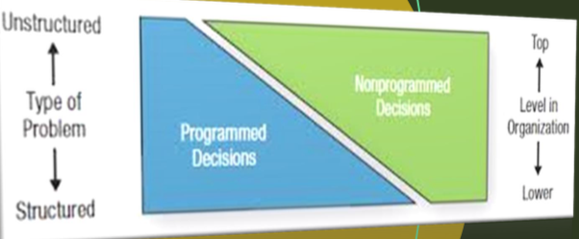
Organization level according to decision type
Top level managers are responsible for Non- programmed decisions
Low level managers are responsible for programmed decisions
Chapter
04
www.midocean.ae

Slide 27
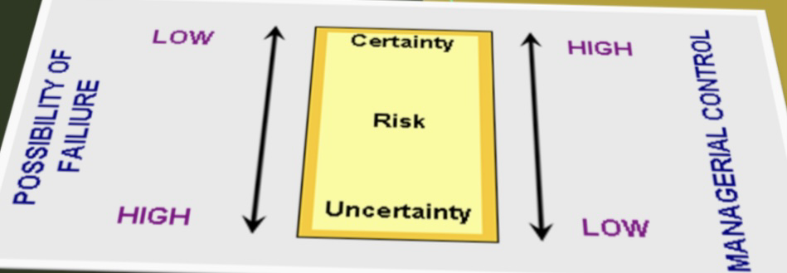
Decisions’ type according to Certainty:
Different views of types
Certain decisions ( eg. Salary calculation)
Uncertain decisions (eg. Climate change)
Chapter
04
www.midocean.ae

Slide 28
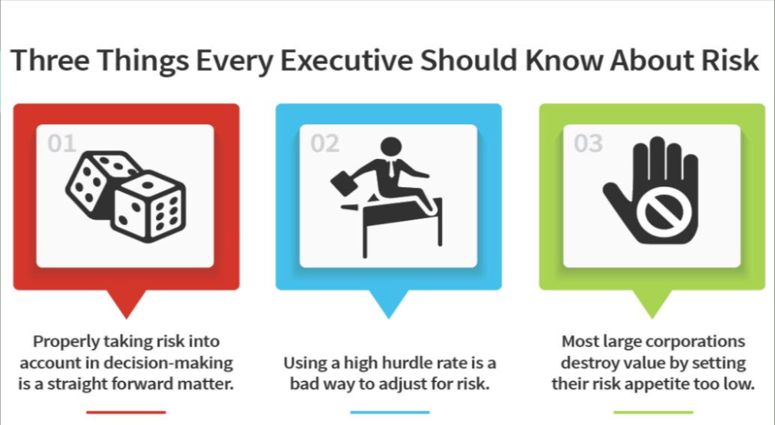
Chapter
04
www.midocean.ae

Slide 29
Chapter
04
Techniques for decision making
www.midocean.ae

Slide 30
Techniques for decision making:
Brainstorming
6 Hats To Thinking
Chapter
04
www.midocean.ae

Slide 31
Using Brainstorming Technique for decision Making:
Nowadays, brainstorming is critical for the growth of creative business ideas.
Chapter
04
www.midocean.ae

Slide 32
Using BrainstormingTechnique for decision Making:
It is a technique of using ideas from a group of people to give ongoing encouragement to that group to generate more fresh ideas.
Chapter
04
www.midocean.ae

Slide 33
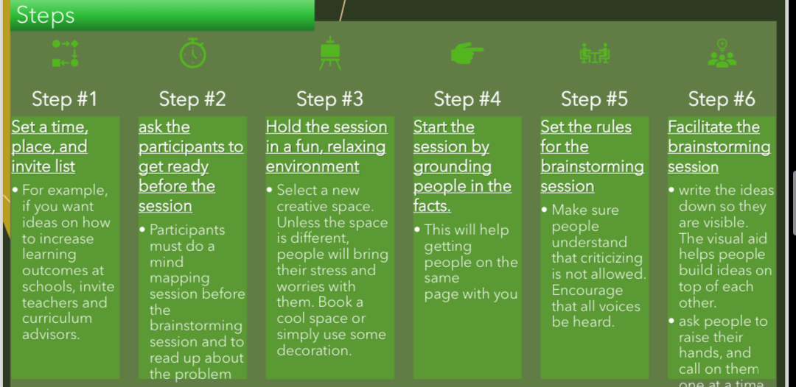
Chapter
04
After the brainstorming session, the evaluation process can begin
www.midocean.ae

Slide 34
Points to keep in mind while planning the brain storming session
1
2
3
4
5
6
Use An Inspiring Space
Focus On Quantity
Have The Right People
Eradicate Negative Thinking
Keep Time Limit in Mind
Equal Importance
Fill the brainstorming with interesting & motivational posters and enables the space to be organized in around table format.
Brainstorming session aims to generate as many ideas as possible
Staff members who are not too close to the problem
Someone must represent the client, who is well versed with the client’s desires
Eliminate negative responses such as: We tried and failed since this type of comments stops creativity.
If the session is stretched to more than 30 minutes it may not be as effective as it needs to be
Use someone other than the boss. The one who can help the session going as nothing kills a brainstorming session than an authority figure.
Chapter
04
www.midocean.ae

Slide 35
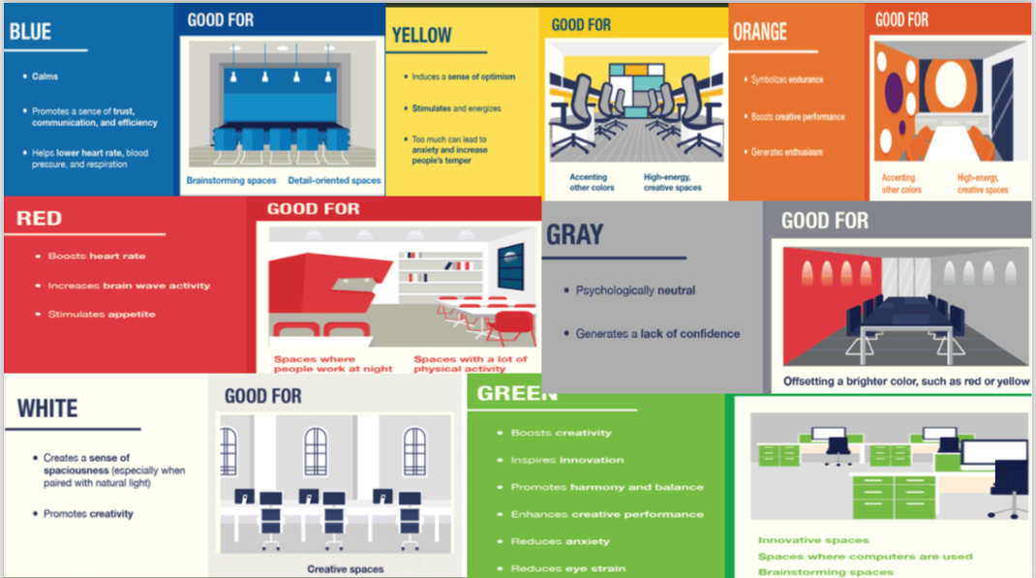
Chapter
04
www.midocean.ae

Slide 36
Brain storming Session
Group brainstorming about “how to help student concentrate in lectures?”
Chapter
04
www.midocean.ae

Slide 37
Determine
﻿﻿What is the place and the invite list of your session
﻿﻿How would you ask the participants to get ready before the session
﻿﻿How would you make the session a fun and relaxing environment
Chapter
04
www.midocean.ae

Slide 38
Exercise:
﻿﻿﻿﻿Do a brain storming session about one of the following topics:
  ﻿﻿How can we make learning more fun
  ﻿﻿How to stop students from skipping classes
  ﻿﻿How to help student get higher grades
Chapter
04
www.midocean.ae

Slide 39
Guide lines
➢ Use hats to focus the thinking … one at a time
➢ Don’t have to use all the hats
➢ Can use some hats more than once
➢ No debates or arguments … brainstorm
Chapter
04
www.midocean.ae

Slide 40
Guide lines
➢ Begin with blue
➢ End with blue
➢ Keep red brief
➢ Keep time (3-4 minutes per hat)
Chapter
04
www.midocean.ae

Slide 41



Thank You

