Slide 1


Project Governance
Prepared by Dr. Fayez Jrad
PMG 424
Lecture 0 Orientation

Slide 2



Project Governance
Lecture 0 Orientation
PMG 424
Prepared by
Dr. Fayez Jrad

Slide 3
Lecture
Session Outline
Orientation
Academic Agenda
Course Objectives
Learning Outcomes
Course Outline
Topics
Conclusion

Slide 4
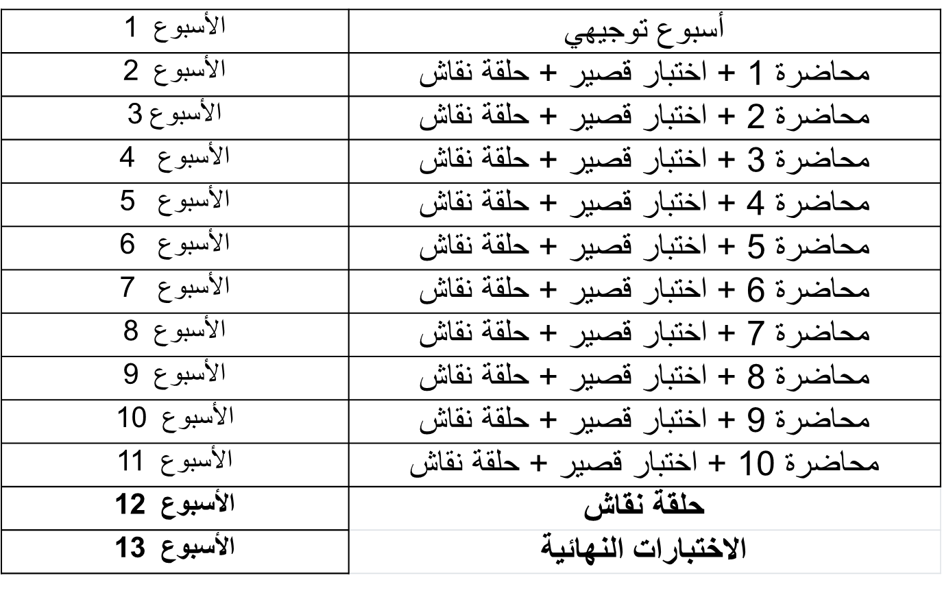
Academic Agenda

Slide 5
Quizzes & Exams
أسئلة الاختبار الفصلي / True-False / MCQ / أسئلة صوتية
تعد الإجابة على الاختبار بمثابة الحضور للطلاب
درجة الاختبار القصير 8 درجات/8 أسئلة (اجمالي 80 درجة)
فترة عقد الاختبار القصير /30 دقيقة/

Slide 6
Quizzes & Exams
الاختبار النهائي سيكون من خلال المودل
أسئلة الاختبار النهائي / True-False / MCQ / أسئلة صوتية
درجة الاختبار النهائي 20 درجة/20 سؤال
فترة عقد الاختبار النهائي /60 دقيقة/

Slide 7
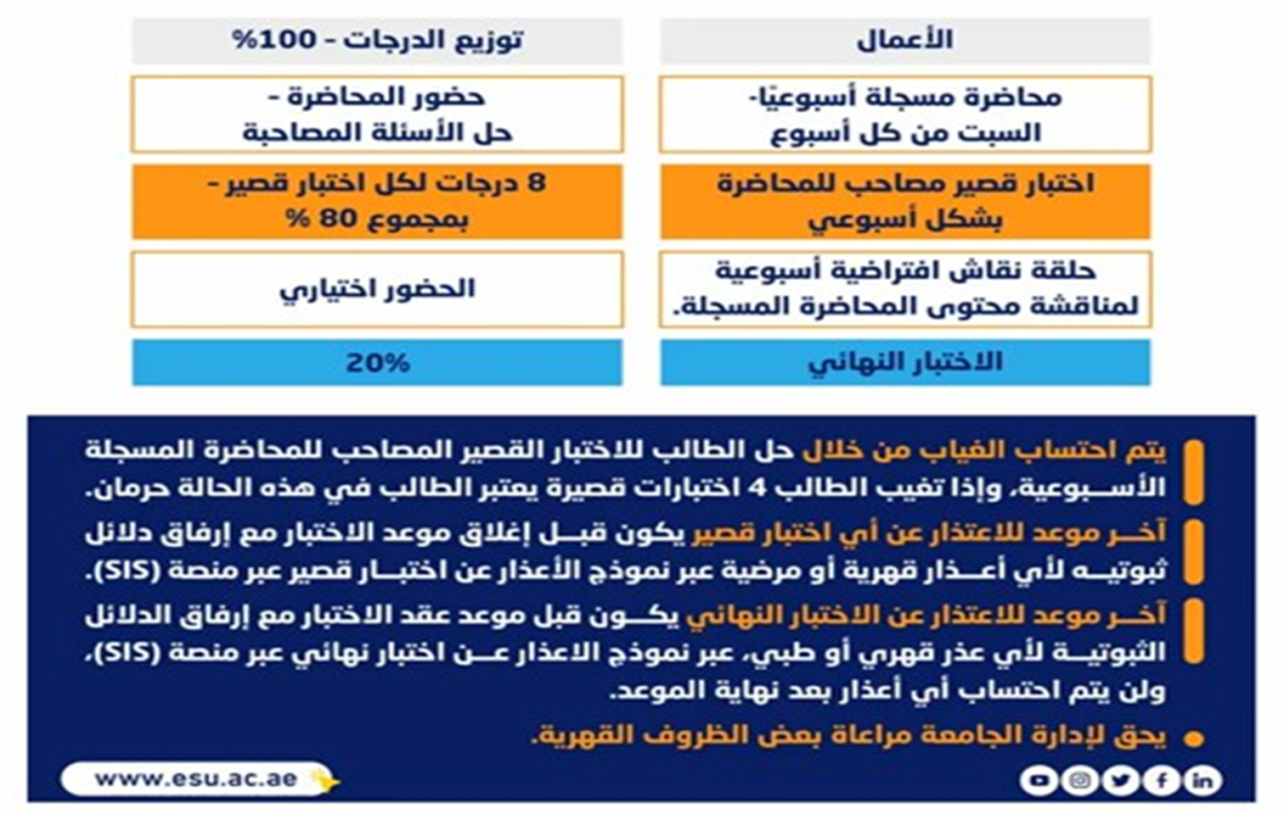
Obligations and Grading

Slide 8
Lecture
Online Lecture
Orientation
Answer your questions/inquiries
Solve different issues/problems
Discuss your opinions with the instructor/classmates
Trigger activities related to previous session topics

Slide 9
Lecture
Course Objectives
Orientation
Introducing the principles of project governance.
Using governance to establish a good project structure, harmonizes processes and resources, and provides a smooth path to achieve project goals.
Applying governance to remove costly inefficiencies that negatively impact smooth running and reduces the risk of conflict.
Providing an opportunity to discuss enterprise projects and other megaprojects.

Slide 10
Lecture
Learning Outcomes
Orientation
Categorize the core issues of project governance within the context of projects and programs.
Evaluate and critique the strengths and challenges of various governance structures.
Given a large enterprise project, recommend methods and procedures that ensure the project is governed according to best practices.
Evaluate how changes to project scope may impact the project’s schedule, cost, and quality, and create a scope document that will produce the desired project outcomes.

Slide 11
Lecture
Orientation
Course Outline
Lecture 1: Definition of Governance.
Lecture 2: Governance Structures and Management Scope.
Lecture 3: Creating Project-focused Governance Structures.
Lecture 4: Transparent and Accountable Organizations.
Lecture 5: Project Ownership vs. Asset Ownership.
Lecture 6: Towards an Integrated Governance Model.
Lecture 7: Effective Project Governance.
Lecture 8: Governance of Portfolios.
Lecture 9: Governance of Programs
Lecture 10:Governance of Projects

Slide 12
Lecture 1:
Introduction to Projects and Governance
Project Concept
A temporary endeavor to create a unique product, service, or result.
Characteristics:
  Complexity
  Limited resources
  Focus on clear objectives

Slide 13
Lecture 1:
Introduction to Projects and Governance
Project Life Cycle
Framing: Conception and initial planning.
Planning: Developing detailed plans.
Execution: Performing the actual work.
Closure: Delivery and closing.

Slide 14
Concept of Project Governance.
Derived from Latin "gubernare" meaning to steer/direct.
Includes: values, responsibilities, processes, and policies that enable projects to achieve organizational objectives.

Slide 15
Lecture 2:
Governance Theories and Their Impact on Project Management
Core Governance Theories
Shareholder Theory: Focuses on maximizing shareholder returns (organization as private property).
Stakeholder Theory: Aims to create value for all parties (employees, customers, community, suppliers) by balancing interests.

Slide 16
Economic & Agency Theories
Transaction Cost Economics: Applied in the pre-contract phase (make-or-buy decisions).
Agency Theory: Applied in the post-contract phase; addresses information asymmetry between principal and agent (project manager).

Slide 17
Organizational Paradigms (Based on Orientation)
Behavioral-oriented Organizations: Strict adherence to processes and standards regardless of who executes.
Outcome-oriented Organizations: Focus on achieving results with greater flexibility.

Slide 18
Four Governance Models (Based on Orientation & Shareholder Philosophy)
Conformist: Strict process compliance to achieve lowest cost (repetitive projects).
Flexible Economist: Cost reduction through efficient methodologies led by experienced project managers.
Versatile Artist: Maximizing benefits by balancing requirements of multiple stakeholders.
Agile Pragmatist: Maximizing technical value by incrementally delivering specific functions.

Slide 19
Lecture 3:
Relationship Between Projects and Organizational Strategy
Strategy and Projects
Projects are created to achieve organizational strategic objectives.
The relationship operates through two cycles:
  Delivery Cycle: Strategy → Objectives → Portfolios → Programs → Projects.
  Control Cycle: Information flow from projects → higher governance levels (via PMOs).

Slide 20
Project as a Temporary Organization & Governance Objectives
Project as a temporary organization formed to achieve a specific outcome.
Objectives of project governance:
  Ensure consistent and predictable delivery.
  Create a supportive environment for success.
  Prioritize projects.
  Identify troubled projects.

Slide 21
Key Governance Bodies
Board of Directors: Sets strategy, defines types/quantities of projects, decides governance model.
Portfolio Management: Selects projects, sets priorities, allocates resources, handles risks and resource bottlenecks.
Sponsor & Steering Group: Sponsor owns the Business Case; Steering Group (chaired by sponsor) approves budget, schedule, success criteria.
Project Management Office (PMO): Strategic (overall objectives) and tactical (supports managers with tools/methodologies).
Program Governance: Program = group of related projects with a common goal. Program Manager acts as sponsor; a Program Board may be formed.

Slide 22
Lecture 4:
Project Management Governance Framework
Factors Affecting Project Management Quality
Education (What can be done): Improves project manager skills, tools, methodologies.
Management Demands (What should be done): Set by senior management (methodologies, reports, planning/control techniques).
Perceived Economic Pressure (What is done): The project manager's feeling of financial pressure or risk of failure (can lead to short-sighted decisions).

Slide 23
Progressive Governance Framework
Step 1 (Foundations - Low investment, low return): Basic training, forming steering committees.
Step 2 (Expansion - Medium investment, medium to high return): External certifications, establishing PMOs.
Step 3 (Maturity - High investment, very high return): Advanced training, benchmarking.

Slide 24
Lecture 5:
Project Ownership vs. Asset Ownership
Asset and Asset Owner Concept
Asset: Anything of value (tangible, intangible, functional) that provides economic benefits.
Asset Owner: Executive responsible for classifying the asset, identifying users, and ensuring compliance.

Slide 25
Project Owner vs. Project Manager
Project Owner: Strategic leader responsible for project vision, objectives, securing funding, and ensuring business case (no daily management responsibility).
Project Manager: Responsible for daily management (schedule, budget, team).
Distinguishing the two clarifies responsibilities, accountability, and efficient resource allocation.

Slide 26
Lecture 6:
Towards an Integrated Governance Model
Components of an Integrated Model
No single governance model fits all organizations.
Components of the integrated model:
  Governance Model: Defines strategic vision.
  Governance Bodies: Entities responsible for implementation (Board, Steering Groups).
  Institutional Theory: Focuses on legitimacy and social acceptance.

Slide 27
Three Forms of Legitimacy
Pragmatic: Based on self-interest.
Moral: Based on ethical approval.
Cognitive: Based on simplicity and clarity.
True success comes from integrating economic and social dimensions.

Slide 28
Lecture 7:
Problems of Ineffective Project Governance
Three Categories of Ineffective Governance Problems
Confusion in governance objectives: Excessive focus on regulatory reporting or stakeholder management.
Conservatism in risk management: Reliance on consensus-based decision-making (slow processes).
Stakeholder issues: Either ignoring them or involving too many.

Slide 29
Characteristics of an Effective Governance Framework
Clear objective.
Fast decisions.
Clear accountability.
Distinct structure between permanent organization and temporary project.
Focus on project delivery as a service.

Slide 30
Lecture 8:
Portfolio Governance
Portfolio Concept and Objectives
Project Portfolio: Grouping of projects and programs with similar skills or needs.
Objective: Effectiveness (doing the right things) by selecting priority projects that support strategy.
Portfolio Governance Structures
Multi-project organizations: Focus on each project individually.
Project portfolios: Maximize effectiveness through skills and objectives.
Project programs: Maximize efficiency through major goals.
Hybrid: Combine efficiency and effectiveness.

Slide 31
Portfolio Optimization Strategies
Value maximization
Balancing
Strategic alignment

Slide 32
Lecture 9:
Program Governance
Program Concept and Objectives
Program: Group of interrelated projects to achieve a common goal not achievable by a single project.
Objective: Maximize efficiency (doing things the right way) and leverage synergies among projects.
Program Types and Governance Mechanisms
Program types: Temporary (defined end date) / Semi-permanent (no defined end date).
Governance mechanism: Executive sponsor + Program Steering Committee.
Program governance focuses on: benefits management, stakeholder management, and governance of projects within the program.

Slide 33
Lecture 10:
Modern Trends in Governance
Difference between governance and management:
  Governance: "Should we do it?"
  Management: "How do we do it?"
Basic Principles of Governance
Strategic alignment
Accountability
Transparency
Assurance
Stakeholder engagement

Slide 34
Governance and Project Management Methodologies
Governance and Project Management Methodologies
Governance methodologies: Top-down / Bottom-up.
Project management methodologies: Predictive, adaptive, emergent.
Future Trends
Adaptive governance.
Data-driven and AI-based governance.
Integration of ESG criteria.
Digital and hybrid governance.
Use of smart tools (e.g., Jira, Tableau).

Slide 35
Conclusion
Definition of governance | Defining governance and why we need it.
Types of Governance Structures | Exploring existing governance theories, paradigms, and structures
Creating Project-focused Governance Structures | Understanding governance in the context and scope of project management
Transparent and Accountable Organizations | Discussing how to create transparent and accountable organizations and the main roles needed
Project Ownership vs Asset Ownership | Differentiating between project ownership and asset ownership
Understanding Project Governance Structures | Understanding governance structures within different scales of projects, programs, and portfolios
Governance, Decisions, Risks, and Resources | Clarifying the interlink between governance and decision-making, risk management, and resource allocation
Verification and Validation | Presenting a model for governance of projects, programs and portfolios, and envisaging the future of project governance
Enterprise PM | Describing how projects on a companywide scale

Slide 36

Reference

Slide 37



Thank You

