Slide 1


Slide 2

Lecture 7
Key Learning Points
The credit process contains several sequential steps, including identifying the credit opportunity, evaluating credits, and monitoring credits on an ongoing basis.
To analyze the borrower’s ability to repay, banks engage in a complex credit analysis process that critically assesses the financial position of the borrower using several different methods and sources of information.

Slide 3
Lecture
Key Learning Points
The five C’s of credit provide a basic framework for good lending and its principles hold true for lending to both small and large companies. Analyzing the business, financial and structural risks.
There are many different sources of information that can assist in the analysis of credit risk of a company. However, the core source is the company’s annual report and audited financial statements, although the “numbers” don’t always tell the full story!

Slide 4
Types of Credit Products
Types of Credit Products:
This section explains the most common commercial and retail credit products that combine the key credit product characteristics covered in the previous section. The credit products are listed alphabetically.

Slide 5
1. Agricultural Loans
Agricultural loans support lending for farming and other agricultural production. Clients borrow money to finance the purchase of fixed assets such as land and equipment, or to cover their cash flow requirements for the growing season until the farm has had time to sell its goods. Facilities are generally medium to long term but can also be short term in nature (to finance seed, feed, and cattle for rearing). The types of loans used may range from asset-based to simple revolving facilities.

Slide 6
2. Asset-Based or Secured Lending
Asset-based or secured lending involves a bank or commercial finance company lending specifically against the borrower’s assets. Commercial bankers will generally lend against inventory (also called stock, stock-in-trade, or items for sale) and receivables (factoring). Asset-based loans generally require a company to be able to repay a loan out of operational cash flow. Thus, the value and marketability of the collateral are important. Asset-based lending can be extended to both commercial and retail customers.

Slide 7
3. Automobile Loans
Automobile or car loans come either as direct automobile loans that finance the purchase of a car between the bank and the customer, in which the bank secures the loan using the car as collateral, or as indirect automobile loans, which are loans arranged between an automobile dealer and the customer. In an indirect automobile loan, the customer applies for a loan through the dealer, who then forwards the borrower’s information to the lending bank. In some instances, this type of loan is thought to allow the borrower (auto mobile purchaser) the ability to obtain a lower interest rate on the loan if the dealer and the bank have an arrangement. The bank may offer a lower interest rate to customers introduced by the dealer.

Slide 8
4. Commercial Paper
Commercial paper refers to very short-term, unsecured notes generally issued by large and financially strong companies. The funds received by the companies are generally used to purchase inventory or manage everyday capital needs. Maturities range from three weeks to nine months, and the bonds usually benefit from a traditional credit line, which is known as a backstop—credit support or backup funds that provide a secondary source of repayment. The commercial paper market is primarily used by large, publicly traded corporations, such as Apple, General Electric, or Wal-Mart.

Slide 9
5. Corporate Bonds
Corporate bonds are debt securities issued by companies and sold to institutional investors such as pension funds or in some cases individuals. Corporate bonds represent a major source of financing, especially for large companies. When corporate bonds are first issued, they are issued in what is called the primary market. But once the bond has been issued and allocations have been made, investors may then trade the bonds in what is called the secondary market.

Slide 10
6. Covered Bonds
Covered bonds are bank issued corporate bonds backed—or covered—by a pool of mortgages or public sector loans and are similar to asset-backed securities created in securitization (Section 5.2.3). However, a critical difference is that if the mortgages or loans in the pool underlying the covered bond are unable to repay the covered bondholders, then the covered bondholders have a general claim on the assets of the bank in addition to the bond’s assets. This is called “dual recourse.”

Slide 11
7. Factoring
Factoring is a service that a specialist financial institution or bank offers to help a company meet its cash requirements and reduce its potential credit losses. There are different types of factoring approaches that can be used separately or in combination. All assure the company of earlier receipt of cash payment. The advantage of factoring is that the company is better able to manage its assets, particularly its cash position.

Slide 12
The major disadvantage is that the company will not receive the full amount of the money due, as the bank or the organization providing the factoring services charges a percentage of the assets as a fee for providing the service, typically called a haircut. The following is a listing of the various types of factoring services available to companies:

Slide 13
Maturity factoring. The bank will effectively take over the company’s receivables, work to collect on them, and take a commission from what-ever is collected. The company receives the funds when due on the invoice, minus the commission.
Finance factoring. The bank will advance funds to the company using the goods and services to be produced with the funds as collateral.

Slide 14
Discount factoring. The bank will advance funds to the company, usually representing no more than 85% of the receivables, and then take full responsibility for collecting the funds owed.
Undisclosed factoring. The bank will take full responsibility for the ` invoices due, pay the company up to 85% of that amount, and then appoint the company its agent to collect the invoices. In this arrangement, outsiders do not perceive the company as needing the funding, and it appears as if the company is conducting its business in a normal manner.

Slide 15
8. Leasing
Leasing allows an individual or a firm (called the lessee in leasing transactions) the right to use an asset that it does not own. In exchange for the right to use an asset, the lessee will make regular contractual payments to the lessor. The lessor owns the asset and provides the lessee the right to use the asset. Leases are both retail and commercial products. As a retail product, leases are often used to finance cars and other expensive consumer products. Retail leases offer flexibility over the time during which lease payments may be made and may even offer lower payments that fit with the lessee’s ability to pay.
As a commercial product, leases are widely used to finance expensive equipment. One of the main reasons for this is that leasing does not require the large capital outlay required to purchase the equipment. This approach is especially beneficial to small and/or rapidly growing firms, where access to cash and the availability of capital may be limited.

Slide 16
Many leasing arrangements include a provision that at the end of the lease the lessee has the right, but not the obligation, to purchase the leased asset at a price negotiated or set when the lease is first signed. This option provides considerable flexibility to the lessee, and may be particularly useful to finance the acquisition of equipment that does not become quickly obsolete. In other instances, the lessee at the end of the lease simply returns the equipment to the lessor, who then must determine what to do with the old equipment. The lessee can then negotiate the leasing and/or acquisition of newer equipment.
A lease where the lessee pays a fee for using the equipment and then returns it to the lessor at the end of the lease’s term is called an operating lease, and a lease that may entail the lessee acquiring the equipment at the end of the term is called a financing lease.

Slide 17
9. Mortgages
A mortgage is a financial arrangement that enables a borrower to acquire a real estate asset and to use the real estate as collateral for the debt. Mortgages are extended to both commercial and retail customers. The real estate being purchased is used as collateral or security for the loan.
Mortgages can be divided into commercial and residential mortgages. Commercial mortgages predominantly finance office buildings, factories, and any other type of real estate that is used for business or industrial purposes. The main users of commercial mortgages are businesses that consider this as an advantageous source of financing because of the lower rate the bank offers in exchange for having the real estate as collateral. Residential mortgages exclusively finance purchases of residential real estate, such as houses and apartments.

Slide 18
EXAMPLE
To support its expansion, Growth Corporation’s management decides to purchase a new ware- house facility and retail distribution center. Bank K provides a USD 5,000,000 mortgage to finance the purchase. In exchange for the loan, Growth Corporation pledges the warehouse as collateral against the loan. Should Growth Corporation fail to make payments on the mort- gage, it may lose the facility to the bank.

Slide 19
10. Overdraft Facilities
Overdraft facilities allow borrowers to borrow funds in excess of those they have deposited into their checking accounts. Overdraft facilities offer a flexible type of financing, but the interest rate is usually significantly higher than other financing options, making it a relatively expensive option. As deposits are received on the account, they are first applied to any borrowed amount outstanding from the overdraft facility. Once the overdraft is repaid, any remaining funds would then be applied to the borrower’s account as a deposit.

Slide 20
11. Home Equity Credit Lines and Home Equity Loans
Popular in the United States, home equity credit lines or loans allow home-owners to borrow against the value of their property in a way similar to mortgages (see Section 4.5.9 for a discussion on mortgages). Generally, there are two different types of home equity credits.
Home equity credit loans are personal revolving credit facilities (see Section 4.5.13 on revolving lines of credit) collateralized by the borrower’s property. The bank issuing the home equity loan limits the amount of the loan to a certain percentage of the equity the homeowner has in the home.
The loan- to-value (LTV) ratio, the ratio of the value of the property to the amount of money borrowed (see Section 4.4.5), is an important analytical tool to determine a home equity loan. The holder may draw down on the home equity loan at any time during its term up to the amount of the line of credit. Interest on the loan is usually tied to a major index such as the U.S. prime rate or LIBOR (London Interbank Offered Rate), plus a set interest percentage.

Slide 21
12. Project or Infrastructure Finance
Project or infrastructure finance funds long-term infrastructure and industrial projects, usually by combining the resources of several banks or other financial institutions to provide the necessary capital. The project itself provides the security for the loans, and the loans are repaid from the cash flow generated from the project.

Slide 22
13. Revolving Lines of Credit
With a revolving line of credit the customer is free to borrow funds and pay back when needed, subject to a pre-agreed credit limit. These lines are generally provided to businesses with a temporary or seasonal borrowing requirement (these are considered commercial loans). Credit cards and home equity lines of credit are examples of retail forms of a revolving line of credit.
Credit card lending is an example of revolving consumer loans and is based on preauthorized lines of credit that can be drawn down as the consumer wishes, through either purchases or cash withdrawals. Credit cards, which are used to access the revolving consumer loans, have one of the highest consumer credit growth rates. The rapid increase in credit card debt has been facilitated by the use of EFTPOS (electronic funds transfer at point of sale) and ATMs (automatic teller machines) in many countries.

Slide 23
The bank extending a revolving line of credit has no real control over whether, when, or how long the funds are used and assumes a greater risk in providing revolving lines of credit than a conventional loan. When financially stressed borrowers with access to revolving lines of credit start to draw on their lines of credit, the bank’s exposure and credit risk increase. This is an inherent risk of revolving lines of credit, and this risk is similar to that of overdraft facilities.

Slide 24
EXAMPLE
Growth Corporation is quickly expanding and wants to be assured that it has the financing to continue this process. It negotiates a USD 1 million three-year revolving line of credit with Bank N. During the first year, it draws down USD 550,000 of the loan, which it repays, with interest, by the end of the year. Because it has a commitment from the bank for another two years, it can continue to draw down and repay as often as it likes until either it reaches the USD 1 million loan limit, or the three-year maturity period expires. Each time it draws down and repays that amount, the repaid funds become available for borrowing. For example, when Growth Corporation repaid the USD 550,000, the full USD 1 million was again available for it to use.

Slide 25
14. Syndicated Loans
Syndicated loans are loans provided to a borrower through the combined activities of several banks. Banks working together to provide the loan are called a consortium. Syndicated loans provide capital to a company when the ability or desire of an individual bank to meet the financing need(s) of the company is insufficient. There are a number of benefits to banks for working as a consortium that include but are not limited to:
Allowing a bank to participate in a lending transaction where it may not otherwise have the opportunity because of the bank’s balance sheet or other constraints
Allowing a bank to reduce its overall risk exposure for the transaction, as any potential loss will be borne by all the bank consortium members.
In a syndicated loan, usually one of the participating banks will act as the agent for the transaction on behalf of all the banks, coordinating their efforts to get the transaction done.

Slide 26
The Credit Process:
Credit analysis or credit assessment is the process of assessing risk as measured by a borrower’s ability to repay the loan. Within the credit analysis or assessment process, analysts also consider possible recovery in the case of default and evaluate the support collateral and other credit support tools that bear on the bank’s final decision to develop a creditor relationship. Having assessed the possibility of repayment, the decision to proceed with a loan is then, effectively, a commercial decision: Is the risk of repayment acceptable, given the exposure to the borrower, and do the terms sufficiently mitigate the bank’s risk?

Slide 27
Credit assessment is not an exact science, and no one factor, ratio, or other indicator alone determines if a particular loan is a suitable risk. The banking industry has developed numerous methods to help structure the credit process and improve financial results and profitability.

Slide 28
Some methods include internal scorecards and facility and borrower ratings; cash flow analysis; computer sensitivity models; and external ratings such as those issued by Moody’s Investors Service, Fitch Ratings, and Standard & Poor’s. Whatever methods are used, credit analysts must balance all the available information and deliver an objective and well-reasoned opinion of the overall risk associated with a particular loan or credit product. Figure 4.6 shows the steps involved in the credit process.

Slide 29
Credit Risk scorecards are mathematical models that attempt to provide a quantitative estimate of the probability that a customer will display a defined behavior (e.g. loan default, bankruptcy or a lower level of delinquency) with respect to their current or proposed credit position. Credit Risk scoring uses observations or data from borrowers who defaulted on their loans plus observations on a large number of borrowers who have not defaulted. Statistically, estimation techniques such as logistic regression are used to create estimates of the probability of default based on this historical data. This model can be used to predict the probability of default for new clients using the same observation characteristics (e.g. age, income, house owner). The default probabilities are then scaled to a “credit score.” This score ranks clients by riskiness without explicitly identifying their probability of default.

Slide 30
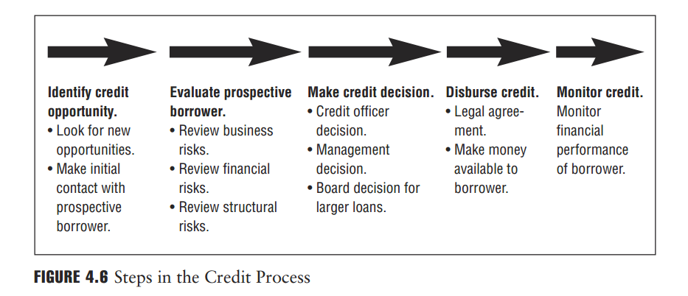

Slide 31
1. Identifying the Credit Opportunity
In the credit process, the loan officer or relationship manager initiates contact with the potential borrower. In many banks, the chief function of the loan officer is marketing: to seek out new business opportunities and present them for evaluation.

Slide 32
2. Credit Evaluation—Companies
After a loan officer identifies an opportunity, the officer will gather all required information from the borrower and present it to the credit analyst. The credit analyst then analyzes the creditworthiness of the potential borrower by evaluating the proposed loan type and the potential risks (business risk, financial risk, and structural risk), and then makes a recommendation to proceed with the loan or not and, if so, on what terms (e.g., amount to be lent, the interest rate for the loan, use of collateral or other security, maturity,
etc.).

Slide 33
The credit analyst’s evaluation is often accompanied by qualitative factors, including site visits to the customer, evaluation of the current business and the potential for continued business, the availability of collateral to support the credit, and other relevant information.

Slide 34
The credit analyst collects and reviews information about the potential borrower, including:
Internal bank records and account performance
Historical and current financial accounts
Management accounts and projections
External ratings of the borrower as provided by independent rating firms such as Dun & Bradstreet or similar (for smaller businesses), and Moody’s, Standard & Poor’s, or Fitch Ratings (for larger firms)
Company websites and brochures
Group structure, ownership, and management information, including information on the board of directors

Slide 35
3. Credit Decision Making
Often, routine credit decisions are made by the loan officer in conjunction with the credit analyst or by a committee. Loan officers are generally compensated by the number of loans generated. This creates a potential conflict of interest and, therefore, poses a risk when the loan officer makes the loan decision. It is in the interest of a loan officer to underwrite as many loans as possible, which may result in the loan officer ignoring signs that would counter the decision to extend the loan.
To guard against this problem, banks implement processes that require all loans to be reviewed by an independent senior manager or credit analyst. Each bank has developed credit decision policies that delineate what types of loans—size, exposure, and business— need to be signed off or ratified by senior management and/or the bank board committee. Generally, the larger and more risky a loan is, the more likely that the loan passes through several levels of the bank’s decision-making hierarchy.

Slide 36
4. Credit Disbursement
Once the credit request has been approved, the loan agreement is prepared for signature. The loan agreement is a legal contract between the bank and the borrower and includes a description of undertakings and understandings, such as the principal, the stated interest rate and its calculation, the schedule of payments and repayments, the use of collateral, covenants, and so on. Once the contract is signed, funds are made available to the borrower.

Slide 37
5. Credit Monitoring
After the credit is underwritten and the funds have been made available to the borrower, the bank continues to monitor the financial performance of the borrower. The contract usually has hard and soft covenants or provisions . An example of a hard covenant is a requirement that the borrower maintains certain key financial ratios throughout the life of the loan. An example of a soft covenant is the requirement that the borrower delivers its financial statements to the lender in a timely manner.

Slide 38
The Credit Analysis Process:
As previously noted, despite the emphasis on quantitative modeling and vigilance, credit analysis is not an exact science, as there is no single formula, ratio, or tool that will determine if a company is an acceptable credit risk. Therefore, it is important to follow some basic principles and practices of good lending as illustrated by the frameworks outlined next.

Slide 39
1. The Five Cs of Credit
The Five Cs of Credit provide a basic framework for good lending, which is particularly relevant to small business lending and to the small and medium enterprise (SME) sector. Bank financing is the primary option for small or recently established firms because these firms do not have access to the financial markets—to issue stocks or bonds—in the same way large, established companies with an established financial history do. Figure 4.7 depicts a schematic of the Five Cs.

Slide 40
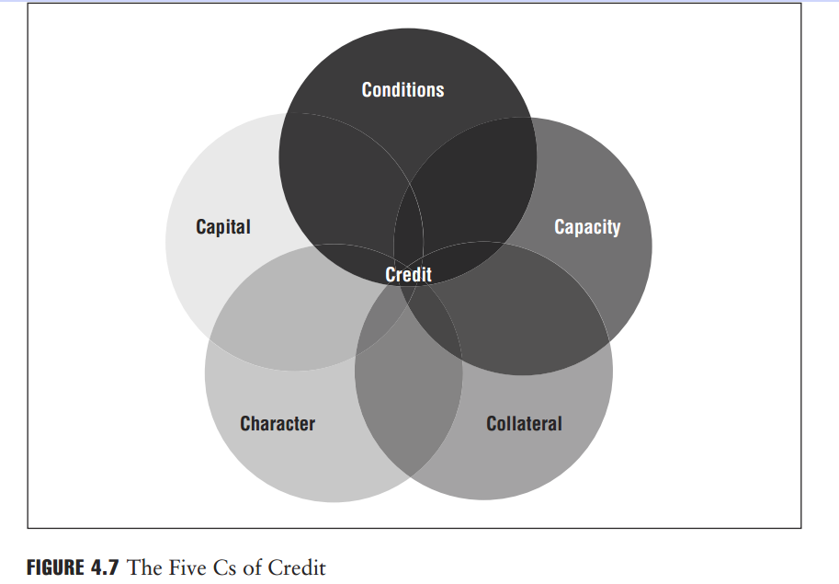

Slide 41
The Five Cs of Credit: No. 1—Character
In analyzing character, the bank seeks to answer the following question: What is the reputation of the company’s management in the industry and in the greater business community?
Bankers will always look to lend money to those with immaculate credentials and references. Credit analysts should determine the quality of management’s relationship with its employees as well as with its customers and how these relationships are managed through the company’s obligations. These characteristics afford insight into management’s character.
Associated with character is management’s ability to administer the company’s future. Indicators of management capabilities include the level of engagement in day-to-day operations, flexibility in embracing current technologies, understanding prevailing industry trends, and, most importantly, its ability to contain costs and seek efficiencies.

Slide 42
The Five Cs of Credit: No. 2—Capital
When analyzing capital, the bank seeks to answer the following question: How is the company currently financed? The relationship between equity and debt is critical, and the higher the level of equity relative to debt, the healthier the company will appear from a credit risk perspective. It also reveals the financial commitment of the company’s owners and indicates how much they have put themselves at risk. Particularly in small and medium-sized businesses where the owners’ wealth is very closely linked to the fortunes of the business, it is not only the company’s financial statements that should receive scrutiny, but also the owners’ personal financial standing, assets, and credit quality.

Slide 43
The Five Cs of Credit: No. 3—Conditions
When analyzing conditions, the bank seeks to answer the following questions: What is the economic situation in the country or countries in which a company operates, and what are the economic conditions of the industry in which it operates?
The credit analyst must determine what outside risks might cause the company’s financial condition to deteriorate.

Slide 44
Example
In a further review of Good Impressions Inc., the analyst at Bank R discovers that the largest single market for its products is Malaysia, where more than 80% of its sales are made, bringing in nearly 90% of its profits. A business that generates income and cash flow in a currency different from the lender introduces considerable risk. One risk is the potential decline in the value of the Malaysian ringgit relative to Good Impressions Inc.’s home currency, the U.S. dollar. If Good Impressions Inc. does not reduce—or hedge—this risk, the cost of the loan to the company could ultimately be much more than anticipated, perhaps making it so costly that the company would default on either its interest payments or repayment of the loan principal.
The analyst making the lending decision must examine the economic conditions under which the company operates (in this case Malaysia and the United States) to determine the potential not only for the direct counterparty credit risk that Bank R would assume with the company, but also for the risks associated with the company’s dealing in a foreign currency and in that particular country.

Slide 45
The Five Cs of Credit: No. 4—Capacity
When analyzing capacity, the bank seeks to answer the following questions: How much cash does the company generate, and are the cash flows sustain- able, repeatable, and predictable? The credit analyst must evaluate the company’s ability to generate sufficient cash flows as well as management’s ability to run its operations efficiently and effectively. The credit analyst works from cash flow projections to determine the debt or exposure a company can incur.
As a company’s sales grow, its assets also increase and the company will need to finance this increase in assets, either through its own liquidity or from external financing. Part of the increase in assets reflects a permanent increase and includes the new factories, facilities, machinery, and production infrastructure a company has created. It also reflects the increasing level of inventory the company has and accounts receivable that the company collected. A company will usually seek to finance most of its permanent increase in assets through medium- and long-term financing, although these needs may also be met through equity financing.

Slide 46
Assessing the quality of the borrower’s assets is also part of capacity analysis and is particularly useful when the company has significant trade receivables that can be used for asset-based lending or converted into cash after collecting on the receivables.
Trade receivables result from credit sales, where the company extends credit to its customers to purchase its products or services in anticipation of payment. In many small and medium-sized businesses, a listing of all debtors and the aging of all invoices due from each provides important information of not only what is due and owed to the company, but also the company’s ability to collect on its debts, implement its policies, and assess whether a buyer is truly creditworthy.
Credit analysts also evaluate a company’s inventory. Inventory has to be of salable quality reflective of the company’s intention to continue business, and, should there be a default, the company’s assets—including its inventory—should be of satisfactory quality to pay debts when sold.
The analyst must also assess the borrower’s liquidity. A business that has enough cash is more likely to pay what it owes when payment is due. Illiquid businesses, which can include businesses that are profitable but lack sufficient cash flows, present potential credit risks.

Slide 47
The Five Cs of Credit: No. 5—Collateral
When analyzing collateral, the bank seeks to answer the following question: In the event the borrower cannot honor its obligations, what assets does it have that the bank can lay claim to in order to satisfy the debt? Section 4.4.5 discusses the role of collateral.

Slide 48
2. The Credit Analysis Path
The Five Cs of Credit just outlined provide a sound framework for analyzing small businesses, and the principles hold equally true for lending to larger companies. However, the credit analysis path described next provides an alternative framework for a more detailed credit analysis or for lending to larger or more complex companies. The credit analysis path depicted in Figure 4.9 requires the analysis of the key business, financial, and structural risks of the credit proposal.
In the credit analysis path, the focus is to analyze the various risks that may impact the borrower. The overall analysis encompasses business—or macroeconomic—risks, financial—or microeconomic—risks, and structural risks. These risk areas overlap, as the factors that impact them are closely related and interdependent. The three areas of analysis are separated into several general layers, or components, and are shown in Figure 4.10.

Slide 49
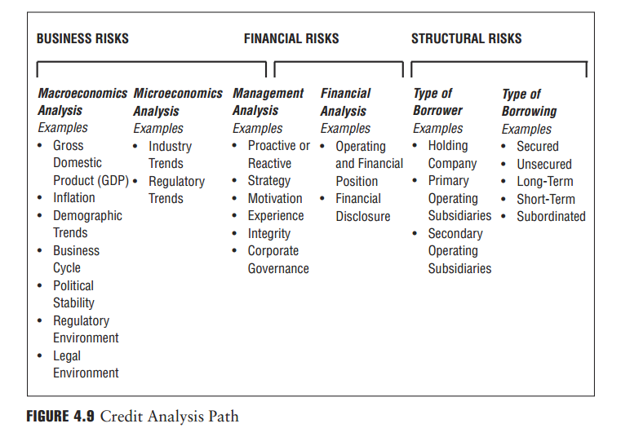

Slide 50
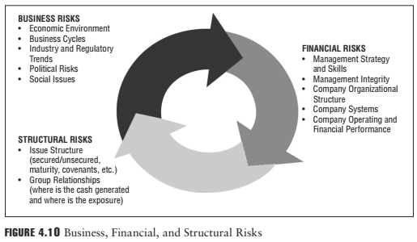

Slide 51
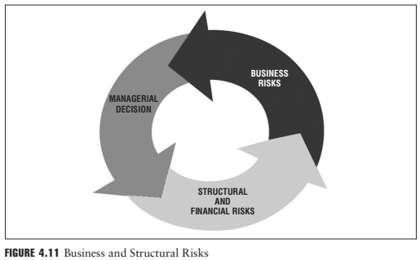
The credit analysis path shows that the company’s decision-making process will directly impact the risks the organization takes, and that management’s decisions are influenced by the industry’s macroeconomic and microeconomic trends. The relationship between business risks and structural risks is illustrated in Figure 4.11.

Slide 52
Structural Risk
In this assessment, the credit analyst must understand the legal structure of the borrower, the various subsidiaries, intracompany transactions, and ownership and partnership linkages. All are analyzed to better gauge the true financial and potential economic exposure embedded in the proposed credit structure. A simple framework for ensuring that the above information is collected should include answers to the following:
■ Who—or which entity—is the borrower?
■ Where—or in which entity—are the assets located?
■ Who—or which entity—generates the cash flows of the business?
■ Are there any intercompany linkages such as guarantees or significant related-party transactions?
Covenants, collateral, and pricing are critical in mitigating structural weaknesses. Structural enhancements such as guarantees (e.g., from a better capitalized parent or government or export trade body) should also be considered in the event of the loan being structurally subordinated to other creditors. Debt that is lent to an entity that is not the generator of the company’s cash flows (i.e., a holding company) is said to be structurally subordinated to debt located at the company’s operating subsidiaries, with the expectation that the claims of the subsidiary’s creditors would be satisfied first in the event of a corporate default.

Slide 53
6. SWOT Analysis
A SWOT analysis is a useful tool for outlining the key issues that emerge
from the analysis of the business, financial, and structural risks as detailed previously. SWOT stands for strengths, weaknesses, opportunities, and threats, and is illustrated in Figure 4.14. A SWOT analysis is used to obtain an objective assessment of a company’s internal strengths and weaknesses and the opportunities and threats presented by the external business environment in which the company operates. This information, coupled with an in-depth analysis of the company’s current financial condition, allows for an objective and forward-looking determination of the potential borrower’s creditworthiness.

Slide 54
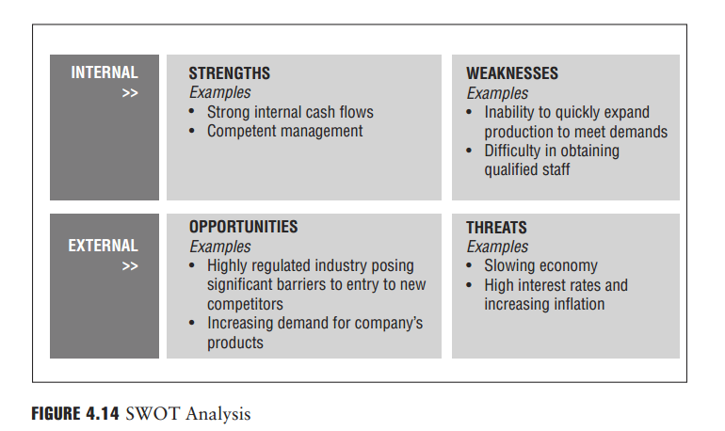

Slide 55
Characteristics of Credit Products:
There is a wide variety of loan types. All were developed to meet specific business needs of different borrowers’ unique situations. This section describes basic lending facilities and their differences. To understand which type of lending facility is appropriate for a borrower, lenders must understand the details of the borrower’s financial status, especially how it relates to existing and anticipated conditions in the local, regional, or international marketplaces.

Slide 56
There are a number of ways a credit product can be classified:
Maturity
Commitment specification
Purpose
Repayment source
Collateral requirements
Covenant requirements
Repayment characteristics

Slide 57
1. Maturity
Credit needs range over different time periods, with the loans made to meet those needs generally classified by maturity. Maturity simply means the date the final payment on the loan or other financial instrument becomes due.
For instance, a loan of a maturity of one year must be repaid in full within one year.

Slide 58
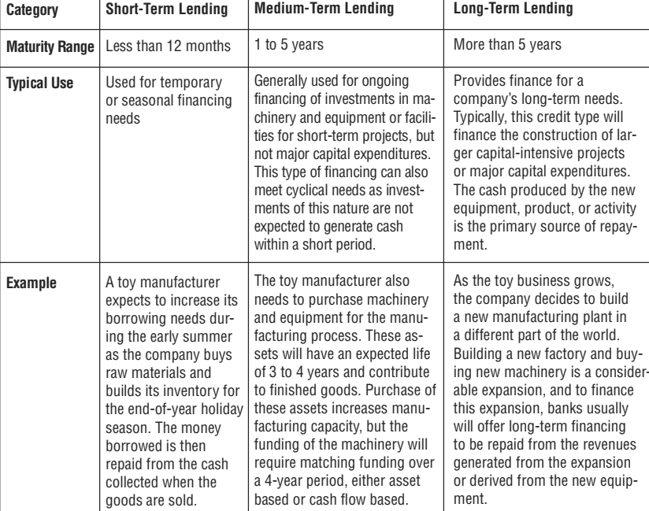

Slide 59
2. Commitment Specification
Banking facilities are further classified as committed or uncommitted. Figure 4.4 outlines the differences between standard bank facilities.
Committed facilities are characterized by formal loan agreements, usually for one year or more. Committed facilities earn a margin for the bank above its own cost of funds and include a facility fee, a commitment fee, and a fee for the amount of the loan the bank has actually extended to the borrower, whether or not the borrower uses the full amount of the loan. The amount of the loan not yet taken by the borrower is referred to as an undrawn commitment.

Slide 60
Uncommitted facilities are less formal arrangements but often include a facility letter stating that funds would be made available on demand but solely at the lender’s discretion. Uncommitted facilities provide a general framework for the terms of the lending without noting the specific contractual terms of that agreement, such as the amount of the loan or its duration, although such facilities are short term in nature (often on demand or overdrafts).
An overdraft occurs when money is withdrawn in excess of what is on the current account. In this situation the account is said to be "overdrawn".

Slide 61
There may be different contractual terms depending on when the facility is used. Uncommitted facilities are generally cheaper than committed facilities and priced on a margin above the bank’s base rate. There may also be an arrangement fee charged at each renewal of the uncommitted facility.

Slide 62
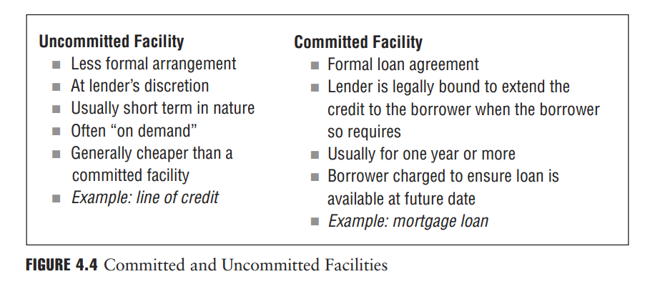
A line of credit (LOC) is an account that lets you borrow money when you need it, up to a preset borrowing limit, by writing checks or using a bank card to make purchases or cash withdrawals.

Slide 63
Banks can also generate income through compensating balances. When a bank extends a committed or an uncommitted facility, it may require the borrower to deposit certain amounts of money with the lending bank for the duration of the loan commitment. These funds are referred to as compensating balances. This arrangement provides the bank with funds to be used for other purposes, thus allowing it to earn a return on those funds in excess of the costs of the services being provided to the borrower. The borrower may also receive a credit for the compensating balance through an offset of the fee for the banking facility.

Slide 64
Compensating balances serve several functions:
They serve as collateral in case the borrower defaults.
They reduce the bank’s interest expenses. Since the deposit usually carries a very low interest rate, sometimes as low as 0%, it allows the bank to secure additional deposits effectively at a very low cost, providing the bank with cheap financing through low-cost deposits. Borrowing at a low rate while lending at a higher rate increases the bank’s potential earnings.
Compensating balances also indirectly increase the interest the borrower pays to the bank and are consequently considered as a charge to the borrower, as interest is charged for the extension of a loan.

Slide 65

3. Loan Purpose
The use of loan proceeds can vary widely and can impact a lender’s credit decision. A loan used to finance inventory, to purchase equipment used in the production process, or to address some other type of working capital need may be viewed as facilitating the normal course of business or perhaps making possible the exploitation of a perceived strategic opportunity.
Typically, there is little credit quality decline inherent in these transactions. Loans, however, can also be used to buy back stock, to finance a leveraged buyout, to pay a dividend, or to fund other shareholder-friendly activities. These loans are typically considered riskier, as they tend to benefit shareholders at the expense of creditors.

Slide 66
4. Repayment Source
Another way to distinguish between the different loan types is to consider how the borrower generates funds to repay the loan. Asset conversion loans, also known as self-liquidating loans, are loans that are repaid by converting the asset that is used to collateralize the loan into cash. The assets used for this type of loan are typically inventory and work in progress (partly completed jobs). The asset conversion loan is normally considered short-term or temporary financing with the asset later being sold on credit terms or for cash that ultimately will be used to repay the loan.

Slide 67
For example, a toy company may need to pay its employees in mid-November, but it is cash-poor because it has laid out most of its funds to produce and market toys that won’t be purchased until December.
One option the toy company might explore is to get an asset-conversion loan. It could take the loan while simultaneously agreeing to put a delivery truck up for sale. When the truck sold, the loan is paid off. If it doesn’t sell, the toy company will be in default on the loan, but the lender will have the truck as collateral.
Asset-conversion loans are short-term loans used when a company needs a quick infusion of cash because it has no liquidity.

Slide 68
Note that these loans are different from asset-based loans in that the asset used as collateral is being sold to repay the loan versus being used simply as collateral for the loan. Agricultural loans (see Section 4.5.1) are asset conversion loans. With cash flow–based loans, a bank provides funds that are repaid with the cash flow from the company’s operations. With asset-based loans, a bank extends a loan after a specific asset or a combination of assets is pledged as collateral or security (see next section on collateral) to cover the loan. Collateral for this type of loan typically includes inventory, machinery and equip-ment, leases, furniture and fixtures, or other tangible assets.

Slide 69
5. Collateral Requirements
Assets pledged by a borrower to secure a loan are called collateral(or security). Collateral is used by the bank to safeguard its capital and acts as insurance in case the borrower cannot repay the loan. In the event of default, the bank has the option of accepting the collateral as full or partial repayment of the loan’s principal, accrued interest, fees and costs, and expenses. As such, collateral plays a major role in a bank’s lending policies—it reduces the potential loss the bank can suffer when a borrower defaults.

Slide 70

Collateral can come in many forms. Cash is the most obvious and most secure form of collateral since it is already liquid. Property is the most common form of collateral, but is unpredictable because its value fluctuates with market conditions and the lender may or may not have access to it. Mortgage lending uses real estate as the collateral for the loan against the property.

