Slide 1


Storage Technologies
IT403
Prepared by
Dr. Ahmed El-Douh
Lecture 4

Slide 2



Storage Technologies
Lecture 4
IT403
Common Storage Protocols
Prepared by
Dr. Ahmed El-Douh

Slide 3
Objectives
Upon completion of this module, you will be able to:
  Describe the definitions of common storage protocols.
  Understand the technical principles of common storage protocols.
  Understand the application scenarios of common storage protocols.

Slide 4
Chapter
Outlines
04
SCSI/iSCSI
SAS
FC/FCOE
PCIe
IB
CIFS/NFS
FTP/HTTP

Slide 5


SCSI And iSCSI in Storage

Slide 6
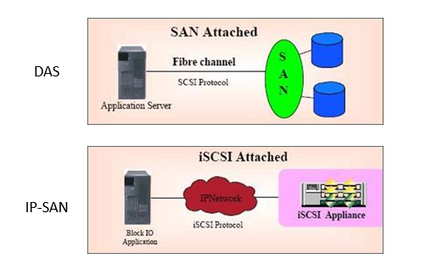
SCSI And iSCSI in Storage

Slide 7
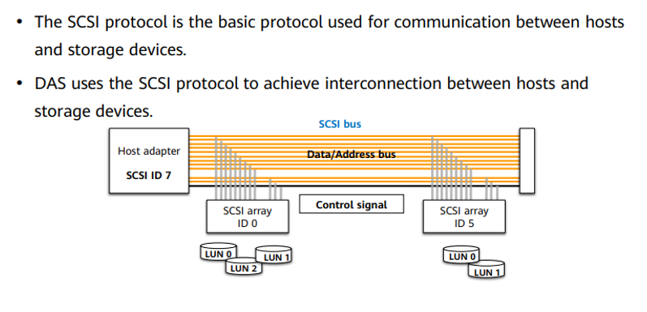
SCSI Protocol and Storage System

Slide 8
What is SCSI ?
SCSI Device Commands
SCSI System Model
SCSI Physical Link Mapping

Slide 9
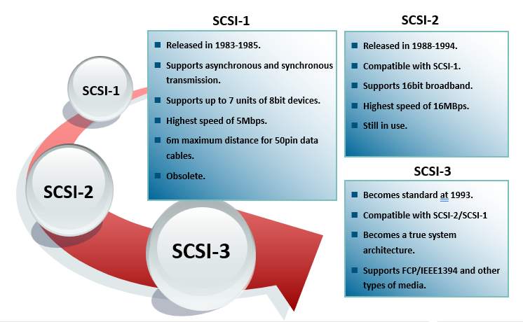
History of SCSI

Slide 10
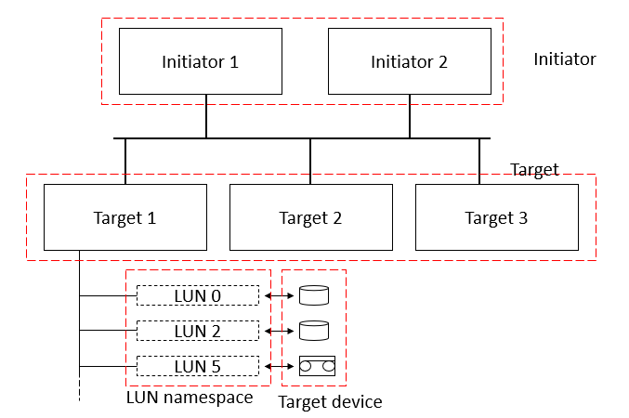
SCSI Logical Topology

Slide 11
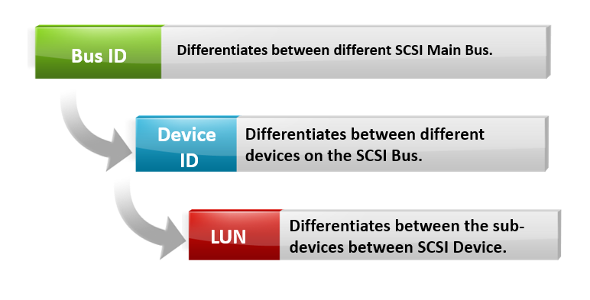
SCSI Protocol Addressing

Slide 12
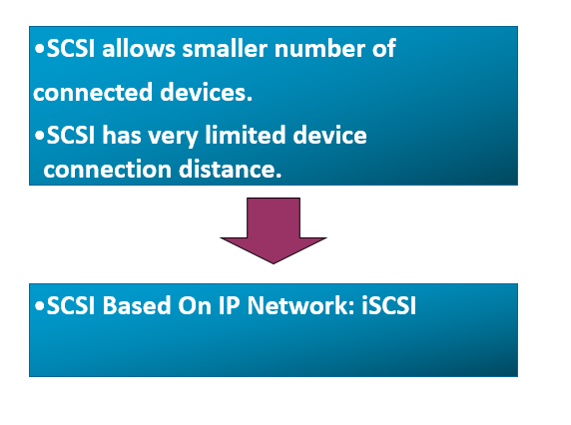
The Birth of iSCSI

Slide 13
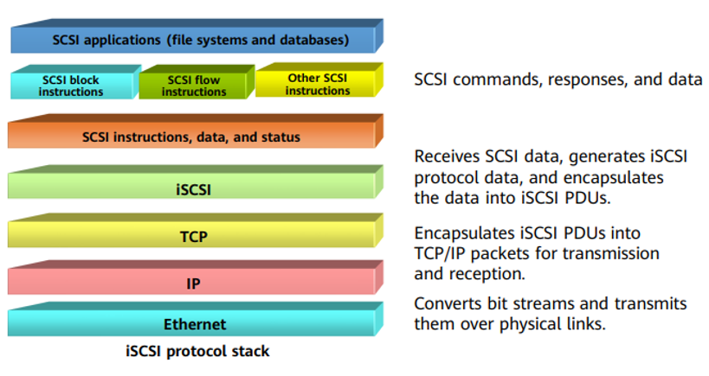
iSCSI

Slide 14
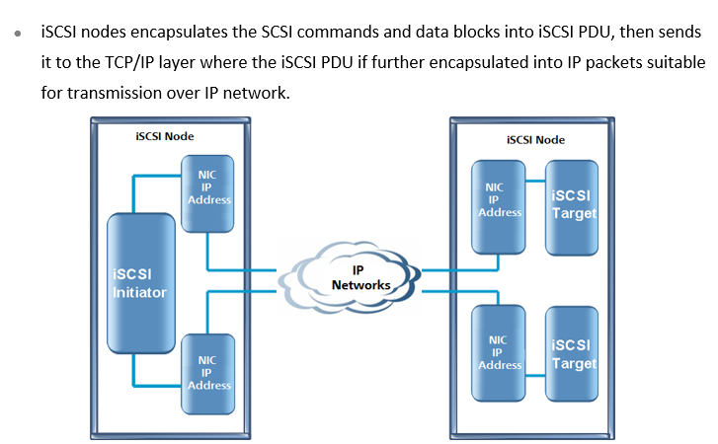
iSCSI System Architecture

Slide 15
SAS (Serial Attached SCSI)

Slide 16
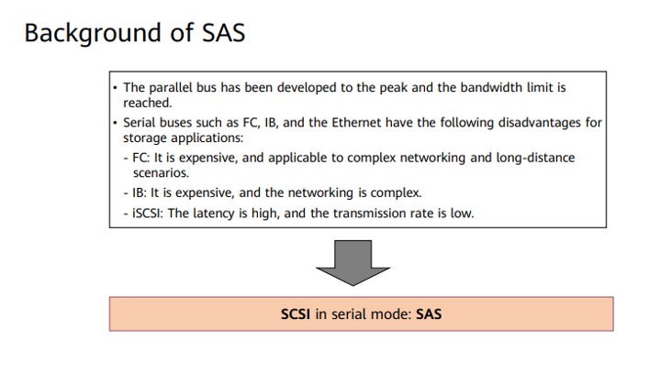
SAS in Storage System

Slide 17
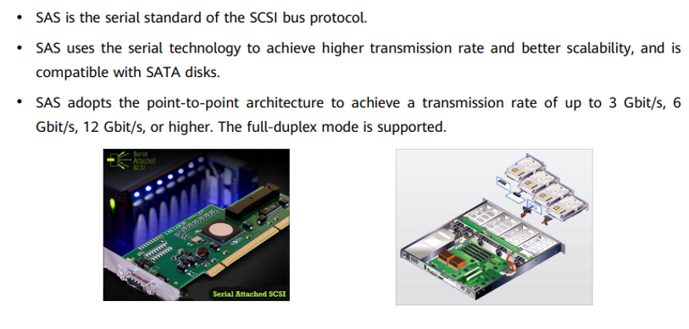
What is SAS

Slide 18
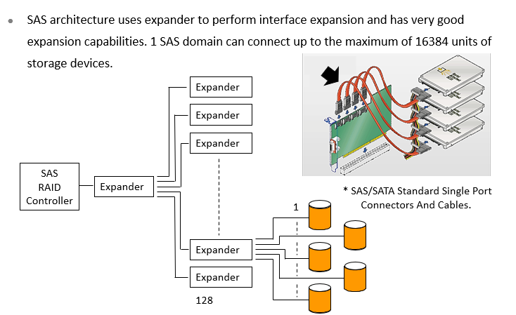
SAS Expansion Capabilities

Slide 19
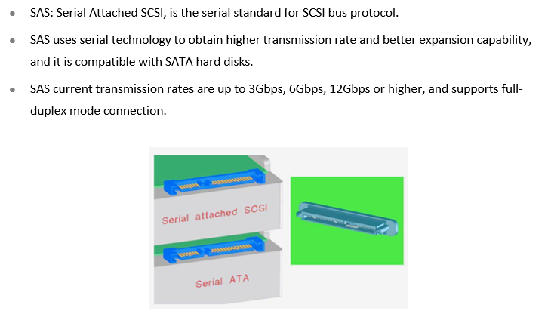
SAS Features

Slide 20
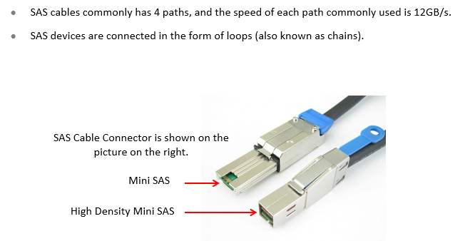
Principles of SAS Cable

Slide 21
Comparison Between SAS And Other Transmission Technologies
Types of Technology | Main Advantages | Main Disadvantages | Fields Of Application
ATA | Low Cost | Low Performance | PC
SCSI | Medium Performance | Drawbacks of Parallel Technologies | Enterprise Grade Storages
FC | High Performance, High Reliability | High Cost | High End Storages
SATA | Low Cost, High Capacity | Low Performance and Low Reliability | Mid and Low End Storages
SAS | High Performance, High Reliability | Medium Cost | Mid and Low End Storages

Slide 22
Fibre Channel (FC) /FCOE

Slide 23
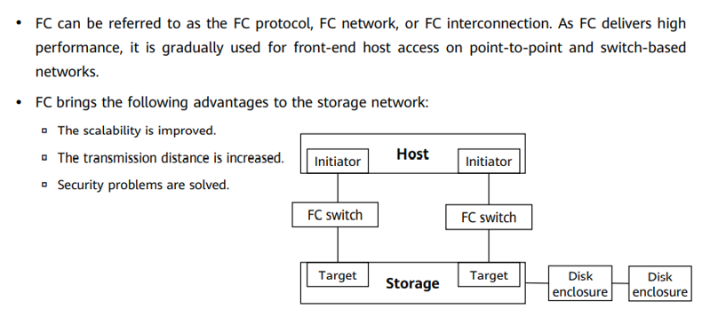
FC in Storage

Slide 24
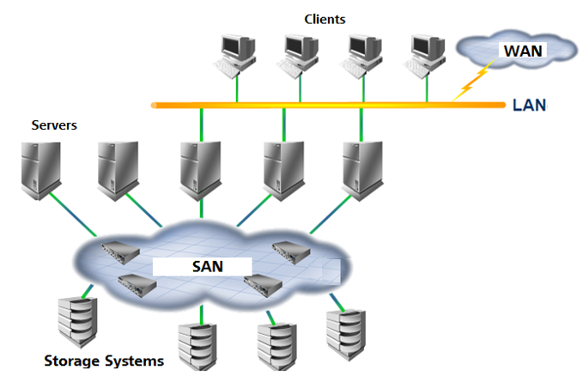
Fibre Channel (FC) In Storages

Slide 25
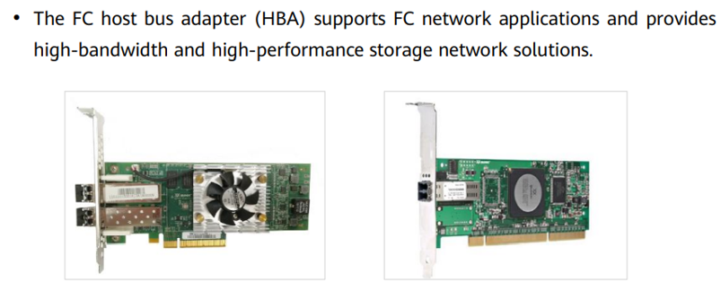
FC Adapter

Slide 26
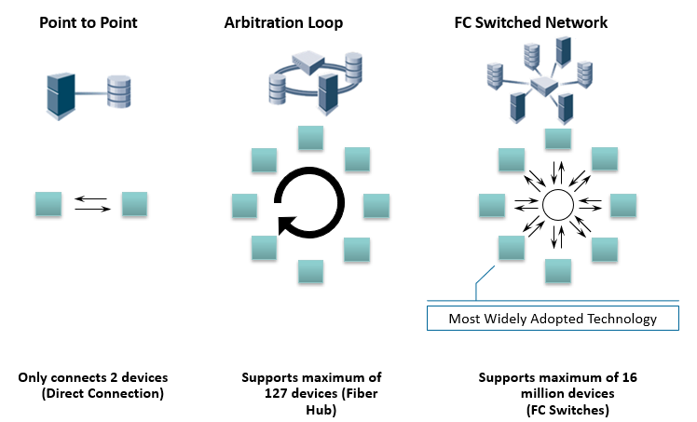
FC Topologies

Slide 27
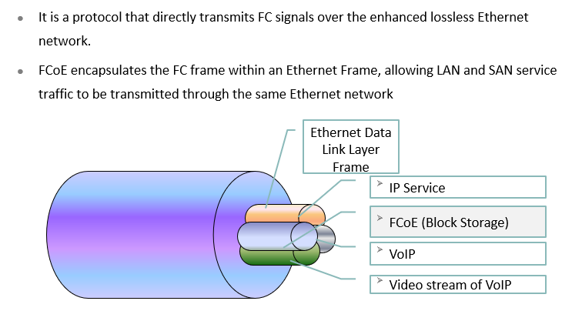
FCoE Protocol

Slide 28
Peripheral Component Interconnect express (PCIe )

Slide 29
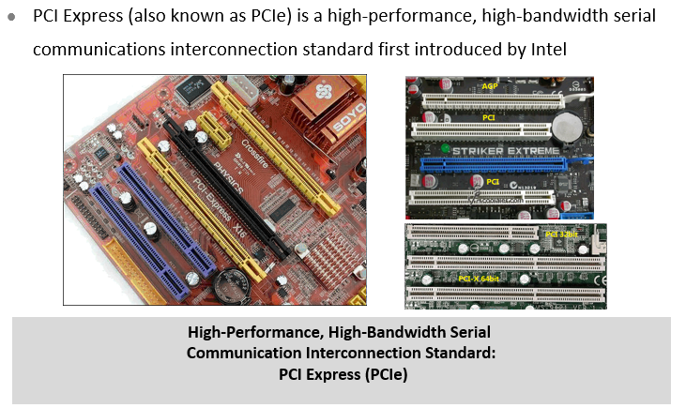
What Is PCIe ?

Slide 30
Chapter
03
InfiniBand (IB)

Slide 31
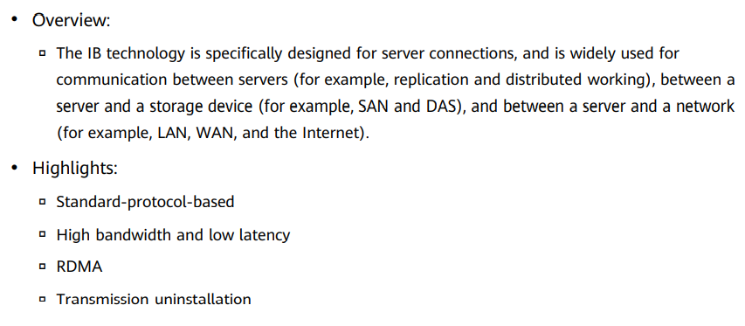
What Is IB ?

Slide 32
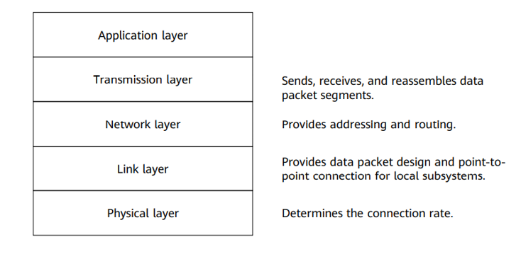
IB Layers

Slide 33
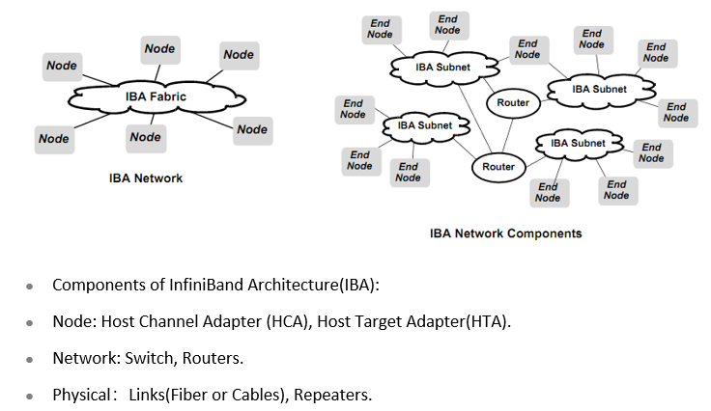
IB Architecture (IBA)

Slide 34
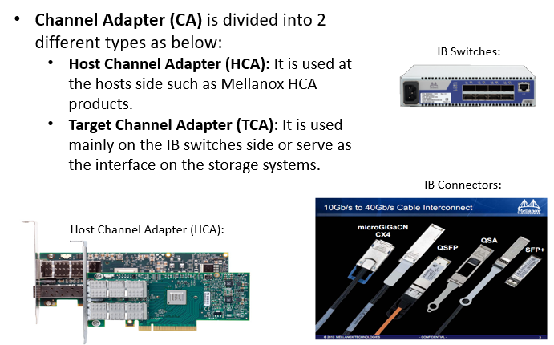
IB Interface

Slide 35
Chapter
CIFS (Common Internet File System)/
NFS (Network File System)
03

Slide 36
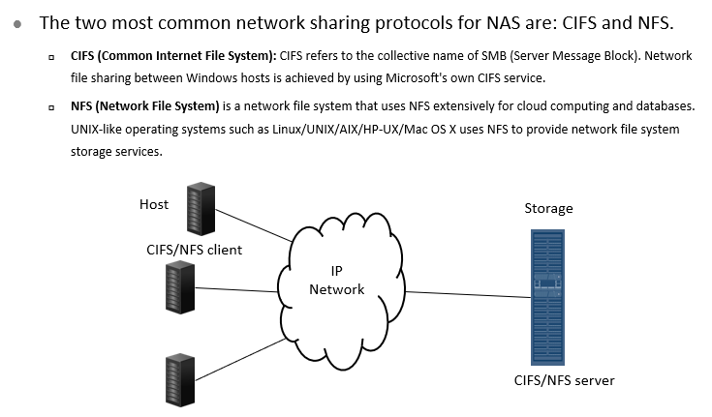
CIFS/NFS In Storage Systems

Slide 37
Chapter
File Transfer Protocol (FTP)/
Hypertext transfer protocol (HTTP)
03

Slide 38
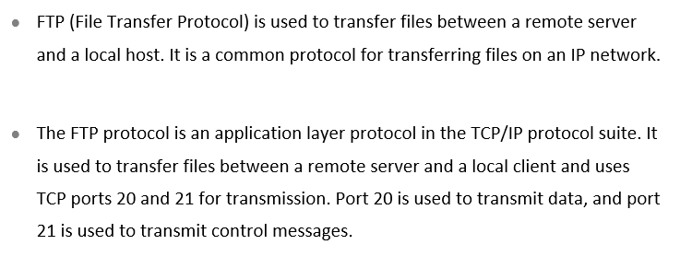
What is FTP ?

Slide 39


FTP Typical Application Scenario - File Uploads and Downloads
IP Network
FTP Client
FTP Server

Slide 40
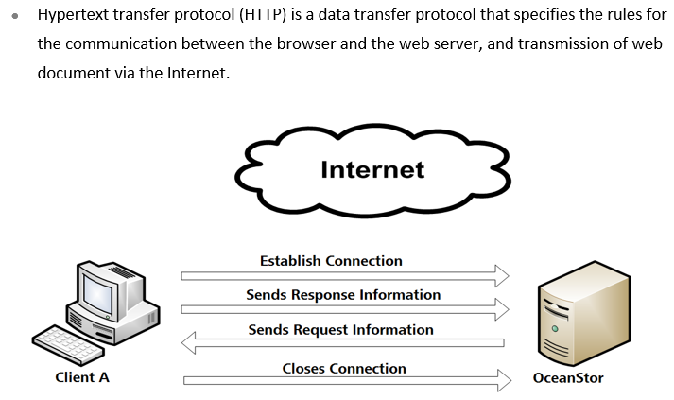
What is HTTP ?

Slide 41
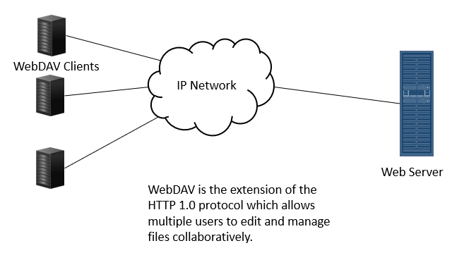
HTTP Typical Application Scenario - Web Access

Slide 42



Thank You

