Slide 1


Creative and Scientific Thinking
Prepared by Prof. Shereen Taie
CRE252
Information Technology Department
Lecture 6

Slide 2




Creative and Scientific
Thinking
Lecture 6
CRE252
Information Technology Department
Prepared by
Prof. Shereen Taie
www.midocean.ae

Slide 3
Learning Objectives:
Quantification and Measurement
Quantification
Discrete quantification
Continuous quantification
Measurement
The Scientific Method
The Many Roles of Theory
Chapter
02
www.midocean.ae

Slide 4
Quantification and Measurement
Chapter
02
www.midocean.ae

Slide 5
Quantification and Measurement:
Turning concepts into variables:
This is done so the concept can be expressed in a form that is
observable and includes some notion of degree or
differentiation.
Chapter
02
www.midocean.ae

Slide 6
The next question is: How does one pin down that degree or differentiation?
The answer involves a two-step process:
Quantification
Measurement.
Chapter
02
www.midocean.ae

Slide 7
Quantification
The idea of quantification means setting up a standard amount of a thing and putting a label on it.
We make it possible to express abstract concepts (such as length)in a manner that provides a common reference for observation.
Chapter
02
www.midocean.ae

Slide 8
Quantification
Isolating standardized units increases the power of description and analysis.
Example: When Gabriel Fahrenheit established the idea of a degree of temperature, he made possible a much more useful description of hot and cold.
Chapter
02
www.midocean.ae

Slide 9
Quantification in social science takes two forms:
Discrete (presence or absence )
Continuous ( variation along a continuum)
Chapter
02
www.midocean.ae

Slide 10

Chapter
02
Quantification
www.midocean.ae

Slide 11
                Discrete quantification
Chapter
02
www.midocean.ae

Slide 12
Quantification: Discrete quantification
Discrete quantification relates to counting the presence or absence of a thing.
It also relates to counting differences of quality as they are captured in categories.
Chapter
02
www.midocean.ae

Slide 13
Quantification: Discrete quantification
Example:
A vote for a candidate is a discrete and specific act that can be counted in a conventional manner.
A Student’s state is a quality that can be counted as being either success, fail.
Chapter
02
www.midocean.ae

Slide 14
Quantification: Continuous quantification
Some quantifications have to capture the notion of variation along a continuum.
  Age is an example of a continuous quantification.
  One can count the number of years in a person’s age, but the quantification of age is an expression of something that is ongoing.
  A reader of a book maybe 25.72 years old today; in a few weeks, he/she will be 26years old.
Chapter
02
www.midocean.ae

Slide 15
Quantification: Continuous quantification
Continuous quantification deals not with discrete items but with dimensions like age, length, and time.
The mark of continuous quantification is that the variable involved may have any value on a scale, whereas in discrete quantification, only whole numbers appear (as in counting).
Chapter
02
www.midocean.ae

Slide 16
Quantification: (Cont…)
One of the distinguishing characteristics of a well developed science is the array of quantifiable variables that are useful to people working in the field.
One of the marks of a smart scientist is the ability to find ways of quantifying important variables in a reliable and meaningful way.
Economics has come a long way by using money as a unit of analysis
Chapter
02
www.midocean.ae

Slide 17
                MEASUREMENT
Chapter
02
www.midocean.ae

Slide 18
MEASUREMENT
Measurement is a process of assigning numbers to some
characteristics or variables or events according to scientific
rules.
Chapter
02
www.midocean.ae

Slide 19
Measurement (Cont…)
Unfortunately for the other social sciences, there aren’t such easily quantifiable units for measuring power or representing psychological stress , happiness, personal security.
There is potential for more precise measurement.
If quantities can be established, measurement becomes much easier.
The most obvious measurement deals with the problem of how much:how much distance, how much money, and so forth.
Chapter
02
www.midocean.ae

Slide 20
Measurement (Cont…)
Some questions of how much are not so easy to measure— public opinion , for example
  divides opinion into favorable versus unfavorable.
  Here, opinion is quantified as a discrete, categorical variable: “Are you for it or against it?”
Chapter
02
www.midocean.ae

Slide 21
Measurement (Cont…)
Some public-opinion polls deal with this by using categories instead of two:
strongly for –– somewhat for –– neither for nor
against –– somewhat against –– against
Chapter
02
www.midocean.ae

Slide 22
Chapter
02
Reliability and Validity of Variables
www.midocean.ae

Slide 23
Reliability and Validity of Variables:
How do you decide which method of measurement (operational definition of a construct) is the best?
There are two general criteria for evaluating the quality of any measurement procedure:
  Validity
  Reliability
Chapter
02
www.midocean.ae

Slide 24
Validity of Measurement:
Concerns the “truth” of the measurement
it is the degree to which the measurement process measures the variable it claims to measure
Example: Is the IQ score truly measuring intelligence? What about size of the brain and bumps on the skull?
Chapter
02
www.midocean.ae

Slide 25
Reliability of Measurement:
Measurement of a variable is said to have reliability if it produces the same result when different people use it.
reliability is the stability or the consistency of measurement.
Chapter
02
www.midocean.ae

Slide 26
Reliability and error of Measurement:
Inconsistency (lack of reliability) of measurement comes from error
The higher the error the more unreliable the measurement
Chapter
02
www.midocean.ae

Slide 27
Reliability and error of Measurement:
Sources of error
  Observer error (the individual who makes the measurements can introduce simple human error into the measurement process)
  Environmental changes (small changes in the environment from one measurement to another (time of the day, distraction الإختلافin the room, lighting)
  Participant changes (participants change between measurements (mood, hunger, motivation)).
Chapter
02
www.midocean.ae

Slide 28
Chapter
02
Hypothesis
www.midocean.ae

Slide 29
Hypothesis:
The purpose of a hypothesis is to organize a study.
If the hypothesis is carefully formed, all the steps of the scientific method follow.
The hypothesis provides the structure.
A hypothesis proposes a relationship between two or more variables.
Chapter
02
www.midocean.ae

Slide 30
Hypothesis:
For example: Political participation increases with education.
It has a subject (the variable political participation), a connective verb (a relationship, increases), and an object (the variable education).
Chapter
02
www.midocean.ae

Slide 31
The Hypothesis
Oxford English Dictionary :
A hypothesis is a supposition,“which serves as a starting point for
further investigation by which it may be proved or disproved….”
A hypothesis stands at the beginning, not the end, of a study, although good studies may suggest new paths of fruitful inquiry and new hypotheses.
Chapter
02
www.midocean.ae

Slide 32
Hypothesis (Cont…)
A hypothesis is an observation, usually based on a cause and effect. It is the basic idea that has not been tested.
A hypothesis is just an idea that explains something . It must go through a number of experiments designed to prove or disprove it.
Chapter
02
www.midocean.ae

Slide 33
The Hypothesis (Cont…)
The importance of establishing a hypothesis correctly before starting off on a research can hardly be overstated. The following rules will help:
First: The variables must be clearly specified and measurable by some technique you know how to use.
Second: The relationship between the variables must be precisely stated and measurable.
Third: The hypothesis should be testable, so that evidence of the relationship can be observed, demonstrated, or falsified.
Chapter
02
www.midocean.ae

Slide 34
The Hypothesis (Cont…)
Forth: The hypothesis, provides the structure for your entire research effort, whether it involves interviews and surveys, analysis of previously collected data, library research, or all three.
It will direct you to relevant information so you do not waste time and effort.
The variables you have selected can be researched through library search engines, Internet resources such as Google Scholar, book indexes, periodical guides, online services , and other computer database searches.
Chapter
02
www.midocean.ae

Slide 35
The Hypothesis (Cont…)
The relationships proposed between the variables suggest the measurement tools and standards for evaluation that you will need to use.
The results of the hypothesis test are the substance of your conclusions.
Chapter
02
www.midocean.ae

Slide 36
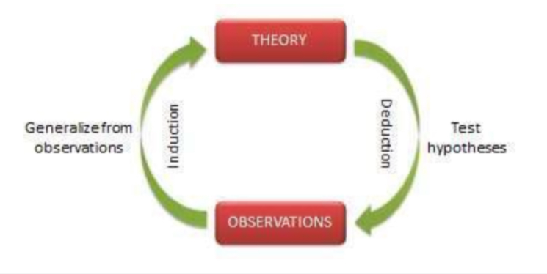
The Hypothesis (Cont…)
Once relationships between variables have been established through hypothesis formation and testing, these relationships can be expressed as generalizations.
Generalizations based on tested relationships are the object of science.
A generalization is a hypothesis affirmed by testing.
As generalizations in a field of study accumulate, they form the raw stuff of theories.
Chapter
02
www.midocean.ae

Slide 37
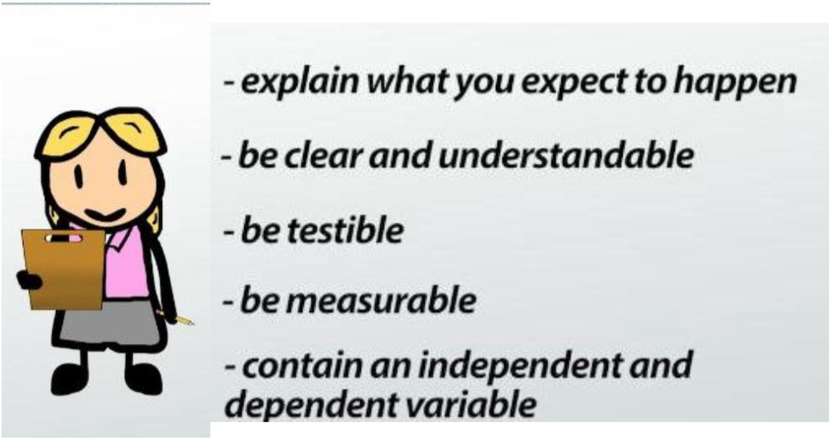
A hypothesis should always:
Chapter
02
www.midocean.ae

Slide 38
Examples of Hypotheses
Question | Hypothesis | Example
How does the sizeof a dog affect how much food it eats? | Larger animals of the same species expend more energy than smaller animals of the same type. To get the energy their bodies need, the larger animals eat more food. | If I let a 70-pound dog and a 30-pound dog eat as much food as they want, then the 70-pound dog will eat more than the 30-pound dog.
Does fertilizer make a plant grow bigger? | Plants need many types of nutrients to grow. Fertilizer adds those nutrients to the soil, thus allowing plants to grow more. | If I add fertilizer to the soil of some tomato seedlings, but not others, then the seedlings that got fertilizer will grow taller and have more leaves than the non-fertilized ones.
Chapter
02
www.midocean.ae

Slide 39
Examples of Hypotheses
Question | Hypothesis | Example
Does an electric motor turn faster if you increase the current ? | Electric motors work because they have electromagnets inside them, which push/pull on permanent magnets and make the motor spin. As more current flows through the motor’s electromagnet, the strength of the magnetic field increases, thus turning the motor faster. | If I increase the current supplied to an electric motor, then the RPMs(revolutions per minute) of the motor will increase.
Is a classroom noisier when the teacher leaves the room ? | Teachers have rules about when to talk in the classroom . If they leave the classroom, the students feel free to break the rules and talk more , making the room nosier. | If I measure the noise level in a classroom when a teacher is in it and when she leaves the room, then I will see that the noise level is higher when my teacher is not in my classroom.
Chapter
02
www.midocean.ae

Slide 40



Thank You

