Slide 1



Project Feasibility Study
PMG201
Prepared by Mrs. Deena Ibrahim
Lecture 10
MONITORING AND CONTROLLING THE PROJECT

Slide 2

The Plan-Monitor-Control Cycle.
Data Collection and Reporting.
Earned Value.
Project Control .
Designing the Control System.
Scope Creep and Change Control.

Slide 3

Introduction
Monitoring is the collection, recording, and reporting of project information that is of importance to the project manager and other relevant stakeholders.
Control uses the monitored data and information to bring actual performance into agreement with the plan. Clearly, the need to exert proper control mandates the need to monitor the proper activities and elements of the project. Frequently, the distinction between monitoring and control is unclarified , and their interaction often makes us think we are working on a single task, but they are quite distinct.

Slide 4

Designing the Monitoring System
The key to setting up a monitoring system is to identify the special characteristics of scope, cost, and time that need to be controlled in order to achieve the project goals as stated in the project plan.
The exact boundaries within which these characteristics should be controlled must be determined, as well as the specified performance characteristics for each level of detail in the project activities.
In order to manage for overall project success, control must be exercised at the detailed work level for each aspect of project performance or there is no guarantee that the desired changes will result.

Slide 5
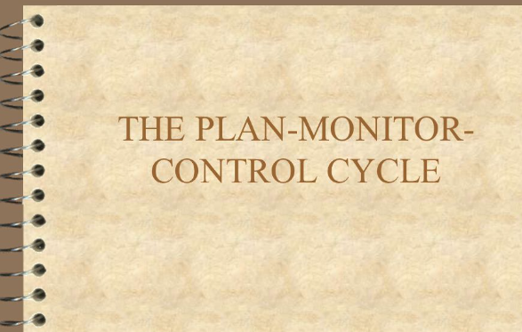
The Plan-Monitor-Control Cycle cont.
The project plan is the primary document to guide the design of the monitoring system in terms of the detailed tasks and resources that need to be controlled in order for the project to achieve its time, cost, and output goals.
Common errors in setting up monitoring systems are monitoring easy measures instead of relevant measures, monitoring activity in place of results, monitoring inputs as alternatives for outputs, and monitoring measures that don ’ t change from one period to the next.

Slide 6
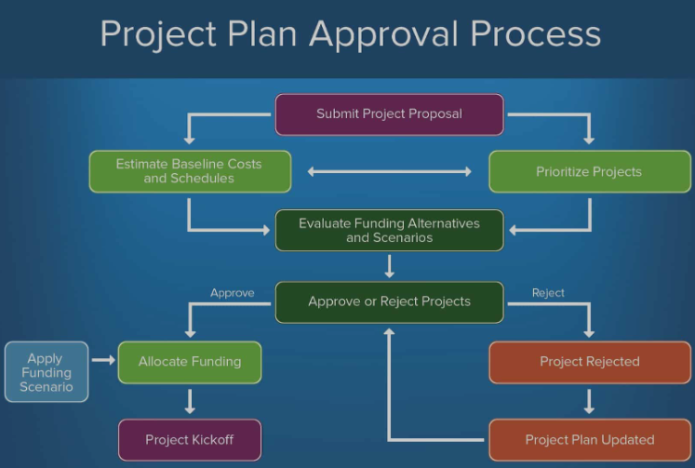
Getting the Project Plan Approved
Review the plan with key stakeholders
Project Plan must be approved
Must get Sign-off to get from Plan to Action

Slide 7

Data Collection and Reporting
Once we have decided on the type of data we want to monitor, the next question is how to collect these data and turn them into information useful for controlling the project. This is the activity of data collection and reporting.

Slide 8
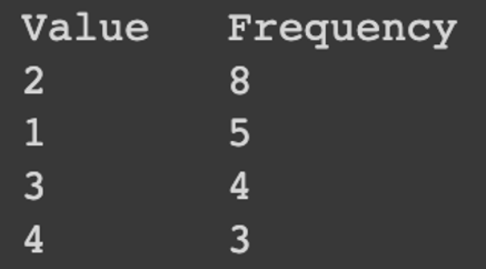
Data Collecting
The majority of data to be collected will eventually exist in one of the following five formats:
1. Frequency counts A simple tally of the occurrence of an event is common — for example, days without an accident. Often a count of events per time period or as a fraction of some standard number is used, such as complaints per month, defects per thousand products.

Slide 9

2. Raw numbers Actual amounts are used, usually in comparison to some expected or planned amount, such as dollars spent, hours required, and pounds consumed. The comparison to plan may take the form of variances, that is, differences between planned and actual, or ratios of one to the other. When collecting raw amounts it is important that the basis, time period, and collection process always be the same.

Slide 10
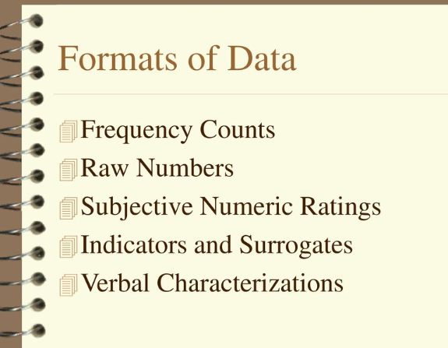
3. Subjective numeric ratings These are usually subjective estimates of some quality offered by specialists in the topic, such as ordinal “ rankings ” of performance. They can be reported in the same ways as raw numbers, but they often cannot be mathematically processed in the same ways raw numbers can.

Slide 11
4. Indicators and surrogates When it is especially difficult to find a direct measure of a variable, indicators or surrogates are frequently used instead. If this approach is taken, it is important that the indicator or surrogate be as directly related to the variable as possible. For example, body temperature is an indicator of infection and years of experience can be a surrogate for expertise.

Slide 12
5. Verbal characterizations Other variables that are difficult to measure, such as team spirit or client – supplier cooperation, may take the form of verbal characterizations. These forms of data are acceptable and useful as long as the terminology is limited and is uniformly understood by all parties.

Slide 13

Reporting and Report Types
There are three distinct types of reports: routine, exception, and special analysis:
Exception reports are primarily intended for special decisions or unexpected situations in which affected team members and outside managers need to be made aware of a change, and the change itself needs to be documented.
Special analysis reports are prepared to disseminate the results of a special study in a project concerning a particular opportunity or problem for the project. They may be distributed to top management, other project managers who would benefit from the knowledge, functional managers, or anyone who might be affected or interested.

Slide 14
Reporting and Report Types
In addition to the benefits of reports for the purposes of control, they offer these benefits.
They provide the mutual understanding between stakeholders in a project regarding the goals, progress, difficulties, successes, and other ongoing events of importance to the project.
They help communicate the need for coordination among those working on the tasks and subtasks of the project.
They establish and maintain a communication network for global projects.

Slide 15
4. Reports can communicate changes in a timely and appropriate fashion, thus minimizing the confusion often encountered during such changes.
5. They help maintain the visibility of the project, and the project team, to top management, functional managers, colleagues, and clients.
7.Finally, status reports help keep the project team motivated.

Slide 16
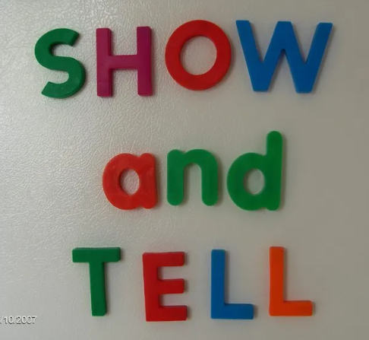
Meetings
The following guidelines should help avoid the problems with meetings:
Some meetings, such as the Weekly Progress Report (also known as “ show and tell ” ), should rarely be held at all.
Distribute a written agenda in advance of the meetings.
If homework needs to be done before the meeting by the attendees, check to be sure they will be prepared, and above all make sure you are prepared.

Slide 17

4. If you chair the meeting, you should take your own minutes.
5.. Remarks are meant to foster group process, not to be documented for eternity and for all to see.
6. Although courtesy is always in order, excessive formality at project meetings is not.

Slide 18

Virtual Meetings, Reports, and Project Management
Virtual meetings are now commonplace. Microsoft Live meeting is one of several packages that allows any number of people to meet, hear, view, and discuss presentations or training sessions on conference call telephone lines and computers. Multiway voice and data communication allows questions and answers, either live (interrupting the meeting) or submitted via the computer. Multiperson conversations are quite possible.

Slide 19

For the monitoring system, data in various forms have to be collected, analyzed, and reported. Data also need to be aggregated, manipulated in various ways, and compared with planned values in order to allow effective control.
The monitoring system helps PMs prevent problems instead of having to solve them. Project reports vary in content and frequency, depending on who the reports are targeted to and what controls they will exert. A special consideration is the relationship between the organization ’ s information system and the project ’ s system.

Slide 20

In addition to printed reports, reports may also have to be given orally at meetings, but steps can be taken to maximize the effectiveness of such meetings.
The Internet and the organization ’ s local area network or intranet have enhanced project communication and meetings as well as facilitated the management of geographically dispersed virtual projects.

Slide 21

Earned Value
Earned value represents a way to capture both in - process performance and cost on a certain date as measured against budget or schedule. Including the planned costs and actual costs allows the calculation of spending and schedule variances, where negative values are undesirable, a projection can be made of costs to completion and total cost for the task or project under consideration.

Slide 22
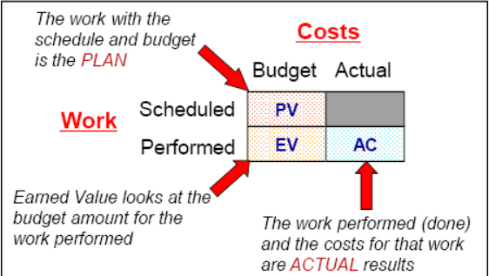
Earned Value
EV= Earned Value (Value of work completed)
PV= Planned Value (Value of work as planned)
AC= Actual Costs (Costs billed to the project)
Reporting on Variances:
  Schedule Variance (SV=EV-PV)
  Schedule Performance Index (SPI=EV/PV)
  Cost Variance (CV=EV-AC)
  Cost Performance Index (CPI=EV/AC)

Slide 23
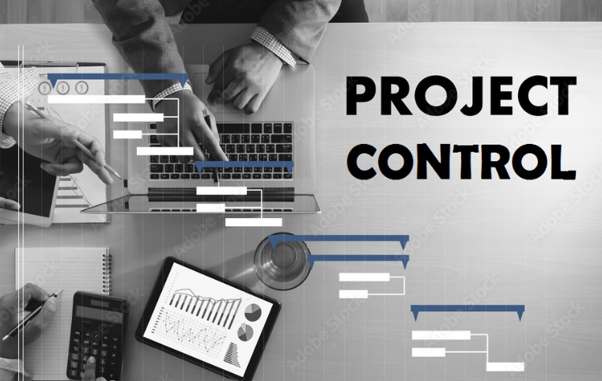
Project Control
Control is one of the PM ’ s most difficult tasks, involving both mechanistic and human elements. Sometimes humans, through action or inaction, set in motion a chain of events that eventually results in a differences between actuality and plan.
Sometimes events occur that affect people in a negative way, leading to undesirable results. Anger, frustration, helplessness, apathy, despair, and many other emotions arise during the course of a normal project and affect the activities of the project team members who experience them.

Slide 24

Purposes of Control
Project control includes both mechanistic and human elements, and because it is closely concerned with human behavior, is one of the most difficult tasks of the PM. It includes two seemingly antithetical purposes:
(1) stewardship of the organization ’ s and the client ’ s physical,
human, and financial assets
(2) the use of these assets to bring project actuality into conformance with the plan. Somehow, the PM must meld these two purposes into a uniform focus of activity.

Slide 25
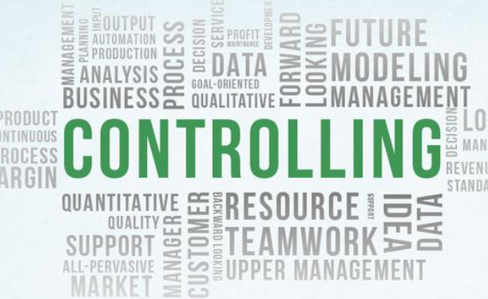
Controlling
Use the project plan as a guide
Monitor and update plan regularly.
Adapt project schedule, budget and work plan as needed.
Document progress and changes, communicate them to the team.
Communicate actions taken to Key Stakeholders.

Slide 26
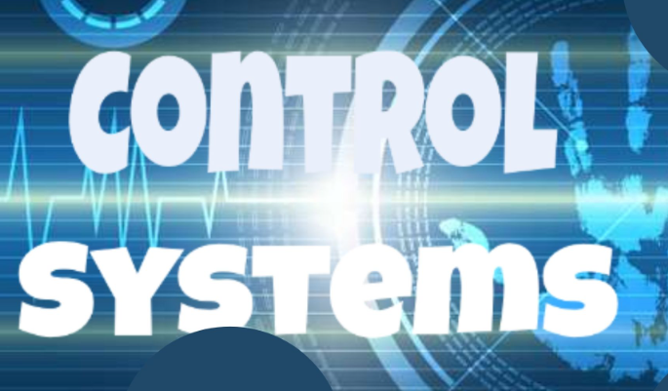
DESIGNING THE CONTROL SYSTEM
When designing the control system, there are certain helpful guidelines to keep in mind. For instance, the primary purpose of the control system is to correct error, not to identify and punish the guilty. The cost of control increases faster and faster while the degree of control — and its value — increases more and more slowly.

Slide 27
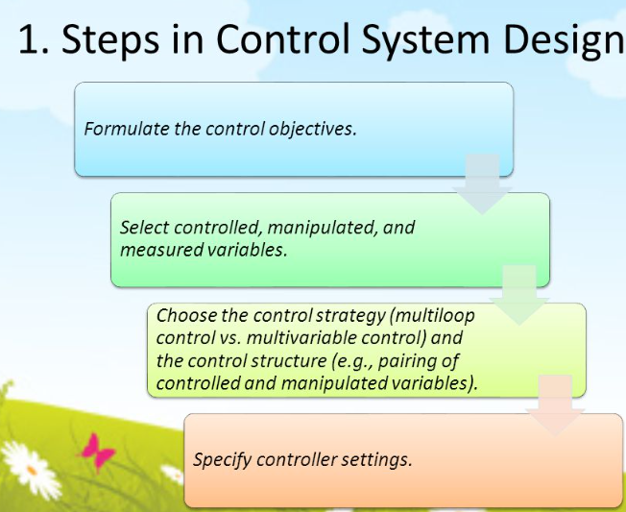
Designing of CONTROL SYSTEM
Designing the project control system entails many issues, but the major guiding objective should be to create a balanced system where the benefits obtained exceed the cost of control.
Two types of control systems are useful for projects: go/no - go controls and post - controls. Tools to aid the PM in control are variance analysis, trend projections, earned value analysis, critical ratios, control charts, and benchmarking.

Slide 28
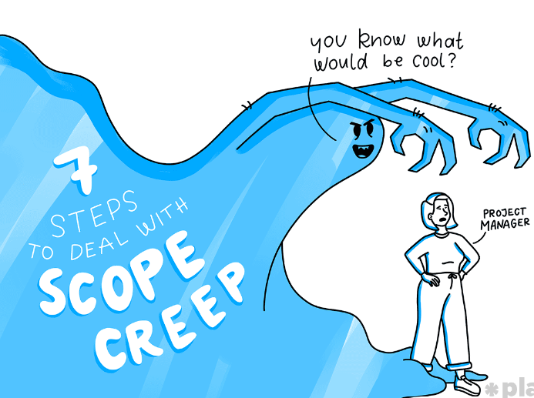
SCOPE CREEP AND CHANGE CONTROL
Avoiding scope creep is not possible. Controlling it, and thereby reducing some of the pain, is possible if the PM follows a few rules:
1. Every project charter must include a change control system by which requests for changes in the project ’ s plan, processes, budget, schedule, or deliverables are evaluated.
2. Every project change must be introduced by a change order that includes a description of the agreed - upon change together with any resulting changes in the plan, processes, budget, schedule, or deliverables.

Slide 29
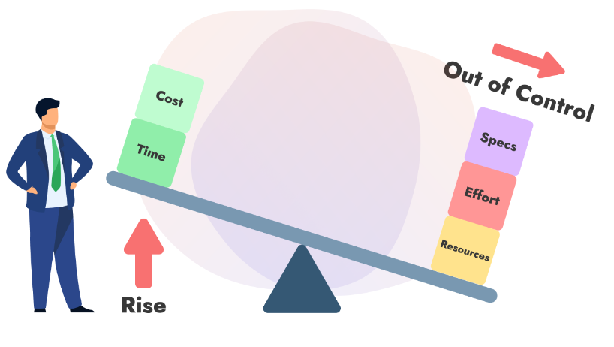
3. Changes must be approved in writing by the client ’ s agent as well as by a representative of senior management of the firm conducting the project.
4. The project manager must be consulted on all proposed changes prior to the preparation and approval of the change order.
5. Once the change order has been approved, the project master plan must be amended
to reflect the change and the change order becomes a part of that plan.

Slide 30
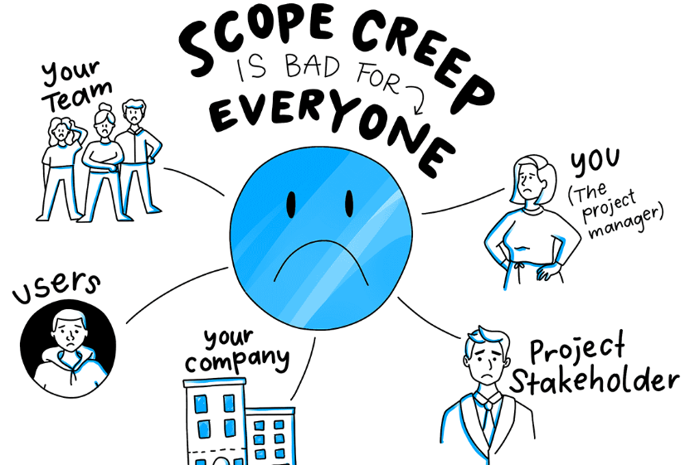
Scope creep arises quite naturally from both the client as well as the project team as new capabilities and needs surface during the course of the project. Rather than trying to ignore or handle change requests on an informal basis, the PM must anticipate that they will inevitably arise and institute a formal change control system to handle them. The purpose of the system is to evaluate each change formally to determine its benefits as well as its costs and other impacts on the project, and to make arrangements for obtaining the resources and altering the project specifications as needed to implement the change.

Slide 31


Slide 32


