Slide 1

Digital Consumer Behavior
Prepared by Dr. Noha El Aswad
Lecture 1
MKT713
Master of Digital Marketing

Slide 2
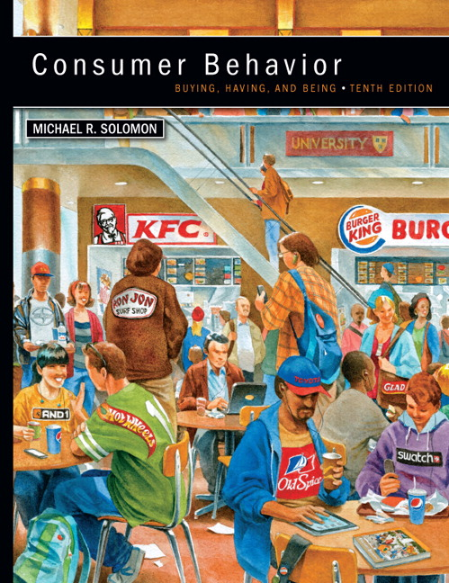

Chapter
01
Buying, Having, Being
CONSUMER BEHAVIOR, 10e
Michael R. Solomon

Slide 3
Chapter
01
Chapter Objectives
When you finish this chapter, you should understand why:
Consumers use products to help them define their identities in different settings.
Consumer behavior is a process.
Marketers need to understand the wants and needs of different consumer segments.

Slide 4
Chapter
01
Chapter Objectives (continued)
The Web is changing consumer behavior.
Consumer behavior relates to other issues in our lives.
Many different types of specialists study consumer behavior.
There are two major perspectives that seek to understand and study consumer behavior.

Slide 5
Chapter
01
Introduction 1/4
The appearance, taste, texture, or smell of the item influences our evaluations of products. A good Web site helps people to feel, taste, and smell with their eyes.

Slide 6
Chapter
01
Introduction 2/4
Consumers take many forms, ranging from an 8-year-old child who begs her mother for an ice-cream to an executive in a large corporation who helps to decide on a multimillion-dollar computer system.

Slide 7
Chapter
01
Introduction 3/4
The items we consume include anything from a massage, democracy, Juicy jeans, music, or a celebrity.

Slide 8
Chapter
01
Introduction 4/4
The needs and desires we satisfy range from hunger and thirst to love, status, and even spiritual fulfillment.

Slide 9

Chapter
01
Learning Objective 1
Consumers use products to help them define their identities

Slide 10
Chapter
01
Consumer Identity as an Aid to Marketers 1/4
Consumers segmented by demographics and psychographics.

Slide 11
Chapter
01
What is Demographics?
Age.
Economic characteristics.
Marital status.
Race.
Gender.

Slide 12
Chapter
01
What is Psychographic?
Lifestyle.
  Personality.
  Social Status.
  AIO (Activities, Interests, Opinions)
  Attitudes.

Slide 13
Chapter
01
Consumer Identity as an Aid to Marketers 2/4
Consumers understood in part based on their consumption communities and reference groups.

Slide 14
Chapter
01
Concept of consumption
The concept of consumption community, claims that in the modem era of high mobility, people look not only to neighborhood as a basis for feelings of community but also to communality of consumption behavior (e.g. give an example ).

Slide 15
Chapter
01
Consumer identity theory
This theory postulated that products and brands have symbolic meanings and display certain images. Consumers' choices to purchase, display, and use the products or brands helped them communicate the symbolic meaning to themselves as well as to others.

Slide 16
Chapter
01
Consumer Identity as an Aid to Marketers 3/4
Brands target consumers using market segmentation strategies.

Slide 17
Chapter
01
Consumer Identity as an Aid to Marketers 4/4
Consumers may choose brands that match with their own identities.

Slide 18
Chapter
01
Exercise 1
A marketer who segments a population by age and gender is using ________ to categorize consumers.
A) demographics
B) psychographics
C) roles
D) lifestyle

Slide 19
Chapter
01
Answer
Answer: A

Slide 20
Chapter
01
Exercise 2
A consumer researcher who examines consumers' lifestyles and personalities is studying ________.
A) demographics
B) psychographics
C) social class
D) usage rates

Slide 21
Chapter
01
Answer
Answer: B

Slide 22
Chapter
01
Exercise 3
In an online ________, members share opinions and recommendations about products.
A) market segment
B) consumption community
C) marketing database
D) culture jam

Slide 23
Chapter
01
Answer
Answer: B

Slide 24
Chapter
01
Exercise 4
Which of the following is the study of the processes involved when individuals or groups select, purchase, use, or dispose of products, services, ideas, or experiences to satisfy needs and desires?
A) lifestyle marketing
B) role theory
C) consumer behavior
D) marketing research

Slide 25
Chapter
01
Answer
Answer: C

Slide 26
Chapter
01
Exercise 5
A(n) ________ is a person who identifies a need or desire, makes a purchase, and then disposes of a product.
A) marketer
B) consumer
C) influencer
D) content generator

Slide 27
Chapter
01
Answer
Answer: B

Slide 28
Chapter
01
Exercise 6
People who belong to the same social class are most likely to have which of the following in common?
A) income level
B) personality
C) ethnicity
D) family structure

Slide 29
Chapter
01
Answer
Answer: A

Slide 30
Chapter
01
Exercise 7
It is the study of why people buy the product, and how they make their decision.
  Marketing management.
  Consume Behavior.
  Marketing plan.
  Cross-functional teams.

Slide 31
Chapter
01
Answer
Answer: B

Slide 32
Chapter
01
Exercise 8
  True and False
  Consumers may choose brands that match with their own identities.

Slide 33
Chapter
01
Answer
True

Slide 34
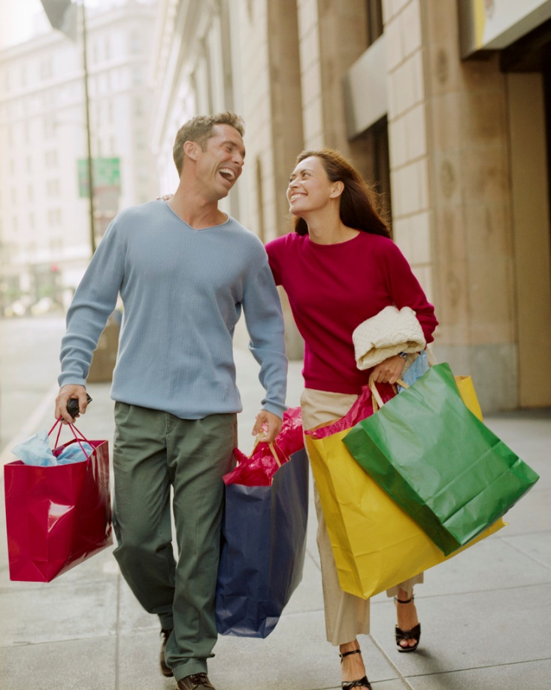
Chapter
01
What is Consumer Behavior?
Consumer behavior: the study of the processes involved when individuals or groups select, purchase, use, or dispose of products, services, ideas, or experiences to satisfy needs and desires.

Slide 35
Chapter
01
For Reflection 1/2
Do your consumption choices differ depending upon the role you are playing at the time?
Give examples from your own life.

Slide 36
Chapter
01
For Reflection 2/2
How do your choices as a consumer differ depending upon whether you are in the role of student, child, employee, and so on?

Slide 37
Chapter
01
Chapter Objectives
We have been learning
Introduction to consumer behavior
Learning Objective 1:Consumers use products to help them define their identities in different settings.
Definition of consumer behavior

Slide 38


