Slide 1



Management of technologies
Lecture 8

Slide 2

Section 2
AN APPROACH FOR MANAGING THE INTEGRATION OF NEW PRODUCT DEVELOPMENT PROCESS IN BIOTECH START-UPS
Lecture
Section 1
USAGE AS A SPARK FOR CO-OPERATION AND INNOVATION GENERATION

Slide 3
Section 1
USAGE AS A SPARK FOR CO-OPERATION AND INNOVATION GENERATION

Slide 4
What is usage?
Today there is not one definition of usage but several. Usage is defined as an action, the fact of using something. It is also a function, a destination, the use for which something is put to. Thus, to study usage therefore involves observing, and interpreting, actions to understand how a product is used. This concept of usage is in this sense closer to that of usability and can be highlighted by ergonomic analysis in real, or realistic situations.
But the significance of usage does not stop at this dimension of action, it relates to the more general dimension of practices, customs and habits. It is thus the whole of a set of social practices.

Slide 5
What is usage?
Usage thus relates, in this dimension, to a number of individuals forming a social group. Usages also relates to habits, all of the practices that a person can develop for and by using something. All things considered, usage seems to be the fruit of experience and beliefs, both at an individual level (practices) and a collective level (habits). The term use thus brings together several meanings. But, these meanings are largely directed towards the same paradigm; the practices of users.

Slide 6
Why usage?
In these times of fundamental technological developments, everyone admits that it is becoming necessary "to think of usages". Although this term is currently restricted to the field of telecommunications, because of the rapid technological developments in this field, we think that it concerns all industrial technical objects. In our field of hand tool design, the question of usage is at the centre of our approach.
Technological evolution in the field of telecommunications does not only modify users' behaviour in their technical relation with the object but also modifies their activity around and with the object. In the case of professional activity, these technological developments, as in the field of car maintenance, affect the work activity of the operators.

Slide 7
Why usage?
New behaviours with tools are thus observed (modification of the frequency of use, for example). New tools, including new technologies, appear and consequently generate new practices and appreciably modify the maintenance professions (evolution of training or efforts concentrated on diagnostics). These evolutions have always been present and have always been followed by industry.
However, the rapid evolution of technologies and professions forces design efforts to be focused around these evolutions.
Moreover, in our experimentation context, co-operation between individuals remains difficult and most of the time functions in an informal manner. Co-operation, although of interest to all individuals concerned, is not a reality. Indeed, existing knowledge on usage within the company is dispersed.

Slide 8
Usage as a source for innovation
The analysis of usage can be a source of innovation thanks to the knowledge that can be extracted about a product. This contribution of new knowledge can, indeed, cause a change in the point of view of a company while calling into question its assets based on its products. Indeed, the results of use analysis can invite designers, as in the methods of creativity based on the phenomenon of coupling, to look at reality from an another point of view in order to change representations. But the characteristic of usage analysis is to make it possible to change representations starting from reality. Analysis of practices and usages can allow the generation of innovative concepts by bringing the designer new knowledge about the product.

Slide 9
Usage as a source for innovation
Thus, by intervening upstream in the conceptual phases of product design, this new knowledge can change the point of view on a product because it opens other fields of reflection, which are necessary for the generation of innovation. Moreover, it is this coming together of different types of knowledge that is necessary for the exploration of new innovations. Thus, in our industrial context, where the product is directly related to the usage that users will put it to and where, as a work tool, it forms part of a work activity, it is, we believe, necessary to centre the process on use activity or work activity in order to innovate.

Slide 10
Usage as a common reference frame for unified design
Mallein (2002) sees three complementary ways to treat usage, and consequently economic value, in the design of a new communicating object: ergonomics, strategic marketing and sociology. We think that this vision can also apply to tool design, because this term is not just for new technologies. If we apply this reflection to our field of hand tool design, i.e. to professional tools design, we can extend this definition of usage:
Ergonomics, indeed, will see in use those aspects related to usability, which relates to use in the sense of utilisation (or micro usage). It will also seek to attribute a meaning in the concept of the tool for the user in a work environment according to the model of activity. This then relates to use within the meaning of work activity (or macro usage).

Slide 11
Usage as a common reference frame for unified design
Mallein (2002) sees three complementary ways to treat usage, and consequently economic value, in the design of a new communicating object: ergonomics, strategic marketing and sociology. We think that this vision can also apply to tool design, because this term is not just for new technologies. If we apply this reflection to our field of hand tool design, i.e. to professional tools design, we can extend this definition of usage:
Sociologists will seek the meanings of use to anticipate the potential positioning of the new products within a coherent cultural framework. In a sense, they analyse social usage.

Slide 12
Usage as a common reference frame for unified design
Mallein (2002) sees three complementary ways to treat usage, and consequently economic value, in the design of a new communicating object: ergonomics, strategic marketing and sociology. We think that this vision can also apply to tool design, because this term is not just for new technologies. If we apply this reflection to our field of hand tool design, i.e. to professional tools design, we can extend this definition of usage:
Marketing will be interested in the act of purchasing and will seek as well as possible to insert the new object into existing markets. This economic approach can supplement that of the sociologist in the sense that it will seek more to define "behaviours of consumption or ways of life associated with income brackets".

Slide 13
Usage as a common reference frame for unified design
Mallein (2002) sees three complementary ways to treat usage, and consequently economic value, in the design of a new communicating object: ergonomics, strategic marketing and sociology. We think that this vision can also apply to tool design, because this term is not just for new technologies. If we apply this reflection to our field of hand tool design, i.e. to professional tools design, we can extend this definition of usage:
The designer will seek a coherence of use in comparison with the products offered on the market from a functional and stylistic point of view.

Slide 14
Usage as a common reference frame for unified design
Mallein (2002) sees three complementary ways to treat usage, and consequently economic value, in the design of a new communicating object: ergonomics, strategic marketing and sociology. We think that this vision can also apply to tool design, because this term is not just for new technologies. If we apply this reflection to our field of hand tool design, i.e. to professional tools design, we can extend this definition of usage:
Tool testers, former users, will seek to understand whether a tool is usable according to the type of vehicle configuration, for example. They will thus seek to propose methods and techniques of assembly and disassembly.

Slide 15
Usage as a common reference frame for unified design
Consequently, many actors in our industrial context are owners of data on usage. Admittedly, this information is partial and one cannot restrict oneself to only one vision of usage. To understand, analyse and "think of usages" with the aim of designing, it is necessary to rebuild usage starting from all the dimensions of usage identified by the design actors.
The "Common Reference system of usage" of ergonomics has no other choice than to nourish the very concept of usage through a common reference framework for all the actors in the design project. Indeed, even if various representations of usage exist between the various actors in design, they are all directed towards a common objective; the users and their behaviour with products. Thus we feel that, due to its interdisciplinary character, a definition of the multiple facets of usage must constitute the Common Reference framework necessary to spark group awareness, which is nourished and maintained by a participative approach that favours interaction between individuals in order to further innovation. Thus we think that usage can be a unifying topic in design.

Slide 16
CONCLUSION AND PROSPECTS
Usage seems to be a federative theme, adapted to our context, which can be the basis for sparking co-operation and innovation generation. We must, then, produce a methodological tool, a support for the rebuilding of usage, which could be transferred to all design actors and can be used as a device for design based on usage.
Moreover, a global approach to co-operation must be defined in order to further this joint attitude to development organised around usage. From our point of view, it must be initially defined around the presentation of the results of the respective studies of the actors.

Slide 17
CONCLUSION AND PROSPECTS
We will use, for that, the upstream approach to generalized creativity of Maxant (2002), which is based on the sharing of common prospective analyses, and we will adapt it to our context. A common tool translating usage must, moreover, be created through our experiments in the field. Although steps and tools are necessary to organize a cooperative innovating process centred on usage, we have not answered the crucial question of how these approaches are driven. Usage alone cannot create a federative and co-operative process. Although approaches and tools can frame this sparking, it must, however,be created and generated. Even if the global company organisation can support this dynamic, who will control this process? We will then come back to the interrogations of Boujut (1998) on the question of property and the responsibility for this driving. As in the majority of companies, the design of products was, formerly, mainly driven by technical aspects. Then other strategic forms appeared in companies.

Slide 18
CONCLUSION AND PROSPECTS
The processes were thus centred on design. We do not wish our process to be centred exclusively on ergonomics. The problem of co-operation, muddied by the question of responsibilities and power structures, would not be solved in this case. Moreover, ergonomics can only partially answer the question of the users. Usage, on the other hand, by its multidisciplinary position and thus multi ownership nature, should be at the centre of the debate. Its driving must thus be carried out by actors in frontier positions between the various professions. Boujut (1998) call them "interface actors" who could control "interface knowledge". This question of driving also arises in our industrial context. Who indeed will manage the interface knowledge on usage? It is necessary to have managers of usage? Who will control the construction of the joint definition and the usage, at appropriate moments, of this common reference framework in design?

Slide 19
Section 2
AN APPROACH FOR MANAGING THE INTEGRATION OF NEW PRODUCT DEVELOPMENT PROCESS IN BIOTECH START-UPS

Slide 20
INTRODUCTION
Today's climate of New Product Development (NPD) is characterized by increased domestic and global competition, technological development waves become shorter, continuous development of new technologies that make existing products obsolete, changing customer requirements which truncate product life cycles and rising PD costs. As product life cycles get shorter and technology seems to change at an ever-increasing pace, it becomes especially critical to have an effective and efficient NPD process to improve company's performance.

Slide 21
INTRODUCTION
The environment for NPD in most technologically advanced industries suggests that the difficulties and uncertainties associated with the NPD are increasing along with the pressure to develop more new products. Time pressures have become more critical as delay in delivery of NP innovations can cost firms significant proportions of related profits. Rolling out new, technically challenging products at the right time has been a key success factor for more than a decade. Improving the speed of product development process can be a powerful competitive advantage. But just focusing on speed to market may miss the point in that the real challenge is how to create faster, better and cheaper products, not just create them faster. Therefore, the scope of the NPD process encompasses the delivery of a fast, high quality, and cost-effective product.

Slide 22
INTRODUCTION
To increase their competitiveness, companies that develop products have realised the importance of improving the efficiency of their development process. Since process improvement requires process understanding, researchers and practitioners put effort into observing product development process - looking for its important characteristics- and developing models and approaches that account for those features.
The reason behind these approaches is that, without an understanding of the NPD process and its constituent elements, the process will not be managed as effectively as it could be. Companies should therefore be paying increasing attention to understand and manage the NPD process.

Slide 23
INTRODUCTION
More specifically, companies should understand how to integrate their NPD process activities. Integrating a complex set of activities that cuts across most functions in a business is a difficult task. To work effectively, the different backgrounds, skills and perspectives must be integrated to form an effective whole. To do so, integration approaches are needed.
What may work for one company may not work for another. It depends on the characteristics of industry, company size, and the NPD process. Some industries have more complex NPD process than others, and integrating its activities is uneasy task. Biotechnology industry is an example of these types of industries.

Slide 24
Biotech Start-ups
Biotechnology is one of the new rapidly developing technologies that have dramatically changed the landscape of competition in many industries. It will be the major technology of the twenty-first century. Biotechnology is highly multidisciplinary; it has its foundation in many fields including biology, microbiology, biochemistry, molecular biology, genetics, chemistry and chemical and process engineering. It has been considered as a series of enabling technologies involving the practical application of organisms or their cellular components to manufacturing and service industries and environmental management. The European Federation of Biotechnology (EFB) considers biotechnology as "the integration of natural sciences and organisms, cells, parts thereof, and molecular analogues for products and services."

Slide 25
Biotech Start-ups
The biotechnology industry is characterized by "hyper-competition" with a high degree of uncertainty about the combined effects of both new technologies and new market structures. In this industry, the revolutionary changes in technology and innovative new products and processes have the potential to threaten the position ofexisting market leaders and their product-market positions.
It is also a sector where we find a large number of R&D alliances, in particular between well-established companies (typically old and large) and start-up companies (typically new and small). There is a certain degree of mutual dependence developed between large and small biotechnology companies. This mutual dependence in cooperative projects consisted of financial support and regulatory know-how provided by large pharmaceutical companies to start-up biotechnology companies, in return for which large companies acquired access to the research skills of these small biotechnology companies. With the increasing number of new products based on pharmaceutical biotechnology, collaboration between start-ups and large companies also provides the first group with access to new markets and distribution facilities.

Slide 26
Biotech Start-ups
An example of this collaboration between large and start-up biotech companies can be taken from the new drug targets industry, where the optimum situation is to take a project from inception to approved drug (e.g. drug discovery, development, production, clinical trial phases I-III, FDA regulatory process, sales and distribution). But this is a long and extremely expensive proposition.
Due to their limited resources, start-ups do not have the capability to develop its Biotech Start-ups Biotechnology is one of the new rapidly developing technologies that have dramatically changed the landscape of competition in many industries. It will be the major technology of the twenty-first century.

Slide 27
THE THREE ELEMENTS OF INTEGRATION APPROACH
Before we introduce the three elements of our integration approach, we will describe what exactly integrated NPD means. Lawrence and Lorsch (1986) define integration as the process of achieving unity of effort among the various subsystems in the accomplishment of the organisation's task.
Hitt et al (1993) state that integration facilitates reciprocal information flow among functions responsible for the development, design and implementation of the innovations. The Product Development and Management Association defines integrated Product development as a philosophy that systematically employs an integrated team effort from multiple functional disciplines to develop effectively and efficiently new products that satisfy customer needs.

Slide 28
THE THREE ELEMENTS OF INTEGRATION APPROACH
Collaboration
Collaboration is the process in which several people, or organisations, with different, possibly complementary skills work together to create new product designs. Collaboration creates synergy in the activities of different individuals by creating and using a common knowledge base, and is promoted by collective goals, mutual understanding, informal activity, shared resources and common vision. This leads to richer communication between different functional areas, which may in turn lead to less problems in the coordination of their activities.

Slide 29
THE THREE ELEMENTS OF INTEGRATION APPROACH
Coordination
Coordination is used here as a state variable referring to "the state of being coordinated." It refers to the degree to which the activities of organisations' members are fitted and linked together in order to accomplish a collective set of tasks. NPD activities need a certain degree of coordination because individuals and functions often lack the knowledge and skills to take into account all relevant design issues, especially those outside of their specialist areas. Within their own context, individuals and functions might well have sufficient knowledge and skills to do a good job, yet unless these are sufficiently coordinated, a project might still fail. Development lead-time, cost and product quality might suffer as a consequence of not having a well-coordinated process.

Slide 30
THE THREE ELEMENTS OF INTEGRATION APPROACH
Communication
Communication is the process in which information originating in one function (sender) is transferred to and put to use by another function (receiver). In other words, output information of one function is transferred to serve as input information for another, with input as well as output information comprising knowledge and know-how, such as ideas, concepts, data, results, analyses and plans. In this process, people from different functional areas share and understand information, usually with the intent to motivate or influence behaviour.

Slide 31
THE THREE ELEMENTS OF INTEGRATION APPROACH
Communication
Communication is enabled and facilitated by meetings, committees, telephone calls, standard forms, memoranda and reports, e-mails and other IS. The relationship between the 3C. Although distinct, collaboration, communication and coordination are related. In particular, greater collaboration will increase the need for coordination and communication since working together requires greater information sharing and greater accessibility to the other party's resources. The converse is not true. Communication and coordination will not necessarily promote collaboration. This relationship is represented in figure 1

Slide 32
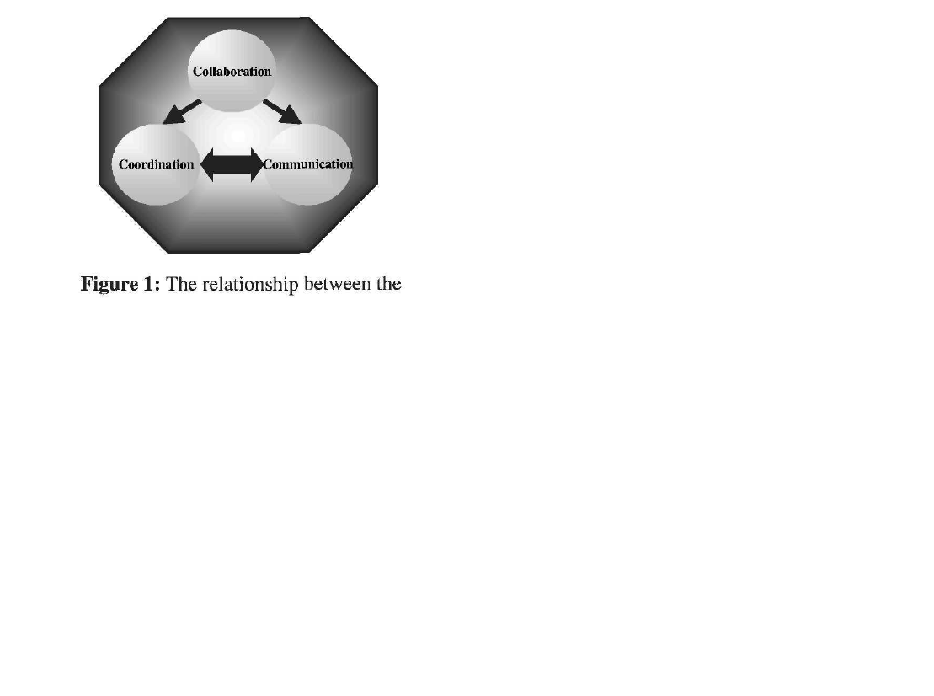

Slide 33
Benefits of Integrating the NPD Process
Several studies found integrating NPD activities to be an effective way of overcoming problems related to long development lead times, poor manufacturability, rework and product below customer expectation.
There are three levels of benefits that can be gained by start-ups:
(i) Project level: developing a new product with less time and cost,
(ii) Company level: Fast Return on Investment (ROI), and cash to start a new project,
(iii) Business level: the company gain a competitive advantage.

Slide 34
THE INTERACTION BETWEEN THE NPD PROCESS AND THE 3C WITHIN AN ORGANISATION CONTEXT
The best way to view the link between the NPD process and the three elements of integration, within the organisation context, is through an organising diagram, see figure 2. However, NPD process requires significant interaction with different levels of an organisation for success.
As shown, the NPD process management reacts with two different organisational levels, strategic and operational levels.
In the first level, the strategic level, as the limited resources force the biotech start-ups to collaborate with other biotech companies, it has to be decided which NPD activities should be carried out in-house, and which should be outsourced. An important consideration is the strategic relevance of certain technologies for a start-up.

Slide 35
THE INTERACTION BETWEEN THE NPD PROCESS AND THE 3C WITHIN AN ORGANISATION CONTEXT
The next important issue is how to select the right partners to execute the outsourced activities. Such decisions are of strategic importance for start-ups and keys to the success of their NPD projects. To be able to take the right decisions, at this level, start-ups should have a clear defined vision and strategy (e.g. growth ambitions, future the start-ups aiming to, disease or technology area, etc.).

Slide 36
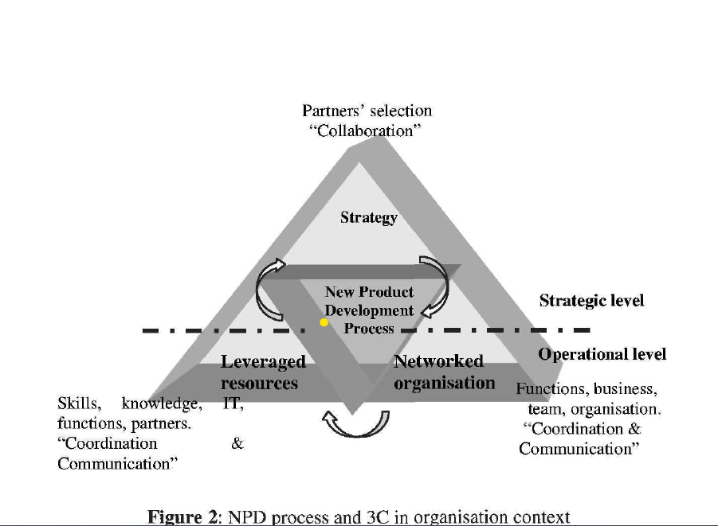

Slide 37
THE INTERACTION BETWEEN THE NPD PROCESS AND THE 3C WITHIN AN ORGANISATION CONTEXT
In the second level, the operational level, once the start-ups have decided what activities to outsource and selected the right partners, the main question is: how to build a collaborative network of different-focused organisations, what is the best technique to have resources, both tangible and intangible, productively shared between network members, and what approach leads to effective communication and coordination of the NPD process activities internally (different units in the start-ups), and externally (with the network members).

Slide 38
THE INTERACTION BETWEEN THE NPD PROCESS AND THE 3C WITHIN AN ORGANISATION CONTEXT
The coordination element aims at streamlining the transition of output from one activity to be the input for another activity, eliminate re-work, and introduce the overlapping of activities. The communication element aims at ensuring the right information are sent to the right place at the right time. The start-ups deal with some issues such as what level of knowledge sharing should they have to allow them to speed up their decision-making, do they need accessible information server with the partners, do they have a sufficient IT infrastructure assisting good communication, do they need to invest in IT to move forward.

Slide 39
THE PHASES OF INTEGRATION PROCESS
As mentioned before, the integration approach is not something that can be "bought off the shelf and implemented in start-ups NPD process without efforts. There are many factors should be taken in consideration to have an effective integration approach, such as the start-up's strategy, the nature of the NPD project, the characteristics of the network, the available and required resources, and the technology needed.
As shown in figure 3, the integration approach consists of three different phases, identification, partner selection, and integration elements phases.

Slide 40
THE PHASES OF INTEGRATION PROCESS
In the first phase, some identification work should be carried out. The goal of this phase is to understand the current situation of the start-ups. The results of this phase will be used latter to select the right partners. However, the start-ups should identify clearly their vision, and their short and long-term strategies. Most strategists agree that the two key questions of company strategy are: what business should the start-up be in, and how to get there.
Moreover, the start-ups should also identify the development project goals. The development projects should be in-line with the start-up's strategy.

Slide 41
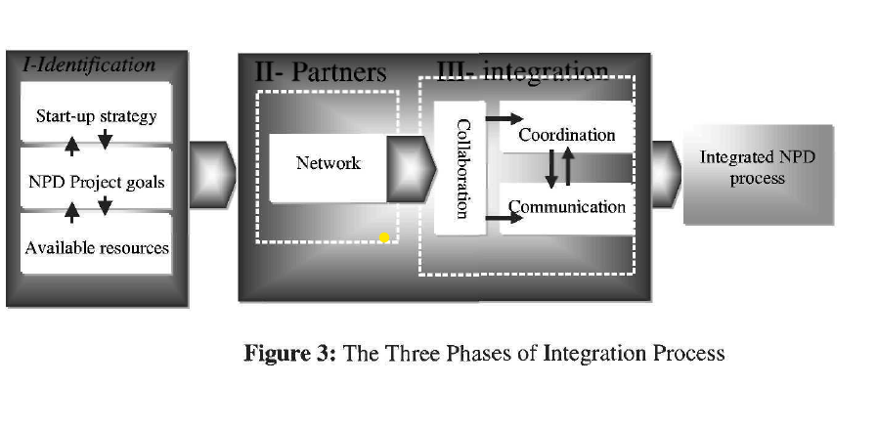
THE PHASES OF INTEGRATION PROCESS
The third element in this phase is the "internal resource analysis". An internal analysis of the start-up's resources helps to identify the start-up's specific strengths and weaknesses and its source of competitive advantage.

Slide 42
THE PHASES OF INTEGRATION PROCESS
The second phase is the partner selection. The goal of this phase is to select the right partners and segment those partners along a spectrum of limited to deep collaboration.
The result of this phase will be used latter to manage the collaboration, communication and coordination of NPD process activities. Start-ups are not expected to invest the same effort, in communication and coordination, with all partners. The more strategic the partner, the better the communication and coordination. However, as stated before, there is no biotech start-up that has the time or resources to develop all the needed capabilities internally. The only way to overcome this obstacle is to collaborate with other partners.

Slide 43
THE PHASES OF INTEGRATION PROCESS
The strategic partners should meet the following requirement: share the same vision for the business, of great importance to development projects and business, current and future business size matching with the start-up plan, can help to have a short-term return, defined long-term potential, and help in improving the NPD process performance.

Slide 44
THE PHASES OF INTEGRATION PROCESS
The third phase consists of three interrelated elements, collaboration, coordination and communication. The goals of this phase are to ensure that:
the people, units and functions within the company or/and from different companies are working and collaborating together for achieving the NPD project goals,
(ii) there is a certain degree of which the activities of NPD process are fitted and linked together in order to accomplish a collective set of tasks,
and (iii) the upstream functions have knowledge of downstream capabilities in order to incorporate these into their activities.

Slide 45
THE PHASES OF INTEGRATION PROCESS
In order to design a good level of integration, the NPD process activities should first be broken down into sub-process and tasks. Followed by finding out the functions of each task, the required input and output of each task, supporting tools, milestones and deliverables, feed-back loops, criteria for transition from one phase to another, etc. When breaking down and scheduling NPD process activities, the relationship between the activities of different people and functions will be clear.
The next step is to find out where coordination and communication are required or have to be enhanced along the process. This step will help in introducing the overlap of activities, which results usually in reducing the time and cost of NPD projects.

Slide 46



Thank You

