Slide 1


DIGITAL MARKETING
APPLICATIONS
Prepared by Dr. HEBA ZIAD
COURSE CODE - MKT720
lecture 3

Slide 2
Digital marketing strategy development
Chapter at a glance
Main topics
Understanding the impact of digital disruptors
Digital marketing strategy as a channel marketing strategy
The scope of digital marketing strategy
importance of integrated digital marketing strategy and digital transformation plan
How to structure a digital marketing strategy
Situation analysis
Setting goals and objectives for digital marketing
COURSE CODE - MKT720

Slide 3
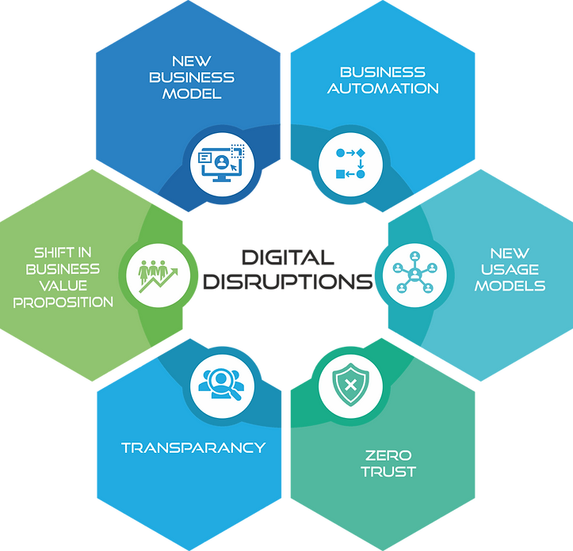
What is digital disruption?
Essentially, it's a paradigm shift associated with technology and has an all-encompassing impact across an organization. The impact of this change and adoption is typically felt in technology, data, process, and people.
Digital disruption :- innovation in digital media , data and marketing technology that enable a change to a new basis for competition in a market or across markets
Why should I care?
Human nature is instinctively fearful of change, yet the inevitability of change is forever present. The rapid advancements of digital technologies during the first two decades of the 21st century combined with globalization have reshaped several industries & economies, enabled new business models, and transformed the way people use products & services and their expectations of them.
​
How can I embrace this opportunity?
For organizations to be resilient from disruptions, they are required to understand, adopt, rationalize and be excited about the change which enables them to embrace the opportunities.
​
chapter 3

Slide 4
7 business models of digital disruption of brands who have embraced the revolution.
1.THE EXPERIENCE MODEL
This is all about giving your consumers a unique experience that they are willing to pay good money for. Think about Tesla. Elon Musk has created a unique product with Tesla and because of how innovative, and how experience-driven it is, the company and its CEO are both benefiting from the success of not only the experience they offer, but how digitally-disruptive Tesla is.
2.THE SUBSCRIPTION MODEL
The subscription model works by bringing a customer into the business based on a monthly payment, giving them continued access to a specific product/service. Take Netflix as an example. They have over 100 million users paying a small monthly subscription fee for access to thousands of films and TV shows.
chapter 3

Slide 5
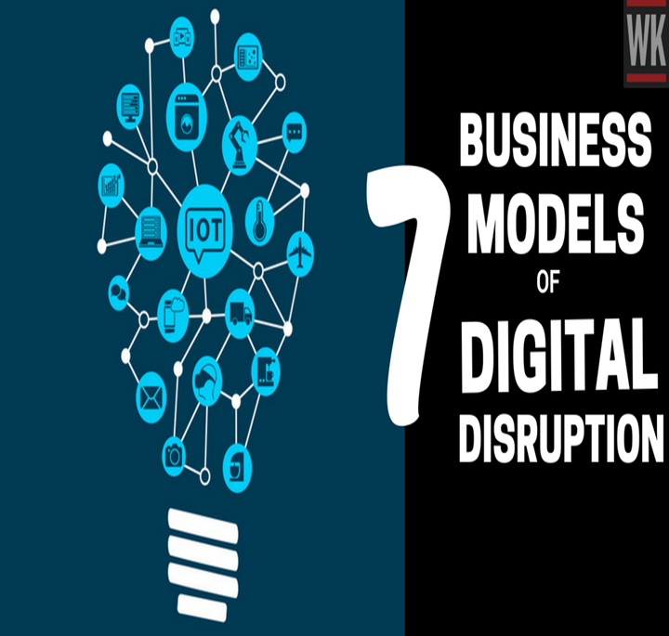
7 business models of digital disruption of brands who have embraced the revolution.
1.THE EXPERIENCE MODEL
This is all about giving your consumers a unique experience that they are willing to pay good money for. Think about Tesla. Elon Musk has created a unique product with Tesla and because of how innovative, and how experience-driven it is, the company and its CEO are both benefiting from the success of not only the experience they offer, but how digitally-disruptive Tesla is.
2.THE SUBSCRIPTION MODEL
The subscription model works by bringing a customer into the business based on a monthly payment, giving them continued access to a specific product/service. Take Netflix as an example. They have over 100 million users paying a small monthly subscription fee for access to thousands of films and TV shows.
chapter 3

Slide 6

3.THE “FREE” MODEL
The free model has been adopted by the likes of Facebook, Instagram, Google and Twitter. The ideology behind the free model is that you, as the user become the product because you are not paying for this. This means that your data becomes the most valuable part of the business, as does your attention for advertising purposes.
4.ACCESS-OVER-OWNERSHIP MODEL
This business model is all about a “sharing” philosophy. You pay to use the product/service, but it does not become yours to own; you are only accessing it. This is one of the most disruptive business models as it gives the same experience as purchasing something, but without having the ownership implications.
5.ECOSYSTEM MODEL
Thanks to the likes of Google and Apple, the Ecosystem model is more disruptive than ever before. This business model is a success because of the way it sells an interdependent suite of products/services that when purchased, increase in value based on how many you own.
This does create consumer dependency but this is what makes Apple users stay with Apple.

Slide 7
6.ON-DEMAND MODEL
As important as on-demand content is, having an on-demand business model serves as an even more vital part of embracing a digital transformation. This works by having users pay for a service that they don’t have time to do for themselves, but is fulfilled by people with time, and short on money.
For example, Uber and Lyft have made the on-demand model a huge success.
7. FREEMIUM MODEL
The freemium model is one of the most popular business models online. This is where users get either a “basic” (free) version of a product/service, or a “free” trial. This user will then have the option to upgrade to a paid version of said product/service.

Slide 8
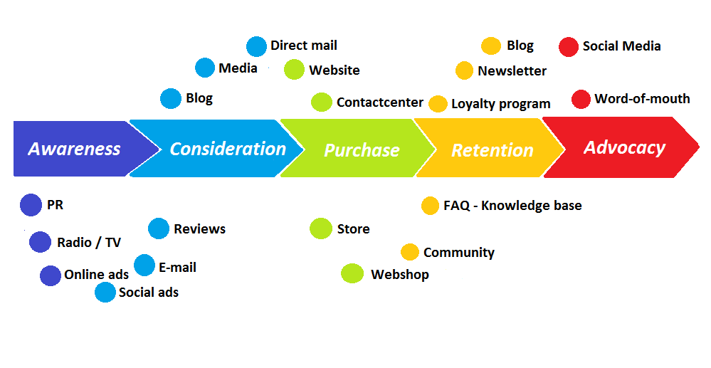
Digital marketing strategy as a channel marketing strategy
For existing businesses, digital marketing strategy is a channel marketing strategy, which defines how a company should set channel-specific objectives and develop differential advantage while at the same time considering how channels should integrate.
The key aim is to use digital channels to enable companies and organizations to stand out from the competition when communicating with relevant target audiences
. Digital channel strategy has two components many may see it simply as a digital communications strategy but it should also define changes to the proposition enabled by digital channels including product, pricing, place, promotion and changes to customer service. The strategy determines the strategic significance of digital channels relative to other communications channels used to communicate directly with customers at different customer touchpoints. Overall, the way people shop is changing as a result of the interventions of digital technologies and social media. Consumer decision making has become more complex and as a result the shopper's path to purchase can mean that they not only encounter all of the traditional (pre-Internet) purchasing cues but this is also integrating with a range of new Internal and external influences on digital marketing strategy
Customer touchpoints Communications channels with which companies interact directly with prospects and customers. Traditional touch points include face to face (in-store or with sales representatives), phone and mail. Digital touchpoints include web services, email and, potentially, mobile phones.
chapter 3

Slide 9
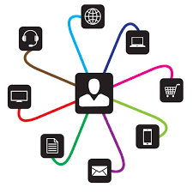
digitally enhanced cues such as social media mentions and comparison sites Businesses can no longer ignore digital channels they are finding ways to increase their reach and number of customer touchpoints.
In order to make best use of digital channels, there are three priorities for businesses:
Eliminate silos and create seamless experiences for consumers, all the way along the path to-purchase. Look for ways to bring together the on- and offline worlds and avoid isolated marketing campaigns, which do not integrate. If there is any friction along the journey a shopper is likely to defect to another supplier
Increase opportunities to digitally interact by understanding more about their paths to-purchase (e.g. provide incentives along the way through digital advertising and mobile promotions).
Analyze and measure consumer behavior at all touchpoints in order to develop deep and insightful understanding of what is driving shoppers' choices and purchase decisions

Slide 10

The focus of digital marketing strategy
is decisions about how to use digital channels to support existing marketing strategies,
how to exploit its strengths and manage its weaknesses,
and to use it in conjunction with other channels as part of a multichannel marketing strategy .
This should define
how traditional marketing channels integrate with digital and support each other to meet corporate and marketing visions and goals.
Multichannel marketing strategy Defines how different marketing channels should integrate and support each other in terms of their proposition development and communications based on their relative merits for the customer and the company.
chapter 3

Slide 11
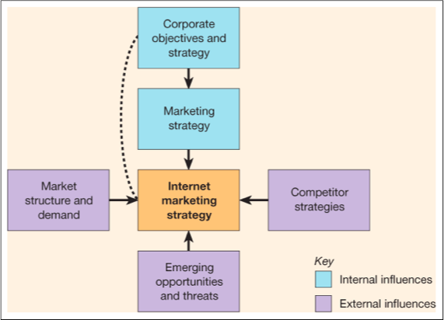
INTERNAL AND EXTERNAL INFLUENCES ON DIGITAL MARKETING STRATEGY

Slide 12
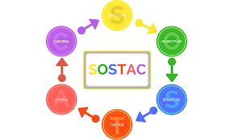
The SOSTAC marketing model, created by PR Smith, is a popular and widely used model for marketing and business planning. Whether you're creating an overall marketing or digital marketing strategy or improving individual channel tactics like SEO or email marketing, this is the tool to use.
SOSTAC stands for
Situation – where are we now?
‍Objectives – where do we want to be?
‍Strategy – how do we get there?
‍Tactics – how exactly do we get there?
‍Action – what is our plan?
‍Control – did we get there?
chapter 3

Slide 13
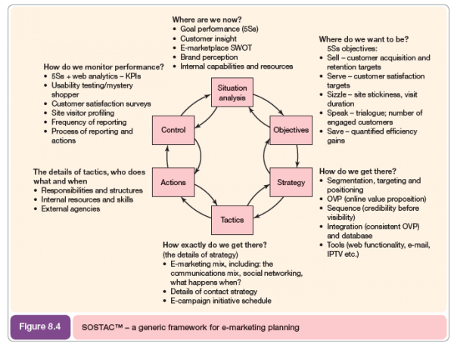
PLANNING FRAMEWORK APPLIED TO DIGITAL MARKETING STRATEGY DEVELOPMENT

Slide 14

SITUATION ANALYSIS – Where Are We Now?
A situation analysis is an overview of your business. It helps you determine where your business stands at the moment so that you can draft your strategy for the future.
A situation analysis has been defined as: A set of methods used to understand an organization's capabilities, customers, potential customers and business environment by analyzing internal and external factors that can affect the business.
components of situation analysis:
A customer analysis helps you to get a good sense of who your customers are so that you can decide which segment you want to target as part of your marketing plan. Among other things, you need to know what is their demographic, their location, how they found you, how they buy from you, what are the perceptions they have of your brand, how do they interact with your brand, and what are their opinions about your competitors?
Product analysis: Evaluate your product or service in terms of how it delivers value to your customers. What we are looking for is a product-market fit perspective.
chapter 3

Slide 15
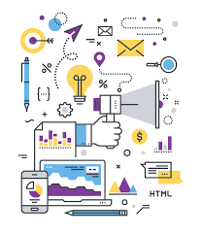
SITUATION ANALYSIS – Where Are We Now?
Competitor analysis: Who are your competitors? How do they have a competitive advantage over you in terms of price, reputation, customer service and size? How do you have a competitive advantage over them?
the environment : These include external factors such as economic, political, social, technological and environmental trends and their possible impact on your business.
SWOT analysis: You can use the findings from your environmental analysis to then conduct a Swot analysis where you look at the strengths, weaknesses, opportunities and threats that may affect your business and performance. Here you also look at internal factors such as whether you have the human capabilities and financial resources for your new marketing plans.
Where Are We Now?
CUSTOMER INSIGHT
GOAL PERFORMANCE
E-MARKETPLACE SWOT
BRAND PERCEPTION
INTERNAL CAPABILITIES AND RESOURCES
chapter 3

Slide 16

OBJECTIVES – Where Are We Going
The second step in drawing up a marketing plan is to be very clear about your long-term objectives such as the vision and mission of your marketing strategy as well as short-term objectives such as the 5S goals defined by PR Smith as:
Sell – Grow sales and market share.
Serve – Add value to what you offer the customer.
Sizzle – Stickiness and the wow factor.
Speak – Two-way communication with customers.
Save – Quantified efficiency gains.
Experts have suggested that each of the 5S goals must be SMART – Specific, Measurable, Achievable, Relevant, Time-bound – to be effective.
chapter 3

Slide 17
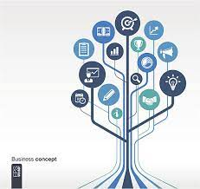
TACTICS – How Exactly Do We Get There.
this section outlines details of strategy such as the methods you use to achieve your objectives. In the context of digital marketing, you need to ask questions like: What data on customers do you have, what do you need? What methods are you going to use to reach them? Advertising, emails, content marketing, SEO or social media? What tools and techniques will you use?
How Exactly Do We Get There
E-MARKETING MIX INCLUDING COMMUNICATION MIX AND SOCIAL NETWORKING
DETAILS OF CONTACT STRATEGY
E-CAMPAIGN INITIATIVE SCHEDULE
chapter 3

Slide 18
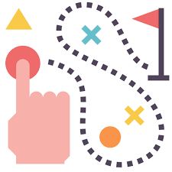
STRATEGY – How Do We Go There?
The strategy is the big picture of how you plan to achieve the objectives you have set.
Here, you need to make clear things like how you plan to divide the market, which segment of customers you should focus on, what message should you use to target each segment, and how your plan compares to that of your competitors.
use a popular marketing model called Segmentation, Targeting and Positioning or STP to help with strategy. In this model you first identify on what basis you want to segment your customers (demographics or lifestyle, for instance), you then pick one or more segments that you think may be the most viable and valuable and then start developing marketing material to position your product or service in such a way that you can target each segment separately.
HOW DO WE GET THERE
OVP (ONLINE VALUE PROPOSITION)
INTEGRATION
SEGMENTATION , TARGETING AND POSITIONING
chapter 3

Slide 19

ACTION – What Is The Plan?
the details of tactics. You determine who does what. You need to assess whether you have the human resources internally or whether you need to hire new staff with the required skill sets. You must determine whether you need the help of any external agencies or consultants. You must see if you have the systems and processes that you need in place, and work towards organizing them if they aren’t.
The details of tactics ,who does what and when
Responsibilities and structure
Internal resources and skills
External agencies
chapter 3

Slide 20

CONTROL – How Do We Monitor Performance?
How do you know you are on track to achieving your targets? Monitoring progress is also an important step. You must put in place systems that help you assess progress periodically – daily, weekly, monthly or quarterly. This will ensure that at the end of the project time period, you don’t suddenly find out that things haven’t gone as planned.
You can use
5Ss + web analytics +KPIs,
site visitor profiles,
usability testing, mystery shopper
customer satisfaction surveys
frequency of reporting, and who reports to whom and what happens to that feedback as part of this monitoring process
chapter 3

Slide 21
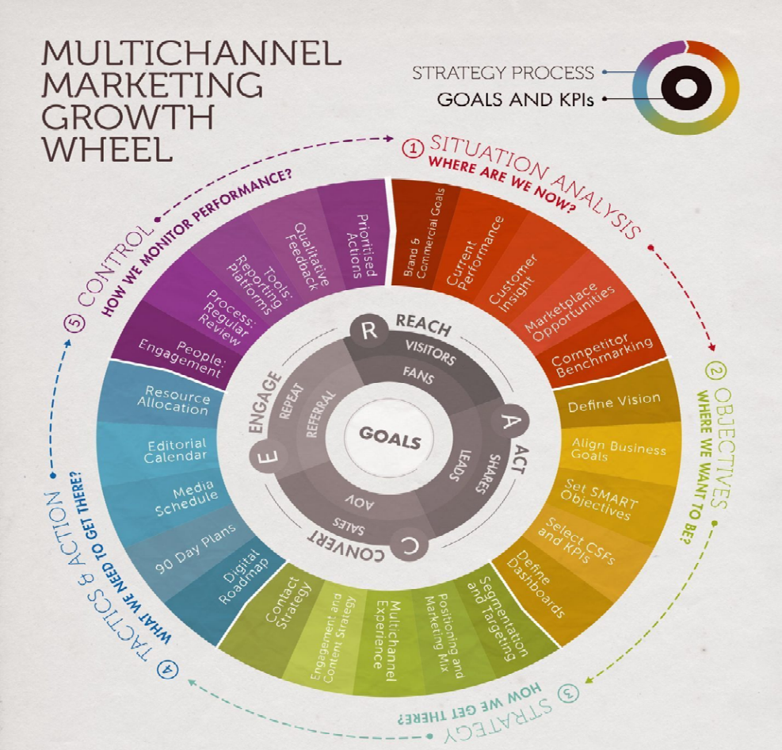
needed as part of the process of producing an integrated digital marketing or multichannel marketing plan.

Slide 22

strategy formulation involves
Involves defining a company's commitment to digital ,setting an appropriate value proposition for customers and identifying the role of the digital channels in exploiting new markets, marketplaces and distributions channels and in delivering new products and services.
Decision 1
Market and product development strategies
Decision 2
Business and revenue models strategies
Decision 3
Target market strategy
Decision 4
Positioning and differentiation strategy
Decision 5
Customer engagement and social media strategy
Decision 6
Multichannel distribution strategy
Decision 7
Multichannel communication strategy
Decision 8
Online communications mix and budget
Decision 9
Organizational capabilities(7S framework)
Digital marketing strategy development

Slide 23
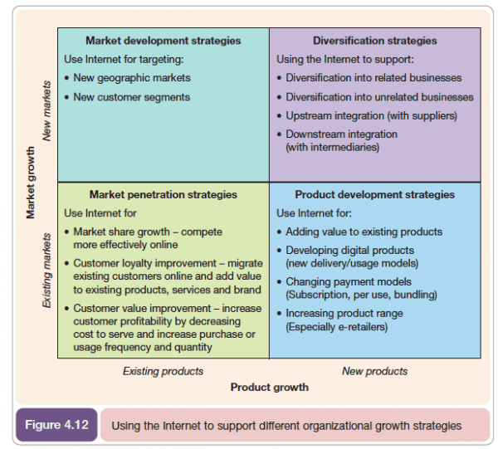
Decision 1
Market and product development strategies
Market penetration This strategy involves using digital channels to sell more existing products into existing markets. Digital channels have great potential for achieving sales growth or maintaining sales by the market penetration strategy. As a starting point, many companies will use digital channels to help sell existing products into existing markets, although they may miss opportunities indicated by the strategies in other parts of the matrix.
Market share growth. Companies can compete more effectively online if they have web- sites that are efficient at converting visitors to sale and mastery of the always-on' online marketing communications techniques such as search engine marketing, affiliate marketing and online advertising.
Customer loyalty improvement. Companies can increase their value to customers and so increase loyalty by migrating existing customers online by adding value to existing products, services and brands by developing their online value proposition
Customer value improvement. The value delivered by customers to the company can be increased by increasing customer profitability through decreasing cost to serve (and so price to customers) and at the same time increasing purchase or usage frequency and quantity, These combined effects should drive up sales.
strategy formulation involves

Slide 24
Decision 1
Market and product development strategies
Market development:-Market development Online channels are used to sell into new markets, taking advantage of the low cost of advertising internationally without the necessity for a supporting sales infrastructure in the customer's country..
3 Product development The web can be used to add value to or extend existing products for many companies.
4- diversification strategies new product are developed that are sold into new markets, the internet alone cannot facilitate these high-risk business strategies but it can facilitate them at lower costs than have previously been possible the option include
Diversification into related businesses
Diversification into unrelated business
Upstream integration with suppliers
Downstream integration with intermediaries
strategy formulation involves

Slide 25
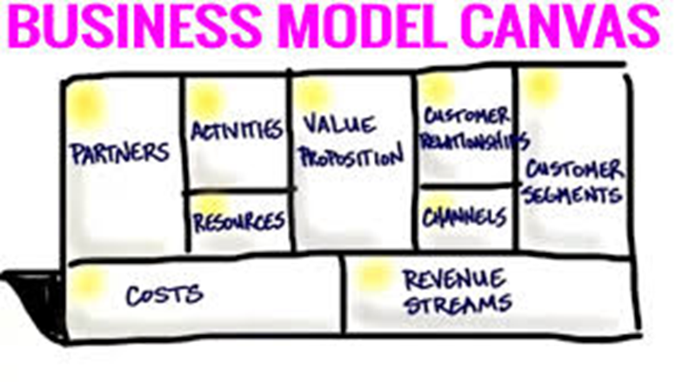
Decision 2
Business and revenue models strategies
What is a revenue model?
A revenue model is a plan for earning revenue from a business or project. It explains different mechanisms of revenue generation and its sources.
Revenue model vs business model
A business model (BM) is a broad term outlining everything concerning the main aspects of the business, all of which are contained in the answers to the following questions.
What value will we create?
How will we deliver it?
How will we bring in revenue?
How will we earn profit?
Business models are often depicted strategically on a business model canvas. This is a compound representation of all the key elements of a BM.
So the BM describes how a business will work from the standpoint of value generation. Revenue models, on the other hand, are a part of the business model used to describe how the company gets gross sales.
strategy formulation involves
Online business model
A summary of how a company will generate a profit –identifying its core product or service value proposition , target customers in different markets ,position in the competitive online marketplace or value chain and its projections for revenue and cost
chapter 3

Slide 26
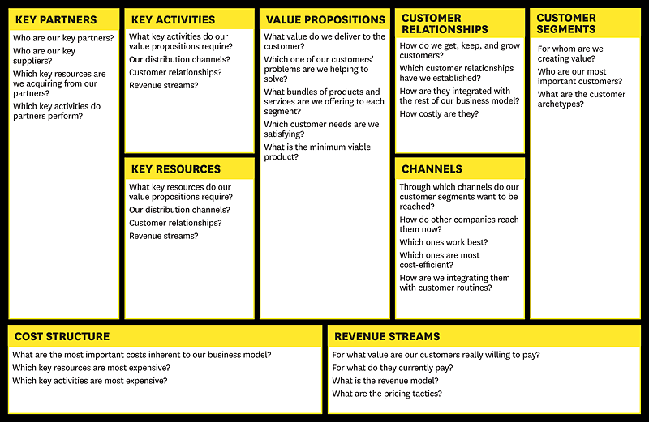
chapter 3

Slide 27

1- Value proposition This is at the heart of what the business offers to its audiences and is arguably most important to success.
2- Customer segments. Different target audiences the value propositions will appeal to. In the business model canvas, the alternatives recommended are mass market, niche market, segmented (broken down further) or a range of diverse segments.
3- Customer relationships. The types of relationships that will be formed, for example self- service, automated services, communities or more personal assistance and this may include co-creation of content
4- Channels. The methods by which an organization's services will be delivered and the audiences reached.
5- Key partners. To exploit online and offline value networks, forming partnerships gives an opportunity of expanding reach and taking advantage of existing organizations and online influencers that have built an audience.
Digital marketing strategy development
chapter 3

Slide 28

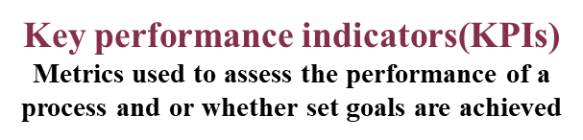
6- Activities. The main activities that need to be performed to deliver the value proposition to develop revenue.
7- Resources. Different types of process and people to complete the activities to create and deliver the value proposition.
8- Cost structure. Different cost-elements, which should be checked against activities and resources Costs are classically broken down into fixed and variable costs and economies of scale.
9- Revenue stream. This is the method by which a business derives income. Common online options are: ad revenue, subscription fees, sales of physical or virtual goods or affiliate- based commission arrangements Licensing and leasing are other alternatives
chapter 3

Slide 29
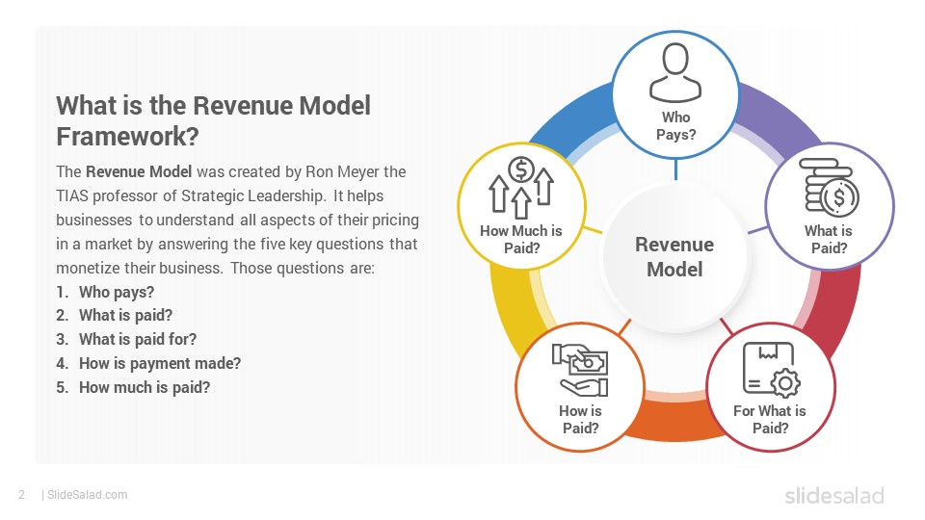

Revenue generation models for digital businesses

Slide 30

Revenue model types
Transaction-based revenue model
A transaction-based model is a classic way a business can earn money. The revenue is generated by directly selling an item or a service to a customer. The customer can be another company (B2B) or a consumer (B2C). The price of the product or service constitutes the production costs and margin. By increasing the margin, the business can generate more income from sales.
Advertisement-based revenue model
The advertisement-based revenue model is a plan with which businesses make money by selling ad spaces. It is one of the most standard methods of producing top-line growth, and it’s valid both for online and offline businesses. It’s often used by websites/applications/marketplaces or any other web resource that attracts huge amounts of traffic.
Commission-based revenue models
A commission-based revenue model is one of the most common ways businesses make money today. A commission is a sum of money a retailer adds to the total cost of a product or service.
Markup revenue model
Markup is the type of revenue model with which you buy a product at a certain cost and then sell it for a higher price: The difference between the two is your profit margin. This model is often used by wholesale, retail, and service-based businesses.
Digital marketing strategy development

Slide 31
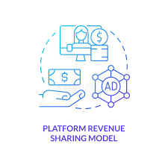
Revenue model types
Affiliate revenue model
The affiliate model is similar to the commission-based model. The main difference is that, with the affiliate model, you do not sell the product or service on your own platform, but rather redirect the customer to the original provider’s platform to make the purchase and earn a commission on any resulting sales. An affiliate model is a contract between a supplier of a product/service and a promoter. A promoter can be another business/media resource/blogger that recommends a supplier’s product. The earnings will come as a percentage of sales or fees for the number of registrations done via referral links.
Interest revenue model
An interest or investment revenue model relates to any type of business that generates revenue in the form of interest on their loans or deposit payments. These are most often banking or electronic wallet companies that work with financial operations.
Donation-based or pay-what-you-want revenue models
This is a revenue model based on investments made by businesses or customers on a voluntary basis. The product or service itself is free to use by default, so that’s the primary value a company brings to the customer. The revenue is generated in the form of donations, or sometimes in the form of “pay-what-you-want.”
Digital marketing strategy development

Slide 32
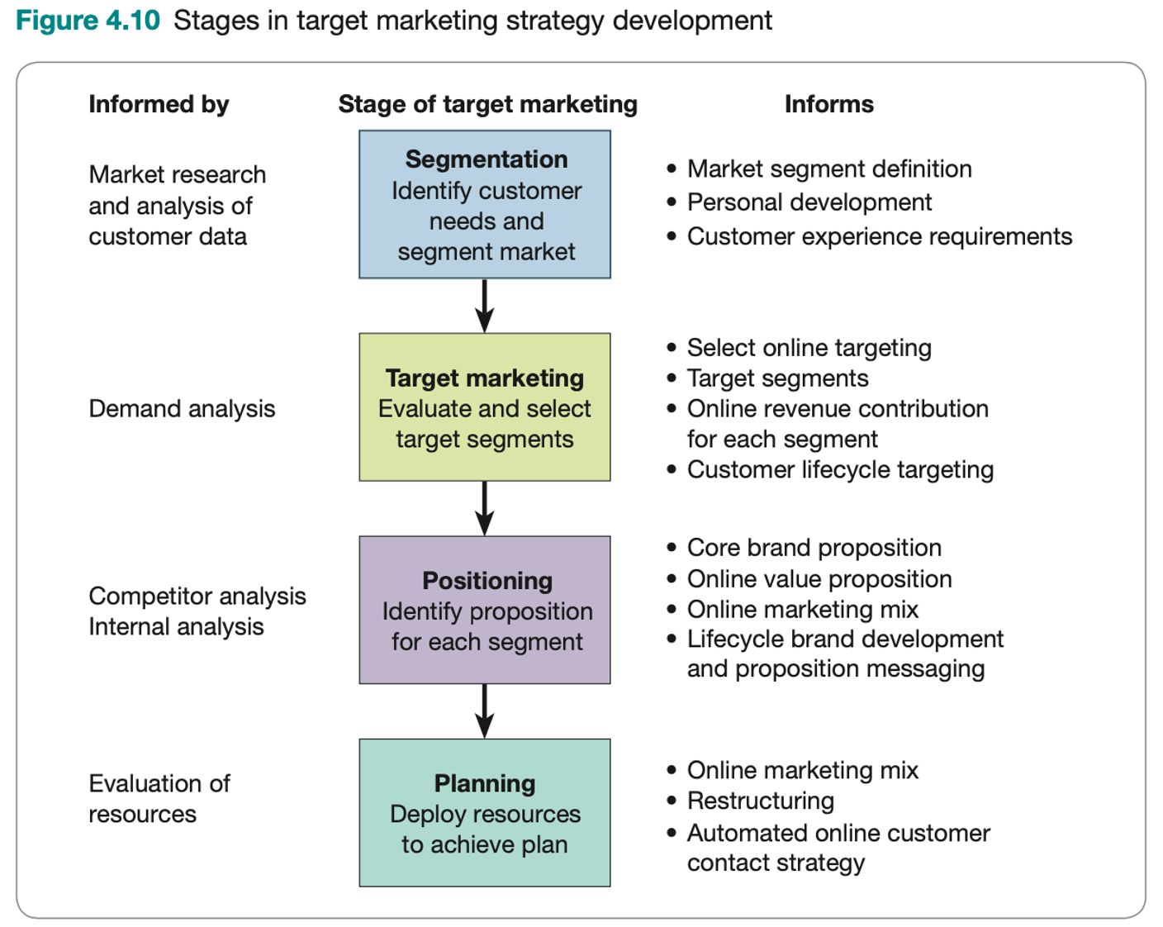
Decision 3
Target market strategy
Target marketing strategy Deciding on which markets to target is a key strategic consideration when planning a d marketing strategy Target marketing strategy involves the four stages shown in Figure digital The two key decisions for the marketing strategist are: Segmentation/targeting strategy. A company's online customers will often have different demographic characteristics, needs and behaviors from its offline customers. It follows that different online approaches to strategic market segmentation may be an opportunity, and specific segments may need to be selectively targeted through online media channels, the company website or email communications, personal development and lifecycle targeting are common approaches for online targeting.
Positioning/differentiation strategy. Competitors' product and service offerings will often differ in the online environment. Developing an appropriate online value proposition is an important aspect of this strategy. The first stage in Figure is segmentation
stage1 Segmentation is a management technique that allows businesses to focus their efforts on the customers they can serve best. When creating digital marketing plans it is useful to distinguish between strategic market segmentation and online tactical segmentation, which is used for online targeting.
Strategic market segmentation can be defined as the identification of individuals or organizations with similar characteristics that have significant implications for determining marketing strategy
chapter 3

Slide 33

Decision 3
In a digital marketing planning context, market segments should be reviewed to assess:
⚫ the current market size or value,
⚫the organization's current and future market share within the segment; the cost-effectiveness and likelihood of a target segment engaging with the organization's offer across all aspects of the buying process-for example, whether it is cost-effective to generate demand of leads and sales use organic media based on content marketing or paid media such as programmatic display, pay-per click advertising (Google Ads), paid social ads or affiliate marketing;
⚫ needs of each segment, in particular unmet needs;
⚫ competitor market shares within the segment;
⚫ organization and competitor offers and propositions;
⚫ usage of the site and conversion to action through web analytics.
chapter 3

Slide 34

Decision 3
Stage 2 in the Figure is target marketing. Here we can select segments for targeting online that are most attractive in terms of growth and profitability. These may be similar or different compared with groups targeted offline. Some examples of customer segments that are targeted online include:
The most profitable customers
Larger or smaller companies
Customer that are difficult to reach using other media
Customer that are brand- loyalty or not brand –loyalty
The number of options used or segment layers and so the sophistication of the approach will depend on resources available ,technological capabilities and opportunities afforded by
Identify customer profile –based demographics characteristics
Identify customer lifecycle groups
Identify behavior in response purchase value
Identify multichannel behavior
Tone and style preference
chapter 3

Slide 35

Decision 4
Stage3 Positioning and differentiation strategy
Ultimately, positioning defines how a company wants to compete and this is determined by the chosen market segmentation, the actual target market and the differential advantage offered by the product or service .The key to this stage of decision-making is to focus on the minds of customers in the chosen target markets. In their minds, most consumers either have a brand attached to product category or they do not; maybe because it is an underdeveloped category or they have yet to exercise a preference. there is opportunity for a brand to take first-mover advantage
Either way, to make a connection with a prospect's mind, it is better to promote a small feature of a brand that is known to the initial connection is made. the prospect rather than a major feature that is unknown By taking this approach, it becomes possible to connect with the target prospect and establish the foundations of a differential market positioning and then build from this point. Online the same principles apply but in a highly complex and dynamic marketplace. Key decisions are about how to enter the minds of the prospective customer, which is the position where the brand wishes to be.
Digital marketing strategy development

Slide 36
Decision 4
Stage3 Positioning and differentiation strategy
Differential advantage The aim of positioning is to develop a differential advantage over competitors. market segmentation is at the heart of developing a differential marketing strategy. Marketing strategists use elements from the marketing mix to establish the difference between their company and their rivals. Many businesses have differentiated their own line offer by using price,
It is important to note that price is not the only way to stand out online; quality of brand experience and quality of service is equally important for creating differential advantage. In a digital marketing contest, differential advantage and positioning can be clarified and communicated by developing an online value proposition (OVP). Developing an OVP, involves:
⚫ developing online content and service and explaining them through messages that: reinforce core brand proposition and credibility communicate what a visitor can get from an online brand that they can't get from the brand offline and they can't get from competitors or intermediaries.
⚫ communicating these messages to all appropriate online and offline customers with touchpoints in different levels of detail, from straplines to more detailed content on the website or in print.
Digital marketing strategy development

Slide 37
Stage3 Positioning and differentiation strategy
Having a clear online value proposition has several benefits:
It helps distinguish an e-commerce site from its competitors (this should be a website design objective).
It helps provide a focus on marketing efforts so that company staff are clear about the purpose of the site.
If the proposition is clear, it can be used for PR, and word-of-mouth recommendations may be made about the company.
It can be linked to the normal product propositions of a company or its product.
Digital marketing strategy development

Slide 38

Decision 5
Customer engagement and social media strategy
Each day there are millions of social network status updates, new blog posts, videos a news articles published. As consumers spend more time online reading and interacting with this content, the challenge of engaging them increases. Given this, we believe that every company must develop a customer engagement strategy as a key part of their digital marketing strategy. This customer engagement strategy reviews approaches to create compelling content and experiences that form the online value proposition. Increasingly, it's most straightforward to achieve online engagement not on a company website but through a social presence on one of the main social networks such as Facebook Google+, LinkedIn, Twitter or other specialist networks. Given the popularity of the social networks, many companies will seek to develop an overall social media strategy. When developing an approach for using each social network to build engagement and community, there are some common decisions across the networks that focus on the types of content and how it is published The answers for each social network will vary, but there are some common themes that should be part of an overall engagement and content marketing strategy.
Social media engagement is a measure of how people are interacting with your social media accounts and content. The term can cover a broad range of actions across all social platforms. For example, engagement might include: Likes and Favorites. Comments,

Slide 39
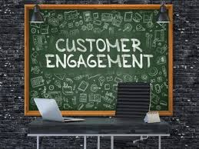
Decision 5
Customer engagement and social media strategy
Social media engagement is the measurement of user interactions with content posted on social media platforms like Twitter, LinkedIn, Facebook, and Instagram. It is a standard metric used by businesses to evaluate their social media performance.
Examples of social media engagement:
Commenting on your post
Sharing your post
Liking your post
Clicking on links to your website
A social media engagement strategy is the plan that connects social media tactics to goals on social networks. The approach summarizes what you plan to do and how you expect to achieve it. The more detailed and specific your strategy is, the more effective it will be.
Social engagement goals can include multiple objectives such as:
Increasing reach
Increasing brand awareness
Building an online community
Promoting a product or service

Slide 40

Decision 5
Customer engagement and social media strategy
How to build a social media engagement strategy
Building a social media engagement strategy isn't easy but with commitment and genuine effort, you'll be on your way to developing a successful plan with positive results.
Consider these steps when building your social media engagement strategy:
Choose an overall goal
Select platform(s) to focus on
Decide how to measure social media engagement
Consider tracking metrics like:
Number of likes/reactions
Number of comments
Total impressions
Post reach percentage
4.Use social media tactics that contribute to reaching the KPIs
Every post your brand makes on social media should be focused on reaching your KPIs. Choose the tactics that make the most sense for your KPIs. Monitor your metrics regularly (weekly, monthly and quarterly) and adjust your tactics as needed.

Slide 41
Decision 6
Multichannel distribution strategy
Distribution channels refer to the flow of products from a manufacturer or service provider to the end customer. At the center of any distribution channel are the movement of goods and the flow of information between different organizations involved in moving goods from which the point of manufacture and the point of consumption.
The key decision as the company is essentially deciding whether the Internet is 'just another communications and/or sales channel or whether it will fundamentally change the way it communicates and sells to its customers.
replacement is most likely to happen when:
⚫ customer access to the Internet is high;
⚫ the Internet can offer a better value proposition than other media;
⚫the product can be delivered over the Internet
⚫ the product can be standardized (the user does not usually need to view to purchase) Only if all four conditions are met will there primarily be a replacement effect The fewer conditions met, the more likely it is that there will be a complementary effect. From an analysis such as that in the Figure, it should be possible to state whether the company strategy should be directed as a complementary or as a replacement scenario.
Distribution channels
the mechanism by which products are directed to customers ,either through intermediaries or directly

Slide 42
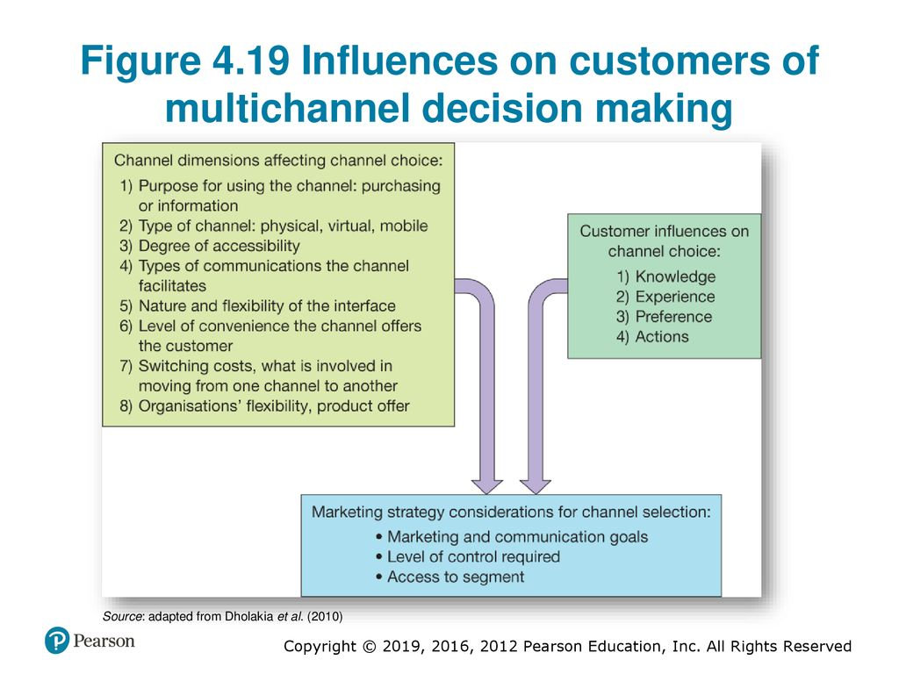
Decision 7
Multichannel communication strategy
The multichannel communications strategy must review different types of customer contact with the company and then determine how online channels will best support these channels.
The main types of customer contact and corresponding strategies will typically be:
⚫ inbound sales-related enquiries (customer acquisition or conversion strategy);
⚫ inbound customer-support enquiries (customer service strategy);
⚫ outbound contact strategy (customer retention and development strategy).
Customer communications channels refer to how an organization influences its customers to select products and suppliers through the different stages of the buying process through inbound and outbound communications.

Slide 43

Multichannel communication strategy
For each of these strategies, the most efficient mix and sequence of media to support the business objectives must be determined. Typically
the short-term objective will be conversion to outcome such as sale or satisfactorily resolved service enquiry in the shortest possible time with the minimum cost. However,
longer-term objectives of customer loyalty and growth also need to be considered. If the initial experience is efficient, but unsatisfactory to the customer, then they may not remain a customer! The multichannel communications strategy must assess the balance between:
Customer channel preferences. Some customers will prefer online channels for product selection or making enquiries while others will prefer traditional channels..
Organization channel preferences. Traditional channels tend to be more expensive to service than digital channels for the company; however, it is important to assess effectiveness and the ability of channels to convert the customer to sale or in developing customer loyalty (the personal touch available through face-to-face or phone contact may result in a better experience for some customers, which engenders loyalty).
Channels and media diverse in recent years and these developments have led to increasingly complex patterns of consumer behavior. For an organization to begin to understand customer behavior online they need to identify target market segments, develop customer profiles and select channels and media that might be suitable for communicating with the chosen segment. As consumer segmentation is a critical aspect of effective multichannel strategy design organizations are faced with making difficult and challenging decisions.
Digital marketing strategy development

Slide 44

Figure there are eight dimensions to consider when making channel choice. This figure shows these dimensions and suggests the factors that affect consumer decision making The channel dimensions have implications for planning and point to key decision areas for an organization that is developing its channel and communication strategies.
For example,
dimension 3 - accessibility - is becoming increasingly important with the widespread adoption of wireless technology and mobile phones;
dimension 5-flexibility of the interface-some channels offer limited flexibility whereas others can be instantaneously tailored
. Customer influences affect their channel choice based on their personal characteristics, which affect how they interact with technology. Both the channel dimensions and customers will shape the strategy decisions a marketer makes but there are also marketing strategy considerations that will influence final channel selection, e.g. goals and objectives.
chapter 3

Slide 45
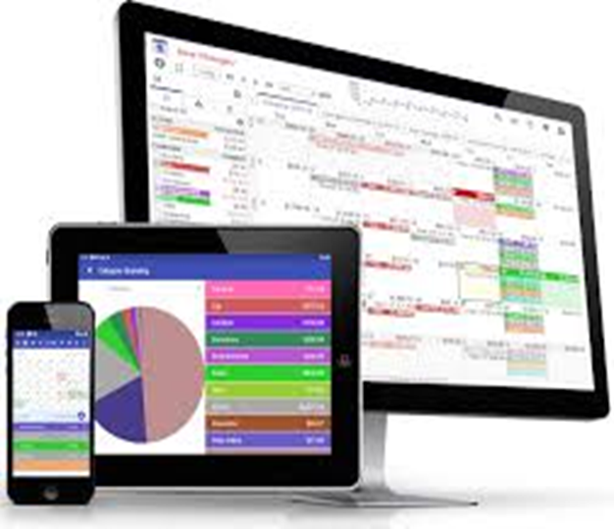
Decision 8
Online communications mix and budget
The decision on the amount of spending on online communications and the mix between the different communications techniques such as search engine marketing, affiliate marketing, email marketing and online advertising closely relates to the changes in levels of adoption of different channels and media and these changes have a cascade effect in terms of implications for planning the communication mix. Making these decisions requires digital marketers to decide the focus of their communications and whether the primary purpose is customer acquisition, retention or relationship building.
Digital marketing strategy development

Slide 46
Decision 9
Organizational capabilities (7S framework) and governance to support digital transformation In addition to the eight decisions we have reviewed related to digital business and revenue models and use of digital communications, there are also decisions related to how the organization manages changes required by deployment of digital media.
What Is the McKinsey 7S Model?
The McKinsey 7S Model is a change management tool for analyzing organizational design, alignment, and performance. It offers a simplified method of identifying organizational gaps, inconsistencies, and conflicts. Additionally, it is useful for mapping out various types of change initiatives in complex environments.
These seven components are grouped into “hard” and “soft” elements. Both are equally important to driving successful change initiatives.
Digital marketing strategy development
chapter 3

Slide 47
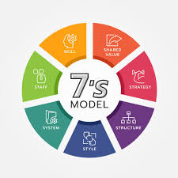
Decision 9
7 Elements Of The McKinsey 7S Model
Let’s look at the different elements of the McKinsey 7S Model in more detail.
1. Structure
This is how the organization is set up for decision-making, ownership, and leadership. It includes hierarchy, the chain of command, and accountability between role players.
2. Strategy
The business’s approach to strategic planning and executing actions that ensure success, sustainability, and competitive advantage.
3. Systems
Systems refers to the processes, infrastructure, and workflows established and utilized within the organization.
.
Digital marketing strategy development

Slide 48

Decision 9
4. Skills
Skills are the competencies and capabilities of people within an organization that help it reach business goals and objectives.
5. Style
Style is the way and manner in which people in the organization operate and interact. This includes interpersonal business relationships, management styles, and codes of conduct.
6. Staff
Staff encompasses human resources and talent management related to company decisions, like hiring, training, retention, and incentives.
7. Shared Values
These are the common objectives and values that help form an organization’s culture and align the other elements within the organization. In and outside of your organization, they influence employee, customer, and work experiences
Digital marketing strategy development

Slide 49


Thank You

