Slide 1


IELTS Preparation
Mini-Course
Lecture 5
Prepared by
Ahmed Soliman

Slide 2
Mastering the IELTS Writing Test
Task 1 (Academic)

Slide 3
🎯 Objectives
By the end of the lesson, students will be able to:
Identify the main features in charts/graphs.
Write an overview of a graph in 1–2 sentences.
Use accurate language for trends (increase, decrease, plateau, fluctuate…).
Write a well-organized Task 1 report (Introduction → Overview → Details).
Avoid common mistakes (comparing irrelevant data, describing every number, using opinion).

Slide 4
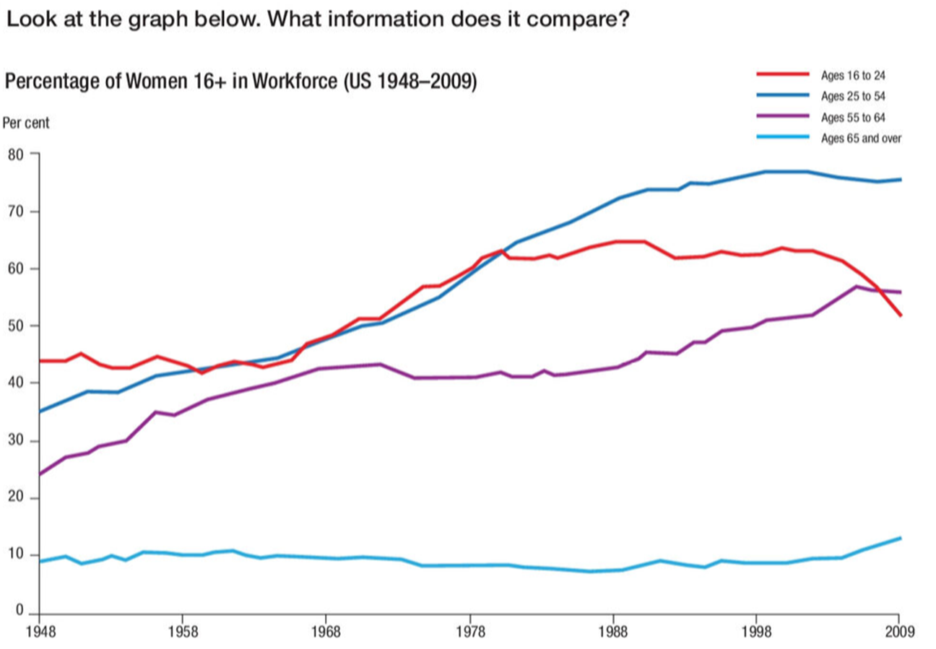
Lead-in
What do you notice?
Is the trend going up or down?
What words can we use to
describe change?

Slide 5
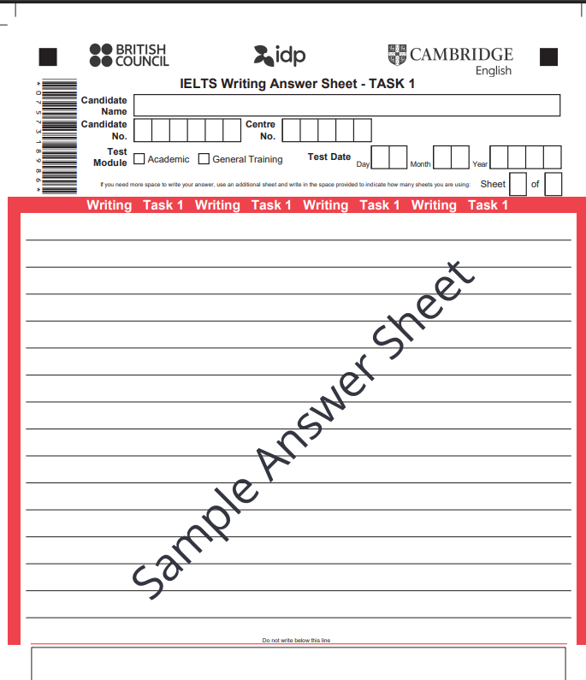
IELTS Writing Answer Sheet

Slide 6
Task 1 Requirements
✔ Length: at least 150 words
✔ Time: 20 minutes
✔ Objective: Describe the data factually, objectively
❌ No opinion
❌ No personal examples

Slide 7
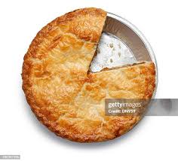
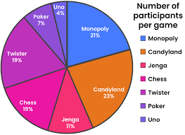

Types of diagrams
Pie chart

Slide 8
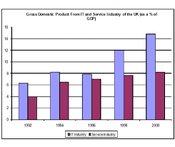

bar chart

Slide 9
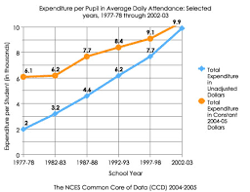

Line chart

Slide 10

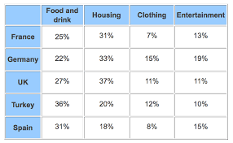
Table

Slide 11
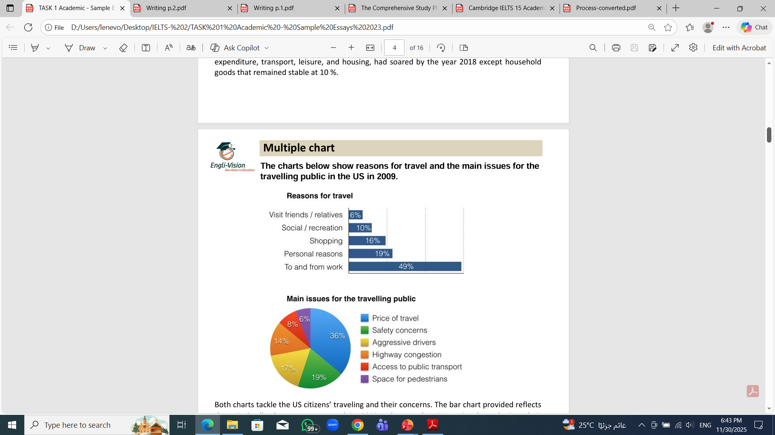
Multiple Charts

Slide 12
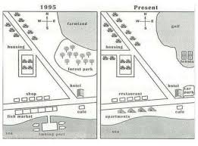
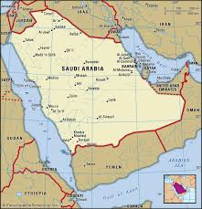
Map

Slide 13
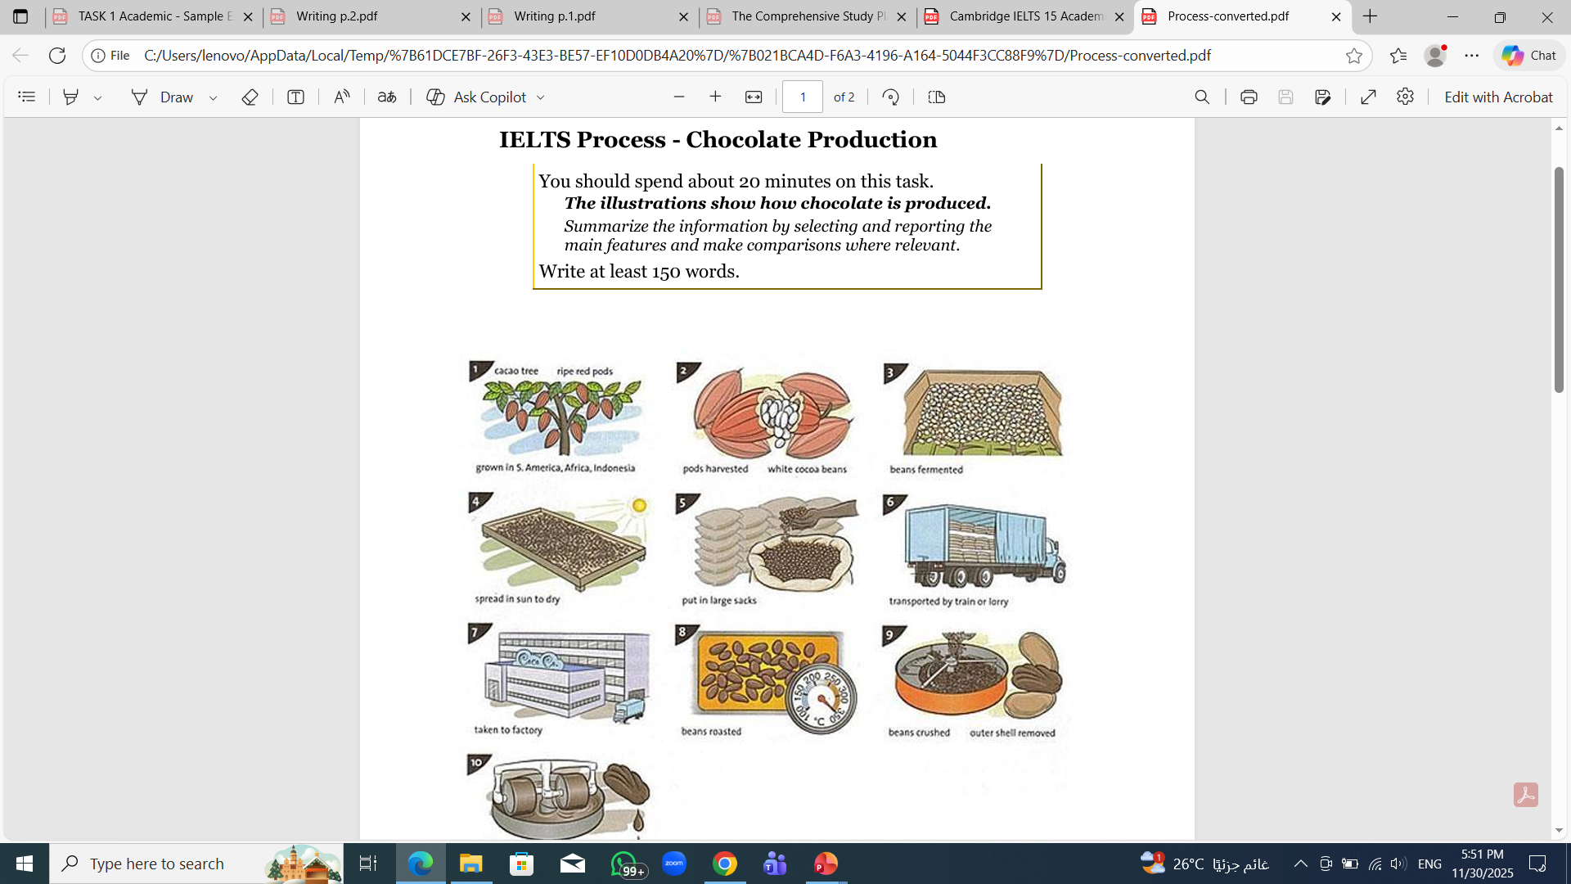
Process

Slide 14
Structure of a Band 7+ Answer
1. Introduction
Rewrite the question using synonyms.
Template:
The chart illustrates…
The table compares…
The graph provides information about…
2. Overview (MOST IMPORTANT)
Write 1–2 sentences summarizing the main trends.
Templates:
Overall, it is clear that…
It can be seen that…
In general,…
3. Body Paragraph 1 & 2 (Details / Analysis)
Group data logically:
highest vs lowest
similarities
time periods
categories
Use comparisons and trend language.

Slide 15
Match the word/ words to the right line:
1
3
2
4

Slide 16
Match the word/ words to the right line:
1
3
remained steady
2
increased
rose
grew
4
decreased
fell
dropped
fluctuated

Slide 17
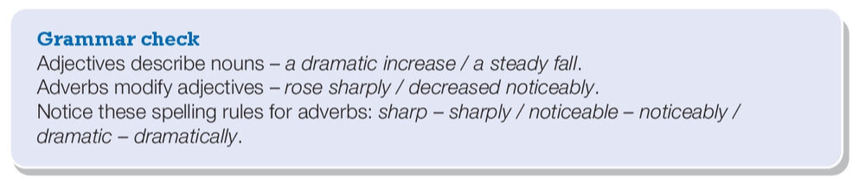
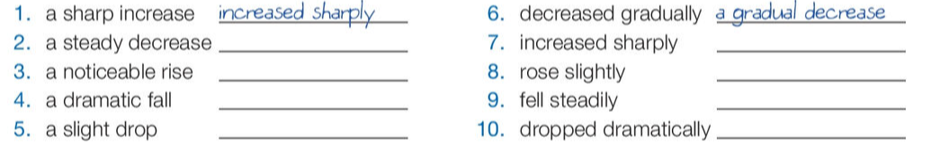
decreased steadily
a sharp increase
rose noticeably
a slight rise
fell dramatically
a steady fall
dropped slightly
a dramatic drop

Slide 18
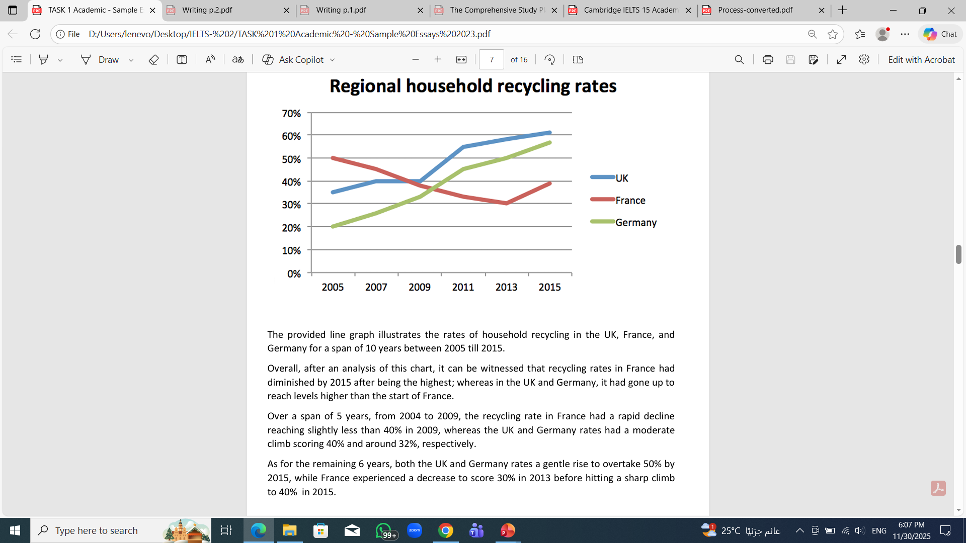
The line graph below shows the household recycling rates in three different countries between 2005 and 2015.

Slide 19
Task A: Identify the following
Highest country
Lowest country
General trends
Task B: Write an Overview

Slide 22
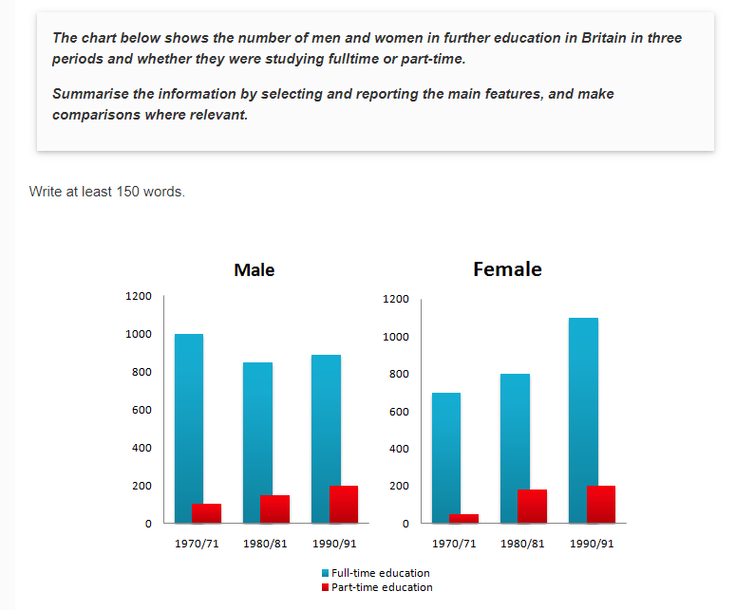

Slide 23
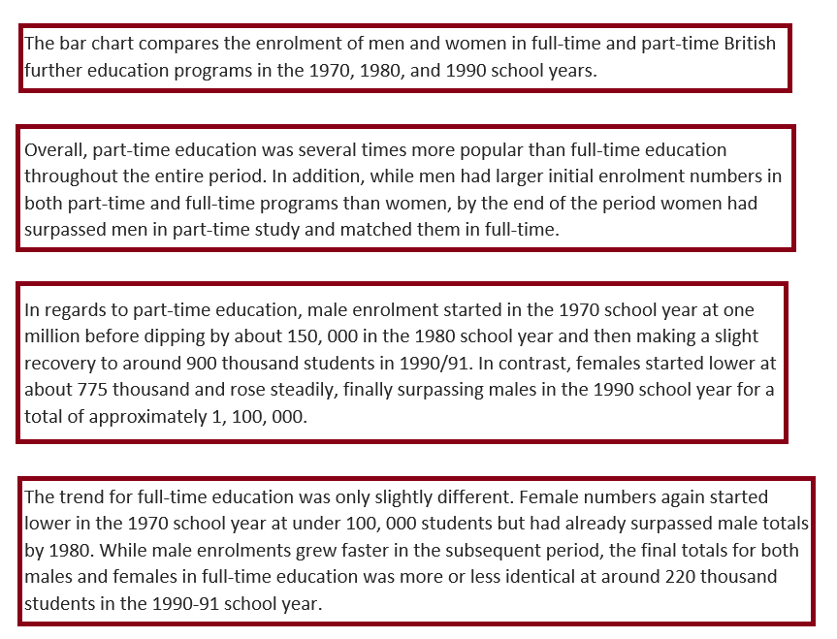

Slide 24
Assessment Criteria (Band Descriptors Summary)
Task Achievement
Overview included
Key trends highlighted
Accurate data selection
Coherence & Cohesion
Logical organization
Clear paragraphs
Linking words (however, meanwhile, in contrast)

Slide 25
Lexical Resource
Appropriate academic vocabulary
Paraphrasing
Grammar Range & Accuracy
Complex sentences
Accurate tenses
Few grammatical errors

Slide 26
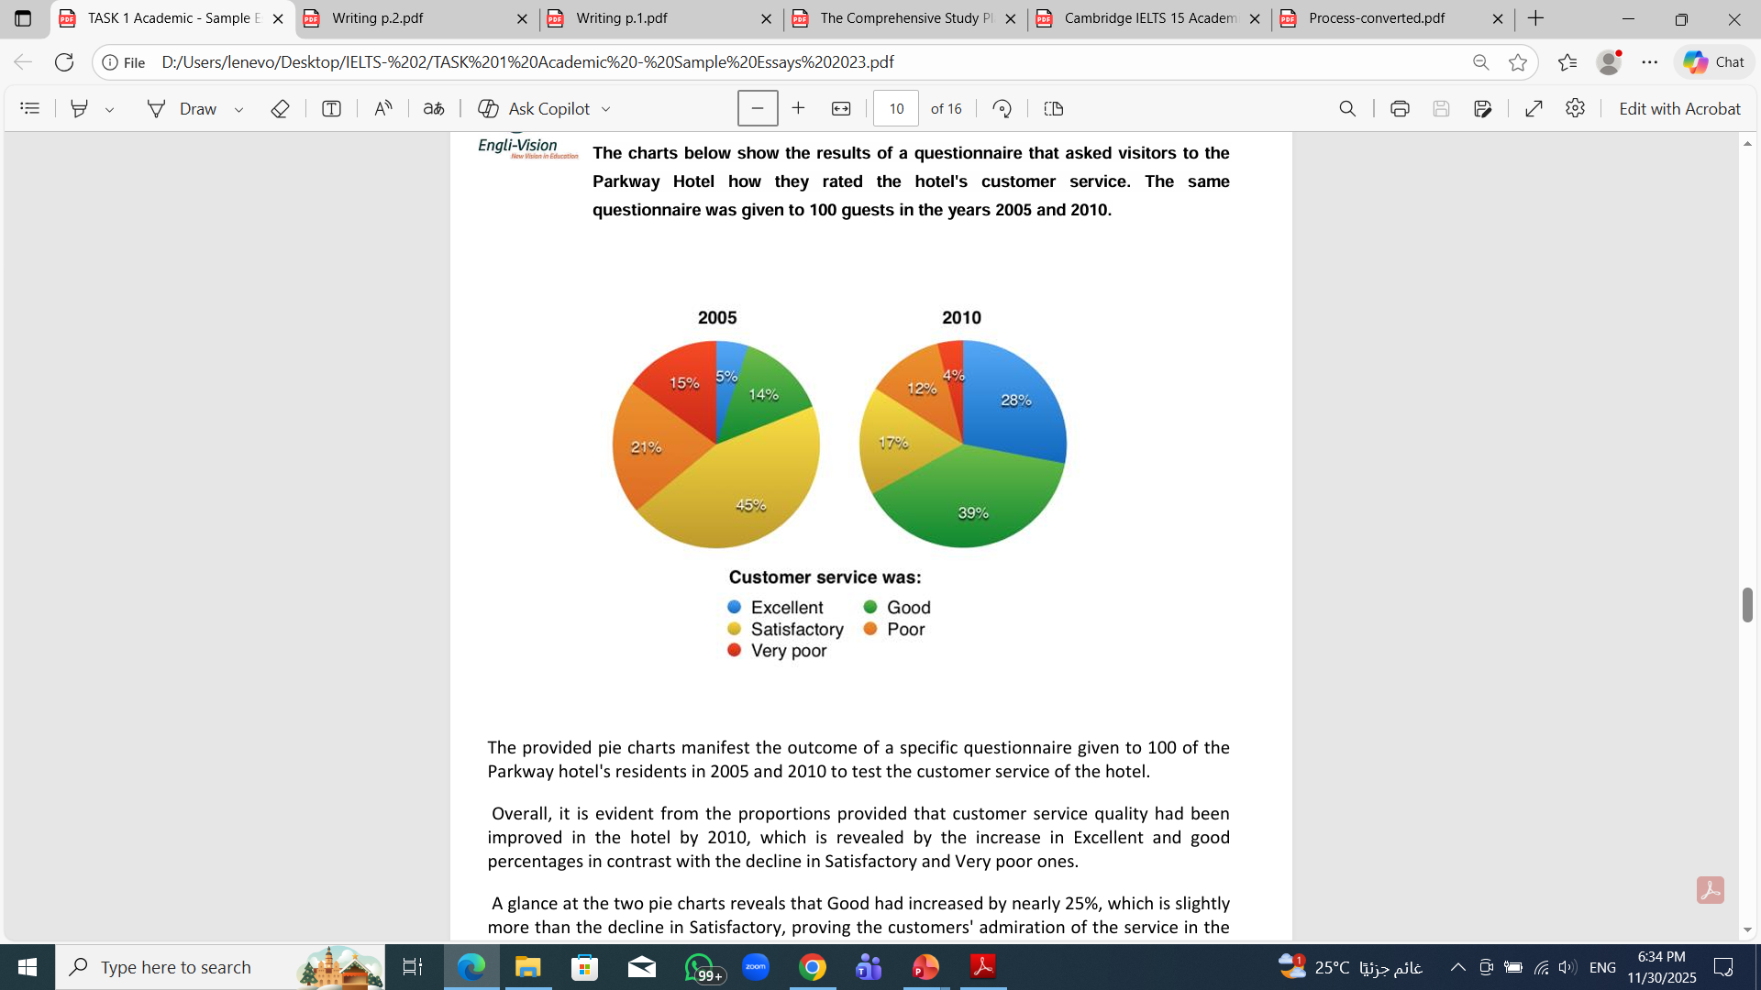
Assignment

Slide 27


Thank You

