Slide 1



Object Oriented Programming
Prepared by Dr. Yasser Abdelhamid
IT223
Object Oriented Programming
Lecture 04

Slide 2

outline
Java program structure
Packages
Constructors
Method declaration
Access Modifiers
Non-Access Modifiers

Slide 3
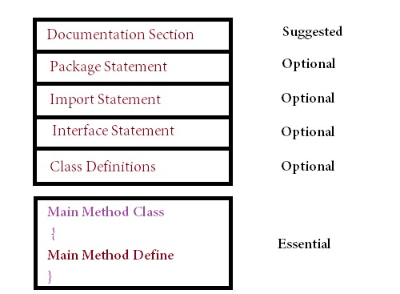
Java program structure

Slide 4
Java Packages
In Java, a package is a way to organize and group related classes, interfaces, and sub-packages.
It provides a mechanism for creating a namespace and helps in avoiding naming conflicts between classes or interfaces with the same name.
A package is represented by a directory structure in the file system.
The package name is used to create a hierarchical structure of directories.

Slide 5
How to create a package?
To create a package in Java, you include a package declaration at the top of each Java source file that belongs to the package.
For example, to declare a class named "MyClass" inside a package named "com.example.package", the package declaration would be:
package com.example.package;
public class MyClass {
// Class members and methods
}

Slide 6
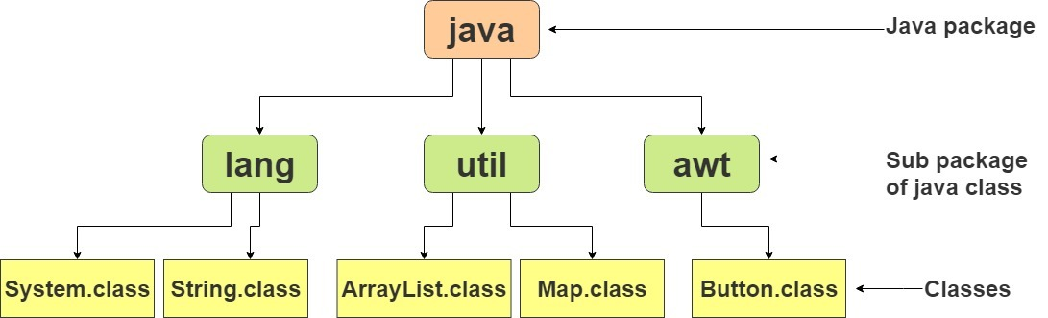
Java API
The Java API is a library of prewritten classes
The library contains a large number of components
To use a class or a whole package from the library, you need to use the import keyword

Slide 7
using java packages
import java.util.Scanner;
// import java.util.*; to import the whole package
class MyClass {
public static void main(String[] args) {
Scanner myObj = new Scanner(System.in);
System.out.println("Enter username");
String userName = myObj.nextLine();
System.out.println("Username is: " + userName);
}
}

Slide 8
User-defined Packages
package mypack;
class MyPackageClass {
public static void main(String[] args) {
System.out.println("This is my package!");
}
}
javac -d . MyPackageClass.java
java mypack.MyPackageClass

Slide 9
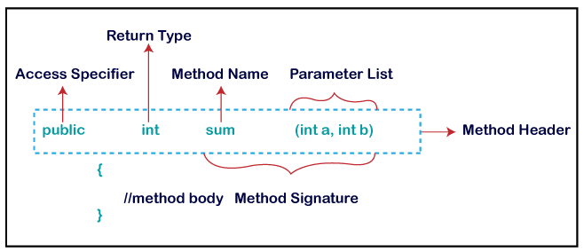
method declaration

Slide 10
method signature
In Java, a method signature refers to the unique combination of a method's name and its parameter types.
It provides a concise summary of the method's characteristics, allowing the compiler and developers to differentiate between different methods with the same name but different parameters.

Slide 11
method signature
The method signature consists of the following elements:
  Method Name: It is the name used to identify the method within its class or interface.
  Parameter Types: It specifies the number, order, and data types of the method's parameters. The parameter types help distinguish overloaded methods, which are multiple methods with the same name but different parameter lists.
Methods cannot have the same name and the same parameter types but different return types.

Slide 12
Example:
public class MyClass {
public void printMessage(String message) {
// Method implementation
}
public void printMessage(int number) {
// Method implementation
}
public int calculateSum(int a, int b) {
// Method implementation
return a + b;
}
}

Slide 13
Constructors
In Java, a constructor is a special method that is used to initialize objects of a class.
It is called when an instance (object) of the class is created using the new keyword.
The constructor has the same name as the class and does not have a return type, not even void.

Slide 14
Constructors
Constructors are primarily used to set initial values to the instance variables of an object or perform any necessary setup tasks when creating an object.
They can take parameters to initialize the object with specific values.
Constructors can be overloaded, which means having multiple constructors with different parameter lists. This allows for object creation with different initialization options.

Slide 15
Example
public class MyClass {
private int value;
// Constructor without parameters
public MyClass() {
value = 0; // Initialize the value to 0
}
// Constructor with a parameter
public MyClass(int initialValue) {
value = initialValue; // Initialize the value to the provided initial value
}
// Other methods and members of the class
// ...
}

Slide 16
example
public class Class1{
int x;
public Class1(int y) {
x = y;
}
public static void main(String[] args) {
Class1 myObj = new Class1(5);
System.out.println(myObj.x);
}
}

Slide 17
Default Constructor
If you do not create a class constructor yourself, Java creates a default constructor that does not make any initializations.
MyClass obj1 = new MyClass(); // Calls the default constructor
MyClass obj2 = new MyClass(10); // Calls the constructor with int parameter

Slide 18
modifiers
In Java, modifiers are keywords that are used to specify the scope, accessibility, and behavior of classes, methods, variables, and other program elements.
Modifiers alter the default behavior of program elements and provide additional control over their visibility, access, and usage.

Slide 19
modifiers
Modifiers are classified into:
  Access Modifiers - control the access level.
  Non-Access Modifiers - do not control access level, but provides other functionality.

Slide 20
class access Modifiers
In Java, class access modifiers are used to control the visibility and accessibility of classes.
They determine which other classes can access and interact with a particular class.

Slide 21
Public class modifier
A public class can be accessed from any other class or package.
It has the widest visibility and is typically used for classes that form the API (Application Programming Interface) of a library or module.
public class PublicClass {
// Class members and methods
}

Slide 22
Example: public class
public class MyPublicClass{
public static void main(String[] args) {
System.out.println(“I am accessible to any other class");
}
}

Slide 23
Default (Package-private) class
If no access modifier is specified, it is considered the default (also known as package-private) access level.
A class with default access can be accessed only within the same package.
class DefaultClass {
// Class members and methods
}

Slide 24
Example: default class
class MyDefaultClass{
public static void main(String[] args) {
System.out.println(“I am accessible only to classes in the same package");
}
}

Slide 25
Attributes access modifiers
In Java, attribute access modifiers are used to control the visibility and accessibility of class attributes (also known as fields or variables).
They determine how other classes can access and modify the attributes of a particular class.

Slide 26
Public attributes
A public attribute can be accessed and modified from any other class or package.
It has the widest visibility and is typically used for attributes that form the API (Application Programming Interface) of a class.
public class MyClass {
public int publicAttribute;
// Other class members and methods
}

Slide 27
protected attributes
A protected attribute can be accessed and modified within the same package or in subclasses (even if they are in different packages).
public class MyClass {
protected int protectedAttribute;
// Other class members and methods
}

Slide 28
Default (Package-private) attributes
If no access modifier is specified, it is considered the default (also known as package-private) access level.
An attribute with default access can be accessed and modified only within the same package.
public class MyClass {
int defaultAttribute;
// Other class members and methods
}

Slide 29
private attributes
A private attribute is the most restricted access level.
It can only be accessed and modified within the same class and is not visible to any other class, even within the same package.
Private attributes are typically used to encapsulate data and enforce information hiding.
public class MyClass {
private int privateAttribute;
// Other class members and methods
}

Slide 30
Method access modifiers
In Java, method access modifiers are used to control the visibility and accessibility of methods.
They determine how other classes can access and invoke methods of a particular class.
Java provides four access modifiers for methods:
  public
  protected
  default
  private

Slide 31
public methods
A public method can be accessed and invoked from any other class or package.
It has the widest visibility and is typically used for methods that form the API (Application Programming Interface) of a class.
public class MyClass {
public void publicMethod() {
// Method implementation
}
// Other class members and methods
}

Slide 32
protected methods
A protected method can be accessed and invoked within the same package or in subclasses (even if they are in different packages).
public class MyClass {
protected void protectedMethod() {
// Method implementation
}
// Other class members and methods
}

Slide 33
Default (Package-private) methods
If no access modifier is specified, it is considered the default (also known as package-private) access level.
A method with default access can be accessed and invoked only within the same package.
It is used when no access control restriction is required for a method.
public class MyClass {
void defaultMethod() {
// Method implementation
}
// Other class members and methods
}

Slide 34
private methods
A private method is the most restricted access level.
It can only be accessed and invoked within the same class and is not visible to any other class, even within the same package.
Private methods are typically used for internal implementation details that are not meant to be exposed or accessed from outside the class.
public class MyClass {
private void privateMethod() {
// Method implementation
}
// Other class members and methods
}

Slide 35
Constructors access modifiers
In Java, constructors can also have access modifiers to control their visibility and accessibility.
The access modifiers for constructors work similarly to those for methods, and they determine how other classes can create and initialize objects of a particular class.
Java provides three access modifiers for constructors:
  public
  default
  private

Slide 36
public constructor
A public constructor can be accessed and used to create objects from any other class or package.
It has the widest visibility and is typically used for constructors that form the public API (Application Programming Interface) of a class.
public class MyClass {
public MyClass() {
// Constructor implementation
}
// Other class members and methods
}

Slide 37
Default (Package-private) constructor
If no access modifier is specified for a constructor, it is considered the default (also known as package-private) access level.
A constructor with default access can be accessed and used to create objects only within the same package.
It is used when no access control restriction is required for the constructor.
public class MyClass {
MyClass() {
// Constructor implementation
}
// Other class members and methods
}

Slide 38
private constructor
A private constructor is the most restricted access level.
It can only be accessed and used to create objects within the same class and is not visible to any other class, even within the same package.
Private constructors are typically used for classes that should not be instantiated directly.
public class MyClass {
private MyClass() {
// Constructor implementation
}
// Other class members and methods
}

Slide 39
attributes, methods and constructors modifiers
public : The code is accessible for all classes
private : The code is only accessible within the declared class
default : The code is only accessible in the same package. This is used when you don't specify a modifier.
protected : The code is accessible in the same package and subclasses.

Slide 40
Non-Access class Modifiers
final:
  The class cannot be inherited by other classes
abstract
  The class cannot be used to create objects.
  To access an abstract class, it must be inherited from another class.

Slide 41
Non-Access attributes and methods Modifiers
final
  Attributes and methods cannot be overridden/modified.
static
  Attributes and methods belong to the class, rather than an object
abstract
  Can only be used in an abstract class

Slide 42
Example: static and public methods
static method, can be accessed without creating an object of the class.
public methods, can only be accessed through creating objects.
public class Class01 {
static void myStaticMethod() {
System.out.println("I am a static method");
}
public void myPublicMethod() {
System.out.println("I am a public method");
}
public static void main(String[] args) {
Class01.myStaticMethod();
Class01 obj1 = new Class01();
obj1.myPublicMethod();
}
}

Slide 43
exercise
Create a class named “Employee”, that has the attributes: name, address, department, id , phone number, and basic salary.
Create the following methods:
  netSal : to calculate net salary which is 80% of the basic salary.
  dispEmp: to display all information of the employee on console.
Create the class “TestClass “ to test the Employee class.

Slide 44
SUmmary
Java program structure
Packages
Constructors
Method declaration
Access Modifiers
Non-Access Modifiers

Slide 45


Thank You

