Slide 1


Data Structures and Algorithms
Prepared by Prof. Shereen Taie
IT251
Information Technology Department
Lecture 6

Slide 2




Data Structures and
Algorithms
Lecture 6
IT251
Information Technology Department
Prepared by
Prof. Shereen Taie
www.midocean.ae

Slide 3
Learning Objectives:
Representation of Stack (or) Implementation of stack
Stack using linked list
Linked list implementation of stack
Adding a node to the stack (Push operation)
Deleting a node from the stack (POP operation)
Display the nodes (Traversing)
QUEUE
Operations on QUEUE
Chapter
02
www.midocean.ae

Slide 4
DATA STRUCTURES
Chapter
03
www.midocean.ae

Slide 5
Representation of Stack (or) Implementation of stack
Chapter
03
www.midocean.ae

Slide 6
The stack should be represented in two ways:
1. Stack using array
2. Stack using linked list
Chapter
03
www.midocean.ae

Slide 7
2. Stack using linked list:
We can represent a stack as a linked list.
In a stack push and pop operations are performed at one end called top.
We can perform similar operations at one end of list using top pointer.
Chapter
03
www.midocean.ae

Slide 8
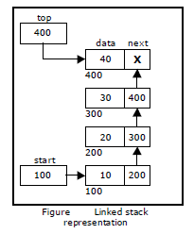
The linked stack looks as shown in figure
Chapter
03
www.midocean.ae

Slide 9

Chapter
03
Linked list implementation of stack
www.midocean.ae

Slide 10
Linked list implementation of stack:
Instead of using array, we can also use linked list to implement stack.
Linked list allocates the memory dynamically.
Chapter
03
www.midocean.ae

Slide 11
Linked list implementation of stack:
However, time complexity in both the scenario is same for all the operations i.e. push, pop.
In linked list implementation of stack, the nodes are maintained non-contiguously in the memory.
Chapter
03
www.midocean.ae

Slide 12
Linked list implementation of stack:
Each node contains a pointer to its immediate successor node in the stack.
Stack is said to be overflown in Linked list implementation if the space left in the memory heap is not enough to create a node.
Chapter
03
www.midocean.ae

Slide 13
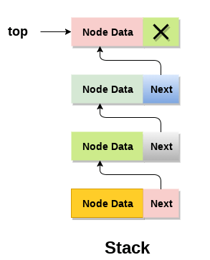
Linked list implementation of stack:
The top most node in the stack always contains null in its address field.
Chapter
03
www.midocean.ae

Slide 14
The linked stack looks as shown in figure
Chapter
03
www.midocean.ae

Slide 15
Adding a node to the stack (Push operation)
Chapter
03
www.midocean.ae

Slide 16
Adding a node to the stack (Push operation):
Adding a node to the stack is referred to as push operation.
Pushing an element to a stack in linked list implementation is different from that of an array implementation.
In order to push an element onto the stack, the following steps are involved.
Chapter
03
www.midocean.ae

Slide 17
Adding a node to the stack (Push operation):
Create a node first and allocate memory to it.
If the list is empty then the item is to be pushed as the start node of the list.
This includes:
assigning value to the data part of the node, and
assign null to the address part of the node.
Chapter
03
www.midocean.ae

Slide 18
Adding a node to the stack (Push operation):
3. If there are some nodes in the list already, then we have to add the new
element in the beginning of the list (to not violate the property of the
stack).
For this purpose,
assign the address of the starting element to the address field of the new node, and
make the new node, the starting node of the list.
Chapter
03
www.midocean.ae

Slide 19
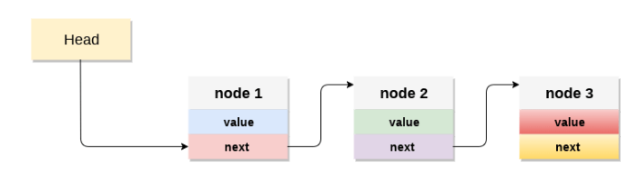
Time Complexity : o(1)
Chapter
03
www.midocean.ae

Slide 20
Deleting a node from the stack (POP operation)
Chapter
03
www.midocean.ae

Slide 21
Deleting a node from the stack (POP operation):
Deleting a node from the top of stack is referred to as pop operation.
Deleting a node from the linked list implementation of stack is different from that in the array implementation.
Chapter
03
www.midocean.ae

Slide 22
Deleting a node from the stack (POP operation):
In order to pop an element from the stack, we need to follow the following steps :
  Check for the underflow condition
  Adjust the head pointer accordingly
Time Complexity : o(n)
Chapter
03
www.midocean.ae

Slide 23
Deleting a node from the stack (POP operation):
Check for the underflow condition:
  The underflow condition occurs when we try to pop from an already empty stack. The stack will be empty if the head pointer of the list points to null.
Chapter
03
www.midocean.ae

Slide 24
Deleting a node from the stack (POP operation):
Adjust the head pointer accordingly:
  In stack, the elements are popped only from one end, therefore, the value stored in the head pointer must be deleted and the node must be freed. The next node of the head node now becomes the head node.
Chapter
03
www.midocean.ae

Slide 25
Display the nodes (Traversing)
Chapter
03
www.midocean.ae

Slide 26
Display the nodes (Traversing):
  Displaying all the nodes of a stack needs traversing all the nodes
  of the linked list organized in the form of stack.
  Traversing عبور: It is used to access each data item exactly once so that it can be processed.
Chapter
03
www.midocean.ae

Slide 27
Display the nodes (Traversing):
To Display the nodes follow the following steps:
  Copy the head pointer into a temporary pointer.
  Move the temporary pointer through all the nodes of the list and print the value field attached to every node.
Time Complexity : o(n)
Chapter
03
www.midocean.ae

Slide 28
Chapter
03
QUEUE
www.midocean.ae

Slide 29
QUEUE:
A queue is linear data structure and collection of elements.
A queue is another special kind of list, where items are inserted at one end called the rear and deleted at the other end called the front.
The principle of queue is a “FIFO” or “First-in-first-out”.
Chapter
03
www.midocean.ae

Slide 30
QUEUE:
Queue is an abstract data structure.
A queue is a useful data structure in programming.
It is similar to the ticket queue outside a cinema hall, where the first person entering the queue is the first person who gets the ticket.
Chapter
03
www.midocean.ae

Slide 31
Real-world examples of queue
Chapter
03
www.midocean.ae

Slide 32

A real-world example of queue can be a single-lane one-way road, where the vehicle enters first, exits first.
Chapter
03
www.midocean.ae

Slide 33
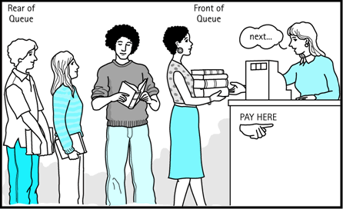
More real-world examples can be seen as queues at the ticket windows and bus-stops and our college library.
Chapter
03
www.midocean.ae

Slide 34
Chapter
03
Operations on QUEUE
www.midocean.ae

Slide 35
QUEUE:
The operations for a queue are analogues to those for a stack; the difference is that the insertions go at the end of the list, rather than the beginning.
A queue is an object or more specifically an abstract data structure (ADT) that allows the following operations:
  Enqueue or insertion
  Dequeue or deletion
Chapter
03
www.midocean.ae

Slide 36
QUEUE:
Operations on QUEUE:
A queue is an object or more specifically an abstract data structure (ADT) that
allows the following operations:
Enqueue or insertion:
which inserts an element at the end of the queue.
Dequeue or deletion:
which deletes an element at the start of the queue.
Chapter
03
www.midocean.ae

Slide 37
QUEUE:
Queue operations work as follows:
1. Two pointers called FRONT and REAR are used to keep track of the first and last elements in the queue.
2. When initializing the queue, we set the value of FRONT and REAR to 0.
Chapter
03
www.midocean.ae

Slide 38
QUEUE:
Queue operations work as follows:
3. On enqueing an element, we increase the value of REAR index and place the new element in the position pointed to by REAR.
4. On dequeueing an element, we return the value pointed to by FRONT and increase the FRONT index.
Chapter
03
www.midocean.ae

Slide 39
QUEUE:
Queue operations work as follows:
5. Before enqueing, we check if queue is already full.
6. Before dequeuing, we check if queue is already empty.
Chapter
03
www.midocean.ae

Slide 40
QUEUE:
Queue operations work as follows:
7. When enqueing the first element, we set the value of FRONT to 1.
8. When dequeing the last element, we reset the values of FRONT and REAR to 0.
Chapter
03
www.midocean.ae

Slide 41




Thank You

