Slide 1


Master Of Real Estate
Management
Prepared by
Dr. Al Montaser Abuhussein
REA655
Artificial Intelligence in Business
Orientation Lecture

Slide 2



Master Of Real Estate
Management
Orientation Lecture
REA655
Artificial Intelligence in Business
Prepared by
Dr. Al Montaser Abuhussein

Slide 3

Orientation Lecture
Introduction

Slide 4

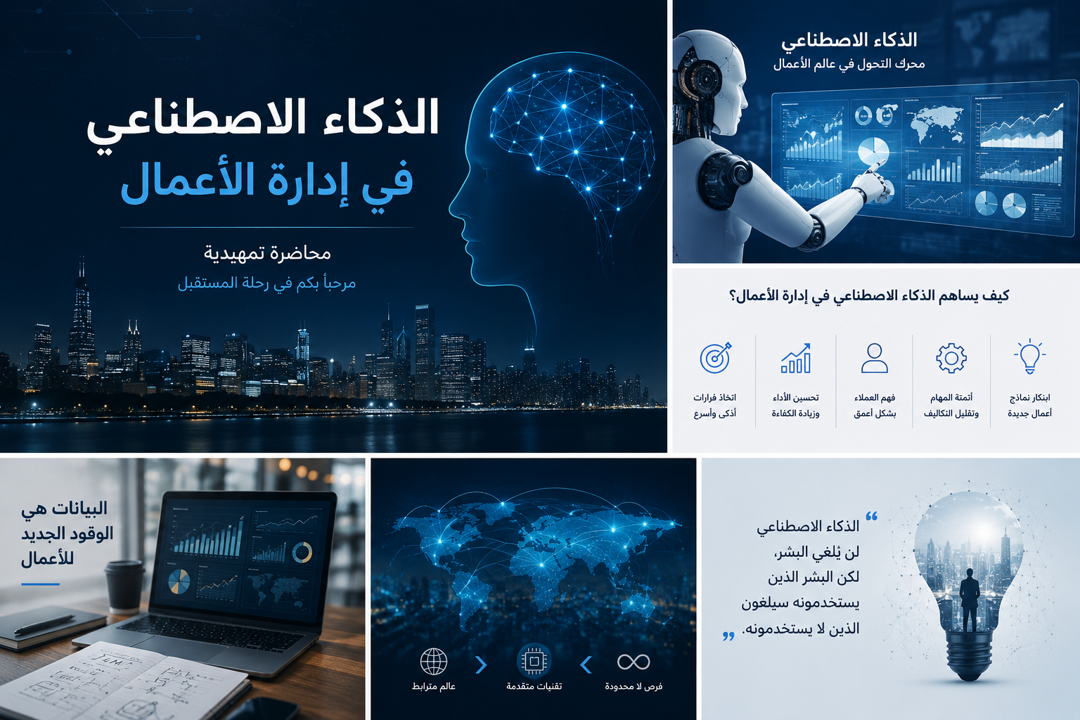
Orientation
Lecture
Course Information
Course Name: Artificial Intelligence in Business.
Course Code: REA655.
Credit Hours: 3 hours.
Instructor: Dr. Al Montaser Abuhussein.
Platform: Moodle.
Artificial Intelligence in Business

Slide 5
Course Description
Orientation
Lecture
This course explores the transformative role of Artificial Intelligence (AI) in modern business environments.
It provides students with a practical understanding of how AI is applied across various business domains such as marketing, finance, supply chain, and human resources.
It combines theoretical insights with real-world case studies to prepare students for the strategic and ethical use of AI in the business world.
Students in this course will learn how AI:
      Improves decision-making.
      Enhances customer experience.
      Optimizes operations.
      Drives innovation.

Slide 6
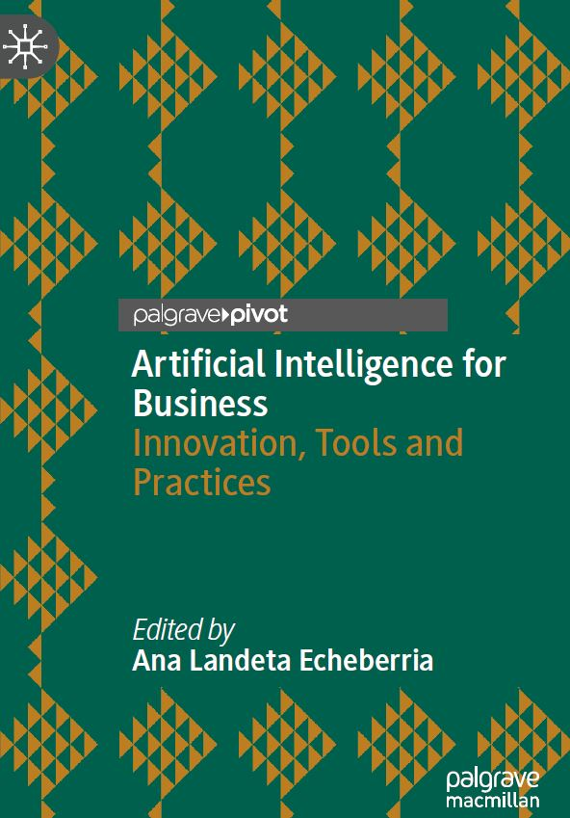
The Reference
Orientation
Lecture
Book title: Artificial Intelligence for Business
Innovation, Tools and Practices.
Author: Ana Landeta Echeberria.
Year: 2022.

Slide 7
Why This Course Matters
Orientation
Lecture
Artificial Intelligence is transforming the real estate industry by making decisions faster, smarter, and more data-driven.
Modern real estate companies use AI for:
  Property valuation
  Market trend prediction
  Investment analysis
  Smart building management
  Customer service and tenant experience
Real estate is becoming increasingly dependent on data analytics and intelligent technologies to improve efficiency and competitiveness.AI helps real estate managers reduce costs, improve operational performance, and make more accurate strategic decisions.
In smart cities and modern property developments, AI plays a major role in energy management, security systems, predictive maintenance, and digital customer interaction.
Understanding AI is now essential for future real estate managers because competitive advantage increasingly depends on technology and innovation.
👉 “AI is no longer optional — it is strategic”

Slide 8
Course Objectives
Orientation
Lecture
By the end of this course, students will be able to:
Understand the fundamentals of AI and its core technologies.
Identify and evaluate business problems where AI can be effectively applied.
Analyze the strategic impact of AI in various business functions.
Explore the implementation challenges, including data, ethics, and organizational change.
Assess the risks and opportunities presented by AI-driven business models.
Develop AI-centric business strategies and solutions.

Slide 9
Teaching Approach
Orientation
Lecture
Lectures (Concepts & Frameworks).
Case Studies (Real-world examples).
Discussions.
Practical Applications.

Slide 10
Course Activities
Orientation
Lecture
Weekly recorded lecture (Every Saturday): Students are required to follow all recorded lectures.
Weekly discussion session: Attendance in discussion sessions is optional; however, it is strongly recommended due to its positive impact on understanding and academic achievement.
Weekly quiz related to each lecture.
Final exam at the end of the course.
Course Assessment:
Weekly Quizzes: 80% (8 marks each).
Final Exam: 20%.

Slide 11
Quizzes
Orientation
Lecture
Weekly quizzes open every Saturday at 10:00 PM (Makkah Time) and remain available for one week. The quiz closes the following Saturday at 9:00 PM.
Quizzes are audio questions.
Each quiz consists of 8 questions, with 1 mark per question (Total: 8 marks per quiz).
The allowed time for each weekly quiz is 30 minutes.
Completing the weekly quiz is considered attendance for students.

Slide 12
Missing Quizzes = absence
Orientation
Lecture
A student will receive a DN (Denied Grade) in cases of absence from more than four quizzes. Exceptions are considered only in cases of force majeure or emergency, provided that official supporting documentation is submitted.
Excuse Policy:
            Submit via SIS platform before deadline
            Official proof required
            No excuses after deadline

Slide 13
Final Exam
Orientation
Lecture
The final exam will be conducted through Moodle.
The exam includes audio questions.
The final exam consists of 20 questions, with 1 mark for each question (Total: 20 marks).
Final exams will take place at the end of the course.

Slide 14

Introduction to AI and Machine Learning.
AI Applications in Business Functions.
AI Strategy and Innovation.
Data and Infrastructure for AI.
Ethical and Legal Considerations.
Change Management and Organizational Readiness.
Capstone: AI in Business – Real-World Case Studies.
Orientation
Lecture
Course Topics Overview

Slide 15
What is Artificial Intelligence (AI)
Orientation
Lecture
Artificial Intelligence (AI) refers to computer systems that perform tasks requiring human intelligence, such as learning, reasoning, and decision-making.AI can analyze data, recognize patterns, and make predictions to support business operations and strategic decisions.
In real estate management, AI is used for:
  Property valuation
  Market forecasting
  Smart building management
  Customer service automation
Examples of AI technologies include: “ChatGPT, Recommendation systems, Self-driving cars”

Slide 16
Artificial Intelligence in Business
Orientation
Lecture
AI in business refers to the use of intelligent technologies to improve organizational performance and decision-making.
Businesses use AI to automate operations, analyze data, improve customer experience, and increase efficiency.AI supports important business functions such as:
  Marketing and sales
  Financial analysis
  Human resources
  Supply chain management
In real estate management, AI helps organizations:
  Predict market trends
  Improve property management
  Analyze investments
  Enhance tenant and customer services

Slide 17
Artificial Intelligence in Real Estate
Orientation
Lecture
AI is transforming the real estate industry through smarter analysis and automated decision-making.AI applications in real estate include:
  Property price prediction and valuation
  Smart property and facility management
  Customer behavior analysis and personalized recommendations
  AI-powered investment and market analysis
AI also supports smart buildings and smart cities through energy management, security systems, and predictive maintenance.
Real estate companies use AI to improve efficiency, reduce costs, and enhance customer and tenant experience.
❝ AI is making real estate more intelligent, efficient, and data-driven. ❞

Slide 18
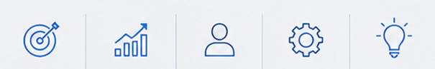
The Importance of AI
Orientation
Lecture
Improves decision-making accuracy.
Enhances operational efficiency.
Reduces costs and saves time.
Supports innovation and competitive advantage.
Improves customer satisfaction.

Slide 19
Benefits of AI in Real Estate
Orientation
Lecture
Faster and more accurate property valuation and market analysis.
Better real estate investment and strategic decision-making.
Improved customer and tenant experience through personalized services.
Automation of repetitive administrative and operational tasks.
Enhanced market forecasting and trend prediction.
Improved efficiency in smart property and facility management.
❝ AI helps real estate organizations become more efficient, competitive, and data-driven. ❞

Slide 20
By the end of the course, students will:
Explain key AI concepts and technologies relevant to business applications.
Critically analyze the role of AI in transforming various business functions.
Develop strategic approaches for AI integration within an organization.
Identify ethical, legal, and operational challenges in implementing AI solutions.
Design a basic AI business use case or project using real-world data and tools.
Communicate AI-driven insights and strategies effectively to stakeholders.
Orientation
Lecture
Learning Outcomes

Slide 21


Thank You

