Slide 1
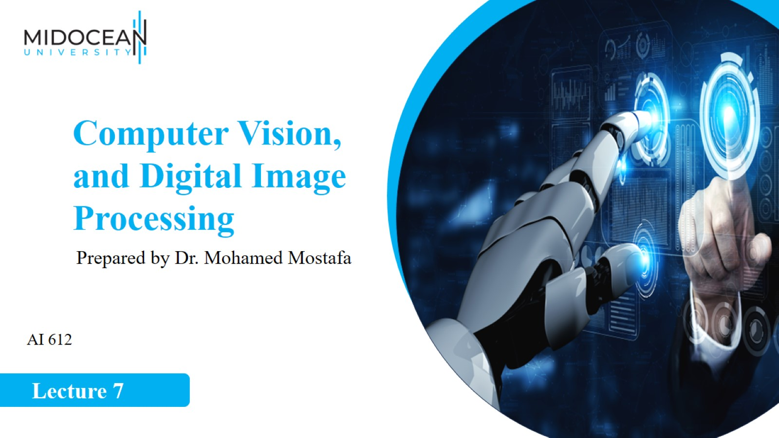

Slide 2
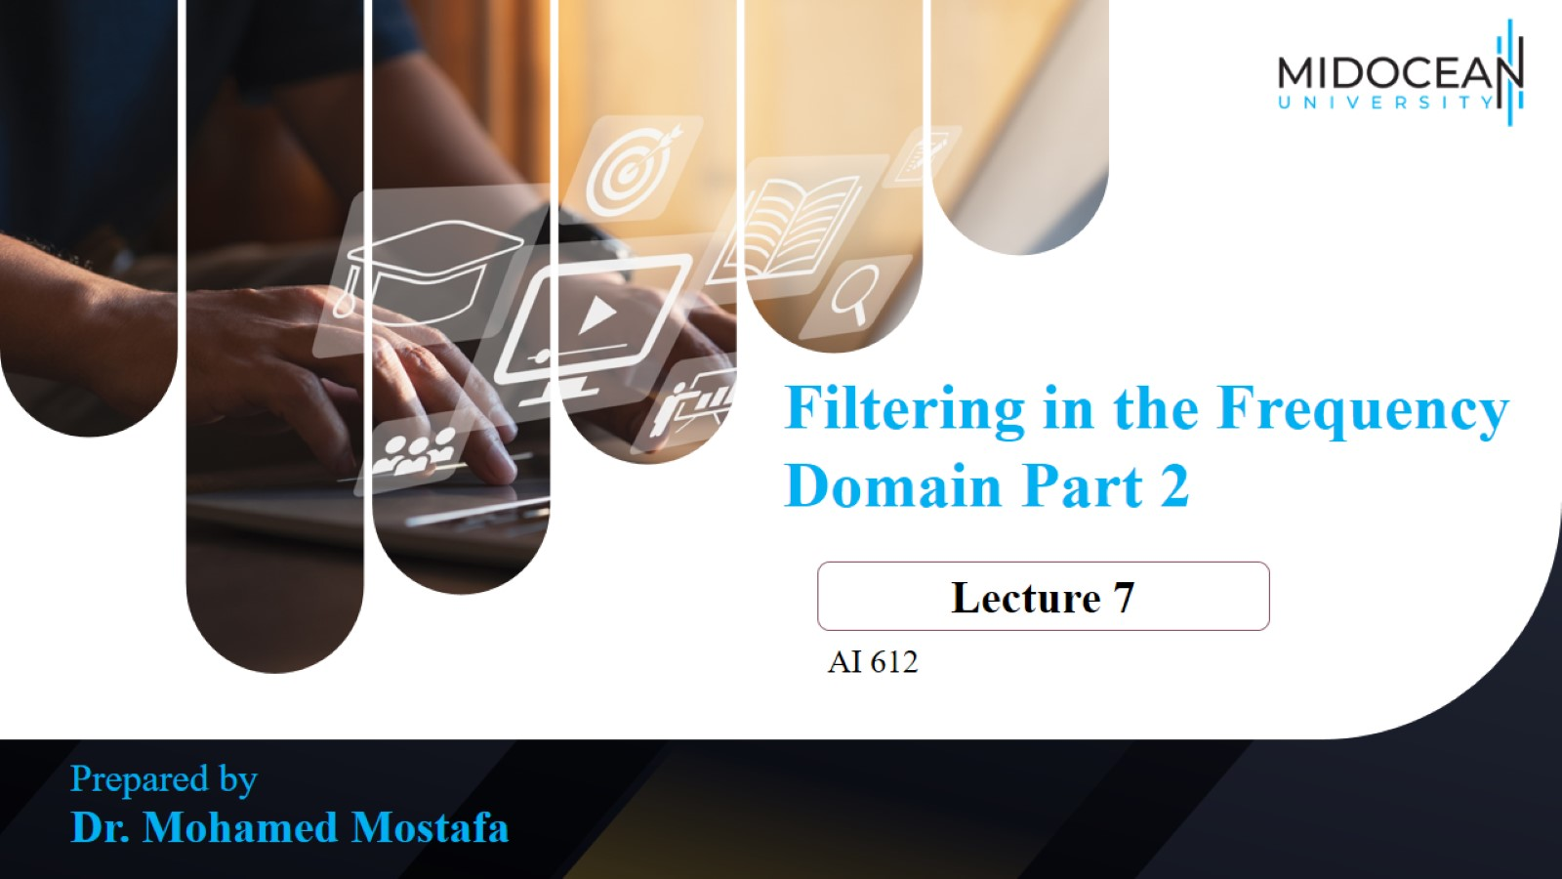

Slide 3
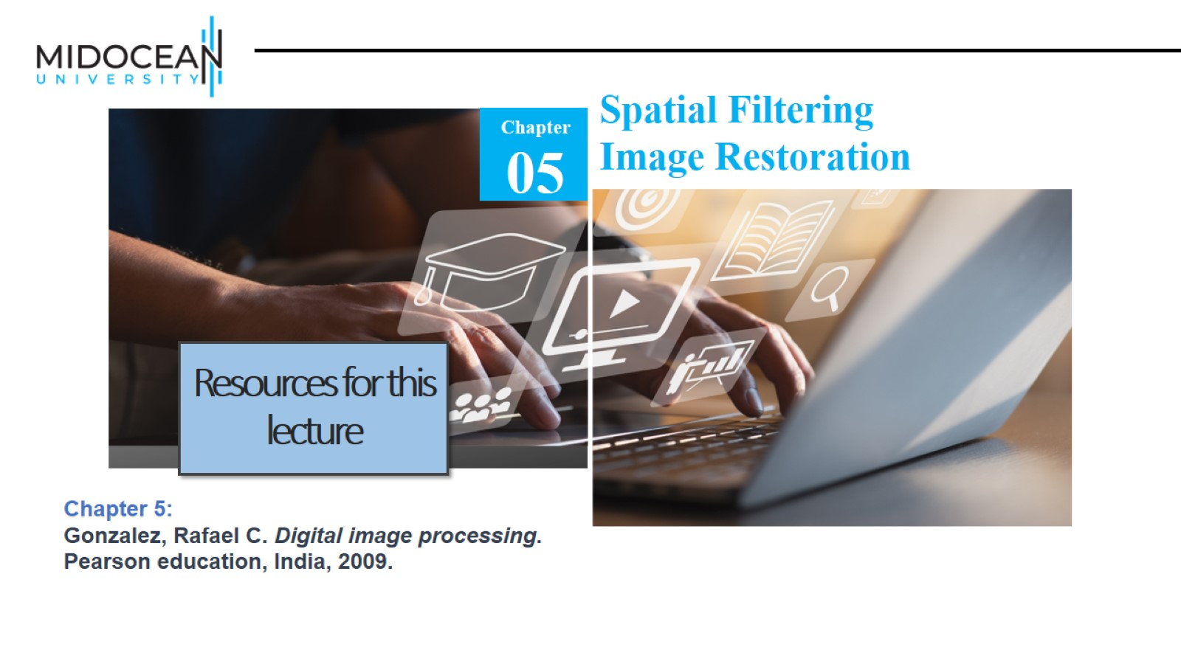

Slide 4
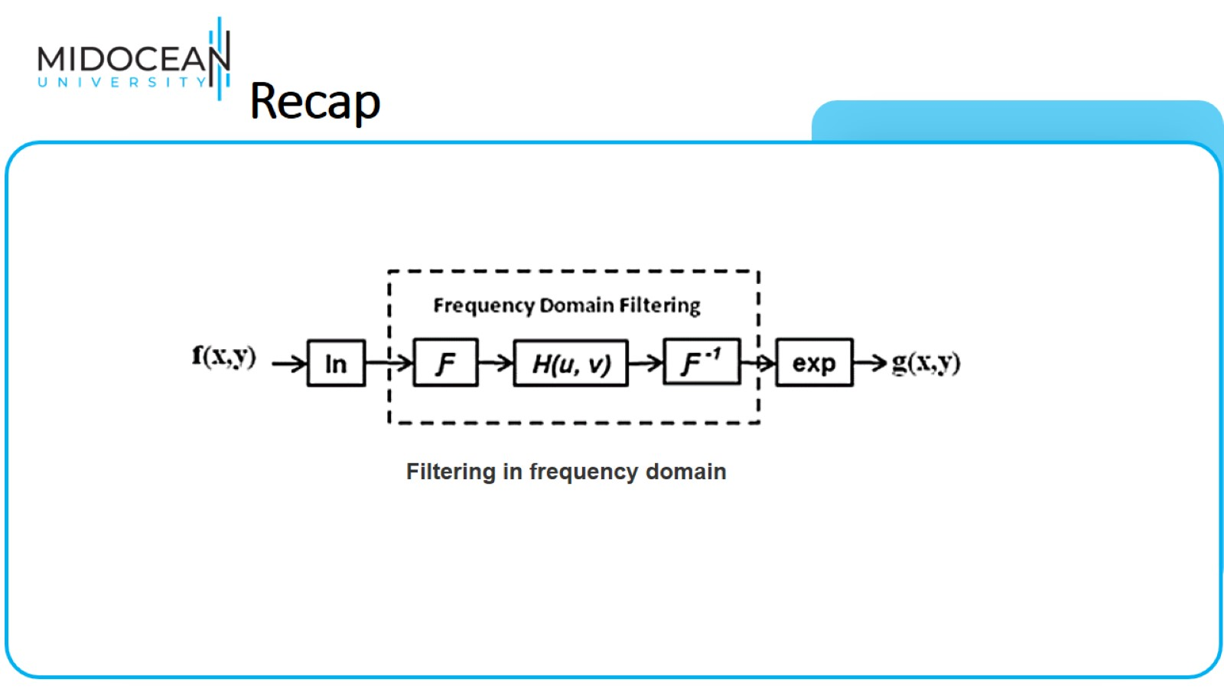
Recap

Slide 5
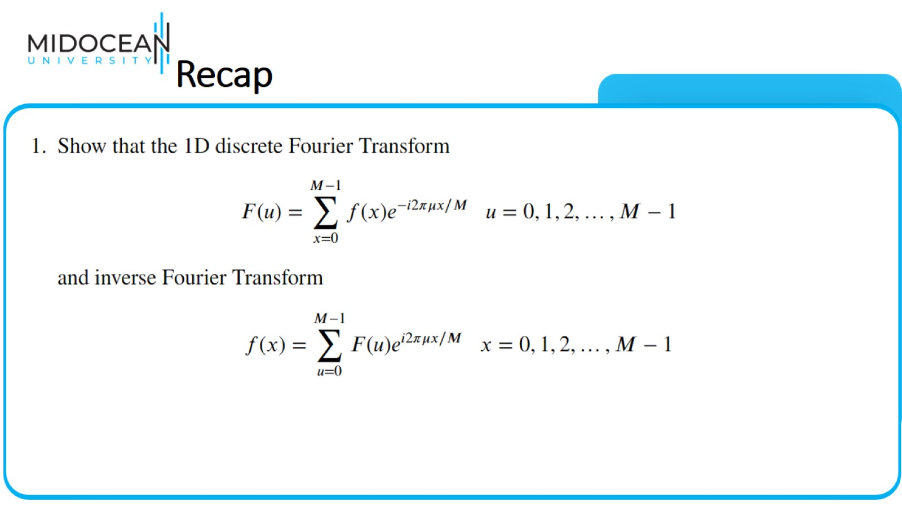
Recap

Slide 6
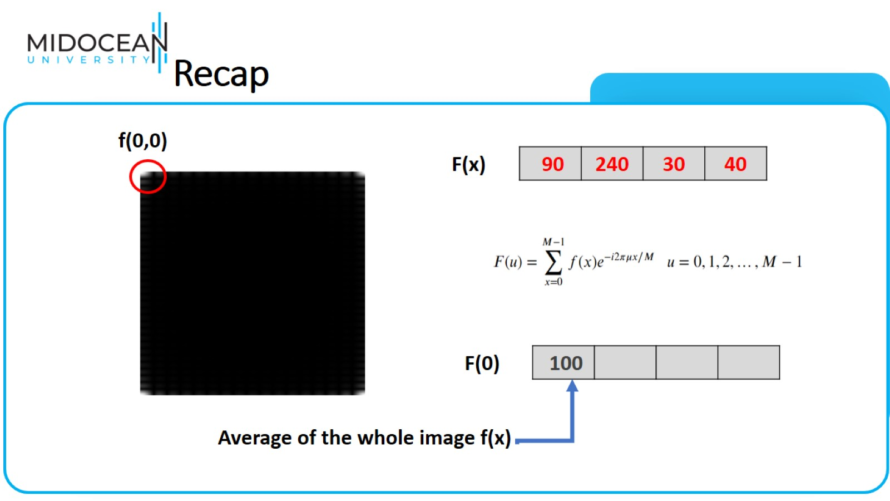
Recap

Slide 7
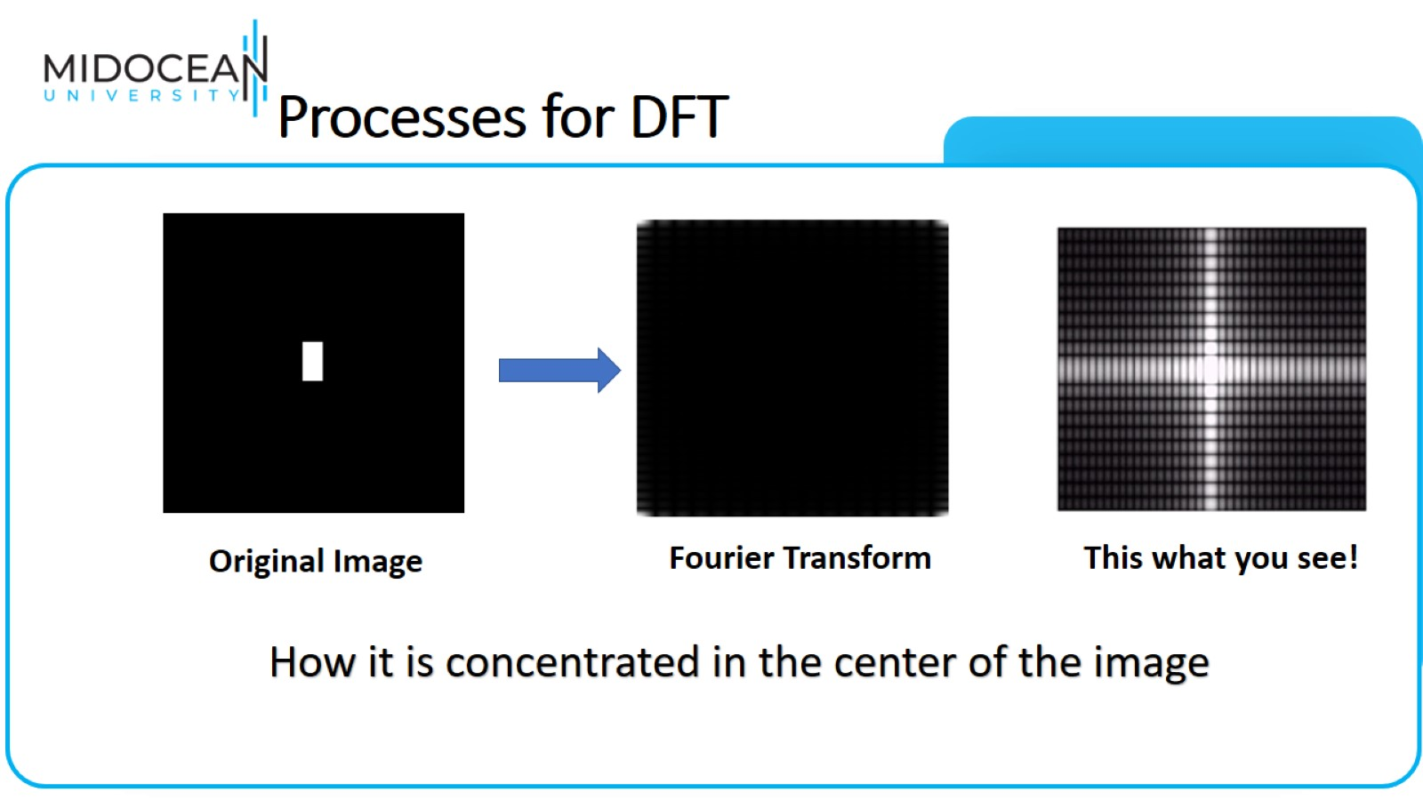
Processes for DFT

Slide 8
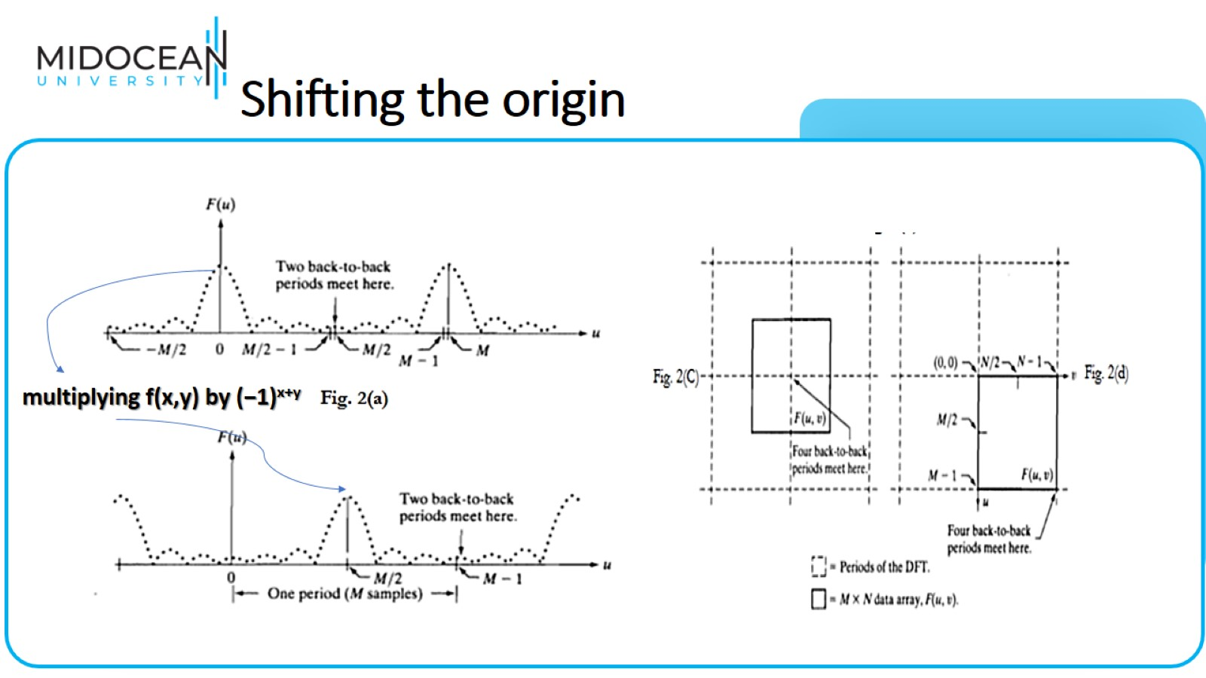
Shifting the origin

Slide 9
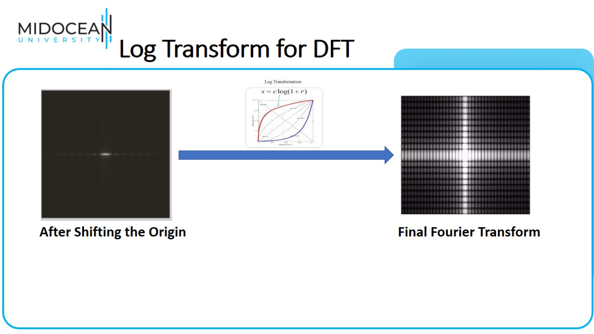
Log Transform for DFT

Slide 10
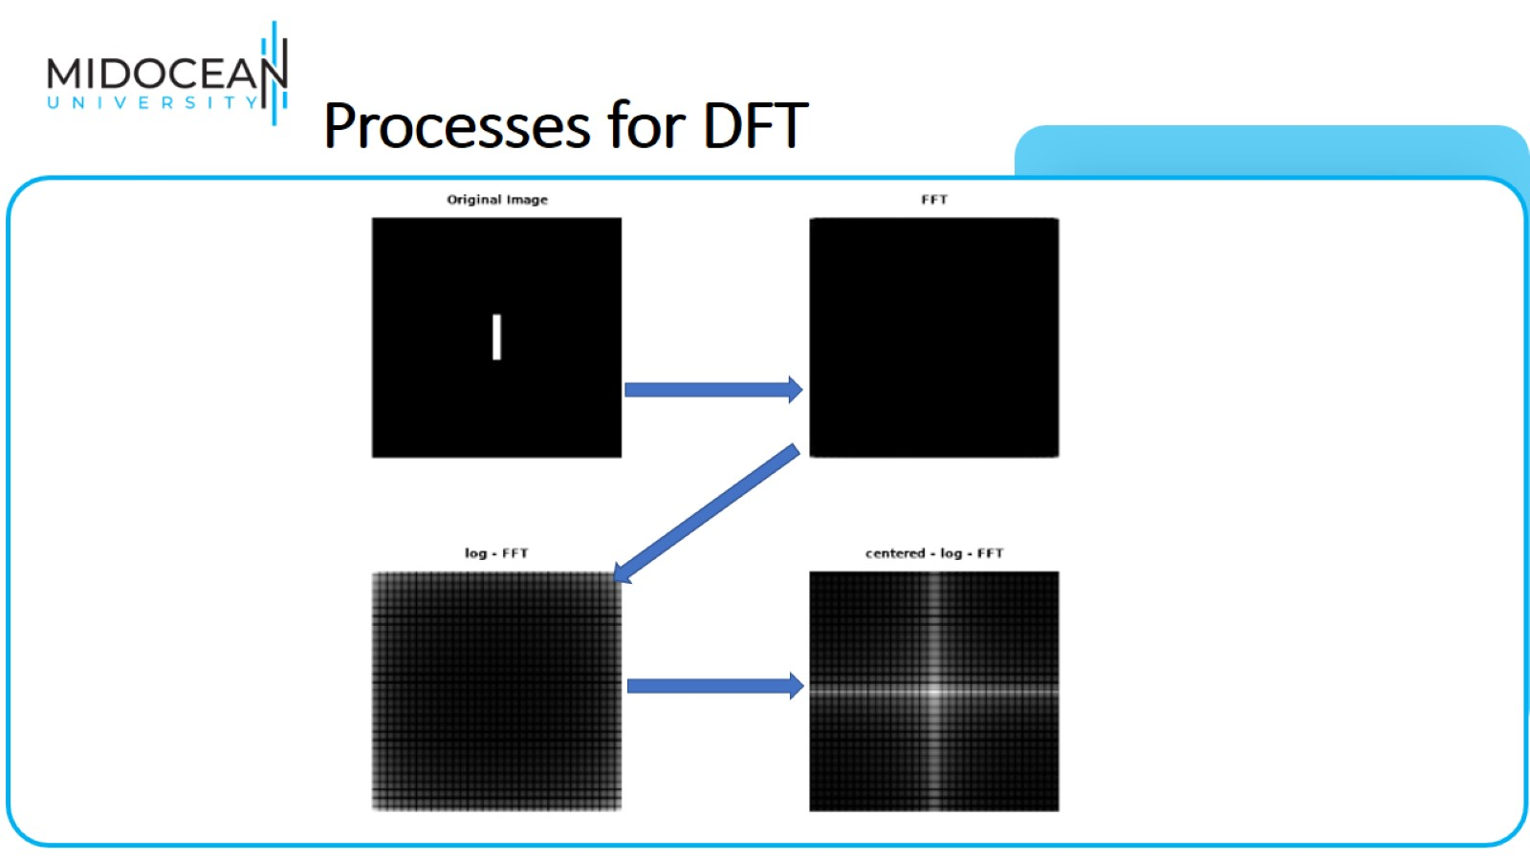
Processes for DFT

Slide 11
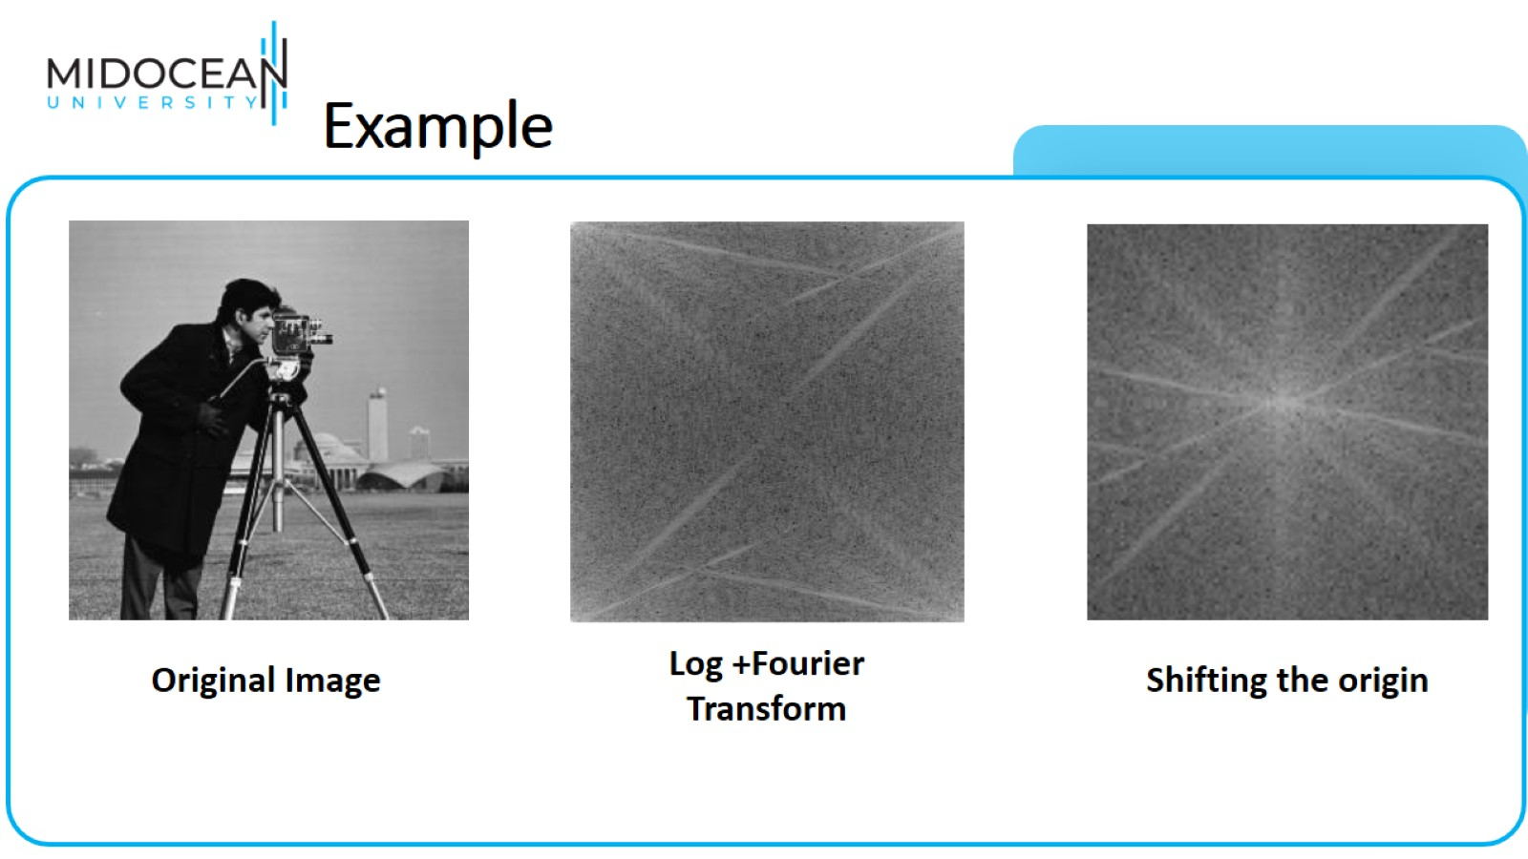
Example

Slide 12
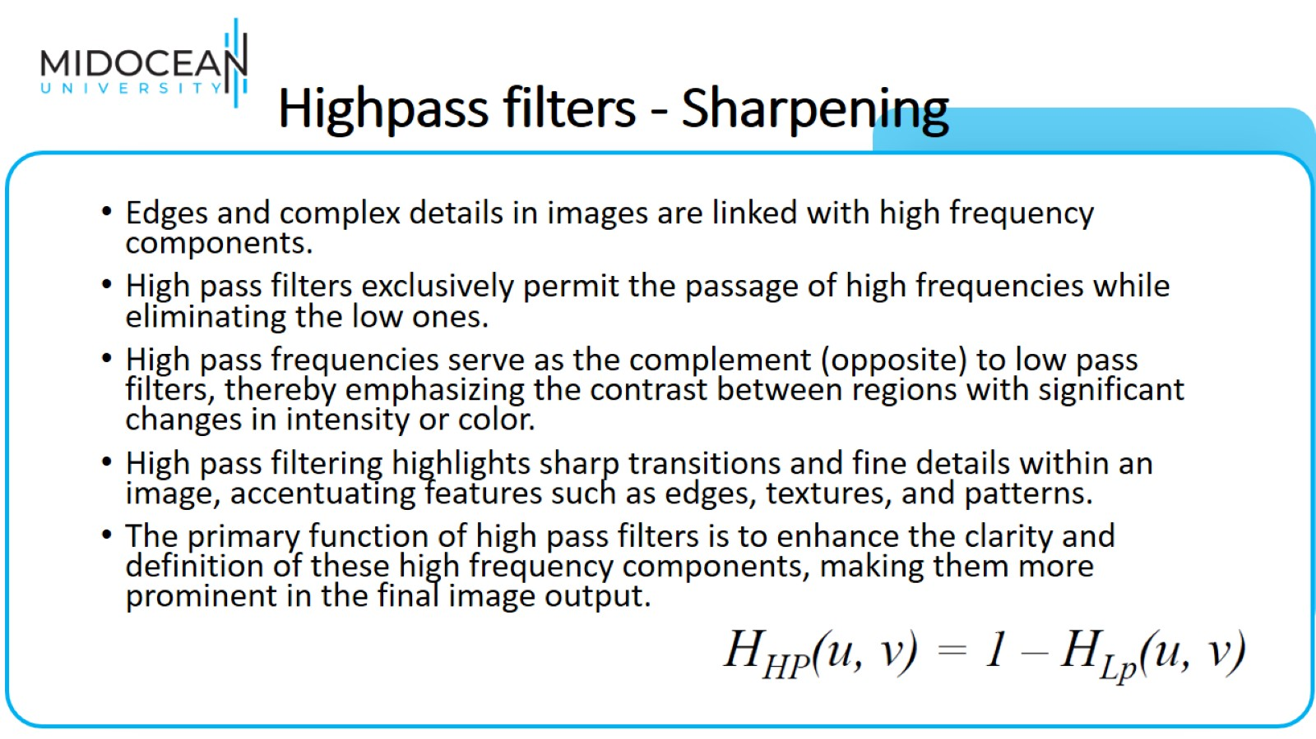
Highpass filters - Sharpening

Slide 13
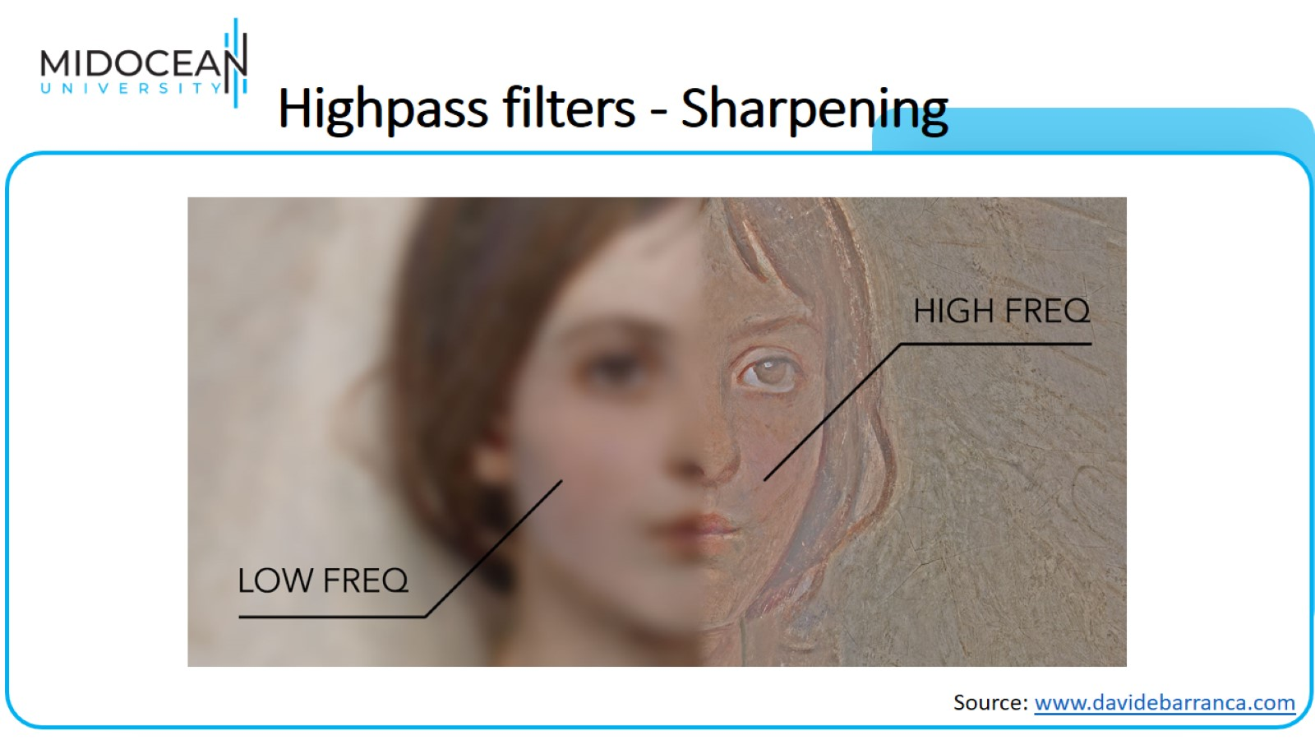
Highpass filters - Sharpening

Slide 14
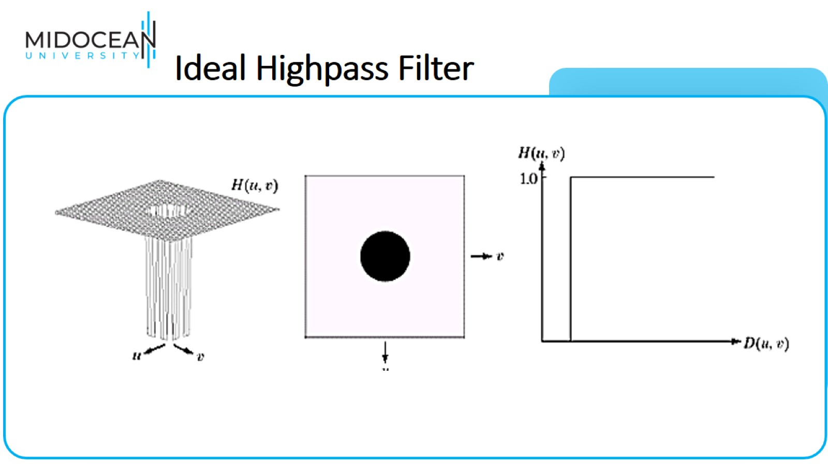
Ideal Highpass Filter

Slide 15
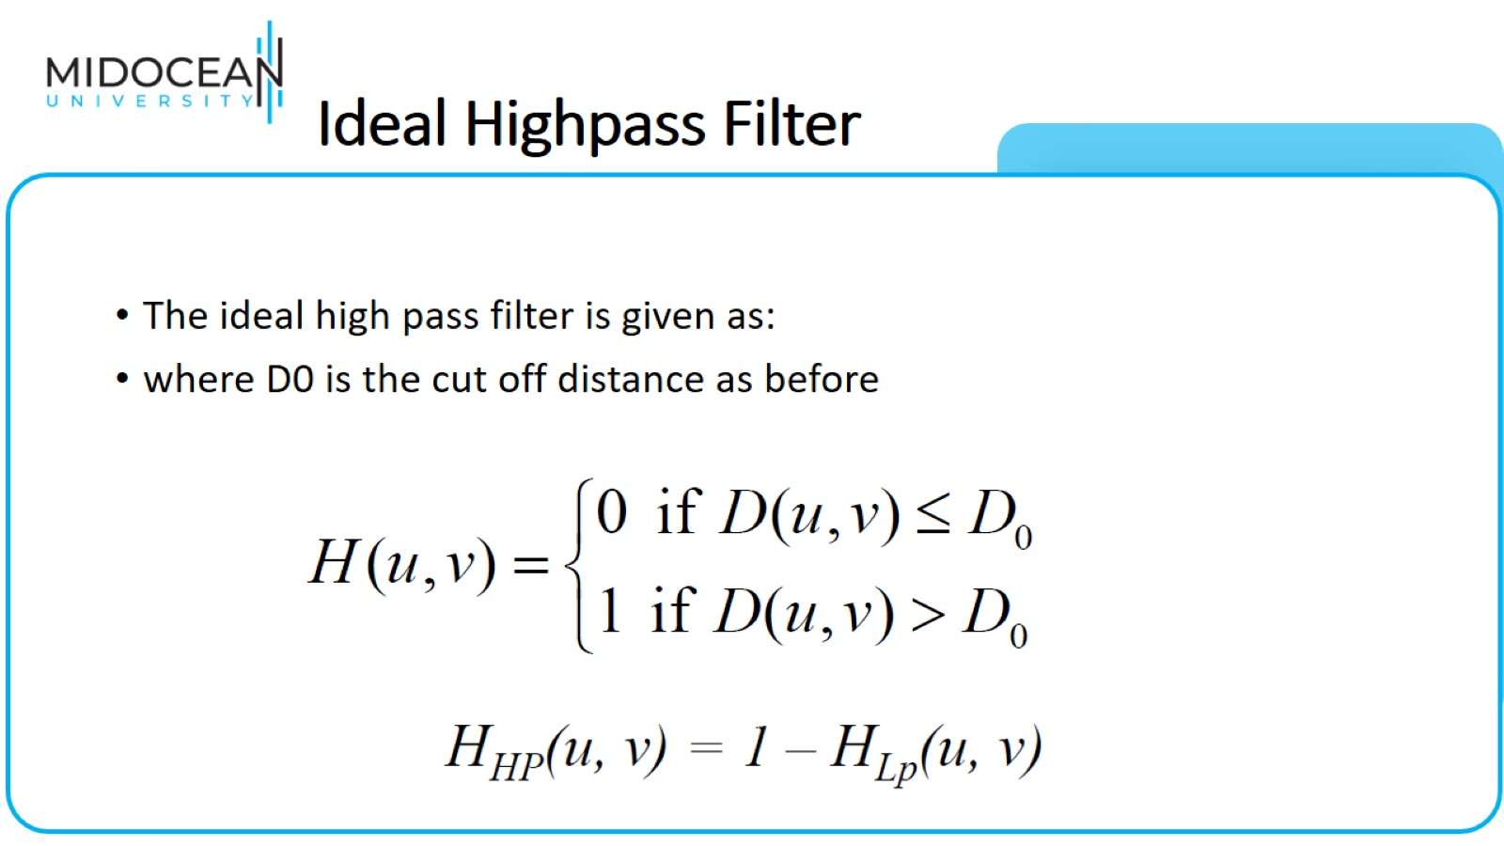
Ideal Highpass Filter

Slide 16
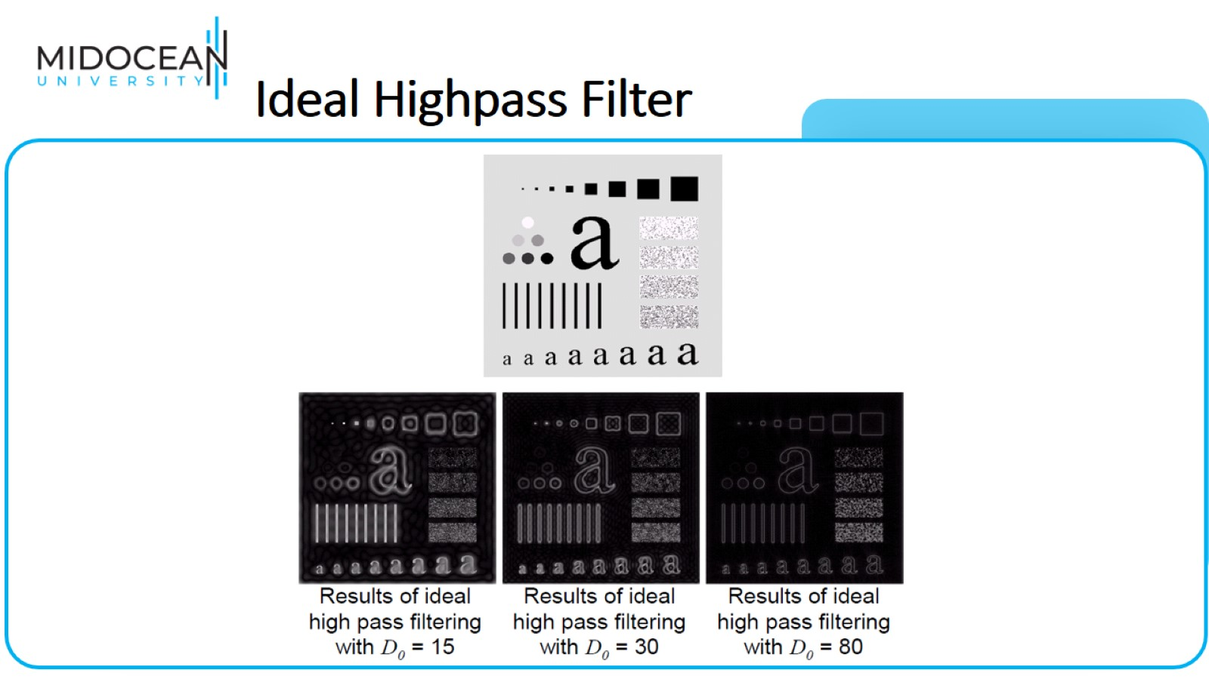
Ideal Highpass Filter

Slide 17
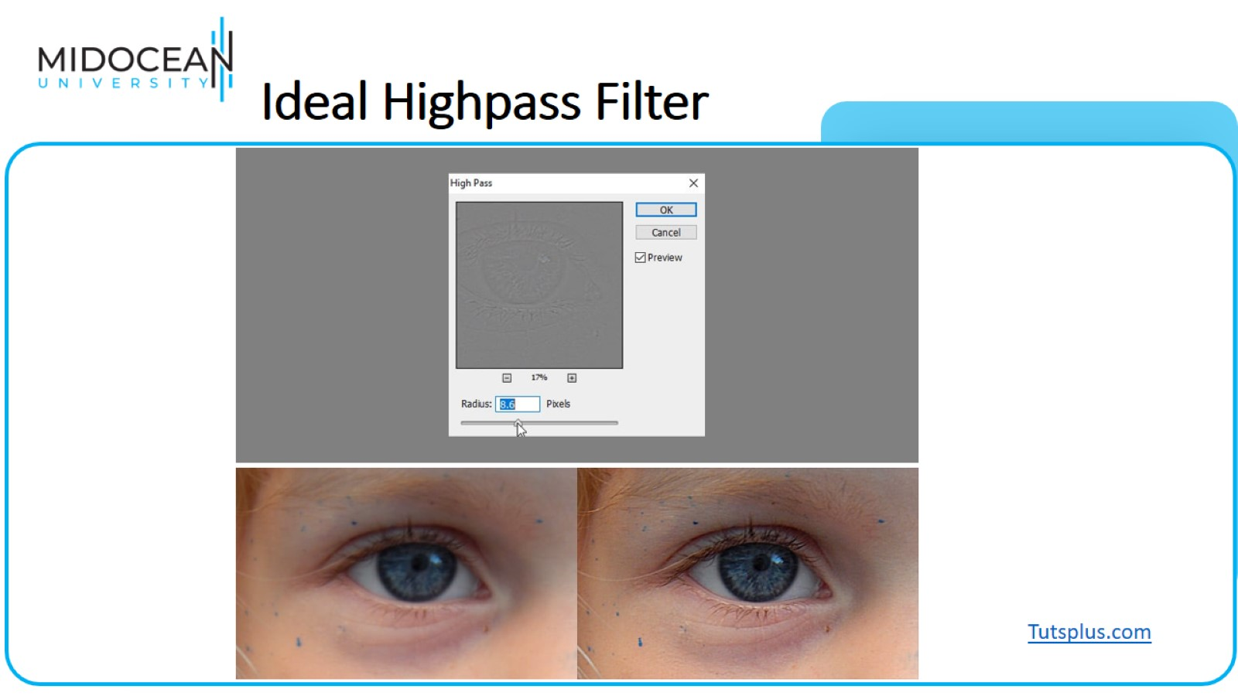
Ideal Highpass Filter

Slide 18
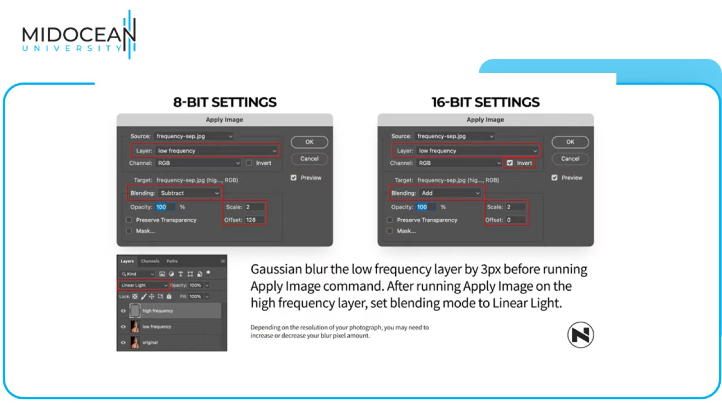

Slide 19
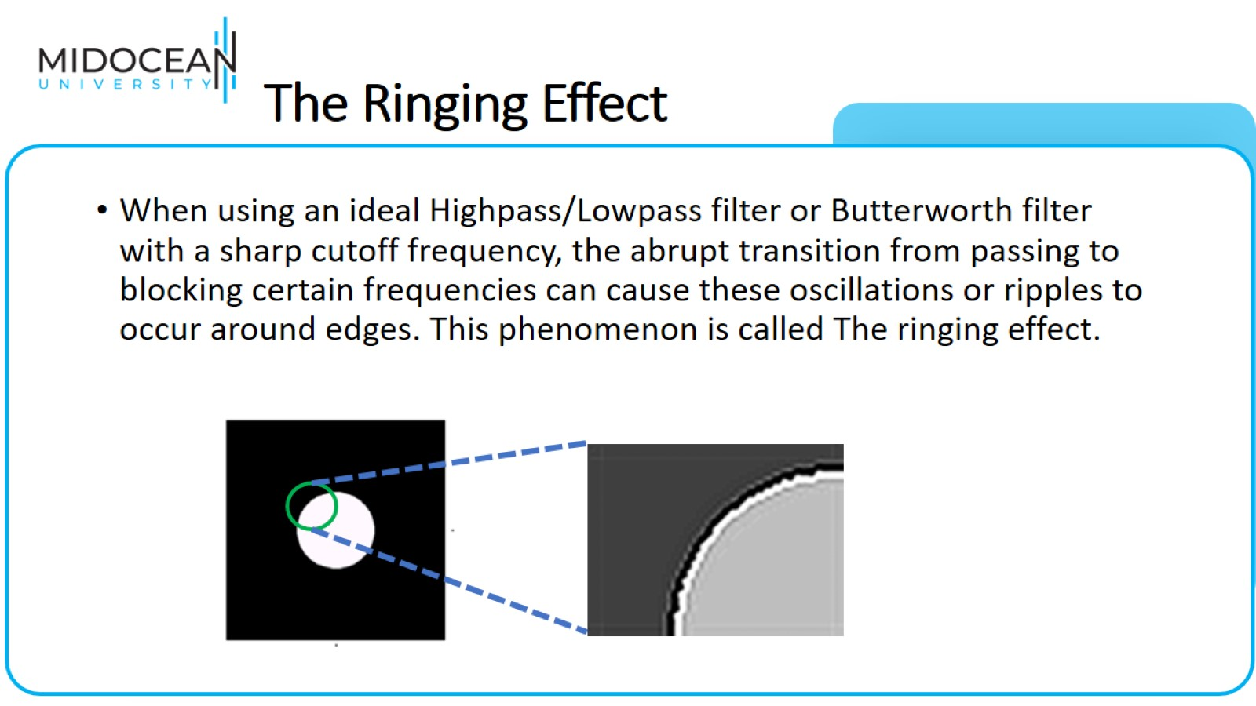
The Ringing Effect

Slide 20
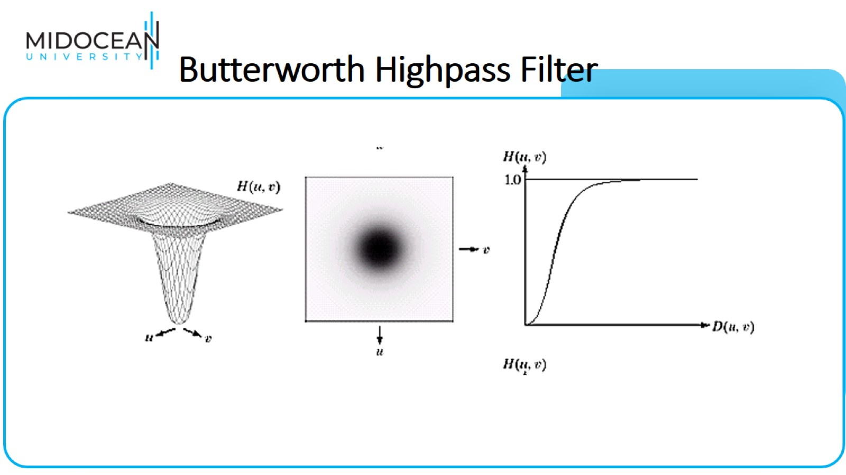
Butterworth Highpass Filter

Slide 21
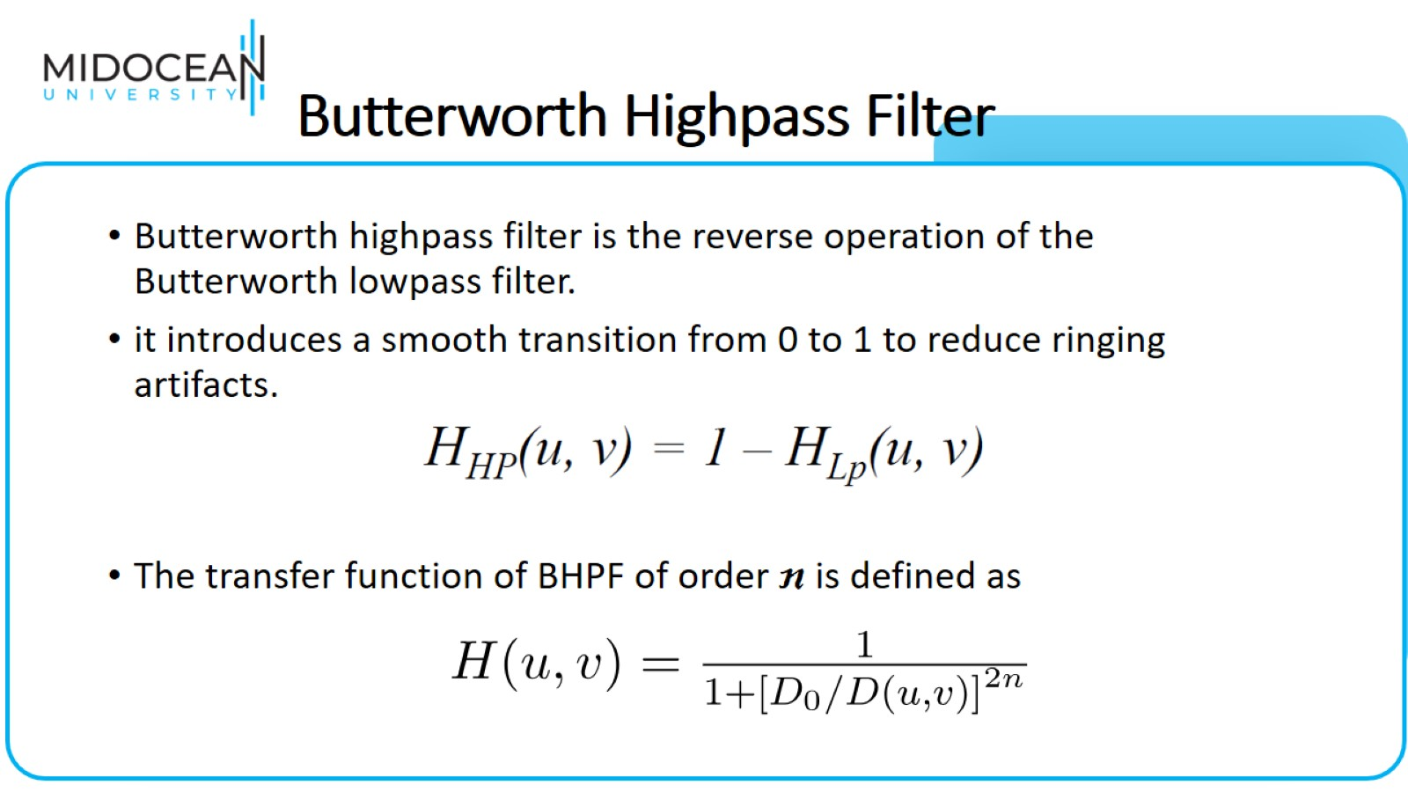
Butterworth Highpass Filter

Slide 22
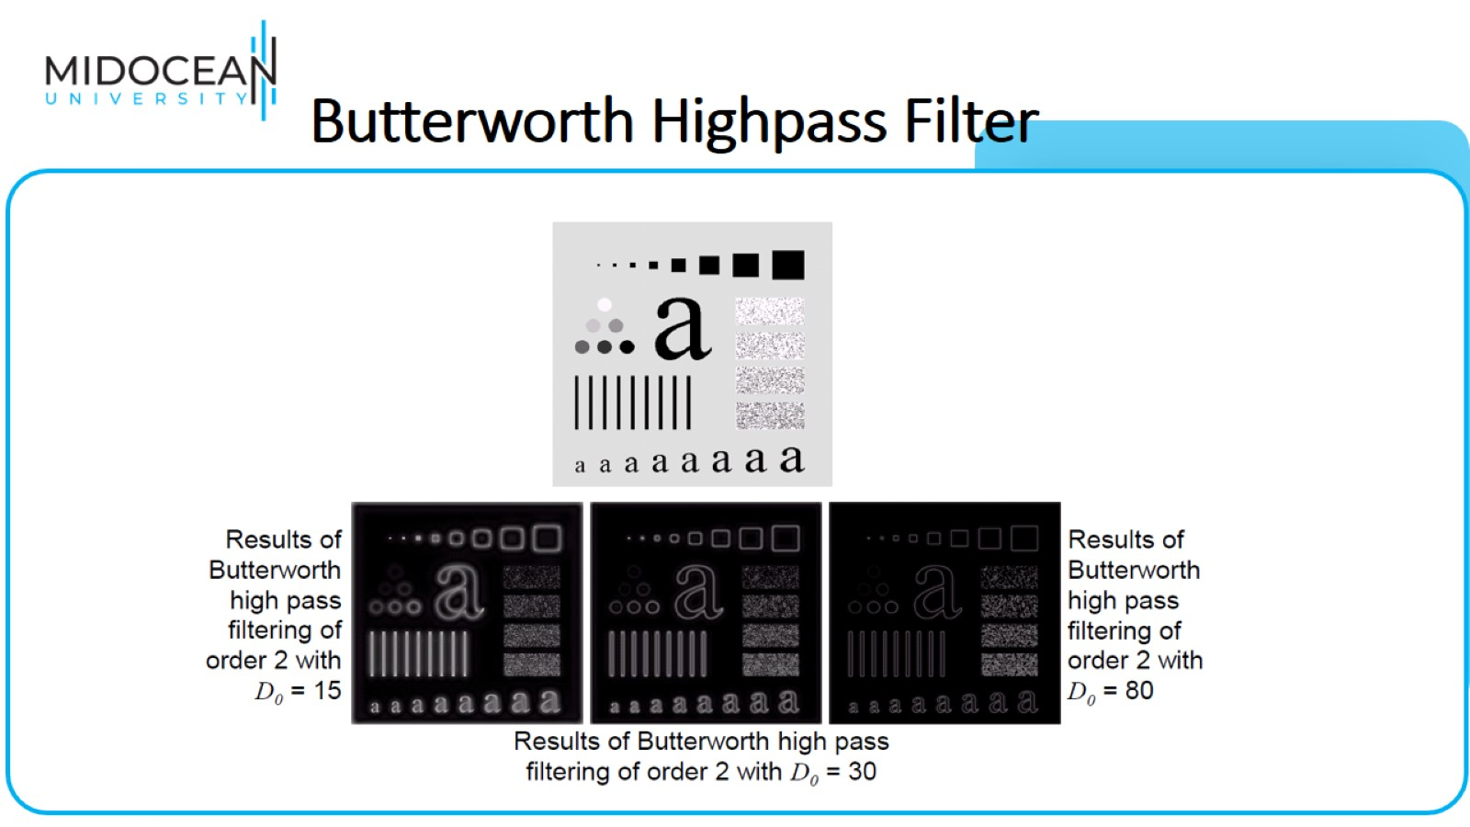
Butterworth Highpass Filter

Slide 23
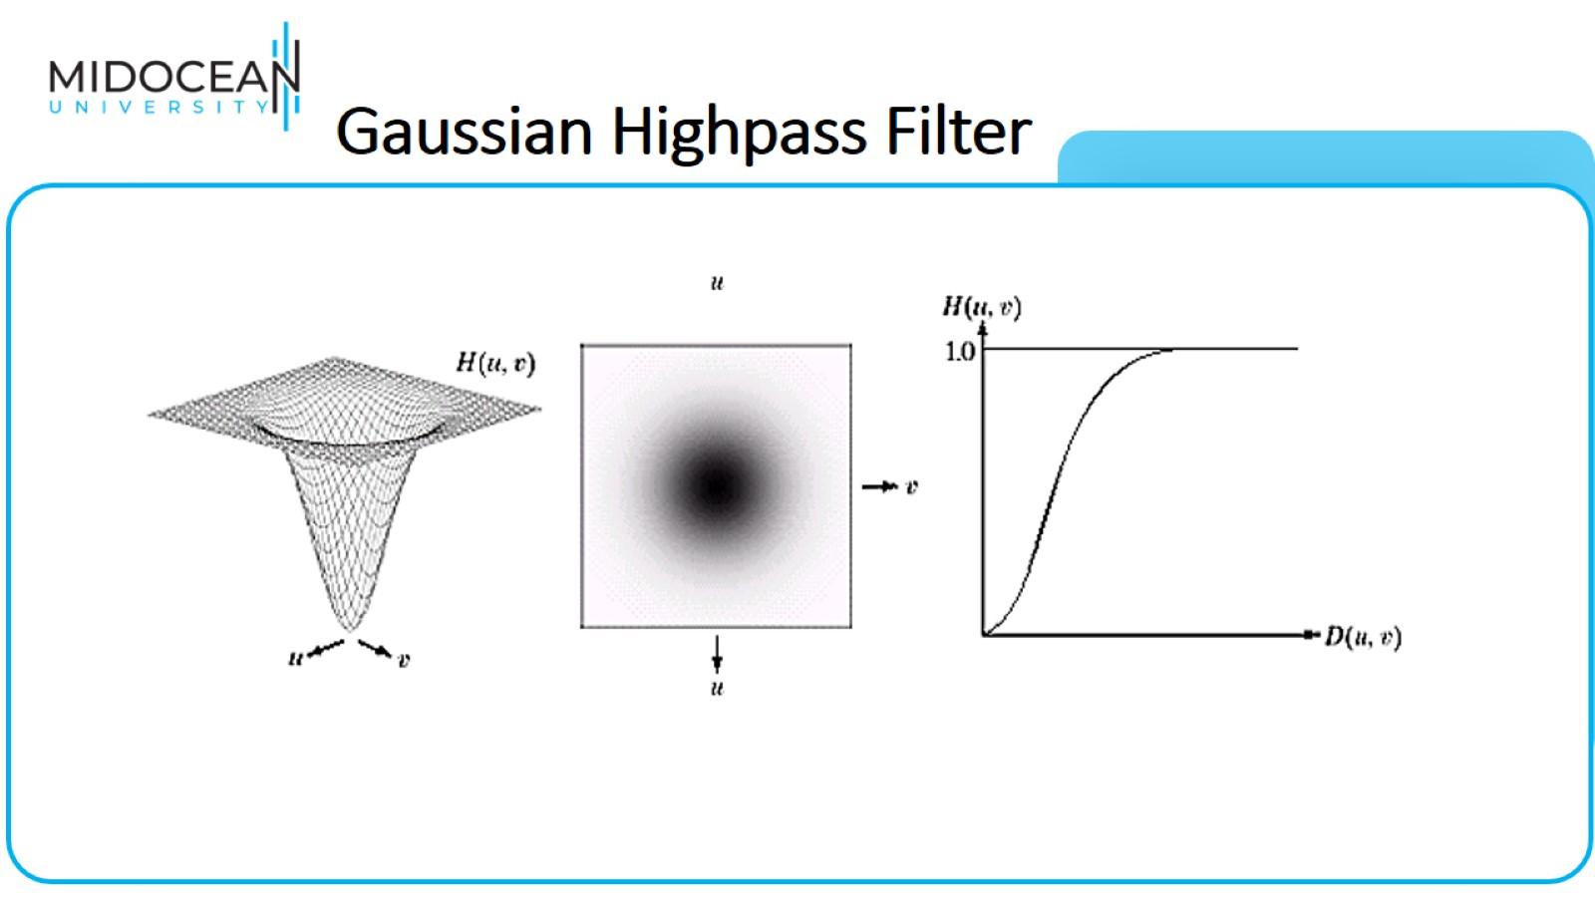
Gaussian Highpass Filter

Slide 24
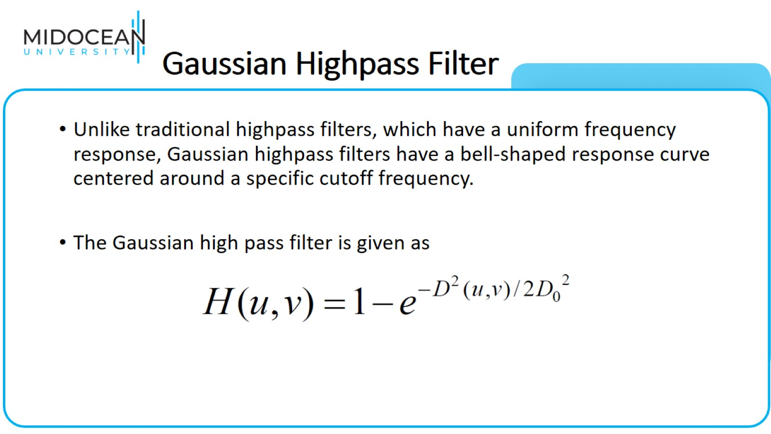
Gaussian Highpass Filter

Slide 25
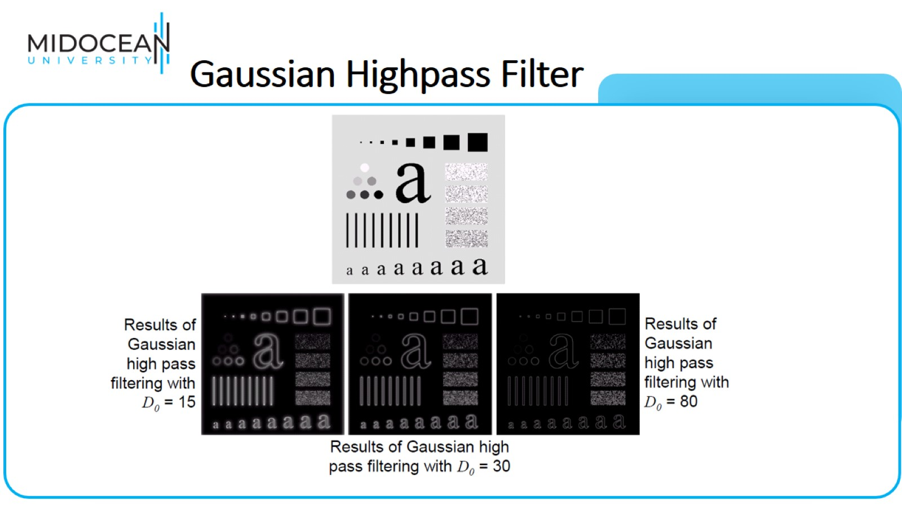
Gaussian Highpass Filter

Slide 26
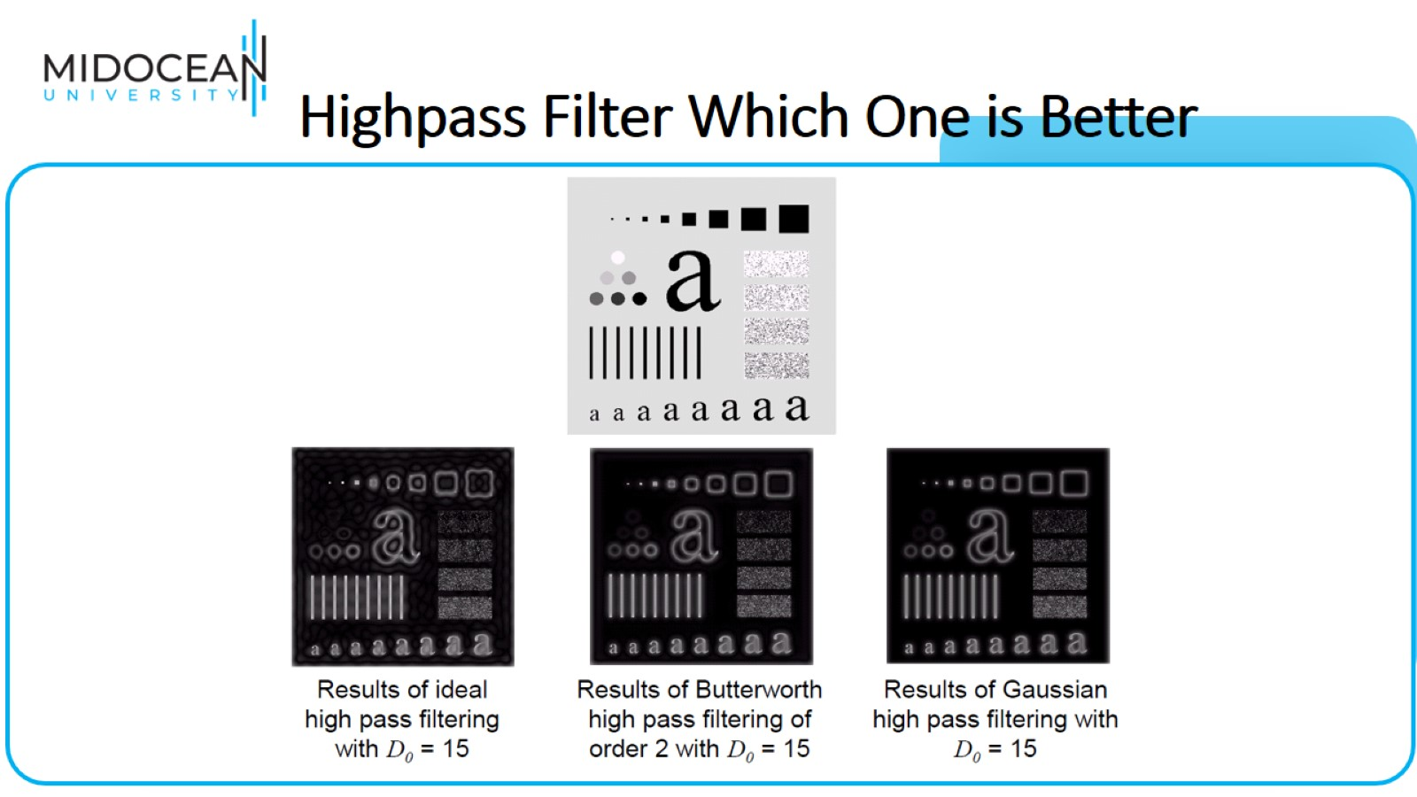
Highpass Filter Which One is Better

Slide 27
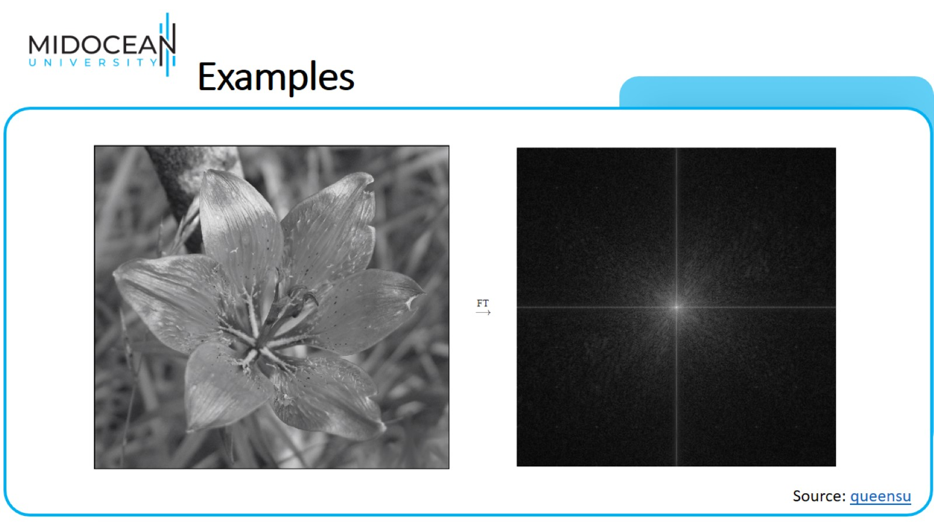
Examples

Slide 28
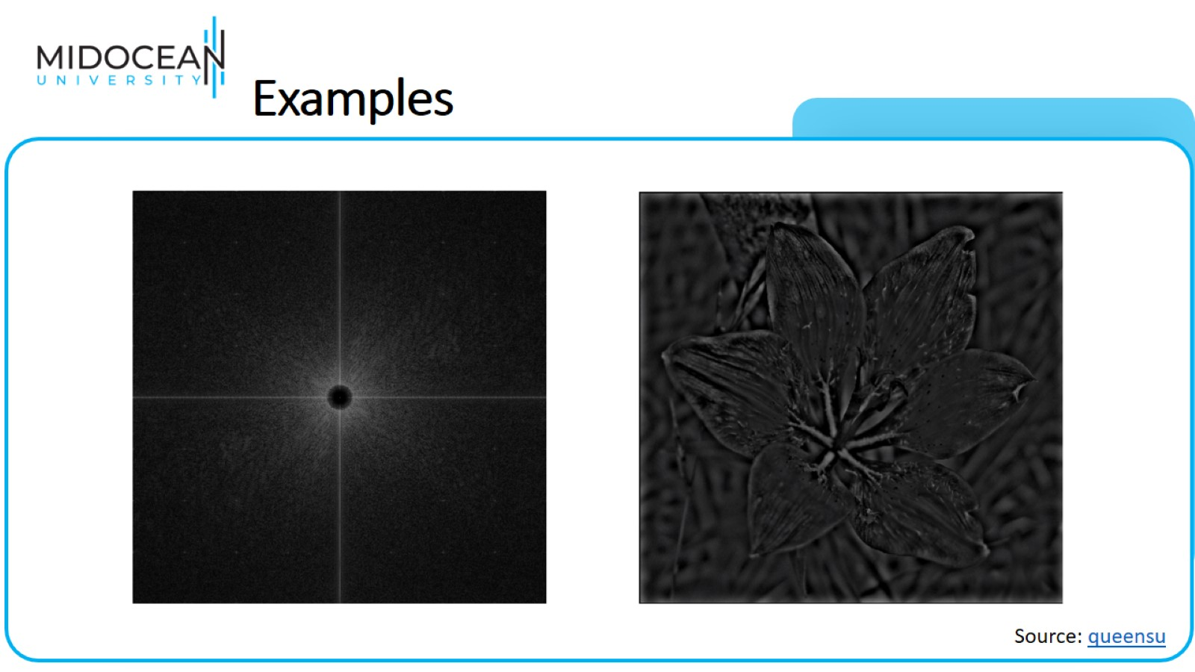
Examples

Slide 29

Image Restoration and Reconstruction

Slide 30
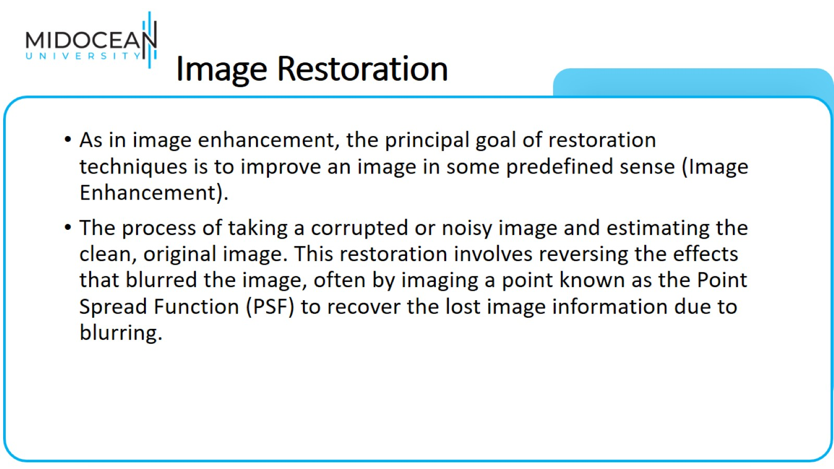
Image Restoration

Slide 31
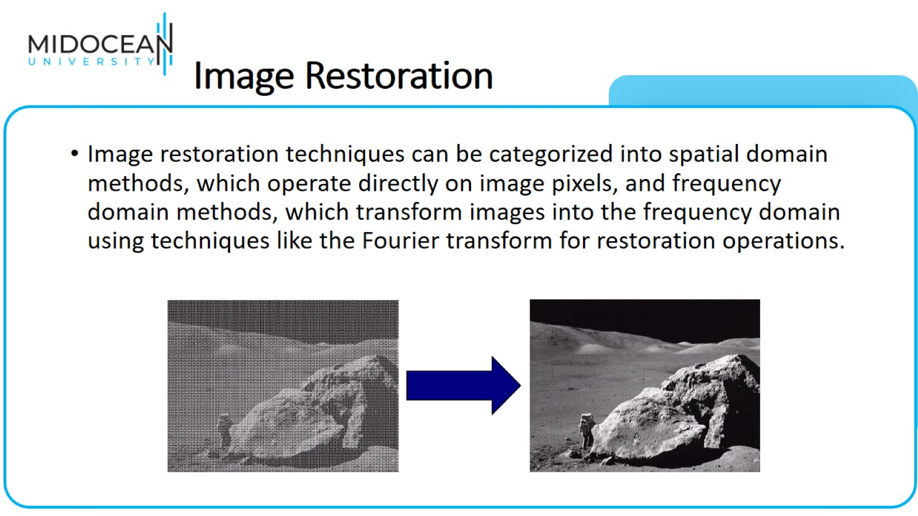
Image Restoration

Slide 32
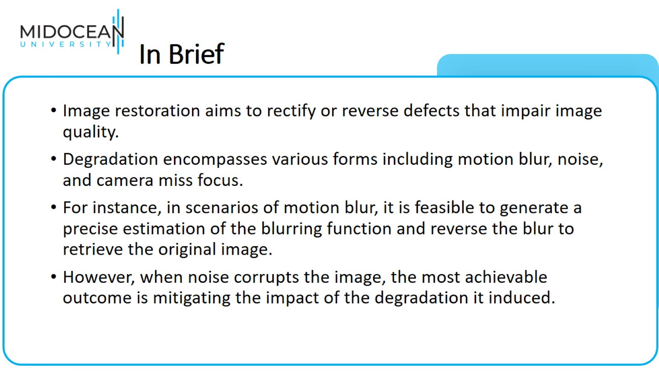
In Brief

Slide 33
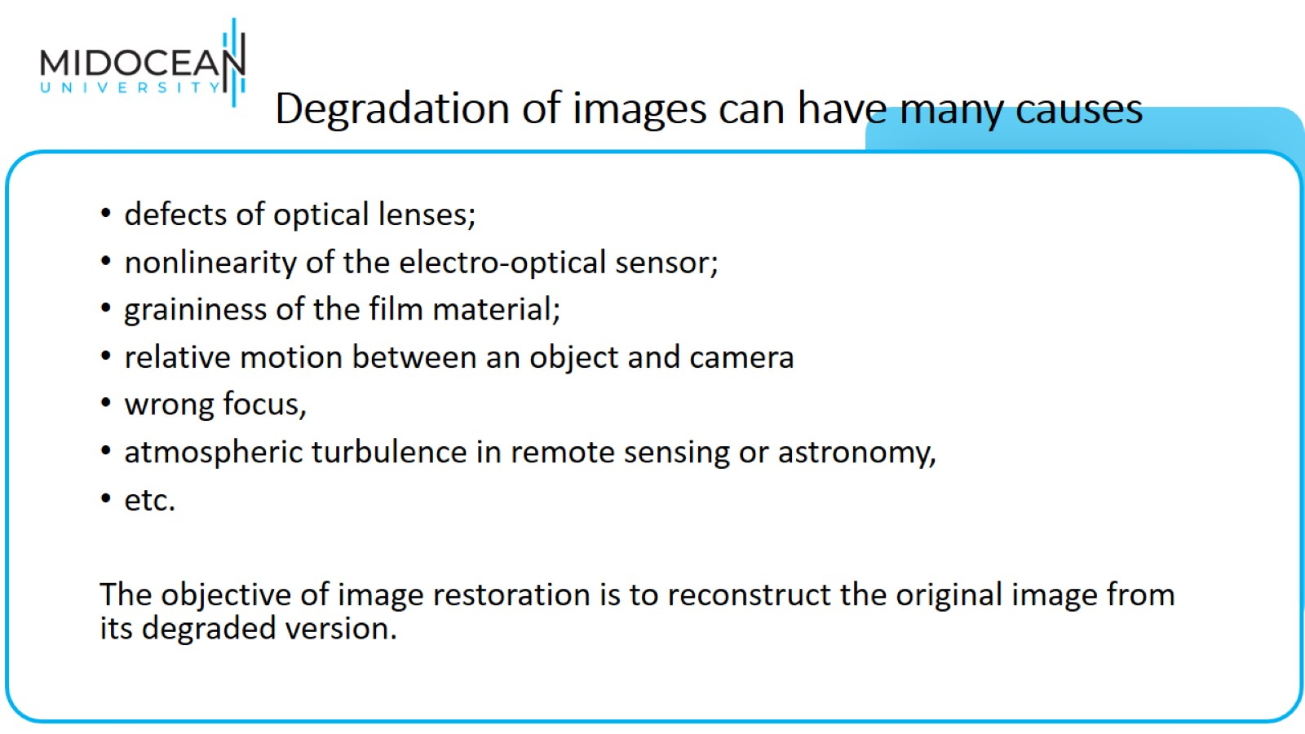
Degradation of images can have many causes

Slide 34
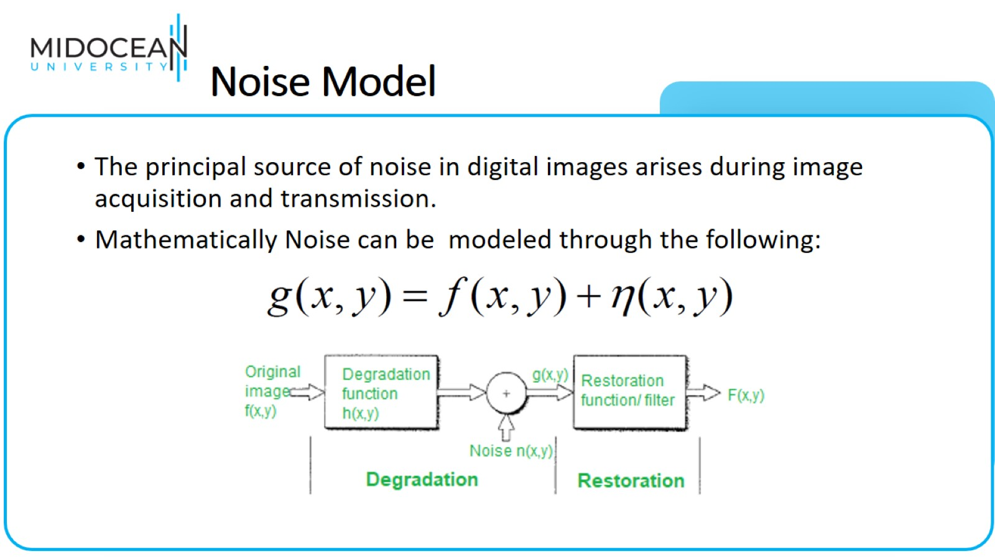
Noise Model

Slide 35
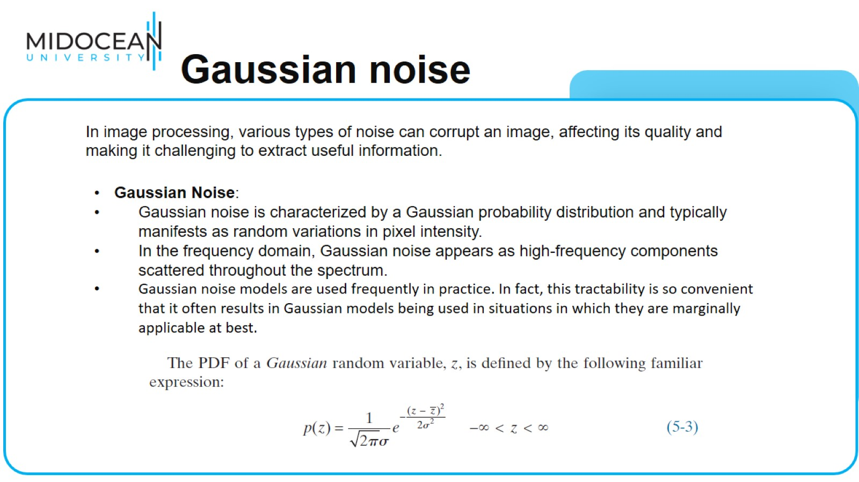
Gaussian noise

Slide 36
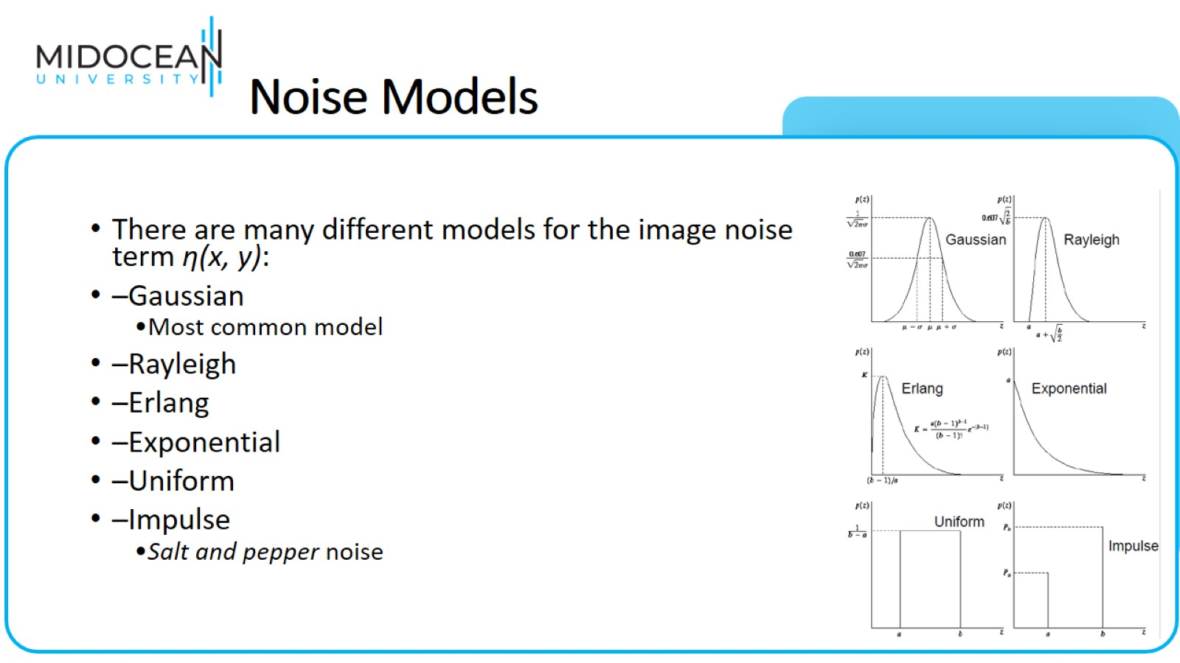
Noise Models

Slide 37
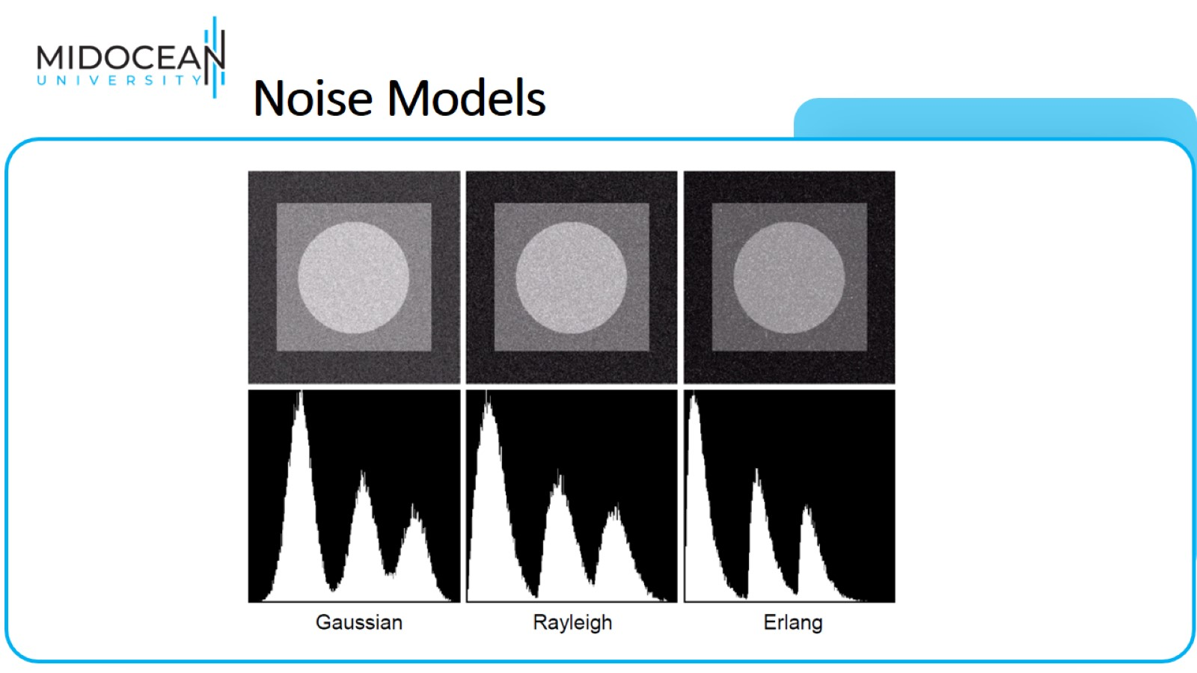
Noise Models

Slide 38
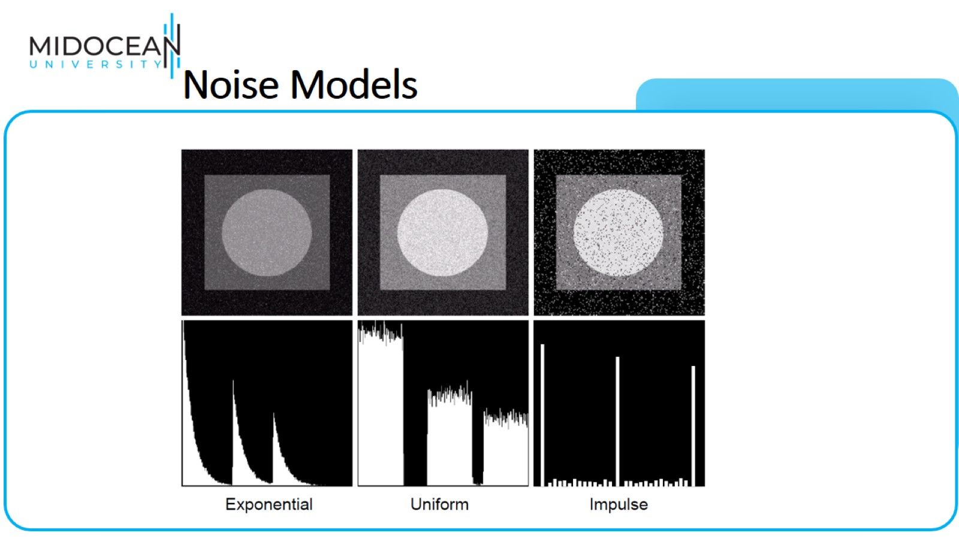
Noise Models

Slide 39
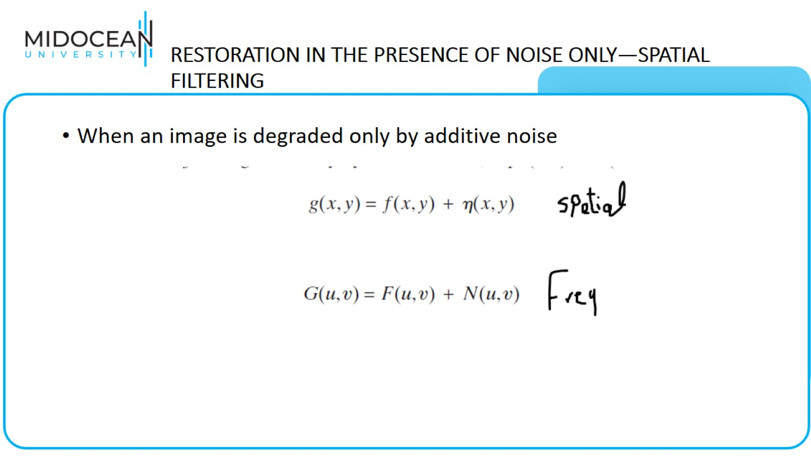
RESTORATION IN THE PRESENCE OF NOISE ONLY—SPATIAL
FILTERING

Slide 40
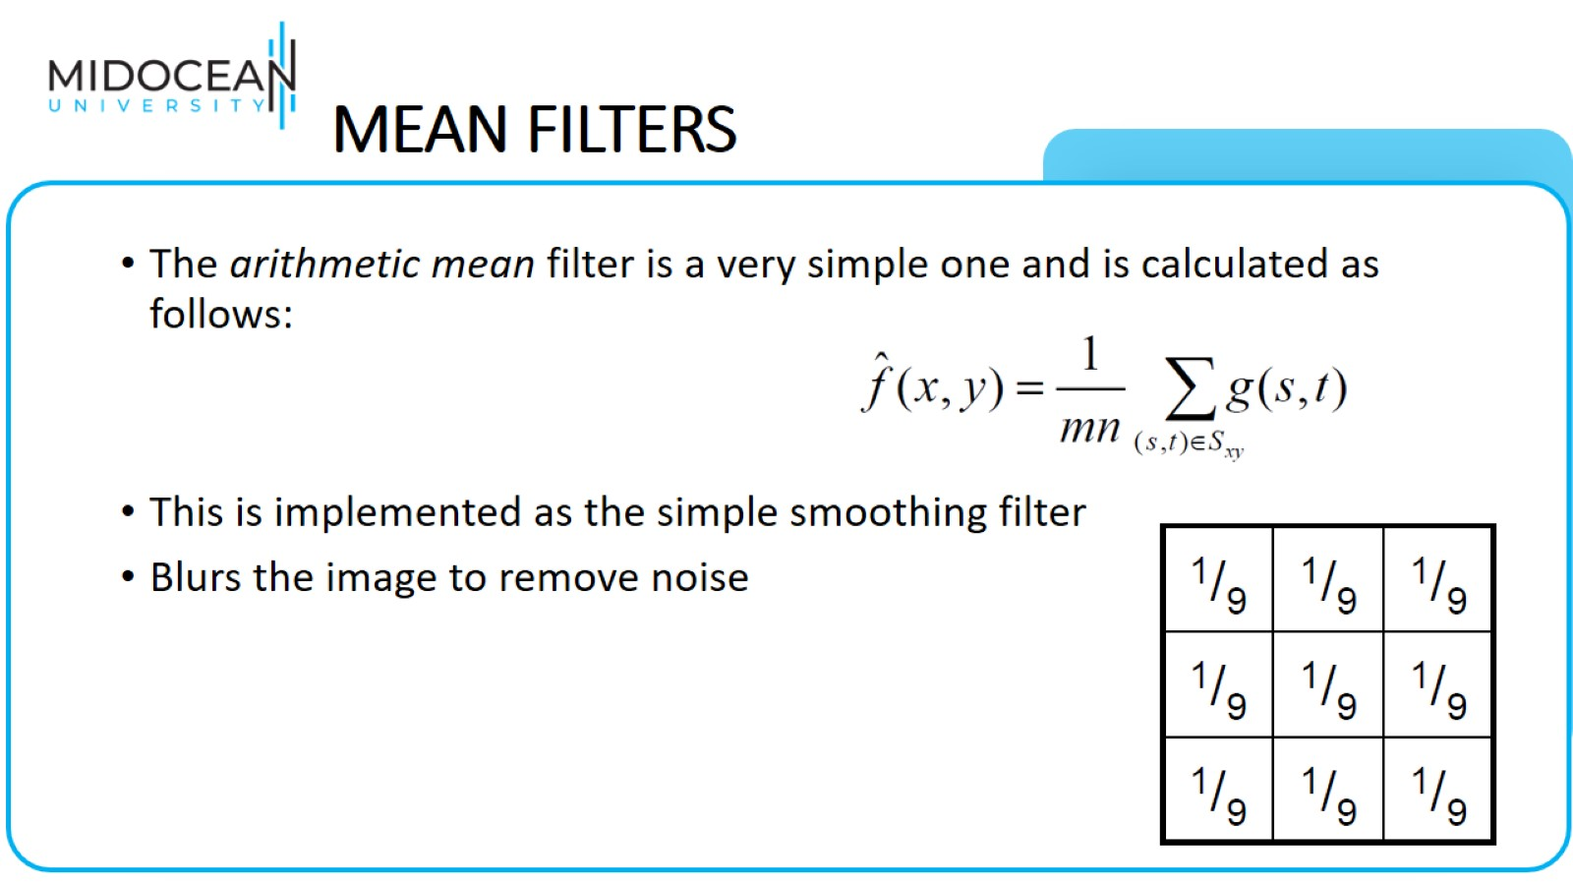
MEAN FILTERS

Slide 41
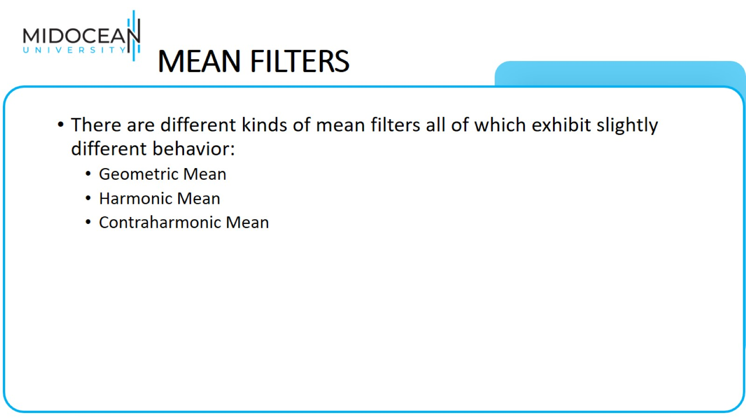
MEAN FILTERS

Slide 42
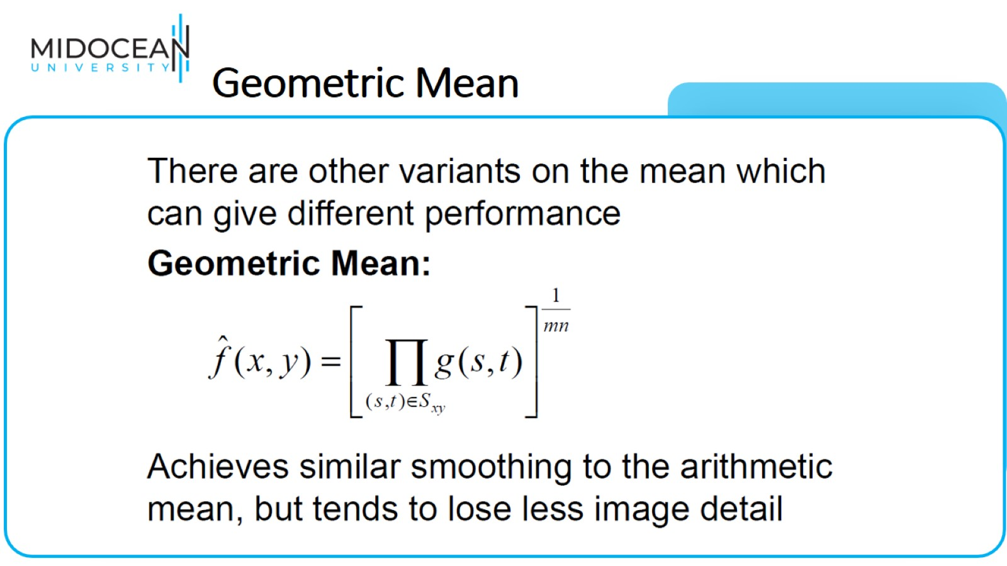
Geometric Mean

Slide 43
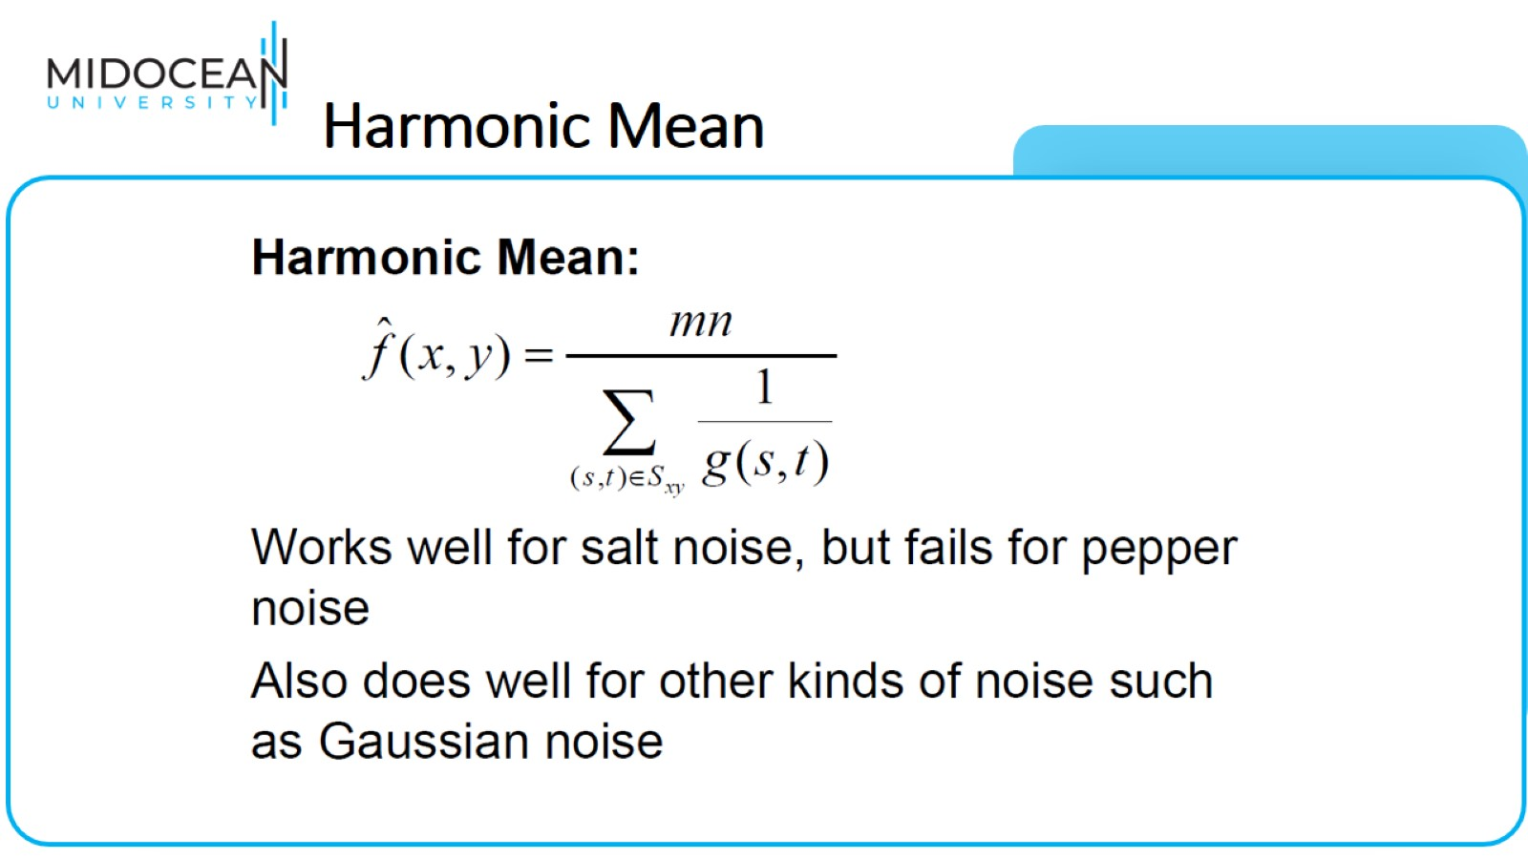
Harmonic Mean

Slide 44
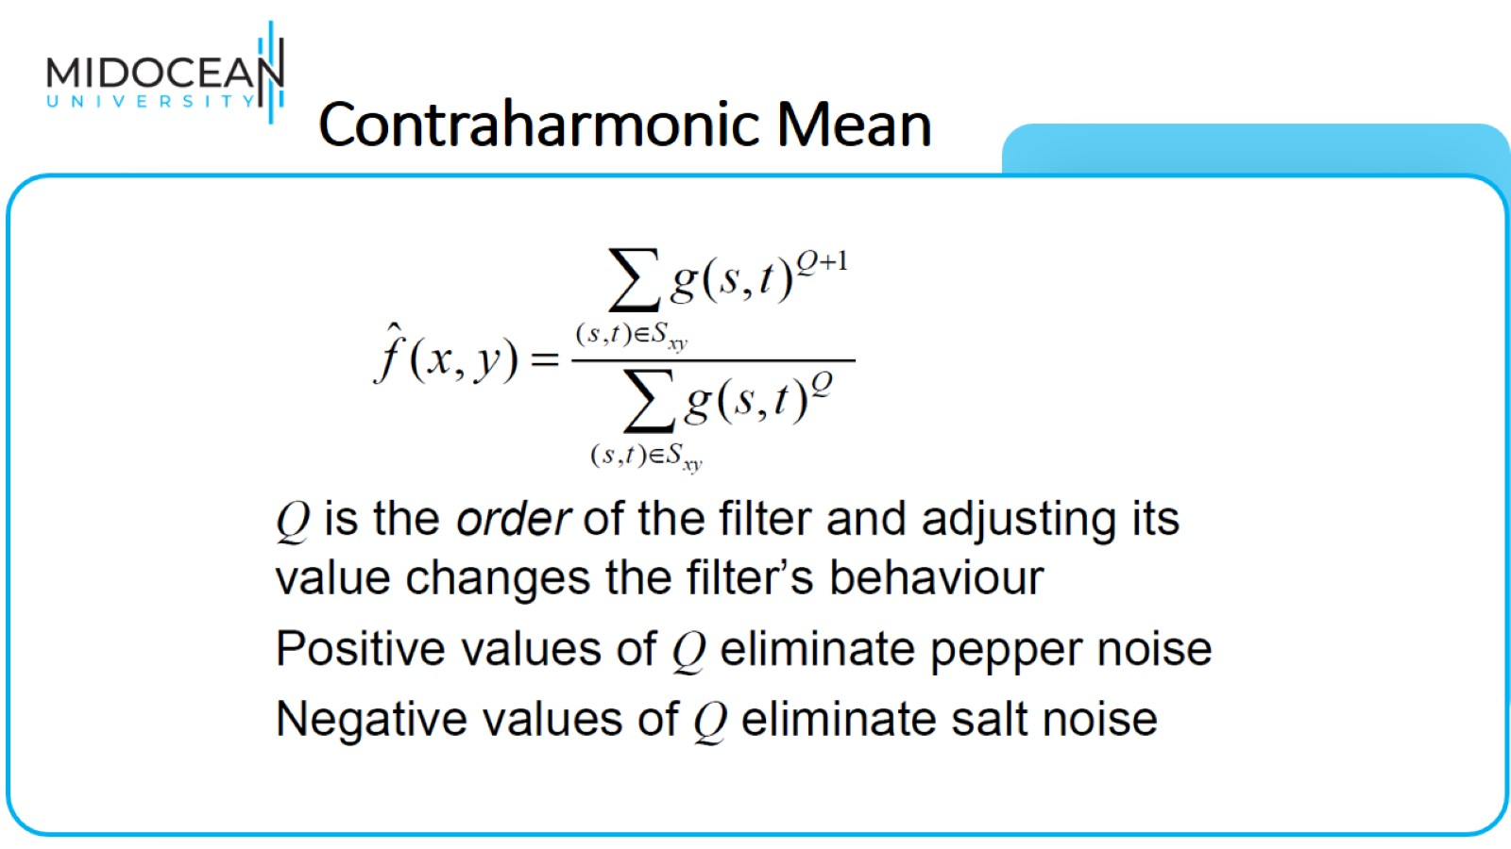
Contraharmonic Mean

Slide 45
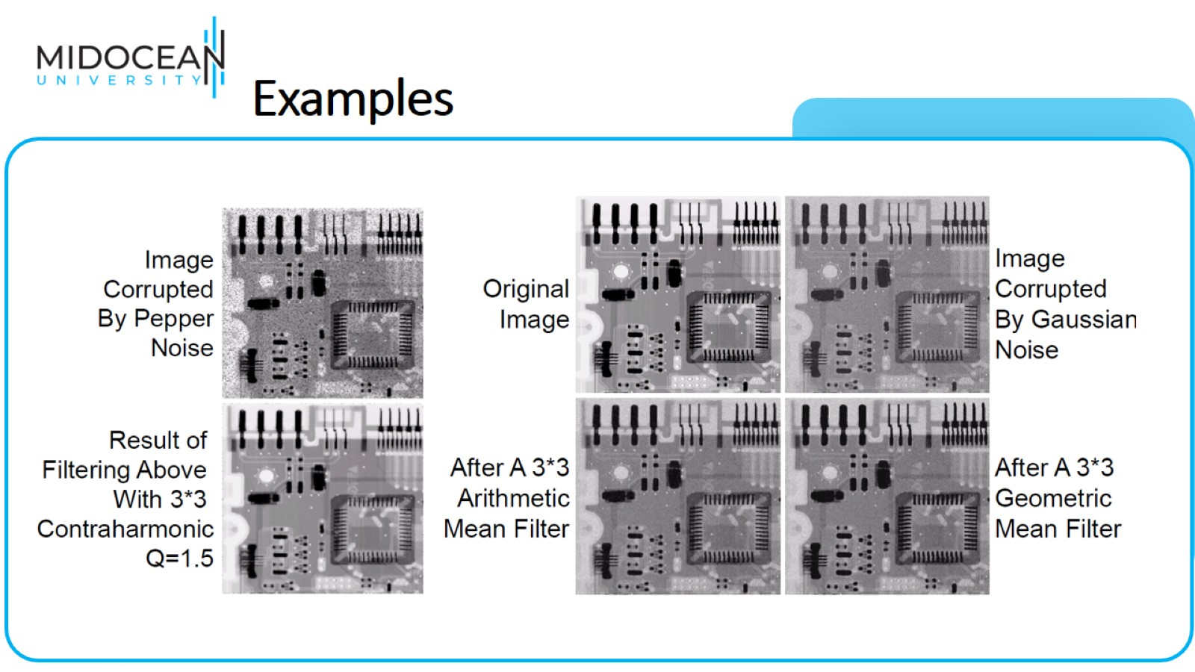
Examples

Slide 46
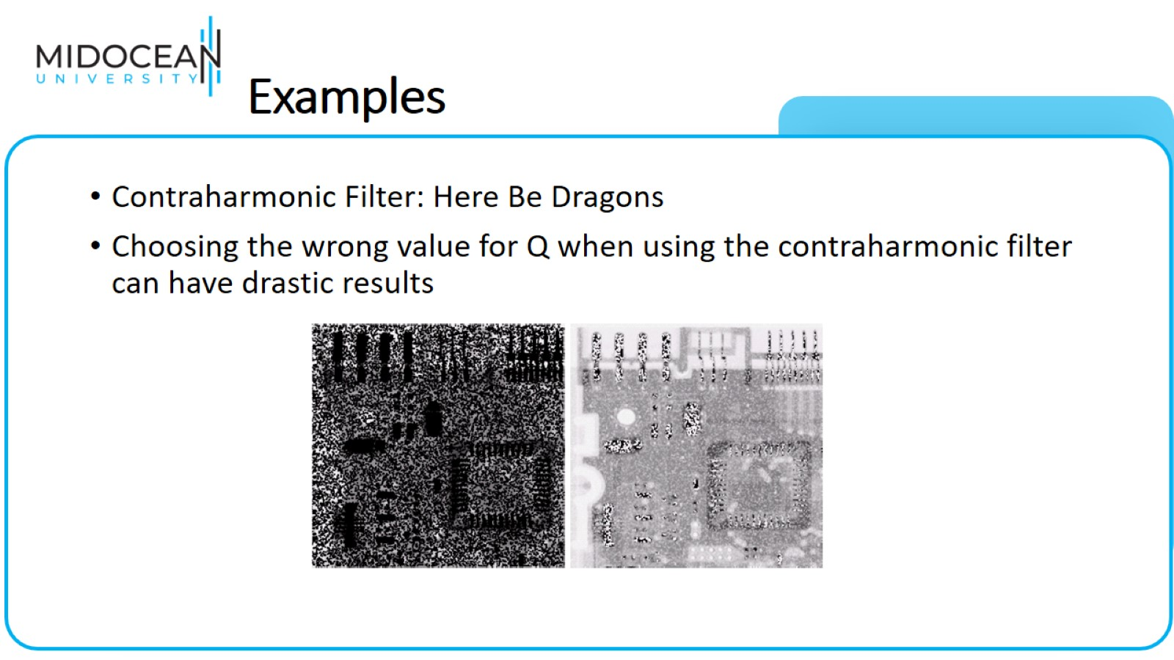
Examples

Slide 47
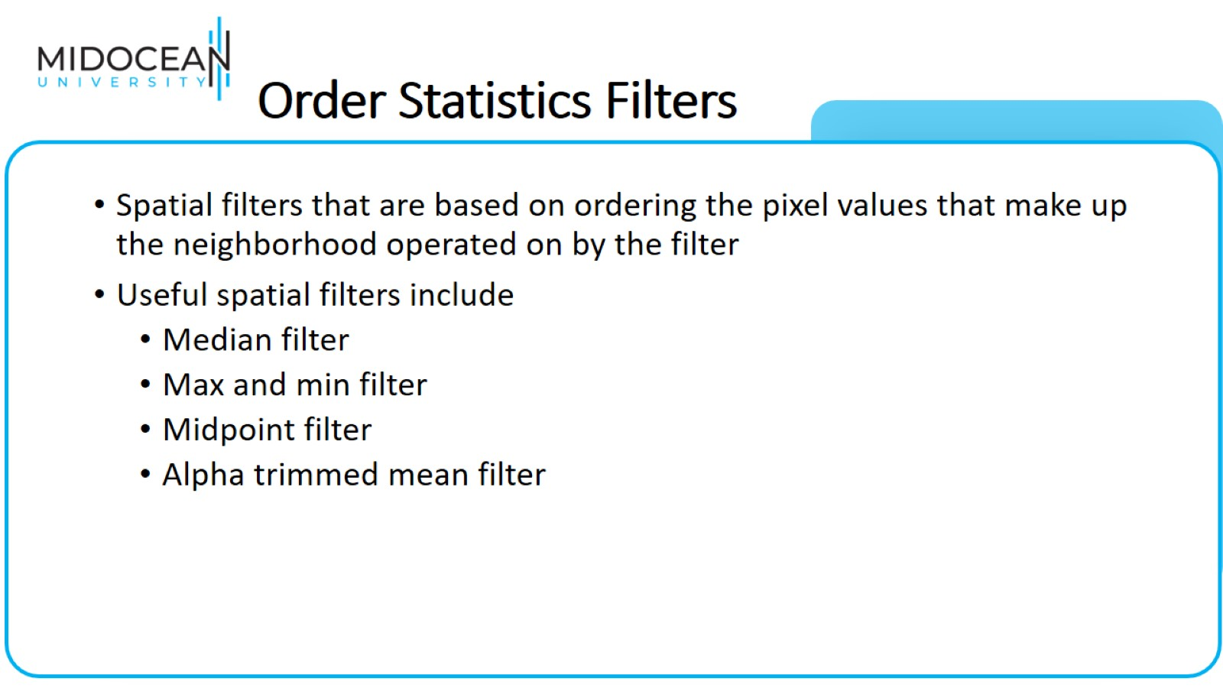
Order Statistics Filters

Slide 48
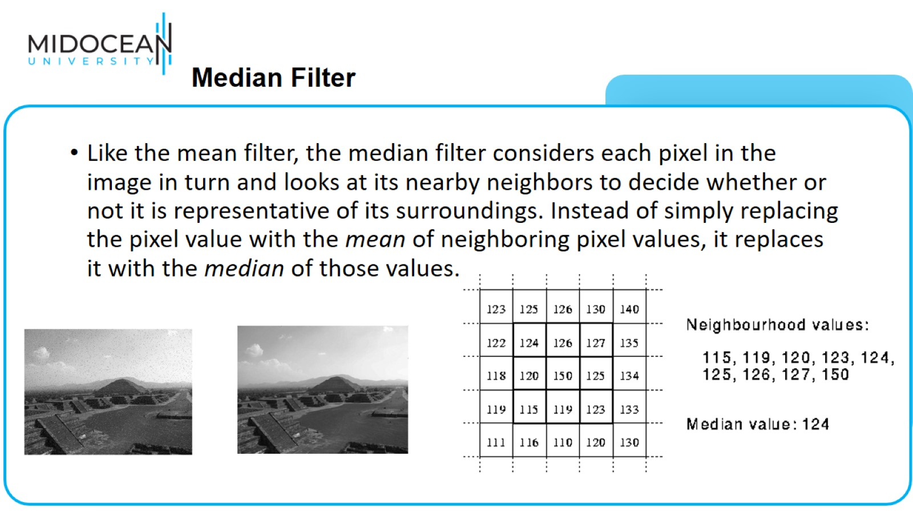
  Median Filter

Slide 49
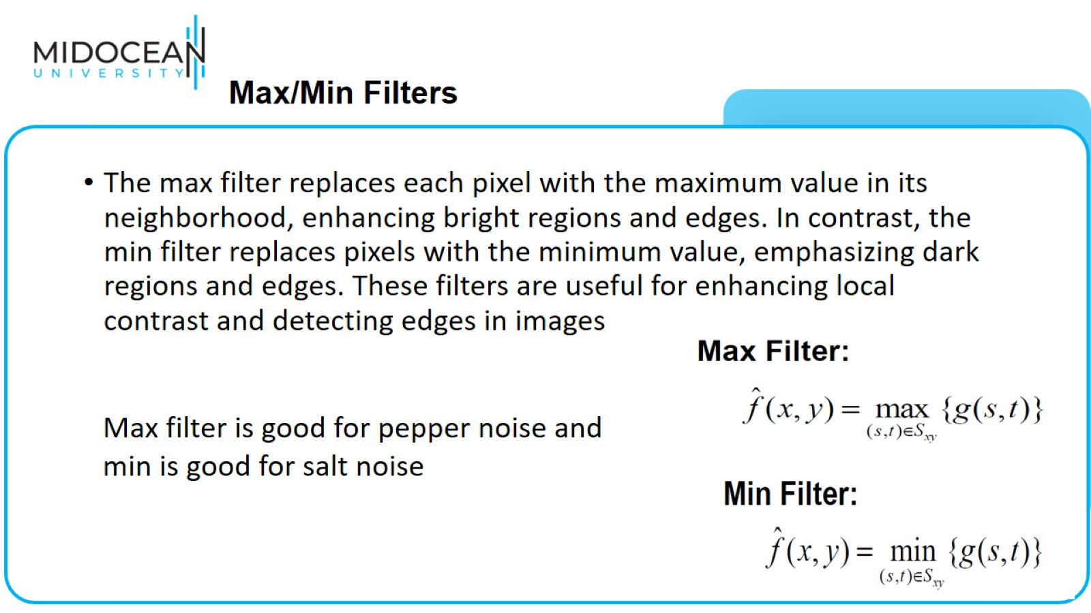
  Max/Min Filters

Slide 50
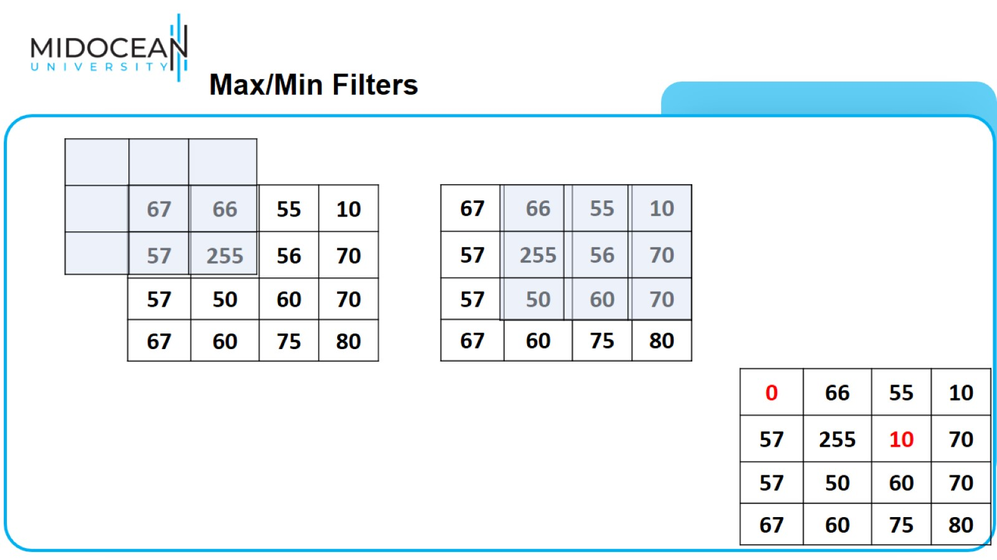
  Max/Min Filters

Slide 51
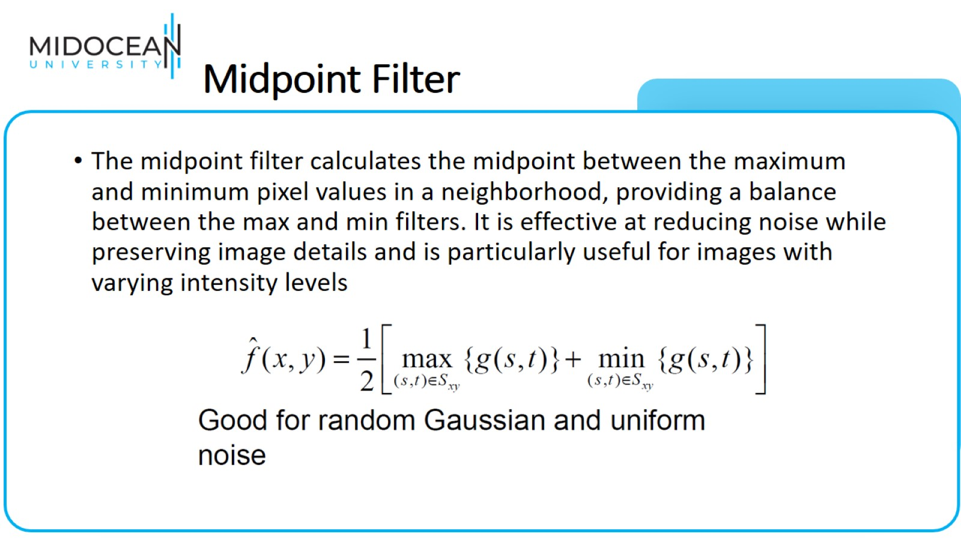
Midpoint Filter

Slide 52

Alpha-Trimmed Mean Filter

Slide 53

Alpha-Trimmed Mean Filter

Slide 54


