Slide 1


Human Resources
Analytics
Prepared by Dr. Samah Abdelfatah
HRM 623
Lecture 5

Slide 2



SCENARIO PLANNING:
PREPARING FOR UNCERTAINTY
Chapter
04
Lecture 05
HRM 623
Prepared by
Dr. Samah Abdelfatah
www.midocean.ae

Slide 3

Chapter
MAIN TOPICS
04
Succession Planning—scenario Planning: Preparing For Uncertainty— The Playbook Concept—quality Employee Engagement Measurement & HUCAMETRICS
www.midocean.ae

Slide 4
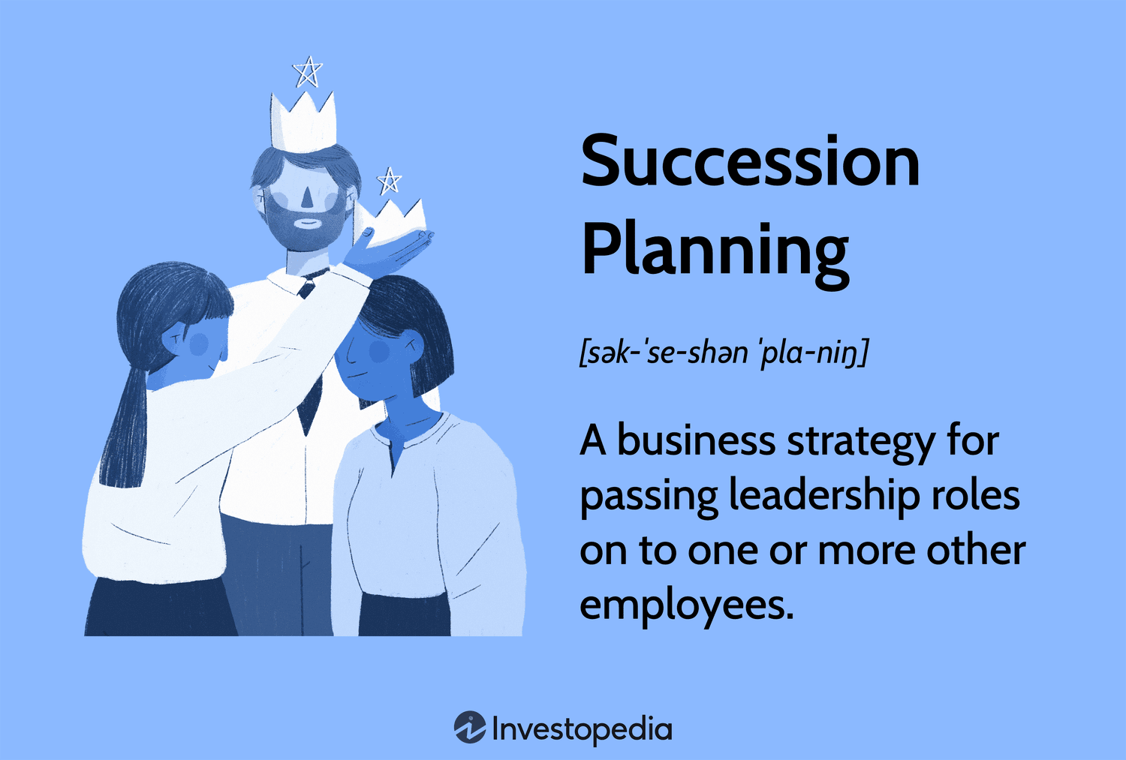
Chapter
04
SUCCESSION PLANNING
Succession planning is the process of identifying the critical positions within your organization and developing action plans for individuals to assume those positions. Taking a holistic view of current and future goals, this type of preparation ensures that you have the right people in the right jobs today and in the years to come.
www.midocean.ae

Slide 5
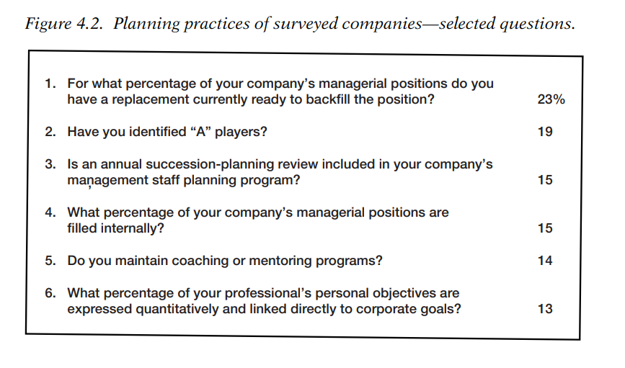
PLANNING PRACTICES OF SURVEYED COMPANIES
www.midocean.ae

Slide 6
Chapter
ADVANCED SUCCESSION PLANNING SYSTEM
04
Given these findings, they have developed an advanced succession planning system built around four imperatives:
1. Responsibility. Assign a senior executive the primary responsibility for managing the system. This person must have the organizational power to keep the system on track and people being developed according to the needs of the organization and the prescribed plan.
2. Identification. Identify high-potential managerial and technical personnel as far down the organization as possible. As organizations become more complex, every manager and professional will be delegated greater discretionary power and faced with higher-risk decisions.
www.midocean.ae

Slide 7
Chapter
ADVANCED SUCCESSION PLANNING SYSTEM
04
3. Design. Develop personal growth programs, and review and update the Hi-Pos’ progress at least annually. Strategic capability implies that these people be exposed to a broad range of on-the-job experiences, as well as formal learning opportunities. Because the market is moving so rapidly, continual review and revision are necessary.
4. Effectiveness. Monitor advancements and their effect on top-line growth and accelerate development where necessary.
www.midocean.ae

Slide 8
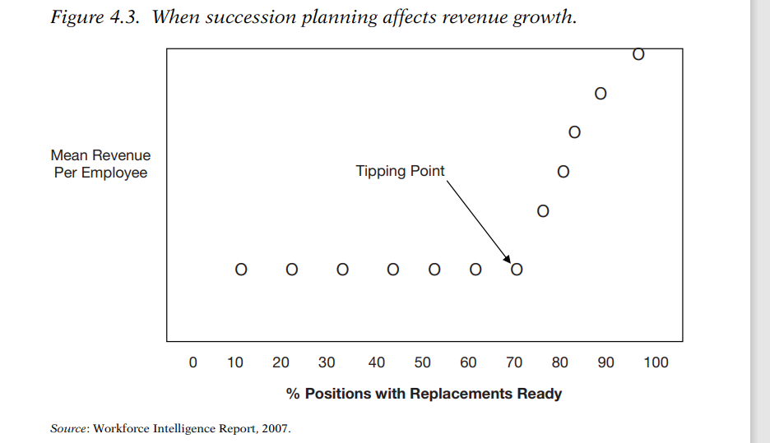
SUCCESSION PLANNING AFFECTS REVENUE GROWTH.
www.midocean.ae

Slide 9
MANAGEMENT SUCCESSION IS A CRITICAL DRIVER OF SUSTAINABILITY
Chapter
04
CEOs accountable for ensuring a continual flow of capable executives, managers, and high-skill professionals.
Research has shown repeatedly a positive correlation between organizational performance and the CEO’s commitment to management development.
In the final analysis, the only corporate resource that matters is people; all other resources are depreciating assets.
www.midocean.ae

Slide 10

SCENARIO PLANNING: PREPARING
FOR UNCERTAINTY
Scenarios are stories about the future that, when taken together, describe a range of plausible future states of an industry, its markets, and a particular business.
Scenarios are a tool for dealing with rapid change, uncertainty, and inherent unpredictability.
Scenarios are not predictions of the future; rather, they are images of possible futures, taken from the perspective of the present
Chapter
04
www.midocean.ae

Slide 11
SCENARIO PLANNING
Scenario planning, encourages a creative tolerance for ambiguity;
It enables an organization to consider what skills and resources it would need to compete effectively in each of the imagined alternative futures.
It enables how it would have to change current practices to survive in that world.
4. scenario planning provides executives with a sense of what events or patterns to look for as early warning
signs that one or more of the projected scenarios might actually be starting to occur.
This early sense of how the future is beginning to unfold
amounts to a form of ‘‘anticipatory insurance.’’
Chapter
04
www.midocean.ae

Slide 12
BUILDING SCENARIOS
The things you know you don’t know
Identify the most critical and potentially impactful unknowns
Select two of the most critical of those un knowns
The third step is to set up a 2x2 matrix
Chapter
Two uncertainties that are essentially independent variables.
Look at four possible combinations
www.midocean.ae

Slide 13
Example of 2X2 matrix for building Scenarios
Data Privacy Regulation | LOW | HIGH
LOW Competitor Emergence | Scenario One Open Data/Low Competition | Scenario Two Restricted Data/Low Competition
HIGH Competitor Emergence | Scenario Three Open Data/High Competition | Scenario Four Restricted Data/High Competition
www.midocean.ae

Slide 14
BUILDING SCENARIOS
Chapter
04
EXAMPLE
The scenario planners selected two aspects of the future economy that they believed were indeterminable:
1. The prevailing kind of organizational strategy, either self organizing or a more traditional, hierarchical approach
2. The global supply of talent, either scarce or in abundance
www.midocean.ae

Slide 15
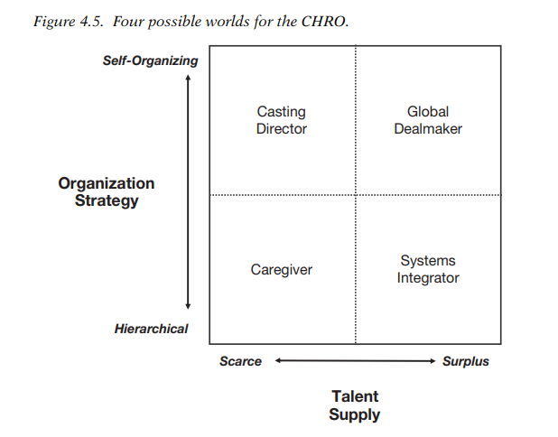
EXAMPLE
Each of the four hypothetical roles for the CHRO is spelled out this way to enable senior executives and HR professionals to imagine the world in which that role would be appropriate.
www.midocean.ae

Slide 16
FROM SCENARIOS TO PLAYBOOKS
Chapter
04
Once you have developed several plausible scenarios, what can you do with them?
Scenarios are not an end in themselves, and if misused they can actually increase organizational risk.
To avoid that, they recommend building a ‘‘playbook’’ containing alternative scripts or action plans for the different futures you have described in your scenarios.
www.midocean.ae

Slide 17
Chapter
THE PLAYBOOK CONCEPT
04
Professional teams in most major team sports—especially those in time-based sports like football, basketball, and soccer—have used playbooks for years.
A playbook contains a series of different offensive and defensive plays that have been developed for a variety of different conditions.
An effective playbook takes into account the unique strengths (and weaknesses) of the team.
www.midocean.ae

Slide 18
Chapter
THE CONTENTS OF A BUSINESS PLAYBOOK
04
Playbook includes six basic ‘‘chapters
1. Analyzing the ‘‘Game.’’ The opening chapter includes a basic analysis of the company’s business environment, focusing on the fundamental drivers of change, including those strategic uncertainties whose combinations lead to a set of plausible alternative futures
2. Assessing the Competitive Position. This chapter includes a thorough examination of the company’s capabilities and limitations, with a particular focus on its position and power in its current channels. What is your present value proposition? Why do your customers buy from you and not your competitors? What are your capabilities and resources?
www.midocean.ae

Slide 19
Chapter
THE CONTENTS OF A BUSINESS PLAYBOOK
04
3. Scenarios—Envisioning the Future. This chapter contains documentation of the alternative futures that come out of the critical uncertainties defined by the scenarios you have created. Detailed economic analyses, customer profiles, and channel structures also described and discussed. The opportunities for changing the rules of the game can be identified.
4. Plays—Setting Our Options. These are the specific strategic moves
that can be made within each scenario. In addition, indicators are identified—environmental factors that can act as signals that one or more of the alternative worlds may actually be occurring, or are becoming more likely.
www.midocean.ae

Slide 20
Chapter
THE CONTENTS OF A BUSINESS PLAYBOOK
04
5. Executing the Plays. This chapter lays out the action steps required to execute each plausible or desirable strategic move. Here, the resources needed to execute each play are defined, as are the managerial accountabilities for ensuring resource availability and actually executing the plays.
6. Tracking, Anticipating, and Acting. This chapter includes the ongoing documentation of the plays as they are executed, and it contains updated environmental assessments as well as any new plays or counter plays as they are developed.
www.midocean.ae

Slide 21
THE PROCESS FOR CREATING A PLAYBOOK
Phase One—Background research and scenario development
Phase Two—Development of strategic options
Phase Three—Acquisition of necessary resources and building ofthe capability to execute
www.midocean.ae

Slide 22
PHASE ONE—BACKGROUND RESEARCH AND SCENARIO DEVELOPMENT
Chapter
04
Phase One corresponds to chapters 1 and 2 of the playbook structure described previously, plus the groundwork for chapter 3.
Phase One includes asking questions like these:
What is changing today about our customers, our competitors, our marketplace?
What is our current position within our supply chain? What is keeping us where we are in the chain?
What forces are changing our channel power relative to our suppliers, our customers, and—if applicable—the ultimate end consumers?
What core business processes drive our industry and channel today?
What kind of channel player do we want to be going forward? What are our ambitions?
www.midocean.ae

Slide 23
PHASE TWO—DEVELOPMENT
OF STRATEGIC OPTIONS
Chapter
04
Phase Two, corresponding to chapters 3 and 4 of the playbook structure, should be completed within four weeks, if at all possible.
The playbook team develops the scenarios in much greater detail, and for each scenario the team asks,
‘‘If this world actually happens, what do we need or want to do?
What capabilities and resources are required to be successful?’’
What impact would each scenario have on our existing resources, market position, and channel partners?
How might our competitors react to each scenario? What opportunities and threats would their reactions create for us?
www.midocean.ae

Slide 24
PHASE THREE—ACQUISITION OF NECESSARY RESOURCES AND BUILDING
OF THE CAPABILITY TO EXECUTE
Chapter
04
Phase Three, corresponding to chapter 5 of the playbook structure, is also best completed within another four to six weeks.
It consists primarily of working through the resource requirements and execution capabilities surrounding each of the strategic options that have come out of the scenario-building process in Phase Two.
It is the same as resource planning; it is sorting through the implications and consequences of each possible scenario. What makes this process different, however, is that no final or formal commitments have been made to any particular strategic move.
www.midocean.ae

Slide 25
Chapter
THE STRENGTHS OF SCENARIO PLANNING
04
Plausibility. The focus is on the logic of the scenario, not on what someone believes will or should happen, but what can happen and why.
Creativity. The brainstorming approach actively encourages out of-box thinking.
Tolerance for Ambiguity. scenarios teach managers that it is all right not to know ‘‘the’’ answer about the future. The most important value of scenarios is that they shift the debate from ‘‘what will be’’ to ‘‘what if.’’
Seeing the Big Picture. In laying out a range of possible futures, we become more adept at considering multiple variables. On the other hand, scenario planning introduces new kinds of risk into the way people think about the future.
www.midocean.ae

Slide 26
Chapter
THE LIMITATIONS OF SCENARIO PLANNING
04
Oversimplification. You can’t cover all the key uncertainties in complete detail.
Team Composition Interacting with Content. The team members and their interaction during scenario building inevitably affect the visions the team produces.
Insight Versus Action. The scenario technique works best in generating new ideas and leaps in understanding. But their only value lies in the way the company acts on the information and ideas the scenarios generate.
www.midocean.ae

Slide 27
QUALITY EMPLOYEE ENGAGEMENT MEASUREMENT
Chapter
04
HUCAMETRICS
So what is HUCAMETRICS and what in the world does quality employee engagement measurement have to do with predicting outcomes?
HUCAMETRICS (hew-ca-MET-rix) is the new science of tracking and applying human capital data to predict employee and business performance and cause and effect.
www.midocean.ae

Slide 28

Chapter
HUCAMETRICS
04
Refer here to the basic HUCAMETRIC predictive model as the CEO success formula:
www.midocean.ae

Slide 29
COMPETENCE—‘‘READY’’
Chapter
04
Think of competence in the organization as a collective rather than
an individual phenomenon, where unity of effort is more important than the sum of the parts.
Competence, for HUCAMETRIC purposes, is the group’s or organization’s collective state of being adequate, well qualified, or masterful in performing a specific set of jobs or functions, measured against set standards, and in consistently and successfully achieving specific outcomes.
www.midocean.ae

Slide 30
Chapter
NON MANAGEMENT COMPETENCE
04
Figure 4.6 is an example of what the non management competence profile may look like.
For these statistics to be useful for predictive and intervention purposes, individual performance results should be aggregated by leader work group.
Most companies underutilize combined individual performance-appraisal scores and fail to adequately manage group performance totals.
www.midocean.ae

Slide 31
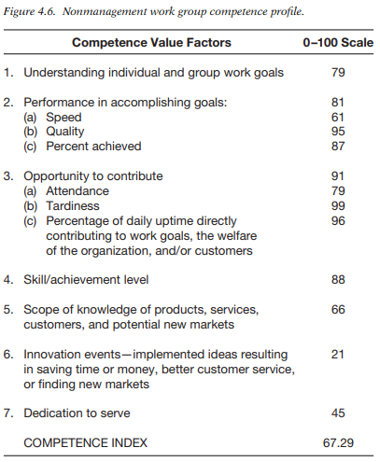
Chapter
www.midocean.ae

Slide 32
Chapter
TOP MANAGEMENT COMPETENCY PROFILE
04
Figure 4.7 is what the top management group profile may look like.
Competency profiles, once calibrated properly, should statistically describe the competency of each work group, as well as the organization as a whole.
Group competency scores can be classified into categories of less than adequate, adequate, well qualified, and masterful for purposes of skills training and transfer management.
www.midocean.ae

Slide 33
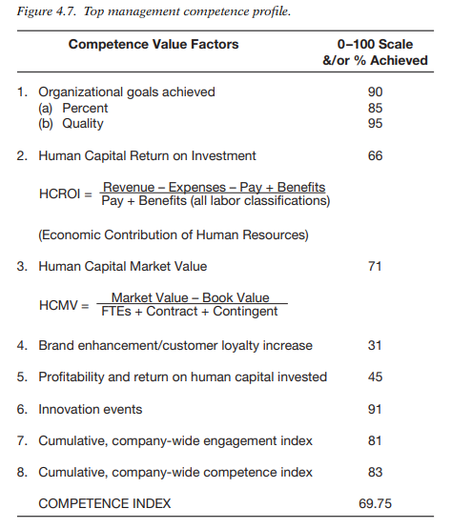
www.midocean.ae

Slide 34
EMPLOYEE ENGAGEMENT—‘‘WILLING’’
Chapter
04
True measurement of engagement statistically describes this state of willingness and predicts the quality, speed, energy, and enthusiasm of human effort in the organization, independent of competence or opportunity to contribute.
‘‘Ready’’ without ‘‘willing’’ results in poor return on human capital because the capital sits idle.
www.midocean.ae

Slide 35
Chapter
EMPLOYEE ENGAGEMENT—‘‘WILLING’’
04
Engagement is often mistaken for satisfaction .As a result, management errantly embarks on fixing the wrong things in an attempt to positively engage more employees.
Two fundamental precepts necessary to positively engage people are often ignored in the survey measurement:
(1) employee sense of fair treatment underpins engagement
(2) the things that engage people are different from the things that disengage them (the opposite of disengagement is not engagement, but no disengagement)
www.midocean.ae

Slide 36
Chapter
EMPLOYEE ENGAGEMENT—‘‘WILLING’’
04
There are a couple of things to note about these findings, based on
Frederick Herzberg’s Two-Factor studies
(1) positive employee engagement cannot be sustained if the majority of disengagement factors is not neutralized, and
(2) to positively engage employees there is more than ‘‘one thing you need to
know’’—most disengagement factors must be neutralized before improvements in engagement factors can have a significant positive influence
Engagement is an individual’s degree of positive or negative emotional
attachment to his or her organization, job, and colleagues.
www.midocean.ae

Slide 37
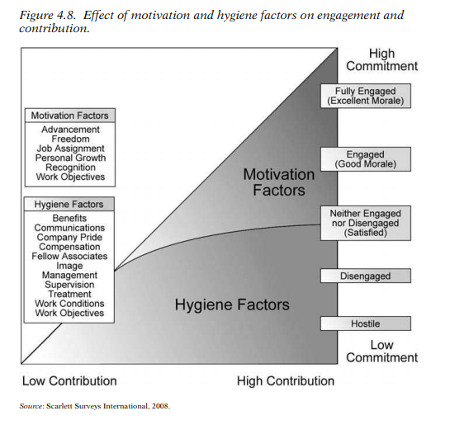
Chapter
www.midocean.ae

Slide 38
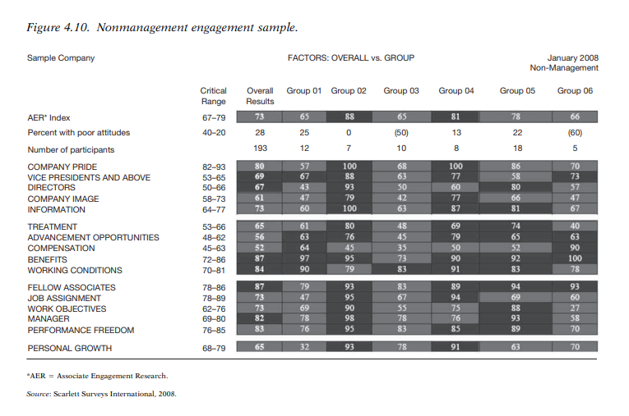
www.midocean.ae

Slide 39
Chapter
ORGANIZATIONAL OPPORTUNITY—‘‘ABLE’’
04
Frederick Herzberg once commented, ‘‘If you want someone to do a good job give them a good job to do.’’ This statement lies at the heart of what organizational opportunity is all about: putting the right people in the right place at the right time doing the job or working for the cause they love.
It covers the following areas: job fit, achievement, recognition, responsibility, advancement, growth, freedom to perform, and a self-classification question involving contribution.
www.midocean.ae

Slide 40
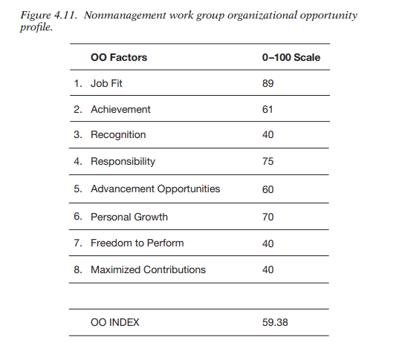

Slide 41
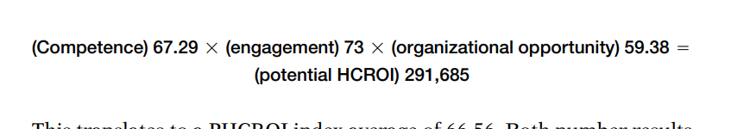
Chapter
THE RETURN ON HUMAN CAPITAL PREDICTOR
04
Based on the example in Figure 4.11, using the index scores of the nonmanagement group, let’s take a look at how things multiply o
Based on the example in Figure 4.11, using the index scores of the non management group, let’s take a look at how things multiply out:
www.midocean.ae

Slide 42
THE ROI OF HUMAN CAPITAL
Chapter
04
The 291,685 can be compared to current revenue per employee, human capital ROI, human capital value added, and human capital market value.
Every time the CEO success HUCAMETRICS are gathered until some type of predictive relationship is established, overall and at the workgroup level.
After the first round of measures, there should be sufficient data from the group profiles to establish some predictive trends.
www.midocean.ae

Slide 43



Thank You

