Slide 1


An Integrated Technical and Fundamental Stock Analysis Model for the Saudi Stock Market (Tadawul)
Thesis Submitted in Partial Fulfillment of the Requirements for the Degree of
Master of Science in Artificial Intelligence
PREPARED BY
SUPERVISED BY
Malek M. Atarji
Dr. Ashraf El-Sayed
ID: 252000474
ACADEMIC YEAR
DEPARTMENT
2025
College of Informatics
Master's Thesis Defense
UAE

Slide 2









Presentation Outline
Midocean University
01
Introduction & Background
02
Problem Statement
03
Research Objectives & Hypotheses
04
Theoretical Framework
05
Literature Review
06
Proposed Methodology
07
Experimental Results
08
Conclusions & Future Work
Malek M. Atarji (ID: 252000474)
Page 2

Slide 3




Introduction
Midocean University
Saudi Stock Market (Tadawul)
The largest and fastest-growing financial market in the MENA region, serving as a critical hub for regional investment.
Vision 2030 Impact
Driving market liberalization and economic diversification, attracting significant foreign institutional investment.
Market Evolution
Experiencing increasing sophistication, liquidity, and volatility, requiring advanced analytical tools.
Technological Need
Growing demand for intelligent, AI-driven decision support systems to navigate complex market dynamics.
Malek M. Atarji (ID: 252000474)
Page 3

Slide 4





Problem Statement & Research Gap
Midocean University
Technical Analysis Limitations
Focuses purely on timing and momentum, often ignoring the intrinsic value and economic health of the company.
The Critical Research Gap
There is currently no integrated, regulatory-compliant model for the Saudi Stock Market (Tadawul) that effectively combines technical timing with fundamental valuation to generate actionable, risk-adjusted trading signals.
Fundamental Analysis Limitations
Identifies value but lacks precise entry/exit timing signals, making it difficult for short-term trading decisions.
Regulatory & Metric Focus
Need for hybrid AI architecture
Most models optimize for statistical accuracy rather than trading profitability and lack tailored compliance for the Saudi market.
Need for practical buy/sell logic
Need for Tadawul-specific adaptation
Malek M. Atarji (ID: 252000474)
Page 4

Slide 5




Research Objectives
Midocean University
Develop Hybrid Model
Construct a stacking ensemble model combining LSTM (technical) and XGBoost (fundamental) analysis.
Define Actionable Signals
Establish practical buy/sell criteria: Take Profit (+5%) and Stop Loss (-2%) within a 30-day holding period.
Evaluate Risk-Adjusted Performance
Assess model efficacy using economic metrics like Sharpe Ratio and Maximum Drawdown rather than just accuracy.
Ensure Regulatory Compliance
Adhere strictly to Capital Market Authority (CMA) regulations by utilizing only publicly accessible and verifiable data.
Create Generalizable Framework
Design a scalable modeling approach applicable to other companies, sectors, and time frames within Tadawul.
Malek M. Atarji (ID: 252000474)
Page 5

Slide 6


Research Hypotheses
Midocean University
H1
Superior Risk-Adjusted Returns
A hybrid ensemble based on fundamental and technical analysis will produce risk-adjusted returns that are significantly higher than a purely technical model or purely fundamental model.
H2
Drawdown Reduction
A hybrid ensemble will demonstrate a lower maximum drawdown relative to single-source models, exhibiting more consistent performance during periods of market instability.
H3
Data Sufficiency
Sufficient quantitative data sources are available within regulatory confines and are publicly accessible to create effective, compliant AI-based trading models within the Tadawul market.
Malek M. Atarji (ID: 252000474)
Page 6

Slide 7




Theoretical Framework: Fundamental Analysis
Midocean University
Intrinsic Value Concept
The core principle that an asset's market price will eventually converge to its true economic value determined by underlying business fundamentals.
Key Financial Ratios
Quantitative metrics used to assess valuation and performance:
Price-to-Earnings (P/E): Measures valuation relative to earnings per share.
Return on Equity (ROE): Indicates profitability and efficiency in using shareholder capital.
Debt-to-Equity (D/E): Assesses financial leverage and long-term solvency risk.
Data Characteristics
Utilizes low-frequency data updated quarterly or annually, derived from audited financial statements (Income Statement, Balance Sheet).
Economic Insight
Provides a deep understanding of company valuation, profitability, and overall financial health, essential for identifying undervalued assets.
Malek M. Atarji (ID: 252000474)
Page 7

Slide 8




Theoretical Framework: Technical Analysis
Midocean University
Market Behavior & Timing
Technical analysis posits that historical price movements and volume patterns can predict future market behavior, focusing on "when" to trade rather than "what" to trade.
Key Technical Indicators
Quantitative tools used to assess momentum, trend strength, and volatility:
• Relative Strength Index (RSI) - Overbought/oversold conditions
• Moving Average Convergence Divergence (MACD) - Trend momentum
• Bollinger Bands - Volatility measurement
• Moving Averages (MA, EMA) - Trend smoothing
High-Frequency Data
Utilizes daily OHLCV (Open, High, Low, Close, Volume) data to capture short-term market dynamics and investor sentiment fluctuations.
Sentiment Capture
Effectively captures collective market psychology and immediate reactions to news, complementing the slower-moving fundamental valuation.
Malek M. Atarji (ID: 252000474)
Page 8

Slide 9




Machine Learning & Deep Learning Approach
Midocean University
LSTM Networks
Long Short-Term Memory networks effectively capture temporal dependencies in sequential OHLCV data for technical analysis.
XGBoost Model
Extreme Gradient Boosting provides robust performance on structured tabular data, offering interpretability through feature importance for fundamental analysis.
Ensemble Learning
Combines multiple models to improve prediction robustness and generalization, reducing the variance associated with single-model approaches.
Stacking Architecture
Utilizes a Meta-learner (Logistic Regression) to intelligently integrate probability outputs from base models for the final trading decision.
Malek M. Atarji (ID: 252000474)
Page 9

Slide 10


Literature Review Summary
Midocean University
Traditional Statistical Models
Models like ARIMA show limited effectiveness in volatile, non-stationary emerging markets due to linear assumptions.
Machine Learning Models
Random Forest and SVM offer improved accuracy but often lack interpretability and economic grounding.
Deep Learning Approaches
LSTM networks excel at technical sequence modeling but frequently ignore fundamental valuation data.
Identified Research Gap
Absence of regulatory-compliant hybrid models integrating technical and fundamental analysis specifically for Tadawul.
Malek M. Atarji (ID: 252000474)
Page 10

Slide 11



Proposed Methodology: Data
Midocean University
Time Period
Analyzing market data from 2021 to 2025, capturing recent market dynamics and post-pandemic recovery trends.
Research Scope
Focusing on large-cap, liquid Tier 1 companies listed on Tadawul to ensure data quality and market representativeness.
Data Sources
Utilizing daily price data (OHLCV) from reliable public providers and quarterly financial statements from official CMA disclosures.
Data Integrity
Ensuring all utilized data is publicly available, verifiable, and strictly compliant with regulatory standards.
Malek M. Atarji (ID: 252000474)
Page 11

Slide 12



Proposed Methodology: Feature Engineering
Midocean University
TECHNICAL FEATURES
60-Day Rolling Window
FUNDAMENTAL FEATURES
Quarterly Updates
MOMENTUM INDICATORS
VALUATION METRICS
Relative Strength Index (RSI) Overbought/Oversold
Price-to-Earnings (P/E) Market Valuation
MACD Trend Momentum
Return on Equity (ROE) Profitability
VS
TREND & VOLATILITY
FINANCIAL HEALTH
Bollinger Bands Volatility Range
Debt-to-Equity (D/E) Leverage Risk
Moving Averages (MA/EMA) Trend Smoothing
Profit Margins Operational Efficiency
Malek M. Atarji (ID: 252000474)
Page 12

Slide 13







Model Architecture: Stacking Ensemble
Midocean University
INPUT LAYER
BASE LEARNERS
META-LEARNER
FINAL OUTPUT
Technical Features
LSTM Network
Prob(Tech)
Daily Price Data (OHLCV)
Sequence Modeling
Logistic Regression
Trading Signal
Stacking Integration
Combines Probabilities
Buy / Sell / Hold
Fundamental Features
XGBoost Model
Prob(Fund)
Quarterly Financials
Gradient Boosting
Malek M. Atarji (ID: 252000474)
Page 13

Slide 14


Trading Signal Definition
Midocean University
Actionable Target Signal
Focus is on generating actionable buy/sell signals rather than simple price forecasting, directly supporting trading decisions.
Success Criteria
Defined by Take Profit (TP) at +5% gain and Stop Loss (SL) at -2% loss, ensuring a balanced risk-reward strategy.
Signal Classification & Holding
Signal = 1 (Buy) if TP is reached before SL within a 30-day holding period; otherwise Signal = 0 (No Trade/Hold).
Risk-Adjusted Logic
Aligns model output with practical trading logic, prioritizing risk management over purely statistical prediction accuracy.
Malek M. Atarji (ID: 252000474)
Page 14

Slide 15



Experimental Results: Baseline Models
Midocean University
MODEL
ACCURACY
SHARPE RATIO
MAX DRAWDOWN
WIN RATE
LSTM (Technical Only)
0.61
0.84
-18%
52%
XGBoost (Fundamental Only)
0.58
0.76
-21%
49%
KEY OBSERVATION
Each individual baseline model captures only a single dimension of market behavior (timing vs. valuation), leading to suboptimal risk-adjusted performance when used in isolation.
Malek M. Atarji (ID: 252000474)
Page 15

Slide 16


Experimental Results: Hybrid Model
Midocean University
MODEL
ACCURACY
SHARPE RATIO
MAX DRAWDOWN
WIN RATE
LSTM (Technical Only)
0.61
0.84
-18%
52%
XGBoost (Fundamental Only)
0.58
0.76
-21%
49%
Hybrid Ensemble (Proposed)
0.68
1.25
-12%
59%
KEY FINDING: SUBSTANTIAL IMPROVEMENT
The hybrid model demonstrates superior performance across all metrics. Most notably, the Sharpe Ratio increased significantly to 1.25, indicating enhanced risk-adjusted returns, while maximum drawdown was reduced to -12%, proving better capital preservation.
Malek M. Atarji (ID: 252000474)
Page 16

Slide 17
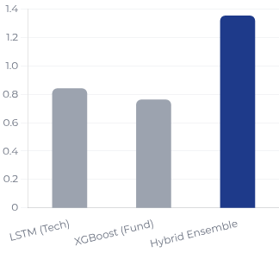
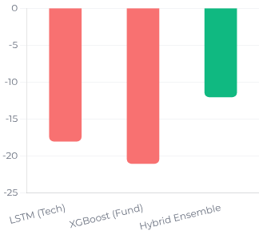
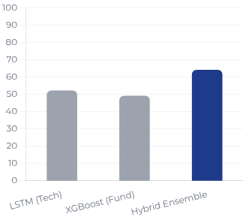

Performance Visualization
Midocean University
Risk Reduced
Most Consistent
Sharpe Ratio
Max Drawdown
Win Rate
Risk-Adjusted Returns (Higher is Better)
Downside Risk (Closer to 0 is Better)
Trading Success % (Higher is Better)
Hybrid Model Superiority
The proposed Hybrid Ensemble outperforms single-source models across all critical metrics, delivering significantly better risk-adjusted returns while effectively managing downside risk.
Malek M. Atarji (ID: 252000474)
Page 17

Slide 18
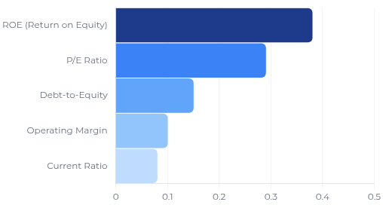
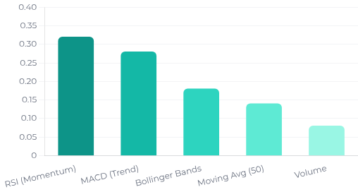

Feature Importance Analysis
Midocean University
Profitability is Key
Fundamental Drivers (XGBoost)
Technical Drivers (LSTM)
Importance of Financial Ratios to Valuation
Contribution of Indicators to Market Timing
Alignment with Economic Theory
The model validates financial principles: ROE (Return on Equity) dominates long-term value assessment, while Momentum Indicators (RSI, MACD) are critical for identifying short-term entry and exit points.
Malek M. Atarji (ID: 252000474)
Page 18

Slide 19






Research Contributions
Midocean University
Innovative Model Architecture
01
Practical Trading Logic
02
First comprehensive Stacking Ensemble for Tadawul that effectively integrates high-frequency LSTM timing with low-frequency XGBoost valuation.
Moved beyond simple price forecasting to actionable signal generation based on realistic Profit/Stop-Loss thresholds (+5% / -2%).
Transparency & Interpretability
03
Regulatory Compliance
04
Leveraged XGBoost feature importance to reveal economic drivers (ROE, P/E) behind AI predictions, building trust with investors.
Exclusively utilized publicly verifiable CMA disclosures, ensuring the model is fully compliant with Saudi market regulations.
Framework Generalizability
05
Academic Literature Gap
06
Created a robust, adaptable framework applicable across different sectors, timeframes, and emerging markets beyond Tadawul.
Filled a critical gap in emerging market literature by proving that hybrid AI models outperform single-source methods in volatile environments.
Advancing FinTech in Saudi Arabia
Malek M. Atarji (ID: 252000474)
Page 19

Slide 20






Conclusions
Midocean University
Successful Hybrid Implementation
01
Superior Performance
02
Successfully developed and validated a Stacking Ensemble AI model integrating LSTM (timing) and XGBoost (valuation) tailored for the Saudi market.
The hybrid model demonstrated significantly higher risk-adjusted returns (Sharpe Ratio) compared to standalone technical or fundamental models.
Enhanced Risk Management
03
Regulatory & Practical Viability
04
Achieved reduced maximum drawdown and greater consistency during volatile periods, protecting capital more effectively than single-strategy approaches.
Proven that verifiable, regulatory-compliant public data is sufficient to build robust, interpretable trading models for Tadawul without insider information.
Hypothesis Validation
05
Intelligent Decision Support
06
All three research hypotheses (H1, H2, H3) were empirically supported, confirming the value of integrating diverse analytical dimensions.
Delivered a practical framework for intelligent trading decisions that balances profit potential with strict risk controls suitable for institutional use.
Ready for Practical Application
Malek M. Atarji (ID: 252000474)
Page 20

Slide 21




Future Work & Recommendations
Midocean University
Market Expansion
Macroeconomic Integration
Extend model application to additional Tadawul sectors and mid-cap stocks to test generalizability across different liquidity profiles.
Incorporate broader economic indicators (GDP, interest rates, oil prices) and regime detection to enhance fundamental analysis capabilities.
Real-Time Deployment
Portfolio Optimization
Implement system for live data feeds and conduct extensive paper-trading to validate performance in real-time execution environments.
Add a portfolio construction layer to optimize allocation sizing based on signal confidence and correlation analysis.
Advanced AI Techniques
Cross-Market Validation
Explore Deep Reinforcement Learning (DRL) approaches to allow the model to learn optimal policy decisions directly from market interactions.
Validate the hybrid framework on other GCC exchanges to assess regional robustness and adaptability to similar emerging markets.
Malek M. Atarji (ID: 252000474)
Page 21

Slide 22





THANK YOU
"An Integrated Technical and Fundamental Stock Analysis Model for the Saudi Stock Market (Tadawul)"
QUESTIONS & DISCUSSION
STUDENT
ID NUMBER
CONTACT
Malek M. Atarji
252000474
252000474 @midocean.edu
Midocean University
COLLEGE OF INFORMATICS
Master of Science in Artificial Intelligence • 2025

